Slide 1
How to setup Amazon’s Relational Data Store (RDS)
W4111 Fall 2015
Eugene Wu

Slide 2
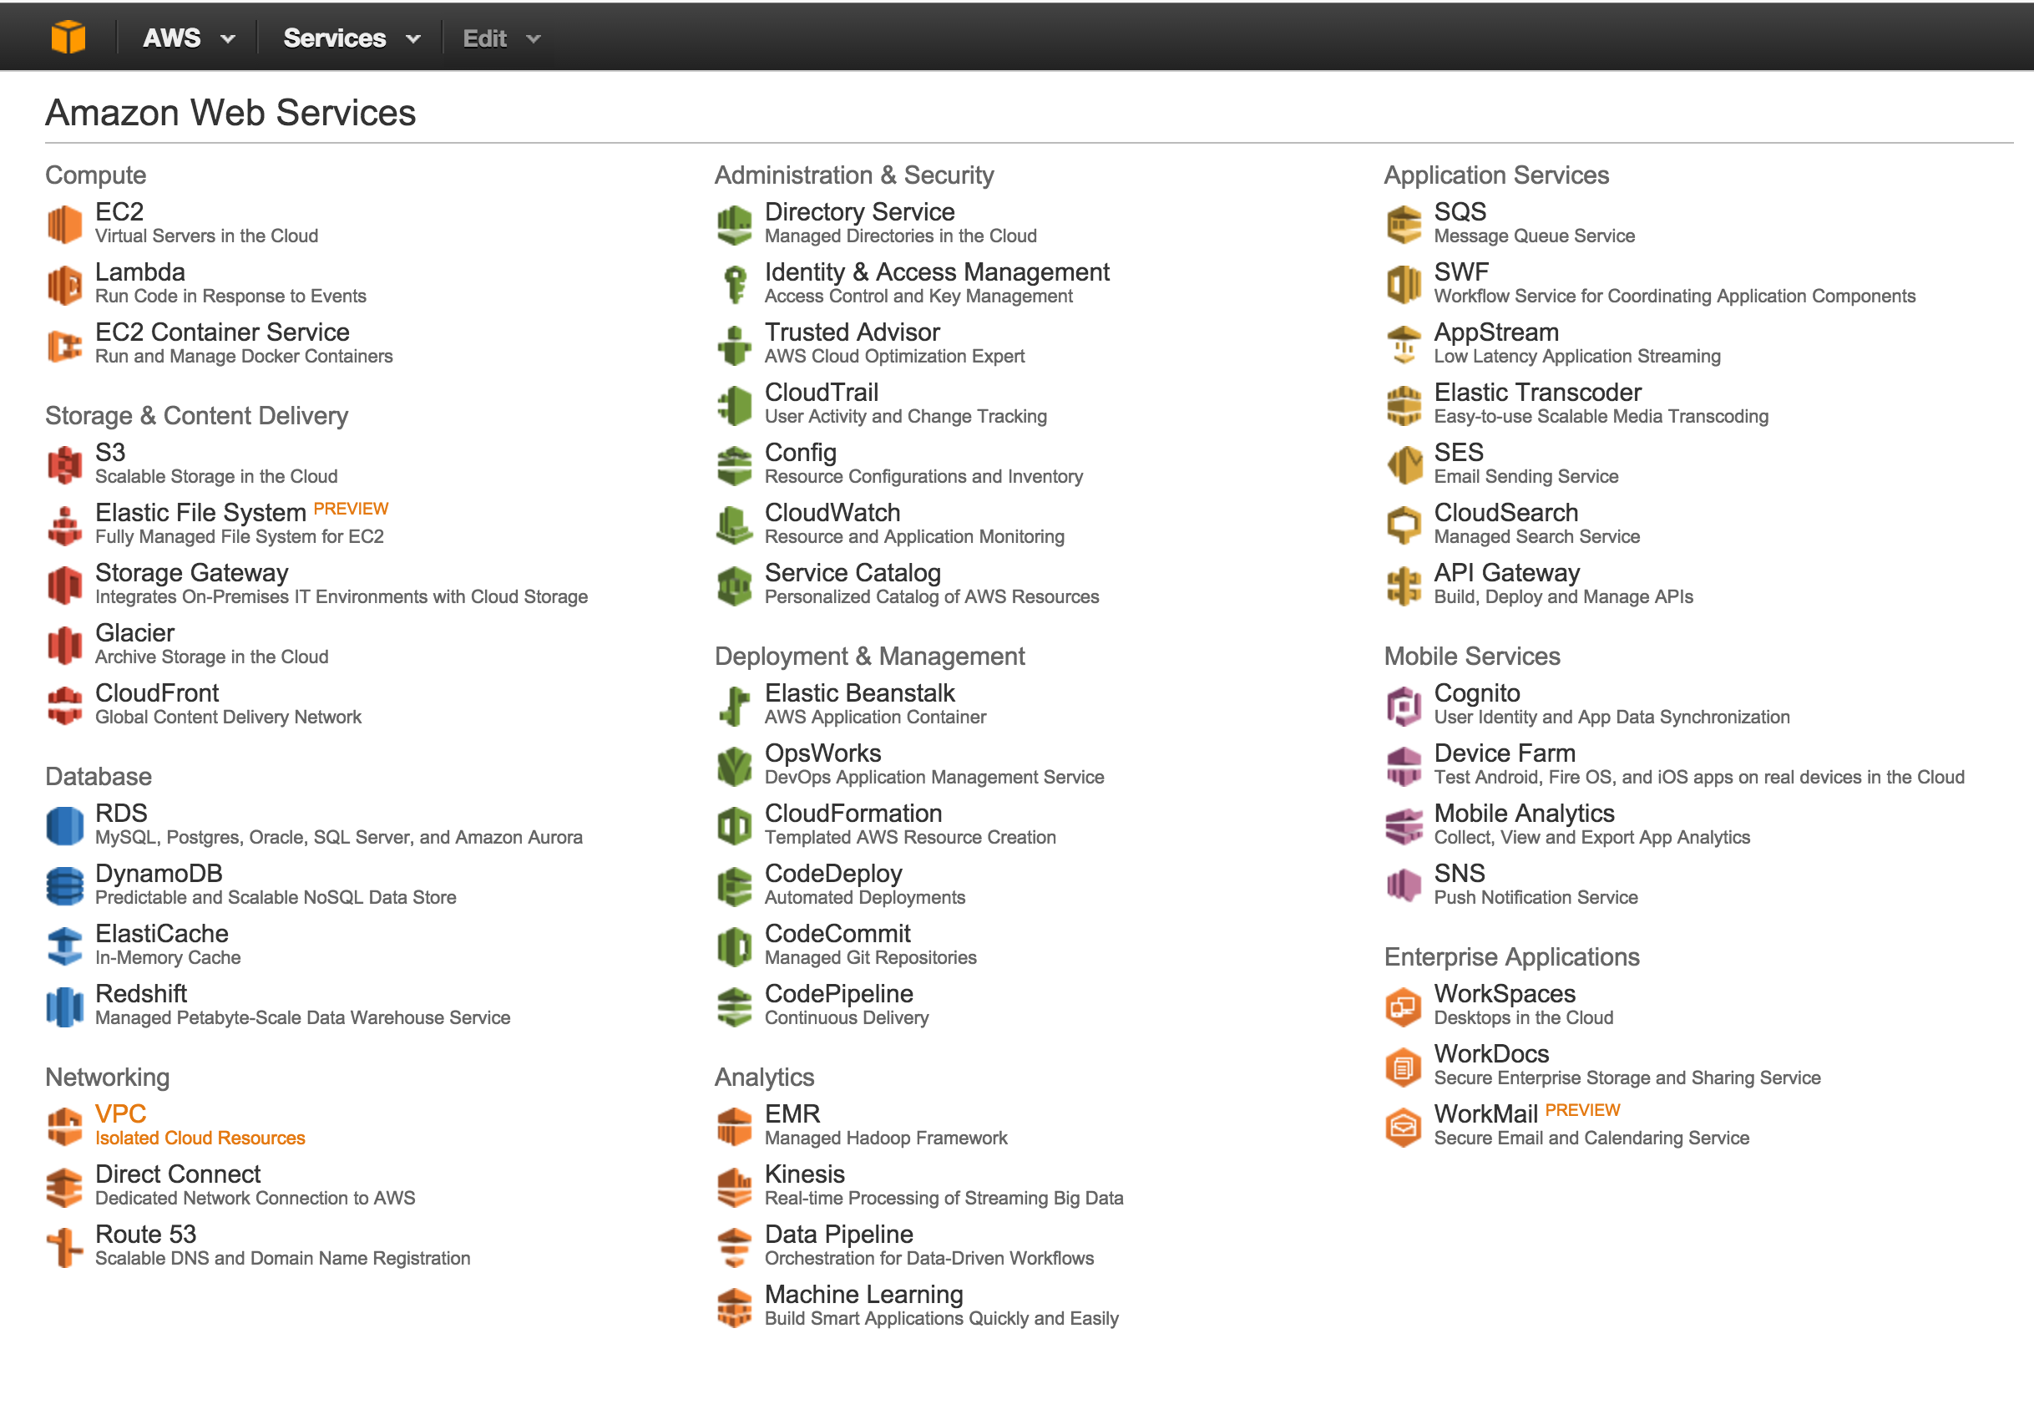
This is in the main AWS console page

Slide 3
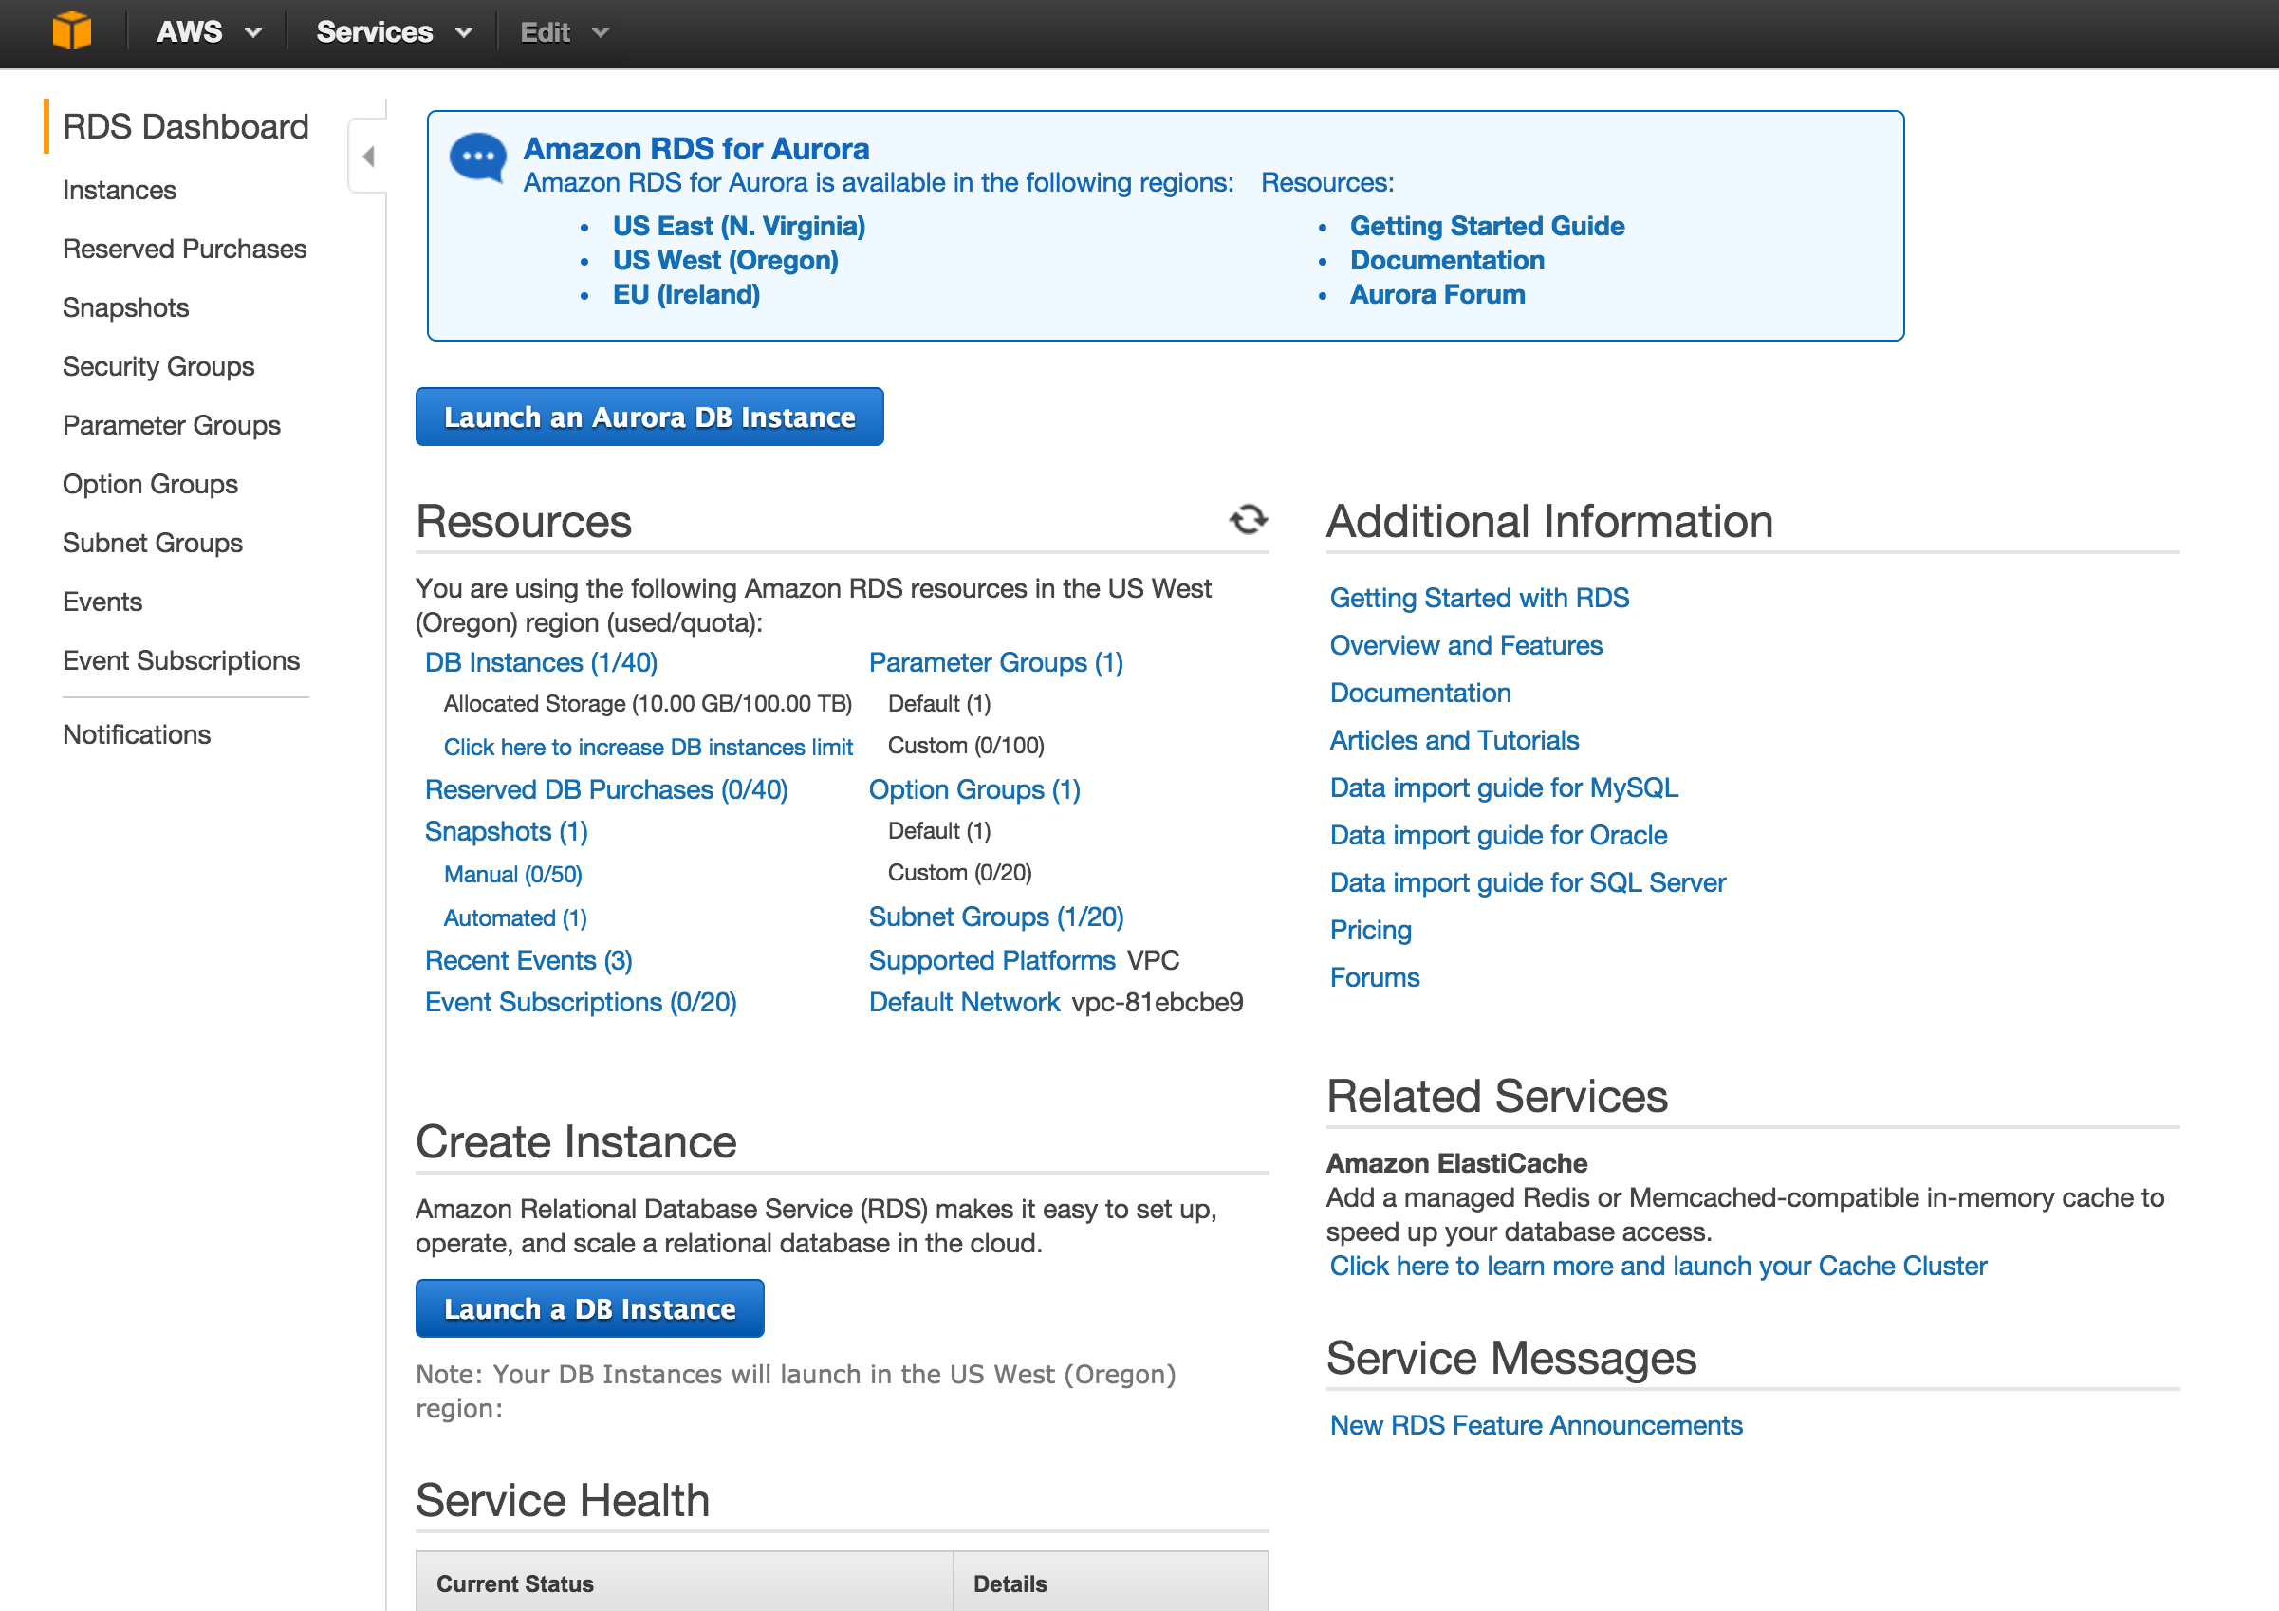

Slide 4
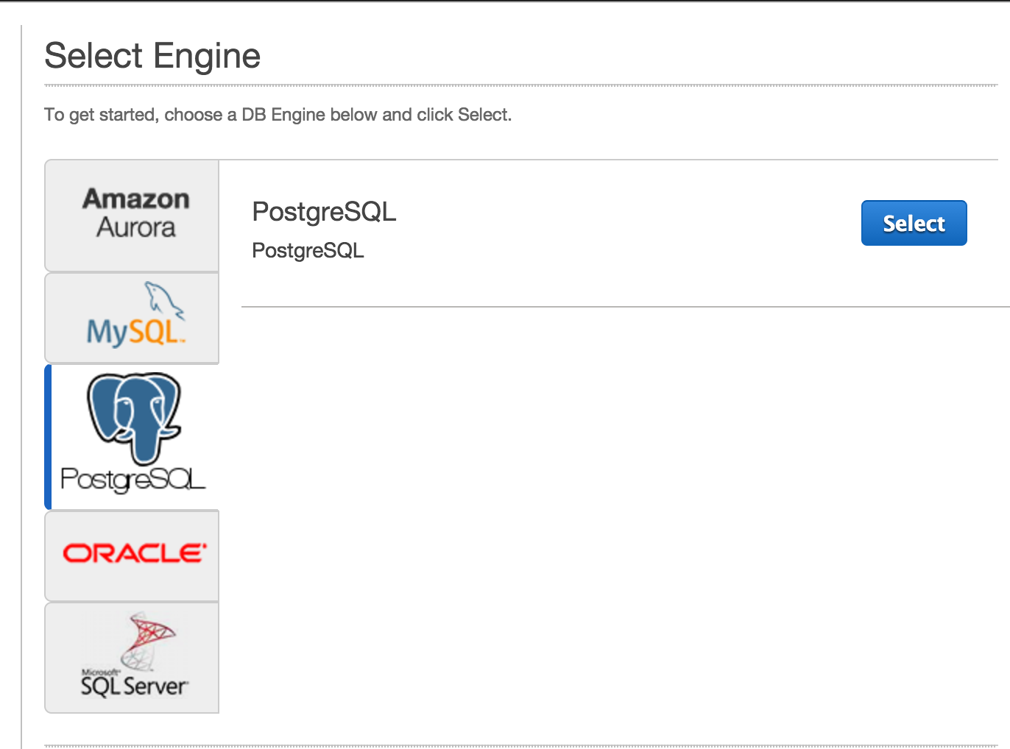

Slide 5
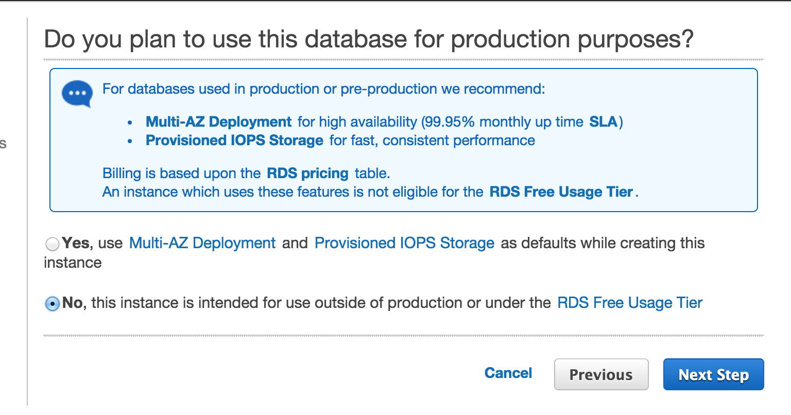

Slide 6
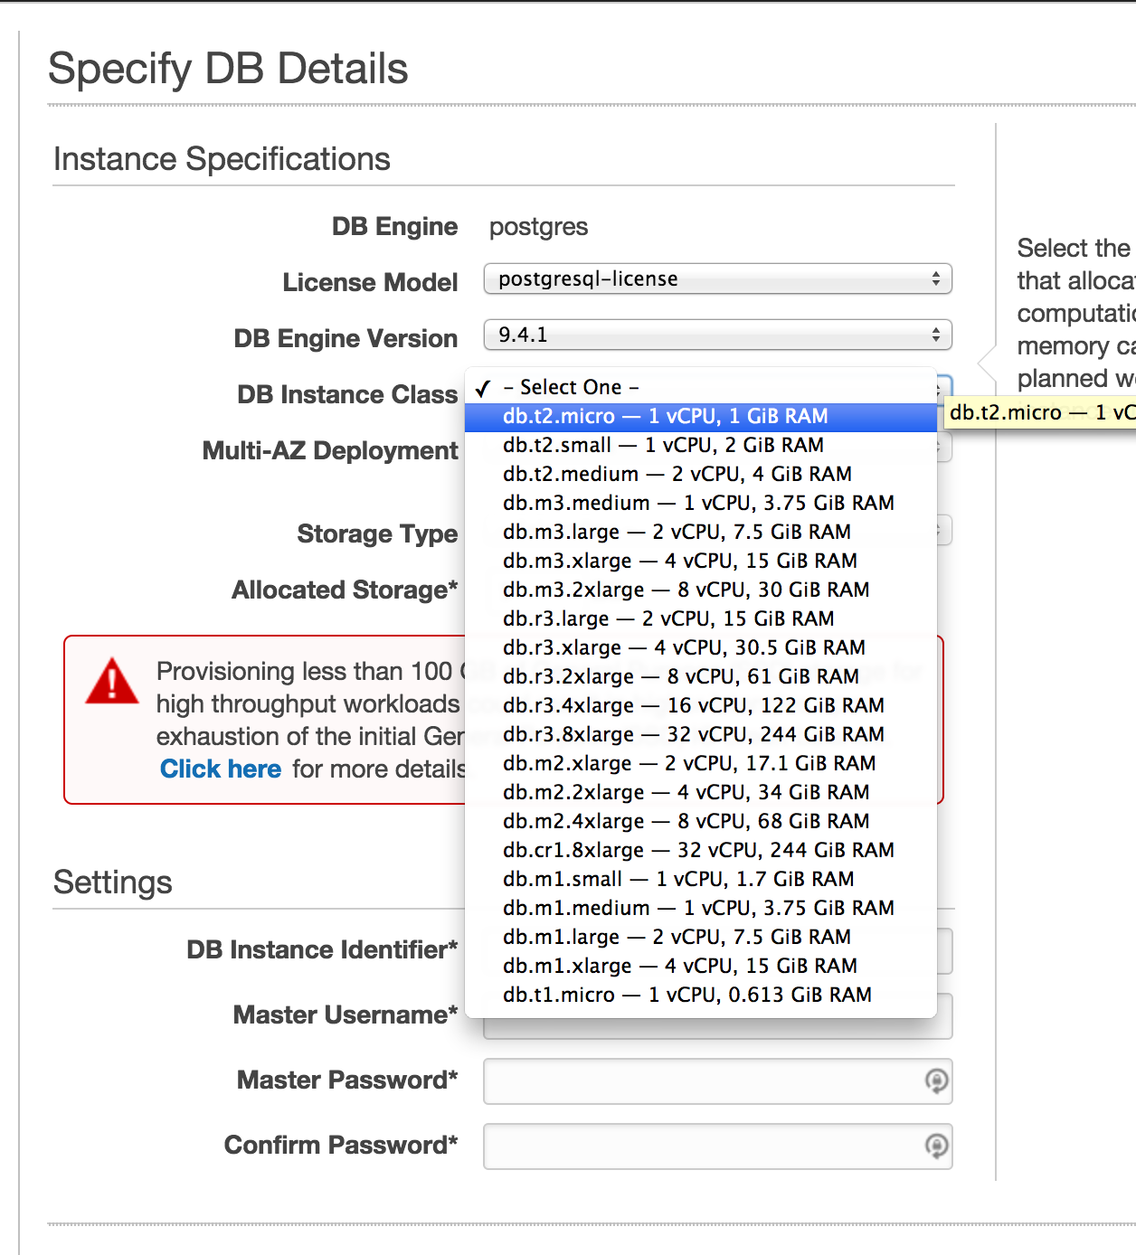

Slide 7
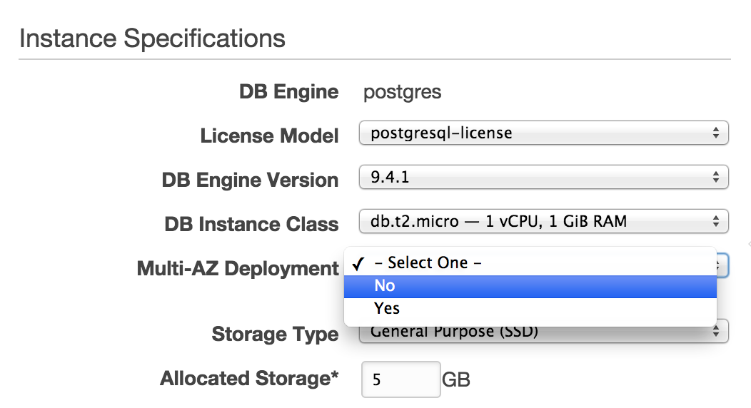
Make sure to set options like the picture →
DB Instance: db.t2.micro
Multi-AZ Deployment: NO
Storage Type: General Purpose
Allocated Storage: 5GB
PLEASE BE CAREFUL: any other option can be VERY expensive (>$200/month)!!

Slide 8
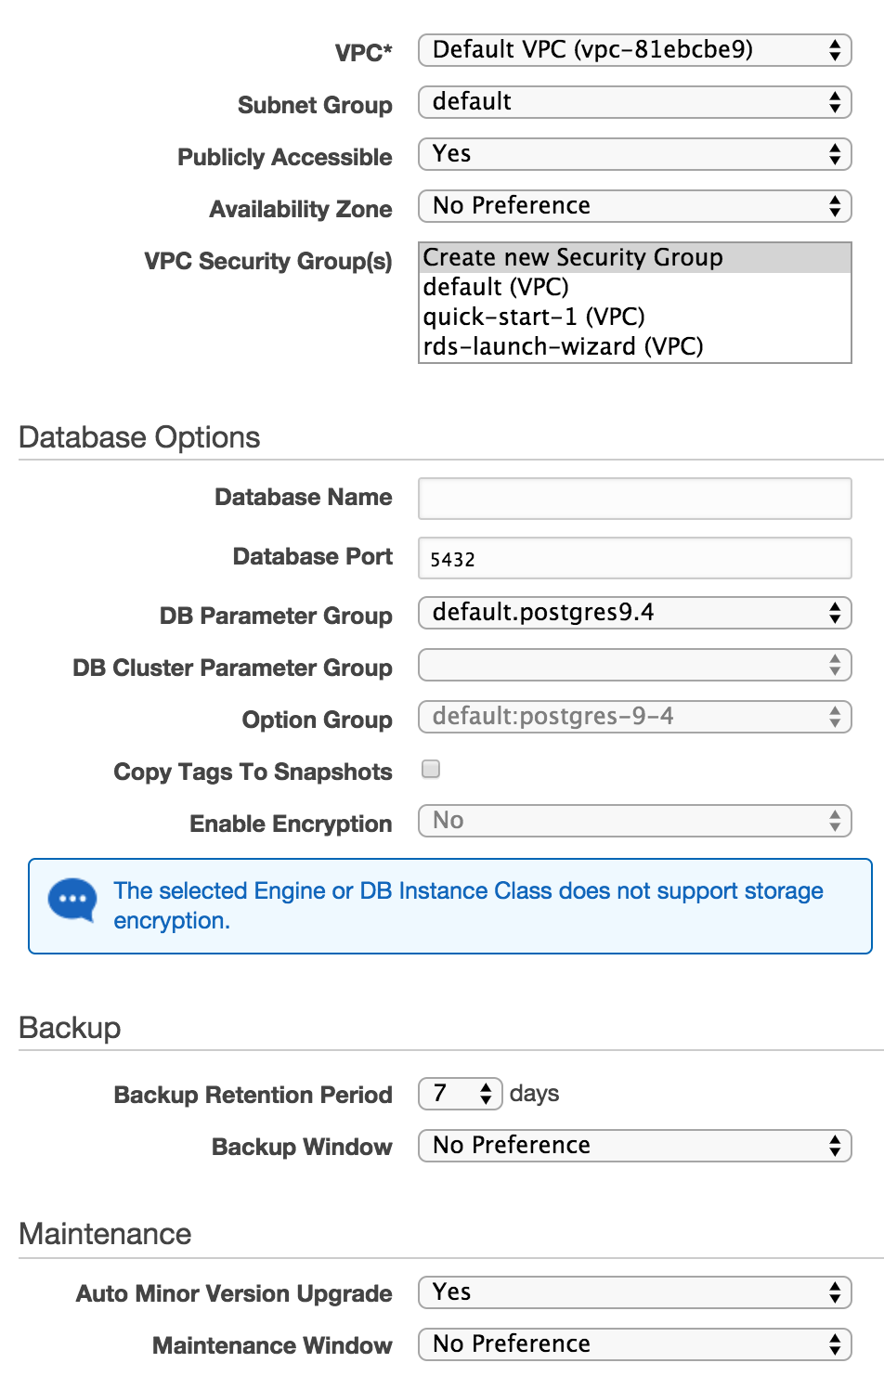
Make sure to set:
Publically accessible: yes
Availability Zone: No preference
Pick a database name and remember it
The defaults are fine for everything else

Slide 9
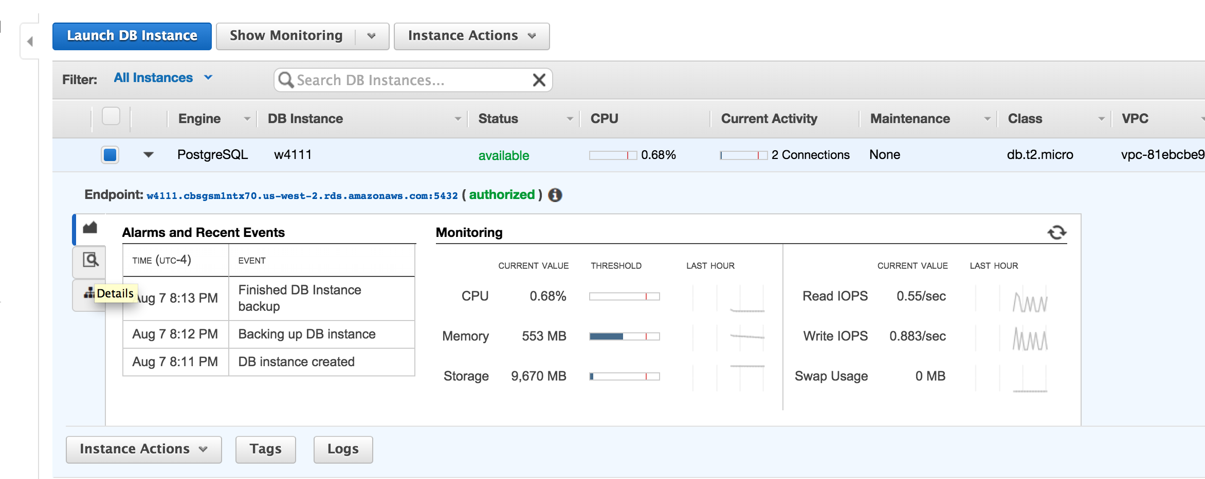
This is where you can find your database host name and port
For example, the staff’s database has the following information:
Host: w4111.cbegsmlstx70.us-west-2.rds.amazonaws.com
Port: 5432

Slide 10
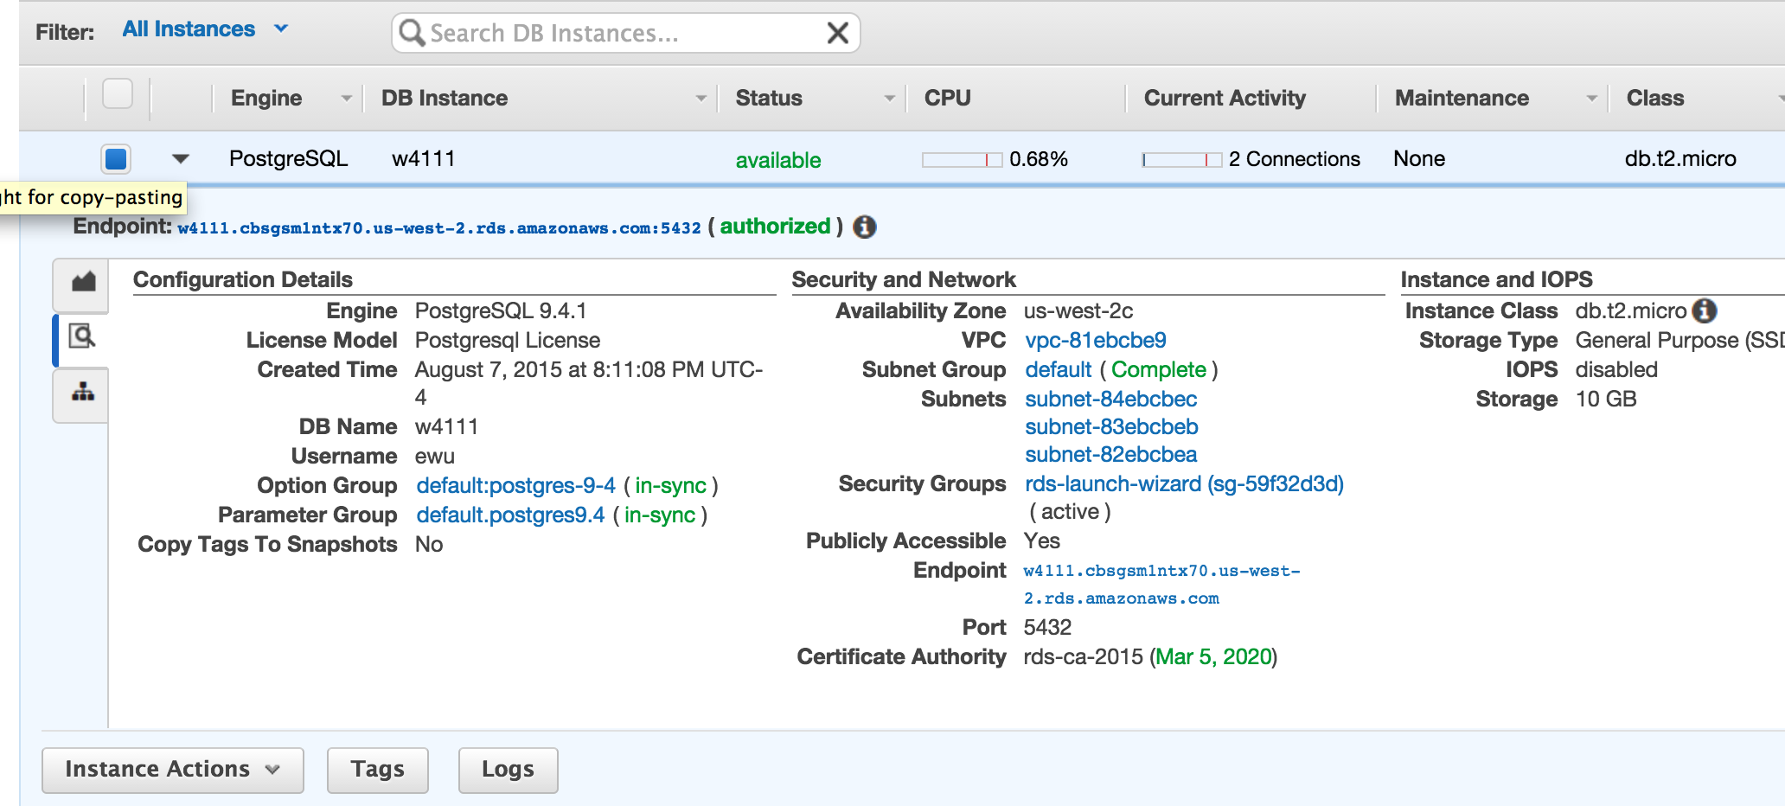
In the details section, it will also tell you the database name and your user name

Slide 11
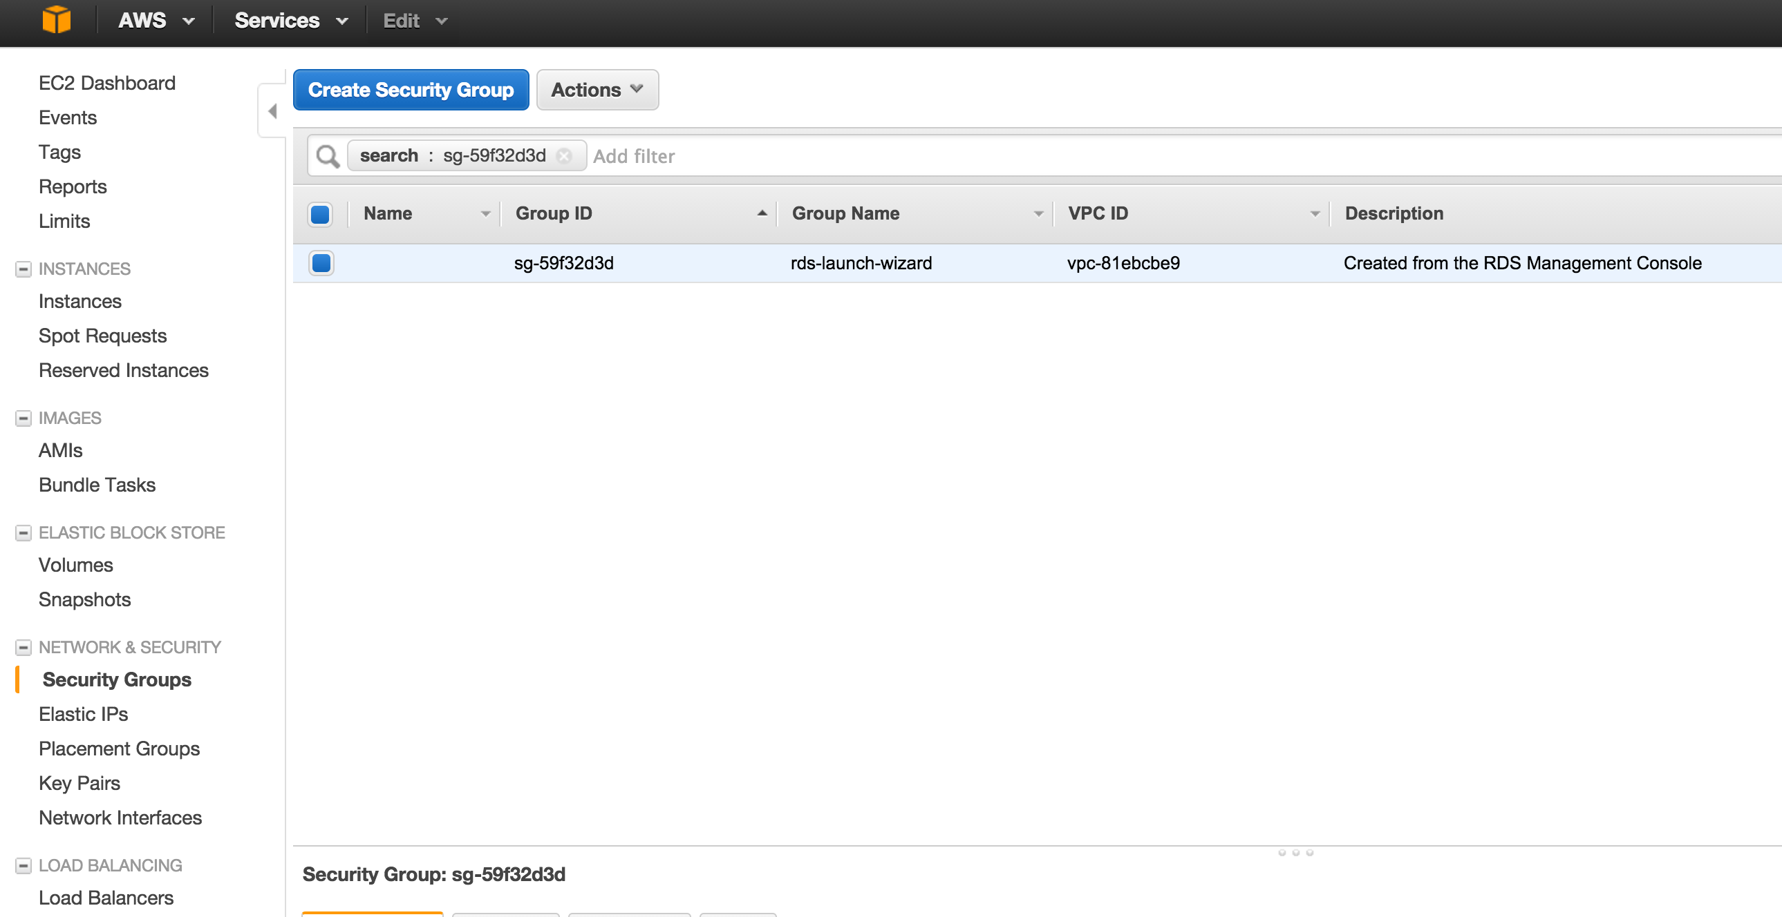
Amazon is strict about security, so the firewall will not let you access the database yet.
Click on Security Groups to let database connections through the firewall.

Slide 12
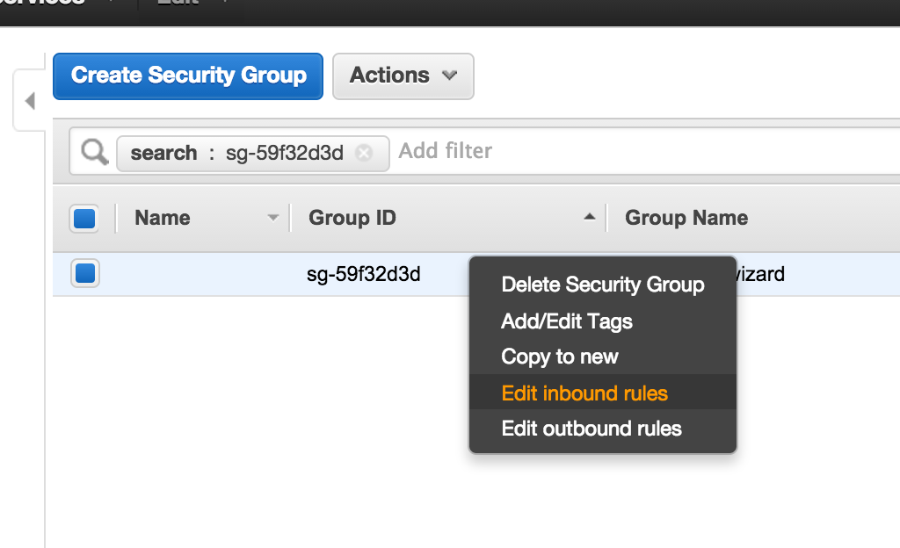
Right click on the security group and click Edit inbound rules

Slide 13
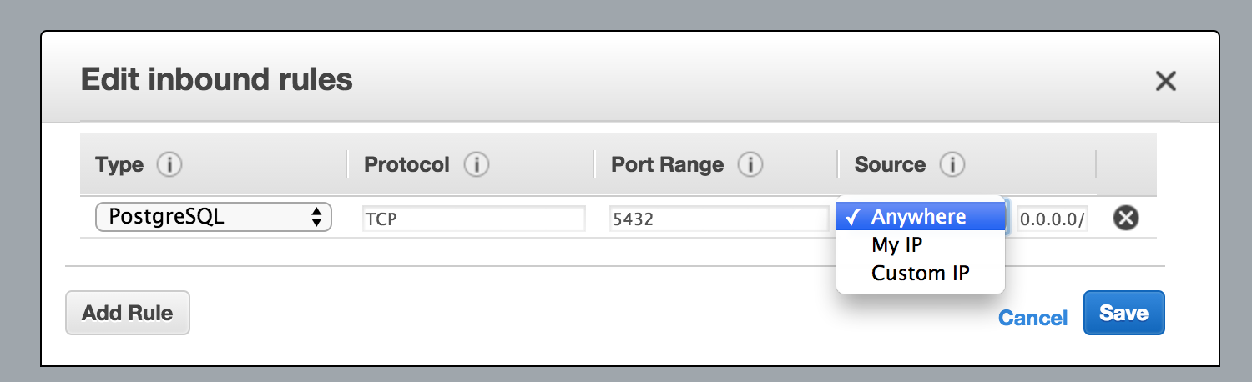
Set the Source to Anywhere so you can access the database from.. anywhere

Slide 14
Now you can access your RDS database!
On your Amazon EC2 machine, you can use the psql command to connect to databases:
psql –h <database host> -U <your username> -W <your database (not RDS) name>
For example, to access the staff RDS instance for project 1 part 2
psql –U myuni –h w4111db1.cloudapp.net proj1part2
Notes:
psql -h w4111.cbsgsm1ntx70.us-west-2.rds.amazonaws.com –U ewu -W w4111

