Slide 1

FINAL YEAR PROJECT VIVA
WatermarkScope
A Benchmark-to-Audit Framework for Source-Code Watermarking in Code Generation Models
Haoyi Zhang | 2254912 Supervisor: Md Maruf Hasan Final Year Project Report | May 2026
Notes:
Good afternoon. I am Haoyi Zhang. My project is WatermarkScope, a benchmark-to-audit framework for source-code watermarking in code generation models. I will present the submitted FYP snapshot first, then show how the five related repositories now continue toward publication-level work.

Slide 2

VIVA POSITIONING
02
Submitted FYP and continuation progress stay separate.
The viva can discuss repository progress without rewriting the submitted evidence surface.
submitted FYP snapshot
viva continuation view
Official report submitted to LMO
Five tracks now near paper shape
Assessed artifact: PDF, repository route, submitted denominators.
Used to explain effort, scope, and future submission plan.
Boundary: updated results do not rewrite the submitted dissertation.
WatermarkScope FYP Viva
Haoyi Zhang | 2254912
Notes:
This slide prevents confusion. The dissertation submitted to LMO is the formal FYP artifact. The current repositories show continuation progress after submission. I will be clear when a number is from the submitted FYP snapshot and when it is a continuation result.

Slide 3
PROBLEM
03
Generated code moves before provenance is checked.
Copying, editing, translation, and reuse make a raw detector score too weak by itself.
generate
edit
translate
reuse
model output
copy / rewrite
language shift
new project
The evaluation question is not just detection; it is whether a bounded claim is defensible.
WatermarkScope FYP Viva
Haoyi Zhang | 2254912
Notes:
The problem is movement. Generated code rarely stays in the original chat. After edit or reuse, I need to know exactly what evidence supports a watermark claim.

Slide 4
METHOD CORE
04
A claim is admitted through an evidence object.
The framework makes denominator, controls, artifact, hash, and boundary explicit.
D
fixed denominator
evidence contract
C
positive / negative controls
claim := f(E, A, B)
H
artifact hash
E = denominator + controls A = access model B = boundary
B
claim boundary
No broader claim without a new admitted surface.
WatermarkScope FYP Viva
Haoyi Zhang | 2254912
Notes:
The central method is an evidence contract. I freeze the denominator and controls, preserve the artifact and hash, state the access model, then report only the claim boundary that follows.

Slide 5
PORTFOLIO
05
Five tracks share a contract, not one score.
Each repository answers a different evidence question and keeps its own denominator.
TOSEM
EMNLP
EMNLP
EMNLP
EMNLP
CodeMarkBench
SemCodebook
CodeDye
ProbeTrace
SealAudit
140/140 canonical runs
30,330/31,200 recovery
0/300 fresh signals
750/750 true owner
320/960 decisive
commit FYP snapshot
commit 69efebc
commit e8f9df3
commit 9e459d4
commit 039275d
shared rule: admit evidence first; publish only the bounded claim
WatermarkScope FYP Viva
Haoyi Zhang | 2254912
Notes:
This is the current project portfolio. CodeMarkBench is the benchmark track. The other four are continuation repositories with the commit snapshots shown on the slide. For the viva, I explain them as progress beyond the submitted FYP snapshot, not as modifications to the submitted PDF.

Slide 6
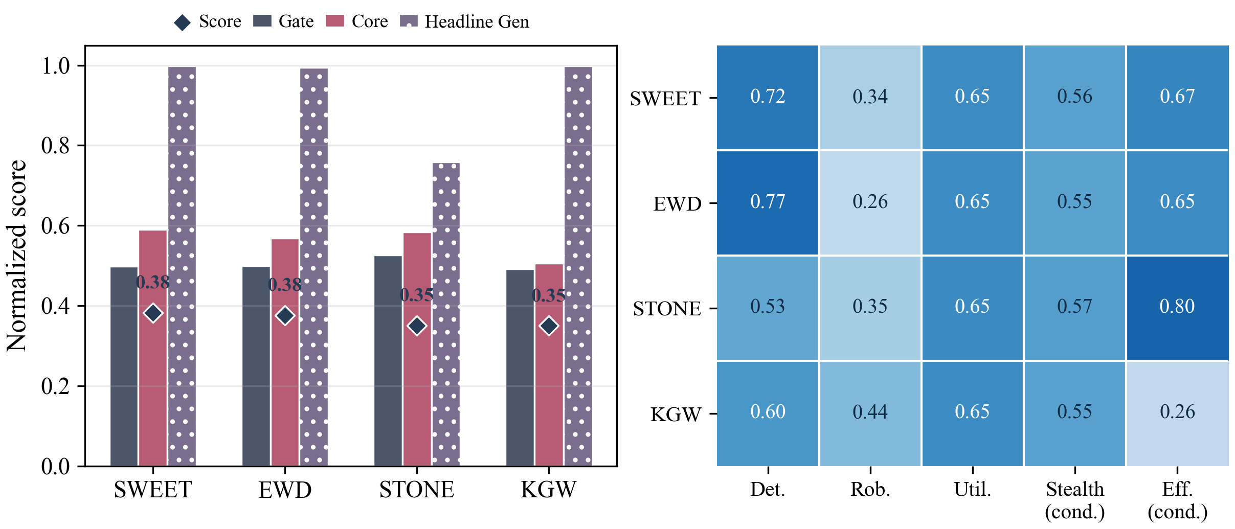
CODEMARKBENCH
06
The benchmark fixes the denominator first.
The release matrix defines models, methods, sources, languages, and attacks before interpretation.
canonical run inventory
140/140
completed before any claim promotion
Artifact preview: score decomposition figure preserved in CodeMarkBench results.
5
models
4
methods
7
sources
5
languages
7
attacks
evaluation axis
evaluation axis
evaluation axis
evaluation axis
evaluation axis
WatermarkScope FYP Viva
Haoyi Zhang | 2254912
Notes:
CodeMarkBench matters because it prevents denominator drift. The run inventory is complete for the submitted snapshot, and the result artifacts are preserved in the repository.

Slide 7
SEMCODEBOOK
07
White-box provenance is strong after zero controls.
The continuation result improves recovery while keeping fixed and blind negative controls clean.
positive recovery
30,330 / 31,200
ablation support
submitted FYP snapshot: 23,342 / 24,000
fixed controls
AST only
0 / 62,400
CFG only
zero-event fail-closed control surface
ECC off
blind replay
unkeyed
0 / 62,400
independent negative replay gate
SSA only
Claim boundary: admitted white-box cells, not universal natural-generation watermarking.
WatermarkScope FYP Viva
Haoyi Zhang | 2254912
Notes:
SemCodebook is the strongest provenance-recovery track. The important evidence is not just high recovery. It is high recovery plus zero hits in fixed controls and blind replay. I should still keep the claim inside admitted white-box cells.

Slide 8
CODEDYE
08
The black-box audit refuses to overclaim.
The latest surface reports a null live signal with calibration and control separation.
0/300
272/300
0/300
0/300
safe reading
null-audit evidence
not prevalence or accusation
fresh live
positive memory
negative control
retrieval control
WatermarkScope FYP Viva
Haoyi Zhang | 2254912
Notes:
CodeDye is conservative. The fresh live signal is zero in the current continuation surface, while positive memory calibration still fires. This supports a null-audit interpretation, not a claim that contamination is absent.

Slide 9
PROBETRACE
09
Owner attribution stays inside its source boundary.
The continuation surface separates true-owner positives from wrong, null, random, and same-provider controls.
true owner positives
false-owner controls
0 / 5,250
750/750
owner-heldout rows
1,200
source-bound commitment / witness verification
task-heldout rows
1,200
AUC = 1.0 under this discrete, finite oracle boundary.
WatermarkScope FYP Viva
Haoyi Zhang | 2254912
Notes:
ProbeTrace is strong but scoped. I should say it verifies active-owner attribution within the registered source and owner boundary. I should not say it proves general authorship.

Slide 10
SEALAUDIT
10
Security triage is selective by design.
The main result is a coverage frontier: decisive rows, hard ambiguity, and review cases are all reported.
80 benign
240 latent risk
484 hard ambiguity
156 review
960 marker-hidden rows: 320 decisive, 484 hard ambiguity, 156 role-based review.
decisive triage
320/960
abstention is not a failure
unsafe passes
0/960
support stress
312/960
blocks unsupported safety claims
WatermarkScope FYP Viva
Haoyi Zhang | 2254912
Notes:
SealAudit should be presented as selective triage. It reports decisive cases and abstention cases together. Zero unsafe pass is not a safety certificate; it is a finite observed outcome inside this surface.

Slide 11
EVIDENCE LEDGER
11
Progress can be shown without moving the baseline.
The table keeps official FYP numbers and continuation numbers in separate lanes.
track
submitted FYP snapshot
continuation surface for viva discussion
CodeMarkBench
140/140 runs
same benchmark track
SemCodebook
23,342/24,000
30,330/31,200; 0/62,400 x2 controls
CodeDye
6/300 sparse live
0/300 fresh; 272/300 calibration
ProbeTrace
300/300 decisions
750/750 true owner; 0/5,250 controls
SealAudit
81/960 decisive
320/960 decisive; 0/960 unsafe pass
WatermarkScope FYP Viva
Haoyi Zhang | 2254912
Notes:
This is the safest way to explain the update. The left lane is the submitted FYP snapshot. The right lane shows current continuation progress. I should not mix the two denominators in one claim.

Slide 12
DEMO 1
12
Demo 1 proves repository inspectability.
Open the project page, then trace one claim to its boundary, manifest row, artifact path, and hash.
01
Project page
02
README / folders
PLAY
03
Claim boundaries
04
Traceability matrix
Insert repository walkthrough video here
05
Result manifest
WatermarkScope FYP Viva
Haoyi Zhang | 2254912
Notes:
For Demo 1, I will insert a 90-second video. The storyboard is: project page, repository README, project folders, CLAIM_BOUNDARIES.md, TRACEABILITY_MATRIX.md, and RESULT_MANIFEST.jsonl. The spoken point is inspectability, not a full experiment rerun.

Slide 13
DEMO 2
13
Demo 2 verifies the inspection route.
The check is intentionally lightweight, so it can run during the viva.
checks documents + manifest
python scripts/viva_check.py
[OK] Viva-facing documents present [OK] Result manifest covers modules [OK] Manifest rows are hash-addressed [OK] Claim boundaries are present [OK] Viva check passed
does not rerun GPU/API jobs
fallback: recorded demo ready
Open viva_check.py
WatermarkScope FYP Viva
Haoyi Zhang | 2254912
Notes:
For Demo 2, I can either run this live or show a 60-second video. The key sentence is: this verifies repository consistency and inspectability, not full GPU or API reproduction.

Slide 14
DEFENCE
14
Q&A rule: answer, bound, then point.
Short answers are stronger than broad claims.
Answer
Bound
Point
one direct sentence
denominator + controls
file, slide, or demo route
Do not claim: universal watermarking, provider accusation, legal authorship proof, or safety certification.
WatermarkScope FYP Viva
Haoyi Zhang | 2254912
Notes:
This slide is mainly for my speaking discipline. In Q&A, answer first, state the boundary second, and point to evidence third. This avoids overclaiming.

Slide 15
PUBLICATION PLAN
15
The FYP becomes five paper tracks.
Current code and experiments were completed individually; later manuscript writing may involve collaborators.
CodeMarkBench
TOSEM
benchmark and executable evaluation
SemCodebook
EMNLP
white-box provenance recovery
CodeDye
EMNLP
black-box null-audit calibration
ProbeTrace
EMNLP
active-owner attribution
SealAudit
EMNLP
marker-hidden security triage
Boundary: future papers are continuations; the submitted FYP artifact remains fixed.
WatermarkScope FYP Viva
Haoyi Zhang | 2254912
Notes:
This is the forward plan. The code and current FYP evidence were built by me. Later papers may involve collaborators for writing and polishing, but the FYP artifact should be evaluated as my individual implementation and evidence organization work.

Slide 16
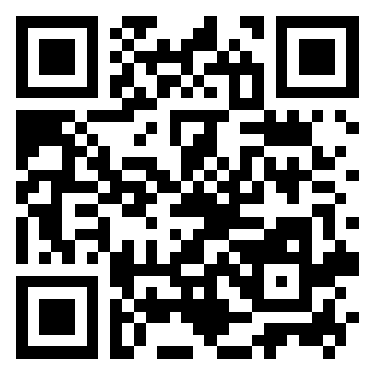
Thank you
Questions?
Project page
Page
Repo
Evidence contract: denominator + controls + boundary
Submitted FYP snapshot is separate from continuation progress
Demo route: page, repository, claim boundary, manifest
Notes:
Thank you. I am ready for questions. Likely Q&A and short answers: 1. Why not one detector score? Answer: Different access models need different evidence objects. One score would mix incompatible denominators. 2. Did the submitted dissertation change after registration? Answer: No. The submitted FYP snapshot is fixed. The current repositories show continuation progress for viva discussion and future papers. 3. Does CodeDye prove contamination or absence of contamination? Answer: No. It reports conservative black-box null-audit evidence with calibration and controls. It is not a provider accusation and not proof of absence. 4. Is ProbeTrace a legal authorship proof? Answer: No. It is scoped active-owner verification under the registered source, owner split, and false-owner controls. 5. Why does SealAudit abstain so much? Answer: Because forced decisions would overclaim. Abstention is part of the safety boundary when evidence is insufficient. 6. What is the main contribution? Answer: WatermarkScope adds an evidence-contract layer: fixed denominators, executable controls, preserved artifacts, access models, and claim boundaries. 7. What can the examiner check quickly? Answer: Open the project page, repository, CLAIM_BOUNDARIES.md, TRACEABILITY_MATRIX.md, RESULT_MANIFEST.jsonl, and run python scripts/viva_check.py. 8. What is the biggest limitation? Answer: Finite denominators. Broader or provider-general claims need new admitted evidence surfaces. 9. Why are there five projects? Answer: They cover different evidence questions: benchmark denominator, white-box recovery, black-box audit, owner attribution, and security triage. Answer pattern: answer first, bound second, point to evidence third.

