Slide 1

Department of Psychological and Behavioral Science
Machine Learning Reveals Global Hemispheric Differences in the Human Brain
Haoyu Hu, Yinuo Liu, Yuzheng Hu, Xiangzhen Kong
Reporter: Haoyu Hu
June, 2022

Slide 2
Introduction
Methods
CONTENTS
Results
Discussion & Conclusion

Slide 3
PART ONE
Introduction

Slide 4

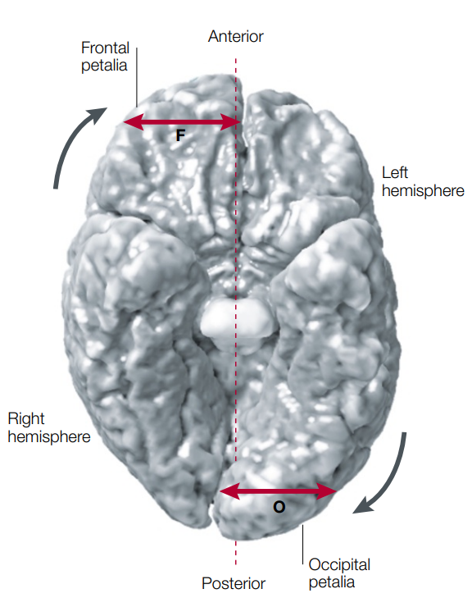
Introduction
Hemispheric asymmetry is a critical feature of human brain structure and function. Figure out the asymmetry of brain structure is also of great significance to brain-related diseases like Alzheimer’s.
Previous research using univariate approaches show little difference between the left and right hemisphere. Thus, using a multivariate machine learning approach is worth exploring.
(Toga, Thompson, 2003, Nat. Neuroscience)

Slide 5
PART TWO
Methods

Slide 6
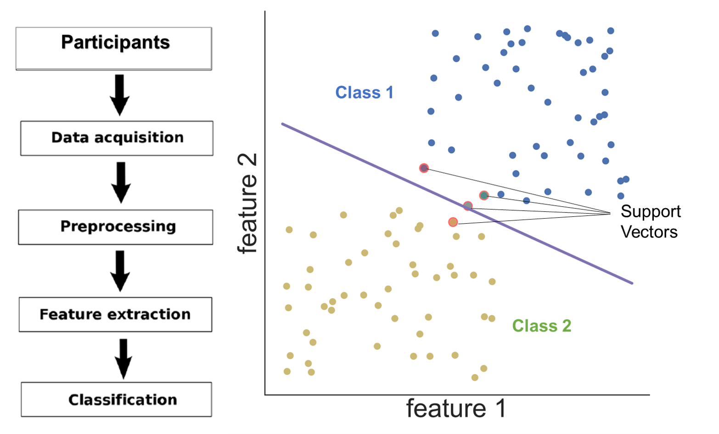
Methods
Code available at: Code For HCP_ML
Support Vector Machine (SVM)
1113 Individuals from HCP
Age: 22 - 35
606 - Female, 507 - Male
Label 1 -> Right Hemi
Label 0 -> Left Hemi
34 brain regions according to the Desikan-Killiany atlas from the aspects of Area & Thickness
70% Training, 30% Testing

Slide 7
PART THREE
Results

Slide 8
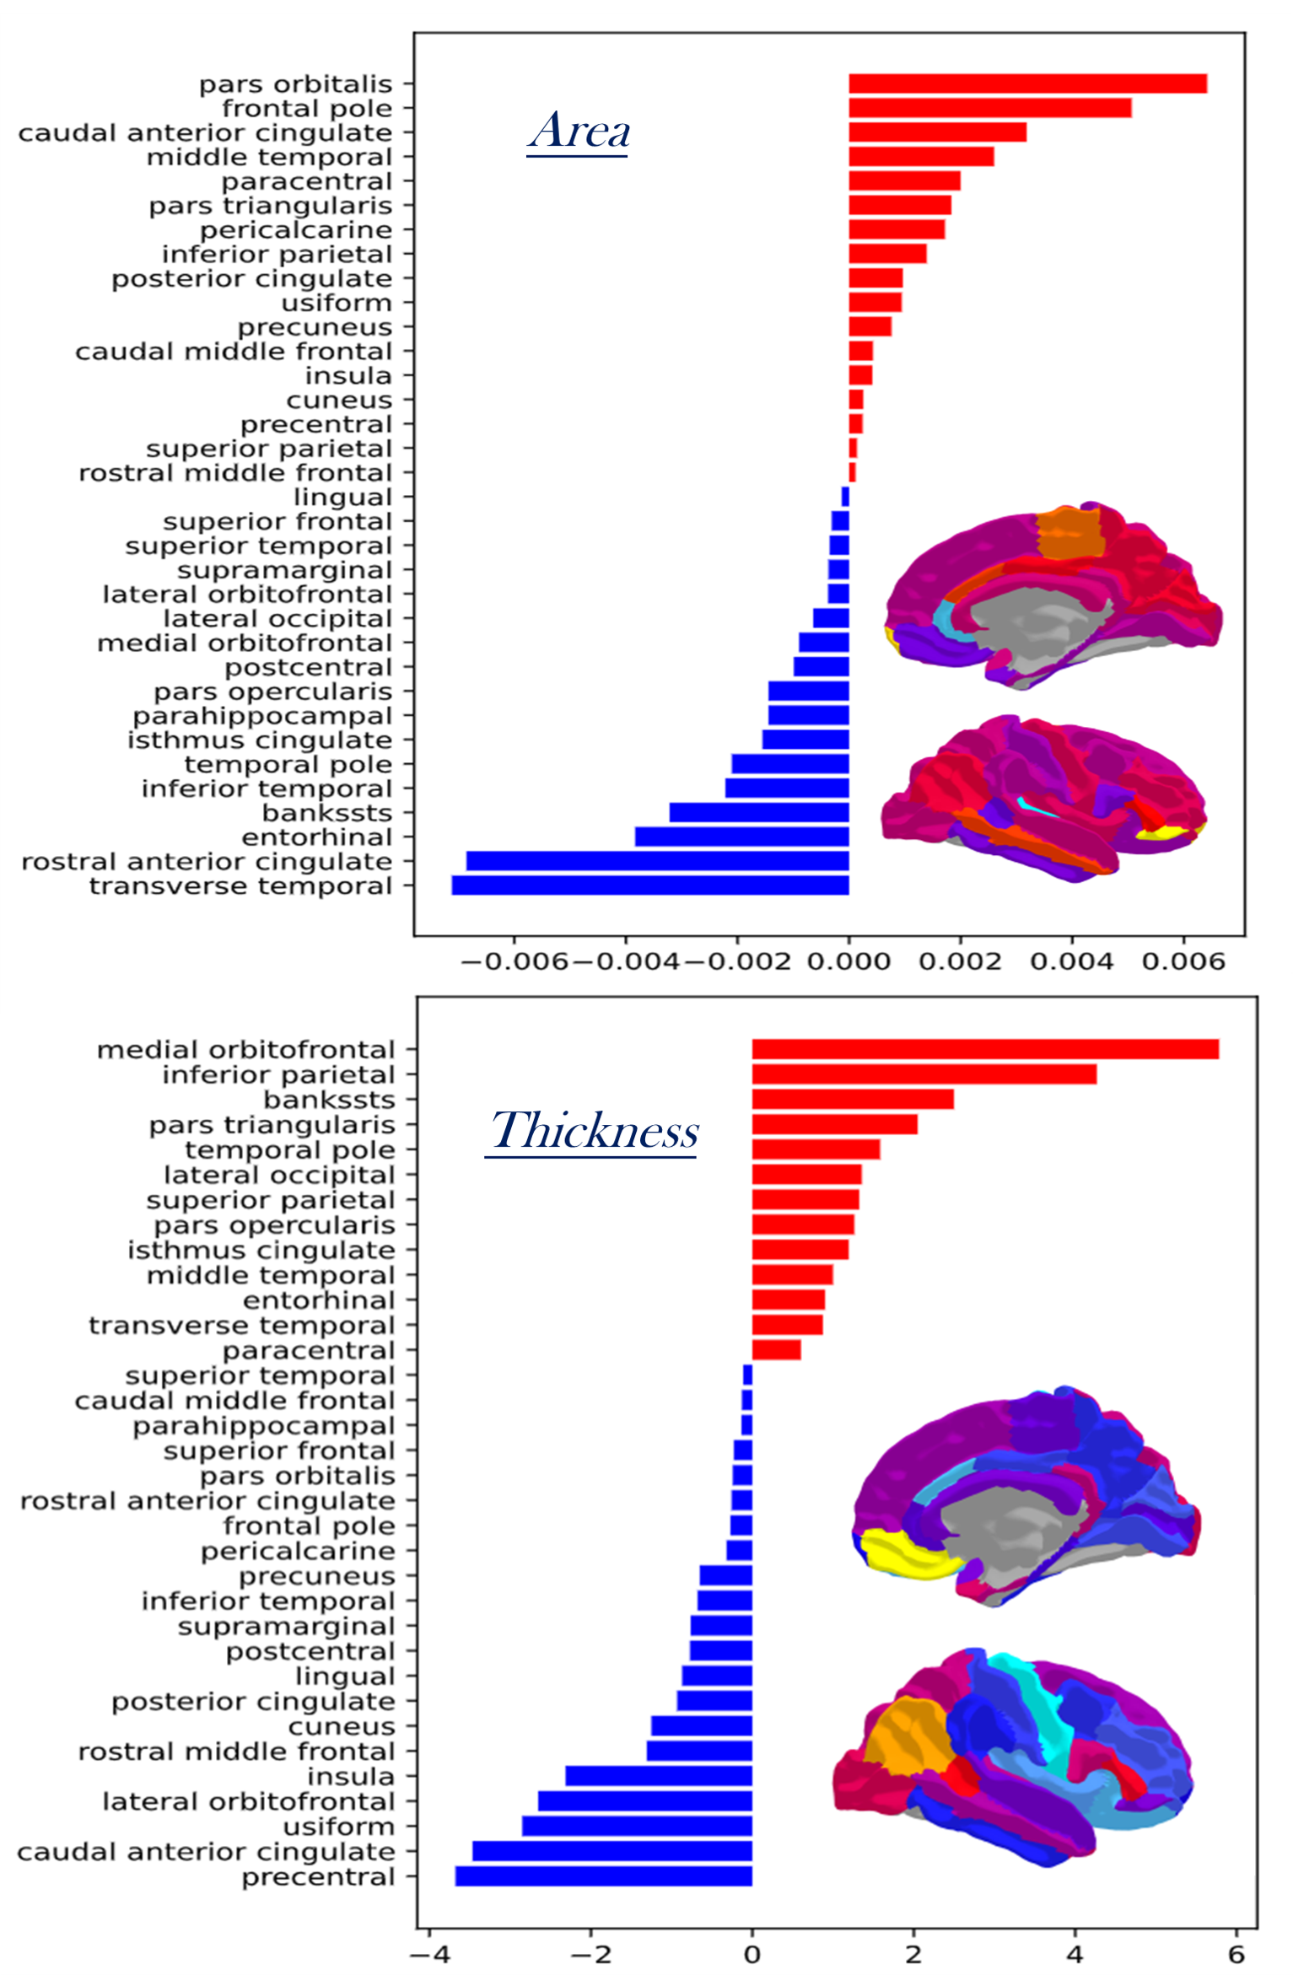
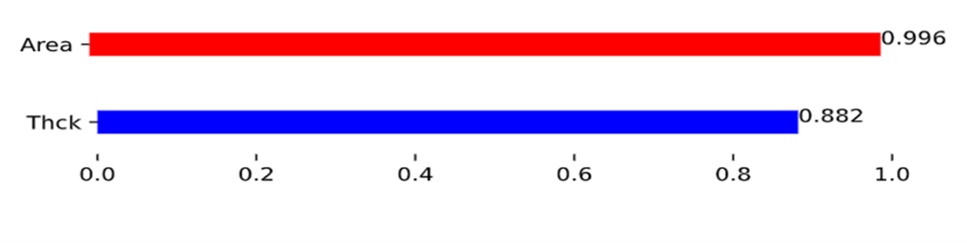
Results
Locally
Globally
Two machine learning models based on various morphometric measures showed excellent performance (88.2% & 99.6%). Even though the effect sizes of univariate hemispheric differences in thickness are small (Cohen's d < 0.5), it is interesting that by using a multivariate approach, we could distinguish the two hemispheres with high accuracy (88.2%).
By extracting the weight of each brain region of the model, we visualized the importance of each brain region for the classification task.

Slide 9
PART FOURTH
Discussion & Conclusion

Slide 10
Discussion & Conclusion
Multivariate analysis could be more beneficial for studies of the link between structural asymmetry and functional lateralization.
The results (importance) extracted from the weight of the trained models, which are (For Area) pars orbitalis, transverse temporal, frontal pole, and rostral anterior cingulate, (For thickness) medial orbitofrontal, precentral, inferior parietal, show high consistency with previous research, such as Kong’s research in 2018. This is a new way of exploring brain structure (combining machine learning).

Slide 11
THANKS!
Feel interested in this topic?
I’m exploring more related projects!
Visit my Homepage at haoyu-hu.github.io
Or contact me at huhaoyu81@gmail.com

