Slide 1
CS203: Data Structure & Algorithm Analysis (DSAA)
Ran Cheng (程然)
https://chengran.tech/
https://emi.sustech.edu.cn/

Slide 2

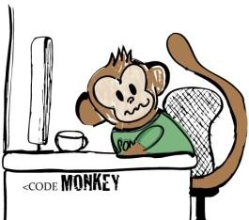
Welcome to DSAA
We will study fundamental data structures
Ways of imposing order on a collection of information
Lists, stacks, queues, trees, hash tables, graphs
We will also:
Study algorithms related to these data structures
Learn how to compare data structures & algorithms
Goals:
Learn to think in a professional manner
To be a (computer) scientist, but not a monkey coder (码农)!

Slide 3
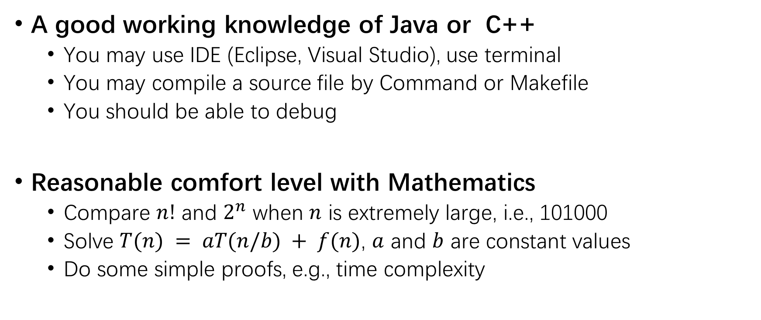
Prerequisites
A good working knowledge of Java or C++
You may use IDE (Eclipse, Visual Studio), use terminal
You may compile a source file by Command or Makefile
You should be able to debug
Reasonable comfort level with Mathematics
Compare $n!$ and $2^{n}$ when $n$ is extremely large, i.e., 101000
Solve $T(n) = aT(n/b) + f(n)$, $a$ and $b$ are constant values
Do some simple proofs, e.g., time complexity

Slide 4
How to learn DSAA
Lectures (2 hours)
Get the main ideas and concepts
Try to be active and think about the questions
Tutorial / Lab (2 hours)
Coding (Java or C++)
Try to use the knowledge learnt in lectures
Read textbook chapters after each class
Thomas H. Corman et. al. Introduction to Algorithms, Third Edition, MIT press, 2009

Slide 5
Class Attendance
Attending classes is basic requirement for a student
Reading slides is just no enough
I may check attendance

Slide 6
Assessment
Continuous Assessment: 50%
Class attendance: 10%
Lab exercises: 20%
Two quizzes: 20%
Exam: 50%
Mid-term Examination: 20%
Final Examination: 30%

Slide 7
Lab exercises
Online Judge: to be introduced in the first lab class
Five problems to get full marks
Zero tolerance on plagiarism!!!
Deadline: 23:59, each Sunday
NO late submission allowed
Suggested solutions will be released on each following Monday

Slide 8
Tentative Schedule
No. | Topic
1 | Introduction
2 | Sorting Algorithms
3 | Linked list
4 | Stacks
5 | Queue
6 | Strings
7 | Tree
No. | Topic
8 | Mid-term Exam
9 | Binary Tree I
10 | Binary Tree II
11 | Graph I
12 | Graph II
13 | Graph III
14 | Revision

Slide 9
Course Materials
Blackboard: https://bb.sustc.edu.cn/
Please check course website regularly
Announcement
Lecture slides
Tutorial / lab exercises
Solutions

Slide 10
Reminder
If you have questions, please try to use google first, then TAs, finally, find me.
DSAA is very time-consuming, so please consider carefully before you select this course.
Curiosity is always the best motivation, so ask yourself if you are really interested.
No pains, no gains!
千里之行，始于足下

Slide 11
Thank you

