Slide 1
Lecture 2 Algorithm Analysis
Ran Cheng (程然)
https://chengran.tech/
https://emi.sustech.edu.cn/

Slide 2
Our Roadmap
RAM Computation Model
Memory, CPU, Algorithm
Algorithm, Pseudocode
Worst Case Analysis
Binary Search Problem
Big-O Notation

Slide 3
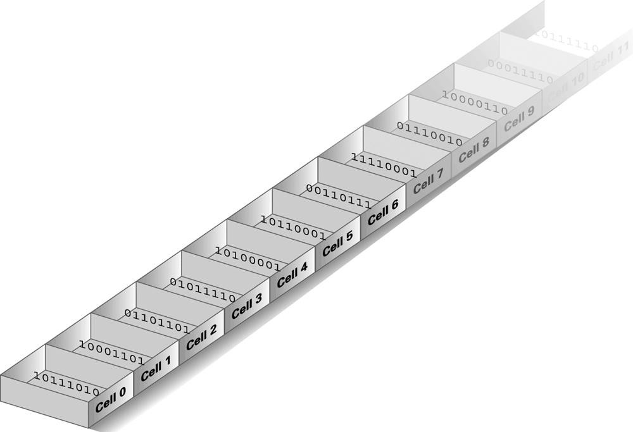
RAM -- Random Access Memory
A finite sequence of cells, each cell has the same number of bits.
Every cell has an address: the first cell of memory has address 0, the second cell 1, and so on.
Store information for immediate use in a computer
ROM?

Slide 4
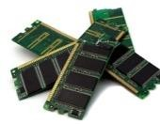
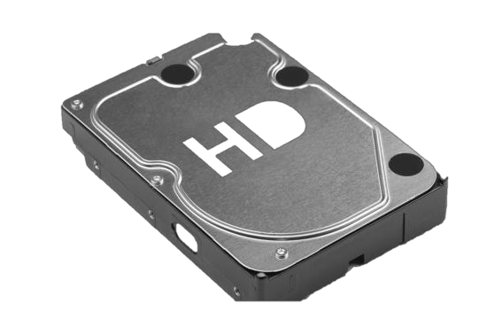

RAM Computation Model
随机存取存储器（英語：Random Access Memory，缩写：RAM）是与CPU直接交换数据的内部存储器。
CPU
RAM
Hard Disk
CPU cost
I/O cost
ALU GB level
TB Level
We focus on this part in CS203

Slide 5
RAM Computation Model
Output
+, -, *, /
Control Unit
ALU
算数逻辑单元
寄存器
Register 1
Register 2
Loading data from memory

Slide 6
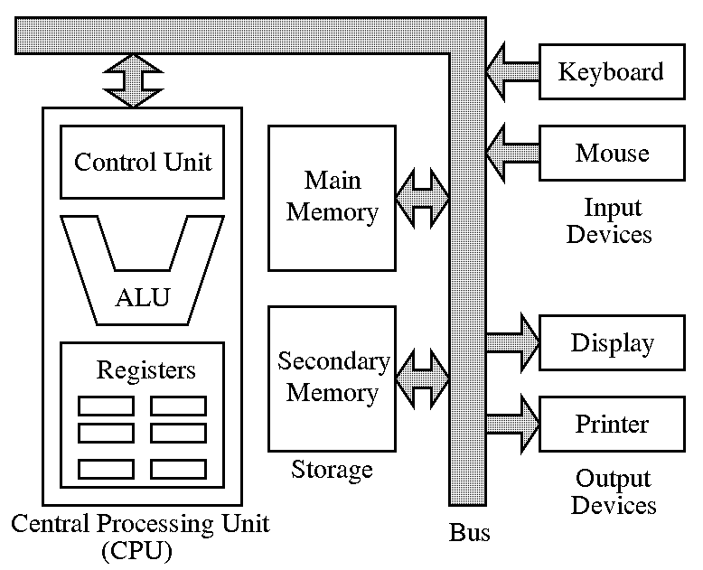
RAM Computation Model

Slide 7
Central Processing Unit (CPU)
Contains a fixed number of registers
Basic (atomic) operations
Initialization
Set a register to a fixed values (e.g., 100, 1000, etc.)
Arithmetic (ALU)
Take integers a, b stored in two registers, calculate one of {+, -, *, /} and store the result in a register
Logic (ALU)
Take integers a, b stored in two registers, calculate one of {AND, OR, NOT, XOR} and store the result in a register
Memory Access
Take a memory address A currently stored in a register, Do the READ (i.e., load data from memory) or WRITE (i.e., flush data to memory)operator

Slide 8

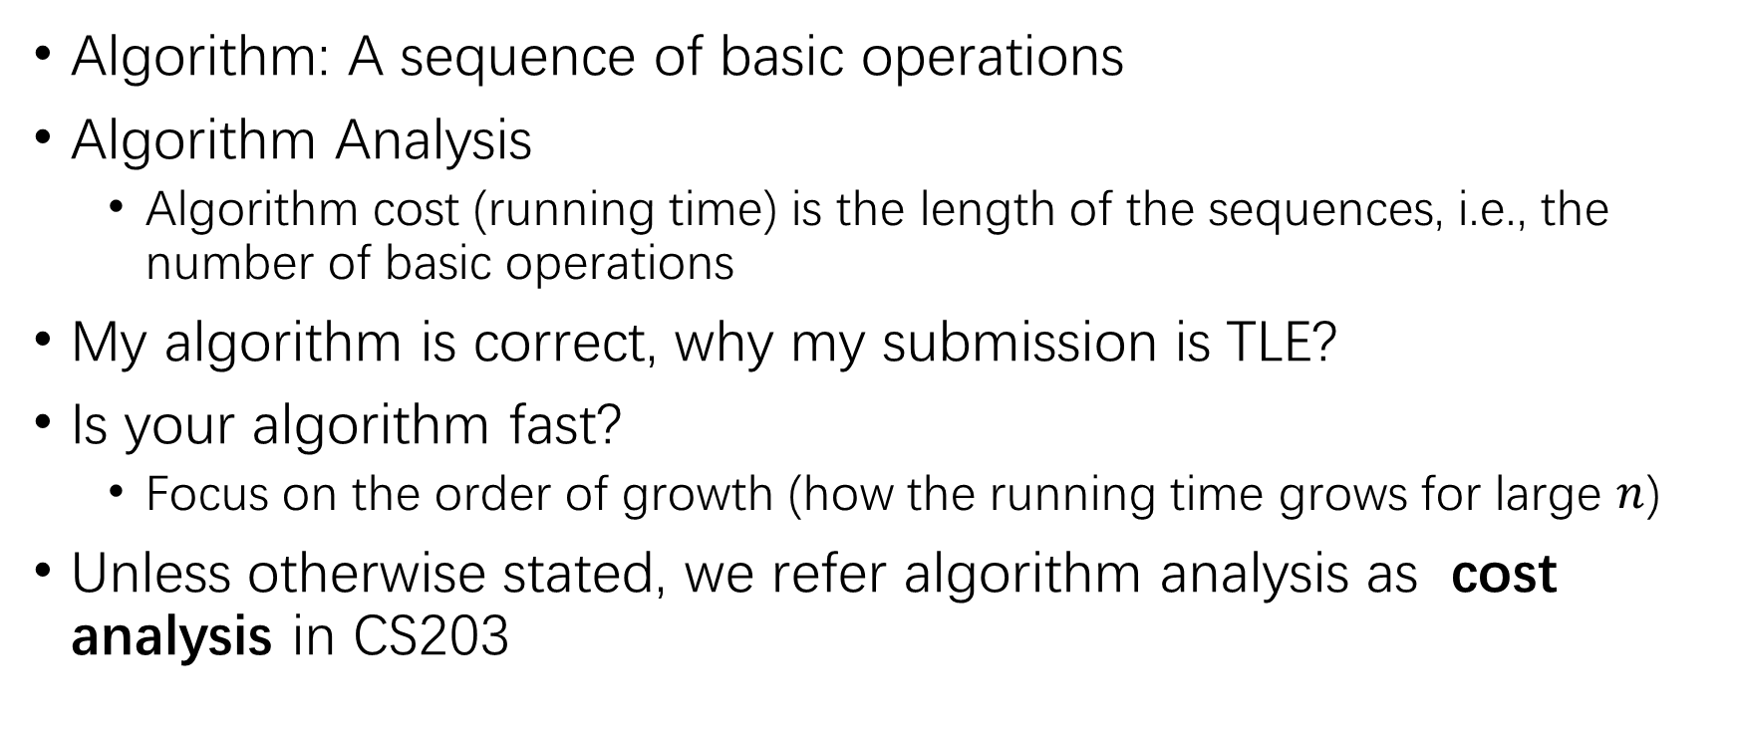
Algorithm Analysis
Algorithm: A sequence of basic operations
Algorithm Analysis
Algorithm cost (running time) is the length of the sequences, i.e., the number of basic operations
My algorithm is correct, why my submission is TLE?
Is your algorithm fast?
Focus on the order of growth (how the running time grows for large $n$)
Unless otherwise stated, we refer algorithm analysis as cost analysis in CS203

Slide 9

Algorithm Correctness
I have passed all test cases, why is still WA?
It is not enough even if you have tested your algorithm on many instances
Will your algorithm fail on some other instances?
Prove correctness of your algorithm
Software testing is another course – out of the scope of DSAA
Guarantee your implementation is correct

Slide 10
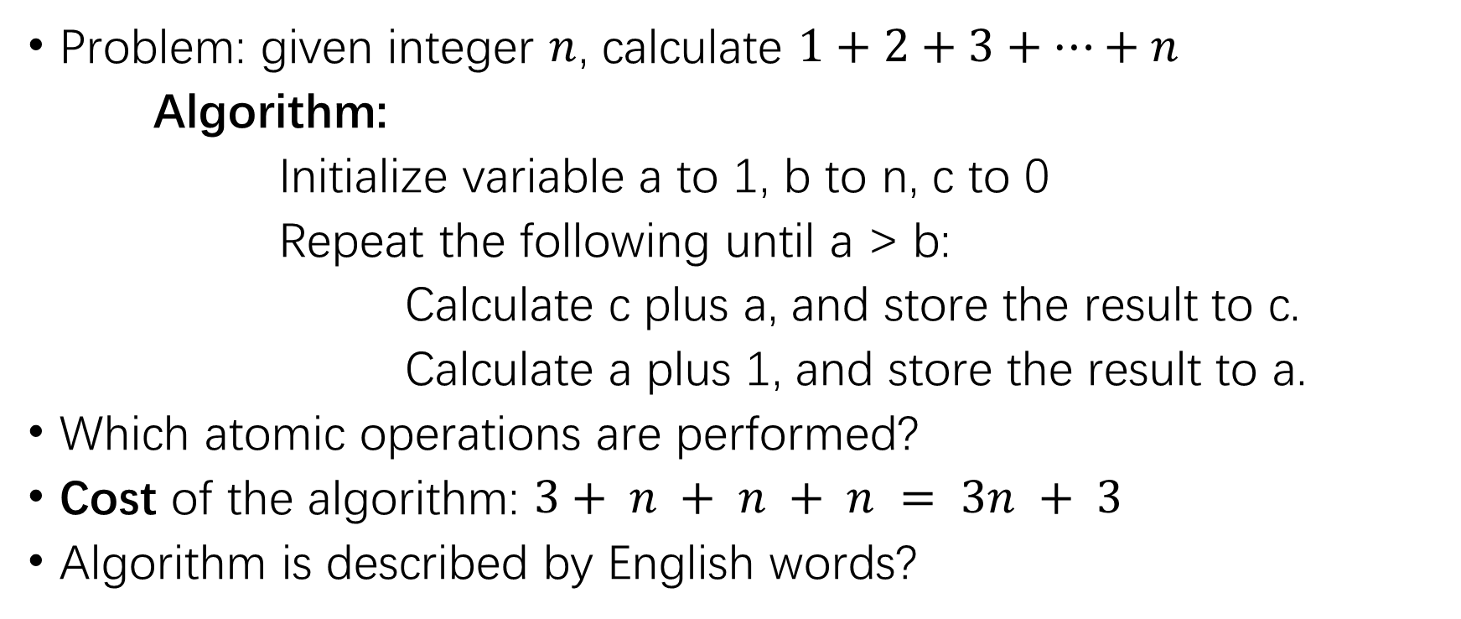
Example I: Summation
Problem: given integer $n$, calculate $1+2+3+…+n$
Algorithm:
Initialize variable a to 1, b to n, c to 0
Repeat the following until a > b:
Calculate c plus a, and store the result to c.
Calculate a plus 1, and store the result to a.
Which atomic operations are performed?
Cost of the algorithm: $3+ n + n + n = 3n + 3$
Algorithm is described by English words?

Slide 11
Example I: Summation
Algorithm:
load n from memory to register b
register a ← 1, c ← 0
repeat
c ← c + a
a ← a + 1
until a > b
return c
This is pseudocode expressing (without ambiguity) how our algorithm runs.
Pseudocode does not rely on any particular programming language

Slide 12
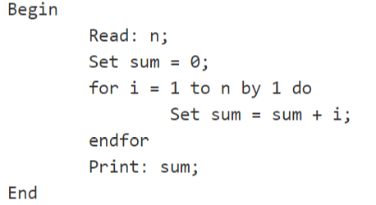
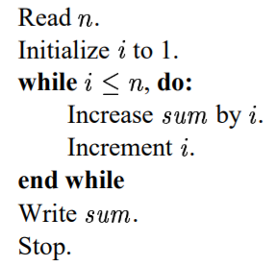

Pseudo Code
Pseudocode (伪代码) is an informal high-level description of the operating principle of a computer program or other algorithm.
Depending on the writer, pseudocode may therefore vary widely in style.

Slide 13

Example II: Summation
Problem: given integer n, calculate $1+2+3+…+n$
Cost of the above algorithm: $3n + 3$
Can we make it faster?
In our middle school math course: $1+2+3+…+n = (1+n)∗n / 2$

Slide 14
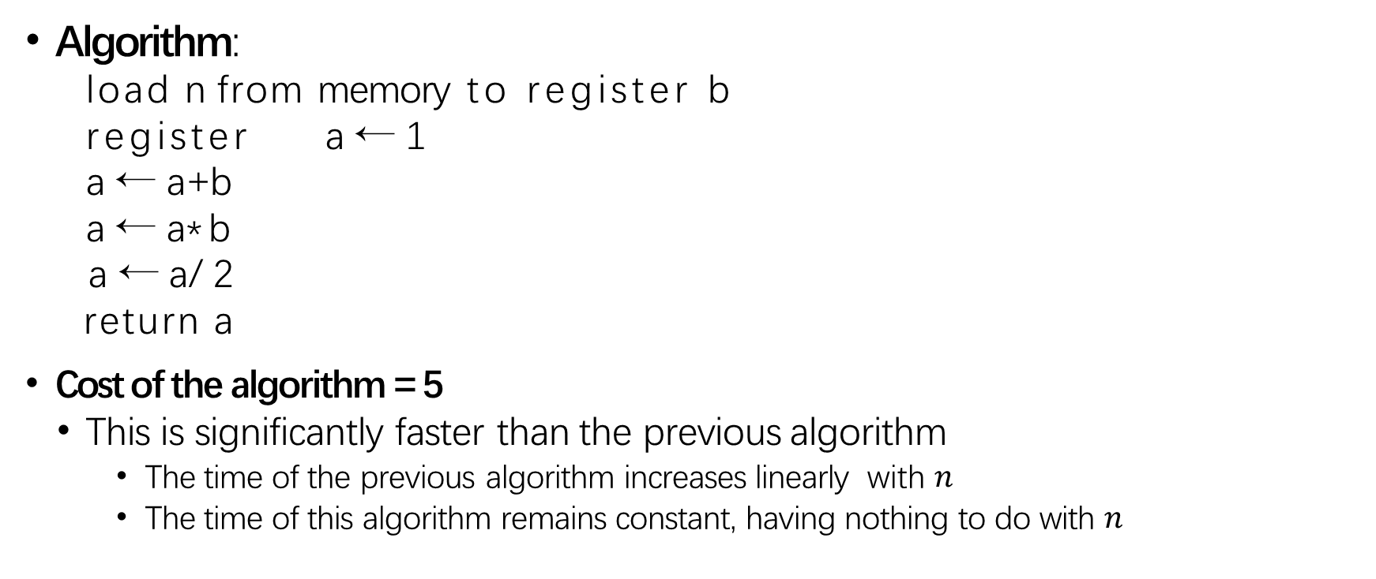
Example II: Summation
Algorithm:
load n from memory to register b
register a ← 1
a ← a +b
a ← a*b
a ← a/2
return a
Cost of the algorithm = 5
This is significantly faster than the previous algorithm
The time of the previous algorithm increases linearly with $n$
The time of this algorithm remains constant, having nothing to do with $n$

Slide 15
Any other way?
public static int sum(int n){
if(n==1){
return 1 ;
}else{
return n + sum(n-1) ;
}
}

Slide 16
Our Roadmap
RAM Computation Model
Memory, CPU, Algorithm
Algorithm, Pseudocode
Worst Case Analysis
Binary Search Problem
Big-O Notation

Slide 17
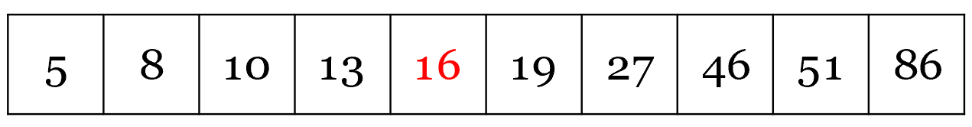
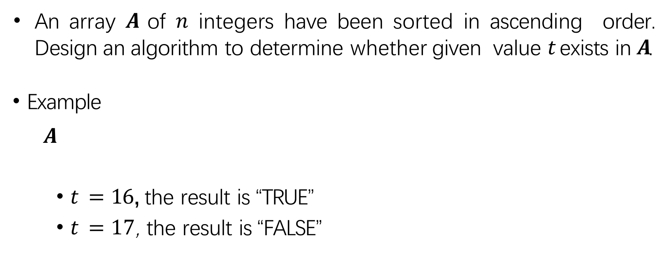
Search Problem
An array $A$ of $n$ integers have been sorted in ascending order. Design an algorithm to determine whether given value $t$exists in $A$.
Example
$A$
$t = 16$, the result is “TRUE”
$t = 17$, the result is “FALSE”

Slide 18

First Algorithm for Search Problem
Algorithm:
Simply read the value of $A[i]$for each $i∈[1, n]$;
If any of those cell equals to $t$, return “TRUE”, otherwise return “FALSE”.

Slide 19
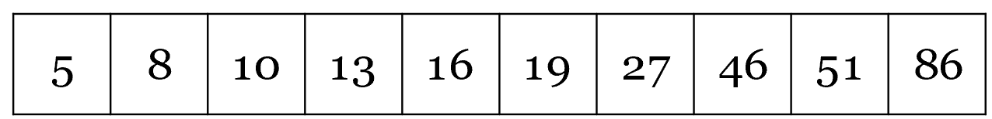
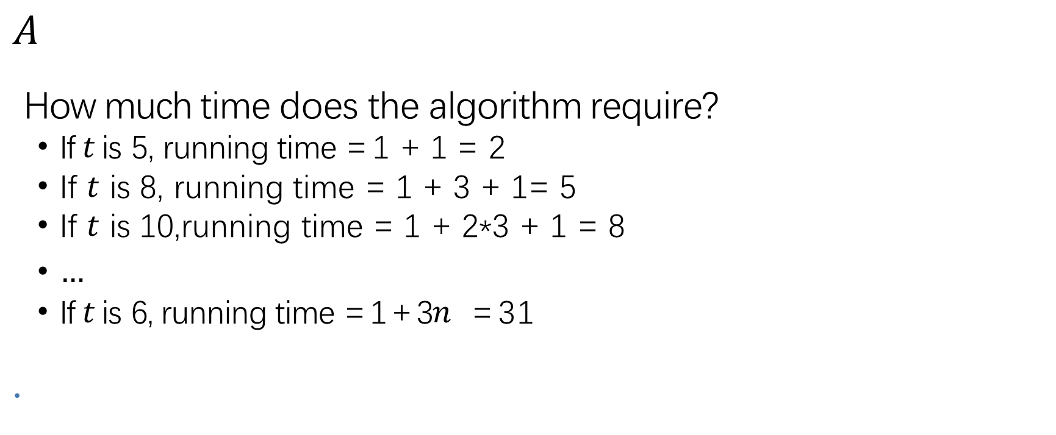
Running time of the First Algorithm
$$A$$
How much time does the algorithm require?
If $t$ is 5, running time = 1 + 1 = 2
If $t$ is 8, running time = 1 + 3 + 1= 5
If $t$ is 10,running time = 1 + 2*3 + 1 = 8
$…$
If $t$ is 6, running time = 1 + 3$n$ = 31

Slide 20
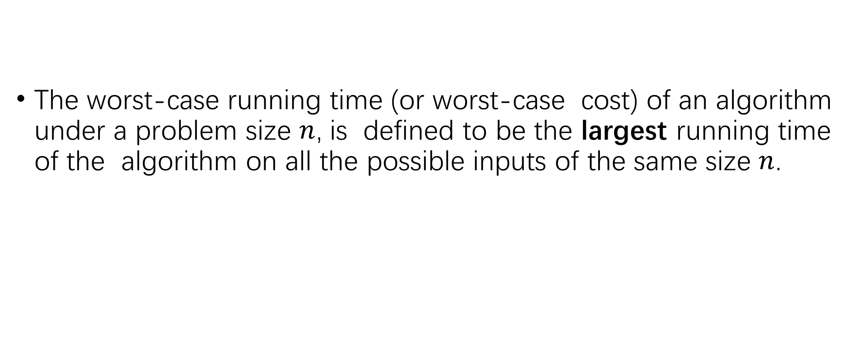
Worst-case Running Time
The worst-case running time (or worst-case cost) of an algorithm under a problem size $n$, is defined to be the largest running time of the algorithm on all the possible inputs of the same size $n$.

Slide 21
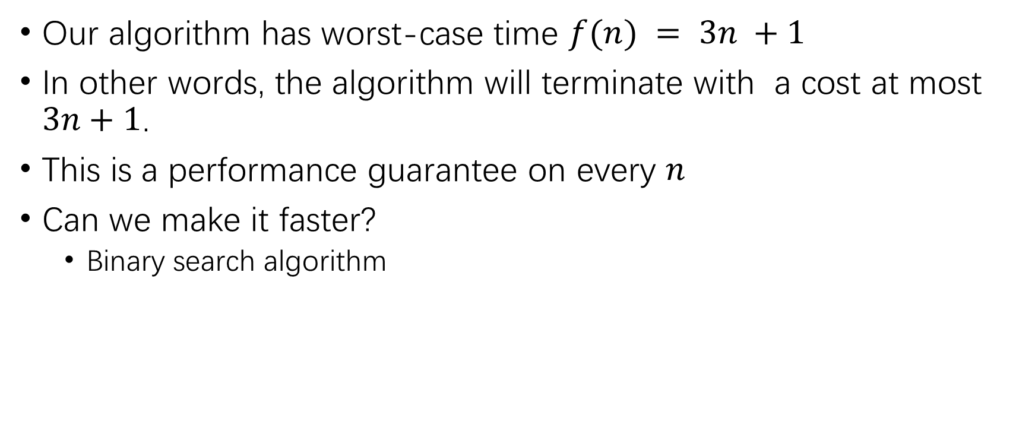
Worst-case Running Time of the First Algorithm
Our algorithm has worst-case time $f(n) = 3n +1$
In other words, the algorithm will terminate with a cost at most $3n+1$.
This is a performance guarantee on every $n$
Can we make it faster?
Binary search algorithm

Slide 22
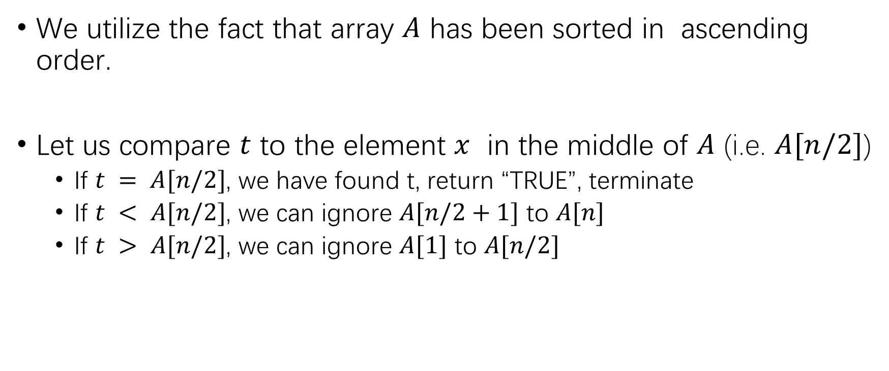
Binary Search Algorithm
We utilize the fact that array $A$ has been sorted in ascending order.
Let us compare $t$ to the element $x$ in the middle of $A$ (i.e. $A[n/2]$)
If $t = A[n/2]$, we have found t, return “TRUE”, terminate
If $t < A[n/2]$, we can ignore $A[n/2+1]$ to $A[n]$
If $t > A[n/2]$, we can ignore $A[1]$ to $A[n/2]$

Slide 23
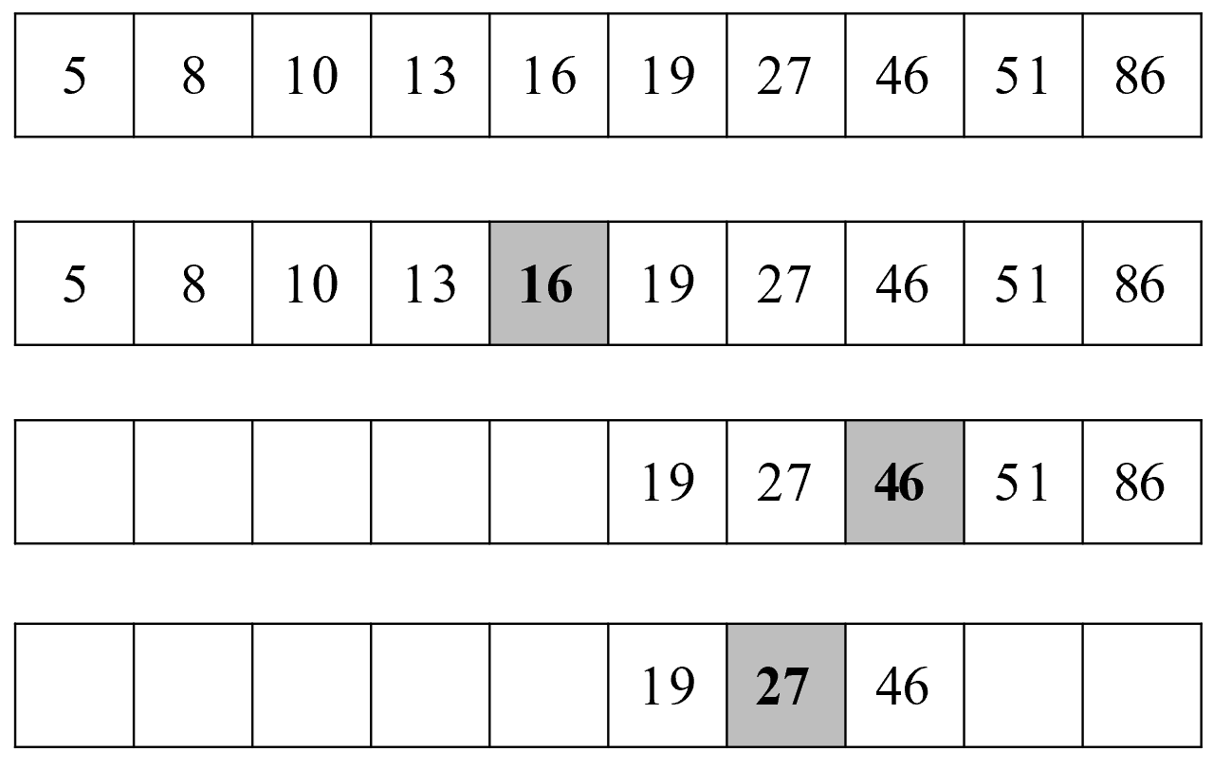








Binary Search Algorithm
$$A$$
$$t=27$$
$$A$$
$$<t$$
$$A$$
$$>t$$
$$A$$
$$=t$$

Slide 24
Binary Search Algorithm
left←1, right←n
repeat
mid←(left+right)/2
if(t=A[mid])then
return TRUE
else if (t<A[mid])then
right←mid-1
else
left←mid+1
until left>right
return FLASE

Slide 25
Worst-case Running Time of Binary Search
Line 1: initialization: 2 basic operations
Line 2 – 10: iteration, each iteration performs at most 8 basic operations
Line 11: termination
How many iterations in the algorithm?

Slide 26
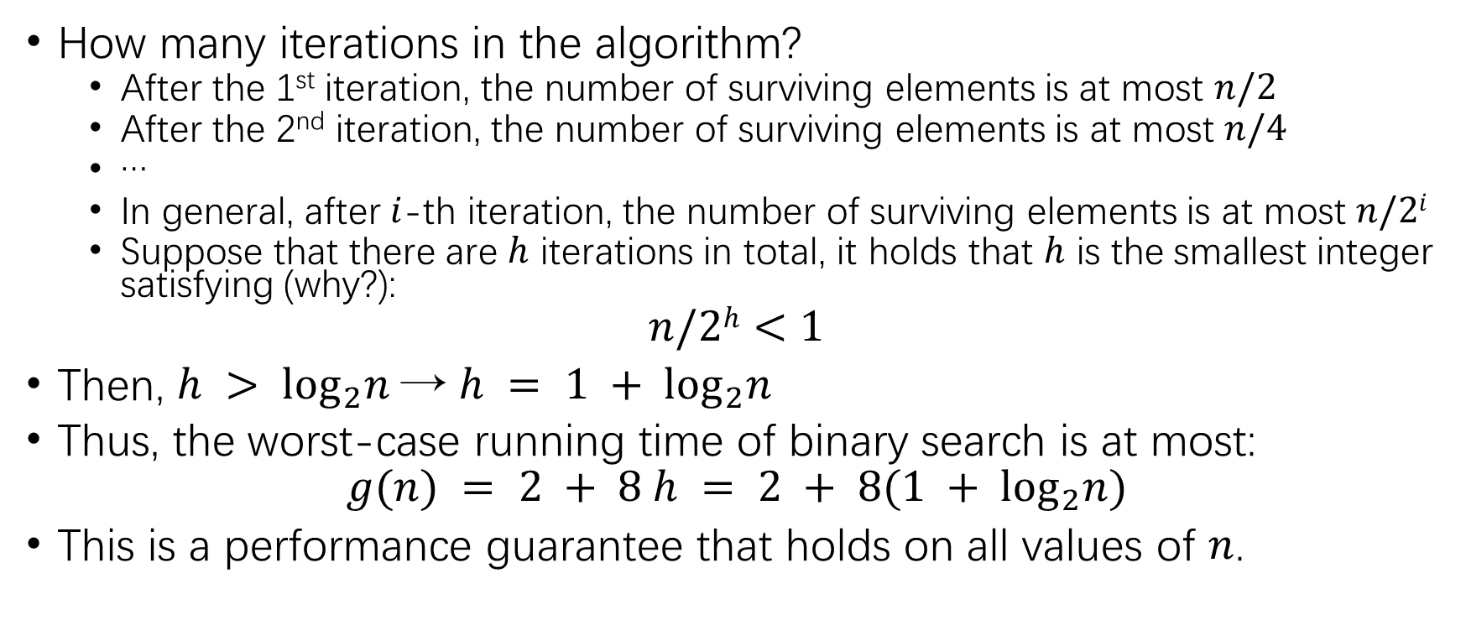
Worst-case Running Time of Binary Search
How many iterations in the algorithm?
After the 1st iteration, the number of surviving elements is at most $n/2$
After the 2nd iteration, the number of surviving elements is at most $n/4$
…
In general, after $i$-th iteration, the number of surviving elements is at most $n/2i$
Suppose that there are $h$ iterations in total, it holds that $h$ is the smallest integer satisfying (why?):
$$n/2h<1$$
Then, $h > \log_{2}n$→ $h = 1 + \log_{2}n$
Thus, the worst-case running time of binary search is at most:
$$g(n) = 2 + 8 h = 2 + 8(1 + \log_{2}n)$$
This is a performance guarantee that holds on all values of $n$.

Slide 27
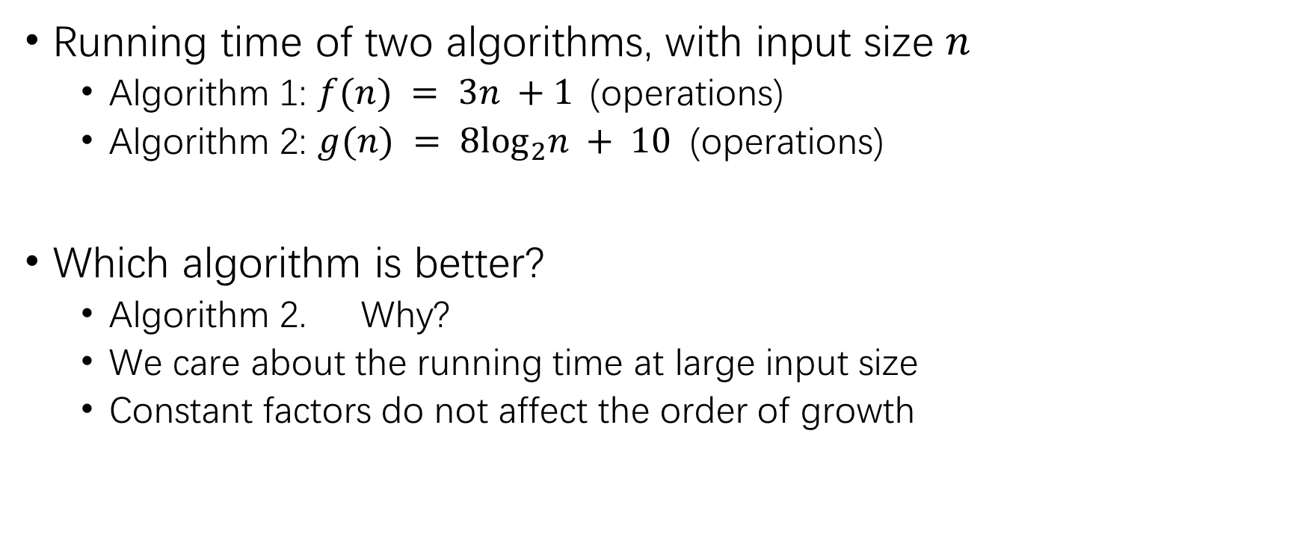
Search Problem
Running time of two algorithms, with input size $n$
Algorithm 1: $f(n) = 3n +1$(operations)
Algorithm 2: $g(n) = 8\log_{2}n + 10$ (operations)
Which algorithm is better?
Algorithm 2. Why?
We care about the running time at large input size
Constant factors do not affect the order of growth

Slide 28
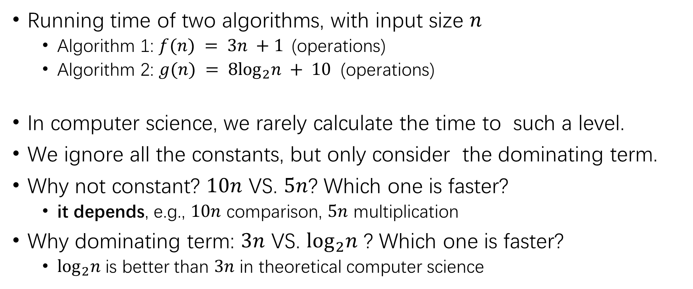
Asymptotic Analysis
Running time of two algorithms, with input size $n$
Algorithm 1: $f(n) = 3n +1$(operations)
Algorithm 2: $g(n) = 8\log_{2}n + 10$ (operations)
In computer science, we rarely calculate the time to such a level.
We ignore all the constants, but only consider the dominating term.
Why not constant? $10n$ VS. $5n$? Which one is faster?
it depends, e.g., $10n$ comparison, $5n$ multiplication
Why dominating term: $3n$ VS. $\log_{2}n$ ? Which one is faster?
$\log_{2}n$ is better than $3n$ in theoretical computer science

Slide 29
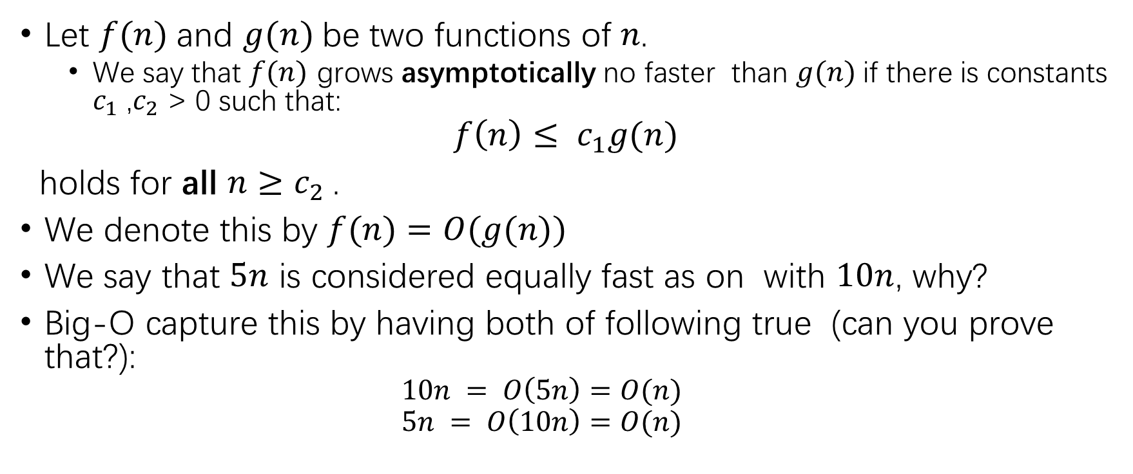
Big-O notation
Let $f(n)$and $g(n)$be two functions of 𝑛.
We say that $f(n)$ grows asymptotically no faster than $g(n)$if there is constants $c_{1}$ ,$c_{2}$ > 0 such that:
$$f\left(n\right)≤ c_{1}g(n)$$
holds for all $n≥c_{2}$.
We denote this by $f(n)=O(g(n))$
We say that $5n$ is considered equally fast as on with $10n$, why?
Big-O capture this by having both of following true (can you prove that?):
$$10n = O\left(5n\right)=O(n)$$
$$5n = O\left(10n\right)=O(n)$$

Slide 30
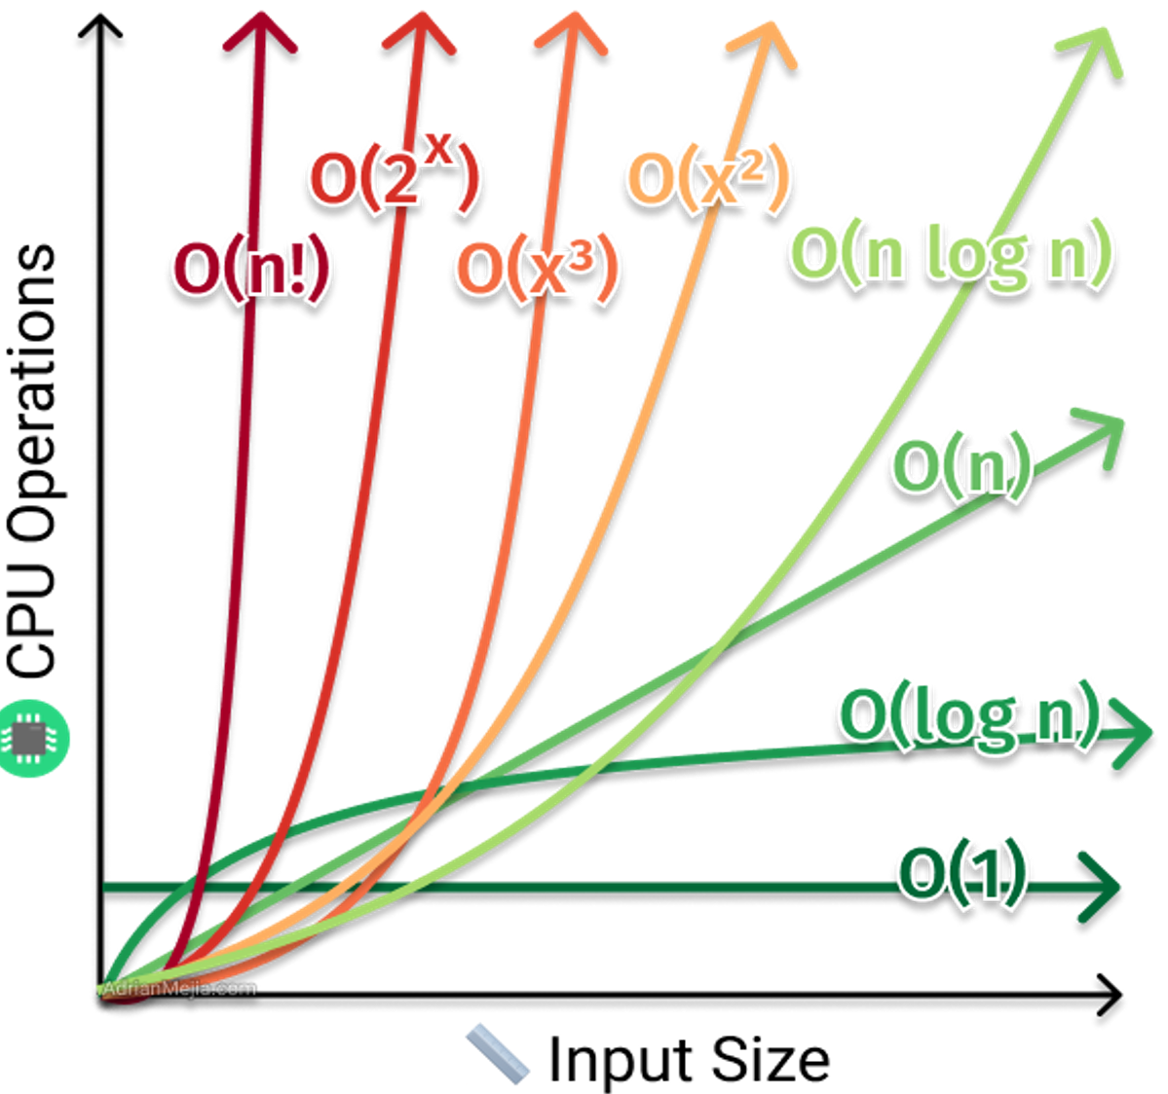
Big-O Complexity

Slide 31
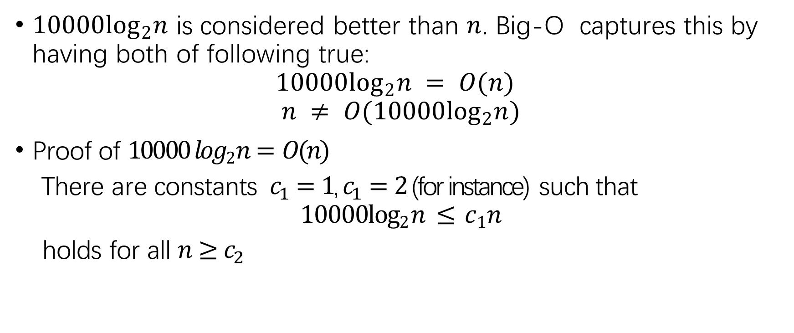
Big-O Example
$10000\log_{2}n$ is considered better than $n$. Big-O captures this by having both of following true:
$$10000\log_{2}n = O(n)$$
$$n ≠ O(10000\log_{2}n)$$
Proof of $10000 log2 n= O(n)$
There are constants $c_{1}=1$, $c_{1}=2$ (for instance) such that
$$10000log2 n ≤ c1n$$
holds for all $n≥c_{2}$

Slide 32
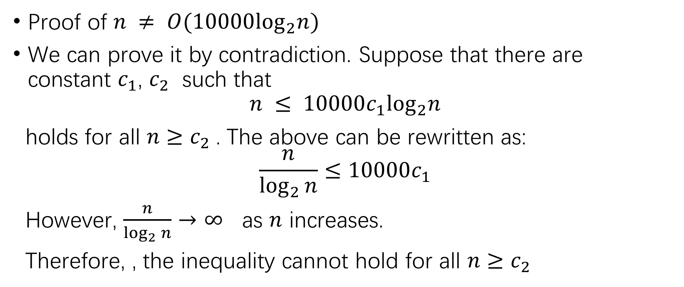
Big-O Example
Proof of $n ≠ O(10000\log_{2}n)$
We can prove it by contradiction. Suppose that there are constant $c_{1}$, $c_{2}$ such that
$$n ≤ {10000c}_{1}\log_{2}n$$
holds for all $n≥c_{2}$. The above can be rewritten as:
$$\frac{n}{\log_{2}{n}}≤10000c_{1}$$
However, $\frac{n}{\log_{2}{n}}→∞$ as $n$ increases.
Therefore, , the inequality cannot hold for all $n≥c_{2}$

Slide 33
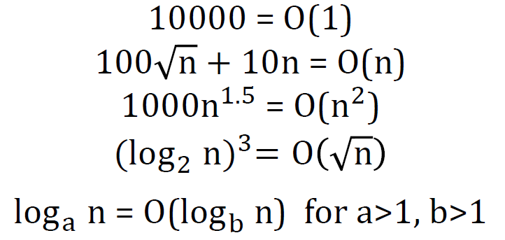

Big-O Exercises
Is $(5n^{2}+3n) = O(n^{2})$?
Is $(5n^{2}+3n) = O(n^{3})$?
Is $(5n^{2}+3n) = O(n)$?
Proof the following statements:

Slide 34
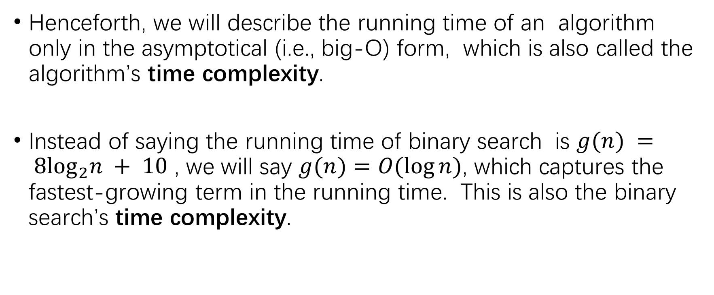
Asymptotic Analysis
Henceforth, we will describe the running time of an algorithm only in the asymptotical (i.e., big-O) form, which is also called the algorithm’s time complexity.
Instead of saying the running time of binary search is $g(n) = 8\log_{2}n + 10$ , we will say $g(n)=O(\log{n})$, which captures the fastest-growing term in the running time. This is also the binary search’s time complexity.

Slide 35
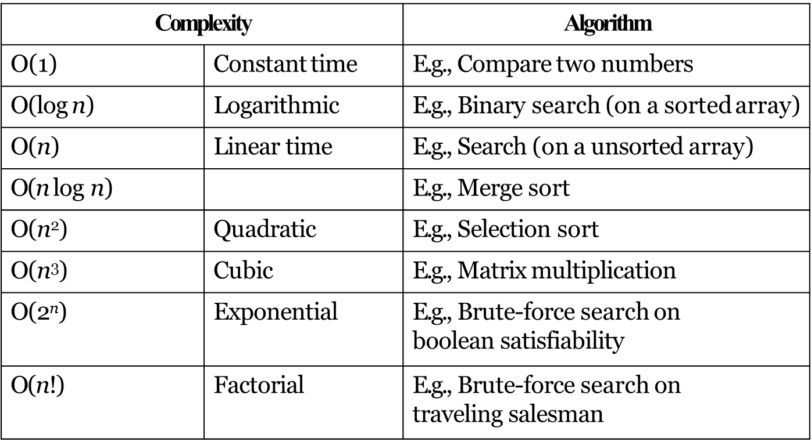
Time complexities of some algorithms

Slide 36
Thank you

