Slide 1
Lecture 4 Linked List
Ran Cheng (程然)
https://chengran.tech/
https://emi.sustech.edu.cn/

Slide 2
Our Roadmap
Definition of Linked List
Operators of Linked List
Illustrative Example

Slide 3
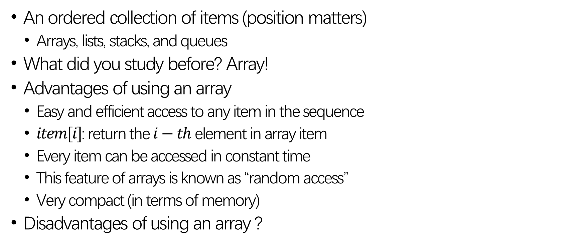
Representing a Sequence of Data
An ordered collection of items (position matters)
Arrays, lists, stacks, and queues
What did you study before? Array!
Advantages of using an array
Easy and efficient access to any item in the sequence
$item[i]$: return the $i−th$ element in array item
Every item can be accessed in constant time
This feature of arrays is known as “random access”
Very compact (in terms of memory)
Disadvantages of using an array ?

Slide 4




Disadvantages of an Array
Have to specify an initial array size
Resize an array is possible, but not so easy
Difficult to insert/delete elements at arbitrary positions
Delete $10$ in array $A$, time complexity?
$$A$$
5 | 8 | 10 | 13 | 16 | 19 | 27 | 46 | 51 | 86
$$A$$
5 | 8 |  | 13 | 16 | 19 | 27 | 46 | 51 | 86
$$A$$
5 | 8 | 13 | 16 | 19 | 27 | 46 | 51 | 86

Slide 5


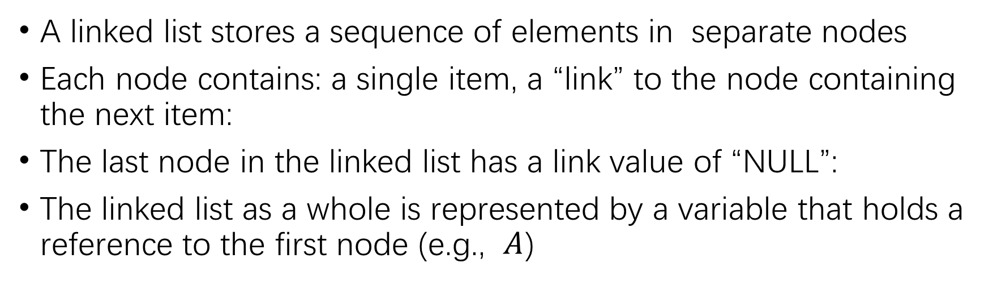

A Linked List
$$A$$
5
8
10
13
16
head
19
27
46
51
86 | ^
A linked list stores a sequence of elements in separate nodes
Each node contains: a single item, a “link” to the node containing the next item:
The last node in the linked list has a link value of “NULL”:
The linked list as a whole is represented by a variable that holds a reference to the first node (e.g., $A$)

Slide 6
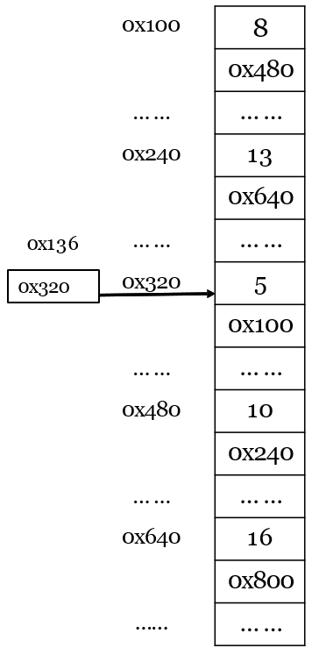
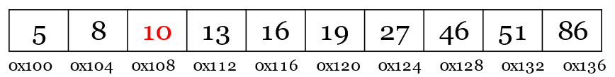
Array vs. Linked List in Memory
In an array, the elements occupy consecutive memory locations:
In linked list, each node is a distinct object. The nodes do NOT have to be next to each other in memory. That’s why we need the links to get from one node to the next.

Slide 7
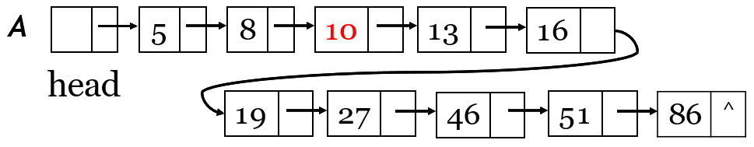
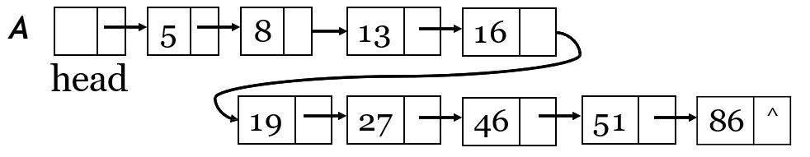

Features of Linked List
It can grow without limit (not fixed length)
Easy to insert/delete an element
Delete 10 in Linked List $A$, before:

Slide 8
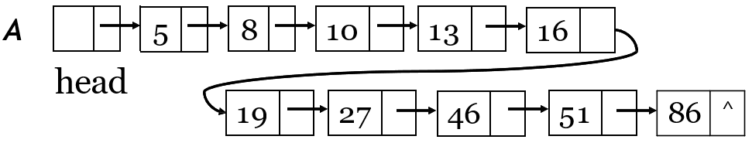
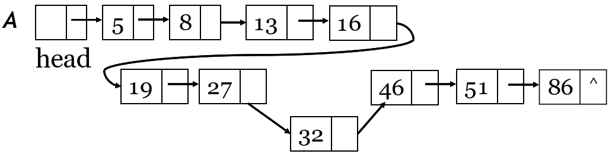
Features of Linked List
Insert $32$ into a linked list at the position between $27$ and $46$:
Time Complexity?

Slide 9
Features of Linked List
Disadvantages of Linked List
They do not provide random access
Need to “walk down” the list to access an item
The links take up additional memory
Not compact (in terms of Memory)
Linked List vs. Array
Space complexity
Time Complexity: Insert, Delete, Find

Slide 10
Our Roadmap
Definition of Linked List
Operators of Linked List
Illustrative Example

Slide 11
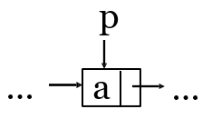
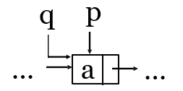
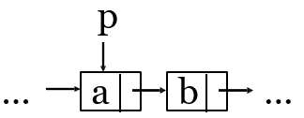
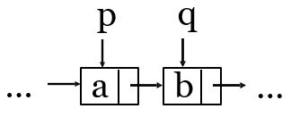
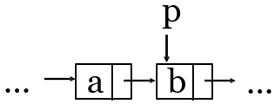
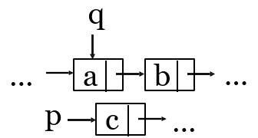
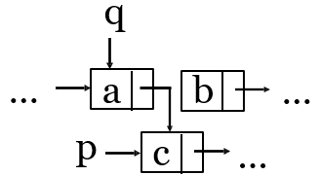
Basic Operators of Linked List
Before
After
① q ← p
② q ← next of p
③ p ← next of p
④ next of q ← p
(a)

Slide 12
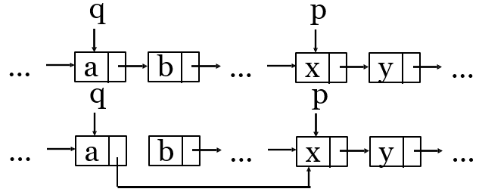
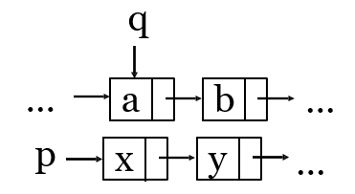
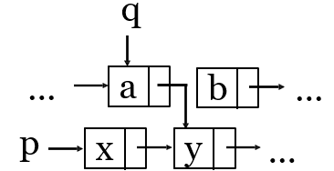
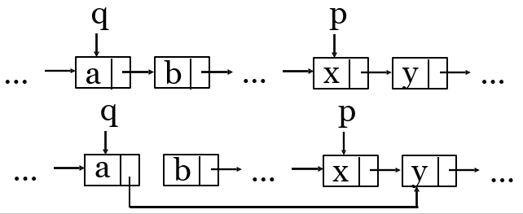
Basic Operators of Linked List
④ next of q ← p
(b)
⑤ next of q ← next of p
(a)
⑥ next of q ← next of p
(b)

Slide 13
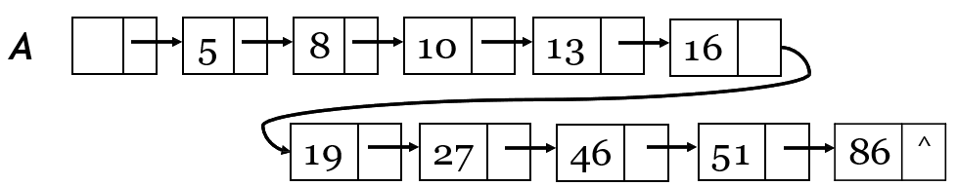
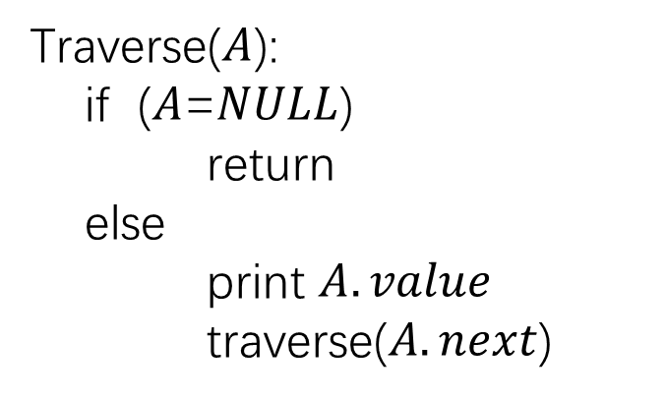
Traverse a Linked List
Many tasks require us to traverse or “walk down” a linked list
Traverse($A$):
if ($A$=$NULL$)
return
else
print $A.value$
traverse($A.next$)

Slide 14
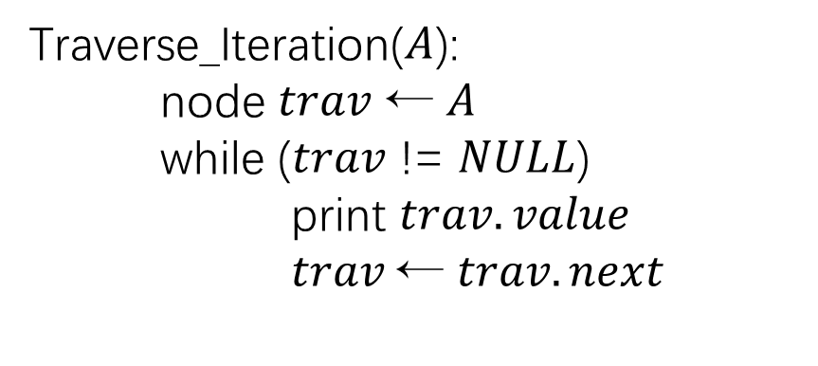
Traverse a Linked List
It can also be done using iteration (for loops, while loops, etc.)
Traverse_Iteration($A$):
node $trav$ ← $A$
while ($trav$ != $NULL$)
print $trav.value$
$trav$← $trav.next$
We use iteration in the following operators, but you can try to use recursion to implement these operators.

Slide 15
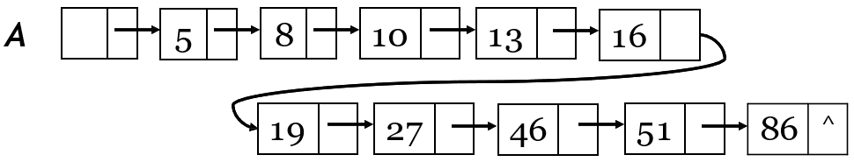
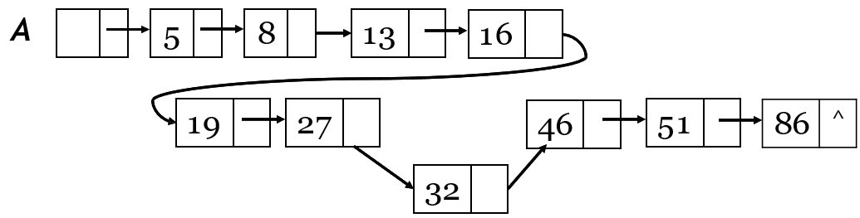

Inserting an Item at Position $i$
Insert $32$ in linked list $A$ at position $8$:
How to do that?

Slide 16
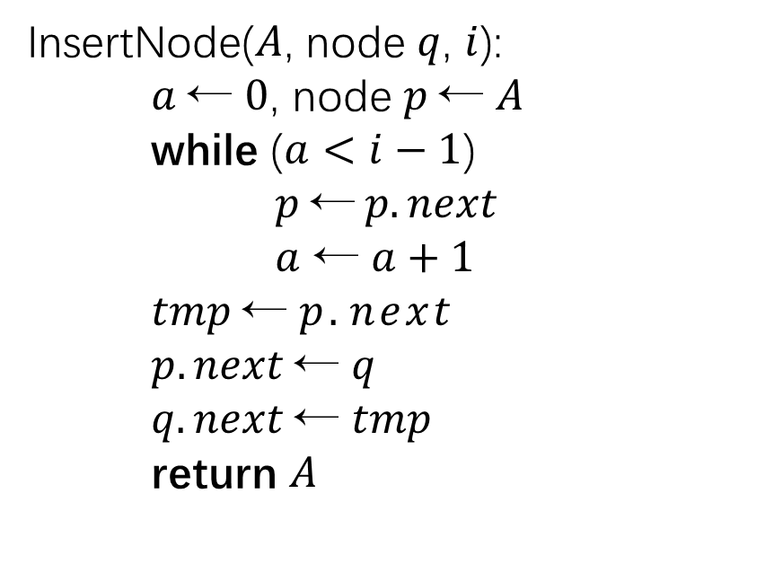
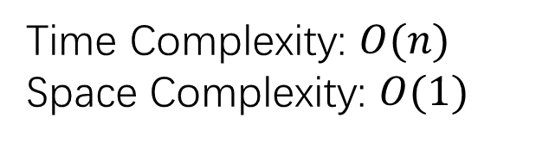
Inserting an Item at Position $i$
InsertNode($A$, node $q$, $i$):
$a$← $0$, node $p$← $A$
while ($a<i−1$)
$p \text{←} p.next$
$a$ ← $a+1$
$tmp$← $p.next$
$p.next$← $q$
$q.next$← $tmp$
return $A$
Time Complexity: $O(n)$
Space Complexity: $O(1)$

Slide 17
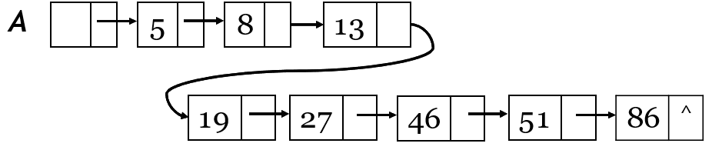


Deleting an Item at Position $i$
Delete item at position $5$ in linked list $A$:

Slide 18
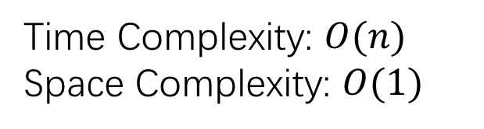
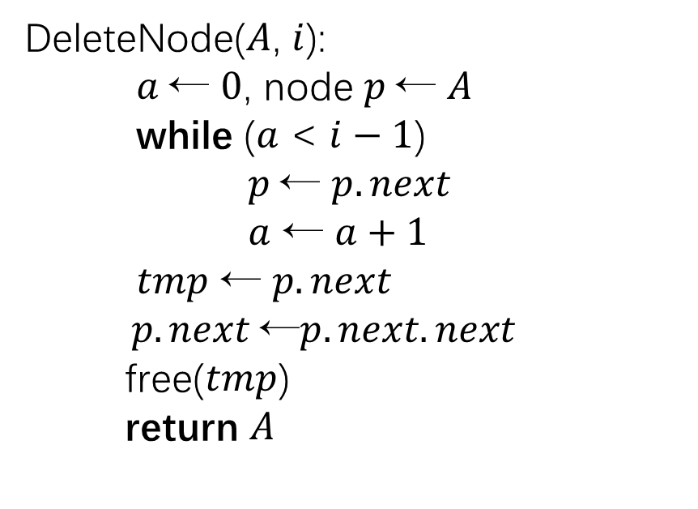
Deleting an Item at Position 𝑖
DeleteNode($A$, $i$):
$a$← $0$, node $p$← $A$
while ($a$ < $i−1$)
$p$← $p.next$
$a$ ← $a+1$
$tmp$ ← $p.next$
$p.next$←$p.next.next$
free($tmp$)
return $A$
Time Complexity: $O(n)$
Space Complexity: $O(1)$

Slide 19
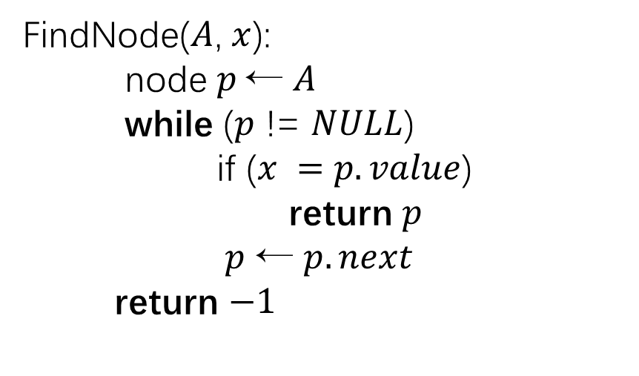
Find an Item
FindNode($A$, $x$):
node $p$← $A$
while ($p$ != $NULL$)
if ($x =$ $p.value$)
return $p$
$p$ ← $p.next$
return $−1$
Time Complexity: $O(n)$
Space Complexity: $O(1)$

Slide 20
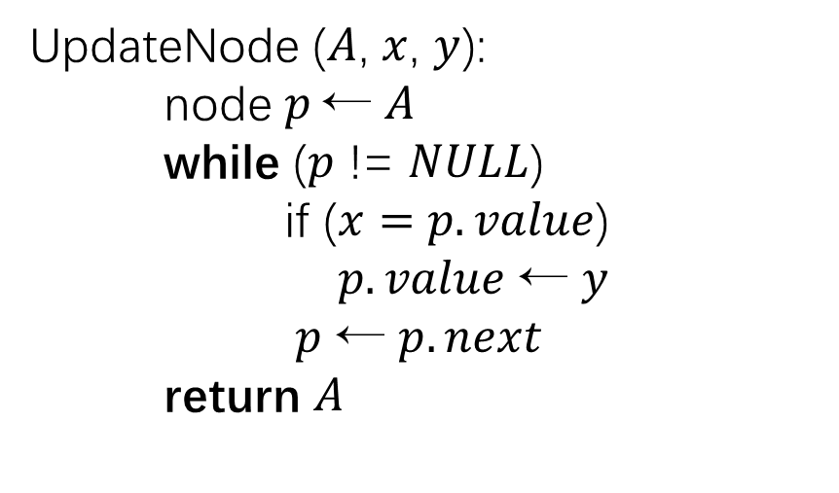
Update an Item
UpdateNode ($A$, $x$, $y$):
node $p$← $A$
while ($p$ != $NULL$)
if ($x=$ $p.value$)
$p.value$ ← $y$
$p$ ← $p.next$
return $A$
Time Complexity: $O(n)$
Space Complexity: $O(1)$

Slide 21
Our Roadmap
Definition of Linked List
Operators of Linked List
Illustrative Example

Slide 22

Operators on Polynomials
Polynomials: $p\left(x\right)= p0+p1x+p2x2+…+pnxn$
A set of ordered pairs of $<p_{i} , i>$where $p_{i}$ is the coefficient and $i$ is the exponent.
We use linked list to store the $<p_{i} , i>$pairs of $p(x)$
Node representation:
node polyItem{
float coef // record pi
int expo // record exponent
node next // reference to next polyItem
}
Question:
How about using array?

Slide 23
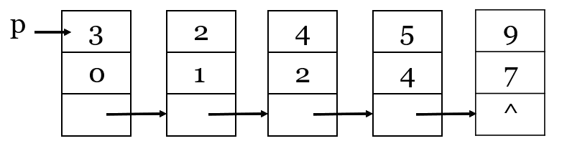
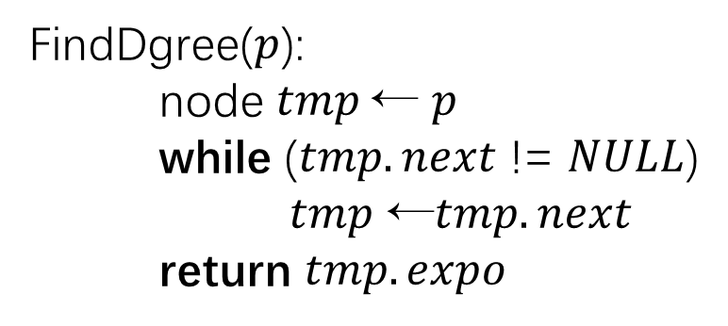
Finding degree of a Polynomials
Polynomials: $p(x) = 3+2x+4x^{2}+5x^{4}+9x^{7}$
FindDgree($p$):
node $tmp$← $p$
while ($tmp.next$ != $NULL$)
$tmp$ ←$tmp.next$
return $tmp.expo$

Slide 24
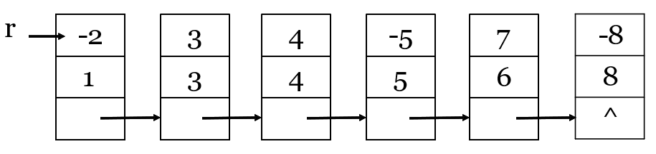
Adding two polynomials
Polynomials: $p\left(x\right)= 3+2x+4x^{2}+5x^{4}+9x^{7}$
Polynomials: $r\left(x\right)=−2x+3x^{3}+5x^{4}−5x^{5}+7x^{6} −8x^{8}$

Slide 25
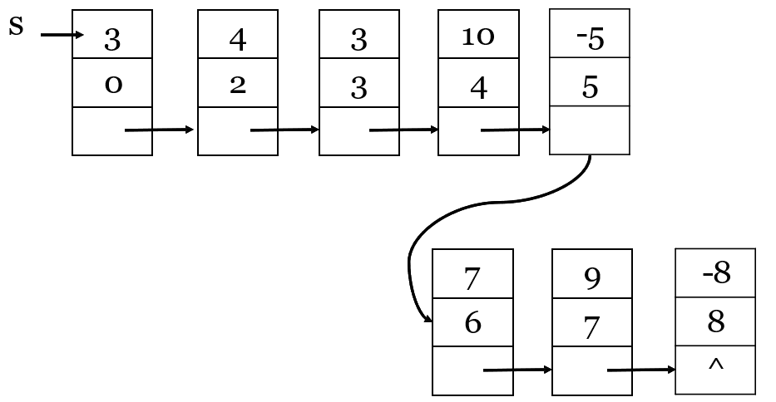
Adding two polynomials
$$s\left(x\right)= p\left(x\right)+ r\left(x\right)= 3+4x2+3x3 +10x4 −5x5+7x6 +9x7− 8x8$$

Slide 26
Subtracting two polynomials
Polynomials: $p\left(x\right)= 3+2x+4x^{2}+5x^{4}+9x^{7}$
Polynomials: $r\left(x\right)=−2x+3x^{3}+5x^{4}−5x^{5}+7x^{6} −8x^{8}$

Slide 27
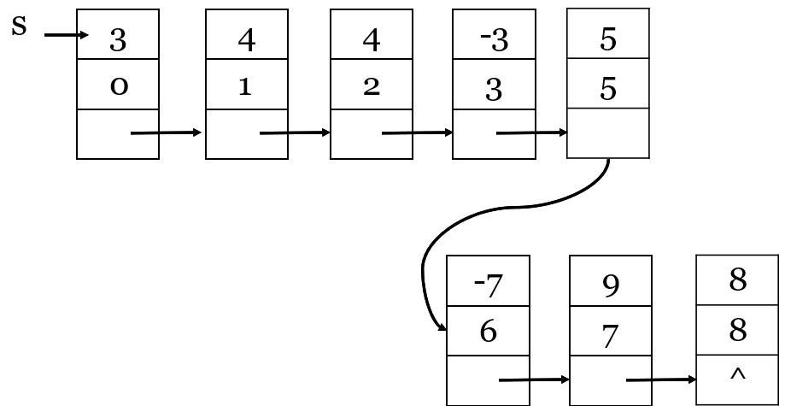
Subtracting two polynomials
$$s\left(x\right)= p\left(x\right)−r\left(x\right)=3+4x+4x^{2}−3x^{3}+5x^{5}−7x^{6}+9x^{7}+8x^{8}$$

Slide 28
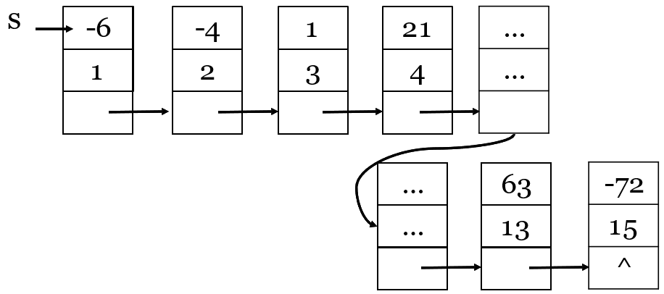
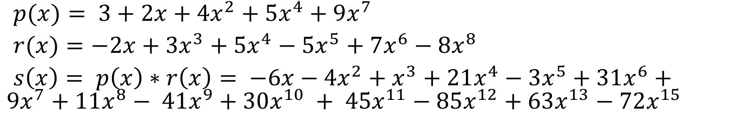
Multiplying two polynomials
$p(x)= 3+2x+4x^{2}+5x^{4}+9x^{7}$
$r(x)=−2x+3x^{3}+5x^{4}−5x^{5}+7x^{6}−8x^{8}$
$s\left(x\right)= p\left(x\right)∗r\left(x\right)= −6x−4x^{2}+x^{3}+21x^{4}−3x^{5}+31x^{6}+9x^{7}+11x^{8}− 41x^{9}+30x^{10} + 45x^{11}−85x^{12}+63x^{13}−72x^{15}$

Slide 29
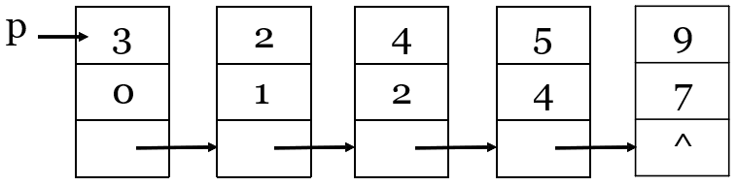
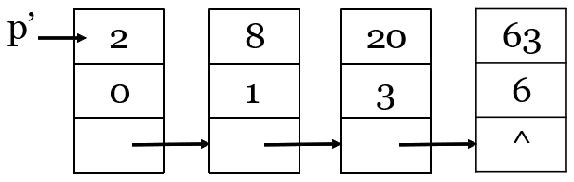
Differentiating of polynomials
$p(x) = 3+2x+4x^{2}+5x^{4}+9x^{7}$
$p’(x) = 2+8x+20x3+63x6$

Slide 30
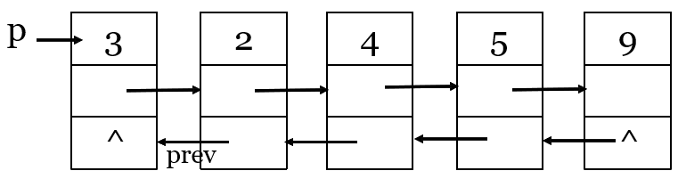
Other variants of Lined List
Doubled Linked List

Slide 31
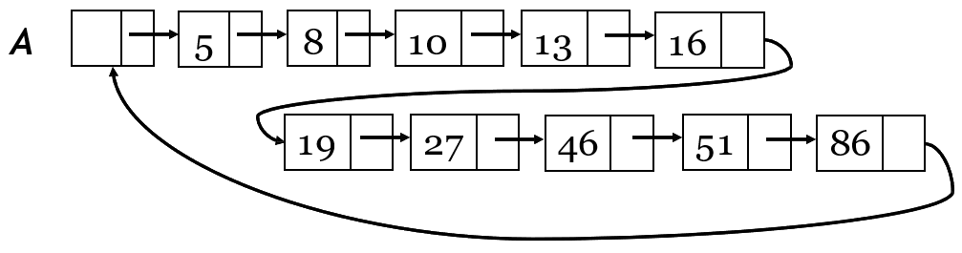
Other variants of Lined List
Circular linked list

Slide 32
Thank you

