Slide 1
Lecture 5 Stack & Queue
Ran Cheng (程然)
https://chengran.tech/
https://emi.sustech.edu.cn/

Slide 2
Our Roadmap
Stack
Queue
Stack vs. Queue

Slide 3
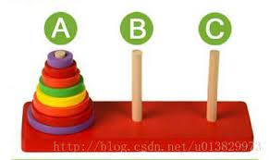
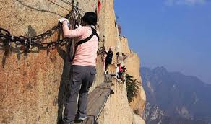
Stack
A stack is a sequence in which:
Items can be added and removed only at one end (the top)
You can only access the item that is currently at the top

Slide 4
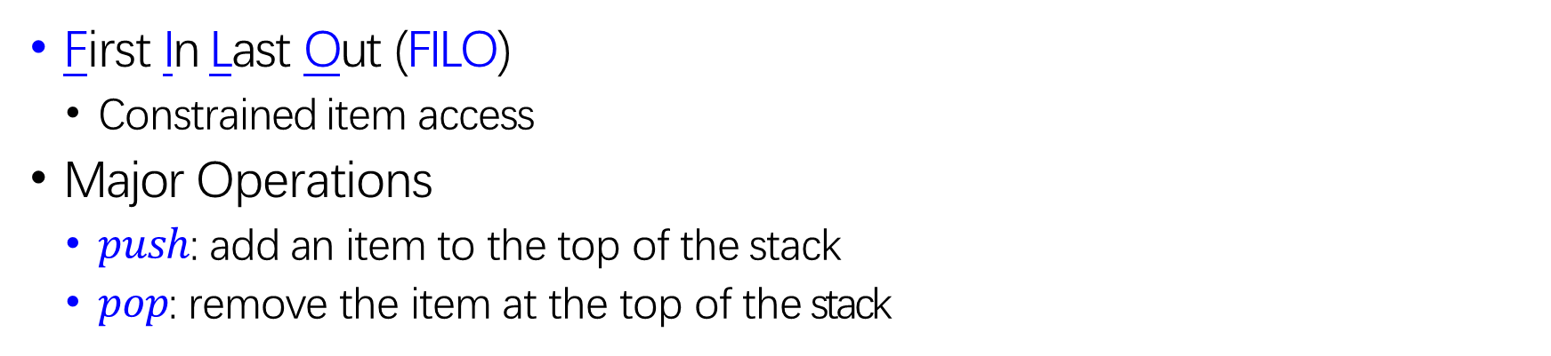
First In Last Out (FILO)
Constrained item access
Major Operations
$push$: add an item to the top of the stack
$pop$: remove the item at the top of the stack
a
c
b
a
b
a
top
top
top
top
empty
push(a)
push(b), push(c)
pop()

Slide 5
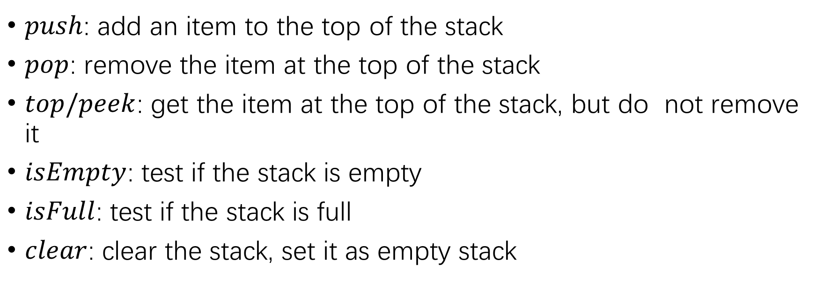
$push$: add an item to the top of the stack
$pop$: remove the item at the top of the stack
$top/peek$: get the item at the top of the stack, but do not remove it
$isEmpty$: test if the stack is empty
$isFull$: test if the stack is full
$clear$: clear the stack, set it as empty stack
c
b
a
d
c
b
a
c
b
a
top
top
top
push(d)
pop()
top
clear()

Slide 6
Implementation
top
9
6
5
4
1
top
9
6
5
4
1 | ^

Slide 7
Implementation of Stack
Array based Stack
MAX_SIZE = n // the max size of stack
top = -1 // the current top position
Array S with n elements
Example
MAX_SIZE = 5
top = -1
Array S
S[4]
S[3]
S[2]
S[1]
S[0]
S
top

Slide 8
Push Operator
push(item):
top++;
S[top] = item
Stack Overflow !!!
push(6)
top=?
???
push(6)
push(5)
top=5
S[4]
S[3]
S[2]
S[1]
S[0]
5
push(5)
push(4)
top=4
4
push(4)
push(3)
top=2
3
push(3)
push(2)
top=1
2
push(2)
push(1)
top=0
1
push(1)

Slide 9
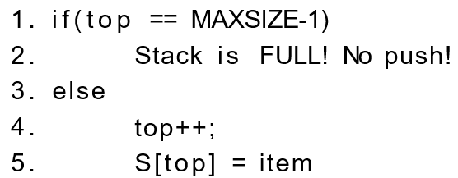
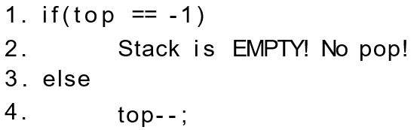
Push/Pop Operator
push(item):
pop():

Slide 10
Applications of Stack
Making sure the delimiters (parens, brackets, etc.) are balanced
Push open (i.e., left) delimiters onto a stack
When you encounter a close (i.e., right) delimiter, pop an item off the stack and see if it matches
Evaluating arithmetic expressions
Parsing arithmetic expressions written using infix notation
The runtime (call) stack in memory
Converting a recursive algorithm to an iterative one by using a stack to store the pointers to the subfunctions

Slide 11
Brackets Balance Problem
a+{2-[b+c ]*(8* [8+g ]/[m-e ]-7)-p}
{[ ]([ ][ ])}
Skip operators and notations
Is the bracket expression balanced or not?
() Yes
[} No
{[()}] No
{[ ]([ ][ ])} Yes
{{{{{{[[[[[[(((((())))))]]]]]]}}}}}} Yes

Slide 12
Brackets Balance Problem
Given a bracket expression, determine whether it is balanced or not?
{[ ]([ ][ ])}
How to solve it by using stack?
Bracket pairs: ( ), [ ], { }
Any ideas?
Methodology
Employ stack store checked left bracket
Pop out left bracket if it is matches

Slide 13
Arithmetic Expression Evaluation
Arithmetic expression
operands (a, b, c), operator (+, *)
a + b * c
Prefix expression
+ a * b c
Infix expression
a + b * c
Postfix expression
a b c * +

Slide 14
Postfix Expression
Infix expression
5 * ((9 + 3) * (4*2) + 7)
Postfix expression
5 9 3 + 4 2 * * 7 + *
Parse postfix expression is somewhat easier problem than directly parsing infix (why)
Postfix has a nice property that parentheses are unnecessary
Postfix expression evaluation
Convert from infix to postfix (one of lab problems)
Evaluate a postfix expression

Slide 15
An example
Given an infix expression a + b * c + (d * e + f)*g，how to convert it to postfix expression?

Slide 16
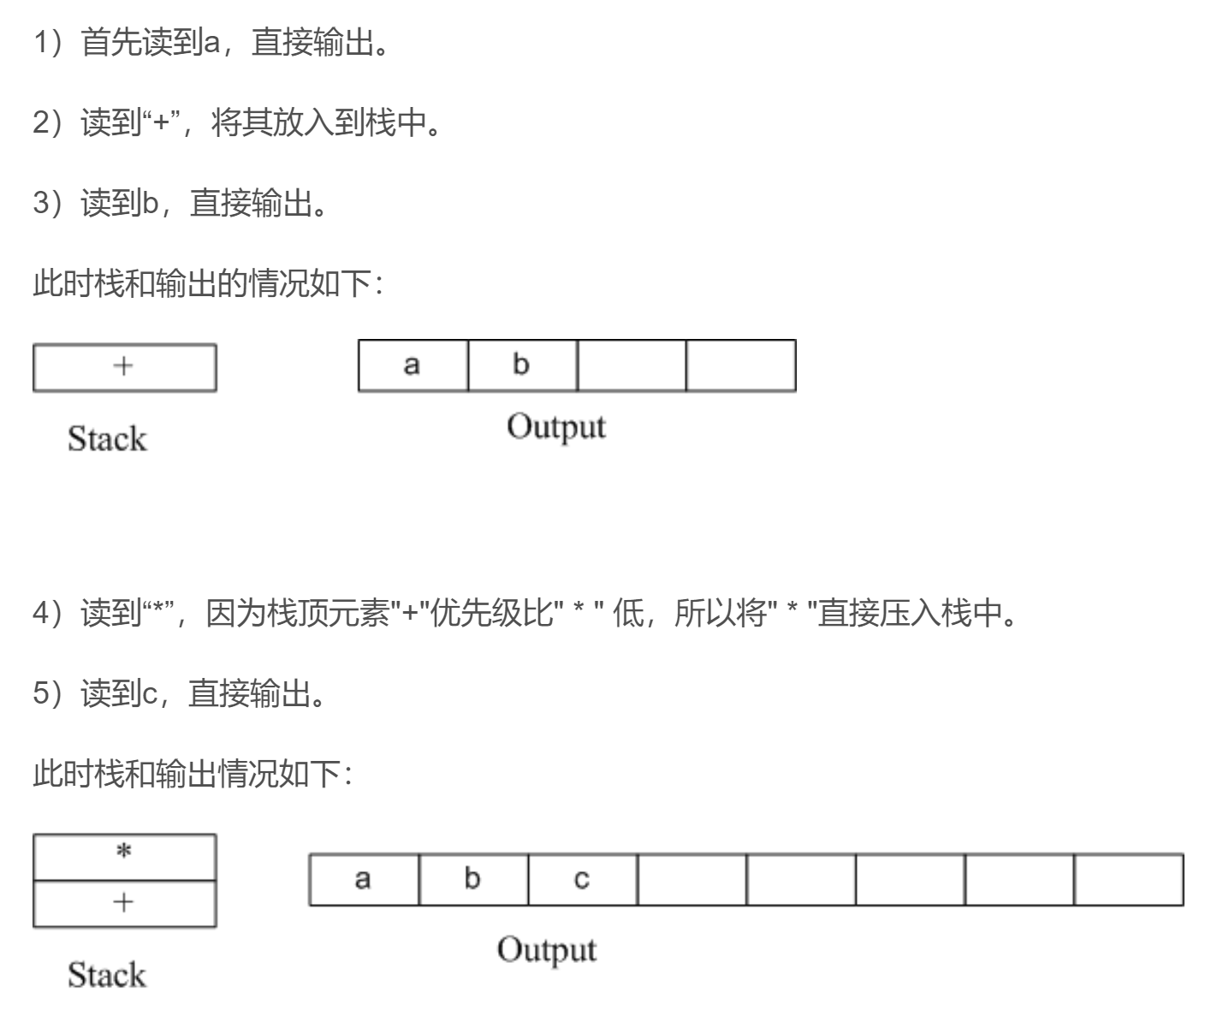
输入为a + b * c + (d * e + f)*g，过程如下:

Slide 17
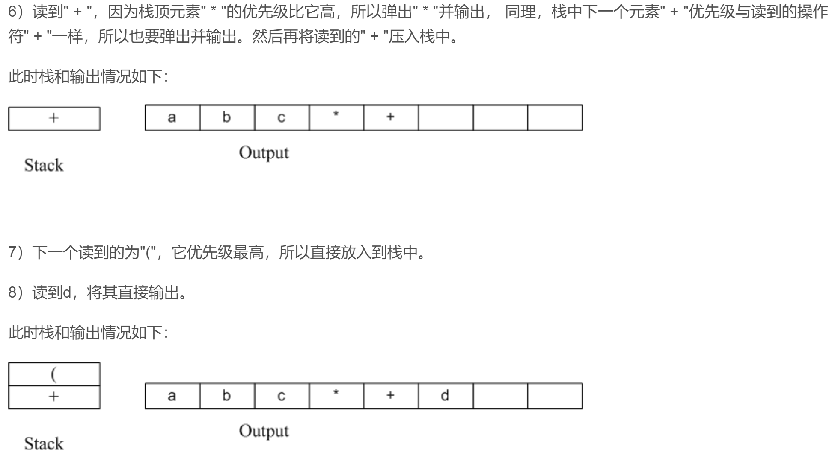
输入为a + b * c + (d * e + f)*g，过程如下:

Slide 18
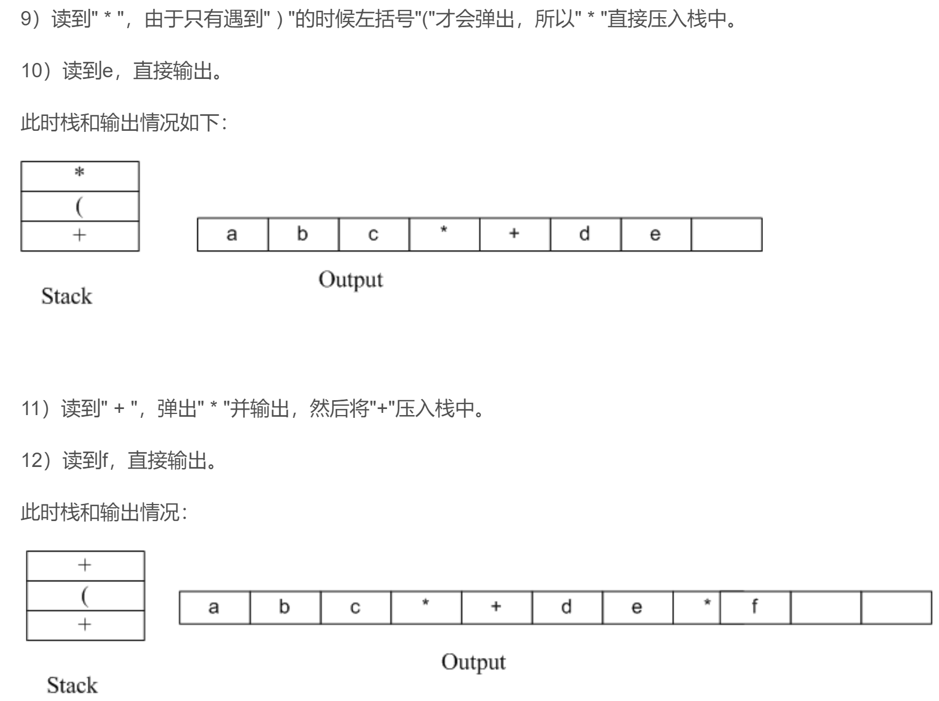
输入为a + b * c + (d * e + f)*g，过程如下:

Slide 19
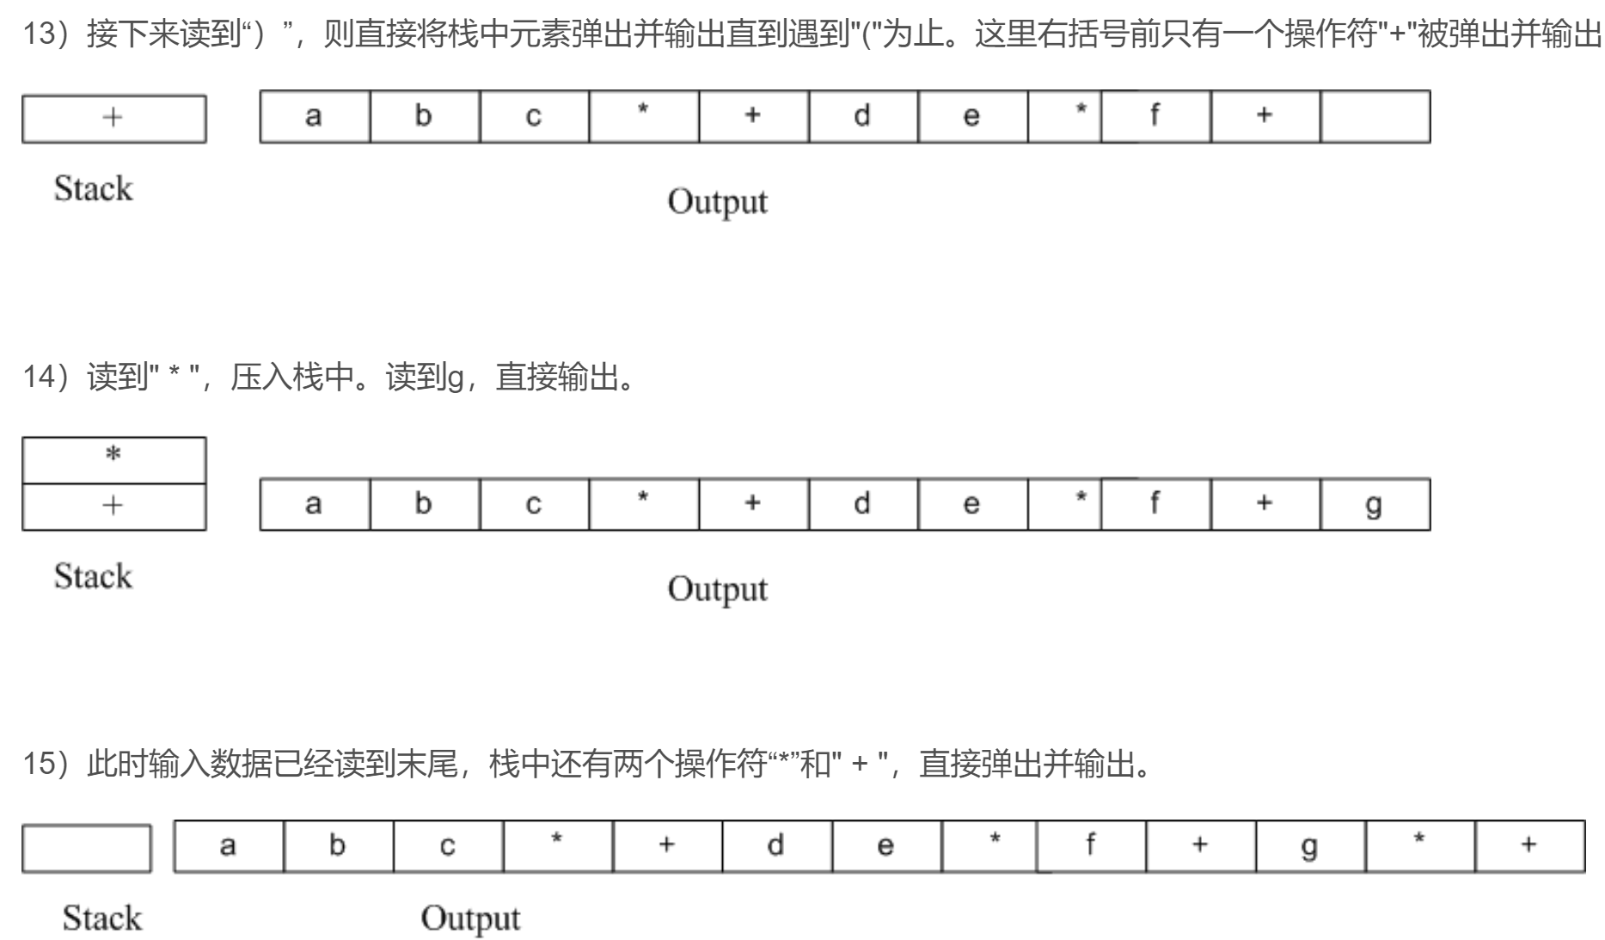
输入为a + b * c + (d * e + f)*g，过程如下:

Slide 20
Postfix Expression: 593+42**7+*
Methodology
Read the tokens in one at a time
If it is an operand, push it into the stack
If it is a binary operator:
pop top two elements from the stack,
apply the operator,
and push the result back on the stack

Slide 21
Postfix Expression: 593+42**7+*
Stack Operations | Stack Elements
push(5) | 5
push(9) | 5 9
push(3) | 5 9 3
push(pop() + pop()) | 5 12
push(4) | 5 12 4
push(2) | 5 12 42
push(pop() * pop()) | 5 12 8
push(pop() * pop()) | 5 96
push(7) | 5 96 7
push(pop() + pop()) | 5 103
push(pop() * pop()) | 515

Slide 22
Our Roadmap
Stack
Queue
Stack vs. Queue

Slide 23
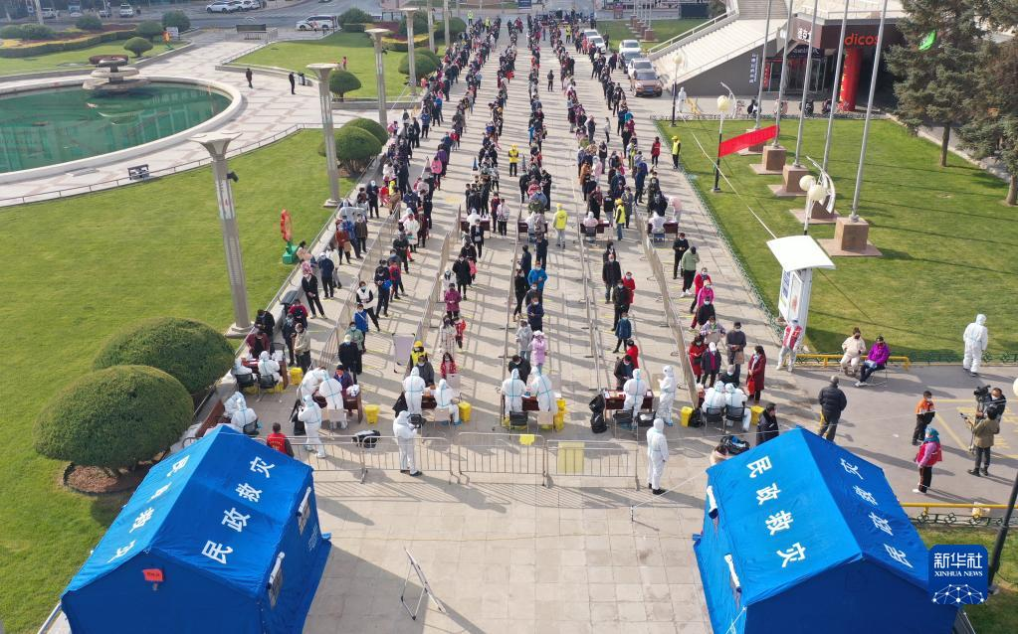

Queue
A queue is a sequence in which:
items are added at the rear and removed from the front
you can only access the item that is currently at the front

Slide 24
Queue
First In First Out (FIFO)
Items access constrained
Major elements
front: the first element in the queue (remove)
rear: the last element in the queue (add)
deQueue
a₁ , a₂ , … , a_{n}
front rear
enQueue

Slide 25
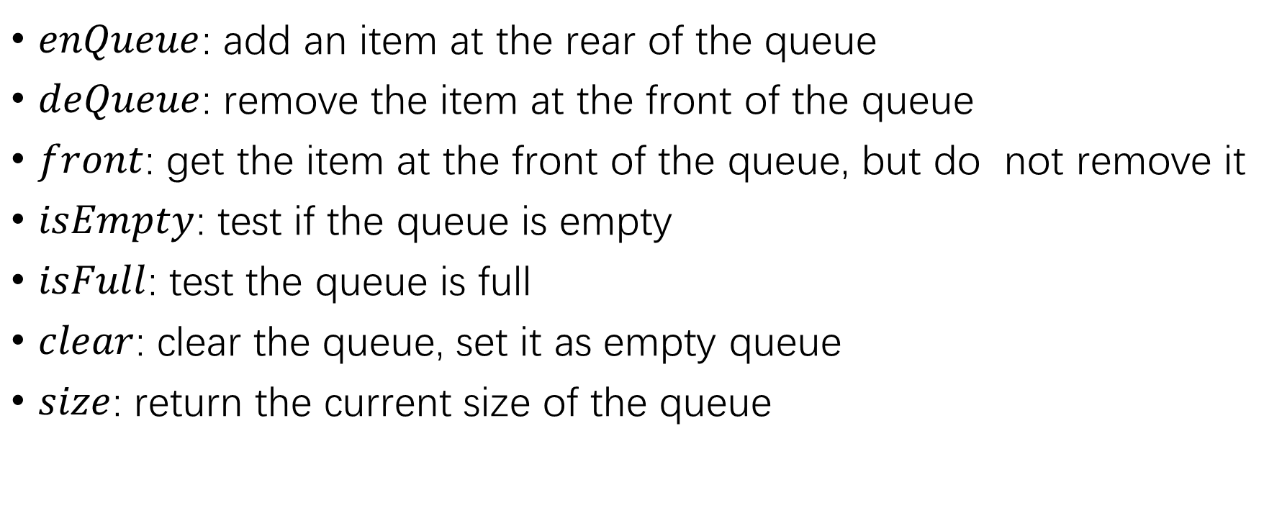
Queue Operations
$enQueue$: add an item at the rear of the queue
$deQueue$: remove the item at the front of the queue
$front$: get the item at the front of the queue, but do not remove it
$isEmpty$: test if the queue is empty
$isFull$: test the queue is full
$clear$: clear the queue, set it as empty queue
$size$: return the current size of the queue

Slide 26
Queue Operations
c
b
a
rear
d
c
b
a
rear
d
c
b
rear
front
front
front
enQueue(d)
deQueue()

Slide 27
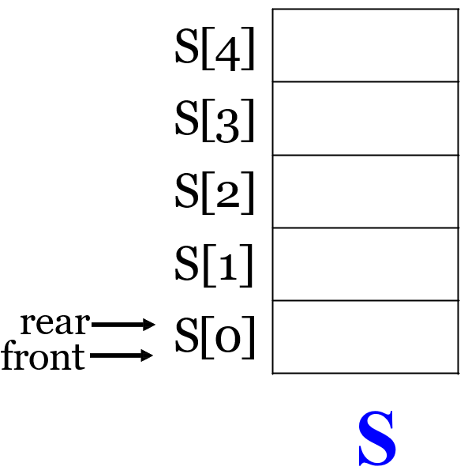
Implementation of Queue
Array based Queue
MAX_SIZE = n // the max size of stack
front = 0 // the current front
rear = 0 // the current rear
Array S with n elements
Example
MAX_SIZE = 5
front = 0
rear = 0
Array S

Slide 28
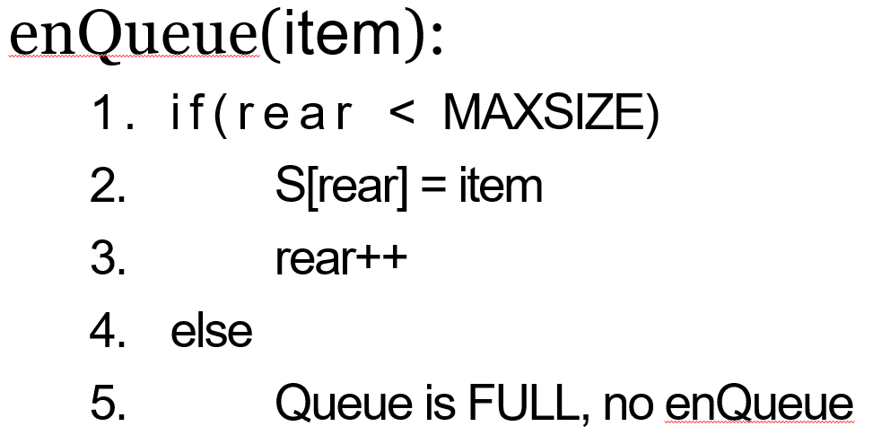
enQueue Operation
S[4]
S[3]
S[2]
S[1]
S[0]
rear=4
4
rear=3
3
rear=2
2
rear=1
front=0
1
enQueue (1), enQueue(2), enQueue(3), enQueue(4)

Slide 29
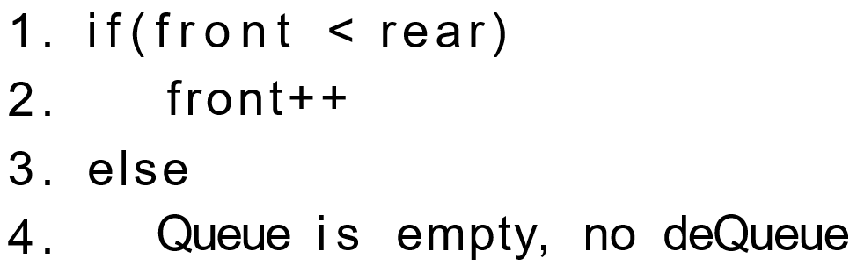
deQueue Operation
Is front moving back?
If not, how to reuse the space?
deQueue():
front=4
S[4]
S[3]
S[2]
S[1]
S[0]
rear=4
front=3
4
front=2
3
front=1
2
front=0
1
deQueue (), deQueue (), deQueue (), deQueue (),

Slide 30





Ring Queue
rear
front
front
d
e
front
0
1
0
1
0
1
2
3
g
2
3
g
5
2
5
b
5
b
4
3
4
4
rear
rear
(a) empty
(b) d, e, b, g enQueue
(c) d, e deQueue
rear
rear
k
0
5
4
i
k
0
5
4
i
k
0
5
4
i
r
1
1
1
2
3
g
front
2
j
2
p
j
b
j
3
3
front
(e)
front
(f)
rear
b, g deQueue
r, p enQueue
(d) i, j, k enQueue

Slide 31
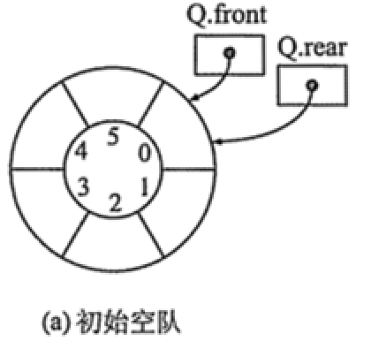
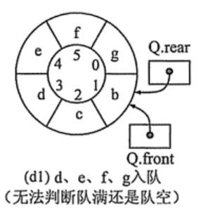
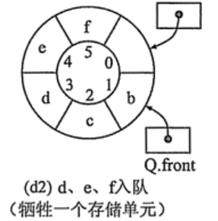
Ring Queue
Empty or Full?
Empty:
Q.front == (Q.rear + 1) % MAXSIZE
Full:
Q.front == Q.rear

Slide 32
Our Roadmap
Stack
Queue
Stack vs. Queue

Slide 33
Stack vs. Queue
 | Stack | Queue
In-Out | FILO | FIFO
Operations | Push, Pop | enQueue, deQueue
Operations Time Complexity | O(1) | O(1)
Implementation | Array-based, Linked-based | Array-based, Linked-based

Slide 34
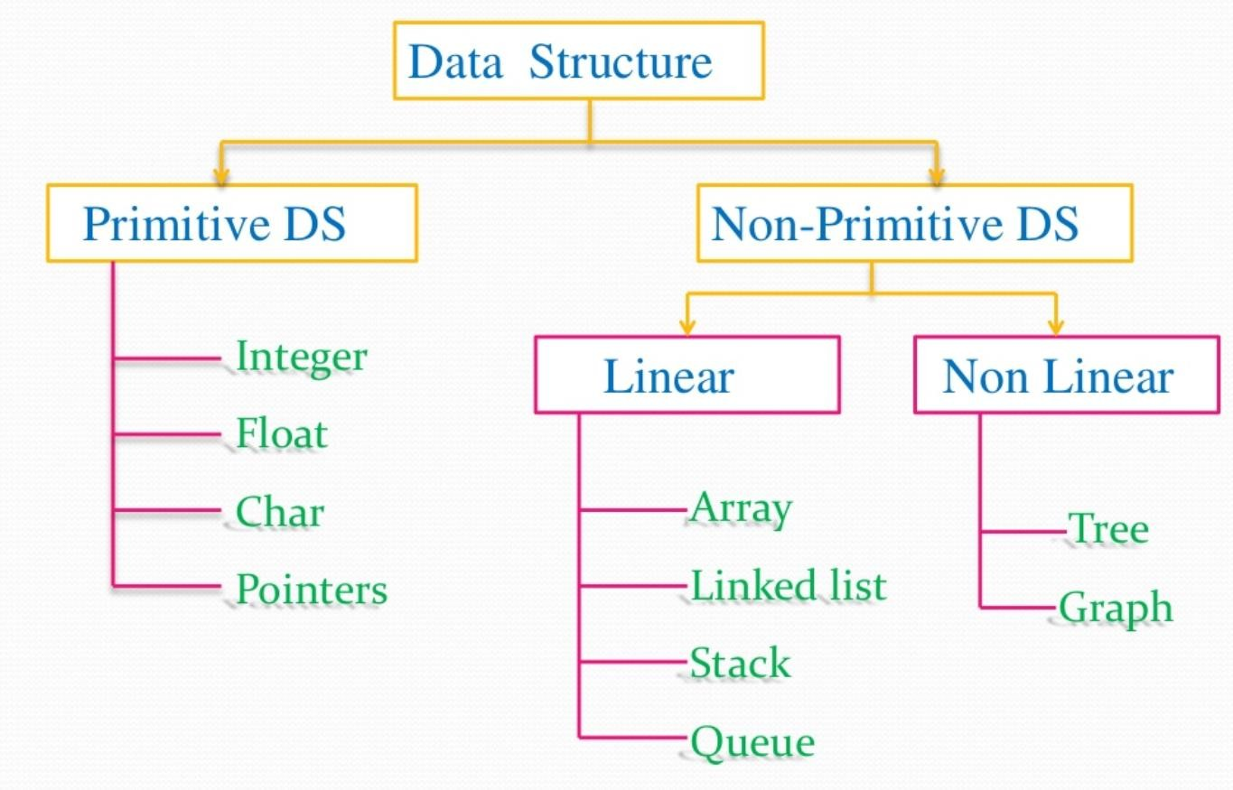
Our Progress

Slide 35
Our Roadmap
Stack
Queue
Stack vs. Queue

Slide 36
Thank you

