Slide 1
Lecture 6 String Matching
Ran Cheng (程然)
https://chengran.tech/
https://emi.sustech.edu.cn/

Slide 2
Our Roadmap
String Concepts
String Matching
Brute Force Solution
Rabin-Karp
Finite State Automata
Knuth-Morris-Pratt

Slide 3
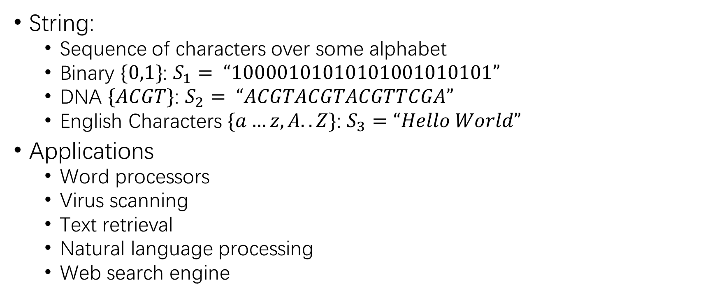
String Definition
String:
Sequence of characters over some alphabet
Binary $\{0,1\}$: $S_{1}= “10000101010101001010101”$
DNA $\{ACGT\}$: $S_{2}= “ACGTACGTACGTTCGA”$
English Characters $\{a…z, A..Z\}$: $S_{3}=“Hello World”$
Applications
Word processors
Virus scanning
Text retrieval
Natural language processing
Web search engine

Slide 4
String Operations
append : append to string
assign : assign content to string
insert : insert to string
erase : erase characters from string
replace : replace portion of string
swap : swap string values
find : find the specific char in the string
That’s all?

Slide 5
Our Roadmap
String Concepts
String Searching Problem
Brute Force Solution
Rabin-Karp
Finite State Automata
Knuth-Morris-Pratt

Slide 6
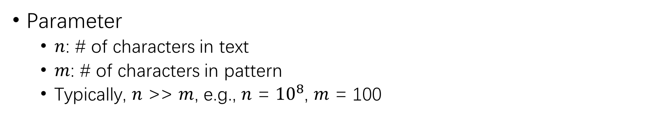
String Matching
Search Text
a | s | s | u | s | u | p | e | r | a | s
Search Pattern
s | u | p | e | r
Successful Search
a | s | s | u | s | u | p | e | r | a | s
Parameter
$n$: # of characters in text
$m$: # of characters in pattern
Typically, $n$ >> $m$, e.g., $n$ = ${10}^{8}$, $m$ = 100

Slide 7
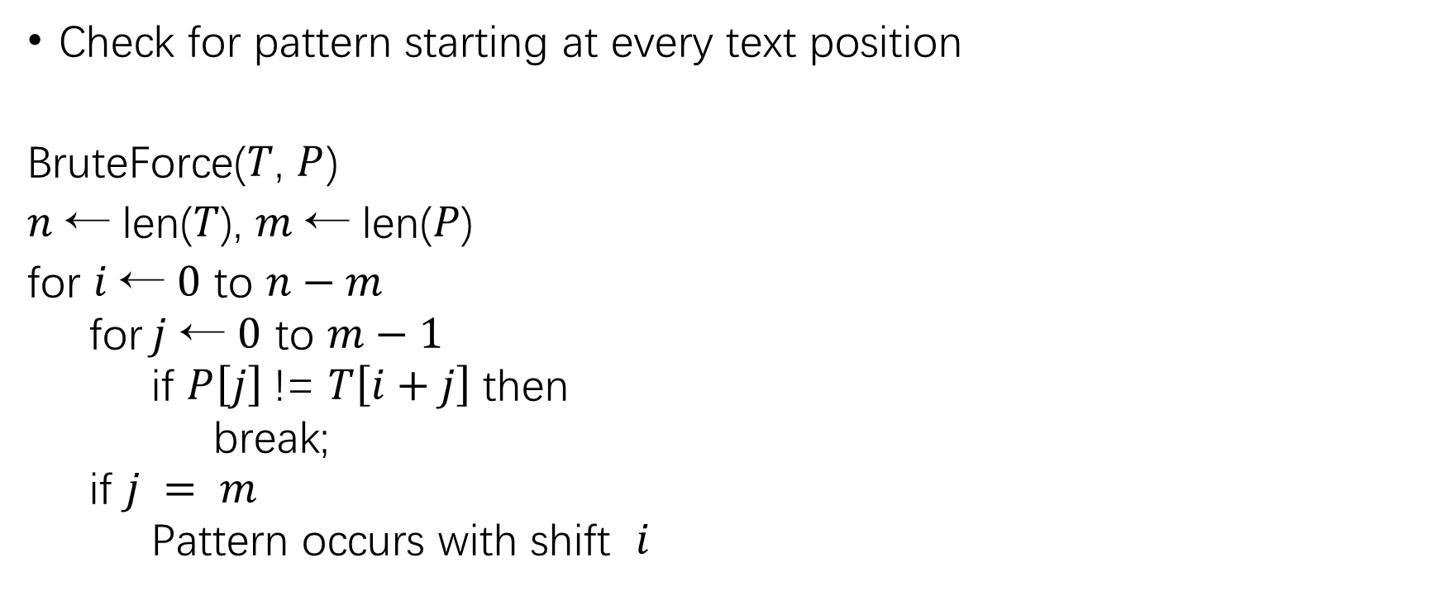
Brute Force
Check for pattern starting at every text position
BruteForce($T$, $P$)
𝑛 ← len(𝑇), $m$ ← len(𝑃)
for 𝑖 ← $0$ to $n−m$
for $j$ ← $0$ to $m−1$
if $P\left[j\right]$!= $T\left[i+j\right]$then
break;
if $j = m$
Pattern occurs with shift $i$
Time complexity?

Slide 8
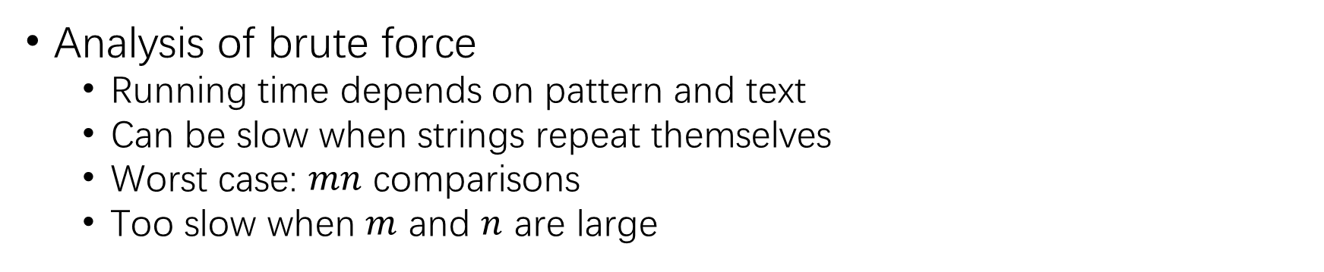
Analysis of Brute Force
Analysis of brute force
Running time depends on pattern and text
Can be slow when strings repeat themselves
Worst case: $mn$ comparisons
Too slow when $m$ and $n$ are large
Search Pattern
a | a | a | a | b
Search Text
a | a | a | a | a | a | a | a | a | a | a | a | a | a | a | b
a | a | a | a | b
 | a | a | a | a | b
 |  | a | a | a | a | b
 |  |  | a | a | a | a
^{b}......

Slide 9

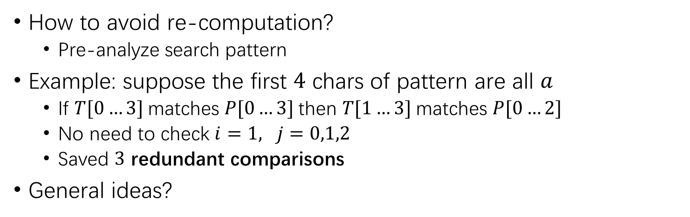

Can we do better?
How to avoid re-computation?
Pre-analyze search pattern
Example: suppose the first $4$ chars of pattern are all $a$
If $T[0…3]$matches $P[0…3]$then $T[1…3]$matches $P[0…2]$
No need to check $i=1, j=0,1,2$
Saved $3$ redundant comparisons
General ideas?
Search Pattern
a | a | a | a | b
$$P$$
Search Text
a | a | a | a | a | a | a | a | a | a | a | a | a | a | a | b
a | a | a | a | b
 | a | a | a | a | b
$$T$$

Slide 10
Our Roadmap
String Concepts
String Searching Problem
Brute Force Solution
Rabin-Karp
Finite State Automata
Knuth-Morris-Pratt

Slide 11


Rabin-Karp Algorithm
Given search text $T$ and search pattern $P$ as follows:
Pattern
1 | 3 | 5 | 9
$$P$$
Search Text
2 | 4 | 6 | 8 | 0 | 1 | 2 | 1 | 3 | 5 | 9 | 7 | 2
 |  |  |  |  |  |  | 1 | 3 | 5 | 9
$$T$$
2468 | 4680 | 6801 | 8012 | 121 | 1213 | 2135 | 1359 | 3597 | 5972
 |  |  |  |  |  |  | 1359

Slide 12
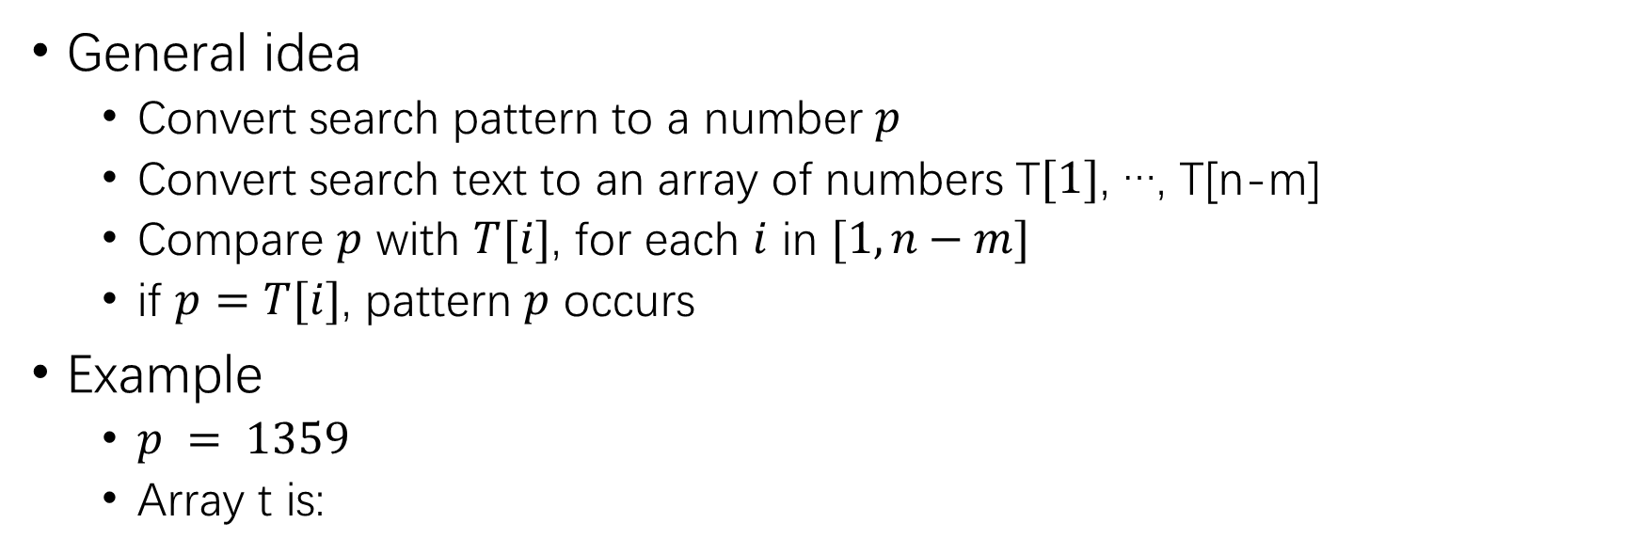
Rabin-Karp Algorithm
General idea
Convert search pattern to a number $p$
Convert search text to an array of numbers T$[1]$, …, T[n-m]
Compare $p$ with $T[i]$, for each $i$ in $[1,n−m]$
if $p=T[i]$, pattern $p$ occurs
Example
$p = 1359$
Array t is:
2468 | 4680 | 6801 | 8012 | 121 | 1213 | 2135 | 1359 | 3597 | 5972
$$T[8, 9, 10, 11]=P[1, 2, 3, 4] →T[8] = p$$

Slide 13
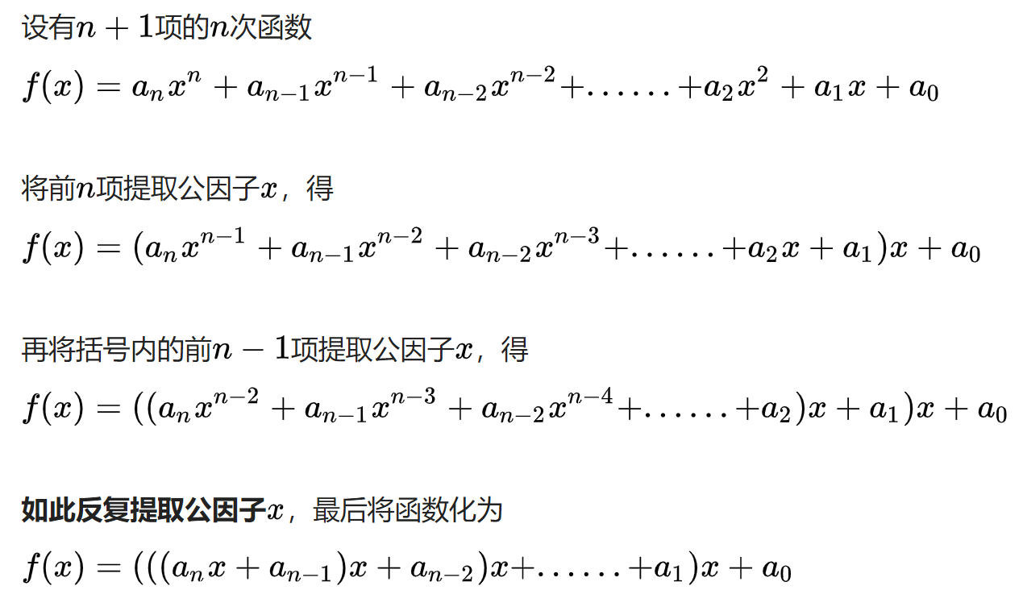
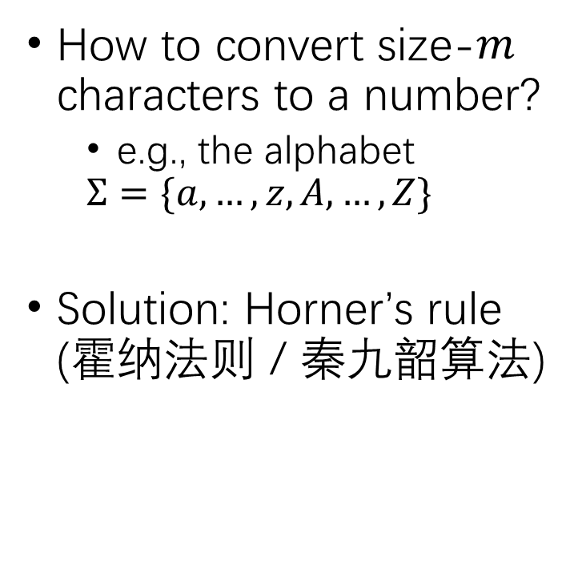
Rabin-Karp Algorithm
How to convert size-$m$ characters to a number?
e.g., the alphabet
$$Σ=\{a,…,z,A,…,Z\}$$
Solution: Horner’s rule (霍纳法则 / 秦九韶算法)

Slide 14
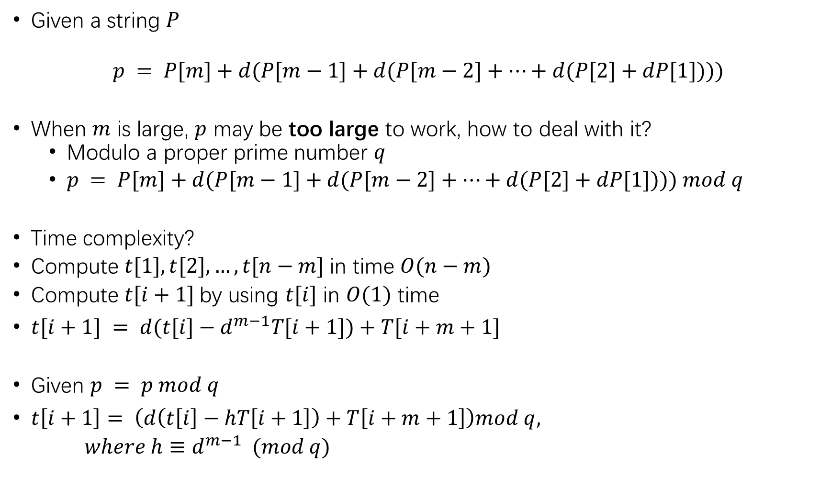
Given a string $P$
$$p = P[m]+d(P[m−1]+d(P[m−2]+…+d(P[2]+dP[1])))$$
When $m$ is large, $p$ may be too large to work, how to deal with it?
Modulo a proper prime number $q$
$p = P[m]+d(P[m−1]+d(P[m−2]+…+d(P[2]+dP[1]))) mod q$
Time complexity?
Compute $t[1],t[2],…,t[n−m]$in time $O(n−m)$
Compute $t[i+1]$by using $t[i]$ in $O(1)$ time
$t[i+1] = d(t[i]−d^{m−1}T[i+1])+T[i+m+1]$
Given $p = p mod q$
$t\left[i+1\right]= \left(d\left(t\left[i\right]−hT\left[i+1\right]\right)+T\left[i+m+1\right]\right)mod q,$
$where h≡d^{m−1} (mod q)$
$t[1] → t[2]→t[3]→t[4]→…→t[n−m]$ in $O(n−m)$

Slide 15
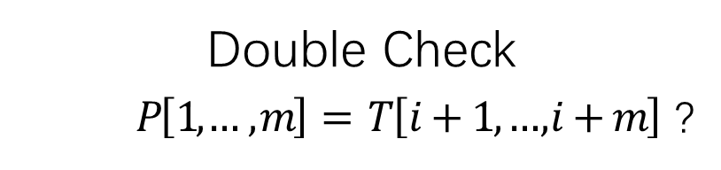
Rabin-Karp Algorithm
What if two numbers are exactly the same after $mod$ ?
3 | 1 | 4 | 1 | 5
2 | 3 | 1 | 4 | 1 | 5 | 2 | 6 | 7 | 3 | 9 | 9 | 2
7
𝑚𝑜𝑑 13
7
Valid match
Invalid match
Spurious Hit (哈希碰撞)
Double Check
$P\left[1,… , m\right]= T\left[i+1, …, i+m\right]$ ?

Slide 16
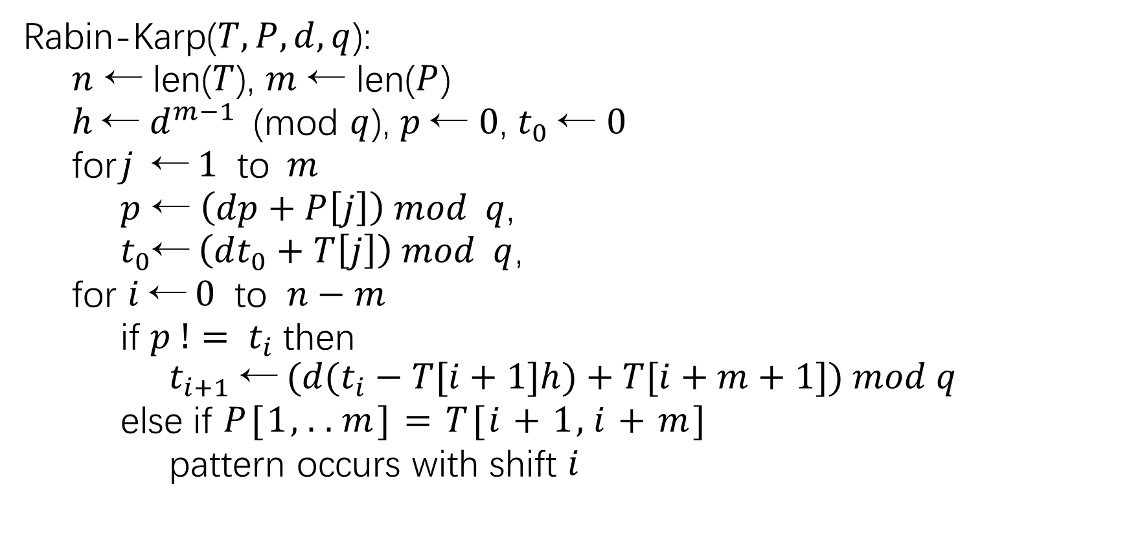
Rabin-Karp($T, P, d, q$):
$n$ ← len($T$), $m$ ← len($P$)
$h$← $d^{m−1}$(mod $q$), $p$← $0$, $t_{0}$← $0$
for $j$←$1$ to$m$
$p$ ← $\left(dp+P\left[j\right]\right) mod q$,
$t_{0}$←$\left(dt_{0}+T\left[j\right]\right) mod q$,
for $i$←$0$ to $n−m$
if $p != t_{i}$then
$$t_{i+1} \text{←} (d(t_{i}−T[i+1]h)+T[i+m+1]) mod q$$
else if $P[1,..m]=T[i+1,i+m]$
pattern occurs with shift $i$

Slide 17
Our Roadmap
String Concepts
String Searching Problem
Brute Force Solution
Rabin-Karp
Finite State Automata
Knuth-Morris-Pratt

Slide 18
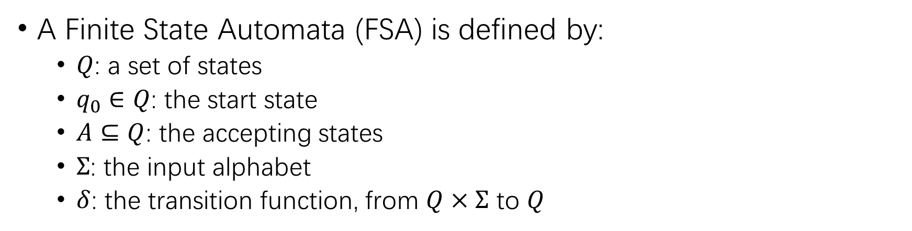
Finite State Automata (FSA)
A Finite State Automata (FSA) is defined by:
$Q$: a set of states
$q_{0}∈Q$: the start state
$A⊆Q$: the accepting states
$Σ$: the input alphabet
$δ$: the transition function, from $Q×Σ$ to $Q$
b
 | 0 | 1
a | 1 | 2
b | 0 | 0
a
a
0
1
2
b

Slide 19
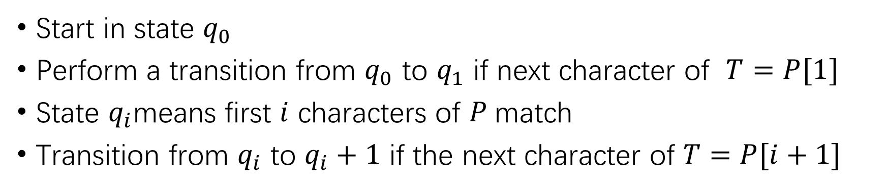
FSA idea for String Matching
Start in state $q_{0}$
Perform a transition from $q_{0}$ to $q_{1}$ if next character of $T=P[1]$
State $q_{i}$means first $i$ characters of $P$match
Transition from $q_{i}$ to $q_{i}+1$ if the next character of $T=P[i+1]$
 | 0 | 1 | 2 | 3 | 4 | 5
a | 1 | 2 | ? | 4 | 5 | 6
b | ? | ? | 3 | ? | ? | ?
Search Pattern
a | a | b | a | a | a
How to fill the BLANKS?
a ₁ a ₂
b
a
a
a
0
3
4
5
6

Slide 20
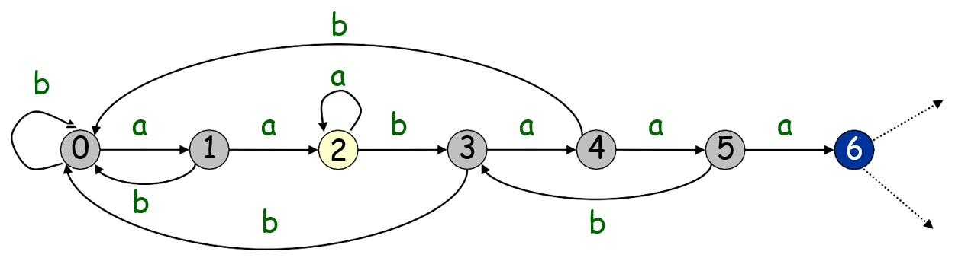
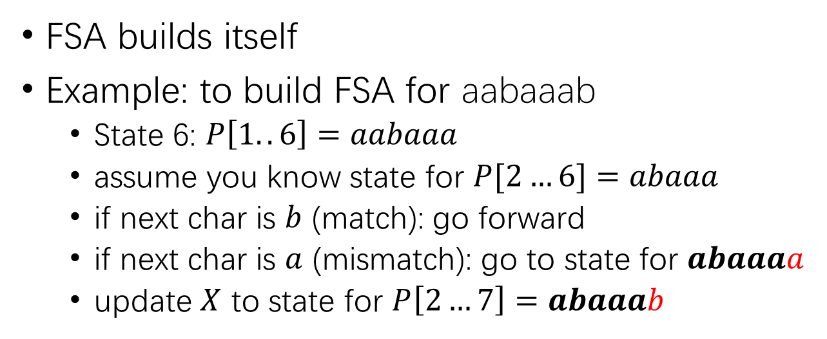
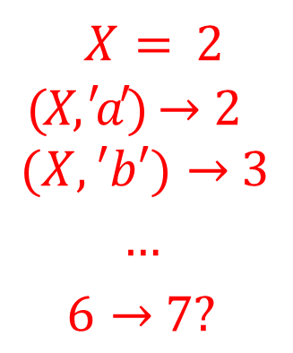
FSA Construction
FSA builds itself
Example: to build FSA for aabaaab
State 6: $P\left[1..6\right]=aabaaa$
assume you know state for $P[2…6]=abaaa$
if next char is $b$ (match): go forward
if next char is $a$ (mismatch): go to state for $abaaaa$
update $X$ to state for $P\left[2…7\right]=abaaab$
$X = 2$
$$(X, ′a′)→2$$
$$(X,′b′)→3$$
$$…$$
$$6→7?$$

Slide 21
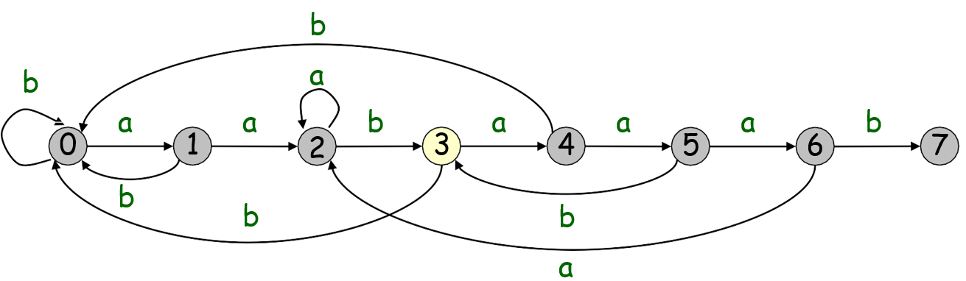
FSA Construction
FSA builds itself
Example: to build FSA for aabaaab

Slide 22
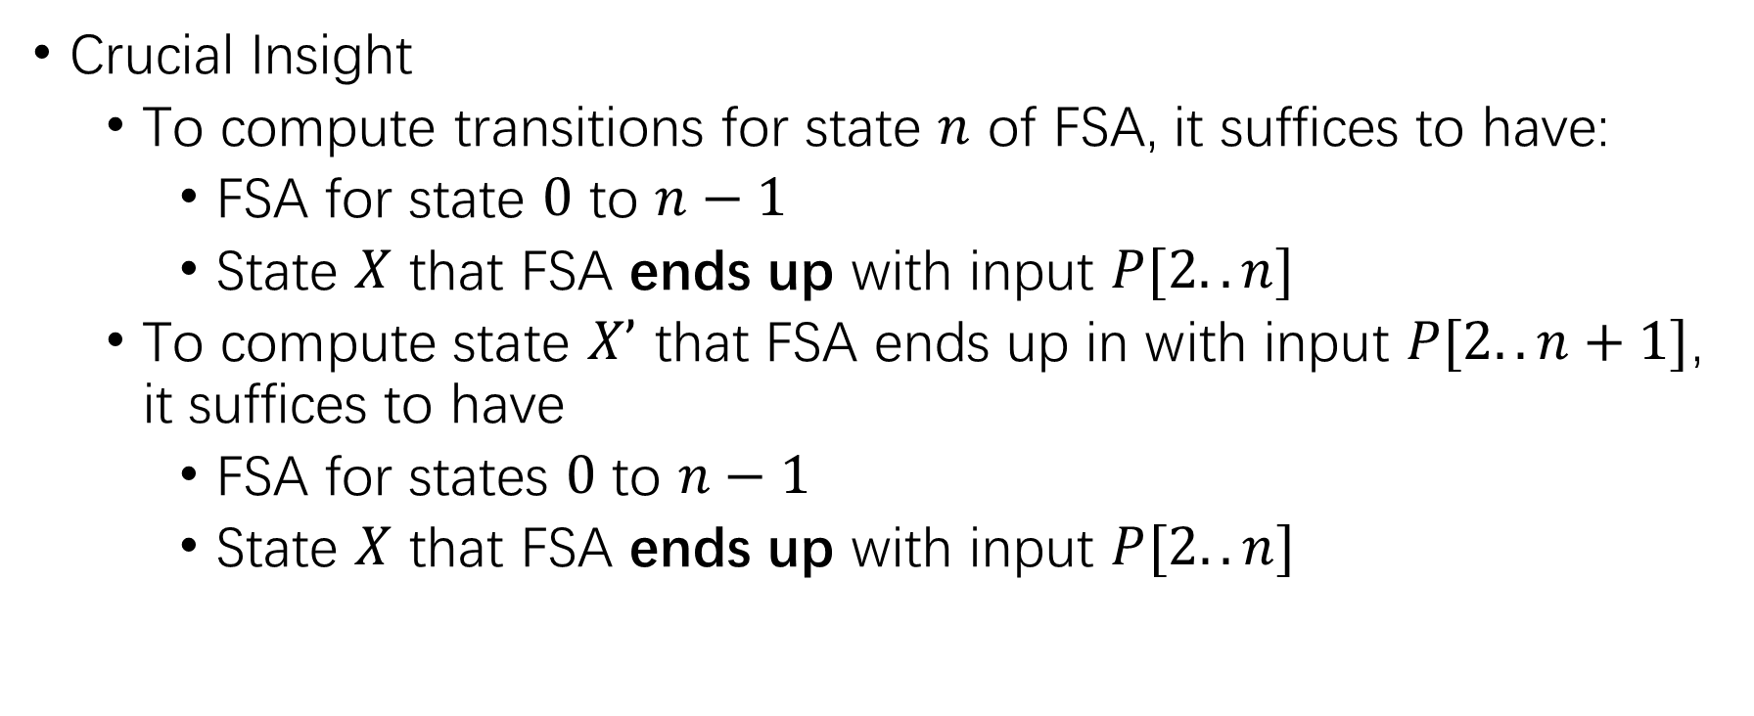
FSA Construction
Crucial Insight
To compute transitions for state $n$ of FSA, it suffices to have:
FSA for state $0$ to $n−1$
State $X$ that FSA ends up with input $P[2..n]$
To compute state $X’$ that FSA ends up in with input $P[2..n+1]$, it suffices to have
FSA for states $0$ to $n−1$
State $X$ that FSA ends up with input $P[2..n]$

Slide 23
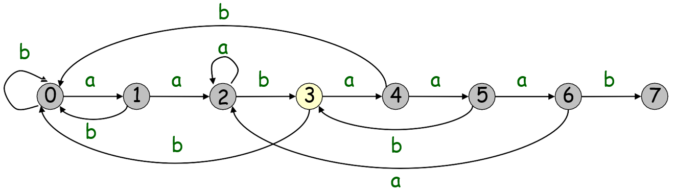
FSA Construction
1234567
aabaaab
aabaaab
1234567
aabaaab
aabaaaa

Slide 24
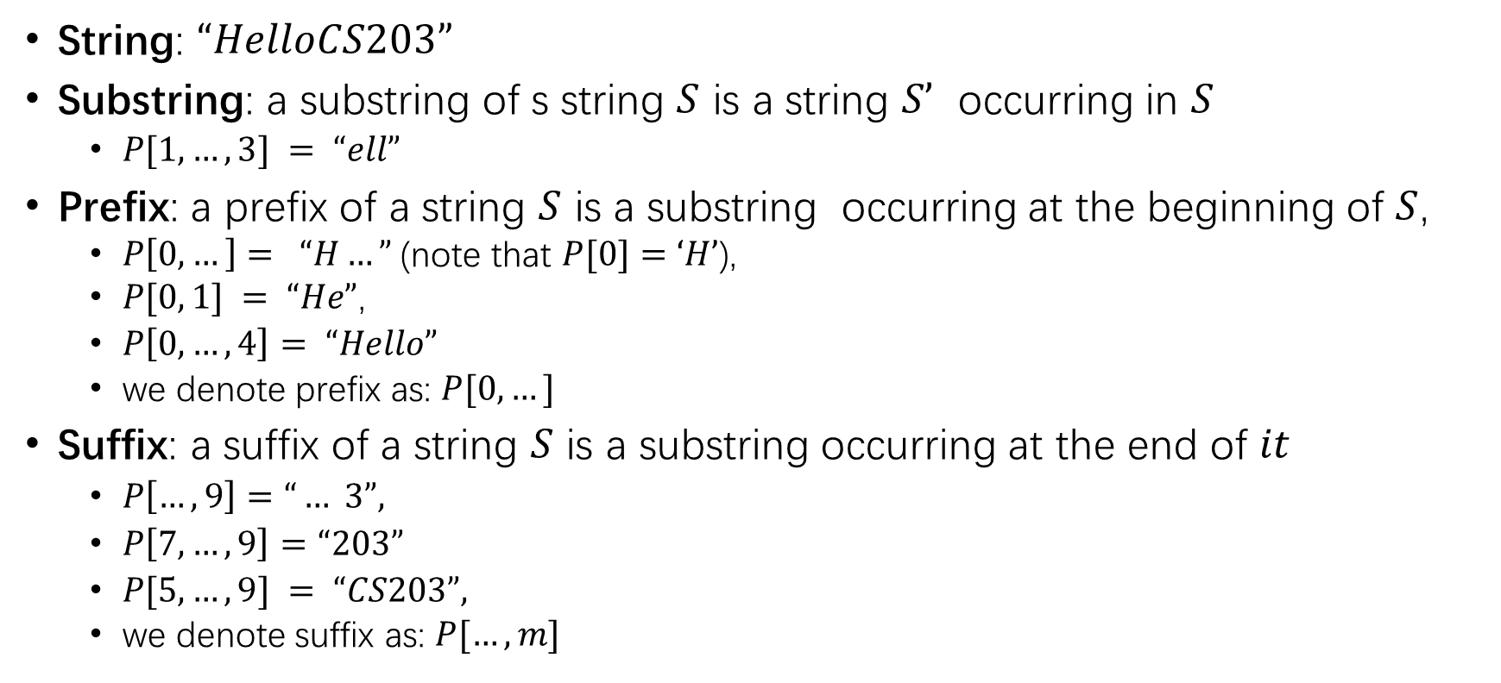
FSA Construction
String: $“HelloCS203”$
Substring: a substring of s string $S$ is a string $S’$ occurring in $S$
$P[1,…,3] = “ell”$
Prefix: a prefix of a string $S$ is a substring occurring at the beginning of $S$,
$P\left[0,…\right]= “H…”$(note that $P[0]=‘H’$),
$P[0, 1] = “He”$,
$P\left[0,…,4\right]= “Hello”$
we denote prefix as: $P[0,…]$
Suffix: a suffix of a string $S$ is a substring occurring at the end of $it$
$P\left[…, 9\right]=“… 3”,$
$P\left[7,…,9\right]=“203”$
$P[5,…,9] = “CS203”,$
we denote suffix as: $P[…,m]$

Slide 25
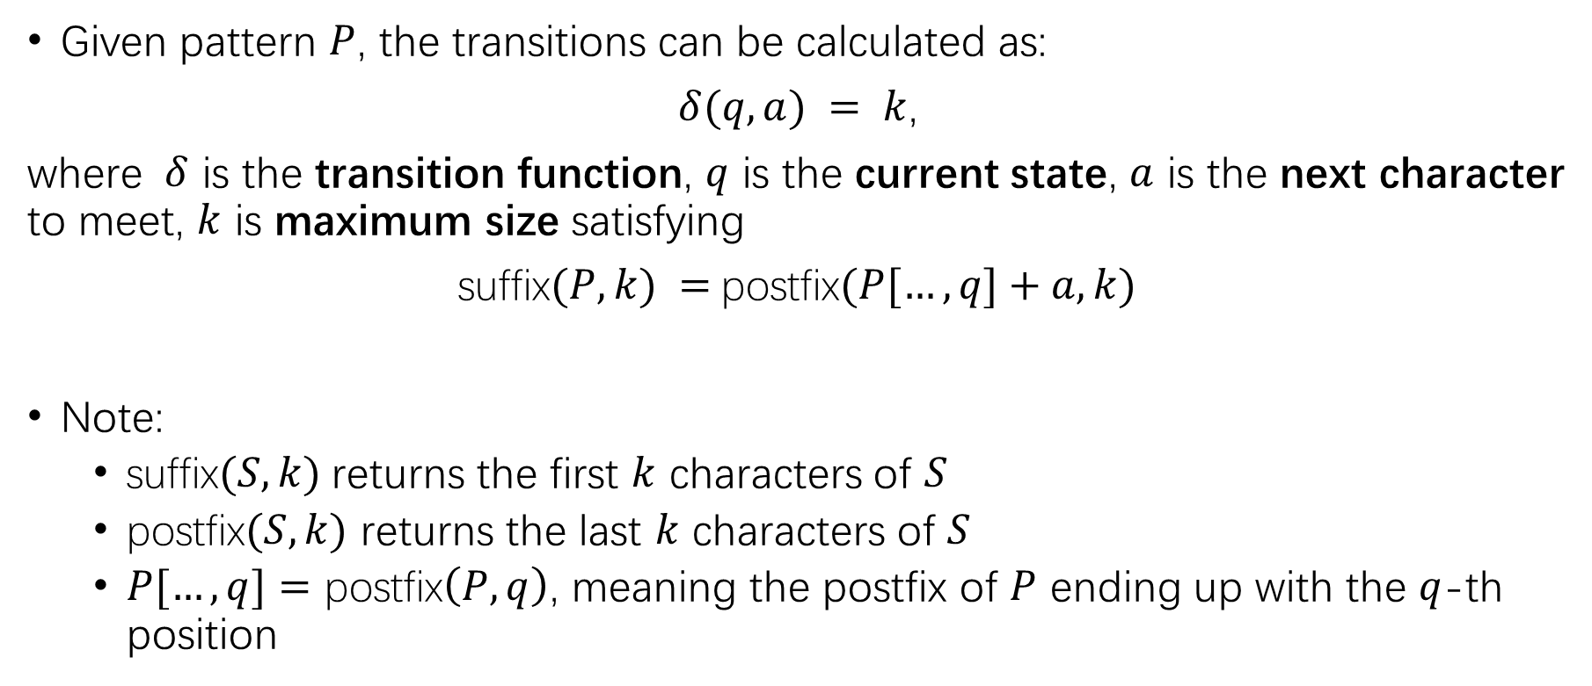
FSA Construction
Given pattern $P$, the transitions can be calculated as:
$δ(q,a) = k$,
where $δ$ is the transition function, $q$ is the current state, $a$ is the next character to meet, $k$ is maximum size satisfying
suffix$(P,k) =$postfix$(P[…,q]+a, k)$
Note:
suffix$(S, k)$returns the first $k$ characters of $S$
postfix$(S,k)$ returns the last $k$ characters of $S$
$P[…,q]=$ postfix$\left(P,q\right)$, meaning the postfix of $P$ ending up with the $q$-th position

Slide 26
Search Pattern
a | a | b | a | a | a | b | b
j | pattern[2..j] | X
a
b
b
a
0
1

Slide 27
Search Pattern
a | a | b | a | a | a | b | b
j | pattern[2..j] |  |  |  |  |  |  | X
0 |  |  |  |  |  |  |  | 0
 | 0
a | 1
b | 0
b
a
0
1

Slide 28
Search Pattern
a | a | b | a | a | a | b | b
j | pattern[2..j] |  |  |  |  |  |  | X
0 |  |  |  |  |  |  |  | 0
1 | a |  |  |  |  |  |  | 1
 | 0 | 1
a | 1 | 2
b | 0 | 0
b
a
a
0
1
2
b

Slide 29
Search Pattern
a | a | b | a | a | a | b | b
j | pattern[2..j] |  |  |  |  |  |  | X
0 |  |  |  |  |  |  |  | 0
1 | a |  |  |  |  |  |  | 1
2 | a | b |  |  |  |  |  | 0
 | 0 | 1 | 2
a | 1 | 2 | 2
b | 0 | 0 | 3
b
a
2
a
a
b
0
1
3
b

Slide 30
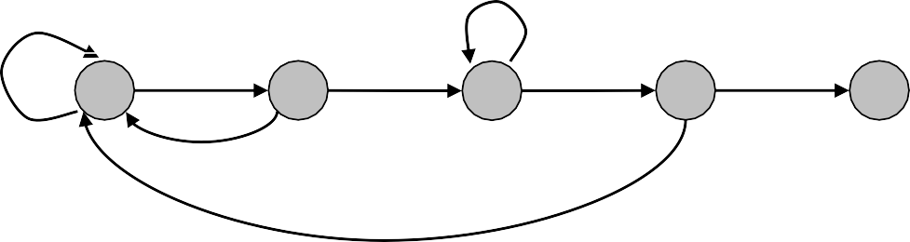
Search Pattern
a | a | b | a | a | a | b | b
j | pattern[2..j] |  |  |  |  |  |  | X
0 |  |  |  |  |  |  |  | 0
1 | a |  |  |  |  |  |  | 1
2 | a | b |  |  |  |  |  | 0
3 | a | b | a |  |  |  |  | 1
 | 0 | 1 | 2 | 3
a | 1 | 2 | 2 | 4
b | 0 | 0 | 3 | 0
b
a
2
a
a
b
a
0
1
3
4
b
b

Slide 31
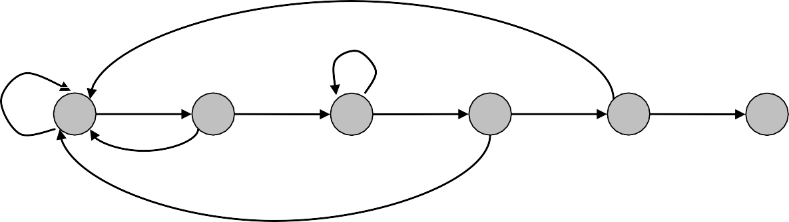
Search Pattern
a | a | b | a | a | a | b | b
j | pattern[2..j] |  |  |  |  |  |  | X
0 |  |  |  |  |  |  |  | 0
1 | a |  |  |  |  |  |  | 1
2 | a | b |  |  |  |  |  | 0
3 | a | b | a |  |  |  |  | 1
4 | a | b | a | a |  |  |  | 2
 | 0 | 1 | 2 | 3 | 4
a | 1 | 2 | 2 | 4 | 5
b | 0 | 0 | 3 | 0 | 0
b a
2
b
a
a
b
a
a
0
1
3
4
5
b
b

Slide 32
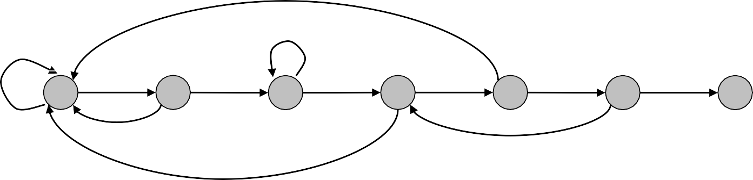
Search Pattern
a | a | b | a | a | a | b | b
j | pattern[2..j] |  |  |  |  |  |  | X
0 |  |  |  |  |  |  |  | 0
1 | a |  |  |  |  |  |  | 1
2 | a | b |  |  |  |  |  | 0
3 | a | b | a |  |  |  |  | 1
4 | a | b | a | a |  |  |  | 2
5 | a | b | a | a | a |  |  | 2
 | 0 | 1 | 2 | 3 | 4 | 5
a | 1 | 2 | 2 | 4 | 5 | 6
b | 0 | 0 | 3 | 0 | 0 | 3
b a
2
b
a
a
b
a
a
a
0
1
3
4
b
5
6
b
b

Slide 33
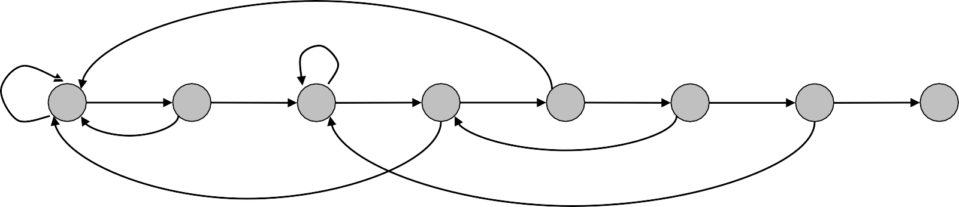
Search Pattern
a | a | b | a | a | a | b | b
j | pattern[2..j] |  |  |  |  |  |  | X
0 |  |  |  |  |  |  |  | 0
1 | a |  |  |  |  |  |  | 1
2 | a | b |  |  |  |  |  | 0
3 | a | b | a |  |  |  |  | 1
4 | a | b | a | a |  |  |  | 2
5 | a | b | a | a | a |  |  | 2
6 | a | b | a | a | a | b |  | 3
 | 0 | 1 | 2 | 3 | 4 | 5 | 6
a | 1 | 2 | 2 | 4 | 5 | 6 | 2
b | 0 | 0 | 3 | 0 | 0 | 3 | 7
b a
2
b
a
a
b
a
a
a
b
0
1
3
4
b a
5
6
7
b
b

Slide 34
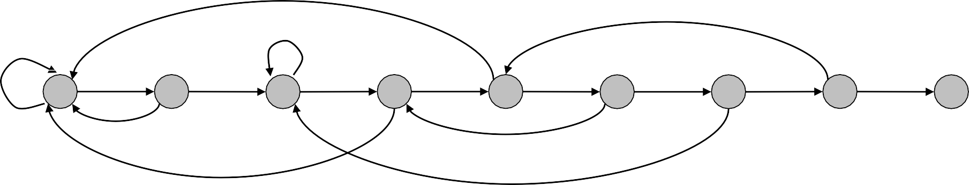
Search Pattern
a | a | b | a | a | a | b | b
j | pattern[2..j] |  |  |  |  |  |  | X
0 |  |  |  |  |  |  |  | 0
1 | a |  |  |  |  |  |  | 1
2 | a | b |  |  |  |  |  | 0
3 | a | b | a |  |  |  |  | 1
4 | a | b | a | a |  |  |  | 2
5 | a | b | a | a | a |  |  | 2
6 | a | b | a | a | a | b |  | 3
7 | a | b | a | a | a | b | b | 0
 | 0 | 1 | 2 | 3 | 4 | 5 | 6 | 7
a | 1 | 2 | 2 | 4 | 5 | 6 | 2 | 4
b | 0 | 0 | 3 | 0 | 0 | 3 | 7 | 8
b a
2
a
b
a
a
b
a
a
a
b
b
0
1
3
4
b a
5
6
7
8
b
b

Slide 35

Transition Function
Transition($P, Σ$):
$M$ ← len(P)
$X$ ← 0
for $j$ ← 0 to $m−2$
for each character $a∈Σ$
if $P\left[j+1\right]=a$ then // char match
$δ\left(j,a\right) \text{←} j + 1$
else // char mismatch
$δ(j,a)\text{←}δ(X,a)$
$X \text{←}$ $δ(X,P[j+1])$
return $δ$
Time Complexity?

Slide 36

FSA-matching algorithm.
Use knowledge of how search pattern repeats itself.
Build FSA from pattern.
Run FSA on text.
Search Pattern
a | a | b | a | a | a
b a
2
b
a
a
b
a
a
a
6
accept state
0
1
3
4
b
5
b
b

Slide 37
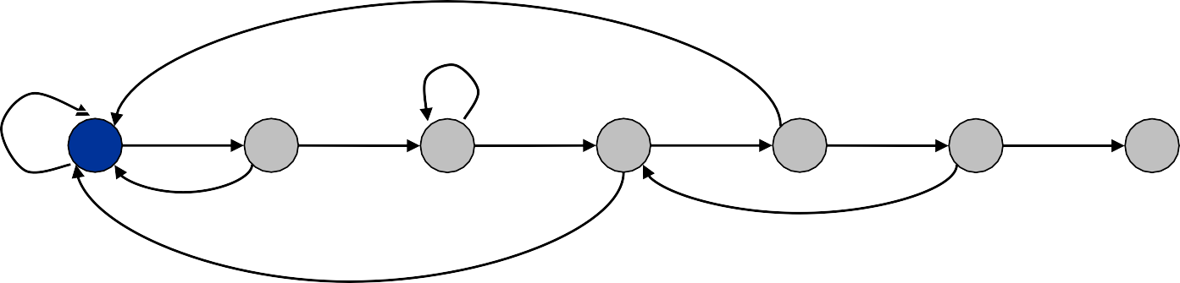
FSA-matching algorithm.
Use knowledge of how search pattern repeats itself.
Build FSA from pattern.
Run FSA on text.
Search Pattern
a | a | b | a | a | a
Search Text
a | a | a | b | a | a | b | a | a | a | b
b a
2
b
a
a
b
a
a
a
0
1
3
4
b
5
6
accept state
b
b

Slide 38
FSA-matching algorithm.
Use knowledge of how search pattern repeats itself.
Build FSA from pattern.
Run FSA on text.
Search Pattern
a | a | b | a | a | a
Search Text
a | a | a | b | a | a | b | a | a | a | b
b a
2
b
a
a
b
a
a
a
0
1
3
4
b
5
6
accept state
b
b

Slide 39

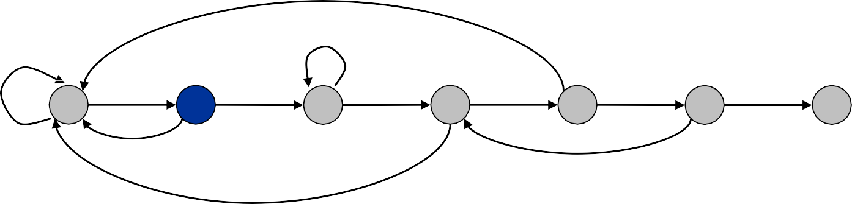
FSA-matching algorithm.
Use knowledge of how search pattern repeats itself.
Build FSA from pattern.
Run FSA on text.
Search Pattern
a | a | b | a | a | a
Search Text
a | a | a | b | a | a | b | a | a | a | b
b a
2
b
a
a
b
a
a
a
6
accept state
0
1
3
4
b
5
b
b

Slide 40

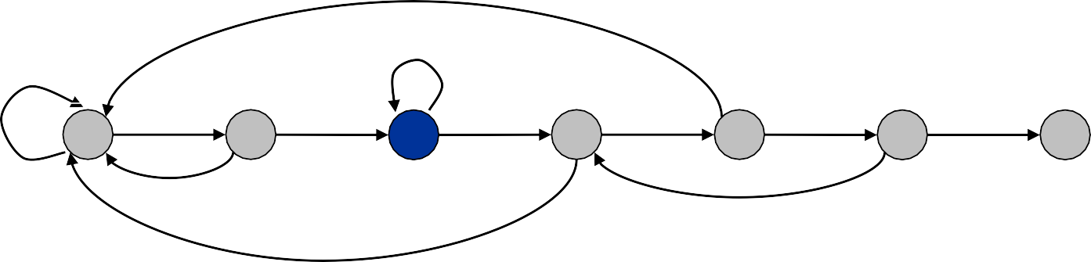
FSA-matching algorithm.
Use knowledge of how search pattern repeats itself.
Build FSA from pattern.
Run FSA on text.
Search Pattern
a | a | b | a | a | a
Search Text
a | a | a | b | a | a | b | a | a | a | b
b a
2
b
a
a
b
a
a
a
6
accept state
0
1
3
4
b
5
b
b

Slide 41
FSA-matching algorithm.
Use knowledge of how search pattern repeats itself.
Build FSA from pattern.
Run FSA on text.
Search Pattern
a | a | b | a | a | a
Search Text
a | a | a | b | a | a | b | a | a | a | b
b a
2
b
a
a
b
a
a
a
6
accept state
0
1
3
4
b
5
b
b

Slide 42

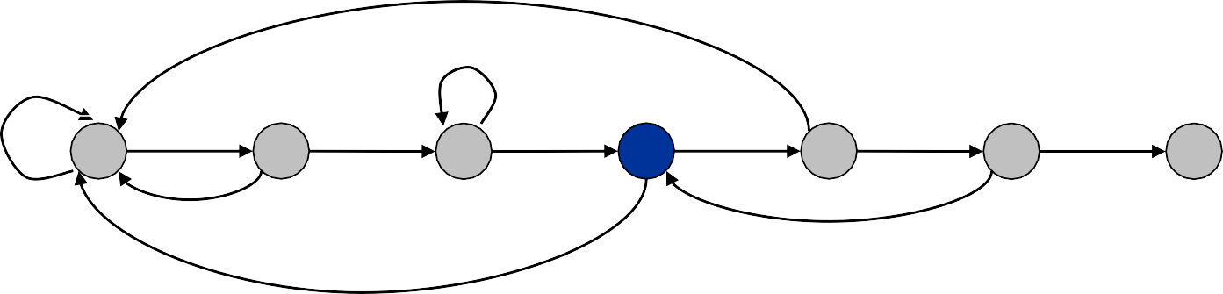
FSA-matching algorithm.
Use knowledge of how search pattern repeats itself.
Build FSA from pattern.
Run FSA on text.
Search Pattern
a | a | b | a | a | a
Search Text
a | a | a | b | a | a | b | a | a | a | b
b a
2
b
a
a
b
a
a
a
6
accept state
0
1
3
4
b
5
b
b

Slide 43


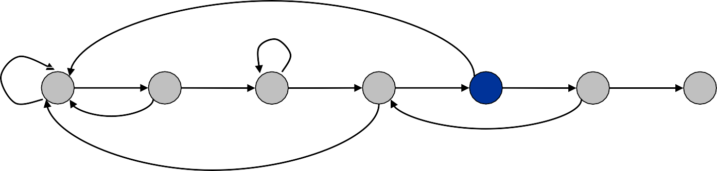
FSA-matching algorithm.
Use knowledge of how search pattern repeats itself.
Build FSA from pattern.
Run FSA on text.
Search Pattern
a | a | b | a | a | a
Search Text
a | a | a | b | a | a | b | a | a | a | b
b a
2
b
a
a
b
a
a
a
6
accept state
0
1
3
4
b
5
b
b

Slide 44

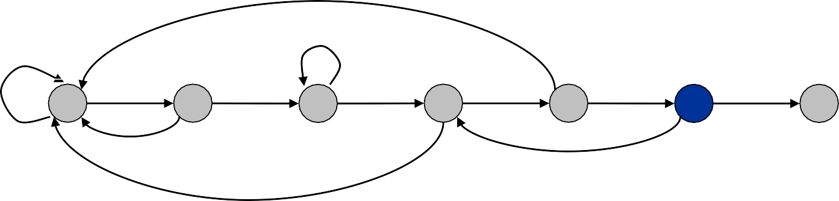
FSA-matching algorithm.
Use knowledge of how search pattern repeats itself.
Build FSA from pattern.
Run FSA on text.
Search Pattern
a | a | b | a | a | a
Search Text
a | a | a | b | a | a | b | a | a | a | b
b a
2
b
a
a
b
a
a
a
6
accept state
0
1
3
4
b
5
b
b

Slide 45


FSA-matching algorithm.
Use knowledge of how search pattern repeats itself.
Build FSA from pattern.
Run FSA on text.
Search Pattern
a | a | b | a | a | a
Search Text
a | a | a | b | a | a | b | a | a | a | b
b a
2
b
a
a
b
a
a
a
6
accept state
0
1
3
4
b
5
b
b

Slide 46



FSA-matching algorithm.
Use knowledge of how search pattern repeats itself.
Build FSA from pattern.
Run FSA on text.
Search Pattern
a | a | b | a | a | a
Search Text
a | a | a | b | a | a | b | a | a | a | b
b a
2
b
a
a
b
a
a
a
6
accept state
0
1
3
4
b
5
b
b

Slide 47





FSA-matching algorithm.
Use knowledge of how search pattern repeats itself.
Build FSA from pattern.
Run FSA on text.
Search Pattern
a | a | b | a | a | a
Search Text
a | a | a | b | a | a | b | a | a | a | b
b a
2
b
a
a
b
a
a
a
6
accept state
0
1
3
4
b
5
b
b

Slide 48


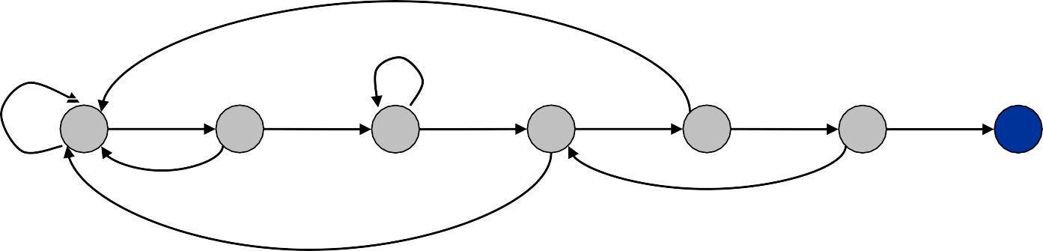
FSA-matching algorithm.
Use knowledge of how search pattern repeats itself.
Build FSA from pattern.
Run FSA on text.
Search Pattern
a | a | b | a | a | a
Search Text
a | a | b | a | a | a | b | a | a | a | b
b a
2
b
a
a
b
a
a
a
6
accept state
0
1
3
4
b
5
b
b

Slide 49
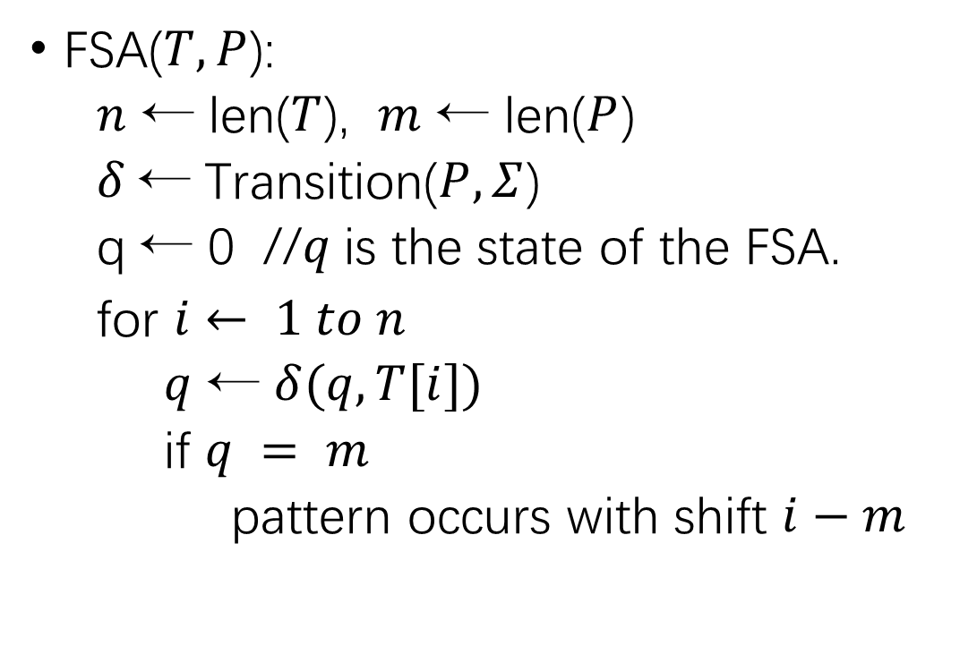
FSA Algorithm
FSA($T, P$):
$n$ ← len($T$), $m$ ← len($P$)
𝛿 ← Transition($P, Σ$)
q ← 0 //$q$is the state of the FSA.
for $i ← 1 to n$
$q$ ← $δ(q,T[i])$
if $q = m$
pattern occurs with shift $i−m$

Slide 50
Our Roadmap
String Concepts
String Searching Problem
Brute Force Solution
Rabin-Karp
Finite State Automata
Knuth-Morris-Pratt

Slide 51
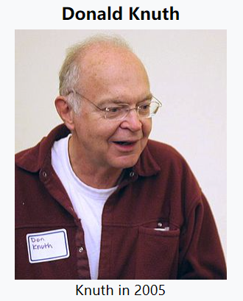
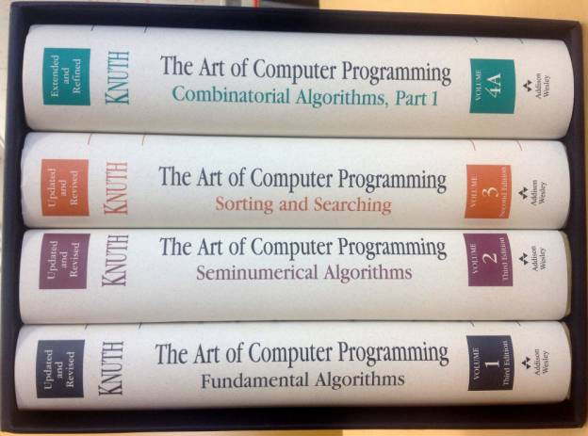

History of KMP
The algorithm was first conceived by James H. Morris; a few weeks later, it was independently discovered by Donald Knuth from automata theory (i.e. FSA)
Morris and Vaughan Pratt published a technical report in 1970; then, the three also published the algorithm jointly in 1977.

Slide 52
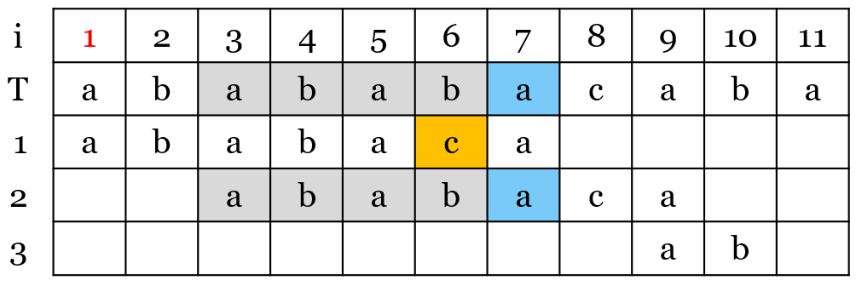
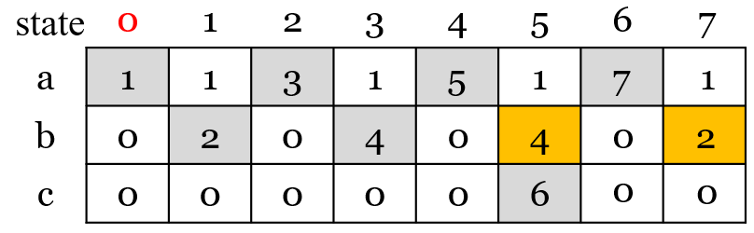
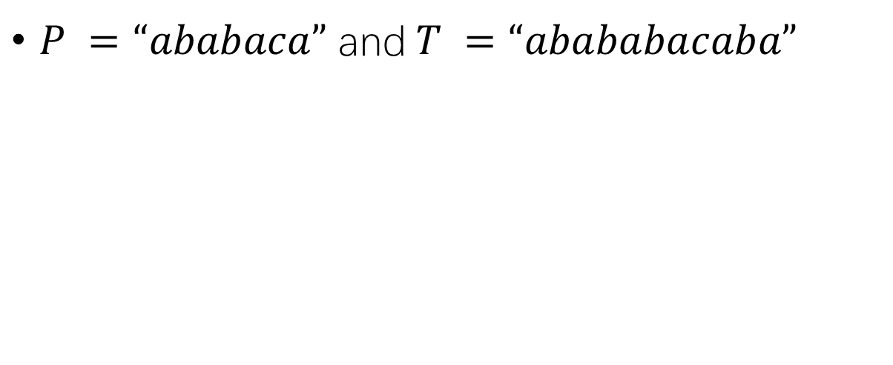
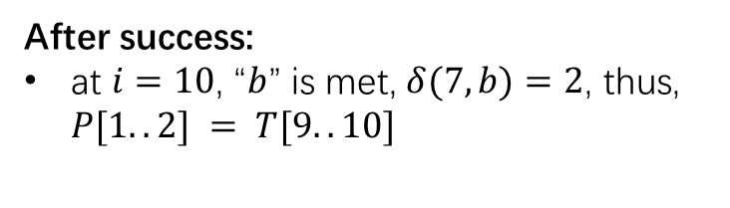

FSA Revisited
$P =“ababaca”$and$T =“abababacaba”$
After failure:
at $i=6$, ‘$c$’ was expected, but not found in $T[6]$
FSA transition to state 𝛿(5,b)=4, it means pattern prefix$P[1..4] =“abab”$has matched the text suffix $T[3..6] = “abab”$
After success:
at $i=10$, “$b$” is met, $δ(7,b)=2$, thus, $P[1..2] = T[9..10]$

Slide 53
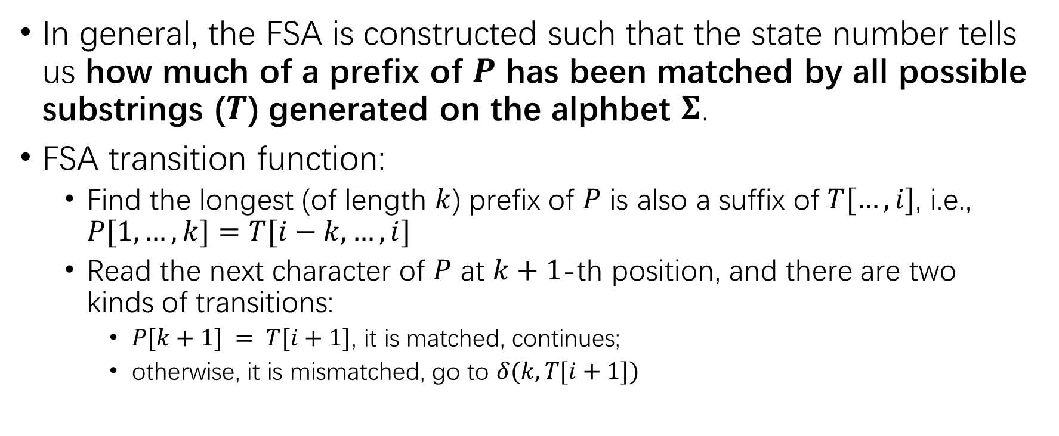
FSA Revisited
In general, the FSA is constructed such that the state number tells us how much of a prefix of $P$ has been matched by all possible substrings ($T$) generated on the alphbet $Σ$.
FSA transition function:
Find the longest (of length $k$) prefix of $P$ is also a suffix of $T[…,i]$, i.e., $P[1,…,k]=T[i−k,…,i]$
Read the next character of $P$ at $k+1$-th position, and there are two kinds of transitions:
$P[k+1] = T[i+1]$, it is matched, continues;
otherwise, it is mismatched, go to $δ(k,T[i+1])$

Slide 54
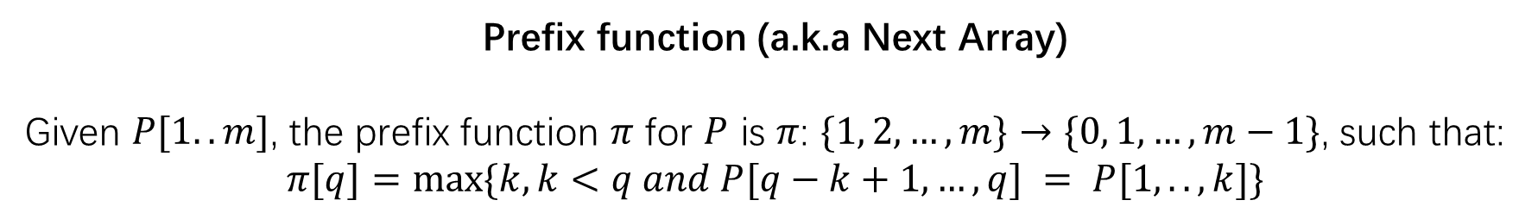
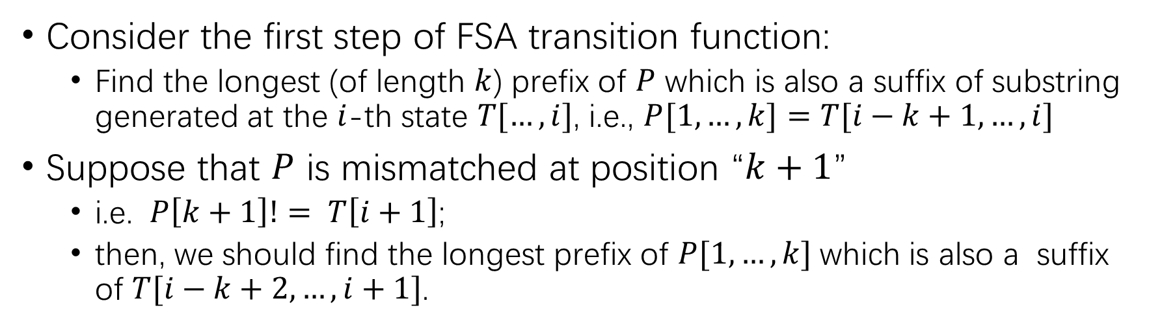
Prefix Function
Consider the first step of FSA transition function:
Find the longest (of length $k$) prefix of $P$ which is also a suffix of substring generated at the $i$-th state $T[…, i]$, i.e., $P[1,…,k]=T[i−k+1,…,i]$
Suppose that $P$ is mismatched at position “$k+1$”
i.e. $P\left[k+1\right]!= T\left[i+1\right]$;
then, we should find the longest prefix of $P[1,…,k]$which is also a suffix of $T[i−k+2, …, i+1]$.
Prefix function (a.k.a Next Array)
Given $P[1..m]$, the prefix function $π$ for $P$ is $π$: $\{1, 2, …, m\}→\{0, 1, …, m−1\}$, such that:
$$π[q]=max⁡\{k, k<q and P[q−k+1,…,q] = P[1,..,k]\}$$

Slide 55
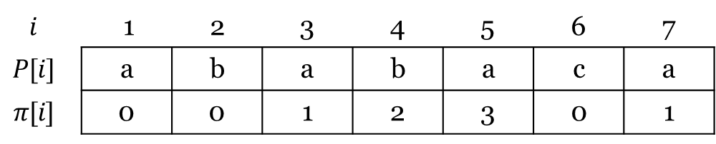
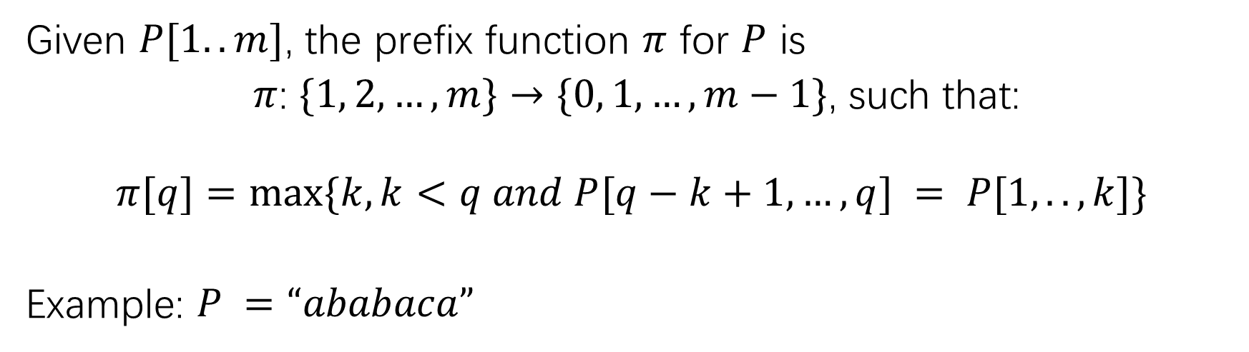
Prefix function (i.e. Next Array in KMP)
Given $P[1..m]$, the prefix function $π$ for $P$ is
$π$: $\{1, 2, …, m\}→\{0, 1, …, m−1\}$, such that:
$$π[q]=max⁡\{k, k<q and P[q−k+1,…,q] = P[1,..,k]\}$$
Example: $P =“ababaca”$
$$i$$ | 1 | 2 | 3 | 4 | 5 | 6 | 7
$$P[i]$$ | a | b | a | b | a | c | a
$$π[i]$$ | 0 | 0 | 1 | 2 | 3 | 0 | 1

Slide 56
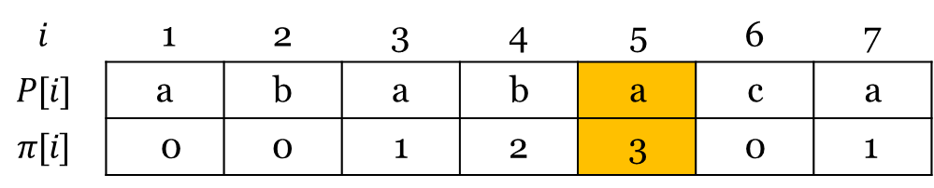
KMP
$P =“ababaca”$ and $T =“abababacaba”$
i | 1 | 2 | 3 | 4 | 5 | 6 | 7 | 8 | 9 | 10 | 11
T | a | b | a | b | a | b | a | c | a | b | a
1 | a | b | a | b | a | c | a
2 |  |  | a | b | a | b | a | c | a
After failure: at $i=5$, ‘$c$’ was expected, but not found in $T[6]$, then we lookup the next array to get $π\left[5\right]=3$ — sliding $P$ to position $3$
$$i$$ | 1 | 2 | 3 | 4 | 5 | 6 | 7
$$P[i]$$ | a | b | a | b | a | c | a
$$π[i]$$ | 0 | 0 | 1 | 2 | 3 | 0 | 1

Slide 57
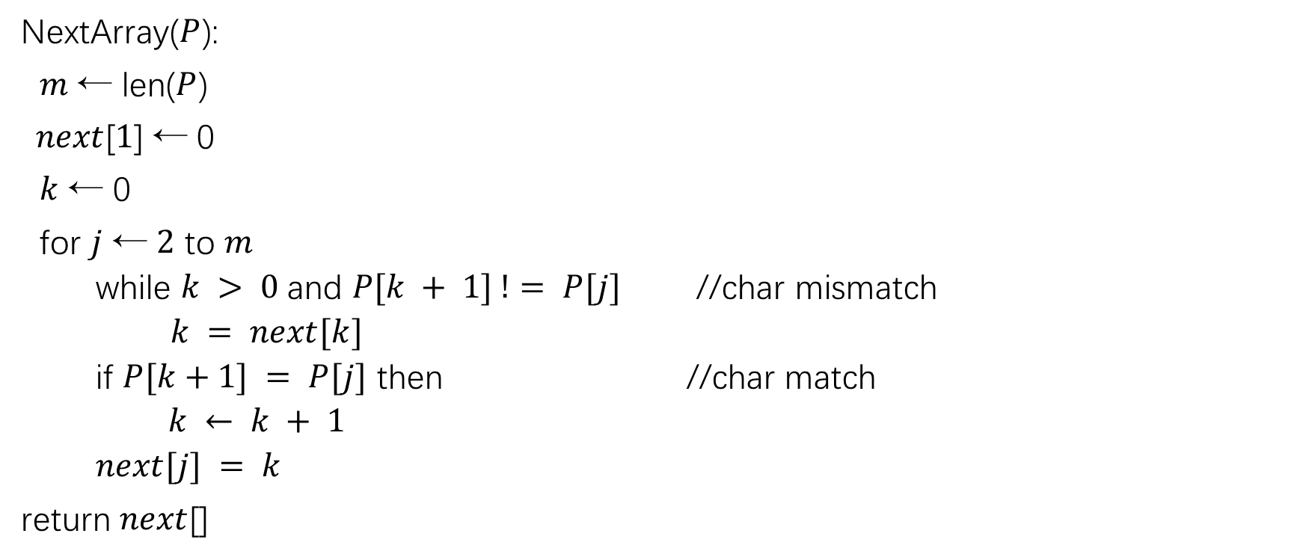
To obtain Next Array
NextArray($P$):
$m$ ← len($P$)
$next$[$1$] ← 0
$k$ ← 0
for $j$ ← $2$ to $m$
while $k > 0$and $P[k + 1] != P[j]$ //char mismatch
$k = next[k]$
if $P[k+1] = P[j]$ then //char match
$k ← k + 1$
$next[j] = k$
return $next$[]

Slide 58

KMP Algorithm
KMP($T$, $P$):
$n$ ← len($T$), m ← len($P$)
$next[]$ ← NextArray($P$)
$q$ ← 0
for $i$ ← $1$ to $n$
while $q > 0$and $P[q + 1] != T[i]$
$q$← next[$q$]
if $P[q + 1] = T[i]$ then
$q ← q + 1$
if $q = m$
pattern occurs with shift $i−m$
Time Complexity?

Slide 59
Our Roadmap
String Concepts
String Searching Problem
Brute Force Solution
Rabin-Karp
Finite State Automata
Knuth-Morris-Pratt

Slide 60
Thank you

