Slide 1
Lecture 7 Tree
Ran Cheng (程然)
https://chengran.tech/
https://emi.sustech.edu.cn/

Slide 2
Our Roadmap
Tree
Basic Concepts
Properties of Tree (focus on binary tree)
Binary Tree Traversal
Binary Tree Applications
Algebraic expression
Huffman encoding

Slide 3
Tree
This lecture provides a formal definition of trees, which constitute an important approach to organizing data in computer science.
We will also prove some basic properties of trees that will be useful in computer science.

Slide 4
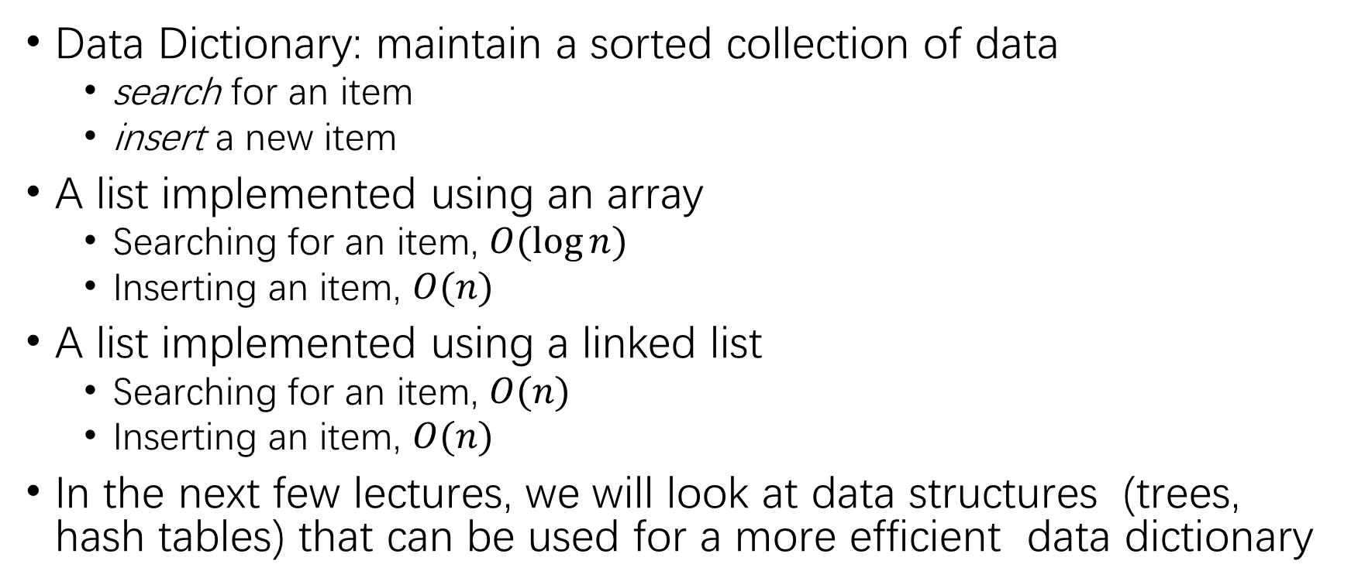
Motivation
Data Dictionary: maintain a sorted collection of data
search for an item
insert a new item
A list implemented using an array
Searching for an item, $O(log⁡n)$
Inserting an item, $O(n)$
A list implemented using a linked list
Searching for an item, $O(n)$
Inserting an item, $O(n)$
In the next few lectures, we will look at data structures (trees, hash tables) that can be used for a more efficient data dictionary

Slide 5
What is a tree
A tree consist of:
a set of nodes,
a set of edges, each of which connects a pair of nodes
Each node may have one or more data items
Key field = the field used when searching for a data item
Multiple data items with the same key are referred to as duplicates
The node at the top of the tree is the root of the tree
root
edge
node
𝑐
"

Slide 6

Tree Property I
A tree with $n$ nodes has $n−1$ edges
Proof?

Slide 7

Hint
For each non-root node $v$, it has one and only one edge point to itself.
A tree with $n$ nodes has $n−1$ non-root nodes.
Thus, this tree has $n−1$edges.

Slide 8
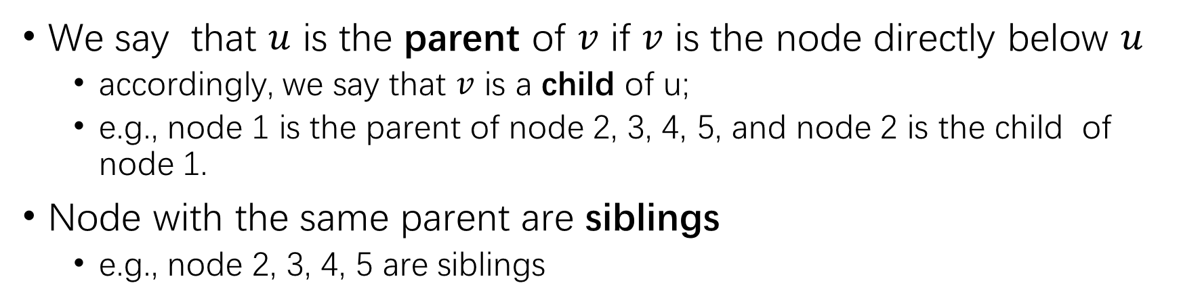
Relationship between nodes
1
Consider a tree 𝑇, let 𝑢 and 𝑣 be two nodes in 𝑇.
2
3
4
5
6 7 8 9
10
We say that $u$ is the parent of $v$ if $v$ is the node directly below $u$
accordingly, we say that $v$ is a child of u;
e.g., node 1 is the parent of node 2, 3, 4, 5, and node 2 is the child of node 1.
Node with the same parent are siblings
e.g., node 2, 3, 4, 5 are siblings

Slide 9
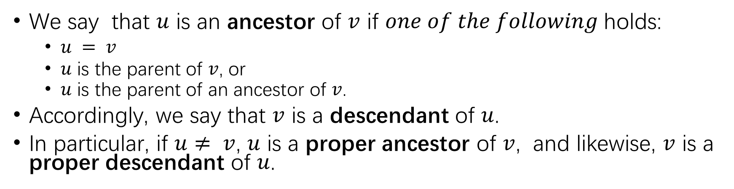
Relationship between nodes
1
Consider a tree 𝑇, let 𝑢 and 𝑣 be two nodes in 𝑇.
2
3
4
5
6 7 8 9
10
We say that $u$ is an ancestor of $v$ if $one of the following$holds:
$u = v$
$u$ is the parent of $v$, or
$u$ is the parent of an ancestor of $v$.
Accordingly, we say that $v$ is a descendant of $u$.
In particular, if $u≠ v$, $u$ is a proper ancestor of $v$, and likewise, $v$ is a proper descendant of $u$.

Slide 10
Tree node types
1
2
3
4
5
Consider a tree 𝑇
6 7 8 9
10
A leaf node is a node without children
An internal node is a node with one or more children, e.g.:
leaf nodes: 5, 6, 7, 8, 9, 10
internal nodes: 1, 2, 3, 4

Slide 11
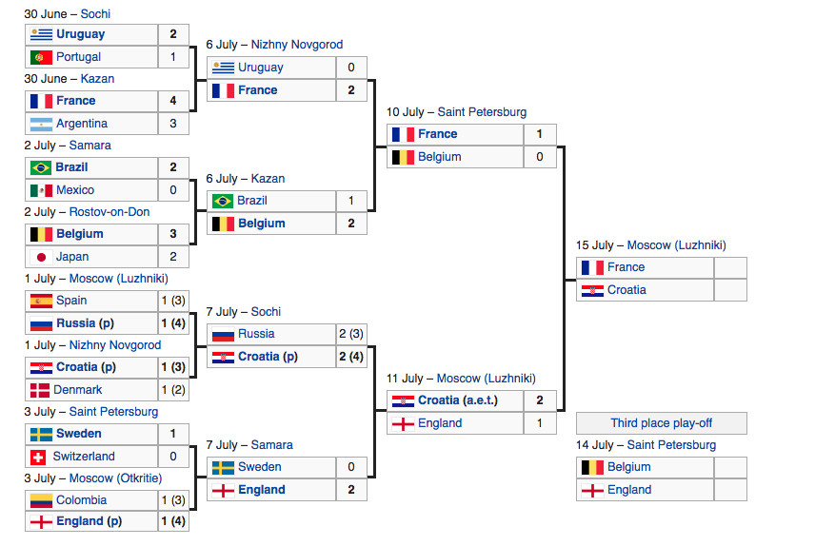
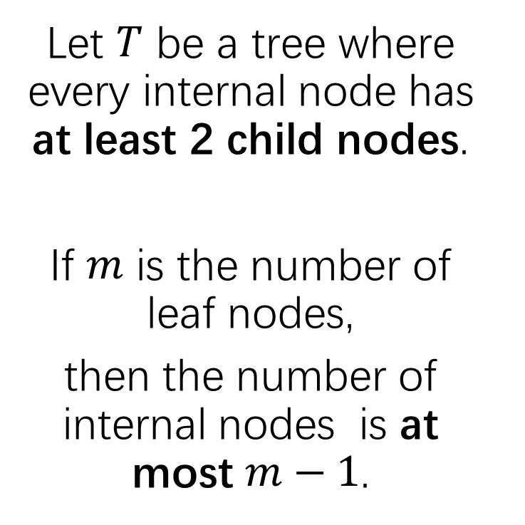
Tree Property II
Let $T$ be a tree where every internal node has at least 2 child nodes.
If $m$ is the number of leaf nodes,
then the number of internal nodes is at most $m−1$.

Slide 12
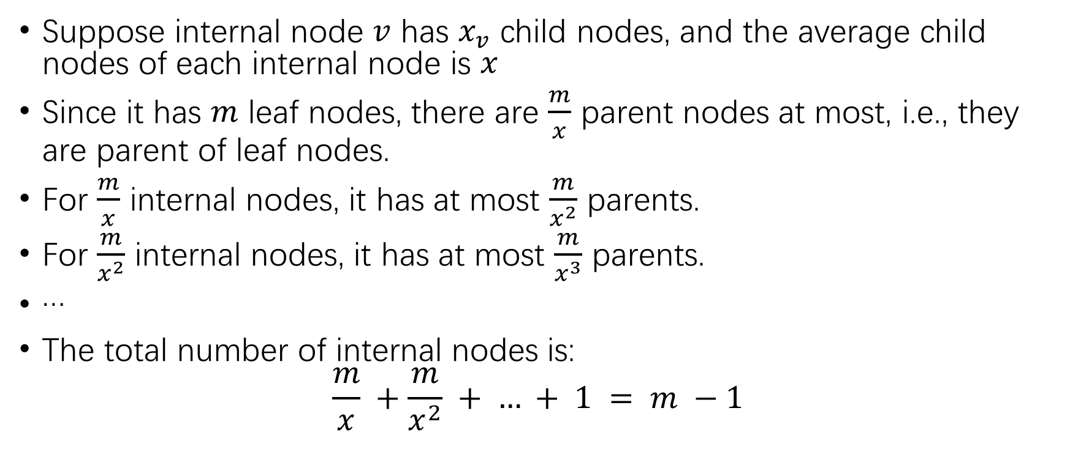
Hint
Suppose internal node $v$ has $x_{v}$ child nodes, and the average child nodes of each internal node is $x$
Since it has $m$ leaf nodes, there are $\frac{m}{x}$ parent nodes at most, i.e., they are parent of leaf nodes.
For $\frac{m}{x}$ internal nodes, it has at most $\frac{m}{x^{2}}$ parents.
For $\frac{m}{x^{2}}$ internal nodes, it has at most $\frac{m}{x^{3}}$ parents.
…
The total number of internal nodes is:
$$\frac{m}{x} +\frac{m}{x^{2}} + … + 1 = m −1$$

Slide 13
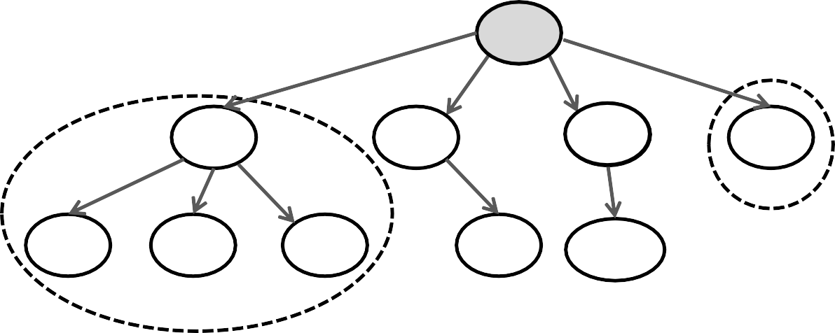
Tree: a Recursive Data Structure
1
2
3
4
5
6 7 8 9
10
Each node in the tree is the root of a smaller tree!
Refer to such trees as subtrees to distinguish them from the tree as a whole
Node 2 is the root of the subtree circled above
Node 5 is the root of a subtree with only one node.
Tree algorithms often lend themselves to recursive implementations

Slide 14
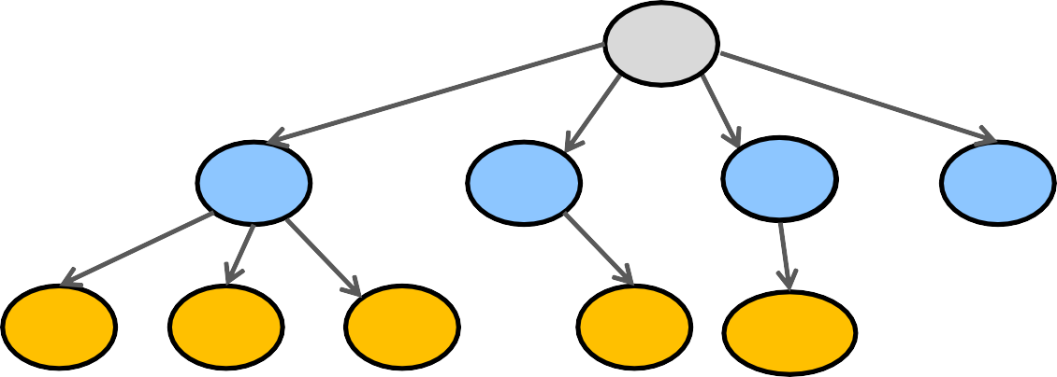
Path, Depth, Level, and Height
Level 0
1
Level 1
Level 2
2
3
4
5
6
7
8
9
10
There is exactly one path (one sequence of edges) connecting each node to the root.
Depth of a node = # of edges on the path leading it to the root.
Nodes with the same depth form a level of the tree.
The height of a tree is the maximum depth of its nodes: the tree above has a height of 2.

Slide 15


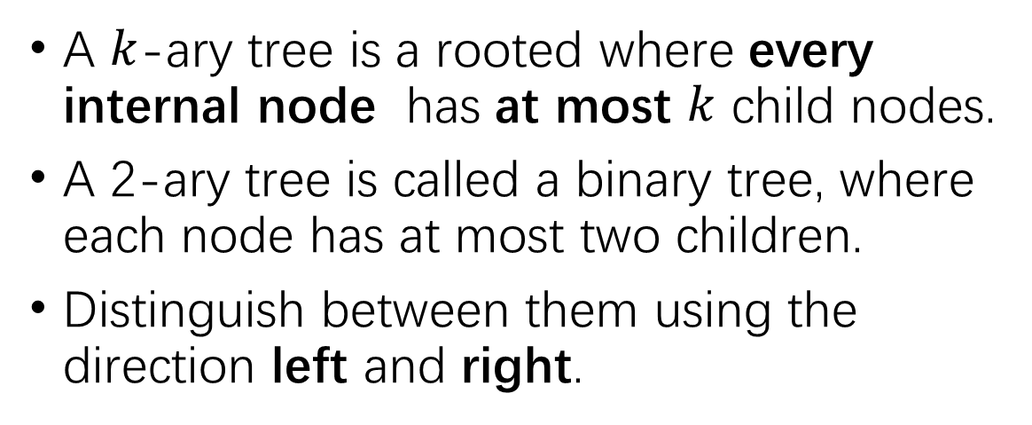


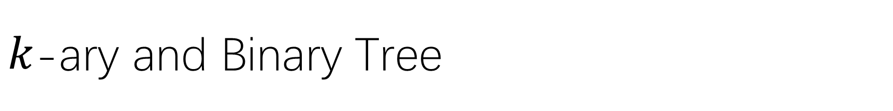







$k$-ary and Binary Tree
A $k$-ary tree is a rooted where every internal node has at most $k$ child nodes.
A 2-ary tree is called a binary tree, where each node has at most two children.
Distinguish between them using the direction left and right.
$$c$$
$$c_{1}$$
$$c_{0}$$
$$c_{1}$$
$$c_{2}$$
$$c_{2}$$
$$c_{3}$$
1
$$c_{5}$$
$$c_{4}$$
$$c_{5}$$
$$c_{4}$$
2
3
4
3

Slide 16
Binary Tree Definition
Binary tree recursive definition
A binary tree is either:
1) empty or
2) a node (the root of the tree) having one or more pieces of data (the key, and possibly others), and:
a left subtree, which is itself a binary tree
a right subtree, which is itself a binary tree
A binary tree implies an ordering among the nodes at the same level.

Slide 17





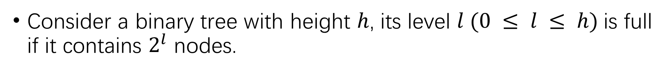






Binary Tree: Full Level
Consider a binary tree with height $h$, its level $l (0 ≤ l ≤ h)$is full if it contains $2^{l}$ nodes.
$$c$$
$$c_{1}$$
$$c_{0}$$
$$c_{1}$$
Levels 0 and 1 are full, but levels 2 and 3 are not.
$$c_{2}$$
$$c_{2}$$
$$c_{3}$$
$$c_{5}$$
$$c_{4}$$
$$c_{5}$$
$$c_{4}$$

Slide 18










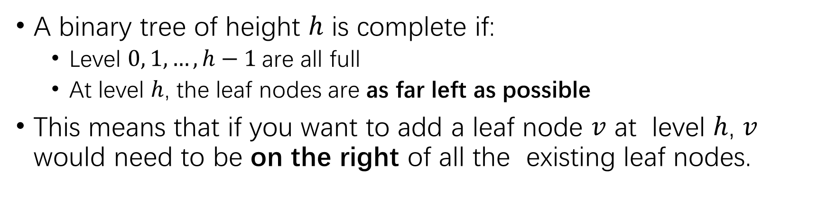
Binary Tree: Complete Binary Tree
A binary tree of height $h$ is complete if:
Level $0, 1, …, h−1$are all full
At level $h$, the leaf nodes are as far left as possible
This means that if you want to add a leaf node $v$ at level $h$, $v$ would need to be on the right of all the existing leaf nodes.

Slide 19

Tree Property III
A complete binary tree with $n ≥ 2$nodes has height $O(log n)$
Proof?

Slide 20
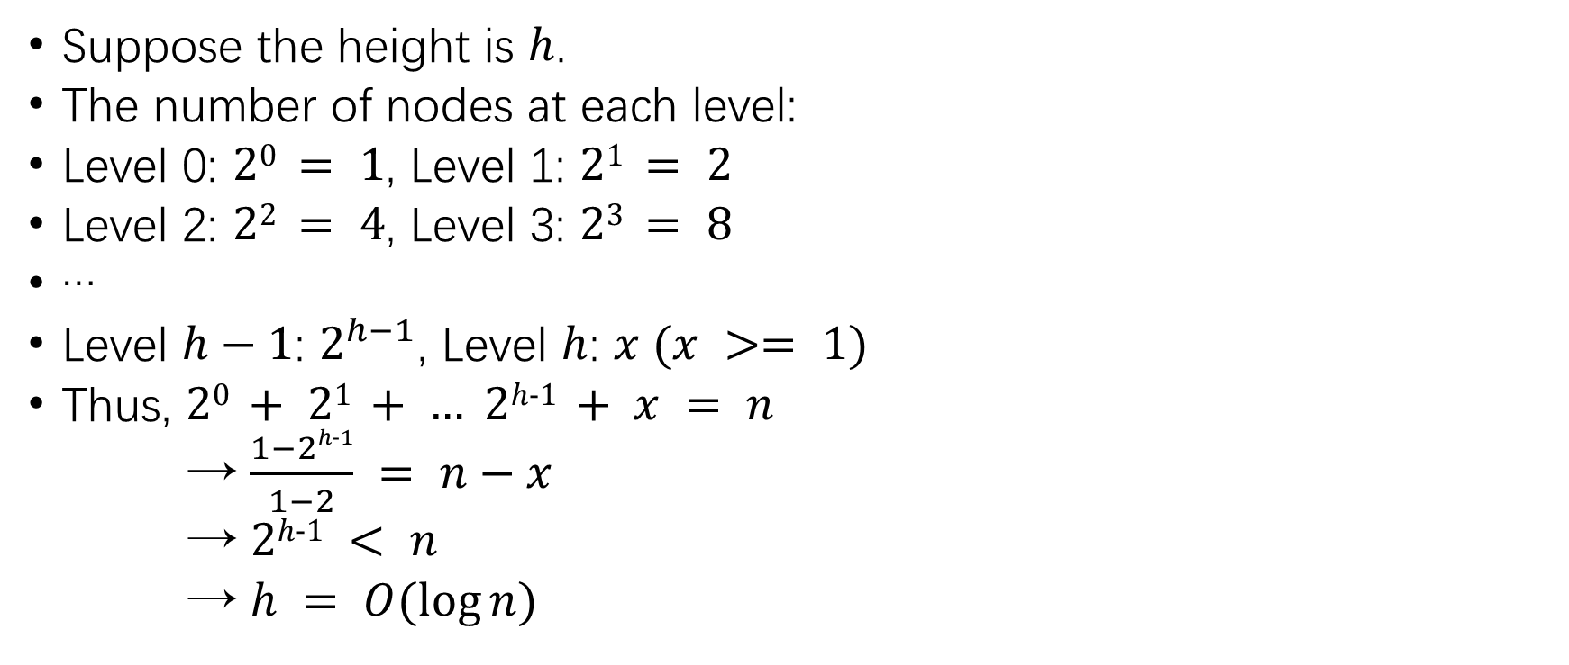
Hint
Suppose the height is $h$.
The number of nodes at each level:
Level 0: $20 = 1$, Level 1: $21 = 2$
Level 2: $22 = 4$, Level 3: $23 = 8$
…
Level $h−1$: $2^{h−1}$, Level $h$: $x (x >= 1)$
Thus, $20 + 21 + … 2h-1 + x = n$
→ $\frac{1−2h-1}{1−2} = n−x$
→ $2h-1 < n$
→ $h = O(log⁡n)$

Slide 21
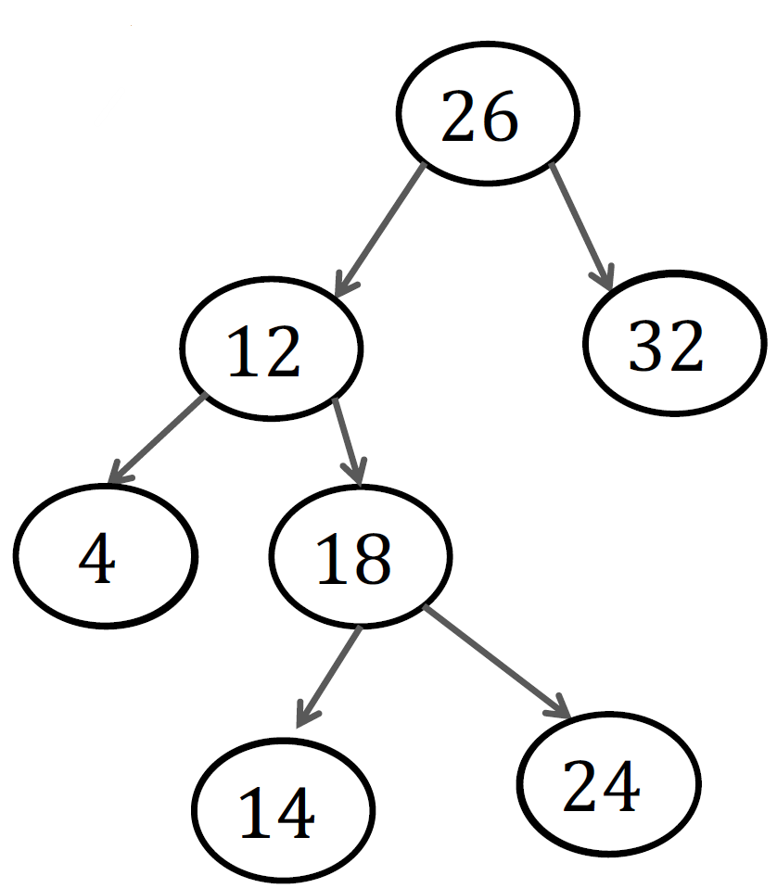
Binary Tree Implementation
Struct treeNode {
Int key;
treeNode left;
treeNode right;
}
26
12
32
^
^
4
^ ^
18
14
24
^
^
^
^

Slide 22
Traversing a Binary Tree
Traversing a tree involves visiting all of the nodes in the tree.
Visiting a node means processing its data in some way, e.g., to print the key
We will look at four types of traversals, each of which visits the nodes in a different order.
To understand traversals, it is helpful if you can remember the recursive definition of a binary tree, in which every node is the root of a subtree.

Slide 23





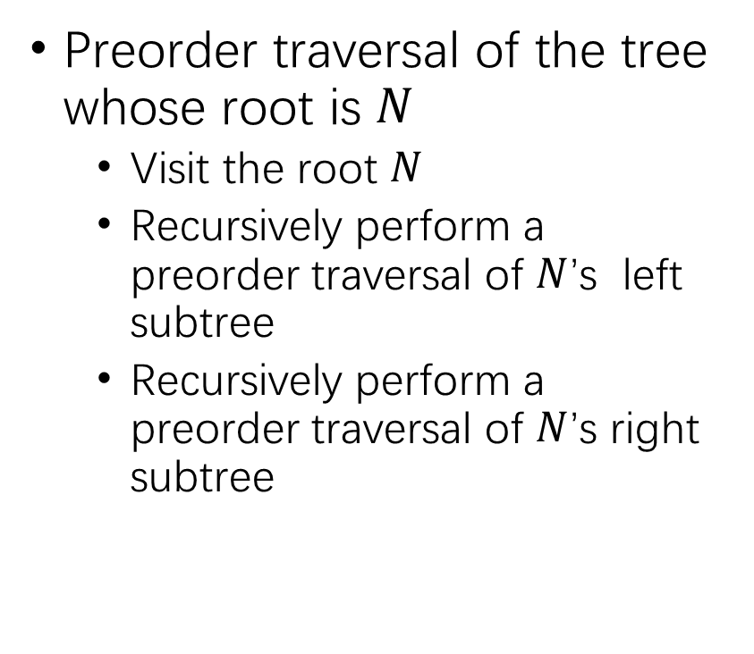






Preorder Traversal
Preorder traversal of the tree whose root is $N$
Visit the root $N$
Recursively perform a preorder traversal of $N$’s left subtree
Recursively perform a preorder traversal of $N$’s right subtree
$$26$$
$$c_{1}$$
$$12$$
$$32$$
$$4$$
$$c_{2}$$
$$18$$
$$24$$
$$c_{4}$$
$$c_{5}$$
$$14$$

Slide 24
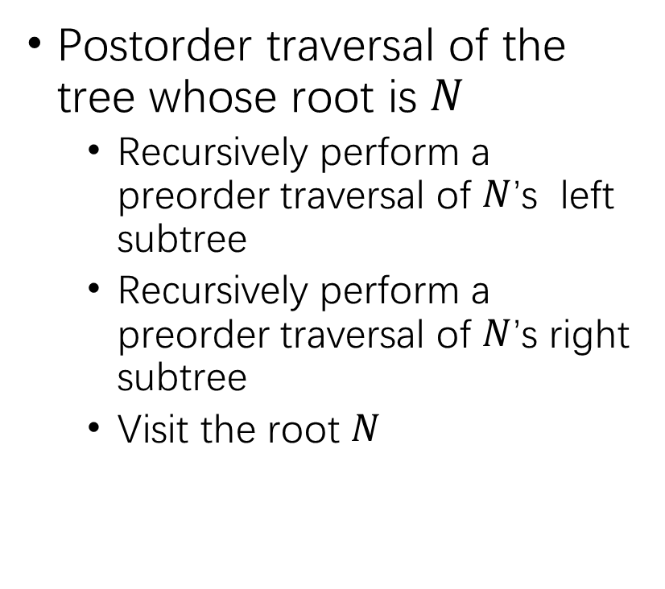
Postorder Traversal
Postorder traversal of the tree whose root is $N$
Recursively perform a preorder traversal of $N$’s left subtree
Recursively perform a preorder traversal of $N$’s right subtree
Visit the root $N$
$$26$$
$$c_{1}$$
$$12$$
$$32$$
$$4$$
$$c_{2}$$
$$18$$
$$24$$
$$c_{4}$$
$$c_{5}$$
$$14$$

Slide 25
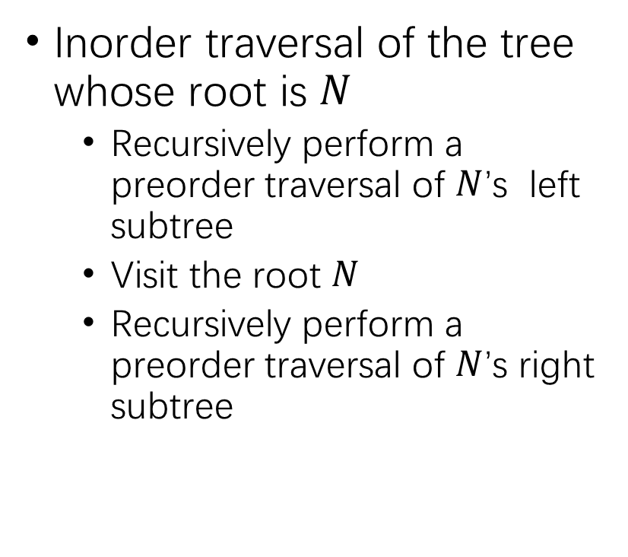
Inorder Traversal
Inorder traversal of the tree whose root is $N$
Recursively perform a preorder traversal of $N$’s left subtree
Visit the root $N$
Recursively perform a preorder traversal of $N$’s right subtree
$$26$$
$$c_{1}$$
$$12$$
$$32$$
$$4$$
$$c_{2}$$
$$18$$
$$24$$
$$c_{4}$$
$$c_{5}$$
$$14$$

Slide 26
Level-order Traverse
Visit the nodes one level at a time, from top to bottom, and left to right.
How to implement?
$$26$$
$$c_{1}$$
$$12$$
$$32$$
$$4$$
$$c_{2}$$
$$18$$
$$24$$
$$c_{4}$$
$$c_{5}$$
$$14$$

Slide 27
Summary
Preorder: root, left subtree, right subtree
Postoder: left subtree, right subtree, root
Inorder: left subtree, root, right subtree
Level-order: top to bottom, left to right

Slide 28
Our Roadmap
Tree
Basic Concepts
Properties of Tree (focus on binary tree)
Binary Tree Traversal
Binary Tree Applications
Algebraic expression
Huffman encoding

Slide 29
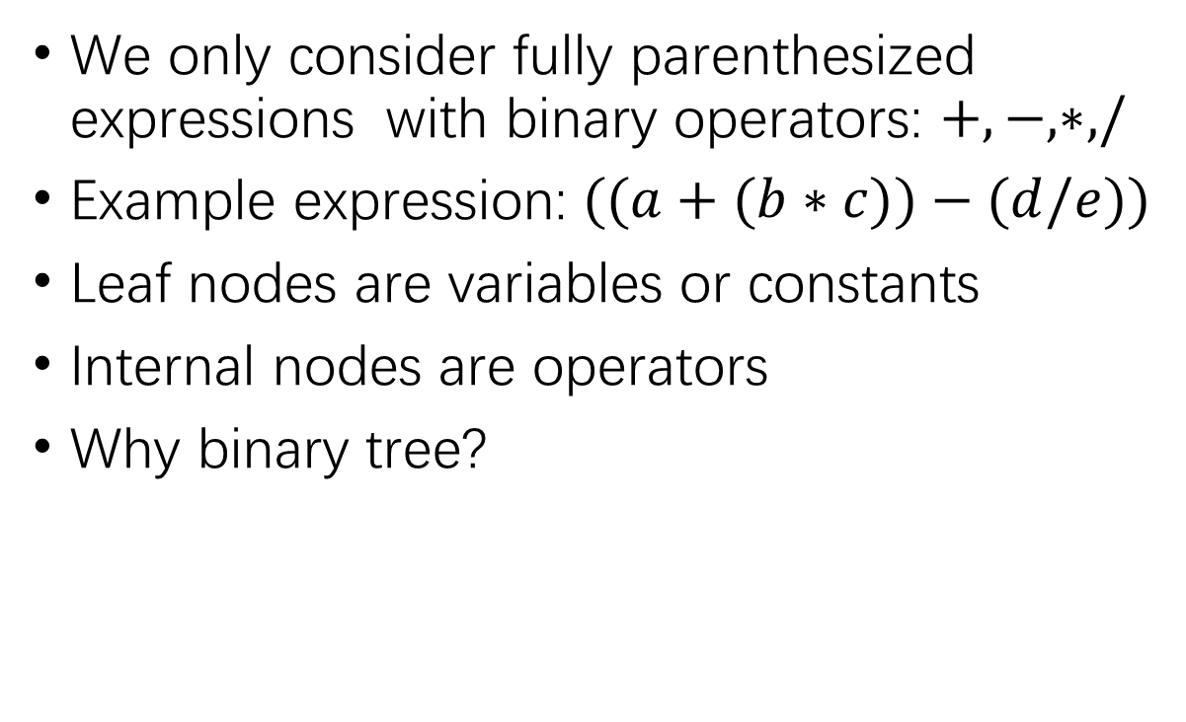
Algebraic Expression
We only consider fully parenthesized expressions with binary operators: $+, −, ∗, /$
Example expression: $((a+(b∗c))−(d/e))$
Leaf nodes are variables or constants
Internal nodes are operators
Why binary tree?
−
+
/
𝑎
∗
𝑑
𝑒
𝑏
𝑐

Slide 30
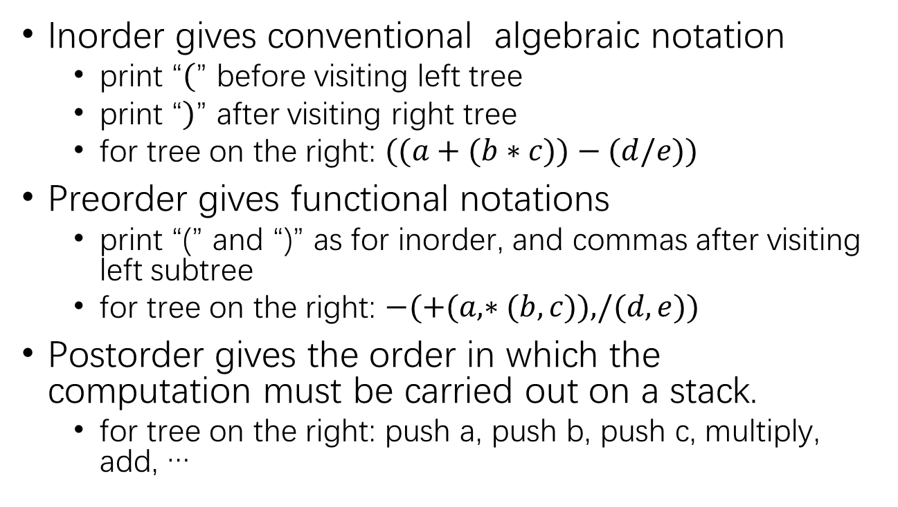
Algebraic-Expression Tree Traversal
Inorder gives conventional algebraic notation
print “$($” before visiting left tree
print “$)$” after visiting right tree
for tree on the right: $((a+(b∗c))−(d/e))$
Preorder gives functional notations
print “(” and “)” as for inorder, and commas after visiting left subtree
for tree on the right: $−(+(a,∗(b,c)),/(d,e))$
Postorder gives the order in which the computation must be carried out on a stack.
for tree on the right: push a, push b, push c, multiply, add, …
−
+
/
𝑎
∗
𝑑
𝑒
𝑏 𝑐

Slide 31
Character Encoding
A character encoding maps each character to a number
Computers usually use fixed-length character encodings
ASCII uses 8 bits per character
“bat” in computer: 01100010 01100001 01110100
Unicode uses 16 bits per character
ASCII codes are a subset
Fixed-length encoding are simple, because:
All character encodings have the same length
A given character always has the same encoding
Problem: fixed length encoding waste space
Solution: a variable-length encoding

Slide 32
Variable-Length Character Encodings
Variable-length encoding
Use encodings of different lengths for different characters
Assign shorter encodings to frequently occurring characters
Example: “test” would be encoded as:
00 01 111 00 → 000111100
Challenge: when decoding an encoded document, how do we determine the boundaries between characters?
For the above example, how do we know whether the next character is 2 bits or 3 bits
Requirement: no character’s encoding can be the prefix of another character’s encoding (e.g., cannot have encodings of ’00’ and ‘001’ at the same time)
e | 01 | s | 111
o | 100 | t | 00

Slide 33

Huffman Encoding
Huffman encoding is a type of variable-length encoding on the basis of the actual character frequencies in a given document.
Huffman encoding uses a binary tree:
to determine the encoding of each character
to decode an encoded file
Example:
Leaf nodes are characters
101 = ‘D’
“000110” = “EEEL”
0
306
1
186
120
E
0
79
1
107
0
1
65
1
33
1
0
42
37
U
42
D
L
0
Z | K | F | C
2 | 7 | 24 | 32
U | D | L | E
37 | 42 | 42 | 120
32
C
0
9
1
24
F
0
1
2
Z
7
K

Slide 34
Building a Huffman Tree
Begin by reading through the text to determine the frequencies
Create a list of nodes containing (character, frequency) pairs for each character that appears in text
Remove and merge the nodes with the two lowest frequencies, forming a new node as their parent
Add the parent to the list of nodes
Repeat steps (3) and (4) until there is only a single node in the list, which will be the root of the Huffman tree.
Example: build the Huffman tree for the following (character, frequency) pairs:
Z | K | F | C | U | D | L | E
2 | 7 | 10 | 12 | 27 | 31 | 43 | 65

Slide 35
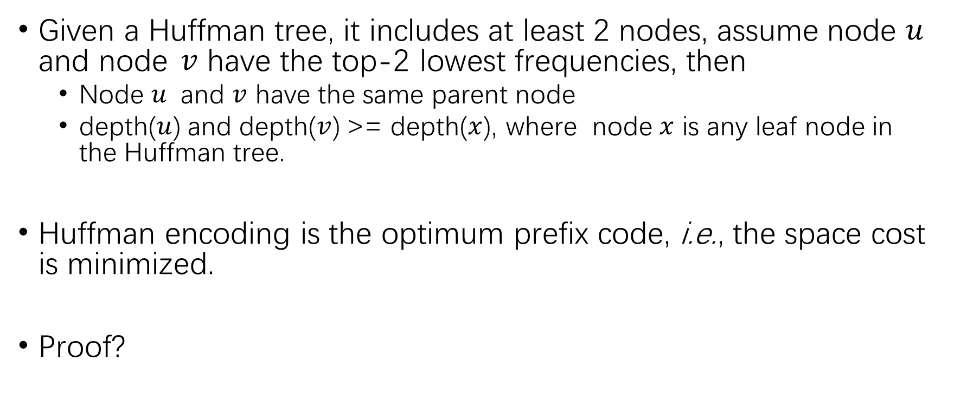
Correctness of Huffman Tree
Given a Huffman tree, it includes at least 2 nodes, assume node $u$ and node $v$ have the top-2 lowest frequencies, then
Node $u$ and $v$ have the same parent node
depth($u$) and depth($v$) >= depth($x$), where node $x$ is any leaf node in the Huffman tree.
Huffman encoding is the optimum prefix code, i.e., the space cost is minimized.
Proof?

Slide 36
Our Roadmap
Tree
Basic Concepts
Properties of Tree (focus on binary tree)
Binary Tree Traversal
Binary Tree Applications
Algebraic expression
Huffman encoding

Slide 37
Thank you

