Slide 1
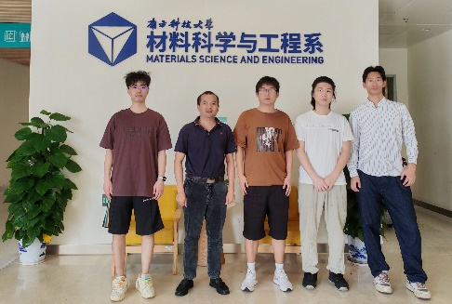

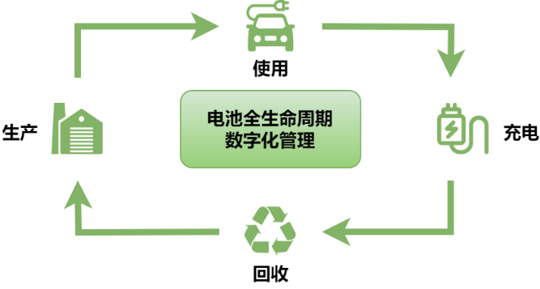
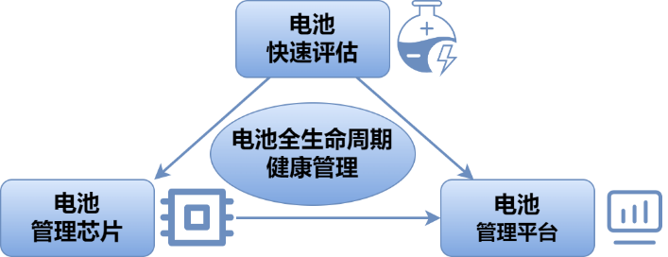
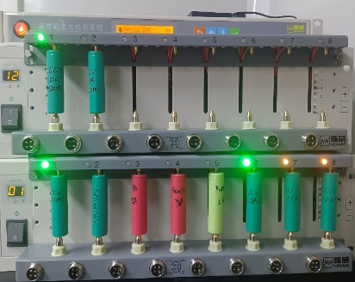
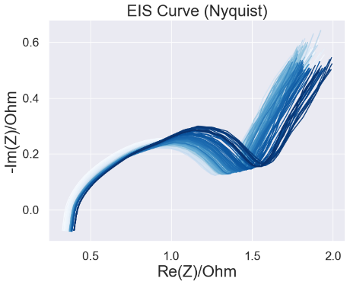
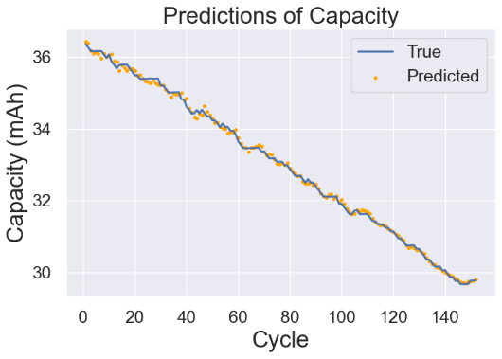
项目小组
学术导师
企业导师
王浩羽
徐涵
李宗润
许家豪*
卢周广
高源
宋轩
袁飞
合作企业
深圳树米网络科技有限公司
电池全生命周期健康管理系统设计
锂电池在新能源汽车等领域应用规模日渐庞大，对于电池健康状态的监测和管理无疑是一项重要的工作。本项目旨在利用电池的特征数据，通过深度神经网络（DNN）预测电池的容量并计算健康状态（SOH），并结合历史容量数据预测电池的剩余使用寿命（RUL）。项目创新性地结合锂电池的充放电曲线以及电化学阻抗谱（EIS）协同完成容量预测任务，在多个数据集上均取得较好的预测结果。
项目团队由材料学与电化学方向、微电子与芯片设计方向、计算机科学与工程方向的三个子团队构成。材料学与电化学团队使用电化学工作站对电池的充放电曲线与电化学阻抗谱进行测量并提供微观/宏观电化学机理的解释；微电子团队负责芯片的设计与制造，芯片集成了多种关键指标的测量功能；计算机团队利用测得的数据设计、验证模型并将模型部署至电池智慧管理平台上。
项目团队测量多组18650锂电池及纽扣电池的充放电曲线、电化学阻抗谱及容量下降曲线。深度神经网络容量预测模型及时间窗口回归模型在上述数据集和开源数据集上均取得最大平均相对误差（MRE）小于2%的优良预测结果。同时，微电子团队设计出先进的测量芯片，计算机工程团队设计并开发嵌入预训练模型的电池健康管理平台。
图1 电池全生命周期数字化管理
图2 跨学科团队协同合作
图3 电化学工作站
图4 自测量的电池电化学阻抗谱
图5 电池容量下降曲线与预测结果

Slide 2
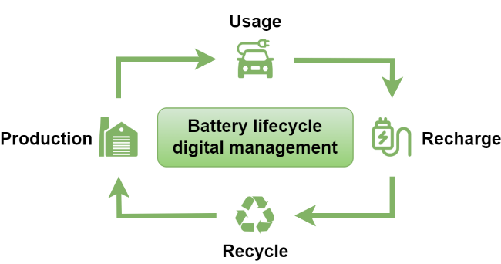
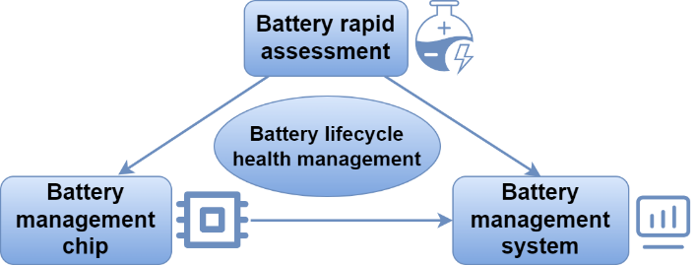
TEAM
ACADEMIC
ADVISOR
INDUSTRIAL ADVISOR
Haoyu Wang
Han Xu
Zongrun Li
Jiahao Xu*
Zhouguang Lu
Yuan Gao
Xuan Song
Fei Yuan
SPONSOR：
Shumi Network Technology Co., Ltd
Battery Lifecycle Health Management System
The scale of lithium-ion battery applications in fields such as new energy vehicles is rapidly expanding, making the monitoring and management of battery health crucial. The project aims to utilize battery characteristic data to predict the capacity with an approach of deep neural networks (DNNs), and to forecast the remaining useful life (RUL) by combining historical capacity data, subsequently. The project innovatively combines lithium-ion battery charge-discharge curves with electrochemical impedance spectroscopy (EIS) to accomplish capacity prediction tasks, achieving satisfactory results on multiple datasets.
Our team consists of three sub-teams: materials science and electrochemistry, microelectronics and chip design, and computer science and engineering. The materials science and electrochemistry team measures battery charge-discharge curves and EIS profiles with electrochemical workstations and provides micro/macro electrochemical mechanisms explanations. The microelectronics team is responsible for chip design and fabrication, integrating multiple measurement functions for key indicators. The computer team designs and validates models, and deploys them to the battery intelligent management platform.
We measure abundant charge-discharge curves, EIS profiles, and capacity degradation for multiple sets. The deep neural network capacity prediction model and time-window regression model achieve a remarkable performance, demonstrating their effectiveness and reliability. Meanwhile, the microelectronics team designs advanced measurement chips, and the computer engineering team deploys pre-trained models to a self-designed battery management platform.
Fig.1 Battery lifecycle disposal route
Fig.2 Interdisciplinary team cooperation
Fig.3 Electrochemical workstation
Fig.4 Self-measured EIS profiles of battery
Fig.5 Battery capacity decline curve and predicted results

