Slide 1
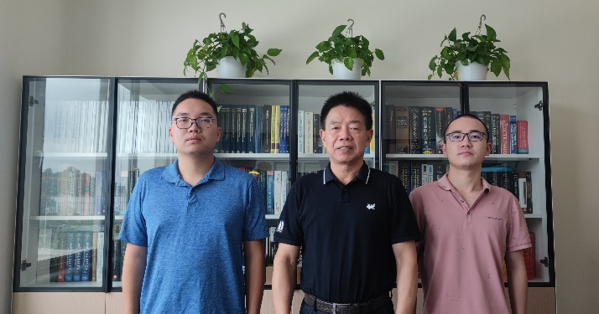

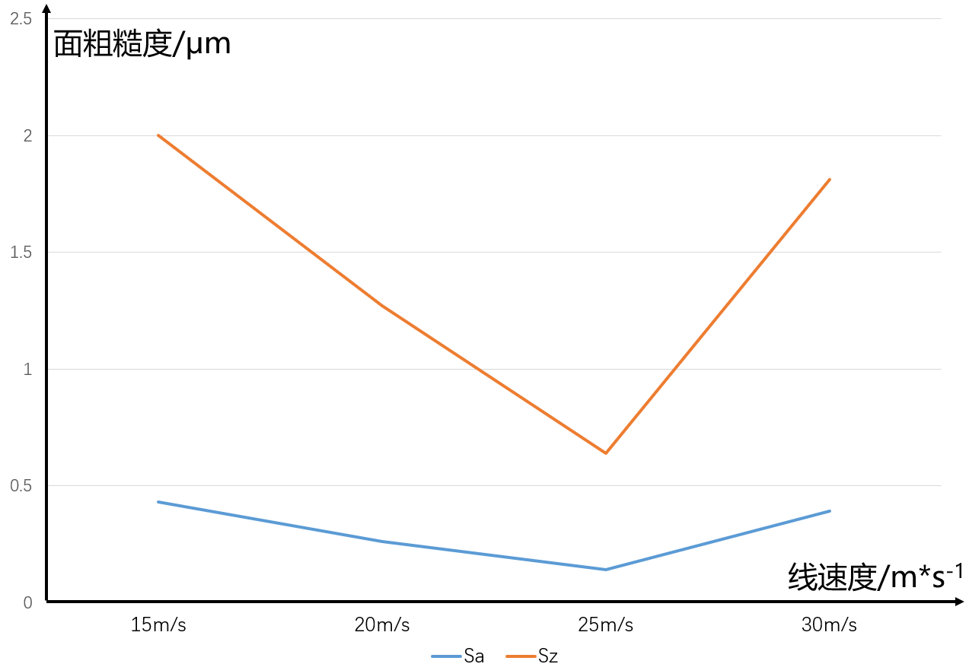
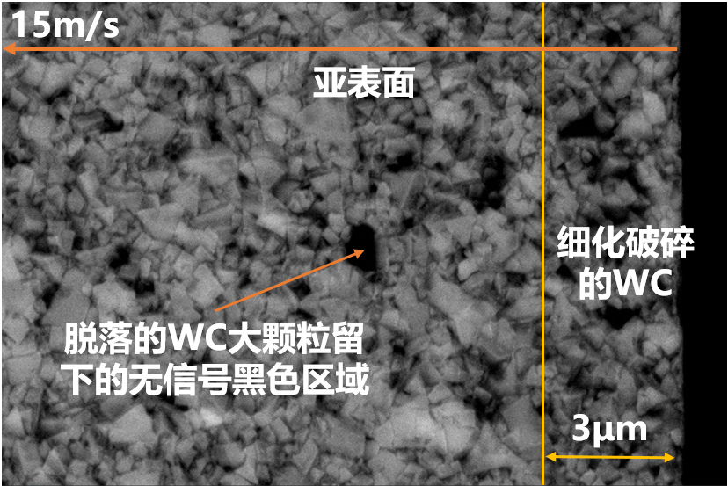
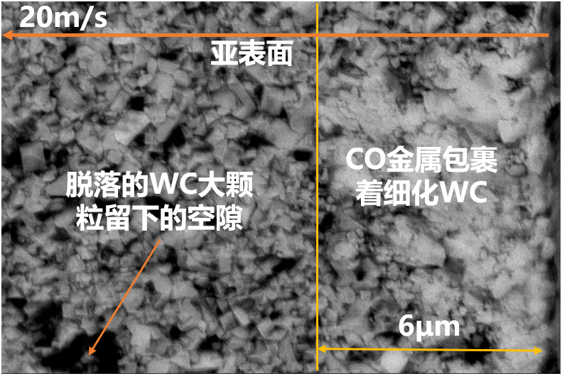
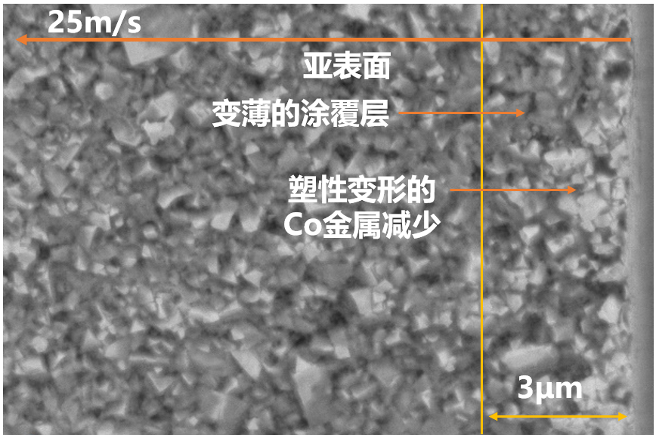
项目小组
学术导师
何孟俯
苏田森
张 璧
合作企业
企业导师
深圳市鑫金泉精密技术有限公司
任冠辉
应用于硬质合金铣刀的工艺窗口优化以及损伤规律探究
由碳化钨和金属钴组成的硬质合金在各种精密机械加工中被广泛应用，具有高硬度和低化学活性的优点。磨床砂轮是加工硬质合金的主要工具，为了应对硬质合金的高硬度特性，通常采用树脂金刚石砂轮进行高效磨削。目前，国产硬质合金铣刀在市场份额上相对较小，大部分销售份额被国外厂商占据。国产硬质合金铣刀存在刀具寿命不稳定的问题，并且传统的铣刀加工工艺流程很少考虑亚表面损伤的问题。
本项目针对铣刀磨削工艺进行了优化，涉及砂轮的选择、铣刀参数的确定、五轴磨床的磨削流程、刀具亚表面深度的观测以及烧伤点元素分析等方面。我们使用了超景深显微镜、激光共聚焦显微镜、扫描电镜（SEM）等仪器来检测磨削结果。通过增加工艺步骤和确定磨削因素对表面粗糙度和亚表面深度的影响，初步优化了铣刀工艺流程。
本项目针对不同的铣刀刃口改变了磨削参数，并进行了粗糙度检测。我们根据不同的磨削参数对刀具进行了模具钢的实验，得到了刀具表面和被加工表面之间的对应关系。同时，我们还观测了不同表面粗糙度下的亚表面损伤，并得出了亚表面损伤随参数变化的趋势。
表1 硬质合金表面质量观测及效果
 | 指标 | 趋势 | 效果
1 | 表面粗糙度 | 随速度先减小后增大，存在最小值。 | 决定了被加工表面粗糙度。
2 | WC破碎程度 | 随速度先减小后增大，趋势基本和粗糙度一致。 | 代表着亚表面裂纹密集程度。
3 | 涂覆层 | 低速时不存在，随着速度增加逐渐变薄。 | 一定程度上保护亚表面。
图1 表面粗糙度随磨削速度变化图
图2 亚表面损伤随磨削速度变化图

Slide 2

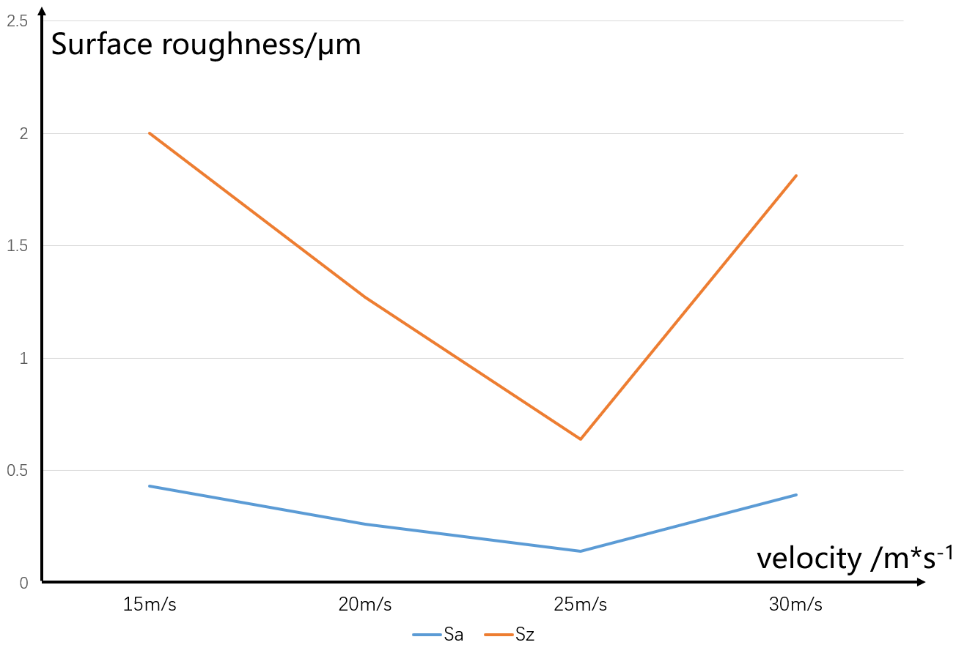
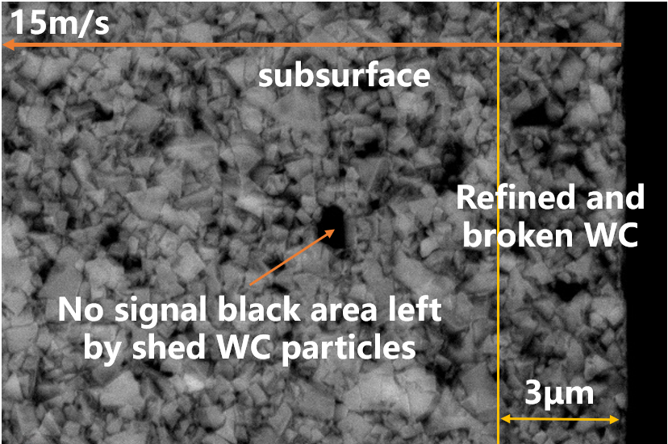
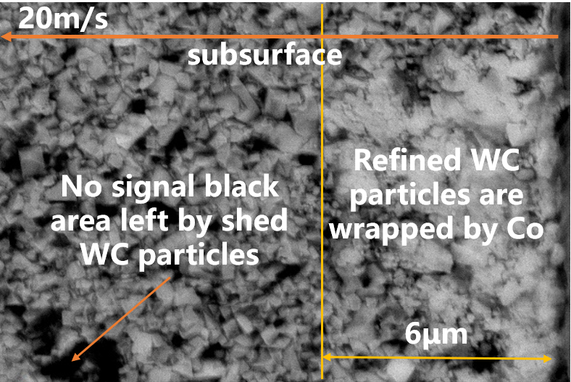
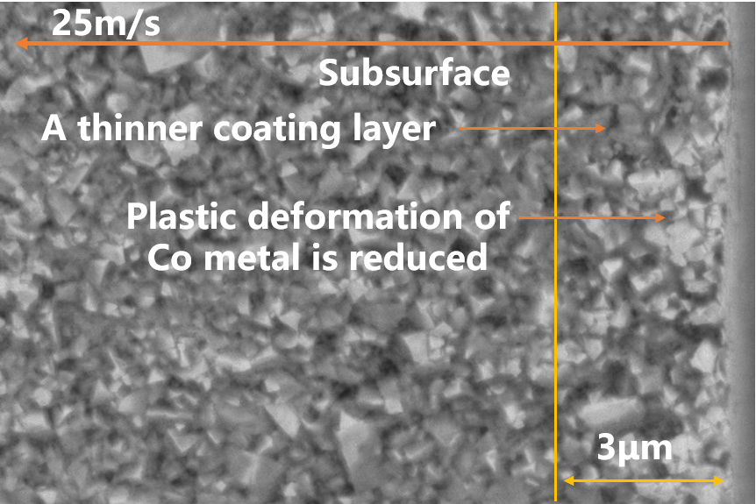
TEAM
ACADEMIC
ADVISOR
INDUSTRIAL ADVISOR
Mengfu He
Tiansen Su
Bi Zhang
Guanhui Ren
SPONSOR：Frontier Manufacturing Science Laboratory
Optimization of Process for Carbide Milling Cutter and Investigation of Subsurface Damage
Cemented carbide, composed of tungsten carbide and cobalt, is widely utilized in various precision machining applications due to its high hardness and low chemical reactivity. Grinding wheel is the primary method employed for machining cemented carbide. To address the challenge of its high hardness, resin diamond wheels are commonly employed for efficient grinding. However, the domestic market share of cemented carbide milling cutters is relatively small, with foreign manufacturers capturing the majority of sales. Domestic cemented carbide milling cutters suffer from issues such as unstable tool life, and traditional milling cutter machining processes often neglect the problem of subsurface damages.
This study focuses on optimizing the grinding process of milling cutters by considering factors such as grinding wheel selection, determination of milling cutter parameters, grinding process optimization, tool subsurface observation, and stain element analysis. The grinding results are analyzed using instruments such as ultra-deep field microscopes, laser confocal instruments, and SEM scanning electron microscopes. By introducing additional process steps and investigating the influence of grinding factors on surface roughness and subsurface damage depth, the milling cutter process flow is optimized.
Furthermore, this project introduces variations in grinding parameters based on different cutting edges of the milling cutter and conducts roughness testing accordingly. Different grinding parameters are applied in corresponding grinding experiments using die steel, allowing for the establishment of a relationship between the tool surface and the machined surface. Additionally, observations are made on subsurface damage for different surface roughness values, revealing the trend of subsurface damage with respect to the parameter variations.
Table.1 Evaluation indicators and effects
 | Index | Variation trend | Function
1 | Surface roughness | As the velocity decreases and it increases. | It determines the roughness
2 | Degree of WC frag-mentation | The trend is basically consistent with the roughness. | It represents subsurface crack density.
3 | Coating layer | It gradually becomes thinner as speed increases. | It protects the subsurface.
Fig.1 Surface roughness variation with grinding speed
Fig.2 Subsurface damage variation with grinding speed

