Slide 1
2024-3-19

Slide 2

Intro
Two Models:
LeNet5
MyModel1: CNN model, more complex that LeNet5
Three Datasets
MNIST
Fashion-MNIST
CIFAR-10 only (for MyModel1 only)
Encoder and Decoder
MLP only
Two pairs of hyper-params with experimental ranges of loss device number
K: 2; R: 1 -> loss number: 0 ~ 3
K: 4, R: 2 -> loss number: 0 ~ 6

Slide 3
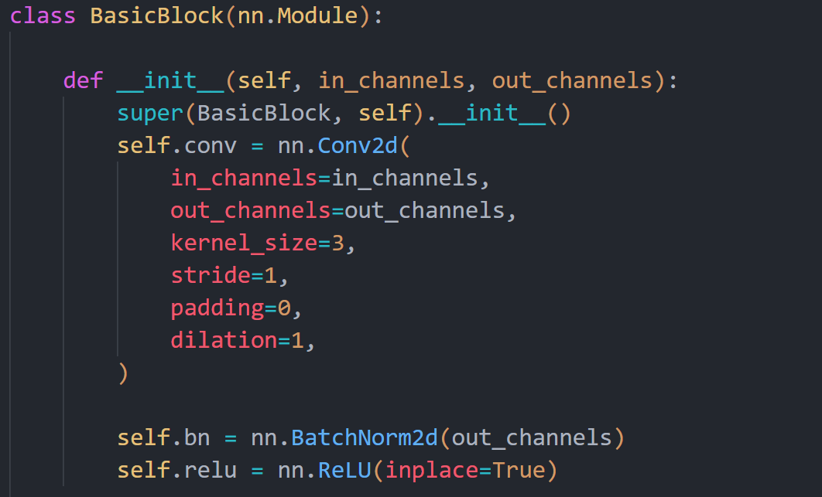
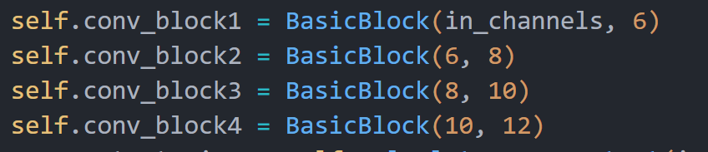
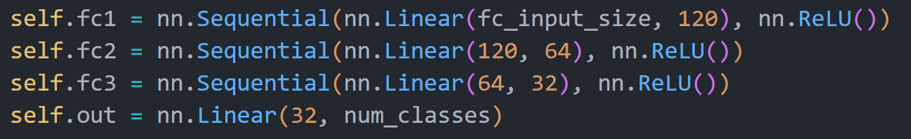
MyModel1

Slide 4
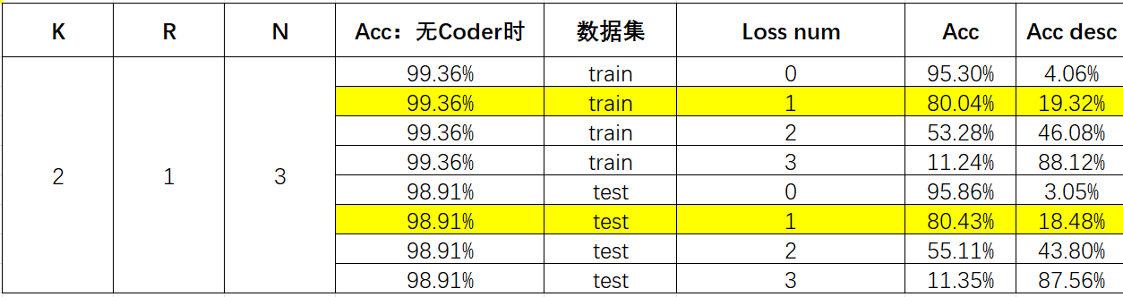
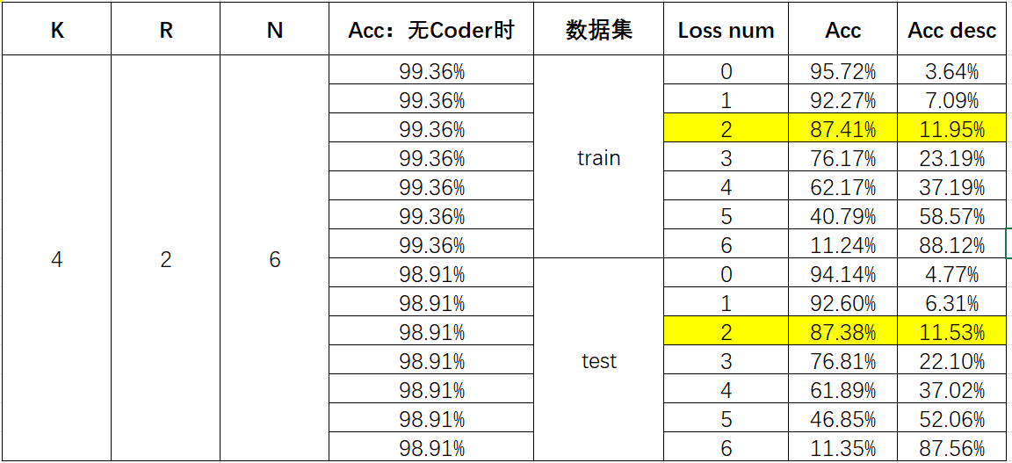
Experimental Results
Model: LeNet5
Dataset: MNIST

Slide 5
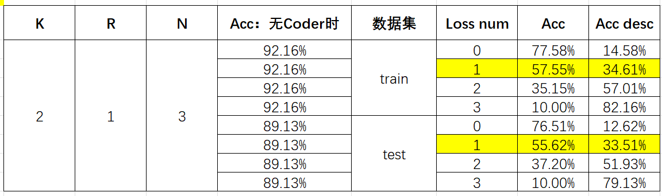
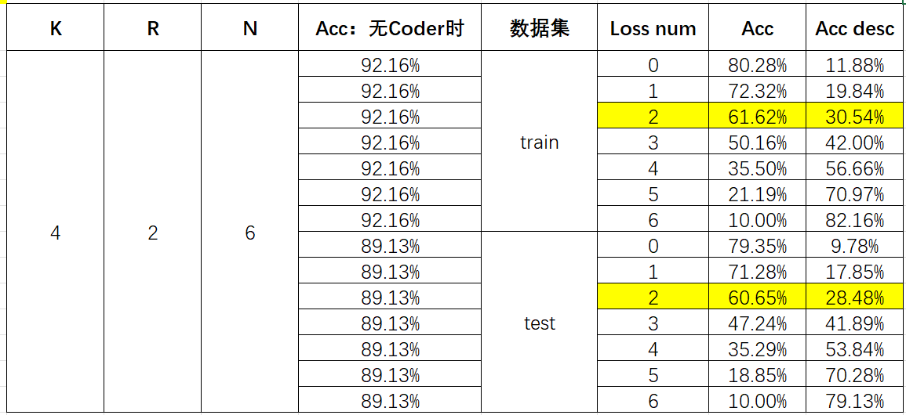
Experimental Results
Model: LeNet5
Dataset: Fashion-MNIST

Slide 6
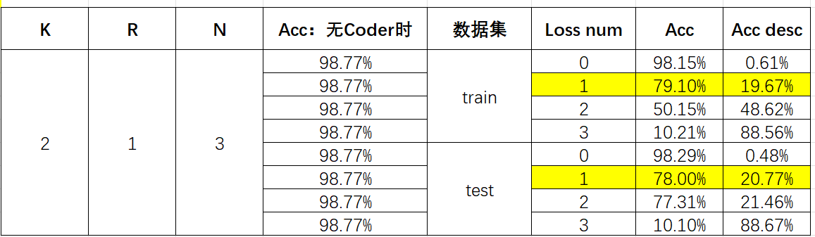
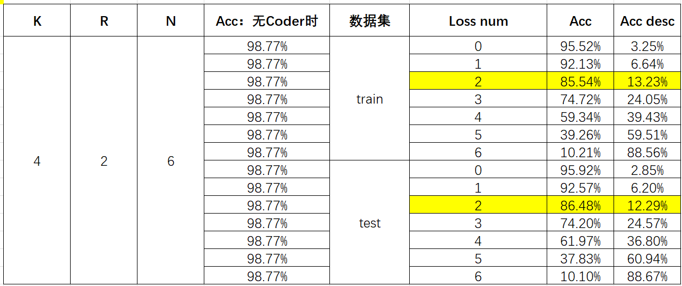
Experimental Results
Model: MyModel1
Dataset: MNIST

Slide 7
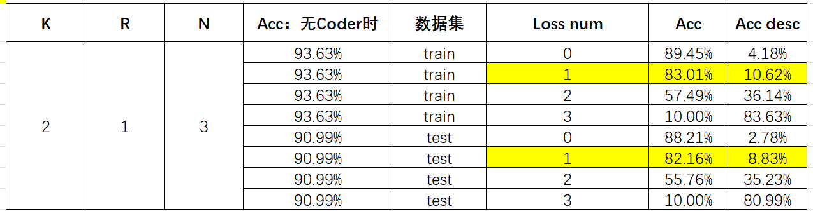
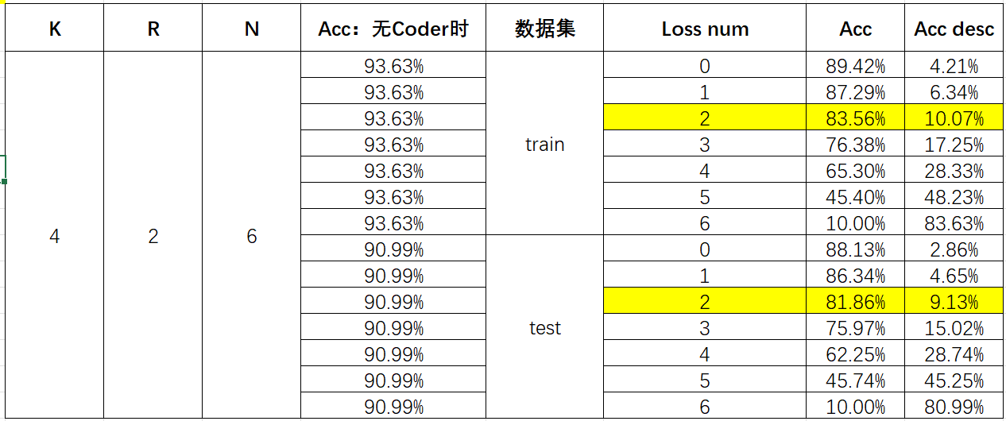
Experimental Results
Model: MyModel1
Dataset: Fashion-MNIST

Slide 8
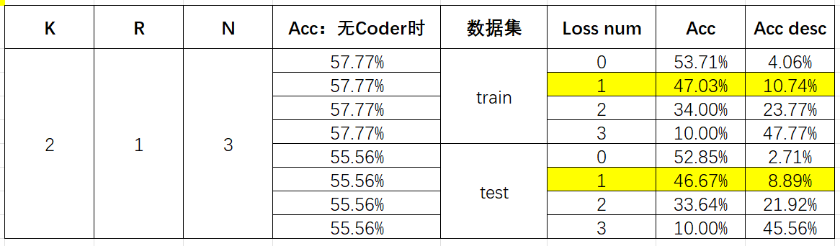
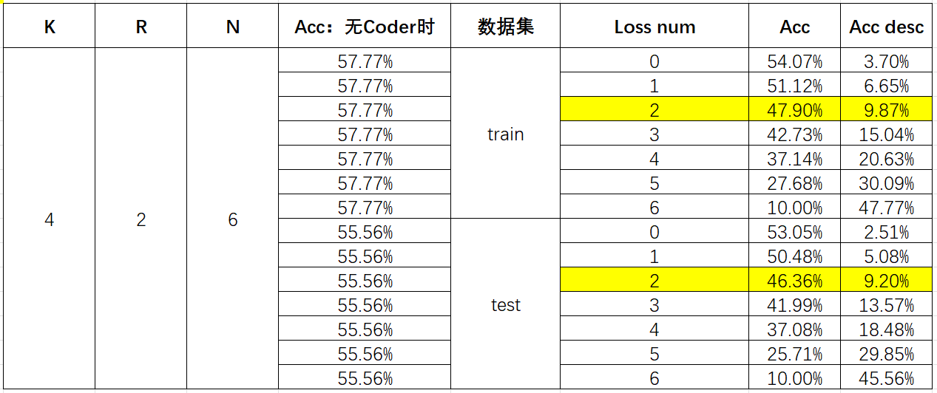
Experimental Results
Model: MyModel1
Dataset: CIFAR-10

Slide 9
Next
先写论文，其他再说；
再摸出来1个模型跑实验，ResNet直接放弃，Vgg16可以一试；
现在都是用MLP的编解码器，需要Conv结构的编解码器的实验
考虑额外的结构
问题：
自己随便搞的模型怎么写在论文中，需不需要很详细
之前写的 Conv 结构的编解码器实验效果不太好，需要再研究一下

Slide 10
THANK YOU!

Slide 11
Subtitle
强调文字
正文

