Slide 1
Apache vs. Nginx
By Haoyuan Xia
4/20/2017

Slide 2

Apache
Apache HTTP Server
Originally based on the NCSA HTTPd Server
Development of Apache began in early 1995
Became the world’s most used web server software
Developed and maintained by an open source community
Notes:
The Apache HTTP Server, usually called Apache (/əˈpætʃiː/ ə-pa-chee), is the world's most used web server software. Development of Apache began in early 1995. Apache played a key role in the initial growth of the World Wide Web\. In 2009, it became the first web server software to serve more than 100 million websites.^{[6]}
Apache is free and open-source software. Most commonly used on a Unix-like system (usually Linux),^{[7]} the software is available for a variety of operating systems besides Unix, including Microsoft Windows.

Slide 3
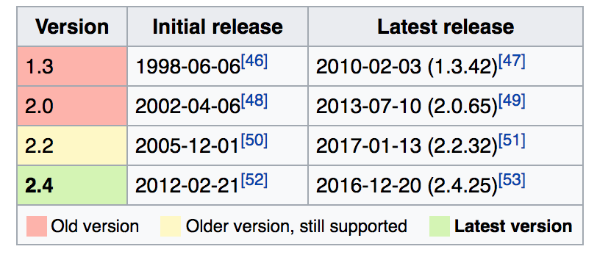
Features
Supports features which extend the core functionality
From server-side programming language support to authentication schemes
Provides a variety of multi-processing modules including process model, worker model and event model.
Notes:
Apache supports a variety of features, many implemented as compiled modules which extend the core functionality. These can range from server-side programming language support to authentication schemes.
Instead of implementing a single architecture, Apache provides a variety of Multi Processing Modules (MPMs), including ……. They allow Apache to better match the demands of each particular infrastructure.

Slide 4

Nginx
Nginx is another web server, which can also be used as a reverse proxy, load balancer and HTTP cache.
A free and open source software
Created in 2004, supported by Nginx Incorporated

Slide 5
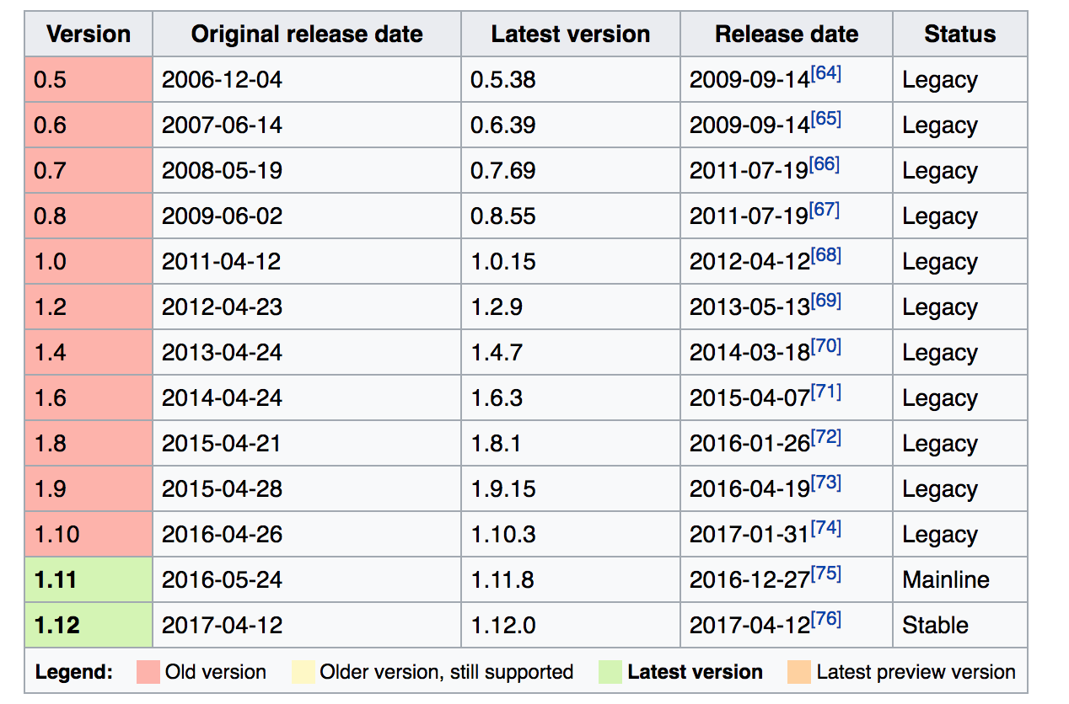
Features
Nginx has a variety of new features
Server dynamic HTTP content
Asynchronous event-driven approach
Notes:
Nginx has a variety of new features.
NGINX uses an asynchronous, event-driven architecture to handle massive amounts of connections, so that it can handle at least 10,000 simultaneous client connections on a single server.

Slide 6
Request Processing Difference
Nginx was written to outperform the Apache web server.
In terms of event model, Apache creates one listener thread passes them to a worker thread for processing, while Nginx does not set up extra worker processes per connection in order to maximize the hardware’s efficiency.
Notes:
The main difference between NGINX and Apache, in terms of the event models, is that Apache creates one listener thread which listens for connections and passes them to a worker thread for processing, while NGINX does not set up extra worker processes per connection. In most cases, Nginx runs one worker process per CPU, maximizing the hardware’s efficiency.

Slide 7
Performance Comparison
Static content: Nginx serves static content much faster than Apache
Dynamic content: performances of them are very similar
Flexibility: Apache has had dynamic module loading for a long time. For Nginx, most modules do not yet support dynamic loading.
Nginx is better to handle massive concurrent connections.
Notes:
For static content, NGINX is about 2.5 times faster than Apache. If you need to serve a lot of static content at high concurrency levels, NGINX can be a real help.
For dynamic content, the performance difference is quite slim.
Apache has had dynamic module loading for the longest time, so all Apache modules support this. In the beginning of 2016, NGINX got support for dynamic module loading, but most modules do not yet support dynamic loading.
What’s more, Nginx is better to handle massive concurrent connections.

Slide 8
Thanks

