Slide 1




BIDS to NiftyTorch: data preparation for deep learning
Farshid Sepehrband, PhD
INI Microstructural imaging Group (IMG)
USC Stevens Neuroimaging and Informatics Institute
Keck school of Medicine, University of Southern California, Los Angeles

Slide 2
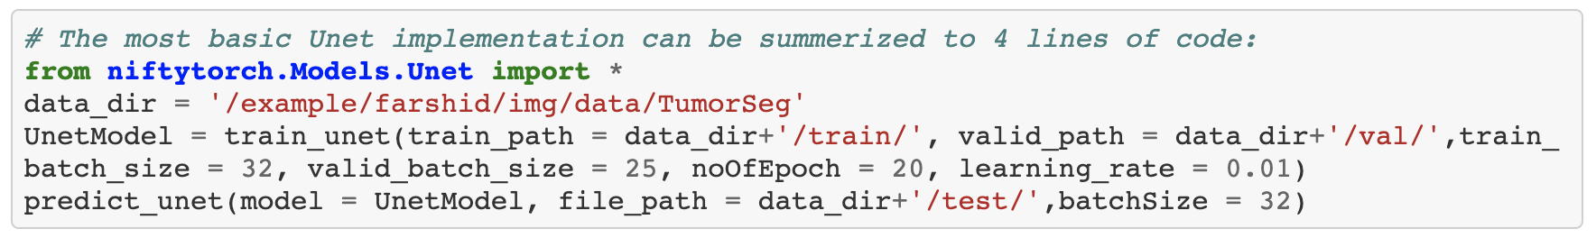
A Python API for deploying deep learning for Neuroimaging research.
Goal: to simplify the deep learning deployment, so neuroimaging researchers can spend less time on coding and focus on their research question. For example:
Deep learning requires specific data preparation, different from conventional image processing technique at subject level. For example, data should randomly split into training and testing, while maintaining balanced study groups.
In this year’s OHBM BrainHack we aim to develop code snippets to prepare and evaluate a given BIDS dataset for deep learning using NiftyTorch.

Slide 3
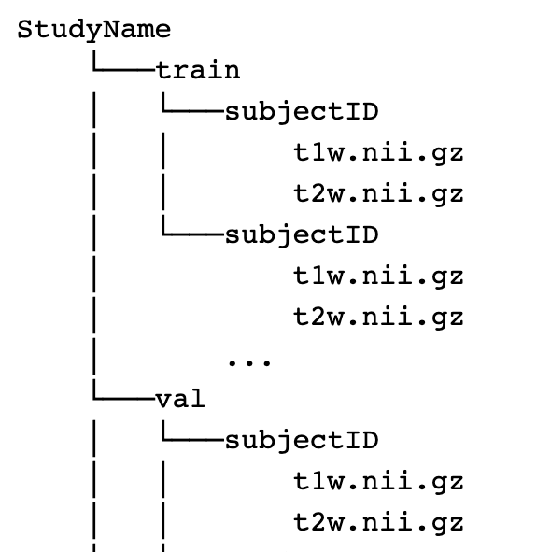
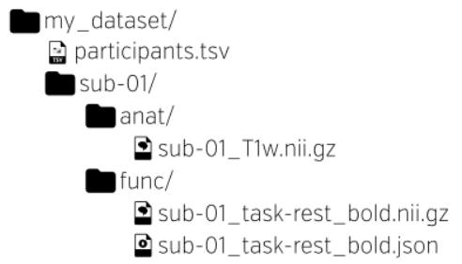
NiftyTorch BrainHack tentative plan
Train / validation generator
Goal: to write a Bash/Python code that takes BIDS dataset and create training and validation folders for deep learning
Dataset evaluator (identify missing)
Goal: to write a Bash/Python code that generates a summary of the imaging data and identify missing data and report class distribution
Quality Assessment
Goal: to write a Bash/Python code that assess the quality of each image and create a summary report. e.g. SNR, CNR, motion …
Additional preprocessing
Goal: to write a Bash/Python code that modify the input data for deep learning. E.g. cropping background and alignment

Slide 4
Resources
BIDS: https://bids.neuroimaging.io
NiftyTorch: https://niftytorch.github.io/doc/
Chat room: https://mattermost.brainhack.org/brainhack/channels/hbmhack-niftytorch
Video chat: Zoom link to be shared via mattermost channel
Practice data: An OpenNeuro data will be use: https://openneuro.org/
Requirement: we recommend installing Python: https://www.anaconda.com/products/individual
Happy Hacking

