Slide 1
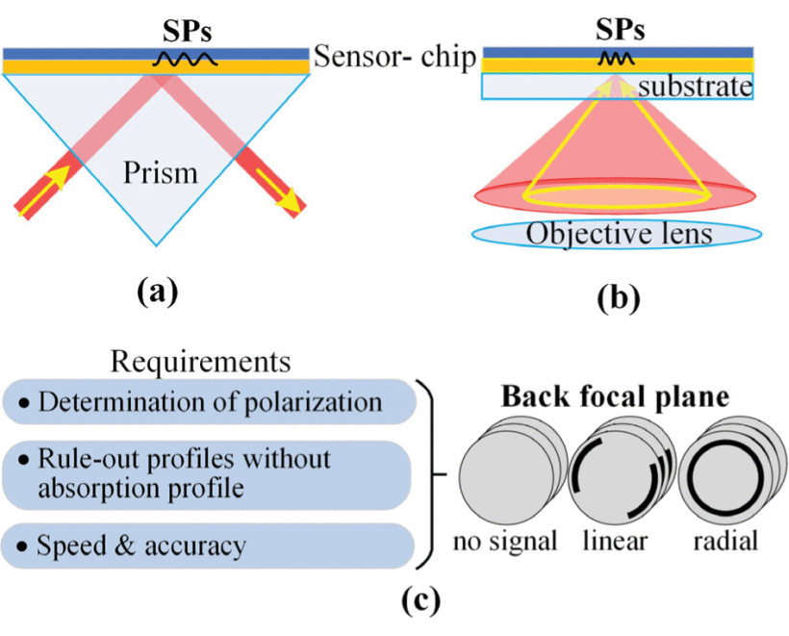
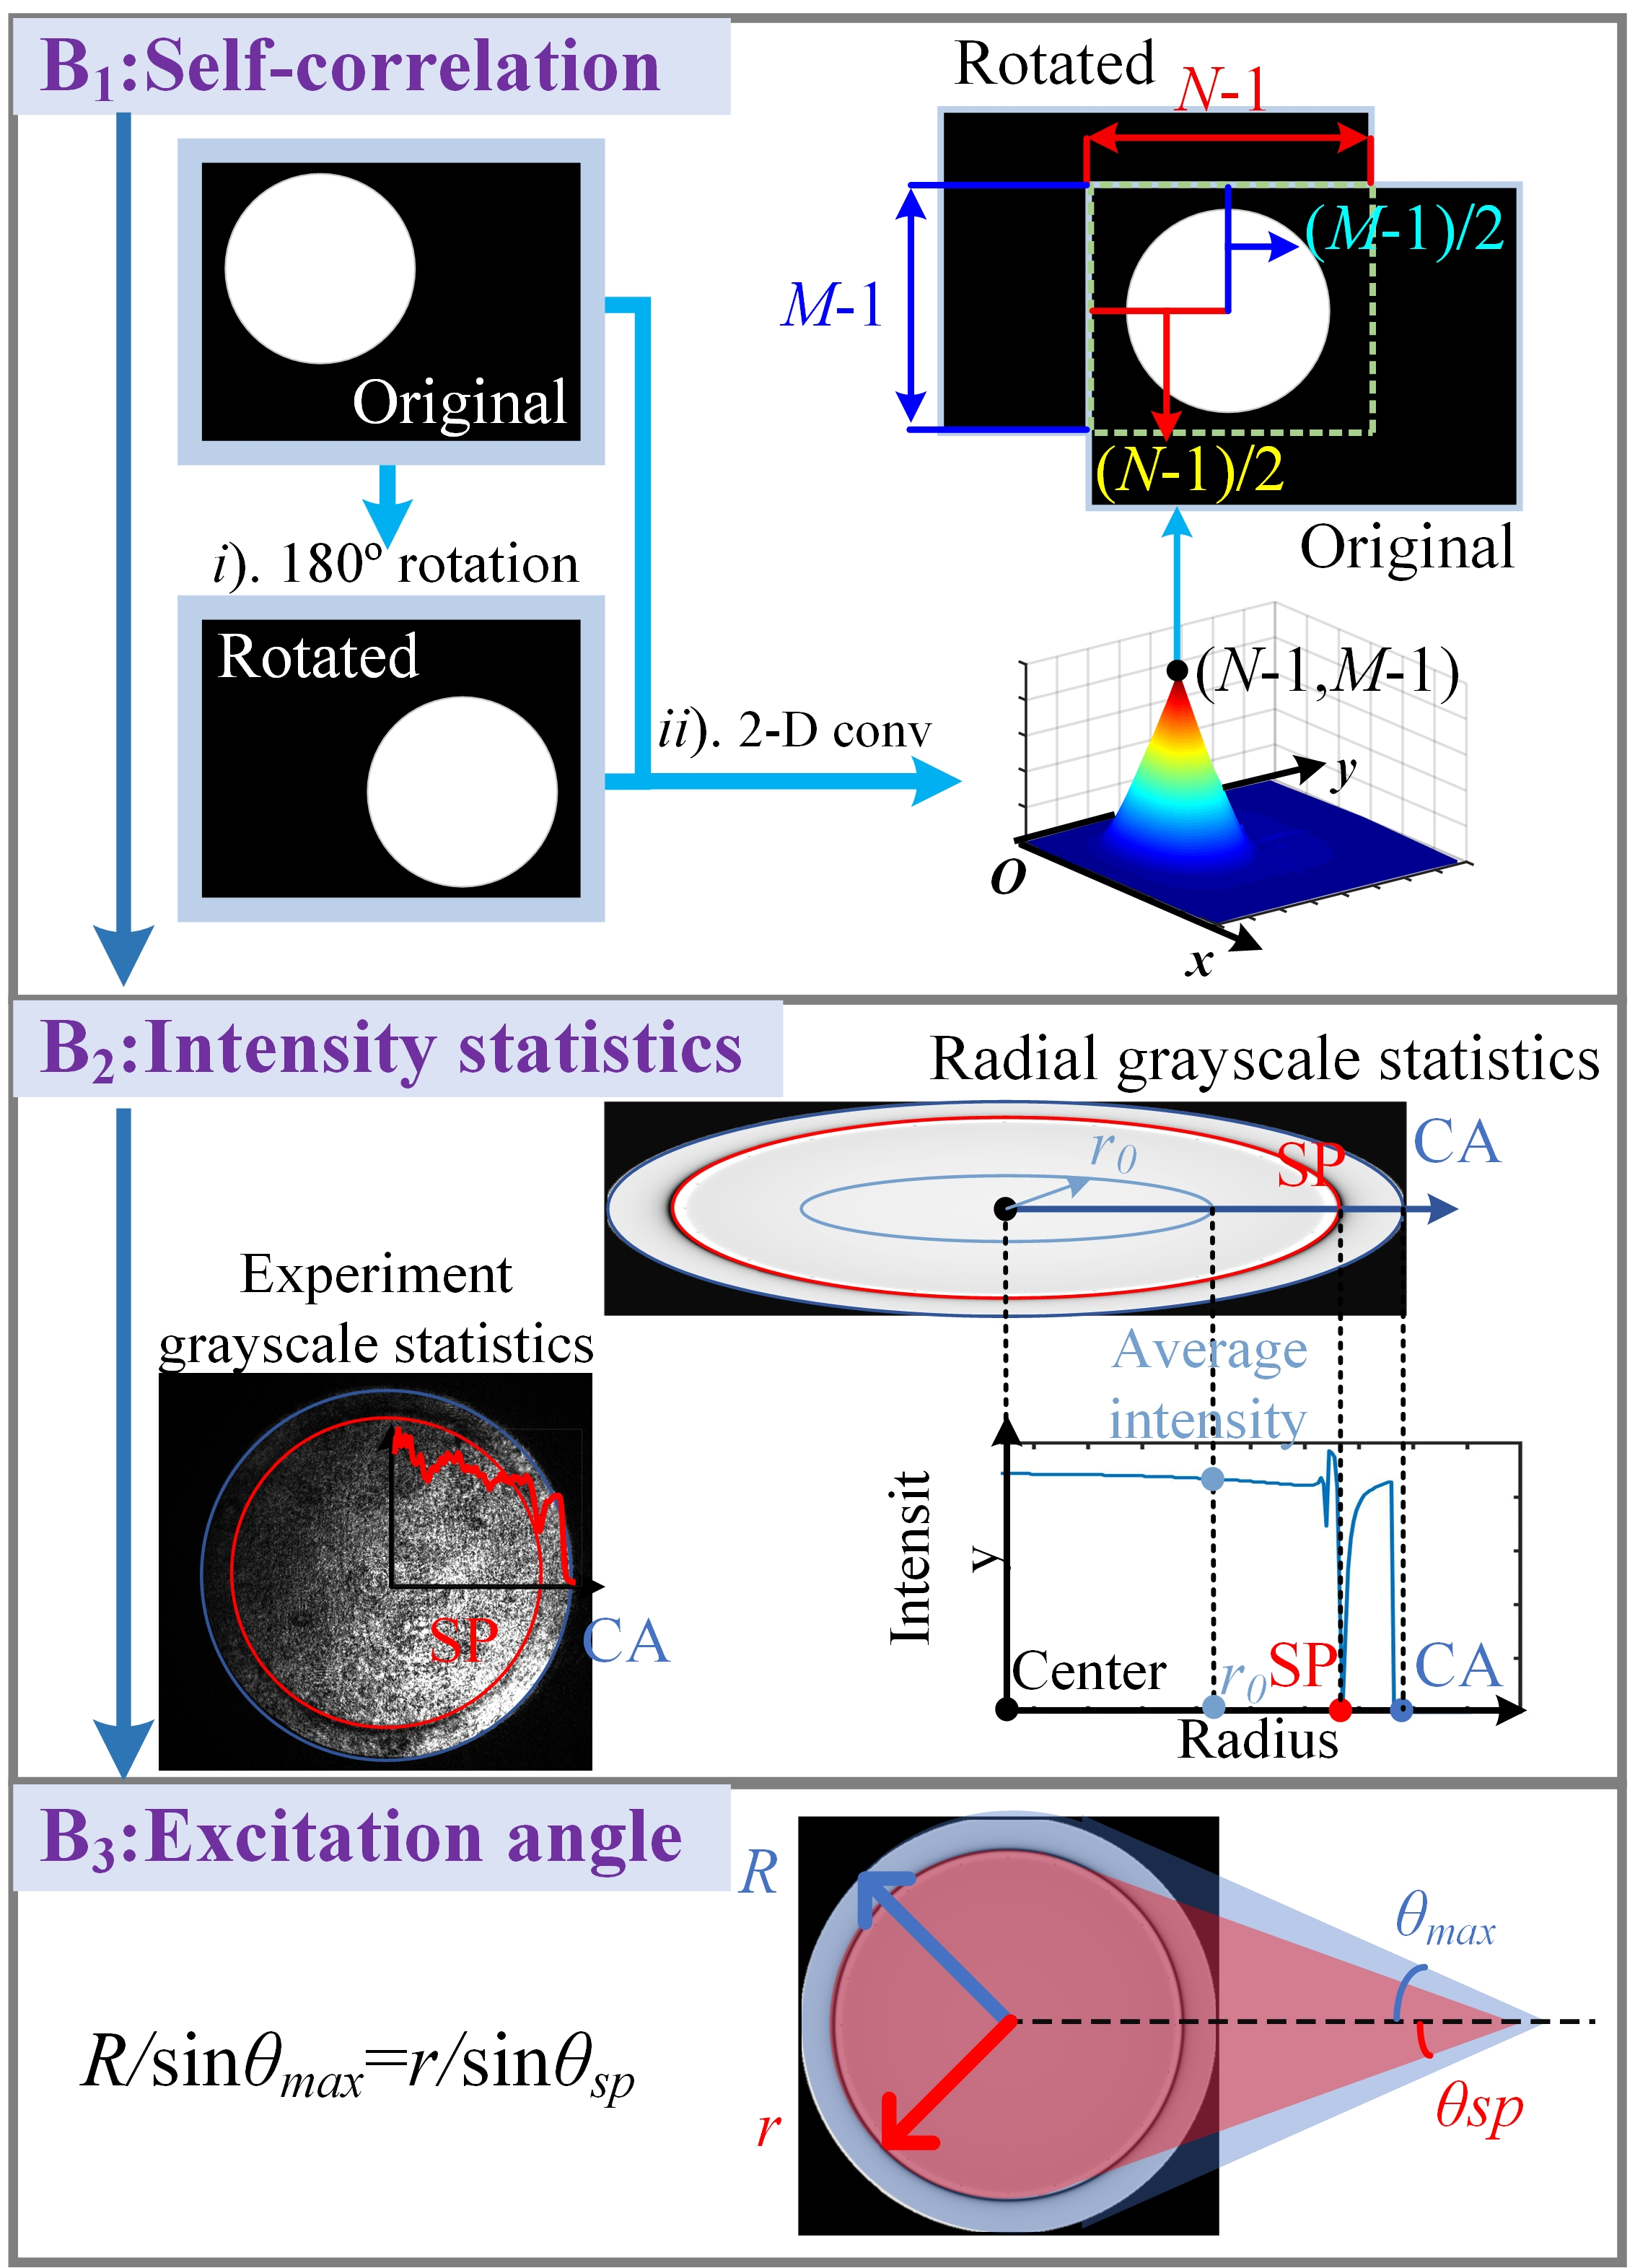
Object
Detection Network
θ_{sp}
θ_{max}
Self-
-Correlation
&
Greyscale Statistics
R
r

Slide 2
