Slide 1



Obstacle Avoidance Trajectory Planning for Gaussian Motion of Robot Based on Probability Theory
Student Name Haozheng Li
Yiyang Bian
Date: 11/10/2021

Slide 2
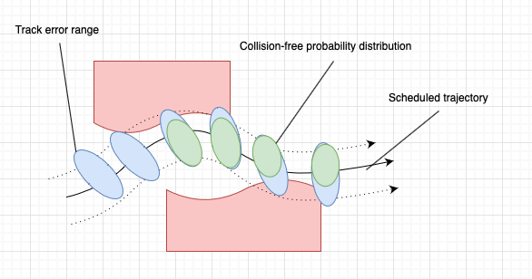
Introduction
The linear control method is used in
combination with Kalman filter to establish
error model of Gaussian motion system.
Then, all feasible trajectories are assessed
by the Gaussian motion model by
calculating the probability of avoiding
obstacles and arriving at the target.

Slide 3
Introduction
The total project will be executed in two stages:
Stage 1
Using the Gaussian distribution in probability
theory is to analyze the motion of the robot on
the predetermined trajectory, and the motion
error distribution in each cycle is analyzed to
calculate the collision probability between the
robot and the obstacle at different moments.
Stage 2
On the basis of the stage 1 experiment, the
robot is assigned multiple trajections, and the
robot searches for the optimal trajectory
according to the collision probability of different
trajections.

Slide 4
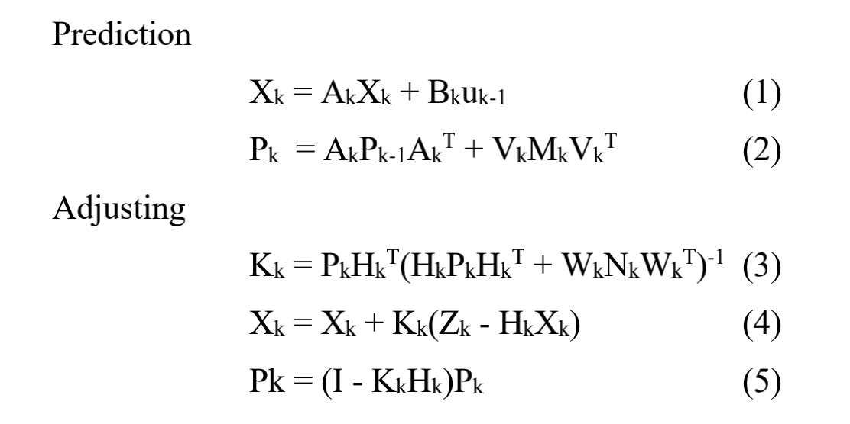
Priori Estimation of Trajectory Error Distribution
Due to the errors in the process of robot movement, the
position deviation between the actual output of the system and
the system instruction is subject to Gaussian distribution in
each control cycle. And because the observation system also
has observation noise subject to Gaussian distribution, the
deviation state of robot trajectory cannot be accurately
reflected. Therefore, moving Kalman filter can effectively
estimate the position of the robot.
The KF process has two steps, namely:
* Prediction step: the next step state of the system is predicted given the previous measurements
* Update step: the current state of the system is estimated given the measurement at that time step
Xk is the optimal estimation of the system state within the
k cycle, and Pk is the covariance estimation of the system state.
Kk is Kalman gain matrix

Slide 5
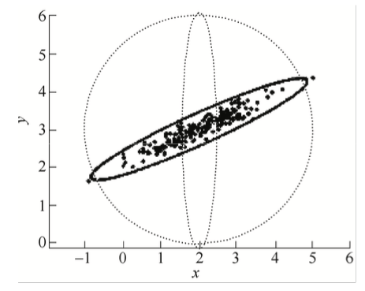
Collision probability calculation
Gaussian motion probability ellipse representation
After we obtained the normal distribution variance of the robot trajectory points in each control cycle. The probability ellipse can be used to represent the distribution of variance.
Notes:
Through the iteration of the trajectory modeling and estimation process in last section, the normal distribution variance of the robot trajectory points in each control cycle is obtained. The probability ellipse can be used to represent the distribution of variance. As in the figure, random points that obey the normal distribution with an expected variance of are distributed, and each random point represents a possible position of a robot.

Slide 6

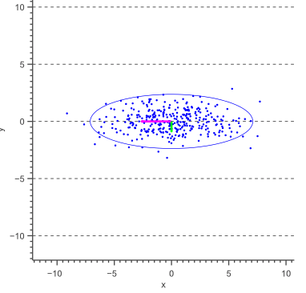

Collision probability calculation
Gaussian motion probability ellipse representation
In the motion probability ellipse, the length of the axes is defined by the standard deviations and of the data. Then choose s and let the scale of the resulting ellipse represents a chosen confidence level.
Notes:
The equation of an axis-aligned ellipse with a major axis of length and a minor axis of length , centered at the origin, is that.
where S defines the scale of the ellipse and could be any arbitrary number. such that the scale of the resulting ellipse represents a chosen confidence level.Our data is sampled from a multivariate Gaussian with zero covariance. This means that both the x-values and the y-values are normally distributed too.

Slide 7
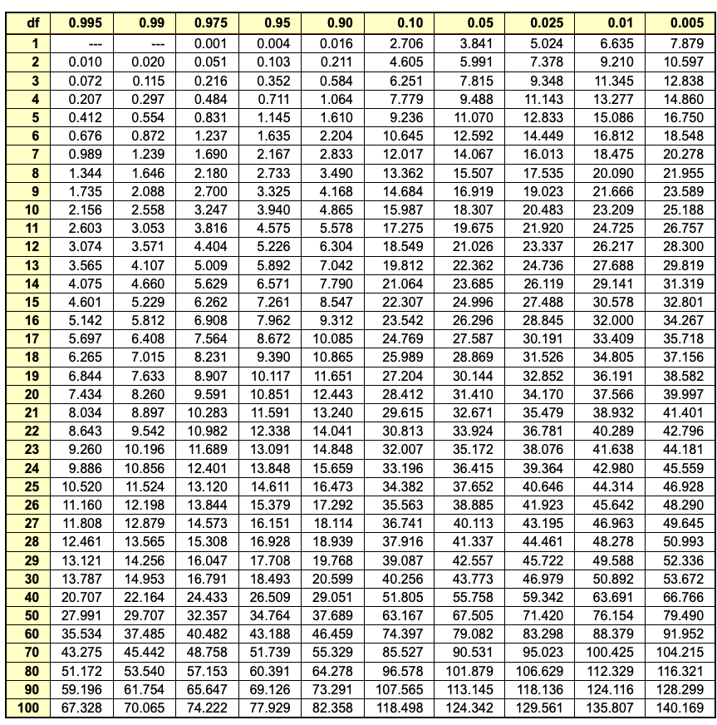
Collision probability calculation
Gaussian motion probability ellipse representation
Sum of squares of independent normally distributed data samples.
The sum of squared Gaussian data points is known to be distributed according to a so called Chi-Square distribution
Notes:
Therefore, we can easily obtain the probability that the above sum, and thus s equals a specific value by calculating the Chi-Square likelihood. In fact, since we are interested in a confidence interval, we are looking for the probability that S is less then or equal to a specific value which can easily be obtained using the cumulative Chi-Square distribution.

Slide 8
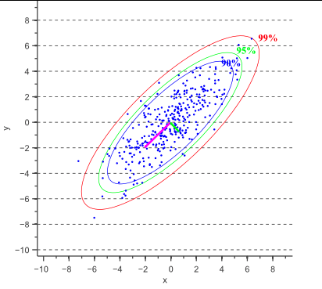


Collision probability calculation
Gaussian motion probability ellipse representation
Notes:
For example, using this probability table we can easily find that, in the 2-degrees of freedom case. Therefore, a 95% confidence interval corresponds to s=5.991. In other words, 95% of the data will fall inside the ellipse defined as. Similarly, a 99% confidence interval corresponds to s=9.210 and a 90% confidence interval corresponds to s=4.605.

Slide 9
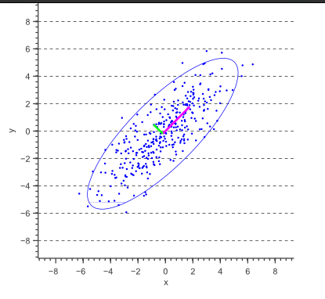

Collision probability calculation
Gaussian motion probability ellipse representation
calculate the covariance matrix of random variables x and y, calculate the eigenvector of the matrix according to the covariance matrix
Define the ellipse The eigenvector in the major axis direction is v1, and the eigenvector in the minor axis direction of the ellipse is v2.

Slide 10
Collision probability calculation
II. Obstacle avoidance probability calculation
As long as the probability ellipse intersects the obstacle, the robot may collide with the obstacle.
Notes:
When the robot performs Gaussian motion near an obstacle, as long as the probability ellipse intersects the obstacle, the robot may collide with the obstacle. From the principles of mathematical statistics, this probability will be reflected in repeated trials of the same trajectory. For the same planned trajectory, the same obstacle, and the same control period, collisions sometimes occur after multiple tests, sometimes not. When the test sample tends to infinity, the ratio of the number of collisions to the total number of tests will be infinitely close to a certain probability value.

Slide 11
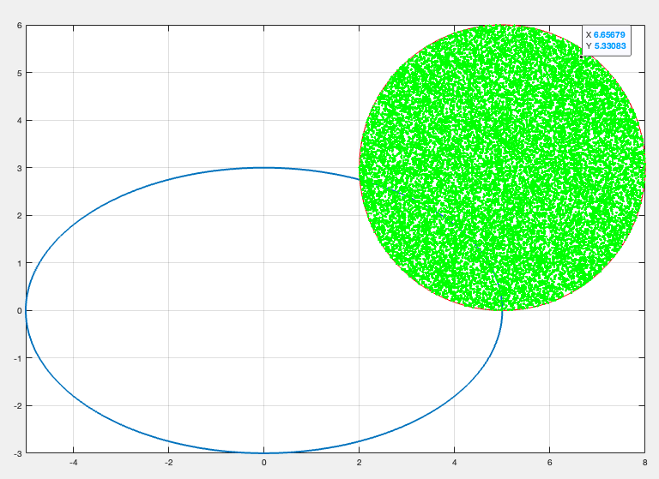

Collision probability calculation
II. Obstacle avoidance probability calculation
Way1: Monte Carlo
Calculate the area ratio of the motion probability ellipse and the obstacle collision interference.
N: Number of total sample
n: Number of sample fall into specific area
Notes:
put sampling points into the obstacle area. Count the number of sampling points in the probability ellipse area .

Slide 12
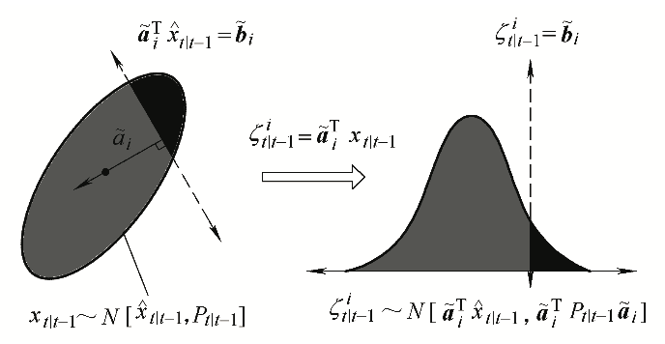

Collision probability calculation
II. Obstacle avoidance probability calculation
Way2: Projection
The obstacle is expressed by the local linearization method
project the two-dimensional probability ellipse into a one-dimensional space for normal distribution probability calculation
Notes:
The obstacle is expressed by the local linearization method, and the vector from the obstacle point closest to the robot's optimal estimated position to the robot's optimal estimated position is represented by . The linearized expression at the obstacle point closest to the optimal estimated position of the robot can be expressed by equation 10.
As shown in Figure 5, in order to project the two-dimensional probability ellipse into a one-dimensional space for normal distribution probability calculation, a plane perpendicular to the vector is used to divide the probability ellipse with a distribution of and project to the one-dimensional space Obtain the normal distribution of . Thus, in one-dimensional space, the collision probability of normal distribution is calculated.

Slide 13

Collision probability calculation
II. Obstacle avoidance probability calculation
Total success probability
Notes:
Since the motion of the robot is a continuous motion in multiple control cycles, each control cycle has the probability of collision with obstacles. The success probability of the final robot trajectory is the factorial of the collision-free probability of the robot in each cycle, as shown in equation (11). When the robot collides without obstacles in a control period, its posterior probability can be further calculated, that is, in the same sample space, the optimal estimated sample position and probability of no collision in this period.

Slide 14
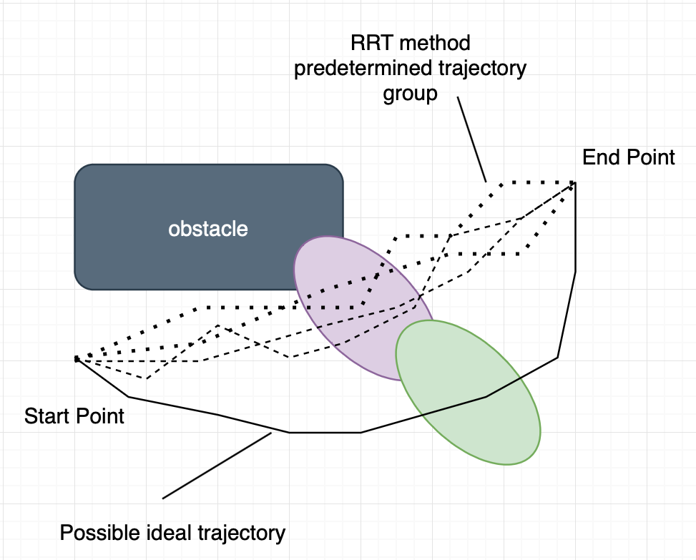
Collision probability calculation
II. Trajectory optimization method
PRM
RRT
A*
D*
GA
Dijkstra
Remind:
these trajectories cannot uniformly cover the robot state space due to optimization screening
the optimization strategy cannot guarantee consistency with the safety of the robot's Gaussian motion.
Notes:
In order to plan the optimal trajectory of the robot's Gaussian motion according to the robot's motion error characteristics and sensor error characteristics before the robot moves, some autonomous optimization strategies can be used, such as genetic algorithm, random extended tree (RRT) and other methods to get a lot of A predefined trajectory to reach the target point. Then use the method based on probability theory described above to evaluate the probability of success of each trajectory.
Among all those method, one thing should be noted is:
optimization methods such as RRT* for pre-defined trajectory planning while applying the method in this paper. Because these methods have their own optimization strategies, the resulting set of predefined trajectories is the result of screening through this optimization strategy. On the one hand, these trajectories cannot uniformly cover the robot state space due to optimization screening, and on the other hand, the optimization strategy cannot guarantee consistency with the safety of the robot's Gaussian motion.

Slide 15
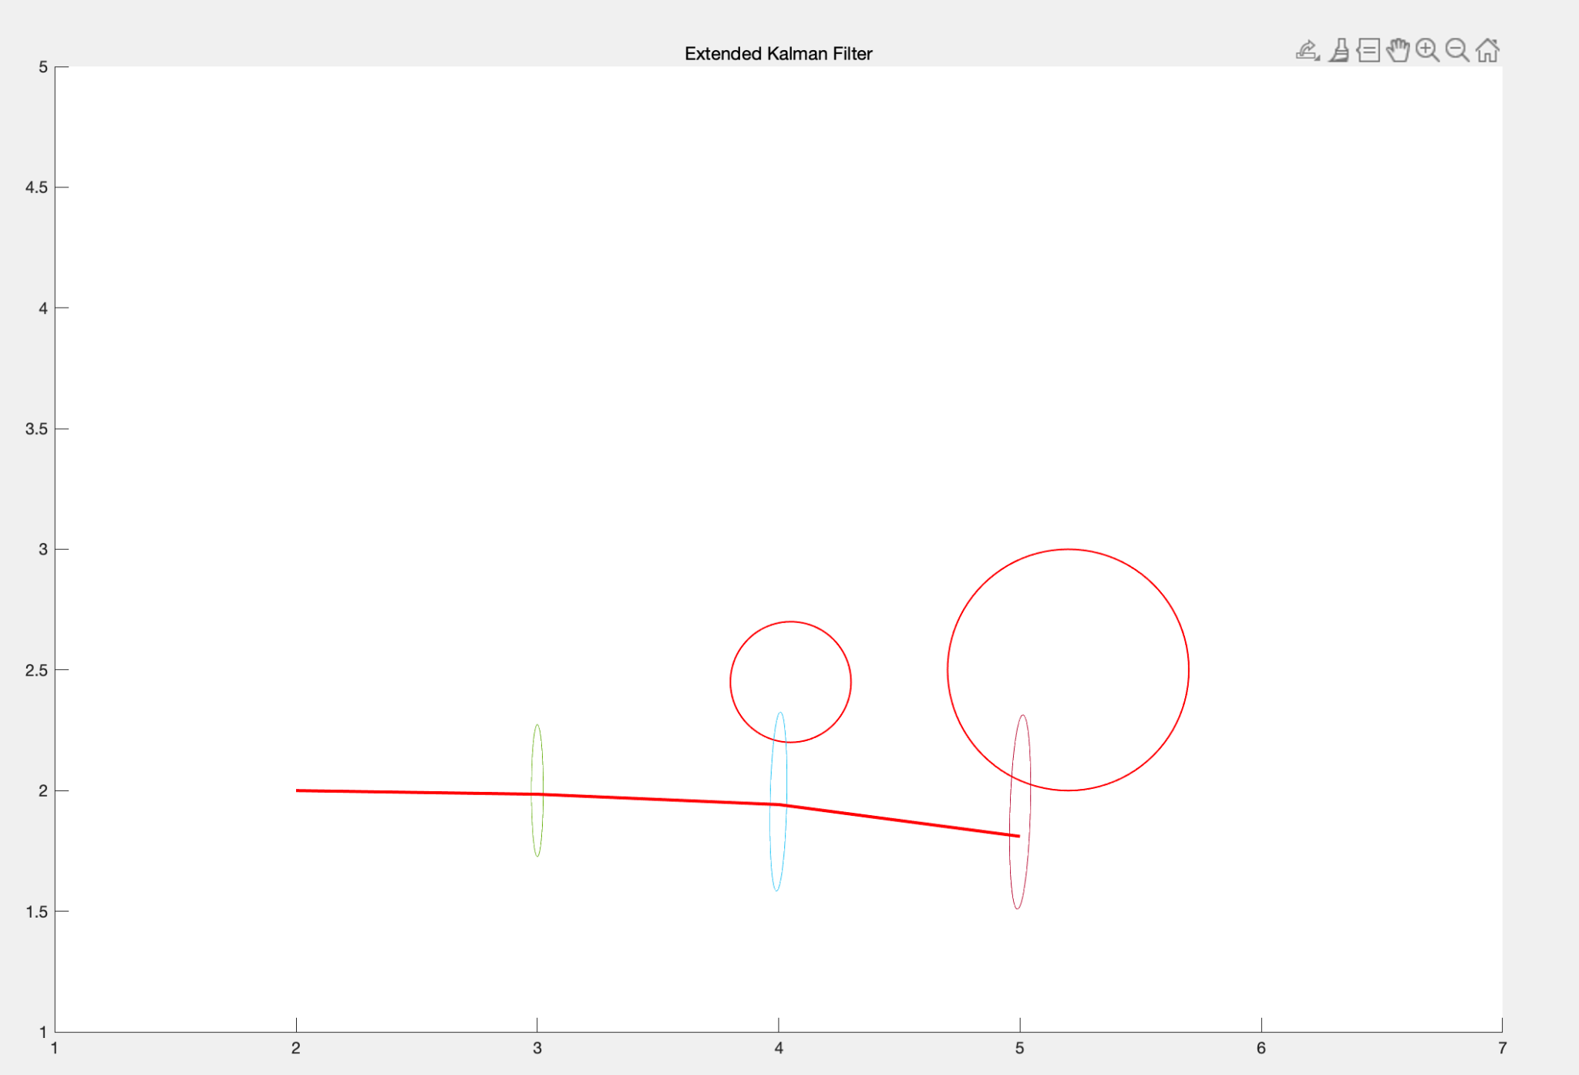
Simulation test
As for the experimental setup, two obstacle areas are set up within the
6*6 area. The starting position of the robot is (2,2) and the ending
position is (5,1.8).

Slide 16
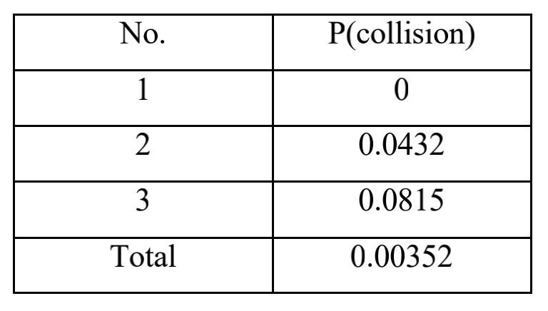
Simulation test
While simulating the trajectory motion, the geometric information of
the probability ellipse for each cycle and the collision with
environmental obstacles are calculated.

Slide 17
Conclusion
Motion errors need to be calculated through experiments before the imputation planning, and its accuracy directly affects the accuracy of the probability estimation of the imputation results in this paper.
It can be seen from the policy test that the greater the trajectory probability ellipse, the greater the robot motion error. When the probability ellipse intersects the obstacle, the robot has the probability of colliding with the obstacle.

