Slide 1

KV-CACHE COMPRESSION · LLM INFERENCE ACCELERATION
JSQKV
Joint Sparsification and Quantization for
KV-Cache Compression and Decode Acceleration
Hao Zhang¹ · Xiaoli Gong¹* · Haoran Li¹ · Huayou Su² · Qingxia Chen³ · Jin Zhang¹
¹ College of Computer Science, Nankai University, Tianjin, China
² National University of Defense Technology, Changsha ³ Qian Xuesen Laboratory of Space Technology, Beijing
* Corresponding author · Code: github.com/Haozon/JSQKV
Notes:
[0:00-0:30] Hello, everyone. Thank you for being here. My name is Hao Zhang, from the College of Computer Science at Nankai University. Today I'll present our work, JSQKV -- a joint sparsification and quantization framework for KV-cache compression and decode acceleration.

Slide 2

MOTIVATION
The KV-Cache Is the Bottleneck of Long-Context Decoding
Autoregressive decoding is increasingly memory-bound
▸ The KV cache grows linearly with context length and is re-read at every decode step.
▸ In long-context serving it dominates memory footprint and bandwidth, capping throughput, batch size, and deployment efficiency.
▸ Decoding is far more memory-bound than prefill — bandwidth, not compute, is the limiter.
Two mainstream compression directions
• Sparsification — evict/prune less useful KV states (StreamingLLM, H₂O, SnapKV, MUSTAFAR).
• Low-bit quantization — reduce numerical precision of retained states (KIVI, KVQuant, QuaRot).
Why it matters at decode time
Linear
KV memory grows with sequence length
Every step
entire cache re-read during decoding
Memory-bound
bandwidth is the true limiter, not FLOPs
2
Notes:
[0:30-1:20] Let me start with the problem. As context windows keep growing, the real bottleneck of autoregressive decoding is no longer computation -- it's the KV cache.
The KV cache grows LINEARLY with context length, and it is re-read at EVERY single decode step. So in long-context serving, it dominates memory footprint and memory bandwidth, and it caps throughput, batch size, and deployment efficiency. The key point on the right: decoding is memory-bound
To address this, the community has two main directions: sparsification -- evicting or pruning less useful KV states -- and low-bit quantization -- reducing the numerical precision of what's kept.

Slide 3
PROBLEM & CHALLENGE
Naive “Sparsify-then-Quantize” Does Not Work
Both directions are effective, but they are still studied in isolation. Simply chaining them fails to jointly preserve quality and deliver real end-to-end speedup.
① Representation & execution gap
Sparsification changes not just how much KV is kept, but the retained token/feature layout.
This shifts quantization granularity, compressed layout, and the decode kernel — so algorithmic compression gains do not automatically become lower memory traffic.
② Online decision gap
Token-differential compression is easy to estimate in prefill, where future attention is observable.
But at decode time a token must be cached before its future importance can be known — the policy is not directly applicable online.
Key challenge: preserve model quality under aggressive compression AND keep the compressed representation directly executable for real decode-time acceleration.
3
Notes:
[1:20-2:10] Both directions work well on their own. The natural idea is to simply combine them -- sparsify, then quantize. But that naive chaining DOES NOT work, for two reasons.
First, a representation-and-execution gap. Sparsification changes not just how MUCH KV you keep, but the retained token and feature LAYOUT. That shifts quantization granularity/ˌɡrænjəˈlærəti/, the compressed data layout, and the decode kernel -- so algorithm/ˈælɡərɪðəm/ compression gains don't automatically become lower memory traffic.
Second, an online-decision gap. Token-differential compression is easy in prefill, where future attention is observable. But during decoding, a token must be cached before we know how important it will be.
So the real challenge, at the bottom: preserve model quality under aggressive compression, and keep the compressed representation directly executable for real speedup.

Slide 4
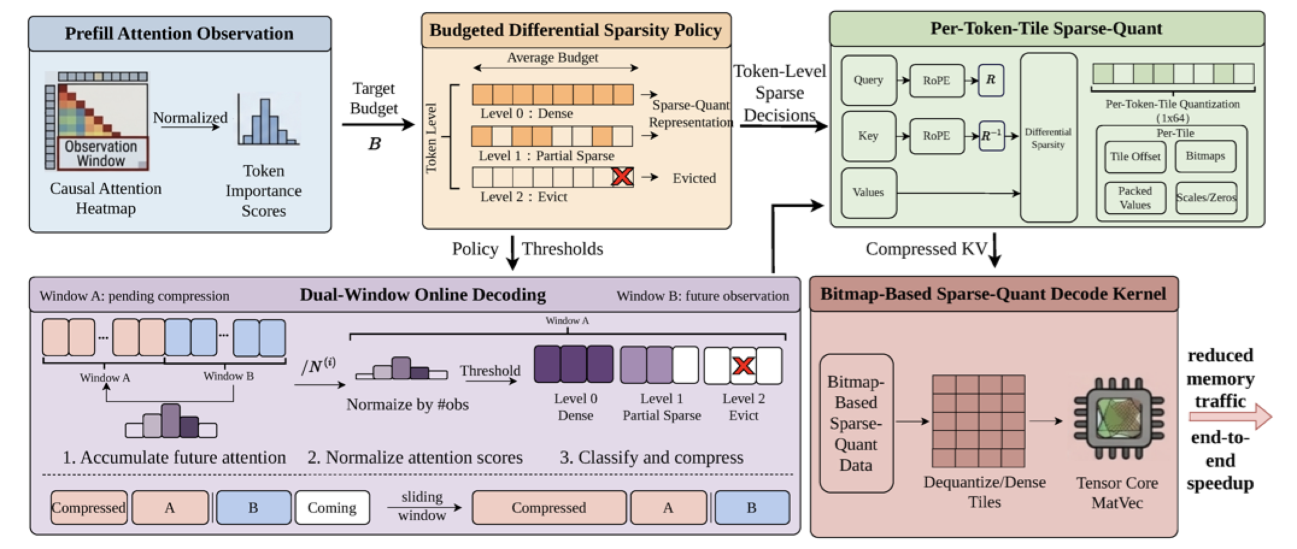
OUR APPROACH
JSQKV: A Unified Sparse-Quant Decode Pipeline
Co-design compression policy → compressed format → execution path in one decode-stage pipeline.
① Differential Sparsity
budgeted 3-level token policy
② Dual-Window Online
apply policy during decoding
③ Per-Token-Tile Quant
Hadamard-stabilized low-bit
④ Sparse-Quant Kernel
load-compressed, compute-dense
4
Notes:
[2:10-2:55] Our answer is JSQKV -- a unified sparse-quant decode pipeline. Instead of treating sparsity and quantization as separate post-processing steps, we co-design three things together: the compression POLICY, the compressed FORMAT, and the EXECUTION path.
Concretely, there are four contributions, shown along the bottom, and I'll walk through each: differential sparsity -- a budgeted three-level token policy; a dual-window mechanism that makes it work online; Per-Token-Tile quantization with Hadamard rotation; and a bitmap-based sparse-quant kernel that loads compressed but computes dense.

Slide 5
METHOD · MODULE 1
Budgeted Differential Sparsity Policy
Idea: not all tokens deserve the same compression.
A fixed sparsity ratio wastes budget on unimportant tokens and over-compresses important ones.
Estimate importance from prefill attention
▸ Score = mean attention a token receives from the last L_obs observation-window queries (SnapKV-style), length-normalized.
Assign each token to one of three levels
▸ Two percentile thresholds (τ_high, τ_low) split tokens under the target average budget B = p₁ρ₁ + p₂.
▸ A small calibration search picks the (p₀, ρ₁) allocation at fixed B.
Level 0 — Dense
Most important tokens kept fully (ρ₀ = 0).
Level 1 — Partial Sparse
Keep only top-magnitude features per key/value vector (ratio ρ₁).
Level 2 — Evict
Least important tokens removed from cache (ρ₂ = 1).
Result: larger gains at tighter (70%) budgets — token-level allocation matters most when budget is scarce.
5
Notes:
[2:55-3:55] First module: budgeted differential sparsity. The idea is simple -- not all tokens deserve the same compression. A fixed sparsity ratio wastes budget on unimportant tokens and over-compresses important ones.
So we estimate token importance from prefill attention: each token's score is the average attention it receives from the last few observation-window queries, in the SnapKV style, length-normalized.
Then we assign every token to one of three levels, shown on the right. Level 0 -- the most important -- stays dense. Level 1 keeps only the top-magnitude features in its key and value vectors. Level 2 -- the least important -- is evicted entirely. Two percentile thresholds split the tokens under a target average budget B, and a small calibration search picks the best allocation at that fixed budget. As we'll see, this matters most when the budget is tight.

Slide 6
METHOD · MODULE 2
Dual-Window Online Execution Mechanism
Challenge: the differential policy needs future attention, which is unavailable when a token is first generated. Solution: delay compression until enough future evidence is accumulated.
Compressed History
already fixed
Window A (to compress)
accumulates future attention
Window B (observation)
newly generated tokens supply evidence
queries in B observe A
1 · Accumulate
Each new query's attention to Window A is summed in a buffer while B fills.
2 · Normalize
Divide by #observations N⁽ⁱ⁾ = 2W−1−i, since earlier tokens are seen by more queries.
3 · Classify & slide
Compare to reused (τ_high, τ_low) → merge compressed A; B becomes new A.
Each token is observed before compression, while uncompressed tokens stay bounded by O(W). Prefill-estimated thresholds are shown to be stable enough to reuse (Appendix).
6
Notes:
[3:55-4:55] But that policy needs future attention -- which we don't have when a token is first generated. That's the second module: the dual-window mechanism.
The trick is to DELAY compression until enough future evidence accumulates. We keep two windows. Window A holds tokens waiting to be compressed. Window B holds newly generated tokens, and their queries OBSERVE Window A, supplying the missing future attention.
Three steps: we accumulate each new query's attention to Window A; we normalize by the number of observations -- since earlier tokens are seen by more queries; and we classify and slide -- comparing against the same thresholds, compressing Window A into history, and Window B becomes the new Window A.
Importantly, each token is observed before it's compressed, and the number of uncompressed tokens stays bounded.

Slide 7
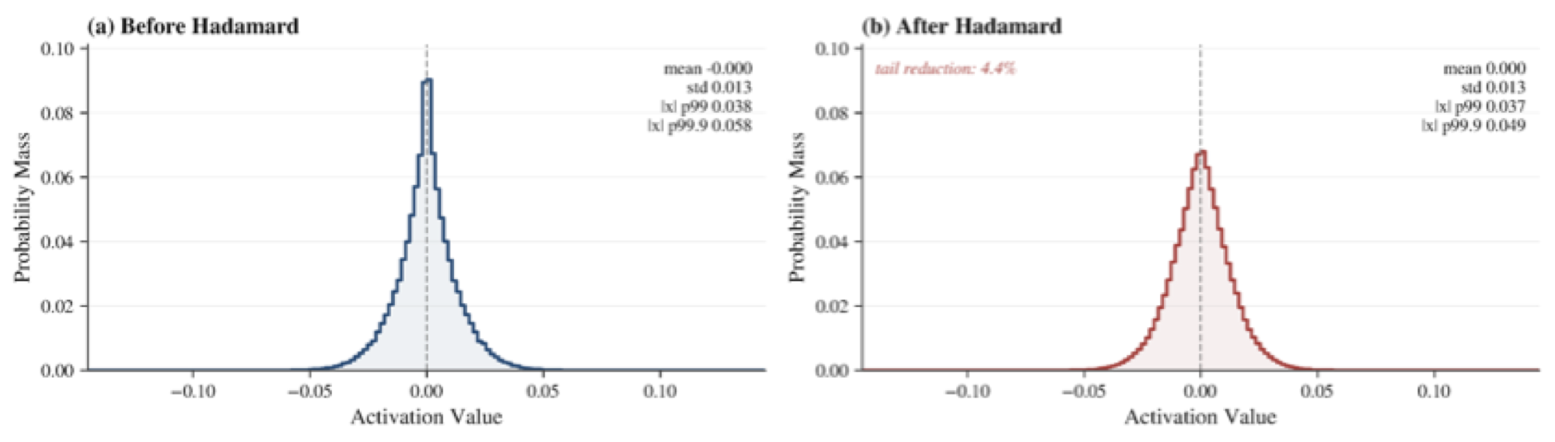
METHOD · MODULE 3
Per-Token-Tile Quantization with Hadamard Rotation
Align the quantization unit with token-level decisions.
▸ Split each key/value vector into contiguous tiles (size g); quantize each tile independently with its own scale & zero-point.
▸ Key states carry outliers that destabilize low-bit quantization.
▸ Apply an orthogonal Hadamard rotation to Q and K before quantizing — it suppresses heavy tails while exactly preserving attention scores (q̃ᵀk̃ = qᵀk).
Key-state distribution before/after rotation (Llama-2-7B): heavy tail suppressed.
WikiText-2 PPL — RTN vs. Hadamard rotation (lower is better)
Setting | 4-bit RTN | 4-bit Rot. | 3-bit RTN | 3-bit Rot. | 2-bit RTN | 2-bit Rot.
Quant only | 5.22 | 5.14 | 6.57 | 5.28 | 115.55 | 5.35
+50% KV sparsity | 5.27 | 5.69 | 6.57 | 6.35 | 115.55 | 6.65
115.55 → 5.35
2-bit PPL collapse is eliminated by Hadamard rotation, while staying compatible with subsequent sparsification.
7
Notes:
[4:55-5:55] Third module: quantizing[ˈkwɒntaɪzɪŋ] what remains. We use Per-Token-Tile quantization -- splitting each key or value vector into small tiles and quantizing each tile independently with its own scale and zero-point. This aligns the quantization unit with our token-level decisions and the tile-based decode path.
The problem is that key states carry OUTLIERS that wreck [rek] aggressive low-bit quantization. Our fix is an orthogonal [ɔːˈθɒɡənl] Hadamard rotation applied to queries and keys before quantizing. It suppresses the heavy tails you can see in the figure -- and because it's orthogonal, it exactly preserves attention scores.
The effect is dramatic. Look at the 2-bit column: plain round-to-nearest blows up to a perplexity of 115, while Hadamard rotation brings it down to 5.35 -- and it stays compatible[kəmˈpætəbl] with the sparsification that follows.

Slide 8
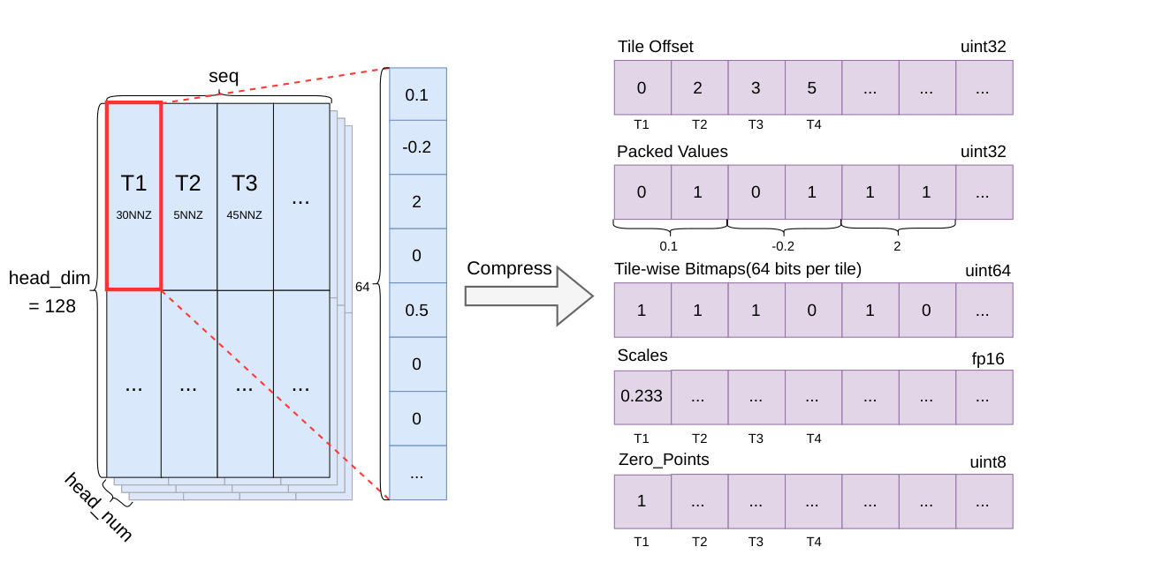
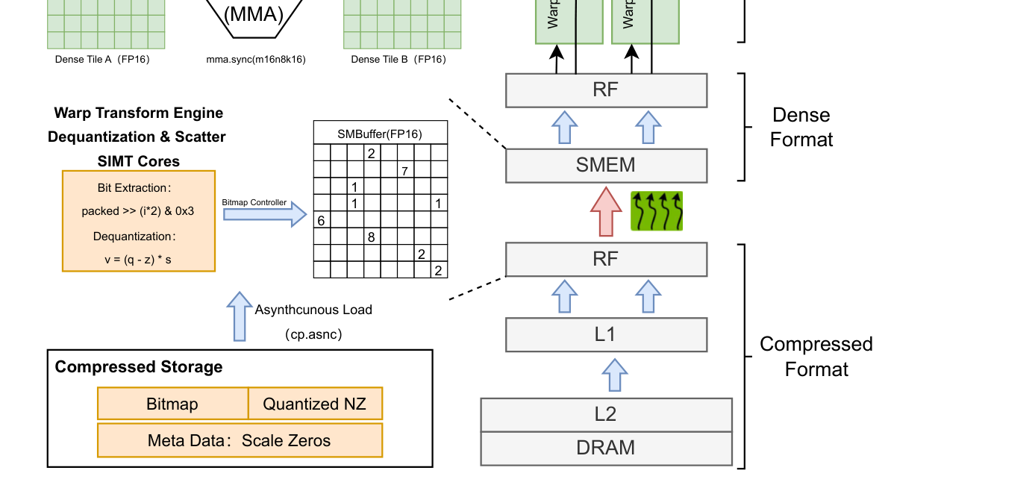
METHOD · MODULE 4
Bitmap-Based Sparse-Quant Format & Decode Kernel
Co-design storage format and kernel so compression cuts decode-time memory traffic — not just storage footprint.
Each 1×64 tile stores:
· Bitmap of nonzeros
· Packed low-bit values
· Per-tile offset
· Scales / zero-points
Kernel loads compressed tiles, unpacks + dequantizes into dense shared memory, then runs Tensor-Core MatVec.
(a) Format: bitmap + packed low-bit values + metadata
(b) Load-as-compressed, compute-as-dense
Sparsity is handled on the loading path; the compute stage stays dense and regular — avoiding irregular access and control-flow divergence that usually limit sparse execution.
8
Notes:
[5:55-6:50] The final module is where compression turns into REAL speedup. We co-design the storage format and the decode kernel.
Each 1-by-64 tile stores a bitmap of nonzero positions, the packed low-bit values, a per-tile offset, and the quantization metadata -- scales and zero-points.
The kernel follows a load-as-compressed, compute-as-dense strategy: it loads the compact tiles from memory, unpacks and dequantizes them into dense shared-memory tiles, and then runs a standard Tensor-Core matrix-vector product.
So sparsity is handled entirely on the loading path -- where the memory savings are -- while the compute stage stays dense and regular. That avoids the irregular memory access and control-flow divergence [daɪˈvɜːdʒəns] that usually kill sparse execution. This is exactly what a memory-bound decode stage needs.

Slide 9
EVALUATION
Experimental Setup
Hardware & Stack
Models
Accuracy Protocol
Efficiency Protocol
· 1 × NVIDIA A100 80GB PCIe
· Intel Xeon CPU, 252 GB RAM
· Python 3.10 · PyTorch 2.6 · CUDA 12.4
· Custom CUDA / Triton kernels
· Llama-3-8B-Instruct (main)
· Llama-2-7B
· Mistral-7B-v0.1
· Qwen2.5-7B-Instruct
· LongBench official pipeline
· 6 tasks: NarrativeQA · Qasper
· MultiFieldQA-EN · HotpotQA · TREC · LCC
· Inputs truncated to 8192 (head-tail)
· Llama-3-8B, 4096 in / 256 out
· Batch size 1 – 8
· Throughput, compression time,
· KV size & ratio
Baselines & compression settings
▸ Baselines: Dense decoding · matched-budget Uniform sparsity (MUSTAFAR) · sequential MUSTAFAR + KIVI (denoted M+K).
▸ Settings: sparse-only at 50% / 70% · joint sparse-quant at 50/50 & 70/70 K/V sparsity with 4-bit and 2-bit quantization. Differential policies selected on a calibration split, re-checked on a disjoint validation split.
9
Notes:
[6:50-7:30] Now to the evaluation. Everything runs on a single A100 , with custom CUDA and Triton kernels.
For accuracy, we use the official LongBench pipeline on six representative tasks, with Llama-3-8B（billion） as the main model, plus Llama-2, Mistral, and Qwen2.5. For efficiency, we measure end-to-end throughput and compression cost at batch sizes one through eight.
Our baselines are dense decoding, a matched-budget uniform-sparsity baseline based on MUSTAFAR, and the sequential MUSTAFAR-plus-KIVI pipeline -- which I'll call M-plus-K. We test both sparse-only and joint sparse-quant settings at 50 and 70 percent.

Slide 10
RESULTS · 1/3
Accuracy — Differential Sparsity Alone
Isolating budget allocation (no quantization): Llama-3-8B-Instruct, 6 LongBench tasks, matched budget.
Method | NrtvQA | Qasper | MF-QA | HotpotQA | TREC | LCC | Avg.
Dense | 23.45 | 42.18 | 43.14 | 46.06 | 74.00 | 57.12 | 47.66
Uniform-50 | 23.44 | 43.73 | 42.93 | 45.94 | 73.50 | 56.03 | 47.59
Differential-50 | 23.44 | 43.73 | 42.93 | 45.94 | 74.00 | 57.08 | 47.85
Uniform-70 | 23.94 | 40.89 | 40.91 | 44.93 | 70.00 | 54.12 | 45.80
Differential-70 | 23.94 | 41.03 | 41.61 | 45.12 | 72.50 | 55.45 | 46.61
Takeaways
▸ Differential ≥ uniform in every setting — never negative.
▸ +0.81 avg at 70% vs +0.26 at 50%.
▸ Token-level allocation matters more as the budget tightens.
10
Notes:
[7:30-8:15] First, sparsity ALONE, to isolate the effect of budget allocation -- no quantization yet.
The takeaway is on the right. Our differential policy is greater than or equal to uniform sparsity in EVERY setting -- it never hurts. And the gain is larger at the tighter 70 percent budget than at 50 percent.
That confirms that : token-level budget allocation matters most exactly when the budget is scarce/skeəs/.

Slide 11
RESULTS · 2/3
Accuracy — Joint Sparse-Quant (Main Result)
Llama-3-8B-Instruct vs. sequential MUSTAFAR+KIVI (M+K) at matched budgets — average over 6 tasks.
Setting | M+K | JSQKV
50/50 + 4-bit | 45.90 | 45.93 (+0.03)
50/50 + 2-bit | 43.38 | 44.02 (+0.64)
70/70 + 4-bit | 44.18 | 45.34 (+1.16)
70/70 + 2-bit | 39.83 | 43.12 (+3.29)
39.83 → 43.12
Largest gain at the most aggressive 70/70 + 2-bit setting (+3.29 avg).
Why JSQKV wins
JSQKV beats M+K in all four settings; the gap widens as compression gets more aggressive — evidence that jointly aligning sparsity, quantization and execution beats a sequential pipeline.
Cross-model (Llama-2 / Mistral / Qwen2.5): favorable but non-uniform, strongest under tight budgets.
11
Notes:
[8:15-9:15] Now the main result -- the FULL joint sparse-quant pipeline against the sequential M-plus-K baseline, averaged over the six tasks.
JSQKV wins in ALL FOUR settings, and the gap widens/ˈwaɪdnz/ as compression gets more aggressive. At the most aggressive setting, 70/70 with 2-bit, the average score jumps from 39.83 to 43.12 -- a gain of over three points.
Why does JSQKV win? Because jointly aligning sparsity, quantization, and execution beats stacking two methods that were never designed to work together. The cross-model results tell the same story -- favorable overall, and strongest under tight budgets.

Slide 12
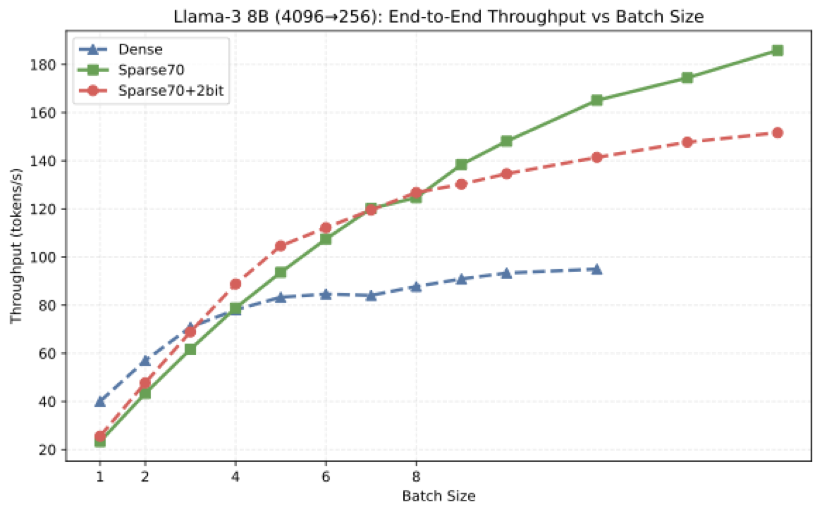
RESULTS · 3/3
Efficiency — Throughput & Compression
+44.2% end-to-end throughput
over dense decoding in long-context serving (70/70 + 2-bit); clearest gains in the small-to-medium batch regime.
Compression statistics (input 4096) — sparsity-only vs. sparse-quant
Method (BS=8) | KV (MB) | Ratio | Time (ms)
Sparse-50 | 2720.2 | 1.51× | 5688.2
Sparse-70 | 1964.3 | 2.09× | 5411.3
Sparse-50 + 2b | 1261.2 | 3.25× | 4317.9
Sparse-70 + 2b | 1176.3 | 3.48× | 4293.2
End-to-end decoding throughput vs. batch size (Llama-3-8B).
Higher compression ratio (2.09× → 3.48×) AND lower compression time (5411 → 4293 ms): the compact sparse-quant representation also cuts write-back cost.
12
Notes:
[9:15-10:10] And crucially, this quality holds up while delivering REAL speedup. On the left, end-to-end throughput versus batch size: the compressed paths pull ahead of dense decoding, with the clearest advantage in the small-to-medium batch regime. Overall, JSQKV improves end-to-end throughput by up to 44 percent over dense decoding.
On the right, compression statistics. Compared to sparse-only MUSTAFAR-70, our sparse-quant path pushes the compression ratio from 2.09x up to 3.48x -- and, notably, it ALSO LOWERS the compression time. So the more compact representation even cuts the write-back cost. Better compression and faster -- not a trade-off.

Slide 13
SUMMARY
Conclusion
JSQKV treats KV-cache compression as a systems-and-algorithms co-design problem — not a simple composition of independent post-processing steps.
Differential sparsity
3-level, budgeted token allocation from prefill attention.
Dual-window online
Makes the policy applicable during autoregressive decoding.
Per-Token-Tile quant
Hadamard-stabilized low-bit representation aligned to tiles.
Sparse-quant kernel
Load-compressed / compute-dense: turns compression into speedup.
Headline results (Llama-3-8B-Instruct)
39.83 → 43.12
avg score, 70/70+2-bit
+44.2%
end-to-end throughput
3.48×
KV-cache compression
13
Notes:
[10:10-11:00] The Conclusion is that KV-cache compression should be treated as a systems-and-algorithms[ˈælɡərɪðəm] co-design problem -- not a simple composition of independent post-processing steps.
JSQKV brings together four pieces: differential sparsity, the dual-window online mechanism, Hadamard-stabilized Per-Token-Tile quantization, and the sparse-quant kernel that turns compression into speedup.
And the headline numbers, on Llama-3-8B: the average score improves from 39.83 to 43.12, throughput improves by 44 percent, and the KV cache is compressed by 3.48 times -- all at the same time.

Slide 14
Thank You
Questions & Discussion
JSQKV — Joint Sparsification and Quantization for KV-Cache Compression and Decode Acceleration
Hao Zhang, Xiaoli Gong*, Haoran Li, Huayou Su, Qingxia Chen, Jin Zhang · Nankai University
Code: github.com/Haozon/JSQKV
Notes:
[11:00-11:15] That's JSQKV. Thank you very much for your attention -- I'd be happy to take your questions.
[Total ~11:15, ~45s buffer before 12:00, then 3-min Q&A.]
Likely Q&A: why differential beats uniform under tight budgets; overhead of the dual-window buffer; why gains shrink at large batch sizes (compute-bound -> dequant overhead less amortized); cross-model variance (Qwen gains big, Llama-2 modest).

