Slide 1
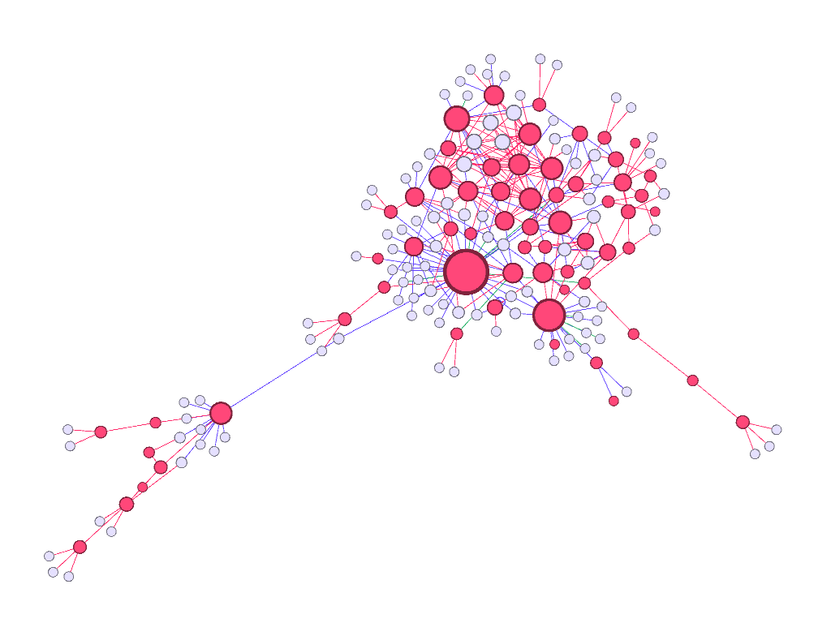
Graph visualisations of COVID-19 cases in the Italian municipality of Vo’
Haplea Ioan Ștefan
Resident MD, Internal Medicine
UMF Cluj-Napoca, Romania

Slide 2
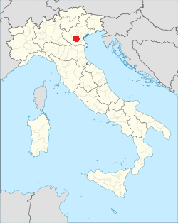
Location
Vo’ is a small town in Italy, 50 km west of Venice

Slide 3
The pandemic
In February and March 2020, during pandemic lockdown, 80% of the 3200 inhabitants were screened for SARS-CoV2 infection
Most had two tests performed, 2 weeks apart
A significant proportion of positive cases were asymptomatic
The results were published in:
Suppression of a SARS-CoV-2 outbreak in the Italian municipality of Vo’. Imperial College COVID-19 Response Team, Lavezzo E, Franchin E, Ciavarella C, Cuomo- Dannenburg G, Barzon L, et al. Nature [Internet]. 2020 Jun 30;

Slide 4
The source of the data
The authors made available the data and the R code at: https://github.com/ncov-ic/SEIR_Covid_Vo
The data is a unique resource for epidemiologists and statisticians
A single easy to read Excel file
Very detailed: gender and age stratification, household identifiers, symptoms check list, severity, hospitalization, outcome
Contact tracing provided by adjacency matrix
Viral levels in swabs (no.of PCR cycles), body temperature
Longitudinal data - affords a glimpse into the temporal dynamics of SARS-CoV2 infection
Has the potential to become the ”Framingham study” of COVID-19
Zuin, Marco, Claudio Bilato, Giovanni Zuliani, and Loris Roncon. 2020. “Italian Vò Municipality Cohort and COVID-19 Epidemiology: The ‘Framingham’ Study of the 21st Century.” European Journal of Internal Medicine 0 (0). https://doi.org/10.1016/j.ejim.2020.07.015.

Slide 5
Graph visualisations
I analyzed the data and constructed contact graphs for visualizations
Each point (node in a graph) represents an individual
The color of the point signifies the status:
Gray – negative and asymptomatic, or unknown
Red – SARS-CoV2 positive, symptomatic disease
Light red - SARS-CoV2 positive, asymptomatic
Blue – negative, symptomatic (e.g. fever caused by flu etc.)
In the following visualisations, the sequence of slides is not necessarily the temporal sequence of the actual discovery of cases
The proximity of two points in the graph plane does not signify geographic proximity of their households
The data seem to tell an interesting story of their own, if only visually, with no graph-theoretic statistics employed

Slide 6

At first, everyone’s status is unknown

Slide 7
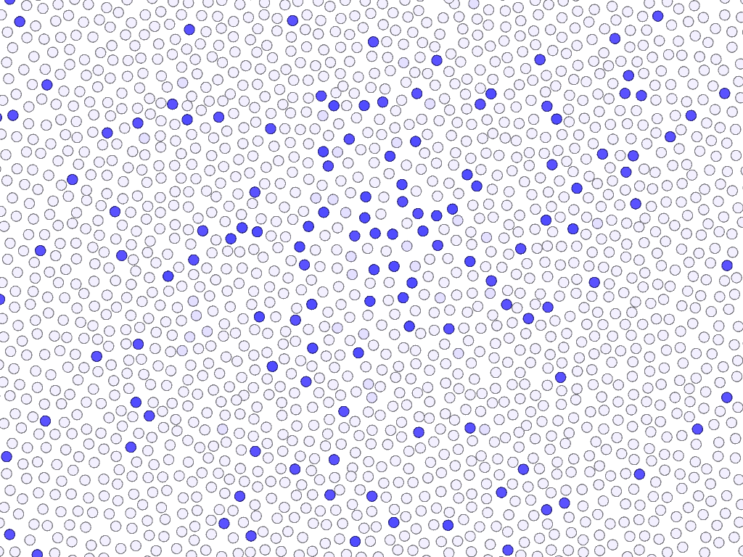
Some inhabitants display symptoms

Slide 8
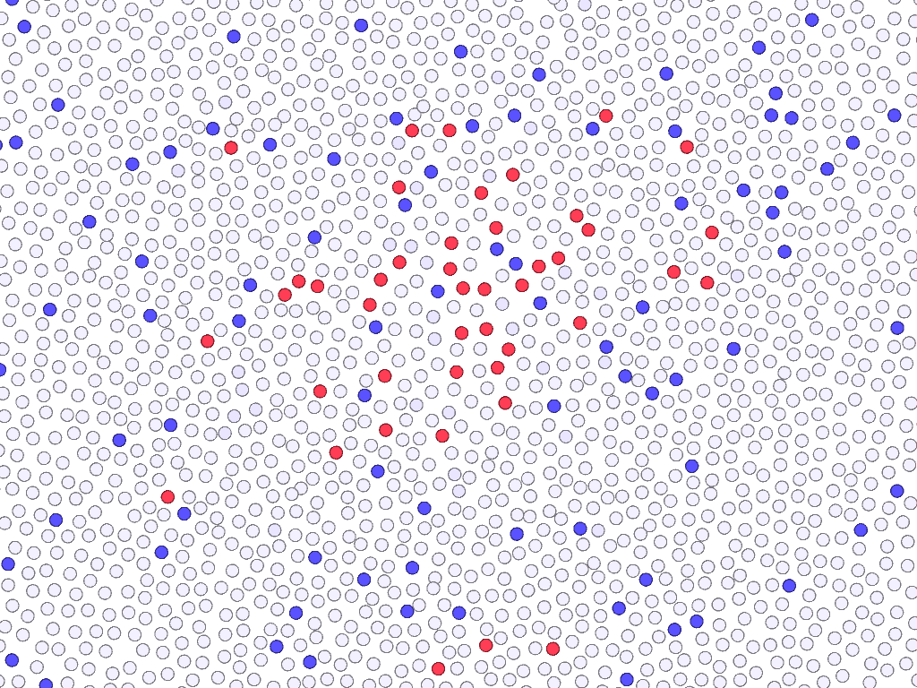
Some of the symptomatic are COVID +

Slide 9
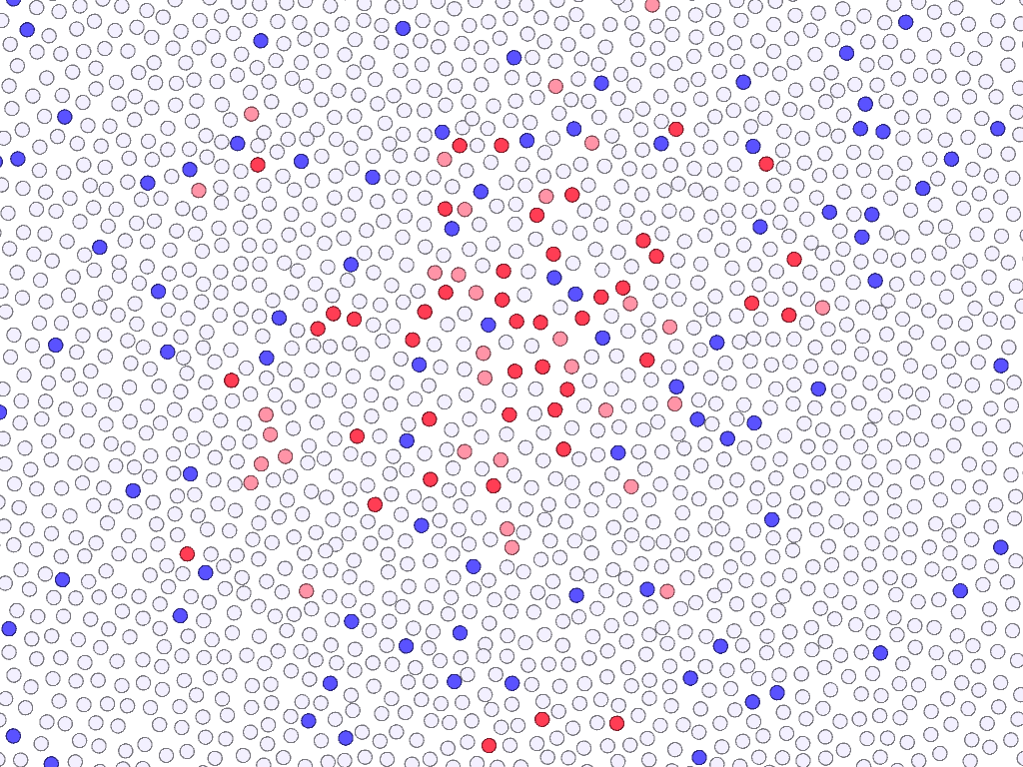
Some more COVID+ are asymptomatic

Slide 10
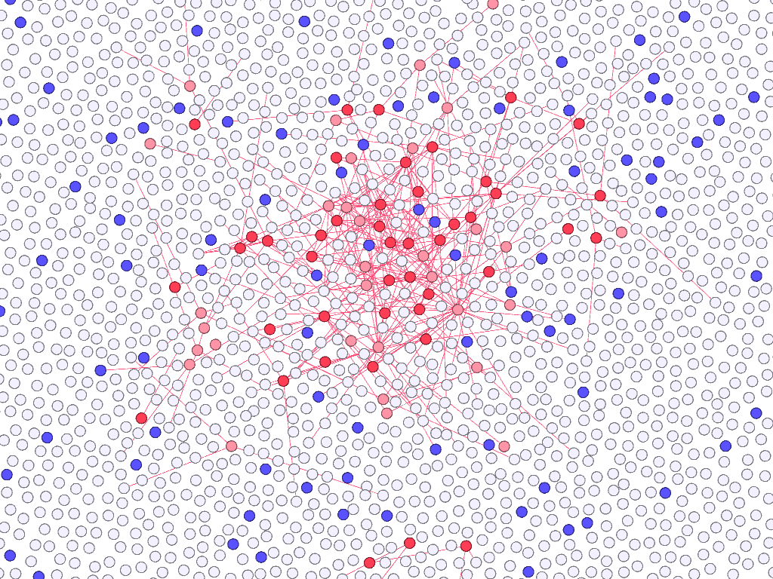
There is a contact net between cases

Slide 11
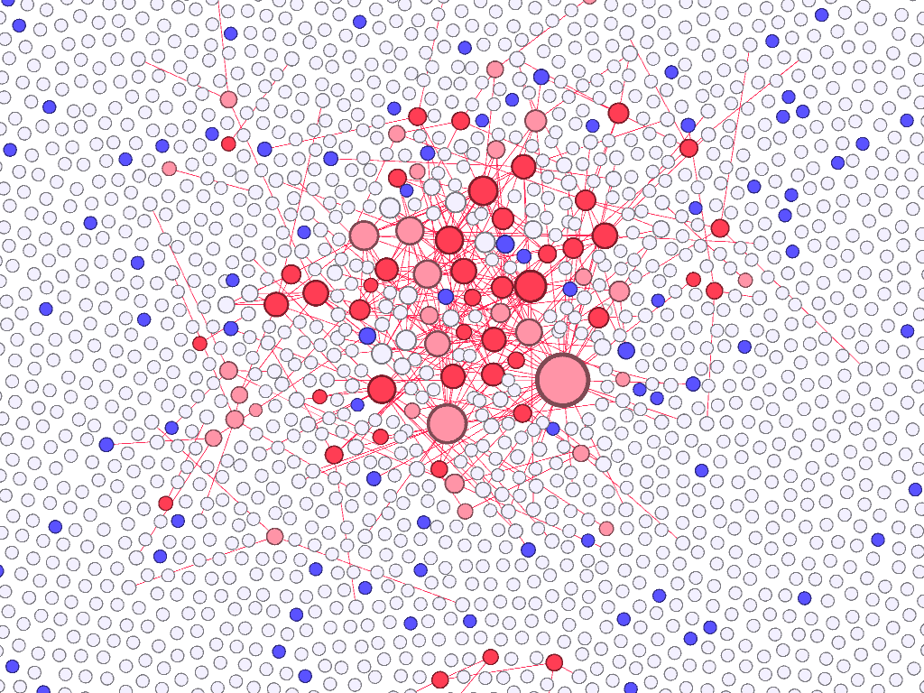
Resize point by the number of contacts

Slide 12
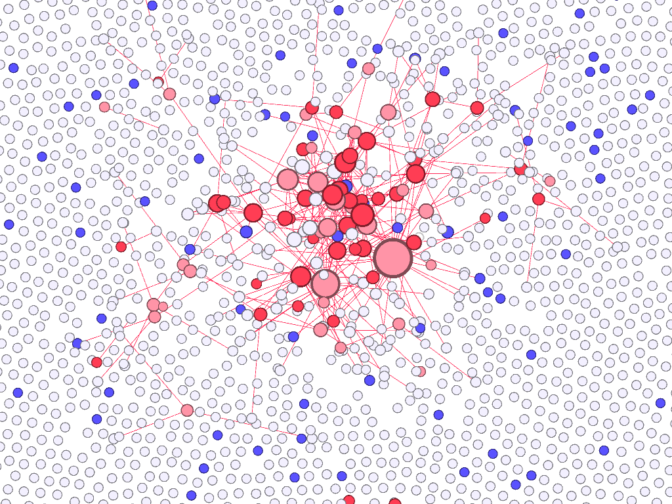
Reshape graph to cluster positive cases

Slide 13
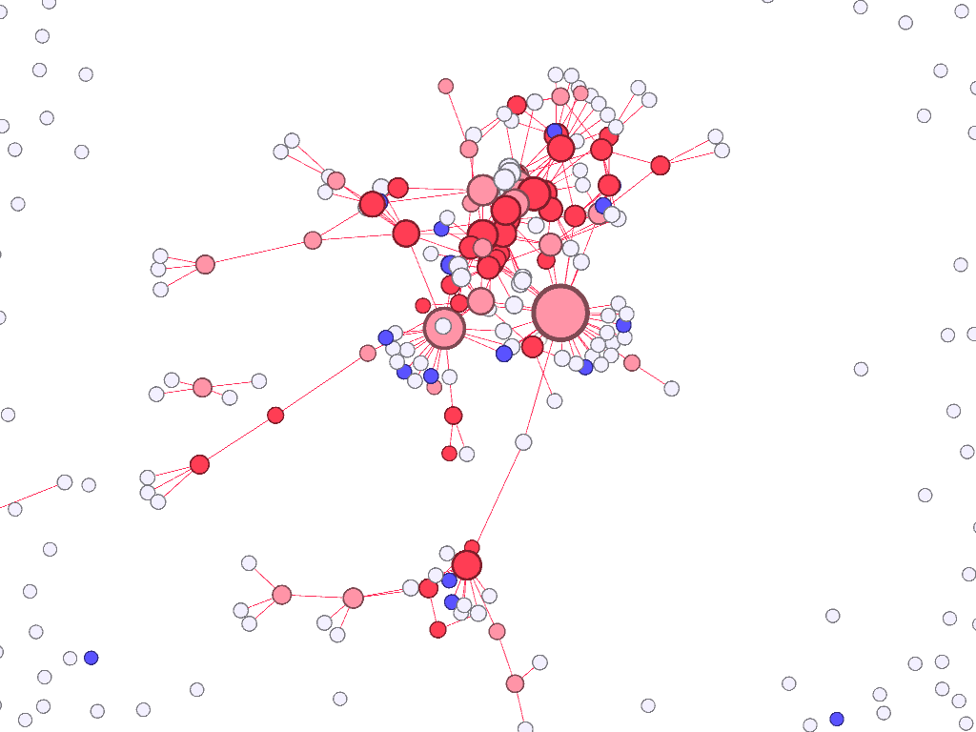
Reshaping

Slide 14
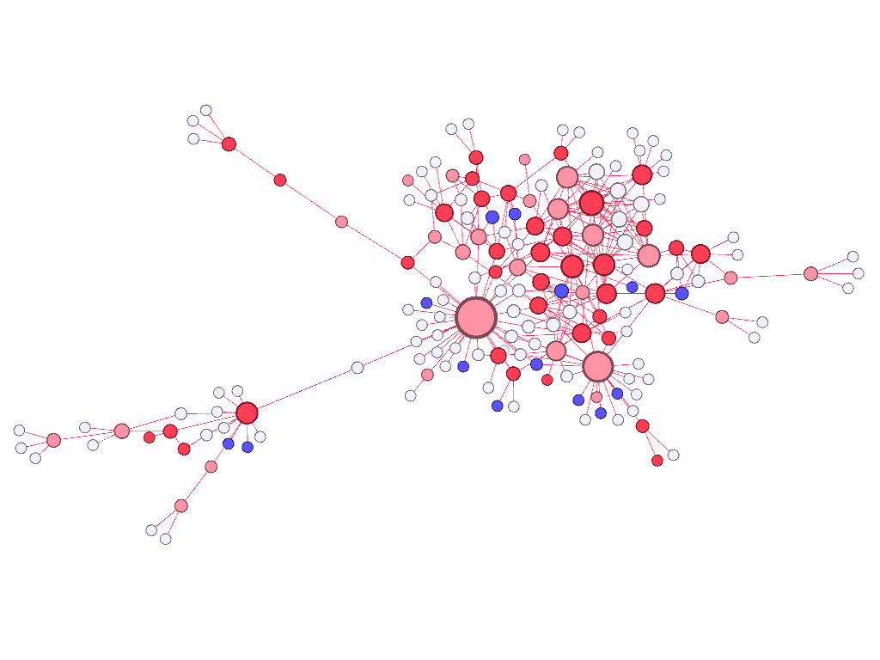
A contact net of COVID+ emerges

Slide 15
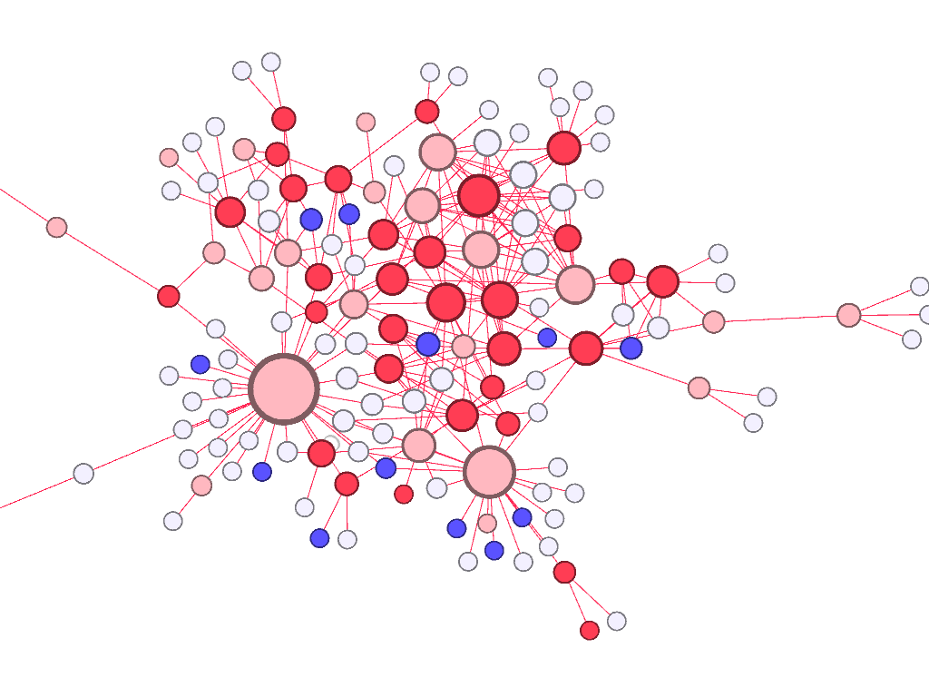
A close-up of the network

Slide 16
Some features of the network
Many COVID+ cases are clustered, some symptomatic and some asymptomatic, a lot of household contacts
A very well connected, asymptomatic COVID+ case did not spread much disease (large point at bottom left)
In the entourage of COVID+ cases, there are always symptomatic cases from other diseases (blue points)

Slide 17
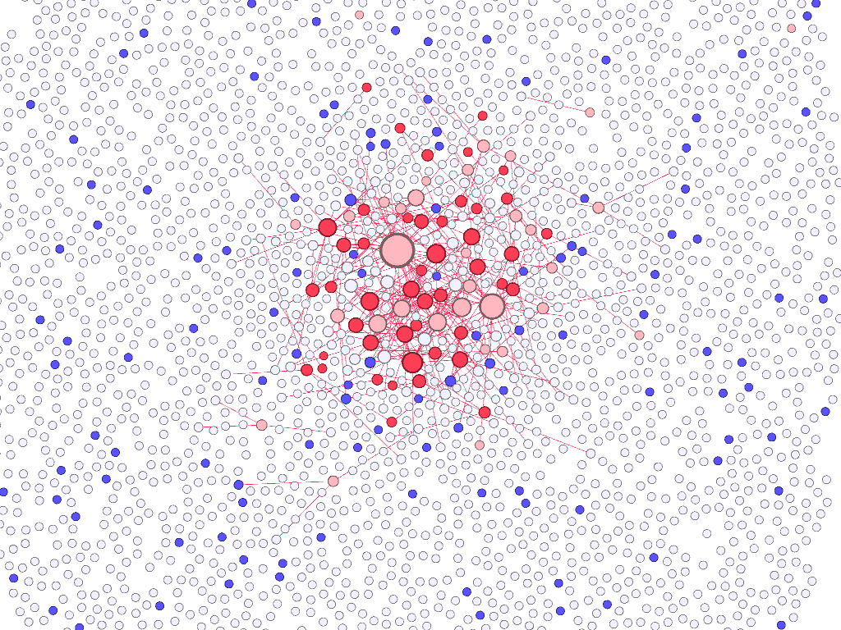
Putting the net back among its peers

Slide 18
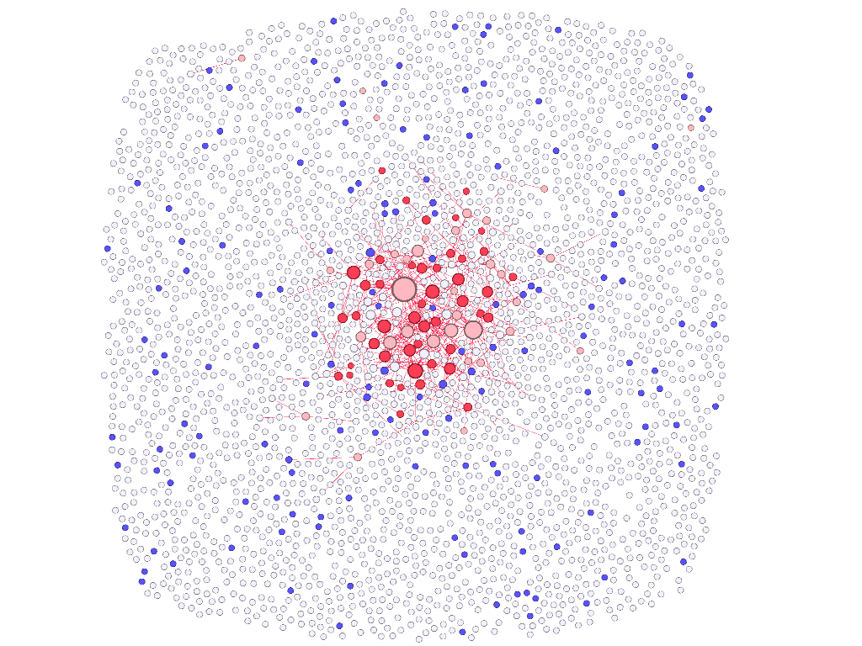
The whole population sampled

Slide 19
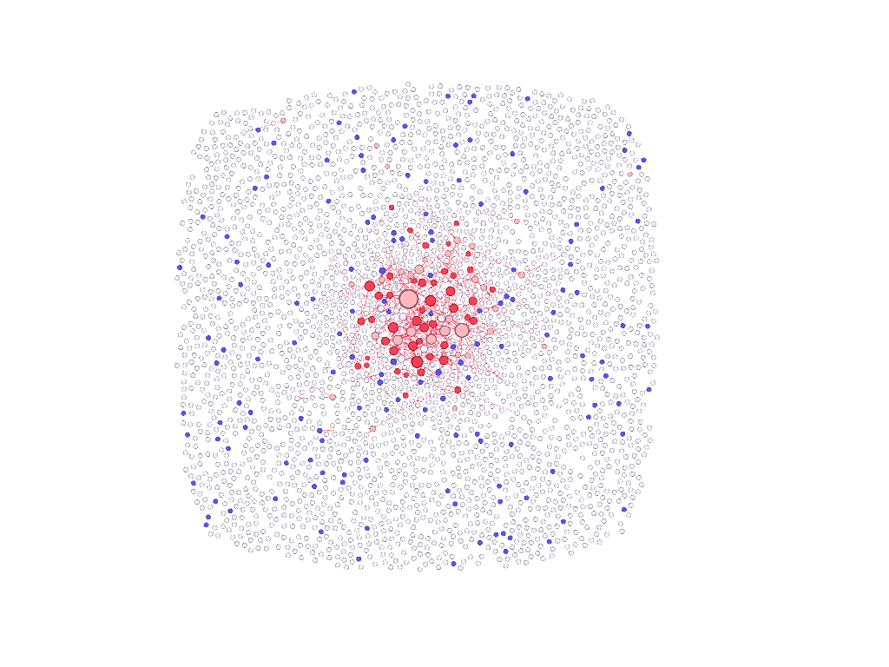
A bird’s eye view of the town

Slide 20
Conclusions
An intuitive sense can be made of :
how common the infection is
how frequent is the asymptomatic carrier status
how often other diseases can produce symptoms similar to COVID-19, in the vicinity of COVID cases
how all of the above occur, interact, and transform into each other not in a well-mixed system, but within a coherent structure
The graph data, the code and the images are available at:
https://github.com/Haplea-Ioan-Stefan/COVID_Vo

Slide 21
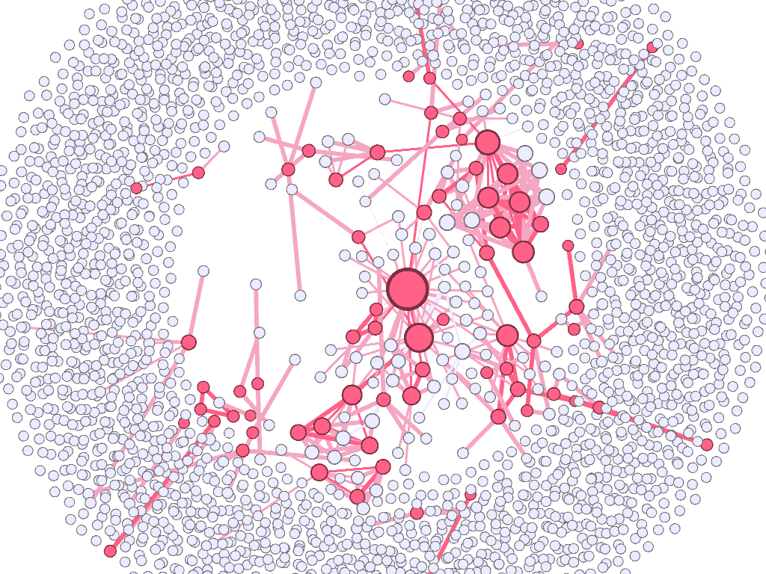
Thank you!

