Slide 1

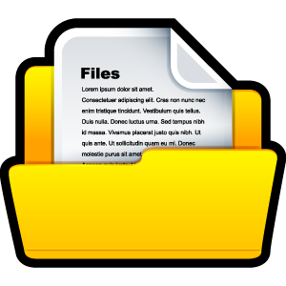
Data Structures and Algorithms Lab Code: 19ECSP201
FILES
Introduction

Slide 2

Why should I file?
Giving a input(large) to a program manually every time is a time consuming job
Can we save the input data?
A programs calculations may be required for the future run
Can we save the output data?
The inference is,
“Can we save the data?”

Slide 3
File Definition
A collection of data or information that has a name.
Almost all information stored in a computer must be in a file.
Reference: webopedia.com
A file is a place on the disk where a group of related data is stored.
Text book definition

Slide 4




File Name
A file name has two parts:
A name and
An Extension
Extension depends on the type of the file.

Slide 5
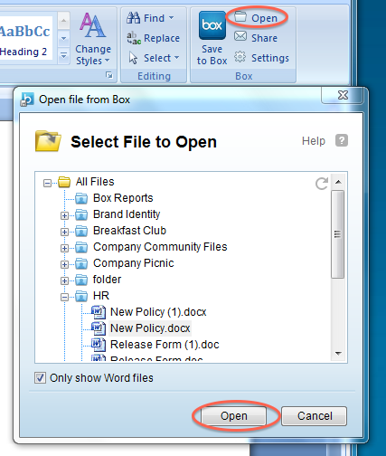
What Happens When I Open a File?

Slide 6
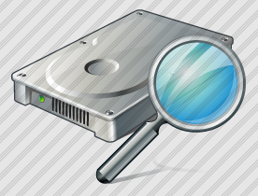
Opening a File
Search the file on the disk
Memory
Disk
Buffer
Loads file form disk to buffer space
F | I | L | E | D | A | T | A | … | …
Sets a character pointer pointing to first character of the buffer
Character Pointer

Slide 7
The Blinking Cursor

Slide 8
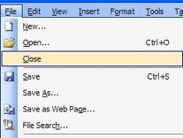
What Happens When I Close a File?

Slide 9
Closing a File
AT THE END OF THIS FILE ASCII VALUE 26 WILL BE WRITTEN
Memory
Disk
Buffer
Marking the end of the file
Characters from buffer are written to file on disk
Memory
Buffer is eliminated form the memory

Slide 10
File Operations
Create a file
Open a file
Read from a file
Write to a file
Move to a specified location in a file
Close a file

Slide 11
References
Contents:
[1] Yashwant P Kanetkar, “Let Us C”, BPB Publications, 2010
Images Icons:
[1]http://pod.doe.in.gov/groups/learningconnectionhelp/wiki/8f52d/images/f1fd4.png
[2]http://sites.box.com/help/images/plugins/office/open_file.png
[3]https://www.ctdlc.org/remediation/3-SoftwareApp/images/fileClose.jpg

Slide 12
Thank you. (More about files and API’s in Next lab session)

