Slide 1
PROMISES
Presenter : yavuz_ka

Slide 2

Synchronous & Asynchronous Behaviours

Slide 3
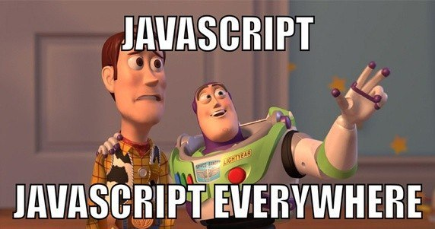
JS Mentality with Promise Perspective
Single threaded
Two bits of script cannot run at the same time!
Also called asynchronous behaviour
The codes are run one after another

Slide 4
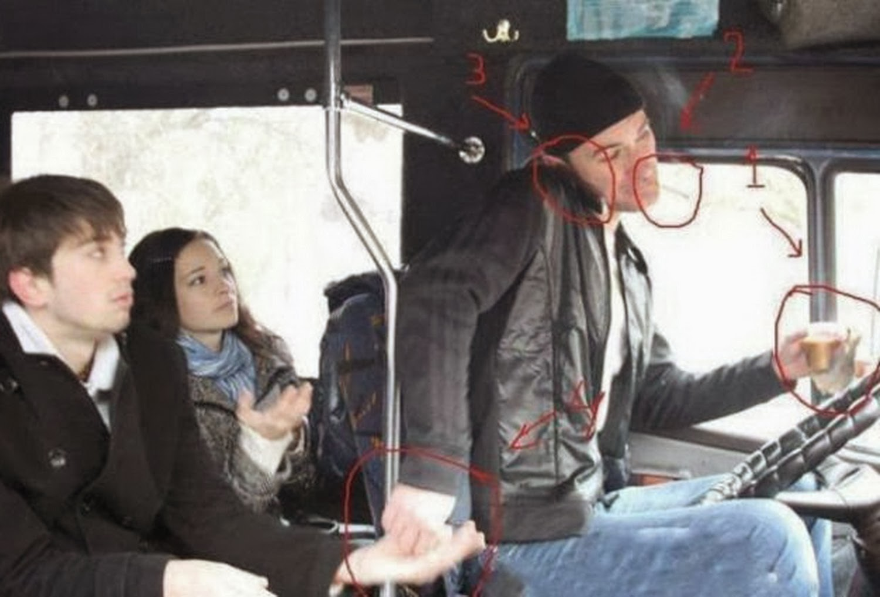
Promise Mentality(Sneezing)

Slide 5
Syntax
var promise1 = new Promise(function(resolve, reject) {
setTimeout(resolve, 100, 'foo');
if(//happy path scenario) {resolve(“gj”)}
else(//error) {reject(“error”)}
});
console.log(promise1);
// expected output: [object Promise]

Slide 6
Promise Terminology
Fulfilled
The action relating to the promise is succeeded
Rejected
The action relating to the promise is failed
Pending
The action relating to the promise is neither fulfilled nor rejected
Settled
The action relating to the promise is either fulfilled or rejected
Definition : A promise is an object that represents the result of an asynchronous operation!

Slide 7
Build & Call a Promise
Return the new promise in the function that is going to be executed in the latest function!!
A promise take one argument which is a function!
Parameter function take two arguments they are resolve and reject!
Body of the parameter function take the action part that we want to execute in queue!
We define resolve and reject parameters with if & else statement in the function which is first!
//executedfunction{promise{action,if,else{}}}
Call the promise with (“then & catch” method)
Execute the function
Then, call back the next function without braces

Slide 8
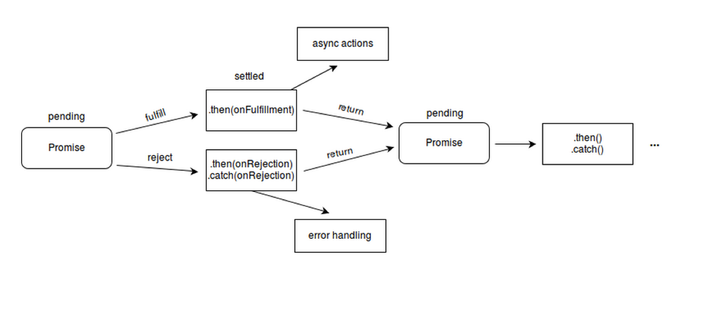
Promise Algorithm

Slide 9
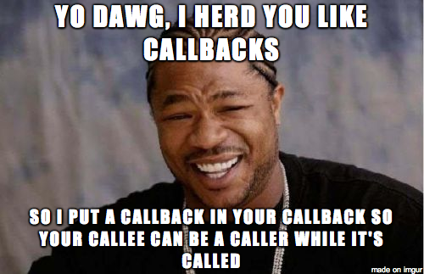
GO TO BRACKET

Slide 10
Async function & await (call)
It makes calling the promise easily!
Syntax
async function smt() {
Await function1
Await function2
}
smt()

Slide 11
Assignment
Imagine you are working in a insurance company! As a manager user, manager want to see the customer who is bigger than 25 so that, he can give better deal to customers.
Initials
There are going to be two different array, one of them have the names and the other one have the ages
Build a multi-dimensional array the name and age is shown in one array for each customer like [[name1,age1], [name2,age2],.....] --------> (function1)
And then find who is older than 25 and show it ------> function(2)

Slide 12
FlowChart

Slide 13
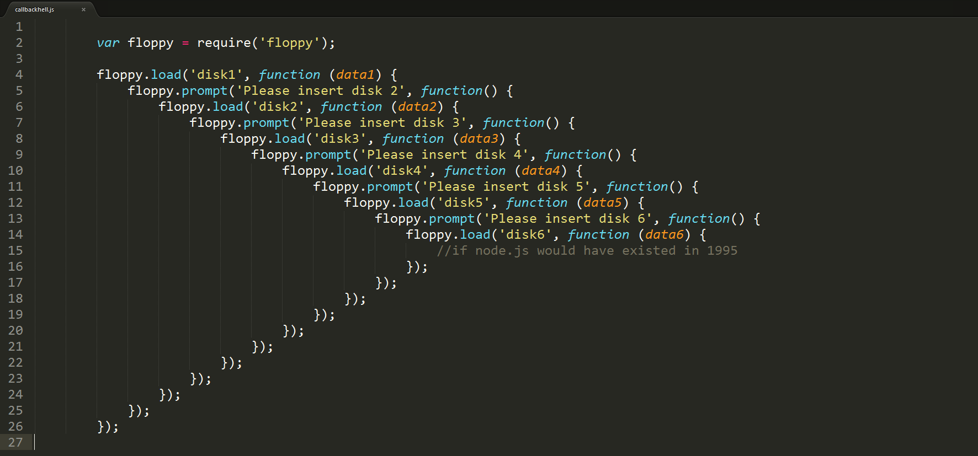
Why Promises
An antidote for callback hell!

Slide 14
2-Composible
var promise1 = Promise.resolve(3);
var promise2 = 42;
var promise3 = new Promise(function(resolve, reject) {
setTimeout(resolve, 100, 'foo');
});
Promise.all([promise1, promise2, promise3]).then(function(values) {
console.log(values);
});
// expected output: Array [3, 42, "foo"]

Slide 15
References
-https://developers.google.com/web/fundamentals/primers/promises
-https://www.youtube.com/watch?v=PoRJizFvM7s
-https://developer.mozilla.org/en-US/docs/Web/JavaScript/Reference/Global_Objects/Promise
-https://goo.gl/images/doi12U
-https://blog.acolyer.org/2017/11/10/a-model-for-reasoning-about-javascript-promises/
-http://bluebirdjs.com/docs/api/promise.all.html
-https://www.google.com/search?q=callback+hell&source=lnms&tbm=isch&sa=X&ved=0ahUKEwi86NK2hrHdAhXM6YMKHTWgBToQ_AUICigB&biw=1600&bih=763#imgrc=9ID9HMmDtL11oM:

Slide 16
THANK YOU FOR LISTENING

