Slide 1


What it takes to survive
DEBT
SUMSY
Notes:
Imagine a village of 512 people. Fields, bakeries, theatres, two banks. Everyone needs two loaves a month; three months without bread, and you die. Now imagine I build it twice, identical, and change one thing: where the money comes from. Then I run each village for ten years, ten times over, and count who still has bread.

Slide 2




Borrowed into being
Paid to everyone
Notes:
In the first village money is what it is for us: it is born when a bank makes a loan, and every coin in your pocket is a coin someone else owes. In the second, everyone receives a fixed income every month — five units — and money that sits idle above a small cushion pays a parking fee: two percent a month simply disappears. Nobody owes anyone for it. That's the whole difference.

Slide 3








One rung at a time
Notes:
I don't switch everything on at once. Bare fields first. Then a government. A theatre. A stock market. Cooperatives. Taxes. One rung at a time, both villages, same rung, and at every rung: who is alive, what does bread cost, what does the government owe.

Slide 4
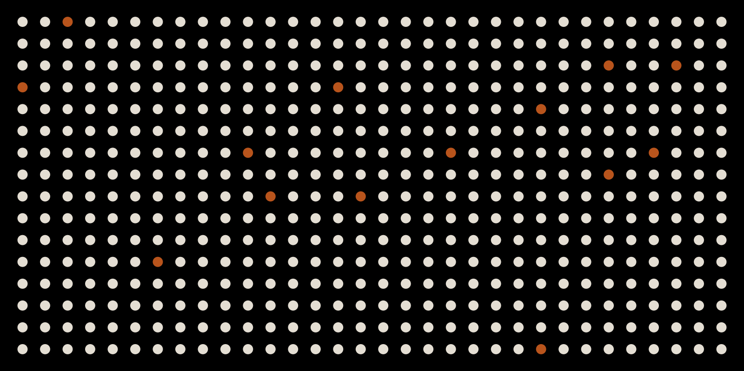
No government
14
510
data: 24 Sept run — to refresh
Notes:
Bare fields, no government. In the debt village, fourteen people are left after ten years. There is no work for most of them, without work no money, without money no bread. In the SuMSy village almost everyone lives: five units a month is a meal. Same fields, same bakers. Only the money.

Slide 5
Living on debt
191k
public debt, year 10
data: 24 Sept run — to refresh
Notes:
Add a government: public jobs and a bread allowance for the unemployed. Now everyone lives — and the government borrows about three quarters of what it spends, every month, for ten years. I tried every tax the village could bear. Balance the books, and fourteen people are left. The debt village lives *because* its government goes into debt. And it can never get out: in that village, every coin in circulation is someone's debt.

Slide 6
A startup cost
Repaid
in every run
data: 24 Sept run — to refresh
Notes:
It does — once. While the new money is still filling up the village, the parking fee brings in little, and the SuMSy government borrows its citizens' savings: about two months of guaranteed income per villager. Then it pays every unit back, in every run (*). A startup cost. One village repays; the other cannot.

Slide 7
Shares widen the gap
rich–poor gap, in meals
data: 24 Sept run — to refresh
Notes:
Now firms get owners, and shares that trade. Money in the SuMSy village had been spread almost evenly. With shares the gap between the richest tenth and the poorest tenth more than triples — from about 23 meals to 78. It stays far below the debt village's, where the gap is over 200 meals. So the money system does a lot, but ownership is the other half of the story. Cooperatives take the SuMSy gap back down to about 63.

Slide 8
What is land worth?
44
1,400
49
debt money
SuMSy
SuMSy + land fee
months of rent
data: 24 Sept run — to refresh
Notes:
Land. In the debt village land sells for about four years of rent. In the SuMSy village, nobody sells — because money melts and land doesn't, so land becomes the thing to hold, and the rare sale goes for a fortune. Silvio Gesell saw this a century ago. The fix is a fee on land, paid out to everyone as a dividend: then land trades again, at the debt village's price, and the gap between rich and poor is the smallest of all three (*).

Slide 9

Everyone greedy
CLOSED
OPEN
×50
data: 24 Sept run — to refresh
Notes:
Then I did something unkind: I made everyone greedy. Spend every surplus, ten loaves at a time, forever. The SuMSy bakeries go bankrupt — and someone reopens one — again, and again, fifty times in ten years (*). And everyone still eats. What it took was two things: prices that move when bread runs short, and a village that starts a new bakery when the last one falls. Money didn't save them. Rules did.

Slide 10








What it takes
DEBT
SUMSY
BOTH
Notes:
Ten years, ten runs, twelve rungs. What it takes to survive: in the debt village, a government willing to be permanently in debt. In the SuMSy village, an income everyone gets and a fee on idle money that pays for the state — and a fee on land, or the rich end up owning the fields. In both: prices that respond, and taxes that stay off bread — the one tax that killed the village was the tax on bread. And the open questions I can't answer yet: how big a public sector can each money afford (*), and what happens in the ten years when you switch from one money to the other. That's the next simulation.

Slide 11
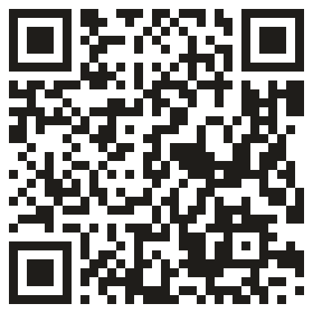
The village is public
Which rule would you change?
Notes:
Everything here is a rule I chose, and every number comes from a run you can repeat: the code, the village and the report are public. I built one village and broke it a hundred ways. The question I'd leave you with isn't which money is better. It's this: every rule of money is a choice someone made. Which of them would you change?

