Slide 1

From Fitbit Behavior to Bellabeat Strategy
Presented by:Farhah
Last Updated: July 26, 2025

Slide 2
From Data to Strategy: Key Steps
01
Purpose & Business Questions
02
Understanding the Data
03
Insights & Patterns from the Data
04
Key Findings
05
Strategic Recommendations

Slide 3
What are we
Talking about?

Slide 4
Purpose & Business Questions
This case study aims to analyze Fitbit user behavior to uncover usage patterns, generate strategic insights, and inform Bellabeat’s marketing for products like Leaf, Time, and Spring.
What are the trends in smart device usage?
How can these trends be applied to Bellabeat’s customers?
How can these trends help shape Bellabeat’s marketing strategy?

Slide 5

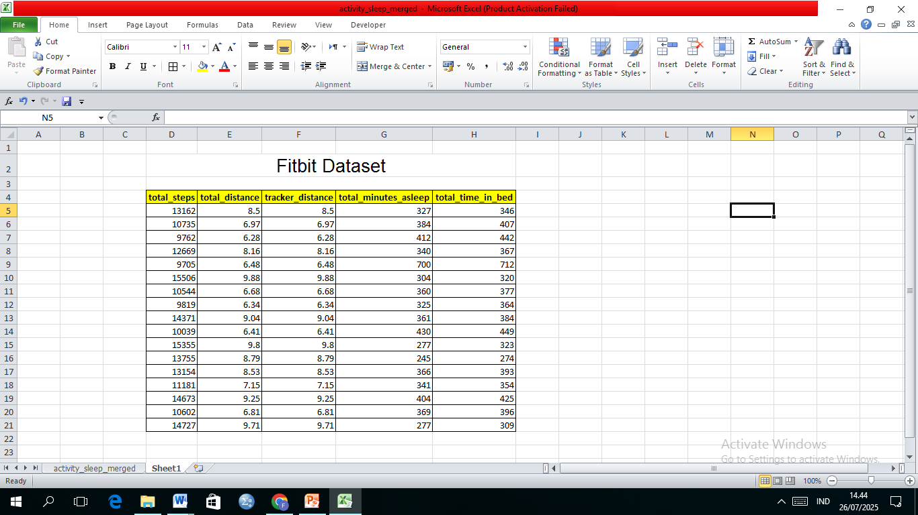


Understanding the Data
Data Sourse
This analysis uses Fitbit Fitness Tracker data publicly available on Kaggle.
Dataset Details
It includes activity, sleep, and weight data from 30 users over 31 days (April 12 – May 12, 2016).
Data Content & Values
Daily records cover steps, calories, sleep duration, and weight logs. Despite limited users, it offers valuable behavioral insights for Bellabeat’s strategy.

Slide 6
Present Data
Daily Activity

Slide 7
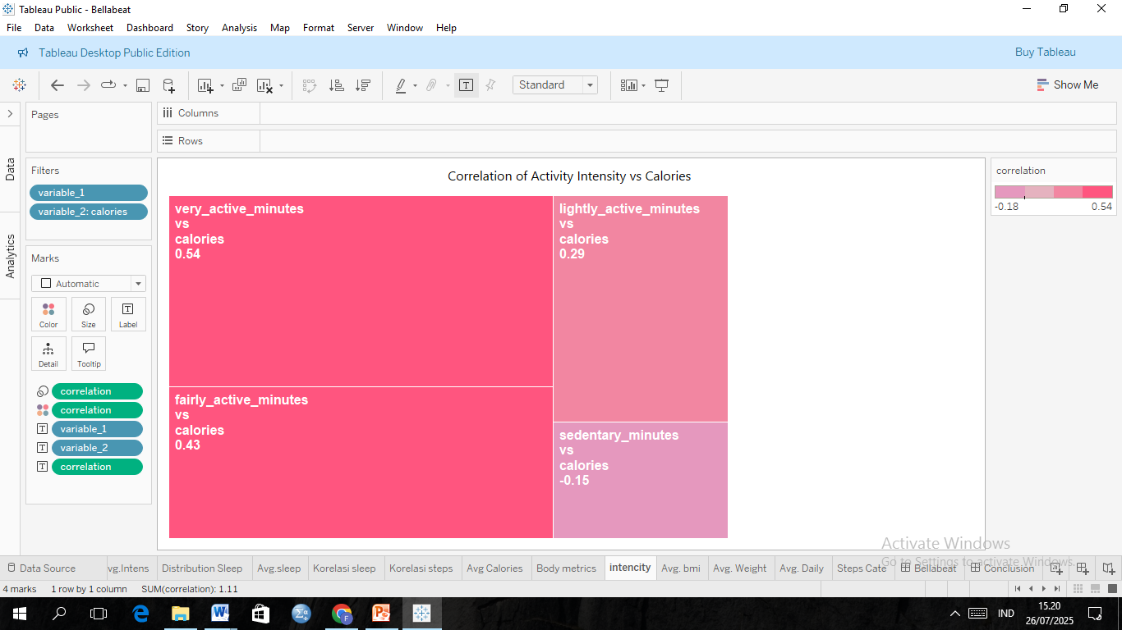



Correlation score
Activity Intensity vs Calories
Very Active
Lightly Active
Shows a moderate positive correlation with calories burned (r = 0.54), indicating high-intensity activity is effective for calorie expenditure.
Has a weak positive correlation (r = 0.29), contributing less to calorie burn.
Fairly Active
Sedentary Minutes
Also positively correlated (r = 0.43), though less impactful than very active minutes.
Shows a weak negative correlation (r = -0.15), more sitting time is associated with fewer calories burned.

Slide 8
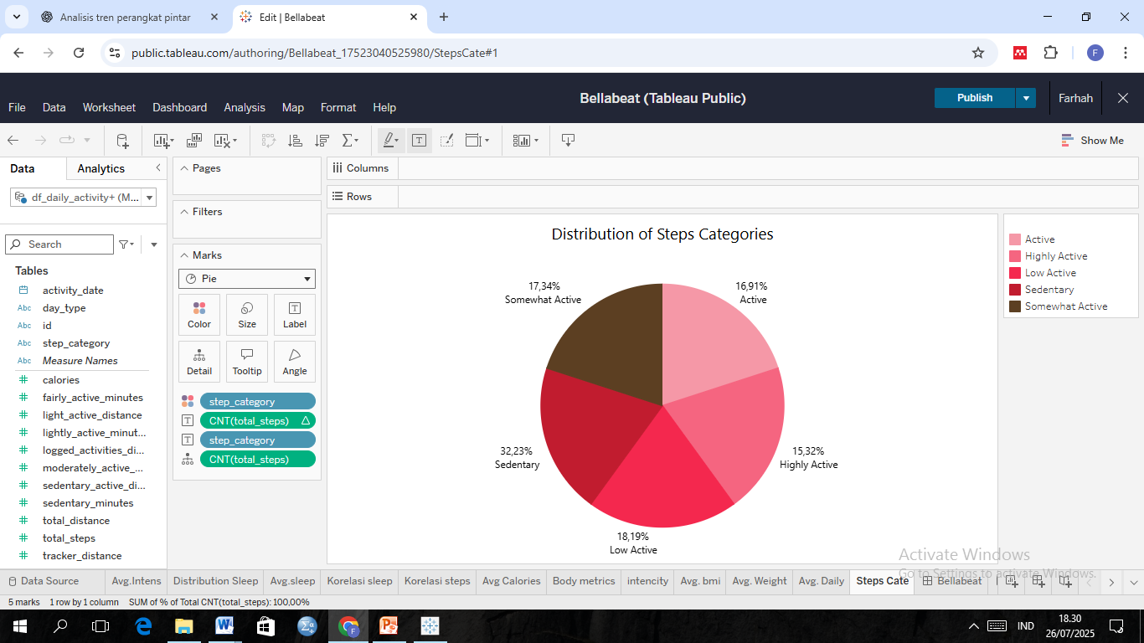
Distribution of Step Categories
32,23%
18.19%
Sedentary
17,34%
Low Active
16,91%
Somewhat Active
15,32%
Active
Highly Active
Based on the daily step classification by Tudor-Locke (2004), the majority of users have not reached the recommended physical activity levels and tend to lead a sedentary lifestyle

Slide 9

Sleep Day

Slide 10
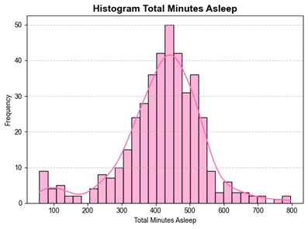
Distribution of Total Sleep Duration
Sleep Distribution Pattern
Number of users per sleep duration range
The distribution of users’ sleep duration is approximately normal but slightly right-skewed due to a few outliers with very long sleep durations (>11 hours)
Majority Sleep Duration
Most users sleep between 350–500 minutes (around 5.8–8.3 hours), with a peak at 420–450 minutes (7–7.5 hours), aligning with the recommended 7–9 hours of sleep per day
Manager
Distribution Line
Overall Sleep Quality
The majority of users appear to have adequate and healthy sleep patterns, although extreme cases of very short (<5 hours) or very long (>10 hours) sleep are present but uncommon.
Text Here
Text Here
Text Here

Slide 11
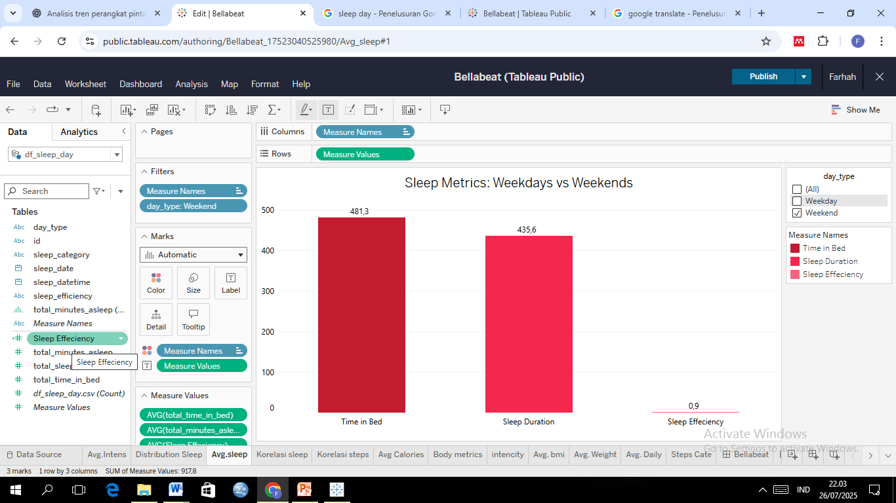
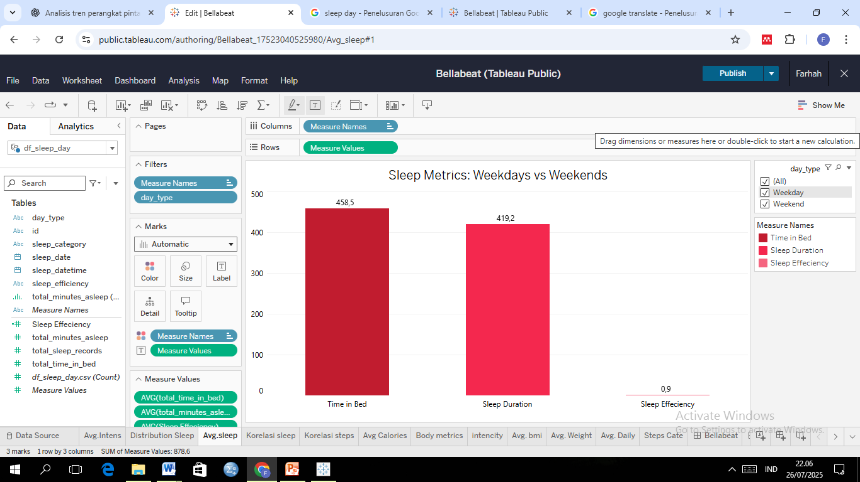
Sleep Metrics: Weekday vs Weekend
Weekday
Average
Weekend
Users tend to sleep longer and spend more time in bed on weekends, yet maintain stable sleep efficiency throughout the week, indicating a fairly regular and healthy sleep pattern.

Slide 12
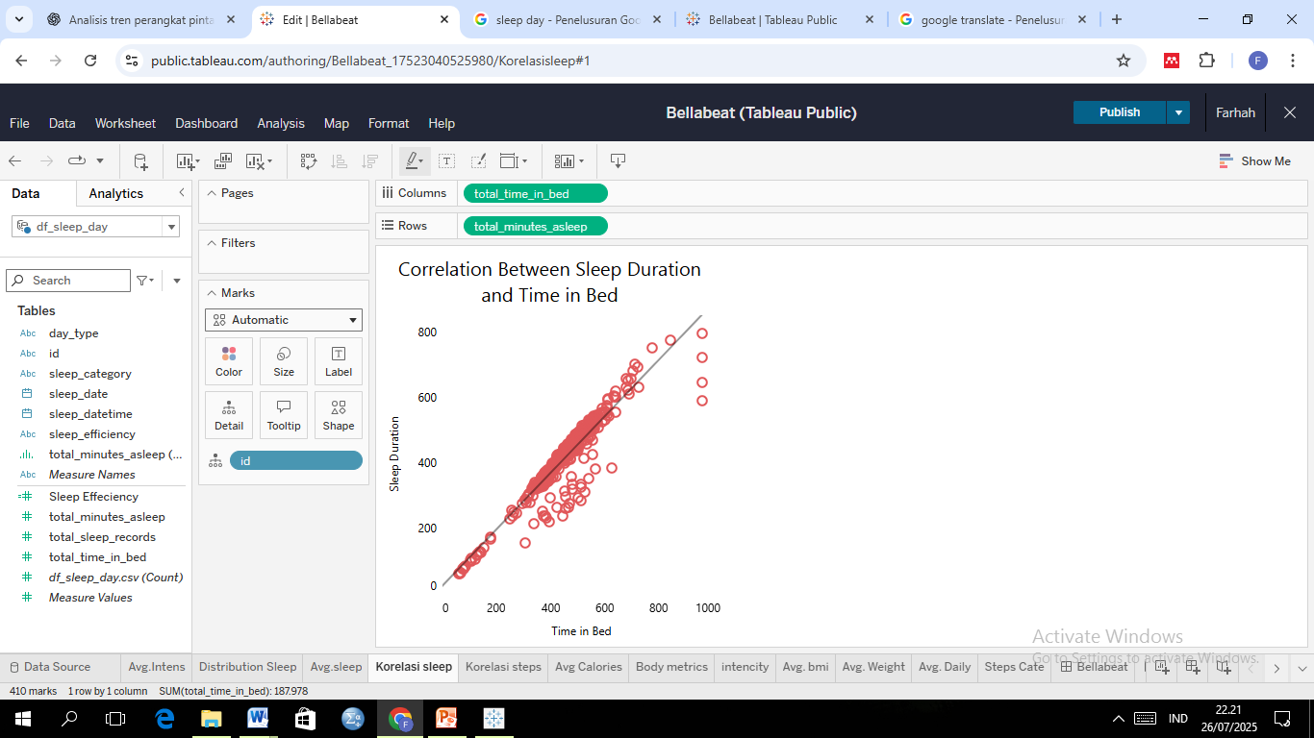
Correlation Sleep Duration vs Time in Bed
0,92
One user's sleep record
Upward Trend: Indicates a strong positive relationship
A strong correlation (0.92) shows that the longer users stay in bed, the longer they sleep, though not all bed time is spent sleeping.
Actual sleep duration (in minutes)
Time in bed not fully used for sleeping
Duration spent in bed (in minutes)

Slide 13
Weight Log Info

Slide 14


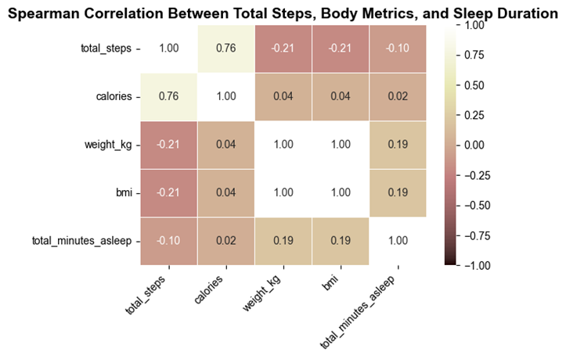
Correlation Between Steps, Body Metrics, and Sleep
Color Intensity: Shows strength of correlation
Positive Correlation
Avg. BMI
25,19
Avg. Weight
72,04
Users have an average body weight of 72 kg and a BMI of 25, which falls at the borderline between normal and overweight. Physical activity shows weak or negative correlations with body weight (-0.21), BMI (-0.21), and sleep duration (-0.10). These weak correlations are likely due to the small sample size and short observation period.
Negative Correlation

Slide 15
Steps vs Sleep

Slide 16

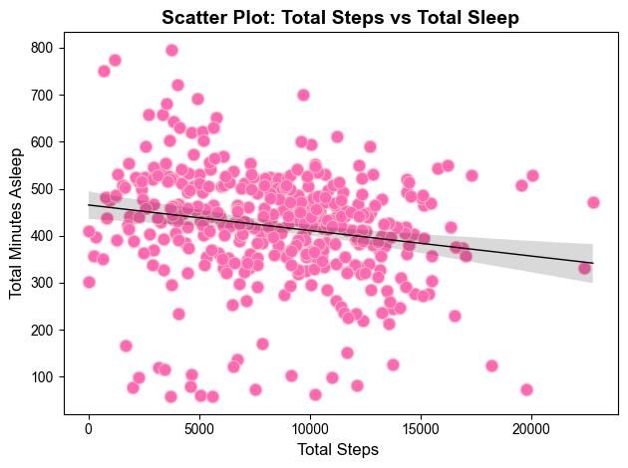
Corelations of Total Steps vs Total Sleep
-0.22
There is a weak negative correlation (-0.22) between daily step count and sleep duration. More steps tend to be followed by slightly shorter sleep, though the relationship is very weak and does not indicate a strong pattern..

Slide 17
The Impact of Steps Categories and Sleep
Duration Categories on Calories
 | Borderline (6–7h) | Long (>9h) | Recommended (7–9h) | Short (<6h)
Active | 2608.45 | 3093.20 | 2511.06 | 2184.76
Highly Active | 2886.35 | 3849.67 | 3229.15 | 2120.46
Low Active | 2395.40 | 2045.33 | 2398.39 | 2494.75
Sedentary | 1970.79 | 1843.32 | 1785.45 | 2024.38
Somewhat Active | 2897.80 | 2288.00 | 2554.56 | 2562.00
Sleep Duration Categories
Higher activity and longer sleep lead to more calories burned. Sedentary users and short sleep durations result in significantly lower energy expenditure.
Steps Categories

Slide 18
Key Findings
Conclusion

Slide 19

Key Trends in Smart Device Usage
Most users are lightly active with prolonged sedentary time.
Sleep duration is mostly healthy, but varies individually.
Weekday-weekend activity patterns are generally consistent.
Activity and sleep quality both impact health, though correlation is weak.
Smart device trends align well with Bellabeat’s health-conscious users. They benefit from features tracking both activity and sleep quality. Given high sedentary time, movement reminders and detailed sleep tracking are essential. Stable sleep patterns offer a chance to improve sleep quality. Bellabeat can position its products as a holistic solution for women's wellness.

Slide 20
Strategic Recommendations
Smart device trends match Bellabeat users’ health focus.
Movement reminders needed due to high sedentary time
Features track both activity and sleep quality.
Bellabeat offers holistic wellness solutions for women.
Bellabeat’s Holistic Approach to Women’s Wellness

Slide 21
THANK YOU
From Fitbit Behavior to Bellabeat Strategy

