Slide 1
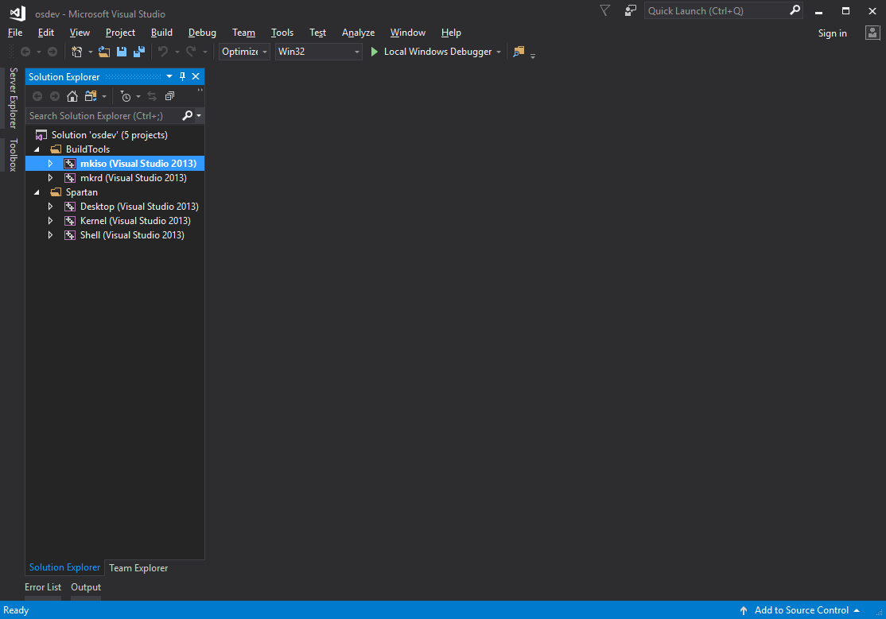
This Project Has ZERO Dependencies

Slide 2
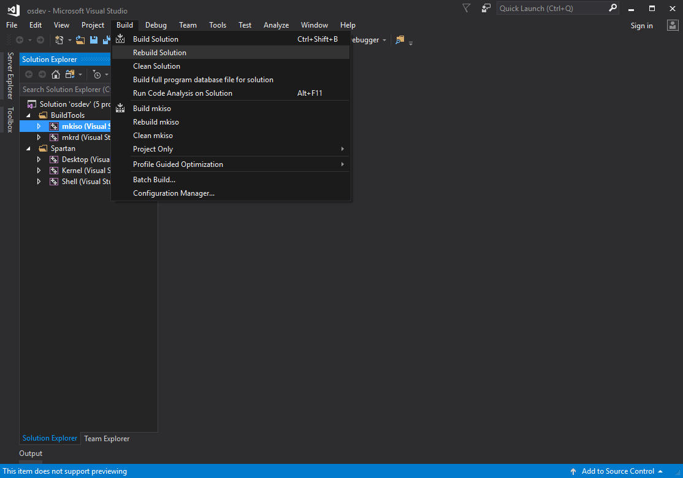
[Menu] -> [Build] -> [Rebuild Solution]

Slide 3
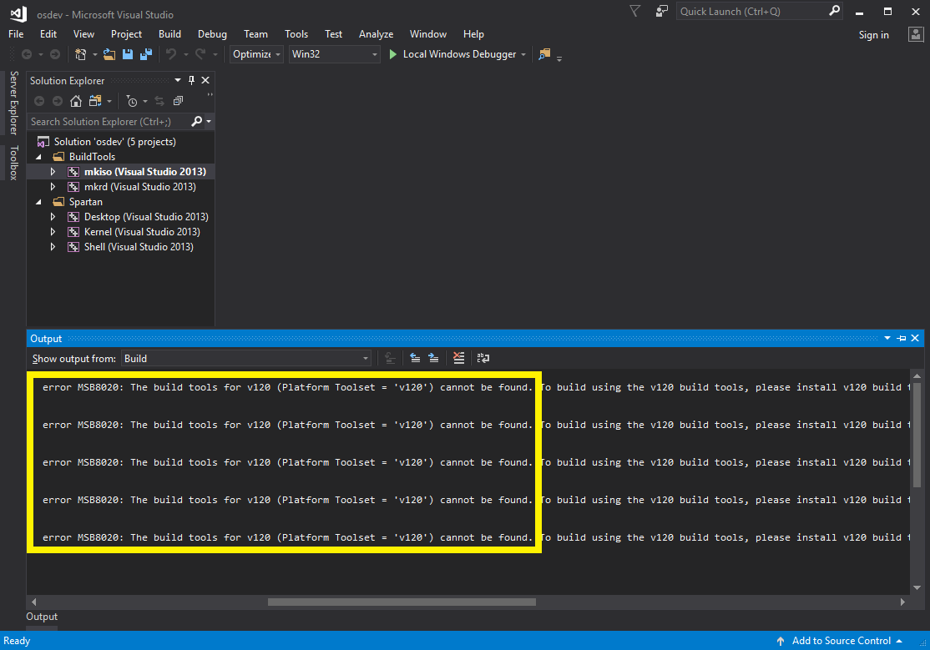
I’m not using any of that but MSVC wants it
Refuses to Build?

Slide 4
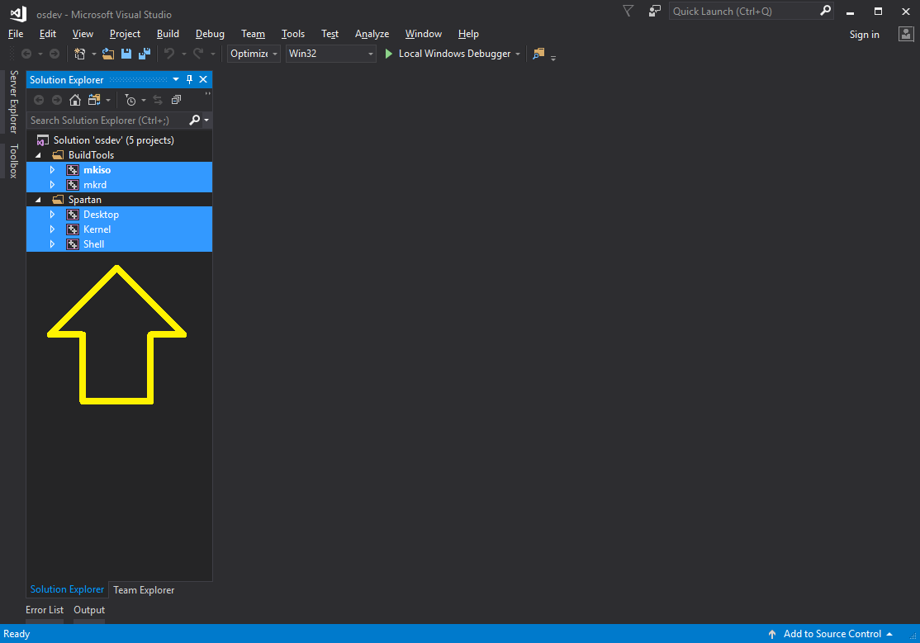
Select All Projects (Ctrl + Click)
SELECT ALL

Slide 5
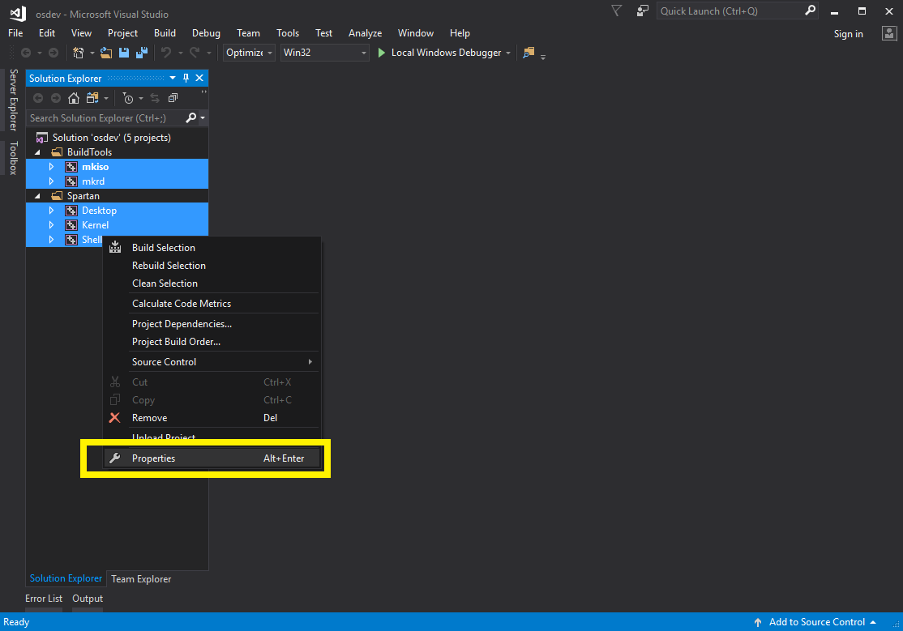
[Right Click] -> [Properties]

Slide 6
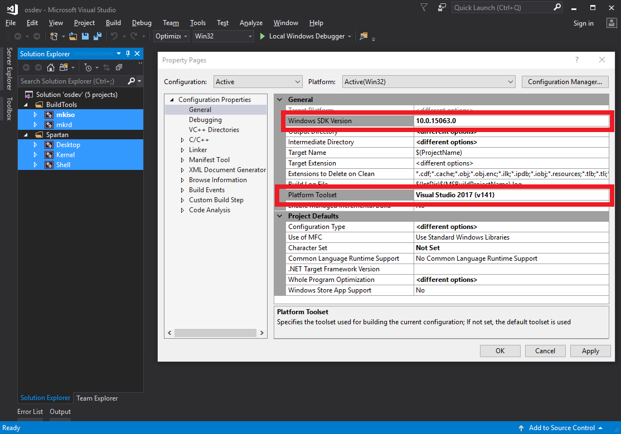
Set Both Window SDK and Platform Toolset as you installation of MSVC suggests

Slide 7
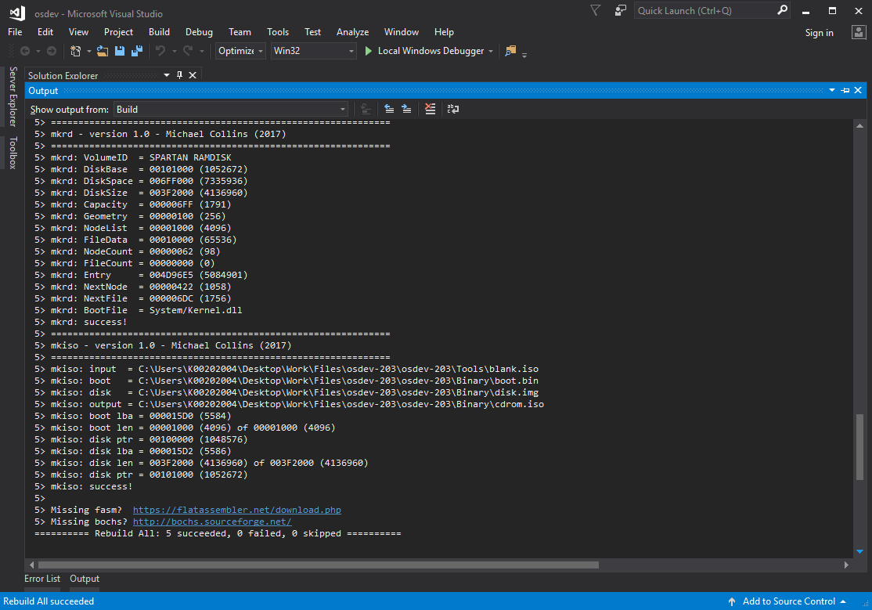
[Menu] -> [Build] -> [Rebuild Solution]

Slide 8
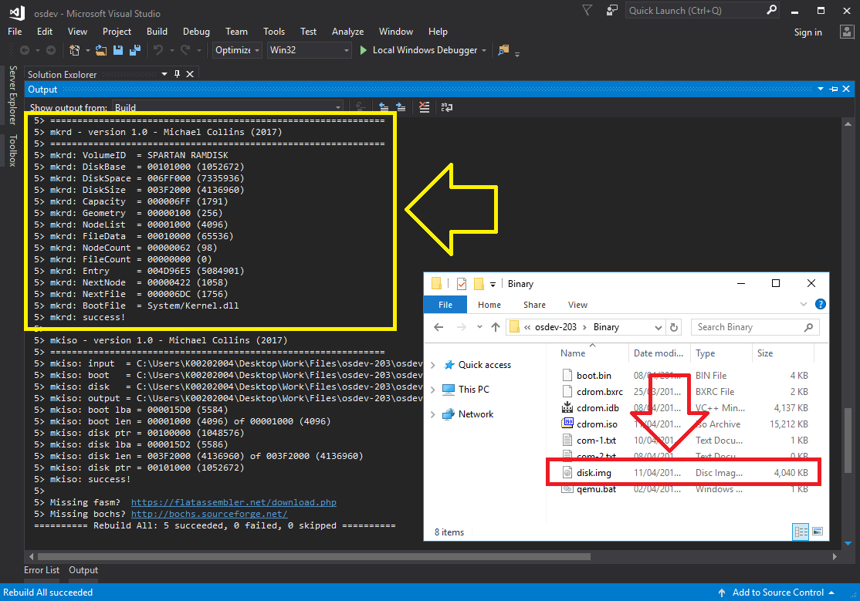
mkrd is the custom build tool which creates the Ram Disk. It outputs Build/disk.img

Slide 9
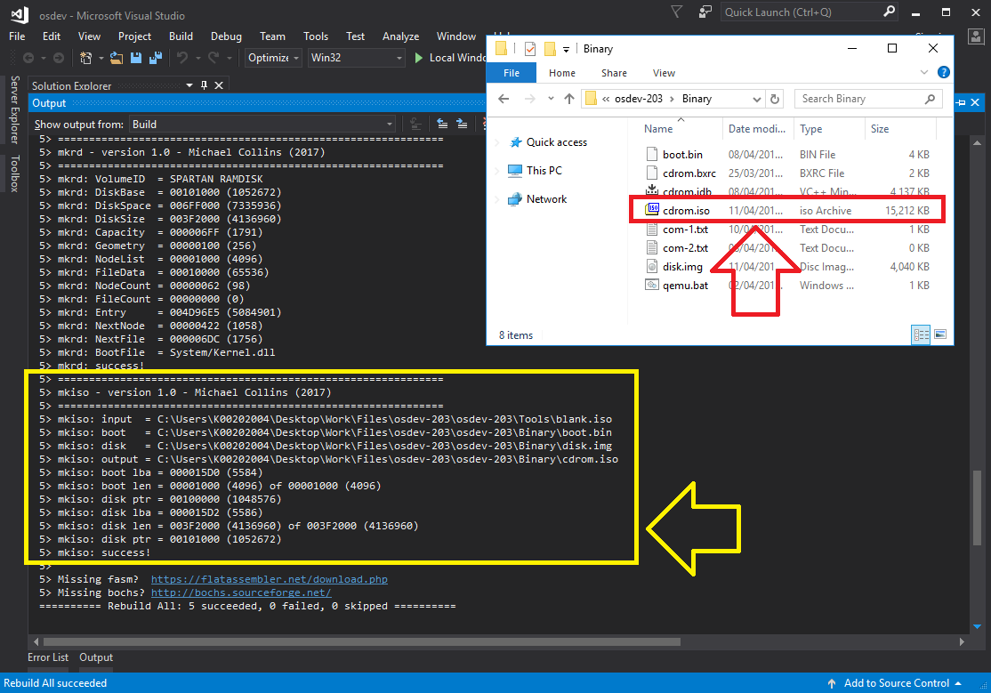
Mkiso builds the cdrom.iso image cdrom.iso IS THE RELEASE BUILD

Slide 10
Wanna run it? You need a Virtual Machine

Slide 11
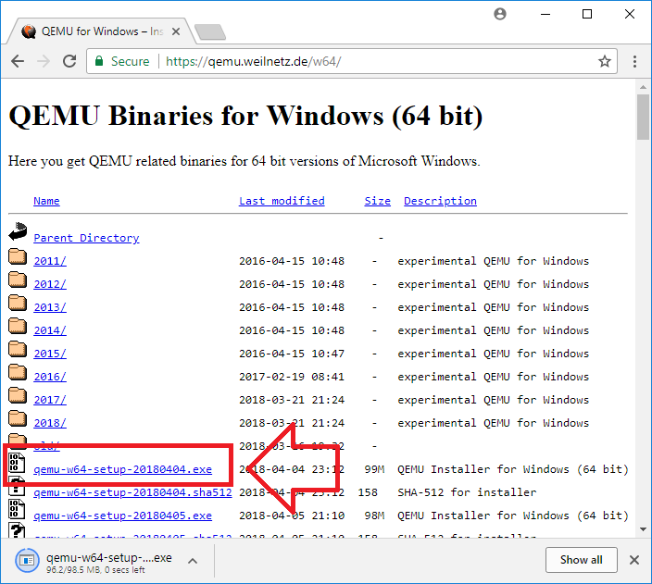
Qemu is a VM and can be obtained here https://qemu.weilnetz.de/w64/

Slide 12
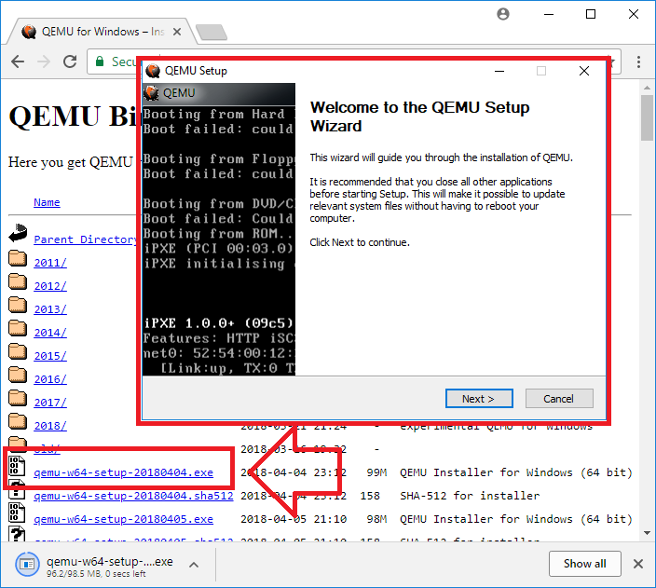
Just Follow the prompts

Slide 13
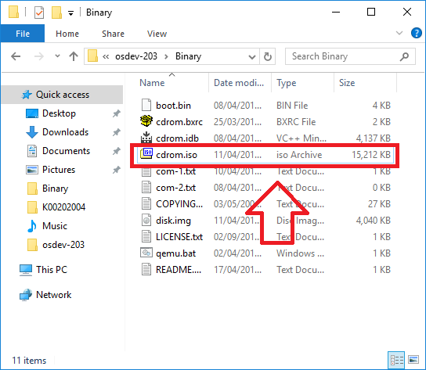
By default Qemu emulates 64 bit system We need arch=i386 so…

Slide 14
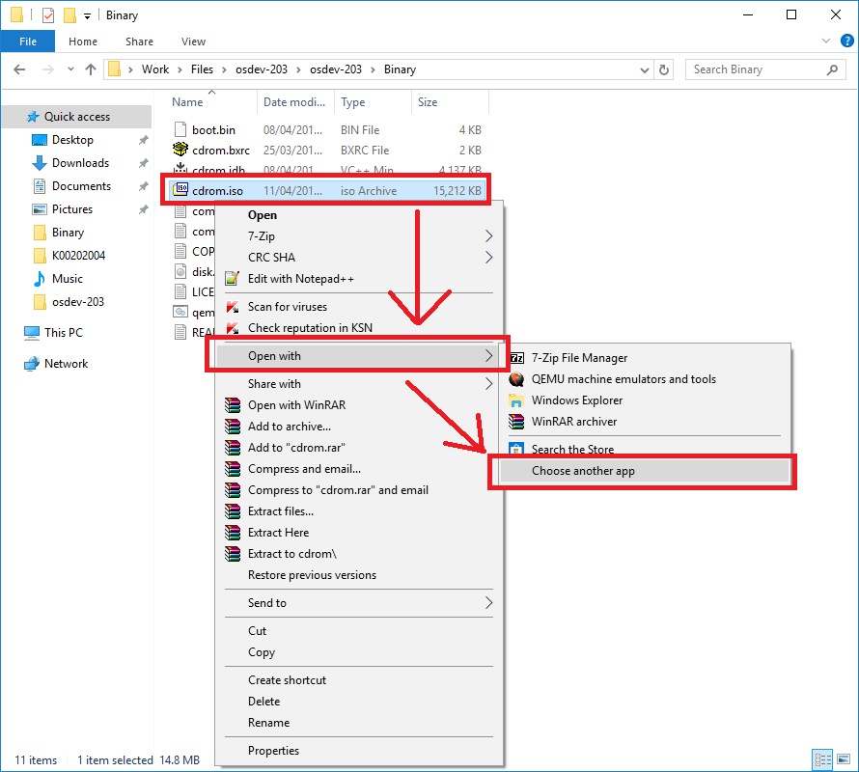
Right Click cdrom.iso and select [Open With] -> [Choose Another App]

Slide 15
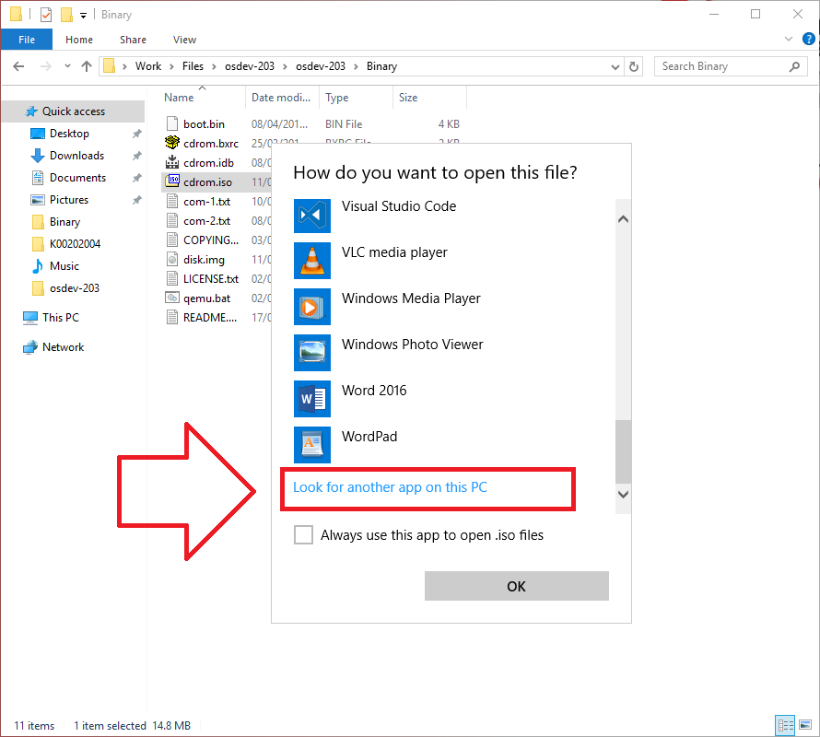
Choose “Look for another app”

Slide 16
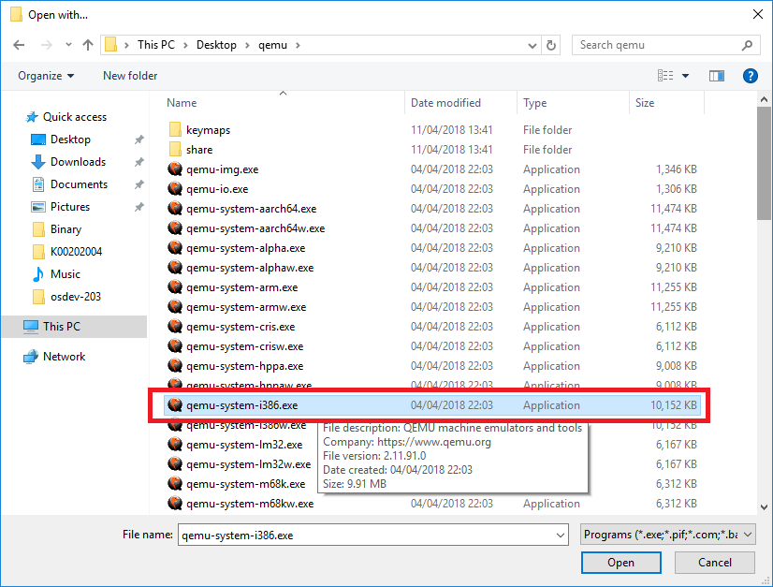
The Qemu version needs to emulate is qemu-system-i386

Slide 17
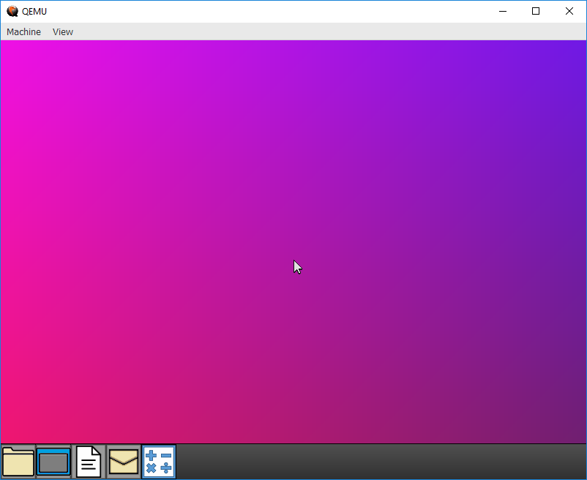
And this is what you will see. This is the Spartan Desktop, enjoy

Slide 18
Qemu is much slower than running on a real machine but the speed is fully interactive

Slide 19
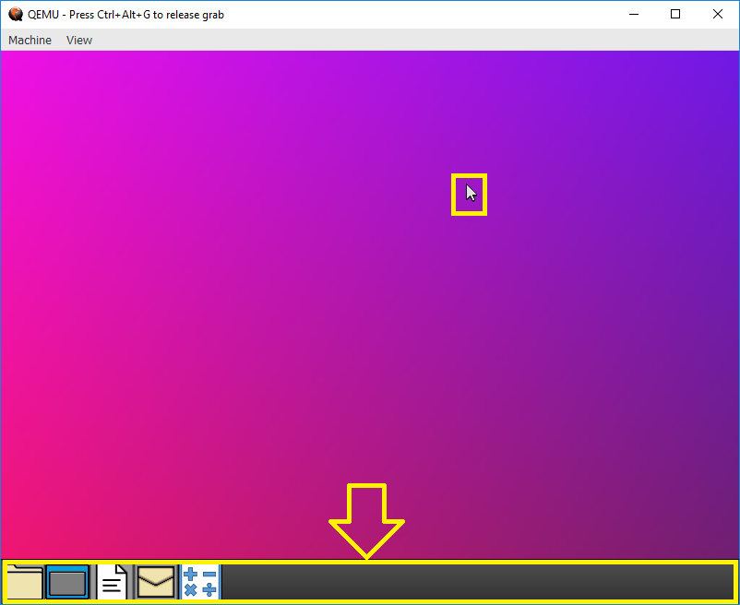
Here the Task Bar and Mouse Cursor have been hilighted

Slide 20
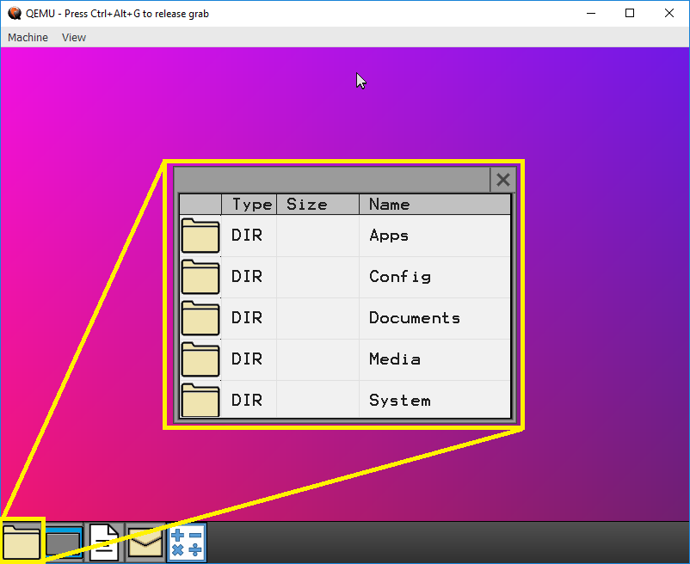
This Utility is the File System Browser It is currently displaying the root directory

Slide 21
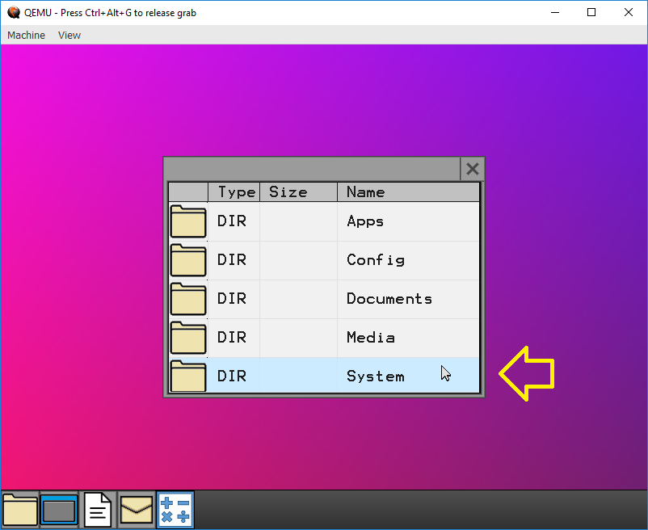
This is the System Folder (Keep out please)

Slide 22
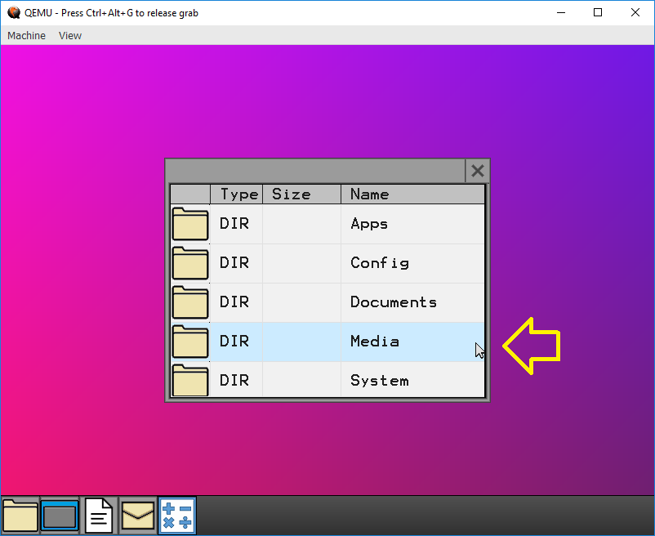
The Media Folder contains Data Files such as Images, Icons, Fonts, Audio, and Video

Slide 23
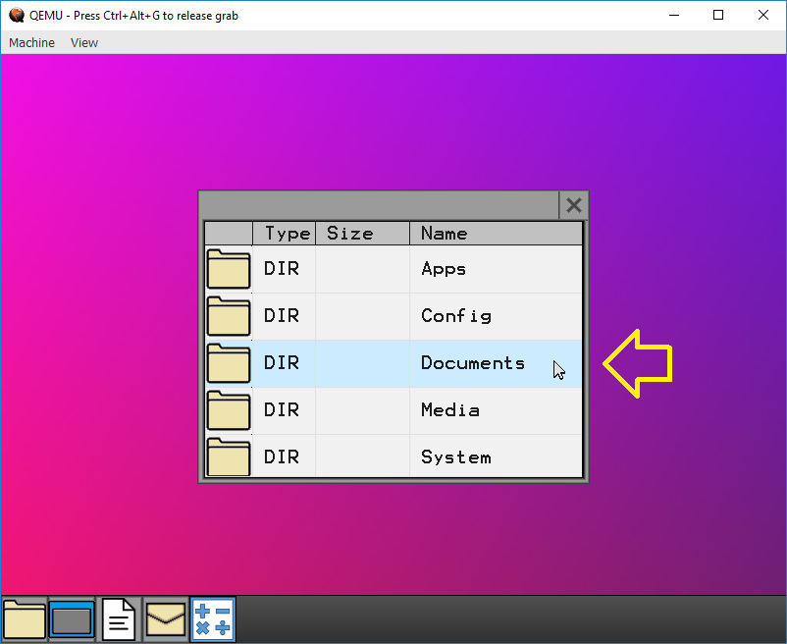
The Documents Folder contains Text Files

Slide 24
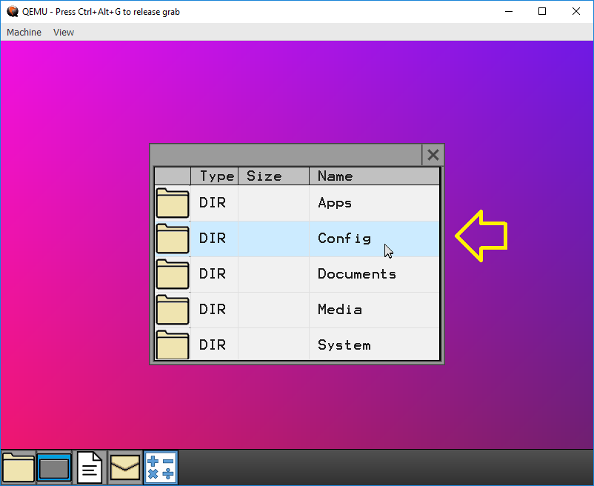
The Config Folder contains configuration files, Currently there is only keyboard settings

Slide 25
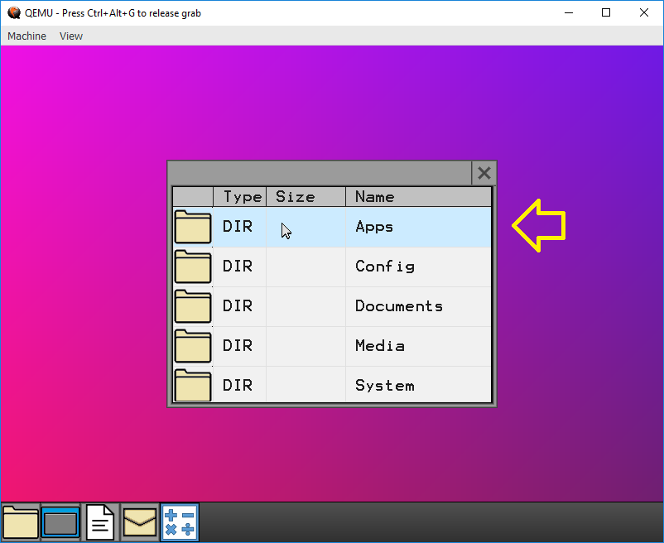
The Apps Directory house Utility Programs and Applications, lets look inside

Slide 26
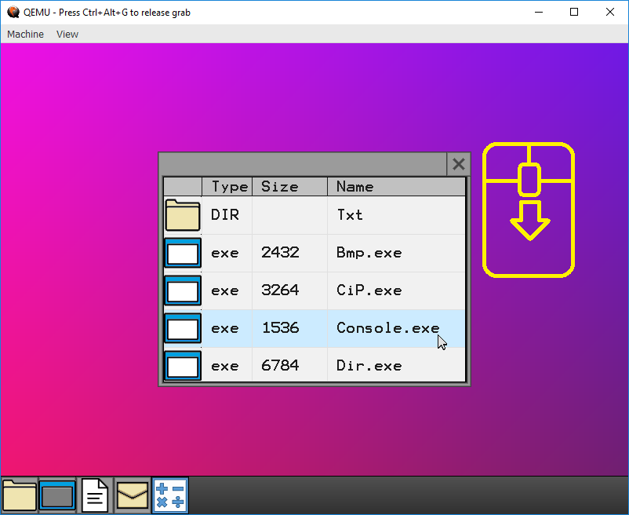
Use the Mouse Wheel to Scroll Down

Slide 27
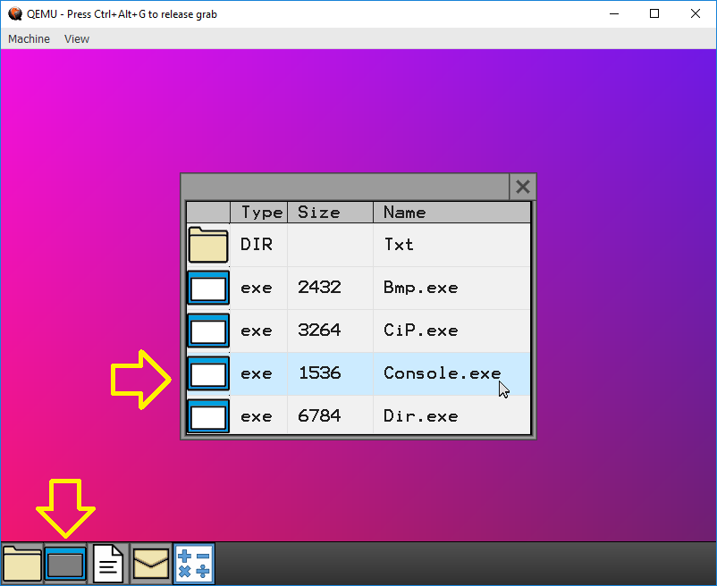
That’s the Console It can also be started from the Task Bar

Slide 28
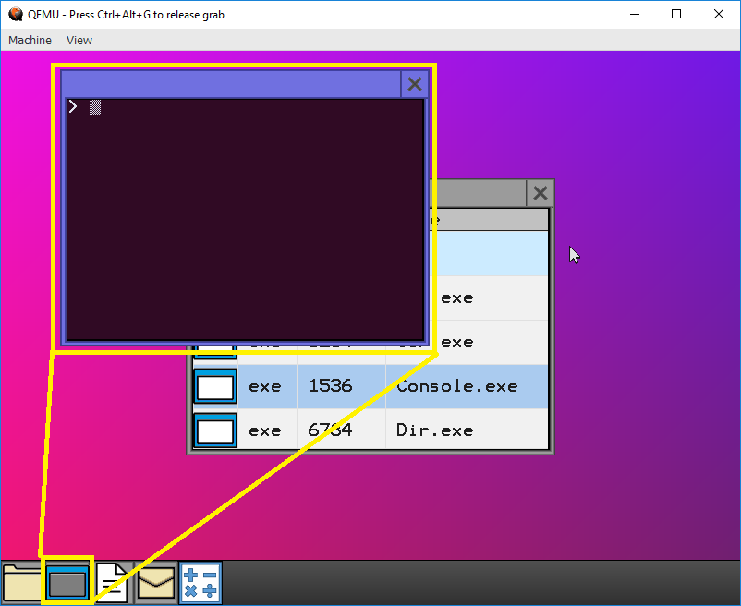
Each window will have one of 4 colours, this one is Blue, there is also, Grey, Red, Green

