Slide 1
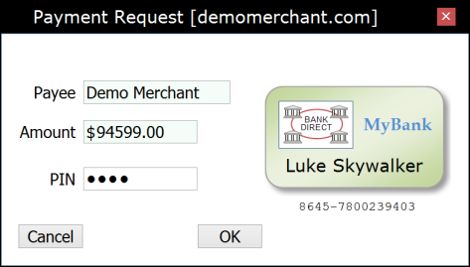
Merchant Web Application (Payee)
Wallet Application (Payer)
Payment Provider (Bank Server)
Client
Server
“Checkout”
HTTP POST/GET
1
Payment HTML page
Starts the Wallet application
Account-2-Account Direct Debit
Web Payment Scheme
◄
Initializing…
WalletInitialized
Information provided by the card-holder token
2
W2NB
window {}
PKI-signed message container
acceptedAccountTypes
paymentRequest {
WalletRequest
W2NB
3
5
payee amount currency
… signature {}
4
paymentRequest {
payee amount currency
… signature {}
“User Accept”
“Select Card”
(Optional)
payerAccount {} ◄
…
signature {} ◄
“PIN + OK”
User authorization
Encrypt the authorized request above using a Payment Provider public RSA or ECDH key ◄
Working…
W2NB
PayerAuthorization
providerAuthorityUrl ◄
accountType ◄
authorizationData {}
6
HTTP Form POST
(Cached)
HTTP GET
authorityUrl
transactionUrl
encryptionParameters {}
…
Signature {}
7
Authority
HTTP Response
authorizationData {}
requestHash {}
accountType payeeAccounts
…
signature {}
HTTP POST
DirectDebitRequest
8
∙ Decrypting authorizationData ∙ Hooking into the local bank payment backend…
paymentRequest {
DirectDebitResponse
payee amount currency
… signature {}
9
HTTP Response
Result HTML page
Closes the Wallet application
accountType
accountReference
payeeAccount
…
signature {}
WebPKI.org/AR 20150928

