Slide 1
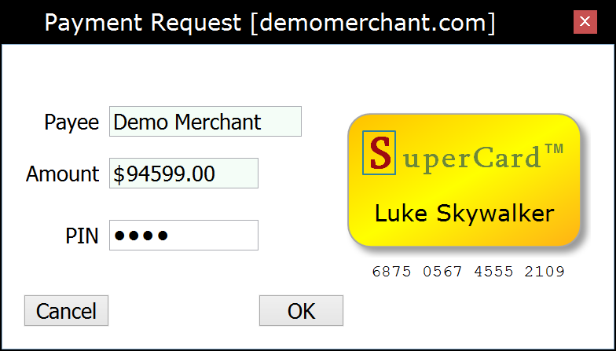
Merchant Web Application (Payee)
Wallet Application (Payer)
Payment Provider (Bank Server)
Acquirer (Card Processor)
Client
Server
“Checkout”
HTTP POST/GET
Card/Acquirer-based
Web Payment Scheme
1
Payment HTML page
Starts the Wallet application
◄
Embeds
Initializing…
WalletInitialized
Information provided by the card-holder token
2
W2NB
window {}
PKI-signed message container
acceptedAccountTypes
paymentRequest {
WalletRequest
W2NB
3
4
5
payee amount currency
… signature {}
paymentRequest {
payee amount currency
… signature {}
“Select Card”
(Optional)
payerAccount {} ◄
…
signature {} ◄
“PIN + OK”
User authorization
Encrypt the authorized request above using a Payment Provider public RSA or ECDH key ◄
Working…
6
W2NB
PayerAuthorization
providerAuthorityUrl ◄
accountType ◄
authorizationData {}
HTTP Form POST
HTTP GET
(Cached)
7
Authority
HTTP Response
authorityUrl
transactionUrl
encryptionParameters {}
…
Signature {}
authorizationData {}
requestHash {}
accountType acquirerAuthorityUrl
expires
…
signature {}
HTTP POST
ReserveFundsRequest
8
HTTP GET
(Cached)
Authority
9
HTTP Response
authorityUrl
transactionUrl
encryptionParameters {}
…
Signature {}
∙ Decrypt authorizationData
∙ Encrypt user account data ∙ Hook into the local bank payment backend…
ReserveFundsResponse
paymentRequest {
10
HTTP Response
payee amount currency
… signature {}
amount
providerAuthorization {
…
signature {}
accountType
accountReference
protectedAccountData {}
expires
…
signature {}
paymentRequest {
payee amount currency
… signature {}
accountType
accountReference
protectedAccountData {}
expires
…
signature {}
HTTP POST
FinalizeRequest
11
12
∙ Decrypt protectedAccountData ∙ Hook into the payment network backend…
13
FinalizeResponse
HTTP Response
requestHash {}
…
signature {}
Result HTML page
Closes the Wallet application
WebPKI.org/AR 20150929

