Slide 1
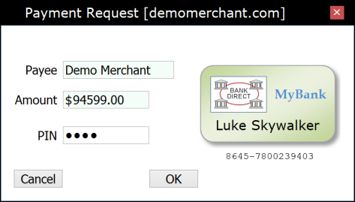
Merchant Web Application (Payee)
Wallet Application (Payer)
Payment Provider (Bank Server)
Client
Server
“Checkout”
HTTP POST/GET
1
Payment HTML page
Starts the Wallet application
Account-2-Account Direct Debit
Web Payment Scheme
◄
Initializing…
Embeds
WalletInitialized
window { }
Information provided by the card-holder token
2
W2NB
PKI-signed message container
acceptedAccountTypes
paymentRequest {
WalletRequest
W2NB
3
5
payee amount currency
… signature { }
4
paymentRequest {
payee amount currency
… signature { }
“Select Card”
(Optional)
“PIN + OK”
User authorization
payerAccount { } ◄
…
signature { } ◄
Encrypt the authorized request above using a Payment Provider public RSA or ECDH key ◄
Working…
6
W2NB
PayerAuthorization
providerAuthorityUrl ◄
accountType ◄
authorizationData { }
HTTP Form POST
HTTP GET
(Cached)
Authority
authorityUrl
transactionUrl
encryptionParameters { }
…
Signature { }
7
HTTP Response
authorizationData { }
requestHash { }
accountType payeeAccounts [{ },…]
…
signature { }
HTTP POST
DirectDebitRequest
8
∙ Decrypt authorizationData ∙ Hook into the local bank payment backend…
paymentRequest {
DirectDebitResponse
payee amount currency
… signature { }
9
HTTP Response
Result HTML page
Closes the Wallet application
accountType
accountReference
payeeAccount { }
…
signature { }
WebPKI.org/AR 20151001

