Slide 1
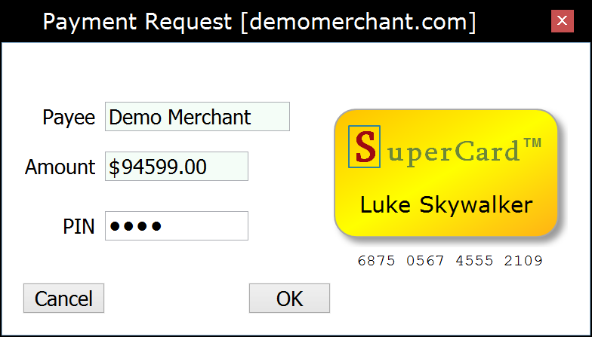
Merchant Web Application (Payee)
Wallet Application (Payer)
Payment Provider (Bank Server)
Acquirer (Card Processor)
Client
Server
“Checkout”
HTTP POST/GET
Card/Acquirer-based
Web Payment Scheme
1
Payment HTML page
Starts the Wallet application
◄
Embeds
Initializing…
WalletInitialized
window { }
Information provided by the card-holder token
2
W2NB
PKI-signed message container
acceptedAccountTypes
paymentRequest {
WalletRequest
W2NB
3
4
5
payee amount currency
… signature { }
paymentRequest {
payee amount currency
… signature { }
“Select Card”
(Optional)
“PIN + OK”
User authorization
payerAccount { } ◄
…
signature { } ◄
Encrypt the authorized request above using a Payment Provider public RSA or ECDH key ◄
Working…
6
W2NB
PayerAuthorization
providerAuthorityUrl ◄
accountType ◄
authorizationData { }
HTTP Form POST
HTTP GET
(Cached)
7
Authority
HTTP Response
authorityUrl
transactionUrl
encryptionParameters { }
…
Signature { }
authorizationData { }
requestHash { }
accountType acquirerAuthorityUrl
expires
…
signature { }
HTTP POST
ReserveFundsRequest
8
HTTP GET
(Cached)
Authority
9
HTTP Response
authorityUrl
transactionUrl
encryptionParameters { }
…
Signature { }
∙ Decrypt authorizationData
∙ Encrypt user account data ∙ Hook into the local bank payment backend…
ReserveFundsResponse
paymentRequest {
10
HTTP Response
payee amount currency
… signature { }
amount
providerAuthorization {
…
signature { }
accountType
accountReference
protectedAccountData { }
expires
…
signature { }
paymentRequest {
payee amount currency
… signature { }
accountType
accountReference
protectedAccountData { }
expires
…
signature { }
HTTP POST
FinalizeRequest
11
12
∙ Decrypt protectedAccountData ∙ Hook into the payment network backend…
13
FinalizeResponse
HTTP Response
requestHash { }
…
signature { }
Result HTML page
Closes the Wallet application
WebPKI.org/AR 20151001

