Slide 1
Bluestock Mutual Fund
Analytics Capstone
End-to-end data analytics on Indian mutual fund data
Python · SQLite · Power BI · Streamlit
Revanth A · Bluestock Fintech Internship · June 2026

Slide 2
Problem & Objective
The Challenge
Indian retail investors have access to 1,900+ mutual fund schemes but lack tools to objectively compare risk, returns, and portfolio quality across fund houses.
The Gap
Raw AMFI data is fragmented across multiple CSVs with inconsistent formats, missing NAV values for holidays, and no unified analytics layer.
The Objective
Build a complete end-to-end analytics pipeline — from raw data ingestion to interactive dashboards — covering 40 schemes, 64,320 NAV records, and 32,778 investor transactions.

Slide 3
Data Sources & Architecture
10 CSV Datasets
Live NAV API
Benchmark Data
AMFI provided
mfapi.in
NSE/BSE
fund_master, nav_history, AUM,
SIP inflows, transactions, portfolio
6 schemes · 16,707 records
fetched via REST API
Nifty 50, Nifty 100 TRI
8,050 daily index records
Pipeline:
Ingest
(Day 1)
Clean
(Day 2)
Analyse
(Day 3–4)
Visualise
(Day 5)
Report
(Day 7)

Slide 4
EDA Highlights — Market Overview
64,320
40
10
32,778
NAV records
Schemes tracked
Fund houses
Transactions
Key EDA Findings:
NAV Trend — All Large Cap funds appreciated 15–25% in 2023 bull run. Nifty crossed 21,000 for the first time.
AUM Distribution — Mirae Asset leads with ₹49,046 Cr. Top 3 funds hold 40% of total tracked AUM.
SIP Growth — Monthly SIP volume grew consistently through 2024. UPI is the dominant payment mode at 45%.
Geographic — Punjab leads in total SIP amount. T30 cities account for 66.72% of all transactions.
Demographics — 26–35 age group drives the most SIP transactions (37% of all SIPs in the dataset).

Slide 5
EDA Highlights — Sector & Risk Analysis
Top Sector Allocations:
Banking
18.5%
IT
14.2%
FMCG
11.8%
Pharma
9.3%
Auto
8.7%
Others
37.5%
Risk Grade Distribution:
6 funds
16 funds
8 funds
6 funds
Low
Moderate
High
Very High
Gilt, Liquid
Large Cap
Mid Cap
Small Cap

Slide 6
Performance Analytics — Key Metrics
35.10%
1.45
86.86
Best 3yr CAGR
Best Sharpe Ratio
Best Composite Score
Axis Midcap Regular
Mirae Asset Large Cap
UTI Mid Cap Regular
0.55%
-13.35%
30.62%
Lowest Expense
Best Max Drawdown
Best Alpha
Direct plan funds
SBI Small Cap Direct
Annualised vs Index

Slide 7
Performance Analytics — Risk Analysis
VaR Analysis (95% confidence):
Small Cap
−2.1% daily
Very High
Mid Cap
−1.8% daily
High
Large Cap
−1.2% daily
Moderate
Gilt
−0.3% daily
Low
Liquid
−0.05% daily
Very Low
Fund Scorecard Formula:
Score = 30% × 3yr Return + 25% × Sharpe + 20% × Alpha + 15% × Low Expense + 10% × Low Drawdown

Slide 8
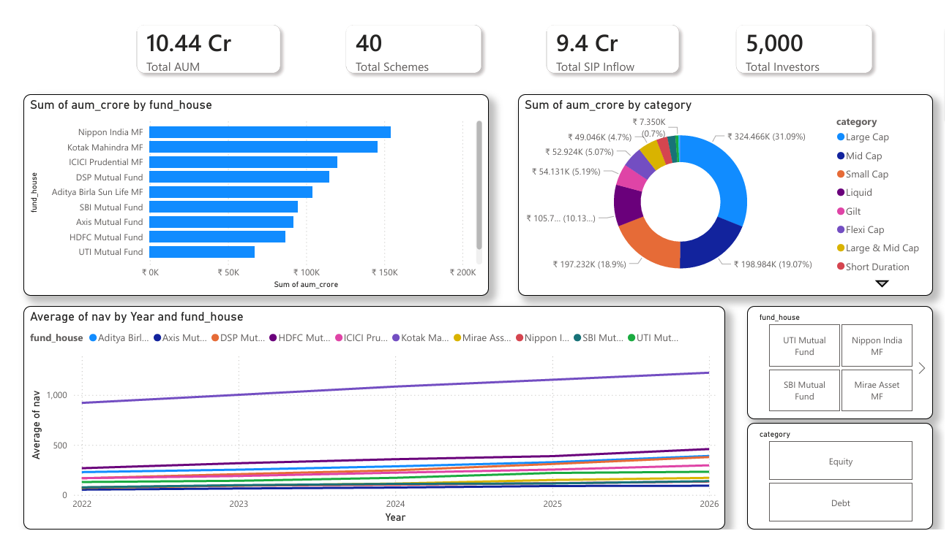
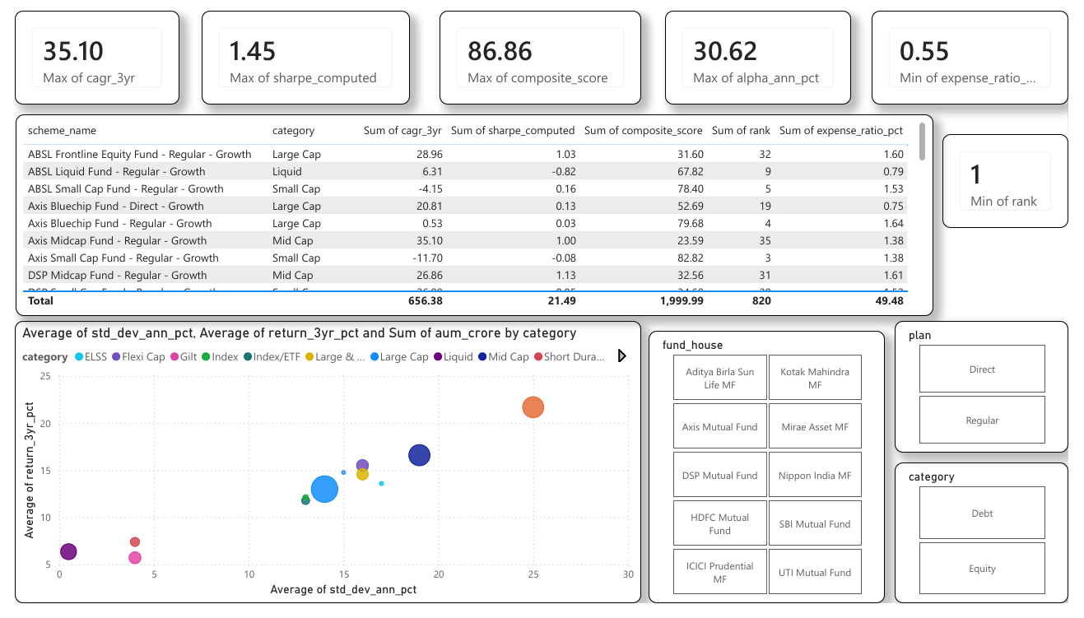
Dashboard — Industry Overview & Fund Performance
[Dashboard Screenshot]
[Dashboard Screenshot]
📌 Page 1: Industry Overview
📌 Page 2: Fund Performance
4 KPI cards · AUM bar chart · Category donut · NAV trend · Slicers
Risk-return scatter · 6 scorecard cards · Sortable fund table · 3 slicers
Tool: Microsoft Power BI Desktop · 4 interactive pages · Slicers on every page

Slide 9
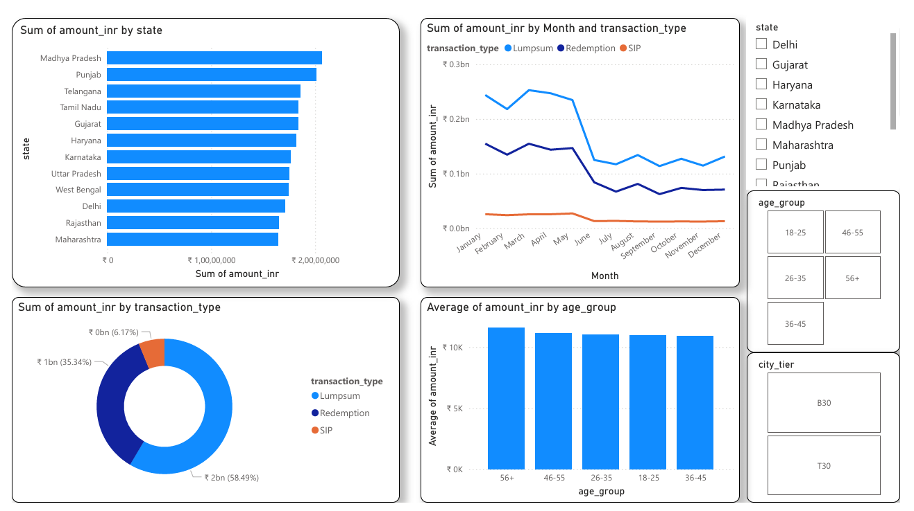
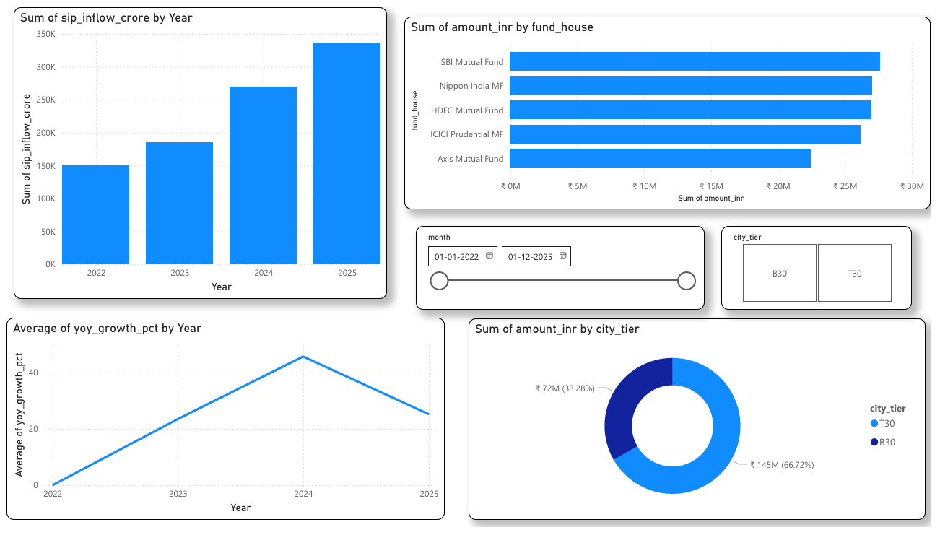
Dashboard — Investor Analytics & SIP Trends
[Dashboard Screenshot]
[Dashboard Screenshot]
📌 Page 3: Investor Analytics
📌 Page 4: SIP & Market Trends
State bar · Transaction donut · Age group · Monthly volume · 3 slicers
Yearly SIP bar · Top 5 fund houses · YoY growth · City tier donut
Bonus B2: Streamlit dashboard also built as alternative — 4 pages with interactive Plotly charts

Slide 10
Key Findings & Recommendations
Direct plans outperform Regular plans by 0.5–1% annually — always prefer Direct for long-term investing.
Small Cap funds deliver highest 3yr CAGR (35.10%) but carry 3x more daily risk than Large Cap.
26–35 age group drives the most SIP volume — ideal target segment for new fund campaigns.
97.8% of investors with 6+ SIPs are technically at-risk by the 35-day gap threshold — consider extending to 45 days.
Punjab leads all states in SIP investment, suggesting strong T2 city penetration outside metros.
UTI Mid Cap ranks #1 in composite scorecard (86.86/100) — best overall risk-adjusted fund in dataset.

Slide 11
Tech Stack & Deliverables
Python
pandas · numpy · scipy · matplotlib · seaborn · plotly · sqlalchemy
Database
SQLite · 9 tables · star schema · 1,11,167 total rows
Dashboard
Power BI Desktop · 4 pages · Streamlit (Bonus B2)
Version Control
Git · GitHub · 10 commits · v1.0 tag
Deliverables submitted:
ETL pipeline (data_ingestion.py, live_nav_fetch.py)
SQLite database (bluestock_mf.db) + schema.sql
EDA notebook (EDA_Analysis.ipynb) + 15 charts
Performance Analytics notebook + fund_scorecard.csv
Power BI dashboard (.pbix) + PDF + 4 PNG pages
Advanced Analytics notebook + recommender.py
Final Report PDF + 12-slide Presentation

Slide 12
Thank You
Bluestock Mutual Fund Analytics Capstone
End-to-end data analytics covering 40 schemes, 64K NAV records, and 32K investor transactions
Intern:
Revanth A
GitHub:
Happy-King-747/bluestock-mf-capstone
Organisation:
Bluestock Fintech MJ28
Date:
June 2026

