Slide 1
Executive Summary
Business Goal: Grow revenue without increasing marketing spend.
Overall ARPDAU declined 16.4%, from $0.3497 to $0.2922.
The decline was primarily a player-mix effect: ARPDAU remained stable or improved within every country tier.
Player growth remained strong: installs reached 26.8K in April vs 9.8K in January, while DAU increased ~6× and cohort retention remained broadly stable.
After adjusting for country-tier mix, Paid Video and Paid Social showed no clear difference in D30 revenue per install +$0.06 (95% CI: −$0.22 to +$0.36).
Churn and early-value models provide useful prioritization signals, but intervention economics and acquisition costs are needed before operational decisions.
Live-Service Mobile Game
Growth Paid Acquisition
Revenue Growth Target
Understand Player Behaviour
Identify Growth Opportunities

Slide 2
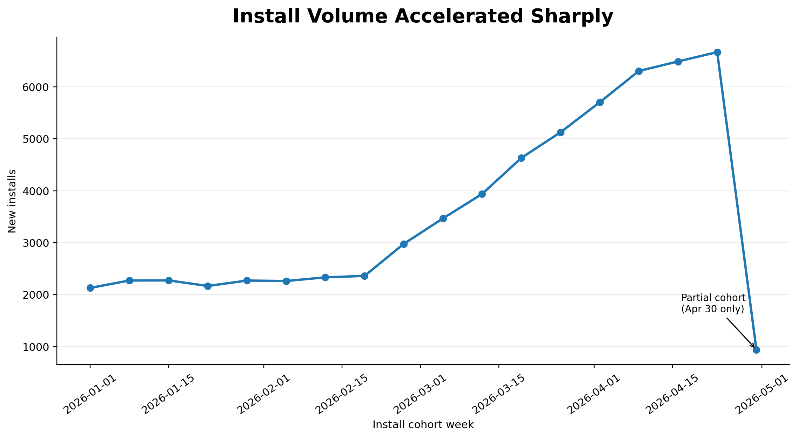
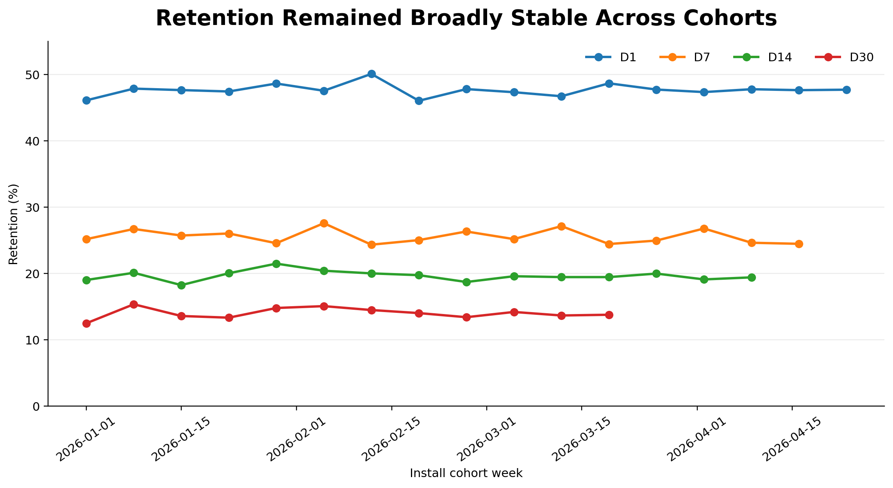
Player Growth Accelerated While Retention Remained Stable
Install volume increased substantially, reaching 26.8K installs in April vs 9.8K in January.
DAU increased ~6×, showing substantial expansion of the active-player base.
Despite this growth, retention remained broadly stable across install cohorts.
Average cohort retention was approximately 48% D1, 25% D7, 20% D14, 13% D30.
Growth accelerated sharply reaching 26.8K installs in April vs 9.8K in January.
Retention remained consistent across mature cohorts despite rapid player growth.
Player growth did not come with a broad deterioration in retention.
Recent cohorts without sufficient observation time are excluded from unavailable retention milestones.

Slide 3
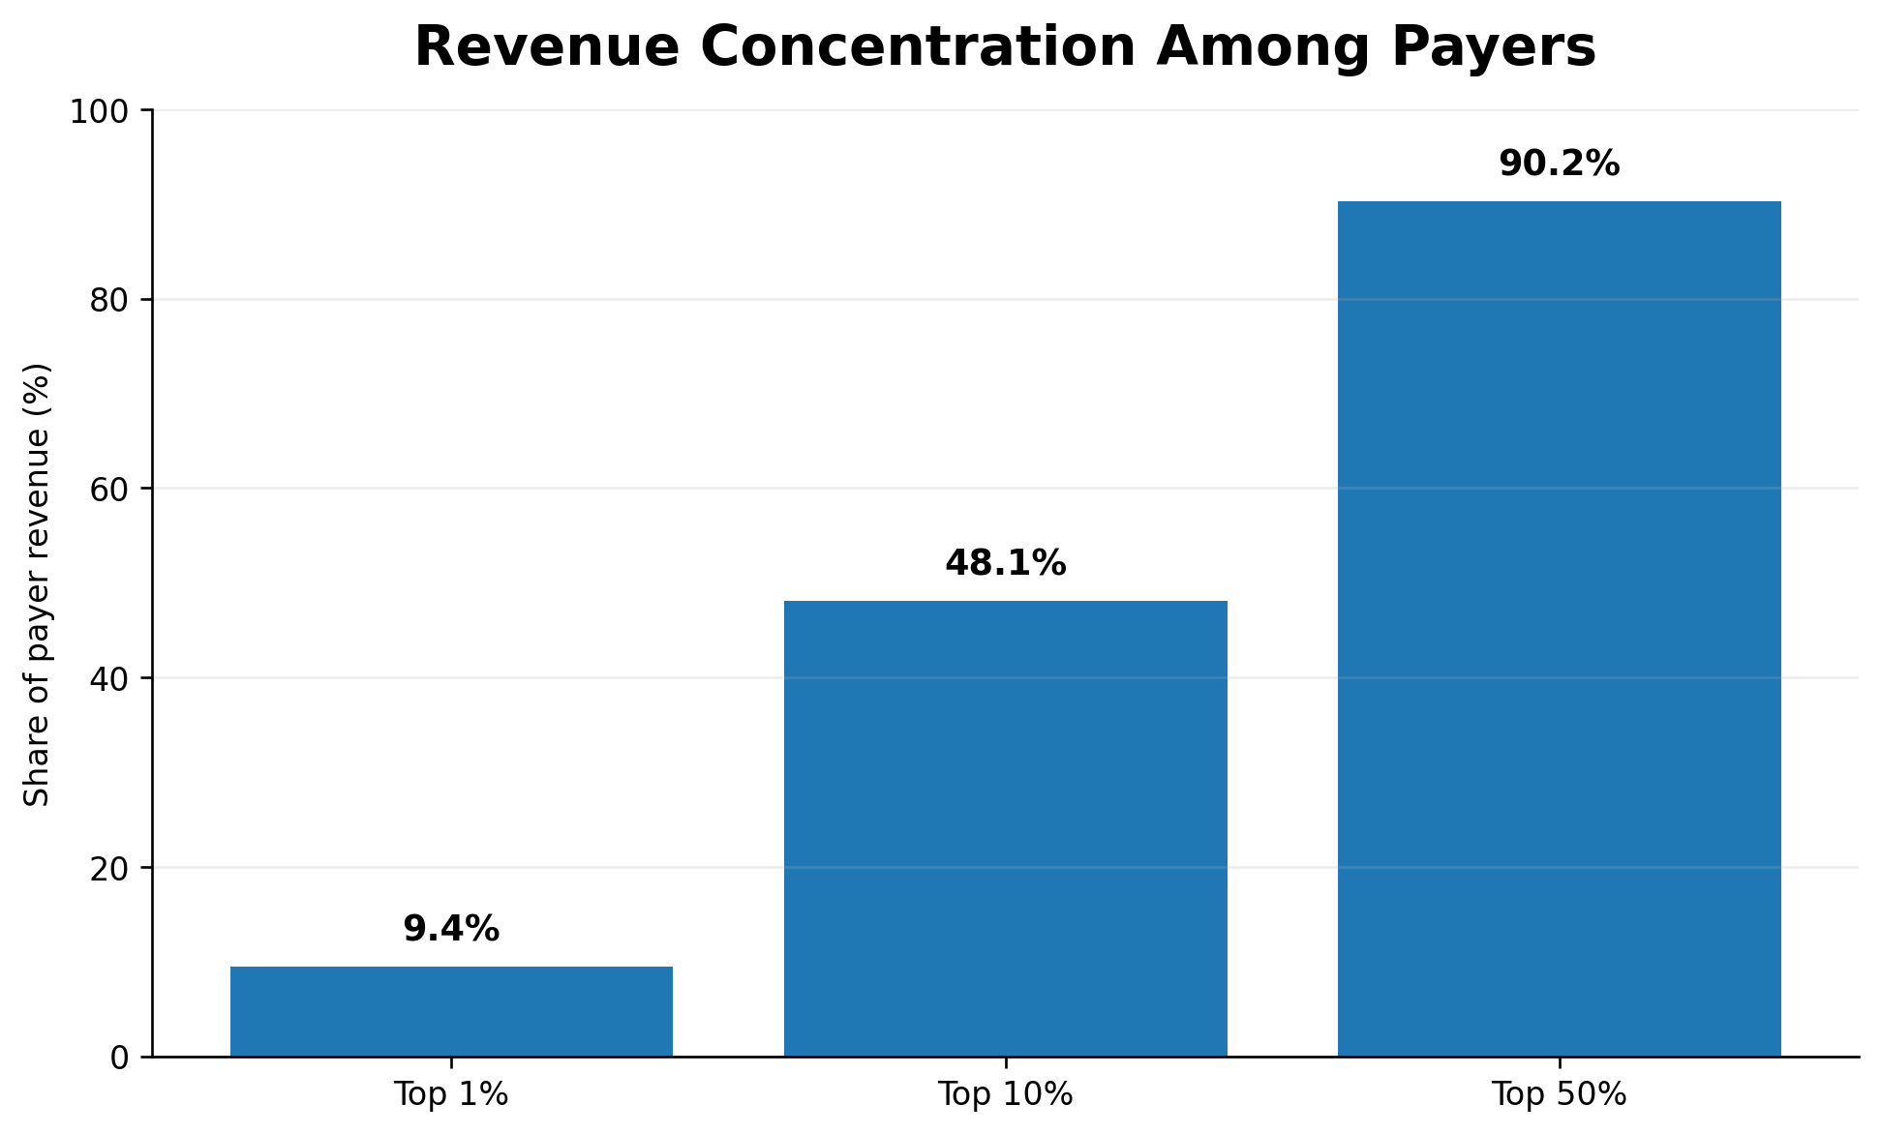
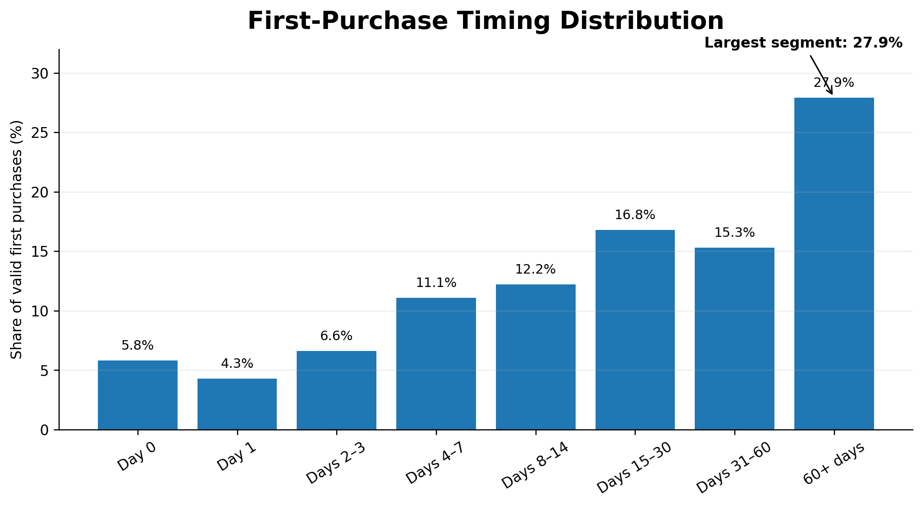
Revenue Is Concentrated, but Spending Continues Across the Player Lifecycle
13.8% of players made at least one purchase during the observed period.
Revenue is concentrated among payers: the top 10% of payers generated 48.1% of payer revenue.
Purchasing is not limited to the early lifecycle: 27.9% of valid first purchases occurred after Day 60.
Repeat spending also extends over time, with 36.3% of repeat-purchase gaps exceeding 30 days.
Revenue is concentrated among payers
27.9% of valid first purchases occurred after D60.
Monetization is concentrated, but meaningful purchase activity continues well beyond the early player lifecycle.

Slide 4
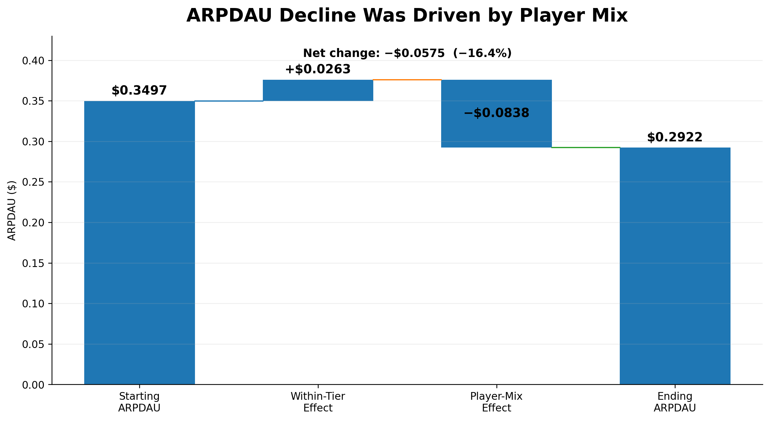
The ARPDAU Decline Was Primarily a Player-Mix Effect
Overall ARPDAU declined by 16.4%, from $0.3497 to $0.2922 between the first and last 30 days.
However, ARPDAU remained stable or improved within every country tier.
Tier 1: +5.1% | Tier 2: +10.8% | Tier 3: +13.6% | Tier 4: +0.6%
This contrast suggests that the overall ARPDAU decline was driven by changes in player composition rather than weaker within-tier monetization.
Within-tier gains were more than offset by the negative change in player composition.
The decline in blended ARPDAU was primarily a player-mix problem, not a broad deterioration in player monetization.
Mix effect exceeds the net decline because within-tier monetization improved and partially offset its impact.

Slide 5
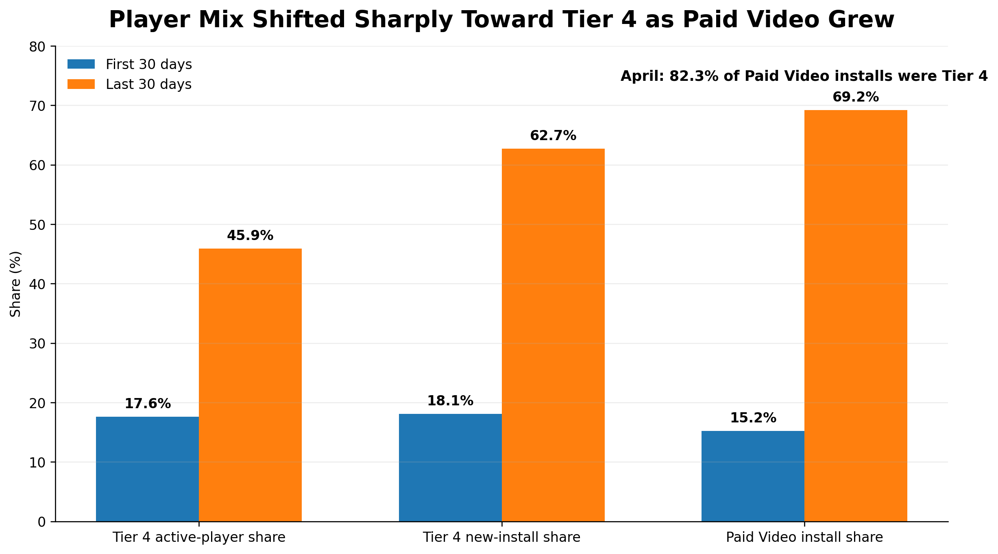
Paid Video Growth Coincided With a Shift Toward Tier 4
Tier 4’s share of active players increased from 17.6% to 45.9% between the first and last 30 days.
Among new installs, Tier 4’s share increased from 18.1% to 62.7%, substantially changing the composition of the player base.
Over the same period, Paid Video’s share of installs increased from 15.2% to 69.2%.
By April, 82.3% of Paid Video installs came from Tier 4, showing the strong overlap between Paid Video growth and the changing country-tier mix.
Paid Video growth occurred alongside a substantial increase in Tier 4 representation.
The growth of Paid Video coincided with a substantially larger Tier 4 player mix, helping explain the composition shift behind the decline in blended ARPDAU.

Slide 6
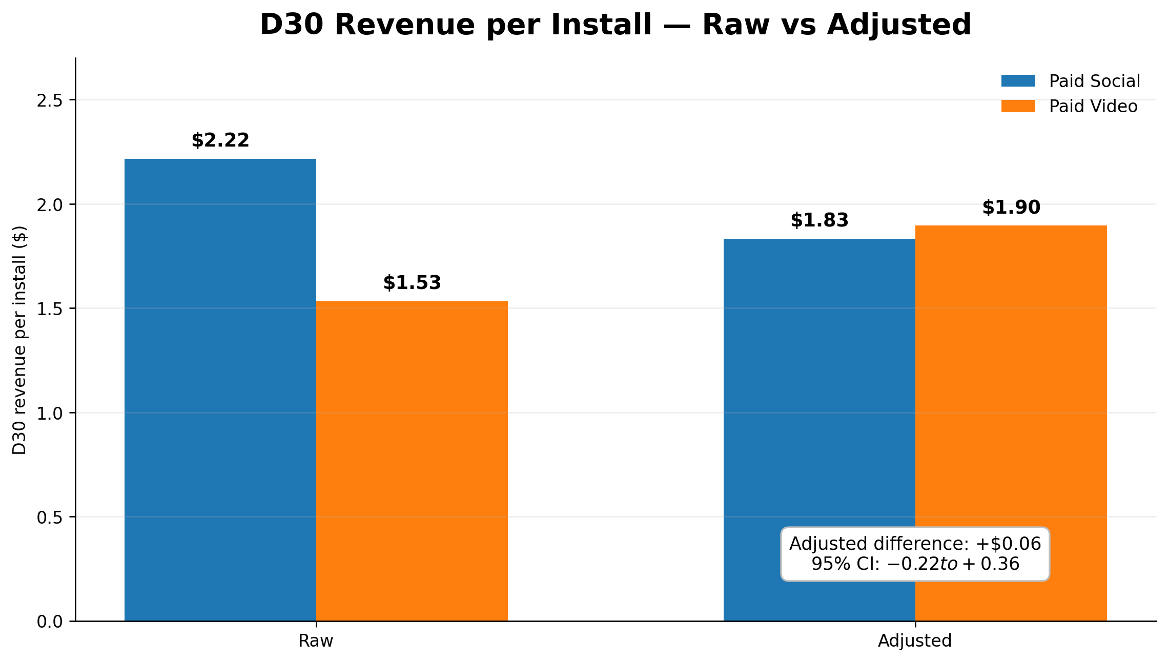
Channel Performance Differences Narrow After Adjusting for Player Mix
Raw D30 revenue per install was $2.22 for Paid Social and $1.53 for Paid Video.
However, the raw comparison is influenced by the different country-tier composition of the two channels.
After adjusting both channels to a common country-tier mix, D30 revenue per install was $1.83 for Paid Social and $1.90 for Paid Video.
The adjusted difference was +0.06 (95%CI:-0.22 to +$0.36), providing no clear evidence of a revenue difference between the channels.
After controlling for country-tier mix, the apparent channel revenue gap largely disappears.
Current evidence does not support reallocating budget between Paid Video and Paid Social based on revenue performance alone.
Marketing spend/CPI unavailable; profitability and ROAS cannot be evaluated.

Slide 7
Predictive Models Can Prioritize Players, but Economics Determine Actionability
The 14-day churn model achieved ROC-AUC 0.73, providing a useful signal for prioritizing at-risk players.
At the reference 0.50 threshold, the model identified 61.5% of future churners, with 27.6% precision.
The early-value model captured 42.2% of actual 90-day revenue within the top 10% of predicted players.
These models are therefore more useful for player prioritization and targeting than as standalone automated decisions.
CHURN PRIORITIZATION
HIGH-VALUE PRIORITIZATION
ROC-AUC
0.73
TOP 10% PREDICTED PLAYERS
Recall 61.5%
Precision 27.6%
42.2%
of actual 90-day revenue
Ranking signal for player prioritization
Reference threshold = 0.50
Identifies at-risk players who can be prioritized for retention interventions.
Identifies a small player segment where a large share of future revenue is concentrated
Predictive signals can focus retention and value programs on smaller player segments, but intervention cost and expected uplift should determine deployment thresholds.

Slide 8
Recommendations, Risks & Next Steps
Recommendations
Manage acquisition quality, not just volume — monitor country-tier mix alongside installs, DAU and blended ARPDAU.
Do not shift spend between Paid Video and Paid Social based on raw revenue differences alone; evaluate channels on comparable player mix.
Pilot targeted retention interventions using churn risk rather than applying incentives broadly.
Use early-value predictions to prioritize high-potential players for differentiated engagement.
Uncertainties
Marketing spend/CPI by channel is unavailable, preventing ROAS or profitability comparison.
Ad revenue is unavailable; rewarded-ad engagement cannot be translated into total revenue impact.
Model deployment economics require intervention cost, incremental uplift and retained-player value.
The observed decline in blended ARPDAU was primarily a player-mix effect, not evidence of broad deterioration in retention or within-tier monetization.

Slide 9
Appendix A1 — Dataset Overview & Table Grains
Dataset Scope
Analysis covers approximately 80K players across a 120-day observation window (Jan 1–Apr 30, 2026).
Five source tables capture player attributes, daily activity, purchases, currency spending, and rewarded-ad engagement.
Analysis was performed at the appropriate grain for each question to avoid mixing player-, day-, transaction-, and event-level measures.
Source Table | Analytical Grain | Primary Use
player_profile | One row per player | Install date, acquisition channel, country tier and player attributes
player_day | Player × active day | DAU, sessions, engagement and retention activity
purchase | Purchase transaction | IAP revenue, payer behaviour and purchase timing
currency_spend | Currency-spend event | In-game economy/spending behaviour
ad_view | Rewarded-ad interaction | Ad engagement, completion behaviour and cap analysis
Revenue in this analysis refers to IAP revenue. reward_amount represents in-game currency and was not treated as ad revenue.

Slide 10
Appendix A2 — Data Quality Issues & Judgment Calls
Data Quality Issue | What Was Observed | How It Was Handled
Non-unique purchase IDs | 122 purchase_ids appeared twice; rows were not exact duplicates | Did not use purchase_id alone as a unique transaction key
Missing activity records | Some purchase-days had no matching player_day record | Used player_day ∪ purchase when defining activity for DAU/retention/churn
Changing install volume | Acquisition volume changed substantially over the analysis window | Used cohort/time-based comparisons rather than blindly pooling periods
Pre-window installs | Some players installed before Jan 1 | Retained where appropriate for active-player analysis; cohort eligibility handled separately
Purchase before install date | 110 payers had first purchase 1–4 days before recorded install date | Excluded these records from time-to-first-purchase distribution, while retaining them in overall payer/revenue analysis
Rewarded-ad logging gaps | Recurring 08:00–13:59 gap plus a full-day gap on Mar 6 | Treated as likely telemetry/availability gaps; avoided interpreting them as true zero engagement
Recent cohort censoring | Recent installs had insufficient observation time for later retention milestones | Reported unavailable D7/D14/D30 milestones as NULL/not observable, not zero
Principle: Preserve valid information where possible, explicitly isolate unreliable fields/periods, and avoid converting missing or unobservable data into behavioral outcomes.

Slide 11
Appendix A3 — Daily Health Metrics
METHODOLOGY
DAU: Unique daily active players from both player_day and purchase.
New Installs: Counted using each player’s recorded install_date.
IAP Revenue: Daily revenue aggregated from all purchase transactions.
ARPDAU: Daily IAP Revenue ÷ DAU, measuring monetization per active player.
Analysis Window: Daily metrics evaluated from Jan 1 – Apr 30, 2026.
RESULTS
PLAYER ACTIVITY
player_day
+
purchase
DAILY REVENUE
IAP Purchases
DAILY HEALTH
DAu
New Installs
ARPDAU
Player activity increased substantially over the analysis period.
DAU increased ~6× from the beginning to the end of the window.
Despite player growth, blended ARPDAU weakened later in the period.
This divergence motivated the subsequent ARPDAU decomposition analysis.
player_day ∪ purchase was used for activity because some valid purchase-days had no corresponding player_day record, avoiding understatement of DAU.

Slide 12
Appendix A4 — Retention Cohort Analysis
METHODOLOGY
Players were grouped into 7-day install cohorts, anchored from Jan 1, 2026.
Player activity was defined using player_day ∪ purchase to capture purchase-days missing from player_day.
Retention was measured at D1, D7, D14, and D30 after install.
Only cohorts with sufficient observation time were included at each retention milestone.
Recent cohorts that had not yet reached a milestone were reported as NULL / not observable, rather than zero.
RESULTS
D1 Retention: ≈ 48%
D7 Retention: ≈ 26%
D14 Retention: ≈ 20%
D30 Retention: ≈ 14%
Overall Finding: Retention remained broadly stable across mature cohorts.
Recent cohorts without sufficient observation time were treated as NULL / not observable rather than zero.

Slide 13
Appendix A5 — Spender Behaviour
METHODOLOGY
Payers: Players with at least one recorded IAP purchase.
Revenue Concentration: Payers were ranked by total IAP revenue to calculate revenue contribution from the Top 1%, 10%, and 50% of payers.
Time to First Purchase: Calculated as days between install date and first valid purchase.
Date Anomalies: 110 players whose first purchase occurred 1–4 days before recorded install date were excluded from first-purchase timing only.
Repeat Purchase Gap: For repeat purchasers, calculated the number of days between consecutive purchases.
RESULTS
Payer rate: 13.8%
Top 10% of payers: 48.1% of payer revenue
D60+ first purchases: 27.9%
Repeat-purchase gaps >30 days: 36.3%
Revenue is concentrated among payers, while meaningful purchase activity continues beyond the early player lifecycle.

Slide 14
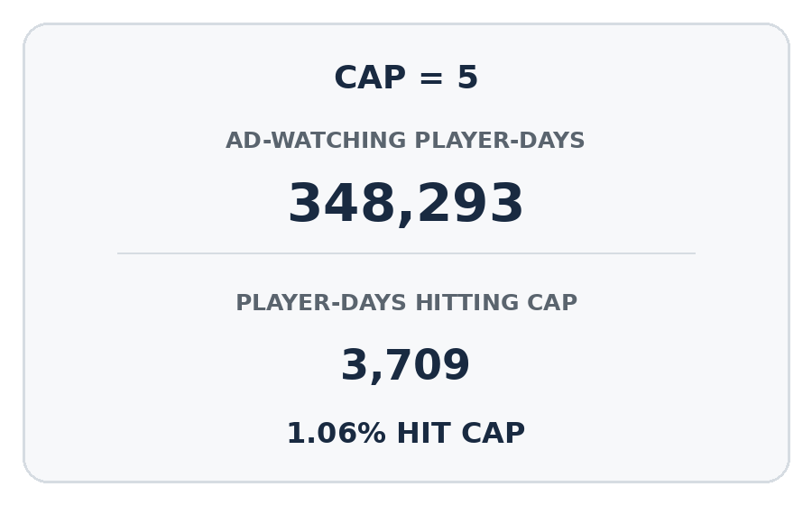
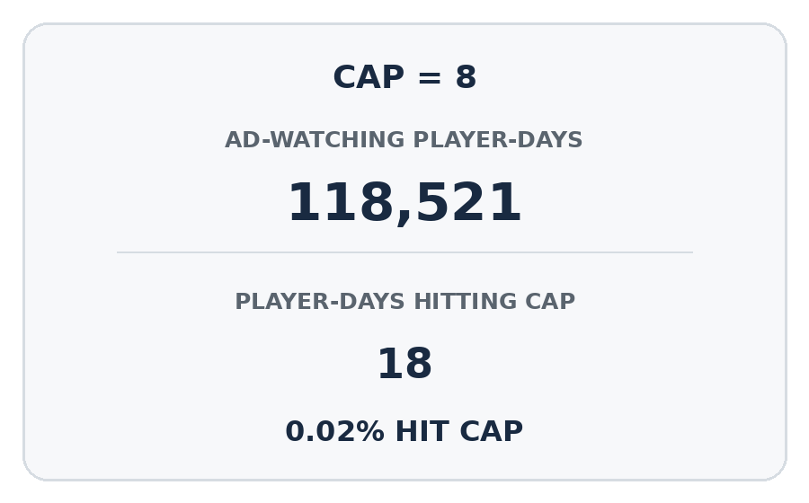
Appendix A6 — Rewarded-Ad Engagement
METHODOLOGY
Rewarded-ad engagement was analyzed using the ad_view table.
Daily ad-view activity was evaluated across the observation window.
Cap-hit rate was calculated among player-days with at least one ad view, separately for each applicable cap.
Hourly patterns were checked to identify potential logging or telemetry gaps.
reward_amount was treated as in-game currency/reward, not advertising revenue.
RESULTS
Data-Quality Finding
A recurring 08:00–13:59 gap and a full-day gap on March 6 were observed in ad_view, while other event tables remained active.
Very few ad-watching player-days reached the observed caps, but telemetry gaps limit strong conclusions about rewarded-ad engagement.

Slide 15
Appendix A7 — ARPDAU Deep-Dive & Decomposition
METHODOLOGY
Compared first 30 days vs last 30 days of the analysis window.
Calculated overall ARPDAU as IAP Revenue ÷ DAU.
Recalculated ARPDAU separately for each country tier.
Decomposed the overall ARPDAU change into:
  Within-Tier Effect: change in monetization within country tiers.
  Player-Mix Effect: change caused by shifts in the share of active players across tiers.
RESULTS
Overall ARPDAU: $0.3497 → $0.2922
Overall change: −16.4%
Within-Tier Effect: +$0.0263
Player-Mix Effect: −$0.0838
Net Change: −$0.0575
ARPDAU was stable or improved within every country tier.
The mix effect is larger than the net decline because positive within-tier monetization partially offset the negative composition effect.

Slide 16
Appendix A8 — Acquisition Channel Comparison
METHODOLOGY
Compared acquisition channels using D7 retention and D30 IAP revenue per install.
D30 revenue included purchases occurring within 30 days after install.
Only installs with a fully observable D30 window were included.
Raw channel revenue was compared first, then adjusted to a common country-tier mix.
95% confidence intervals were used to assess uncertainty in the channel difference.
RESULTS
Raw D30 revenue/install:
Paid Social $2.22 | Paid Video $1.53
Adjusted D30 revenue/install:
Paid Social $1.83 | Paid Video $1.90
Adjusted difference: +$0.06
95% CI: −$0.22 to +$0.36
The confidence interval includes zero; no clear evidence of a
D30 revenue difference after controlling for country-tier mix.
Marketing spend/CPI is unavailable, so channel profitability and ROAS cannot be evaluated.

Slide 17
Appendix A9 — Churn Prediction Model
METHODOLOGY
Used the previous 14 days of player behaviour to predict churn in the next 14 days.
Churn = no observed activity during the following 14 days.
Activity combined player_day and purchase records.
Used a time-based train/test split to avoid future-data leakage.
Model evaluated using ROC-AUC, PR-AUC, precision and recall
RESULTS
14-Day Player Behaviour
Test players: 9,617
Churn Model
Churn rate: 13.9%
Churn Risk Score
ROC-AUC: 0.73
PR-AUC: 0.28
Targeted Retention
Threshold 0.50Recall: 61.5%Precision: 27.6%
BUSINESS USE
The model can prioritize higher-risk players for targeted retention interventions rather than treating all active players equally.
0.50 is a reference threshold, not an optimized business threshold; deployment should depend on intervention cost, expected uplift, and retained-player value.

Slide 18
Appendix A10 — 90-Day Player Value Prediction
METHODOLOGY
Used only the first 7 days of player behaviour as model features.
Predicted IAP revenue during the first 90 days after install.
Included only players with a fully observable 90-day revenue window.
Used a two-stage approach to handle the large number of zero-revenue players.
Evaluated both prediction error and player ranking quality.
RESULTS
First 7-Day Behaviour
9,809 Eligible
90-Day Value Model
Two-Stage Model
Player Value / Ranking
MAE: $4.96
RMSE: $15.45
High-Value Prioritization
Top 10% capture
42.2% Revenue
INTERPRETATION
The model is more useful for ranking and prioritizing high-value players than for estimating exact future revenue.
Predicted average revenue ($2.84) was below actual average revenue ($4.51), indicating that the model is not fully calibrated for absolute revenue prediction

Slide 19
Appendix A11 — Limitations, Uncertainties & Dead Ends
LIMITATIONS
Marketing spend and CPI were not available, so channel profitability and ROAS could not be measured.
Actual ad revenue was not available, so rewarded-ad activity could not be converted into revenue impact.
ad_view had recurring logging gaps, including a full-day gap on March 6, which limits the reliability of ad-engagement analysis.
The 90-day value analysis included only players with a complete observation window, so newer cohorts could not be evaluated.
UNCERTAINTIES
Paid Video growth and the Tier 4 mix shift occurred together, but causality cannot be established.
After country-tier adjustment, no clear revenue advantage was found between Paid Video and Paid Social.
The best churn threshold remains uncertain without intervention cost and uplift data.
DEAD ENDS
I could not identify the most profitable acquisition channel without marketing cost data.
I could not measure the financial impact of rewarded ads without ad-revenue data.
I could not select a final churn intervention threshold from model performance alone.
These limitations do not invalidate the observed patterns, but they restrict how far the results can be translated into budget, monetization, and intervention decisions

Slide 20
Appendix A12 — What I Would Do With Another Week
Add marketing spend and CPI to calculate CAC, ROAS, and channel profitability.
Extend the ARPDAU decomposition across weekly/monthly periods to confirm whether the player-mix effect persists.
Validate ad_view logging gaps and include actual ad revenue in the monetization analysis.
Test churn-based targeting through a retention experiment and measure incremental retention/revenue uplift.
Validate the 90-day value model on additional mature cohorts and improve revenue calibration.
COMPLETE DATA
• Spend + CPI
• Ad revenue
VALIDATE INSIGHTS
• ARPDAU mix
• Ad telemetry
RUN EXPERIMENT
• Churn-based
retention test
MEASURE IMPACT
• Incremental lift
• ROAS
• Player value
Goal: convert current diagnostic findings into experimentally validated and economically measurable decisions.

