Slide 1
Info 5100

Slide 2
Object Oriented Programming
1. What is Object?
Data (Properties) Data describes features of an object.
Behaviors (Methods)
Methods are the tasks that an object performs.

Slide 3
What is a class
A class provides a definition for an object, describing an object’s attributes (data) and methods (operations).
An object is an instance of a class. With one class, you can have as many objects as required.

Slide 4
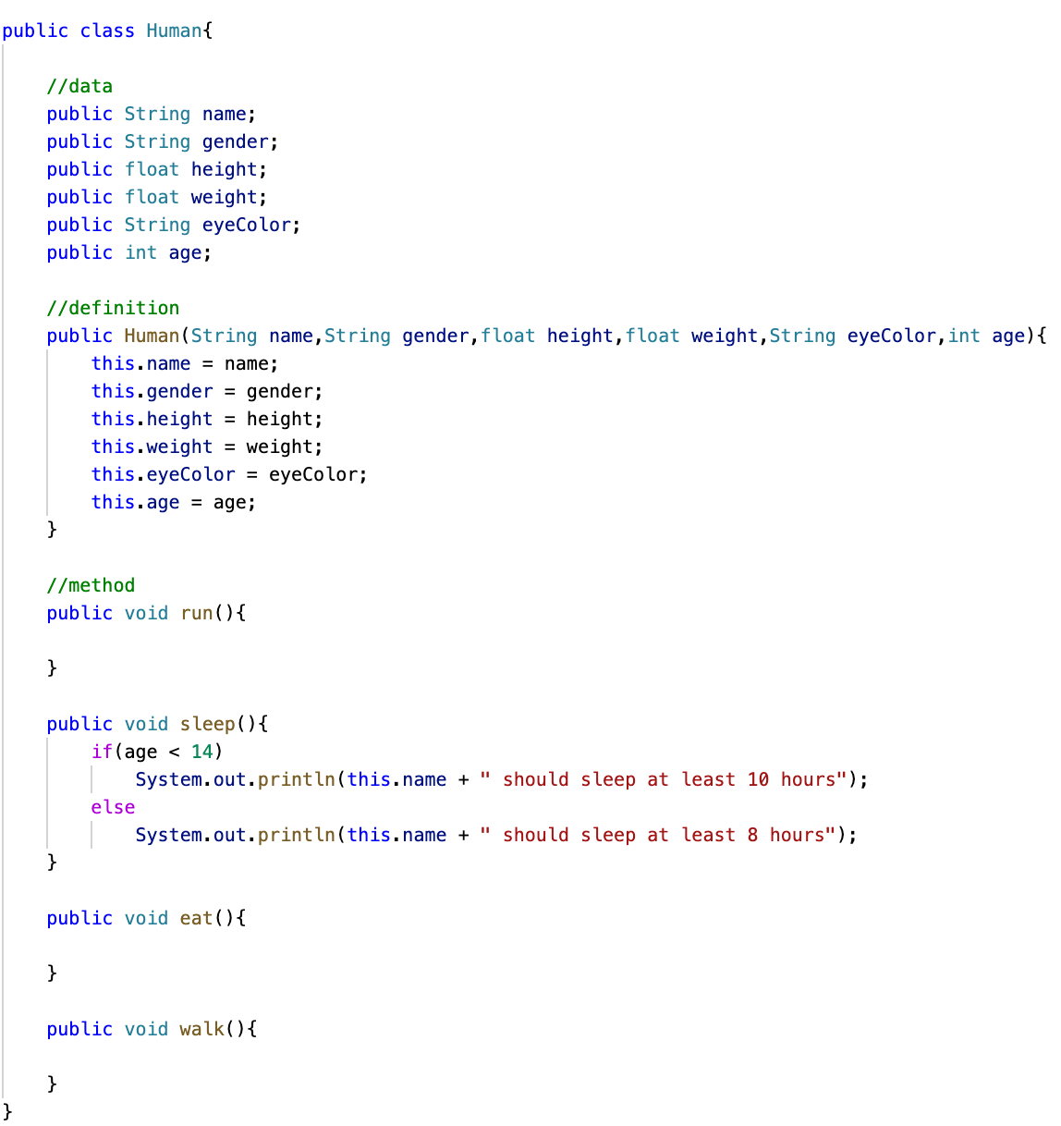
Object Oriented Programming

Slide 5
Class, object, methods, and instance variables
Object: Objects have states and behaviors.
Class: A class can be defined as a template that describes the behavior and state that the object of its type supports.
Methods − A method is basically a behavior. A class can contain many methods.
Instance Variables − Each object has its unique set of instance variables.

Slide 6
Java Modifiers
Access Modifiers − default, public , protected, private
Visible to the package, the default. No modifiers are needed.
Visible to the class only (private).
Visible to the world (public).
Visible to the package and all subclasses (protected).

Slide 7
Basic Datatypes
Primitive Data Types
Reference/Object Data Types

Slide 8
Primitive Data Types
Byte
Short
Int
Long
Float
Double
Boolean

Slide 9
Java Variables
Local Variables
Class Variables (Static Variables)
Instance Variables (Non-static Variables)

Slide 10

Arrays
Java provides a data structure, the array, which stores a fixed-size sequential collection of elements of the same type.
Instead of declaring individual variables, such as number0, number1, ..., and number99, you declare one array variable such as numbers and use numbers[0], numbers[1], and ..., numbers[99] to represent individual variables.

Slide 11
Decision Making
An if statement can be followed by an optional else if...else statement, which is very useful to test various conditions using single if...else if statement.

Slide 12
String Class
Strings, which are widely used in Java programming, are a sequence of characters. In Java programming language, strings are treated as objects.

Slide 13
Creating an Object
MyNewClass obj = new MyNewClass()
Constructors can be public, private, protected or default(no access modifier at all).
Same as class name.
Doesn’t have a return type.
It is automatically called when the object of class is created

Slide 14
Destructor
Destructors in Java also known as finalizers are non-deterministic. The allocation and release of memory are implicitly handled by the garbage collector in Java.
Use of finalize -- can be called when garbage collector delete the object.
java.lang.Object.finalize()
protected void finalize() : A subclass overrides the finalize method to dispose of system resources or to perform other cleanup.
Hello two = new Hello(“three”);
two = new Hello(“two”);

Slide 15
Garbage Collector
A garbage collector is a program that runs on the Java virtual machine to recover the memory by deleting the objects which are no longer in use or have finished their life-cycle. An object is said to be eligible for garbage collection if and only if the object is unreachable.
It automatically deletes the unused objects that are unreachable to free up the memory
Garbage collection makes Java memory efficient
It need not be explicitly called since the implementation lives in the JVM
Garbage collection has become an important and standard component of many programming languages

Slide 16
Java OOP Principles
Abstraction
Encapsulation
Inheritance
Polymorphism

Slide 17
Encapsulation
Encapsulation is a mechanism where you bind your data and code together as a single unit.
We can achieve encapsulation in Java by:
Declaring the variables of a class as private.
Providing public setter and getter methods to modify and view the variables values.

Slide 18
Advantages of Encapsulation
Data Hiding: The user will have no idea about the inner implementation of the class.
Increased Flexibility: We can make the variables of the class as read-only or write-only depending on our requirement.
Reusability: Improves the re-usability and easy to change with new requirements.
Testing code is easy: Encapsulated code is easy to test for unit testing.

Slide 19
Abstraction
Abstraction is the methodology of hiding the implementation details from the user and only providing the functionality to them
when you get a call, we get an option to either pick it up or just reject it. But in reality, there is a lot of code that runs in the background. So here, you don’t know the internal processing of how a call is generated, that’s the beauty of abstraction.

Slide 20
Ways to Achieve Abstraction
Abstract class
Interface

Slide 21
Abstract Methods and Classes
An abstract class is a class that is declared abstract—it may or may not include abstract methods. Abstract classes cannot be instantiated, but they can be subclassed.
An abstract method is a method that is declared without an implementation (without braces, and followed by a semicolon)
When an abstract class is subclassed, if the subclass does not provides implementations for all of the abstract methods in its parent class. Then the subclass must also be declared abstract.

Slide 22
Interfaces
An interface is a reference type, similar to a class, that can contain only constants, method signatures, default methods, static methods, and nested types. Method bodies exist only for default methods and static methods.
Interfaces cannot be instantiated—they can only be implemented by classes or extended by other interfaces.
A class that implements an interface must implement all of the interface's methods

Slide 23
Advantages of Abstraction
Loose-coupling: Enable better scalability, better testability.
Reusability: Improves the re-usability and easy to change with new requirements.
Security: It helps in increasing security as information is kept hidden.

Slide 24
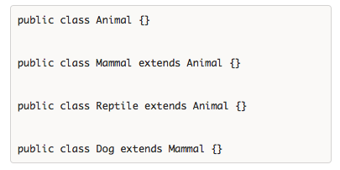
Inheritance
Animal is the superclass of Mammal class.
Animal is the superclass of Reptile class.
Mammal and Reptile are subclasses of Animal class.
Dog is the subclass of both Mammal and Animal classes.
Mammal IS-A Animal
Reptile IS-A Animal
Dog IS-A Mammal
Hence: Dog IS-A Animal as well

Slide 25
Super Keyword
The super keyword is similar to this keyword. Following are the scenarios where the super keyword is used.
It is used to differentiate the members of superclass from the members of subclass, if they have same names.
It is used to invoke the superclass constructor from subclass.

Slide 26
Static Method
The static keyword is used to create methods that will exist independently of any instances created for the class.

Slide 27
Inheritance
Inheritance in Java is a mechanism in which one object acquires all the properties and behaviors of a parent object.
When you inherit from an existing class, you can reuse methods and fields of the parent class. Moreover, you can add new methods and fields in your current class also.
Inheritance represents the IS-A relationship which is also known as a parent-child relationship.

Slide 28
Final keyword
Final is a non-access modifier applicable only to a variable, a method or a class.
Final Variable - To create constant variable
Final Method - Prevent method overriding
Final Classes - Prevent Inheritance

Slide 29
Scope of Variables In Java
Java programs are organized in the form of classes. Every class is part of some package. Java scope rules can be covered under following categories.
Member Variables (Class Level Scope)
Local Variables (Method Level Scope)
Loop Variables (Block Scope)

Slide 30
Member Variables (Class Level Scope)
Modifier | Package | Subclass | World
Public | Yes | Yes | Yes
Protected | Yes | Yes | No
Default | Yes | No | No
Private | No | No | No

Slide 31
Packages
Package in Java is a mechanism to encapsulate a group of classes, sub packages and interfaces
Preventing naming conflicts
Making searching/locating and usage of classes, interfaces, enumerations and annotations easier
Providing controlled access: protected and default have package level access control.
Packages can be considered as data encapsulation (or data-hiding).

Slide 32
Built in packages
These packages consist of a large number of classes which are a part of Java API.Some of the commonly used built-in packages are:
java.lang: Contains language support classes(e.g classed which defines primitive data types, math operations). This package is automatically imported.
java.io: Contains classed for supporting input / output operations.
java.util: Contains utility classes which implement data structures like Linked List, Dictionary and support ; for Date / Time operations.

Slide 33
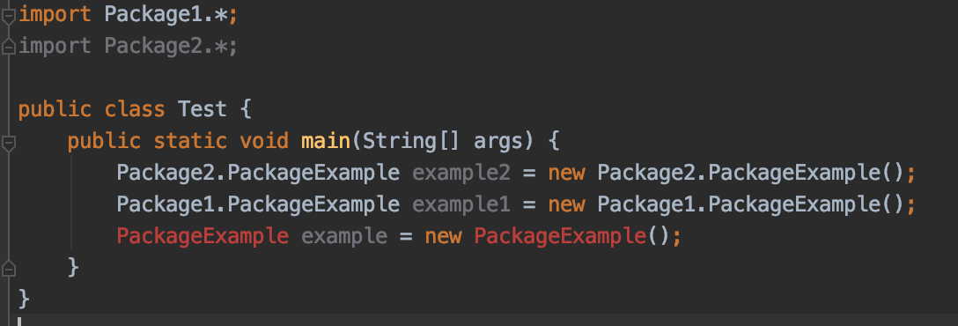
Name conflict

Slide 34
Exception Handling
in Java, the code can experience errors while executing our instructions. Good exception handling can handle errors and gracefully re-route the program to give the user still a positive experience.

Slide 35
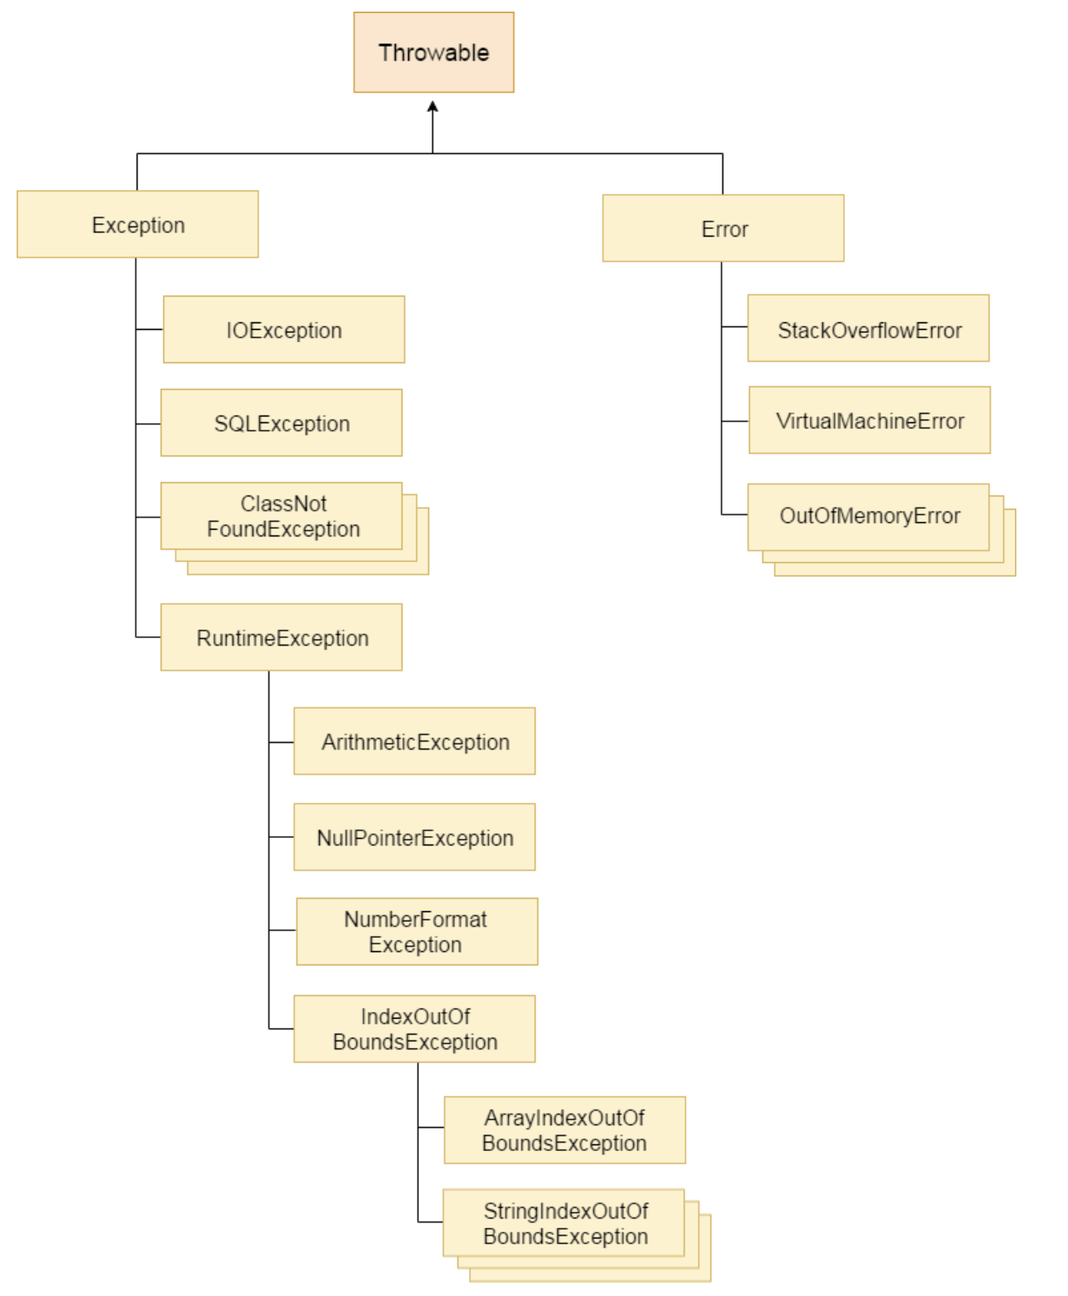
Exception Hierarchy

Slide 36
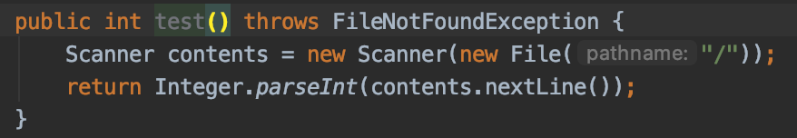
Exception Handling - throws
The simplest way to “handle” an exception is to rethrow it

Slide 37
Exception Handling - try and catch
f we want to try and handle the exception ourselves, we can use a try-catch block. We can handle it by rethrowing our exception
Java lets us handle subclass exceptions separately, remember to place them higher in the list of catches.

Slide 38
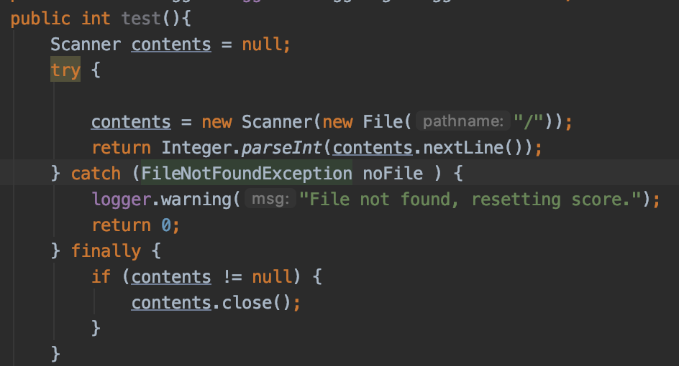
Exception Handling - finally

Slide 39
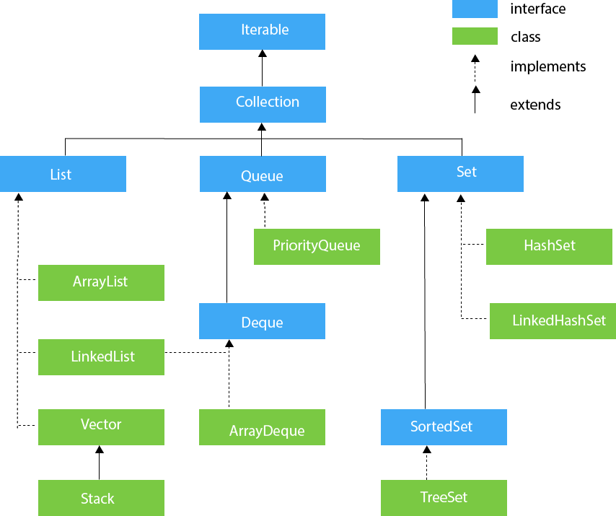
Java Collections

Slide 40
The List Interface The ArrayList Class and The LinkedList Class
The List interface extends Collection and declares the behavior of a collection that stores a sequence of elements.
The ArrayList class Implements a dynamic array by extending AbstractList and implements the List interface.
The LinkedList class implements a linked list by extending AbstractSequentialList and implements the List interface.

Slide 41
The Set Interface The HashSet Class and The TreeSet Class
Set extends Collection to handle sets, which must contain unique elements.
HashSet extends AbstractSet for use with a hash table and implements the Set interface
TreeSet provides an implementation of the Set interface that uses a tree for storage.

Slide 42
The Map Interface The HashMap Class and The TreeMap Class
The Map interface maps unique keys to values.
Given a key and a value, you can store the value in a Map object. After the value is stored, you can retrieve it by using its key.
The TreeMap class implements the Map interface by using a tree. A TreeMap provides an efficient means of storing key/value pairs in sorted order and allows rapid retrieval.

Slide 43
The Stack Class
Stack is a subclass of Vector that implements a standard last-in, first-out stack.
Object peek( )
Returns the element on the top of the stack, but does not remove it.
Object pop( )
Returns the element on the top of the stack, removing it in the process.
Object push(Object element)
Pushes the element onto the stack. Element is also returned.

Slide 44
Lamda Expressions
A block of code that you can pass around so it can be executed later, once or multiple times.
Anonymous methods.
Reduce verbosity caused by anonymous classes.

