Slide 1
ASSIGNMENT 1 : SOLVING BLOXORZ
INTRODUCTION TO ARTIFICIAL INTELLIGENCE (CO3061)

Slide 2
Team member :
Võ Đăng Thi - 2012089
Trịnh Cao Thắng - 2014550

Slide 3

OVERVIEW BLOXORZ
Single player game
Control the block to the finish tile
There are rules to move the block

Slide 4
MOVE
5 varieties : Up, Down, Left, Right and Swap
Block size : 2x1 or 2 blocks 1x1 if the block is divided
3 state : Stand, Fall and Divided
Stand covers area of 1x1
Fall and Divided covers 2x1 area

Slide 5









Special tiles and block notations
Void tile
Normal tile
Bridge activation - Soft
Block
Bridge activation - Hard
Finish tile
Bridge tile
Soft tile
Divide tile

Slide 6
MOVING DEMO

Slide 7
SOLUTION-SEARCHING ALGORITHMS
Breadth First Search (BFS)
Astar (A*)
Monte Carlo Tree Search

Slide 8
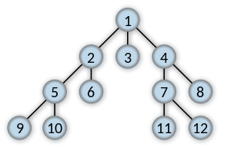
Breadth First Search
Search all visited node in a same level before going to the next level
Complexity : O(V + E)

Slide 9



A*
Determine what node is relatively sufficient to continue on searching
Evaluating function : n is the next node to travel
$$f\left(n\right)=g\left(n\right)+h(n)$$
$$g(n)$$
The cost of travelling from the start node to n
$$h(n)$$
Heuristic function to approximate the cheapest path from the node n to the goal

Slide 10
MONTE CARLO TREE SEARCH
4 main steps : selection – expansion – simulation - backpropagation
Selection : traverses the tree from the root to a leaf node, using a selection policy to choose which child nodes to visit
Expansion : adds one or more child nodes to the tree.
Simulation : plays out a random sequence of actions from the newly added node until the end of the game is reached
Backpropagation : the statistics collected during the simulation are propagated back up the tree to update the expected rewards of each visited node.

Slide 11
ASSIGNMENT : INIT GAME

Slide 12
INPUT GAME
<ID> <start.x> <start.y>
<#bridge_activation> <bridge_act1.x> <bridge_act1.y> <Alphabet> …
<int> <int> …. <int> (20)
… (20)
<int> <int> … <int> (20)

Slide 13
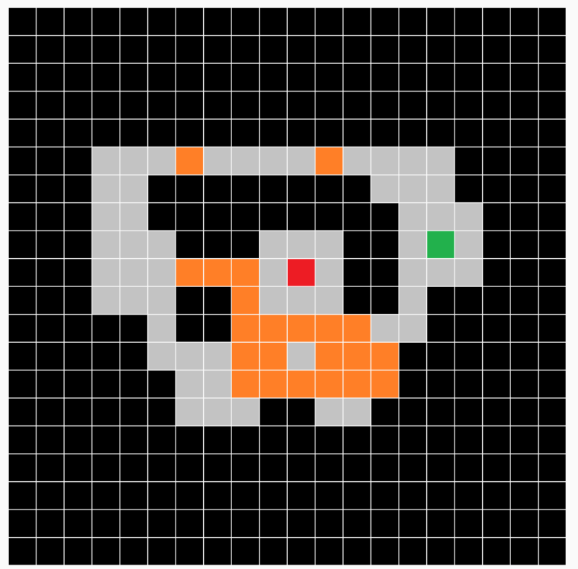
6 8 15
0
00000000000000000000
00000000000000000000
00000000000000000000
00000000000000000000
00000000000000000000
00011151111511110000
00011000000001110000
00011000000000111000
00011100011100111000
00011155517100111000
00011100511100100000
00000100555551100000
00000111551555000000
00000011555555000000
00000011100110000000
00000000000000000000
00000000000000000000
00000000000000000000
00000000000000000000
00000000000000000000

Slide 14
Class Game()
Attributes
+ id : level id
+ start : start position (x, y)
+ state : 20x20 list denoting the board
+ bridge_list : list of bridge_activation tile, their coordinates and the alphabet letter
+ pos : current position (x, y)
+ state_block : “STAND” of “FALL”
+ goal : the finish coordinate
+ level : a copy of the class to RESET

Slide 15
Class Game()
Methods
+ is_move_legal() : determines if a given move is legal or illegal
+ if_move() : returns the coordinates if the block moves in a given direction
+ move() : moves the block in corresponding direction
+ find_finish_state() : find the finish tile in the board, which is number 7
+ list_legal_move() : returns a list of legal moves in current state.
+ move_in_order(string) : move the block in the corresponding string of direction (WAA example)

Slide 16
Class BFS()
Inherits almost all methods and attributes ò class Game()
New Methods
+ move() : now will return an object when moving in a direction
+ Solve() -> return direction string
Create 2 queues, contain the nodes that are being and will be visited.
Add start node.
Loop: Do while the queue is not empty -> pop a node, explore neighbor nodes of that node. If the nodes end then return the result
If neigboring nodes is not in both list, or in both list but has smaller g() function value, that node will be added or replaced into open_list.
Loop again

Slide 17
Class Astar()
Inherits almost all methods and attributes of class BFS()
New Methods
Heuristic_func() -> evaluating function to compute the goodness of a node. The better the node, the small the value
Here, we wil consider the function f = g + h instead of g to find the optimal node.

Slide 18
MCTS: 4 stage:
1. Selection: search the tree until a leaf is found
Best_neighbor() : choose the route that has a highest probability to reach the goal
2. Expansion: if the leaf is not the end node, we pick the node’s children
Tree_policy() : choose a legal move randomly
Get_neighbor() : list all legal moves
3. Simulation: from that children node, we randomly simulate until we reach the goal
Blind_search() : randomly simulate until we reach the goal
4. Back propagation : update the info about the optimality from the node back to the root node
Backup()
Cal_reward(_)-> Calculate the optimality for simulation

Slide 19
Results

Slide 20
Runtime
Level | BFS | A* | MCTS
1 | 0.142 | 0.056 | 6.735
2 | 0.596 | 0.479 | 118.977
3 | 0.239 | 0.223 | 158.164
4 | 0.177 | 0.168 | 559.987
5 | 0.268 | 0.268 | 1096.065
6 | 0.310 | 0.299 | 156.812
7 | 0.379 | 0.296 | 6.735

Slide 21
Memory Allocation
Level | BFS | A* | MCTS
1 | 545966 | 292684 | 14820285
2 | 1130017 | 1107630 | 34526923
3 | 830465 | 726808 | 28268842
4 | 600184 | 557144 | 59184365
5 | 946941 | 922045 | 77573574
6 | 1136326 | 1038217 | 30856151
7 | 1412319 | 1149375 | 14820285

Slide 22
THANK YOU

