Slide 1
Data Science Capstone Project - The Battle of the Neighborhoods
Relocating to Miami after retirement

Slide 2
Introduction
Miami is one of the most popular places to retire.
Use data science skills to help customers who would consider relocating to Miami after retirement to get familiar with the city, as well as to find some areas they might be interested in.
Focus on the analysis and comparison of different zip code areas for four specific category groups:
hospital facilities
grocery shopping markets
indoor entertainment places
outdoor opportunities

Slide 3
Data
List of zips in Miami and related information, such as latitude and longitude coordinates and population of those zips. This information is required to plot the map, get the venue data, and do all the analysis.
Use geopy library to get the geographical coordinates of Miami, FL.
Use Foursquare API to get venues for each zip in Miami. The venue data in category groups like hospital facilities, grocery facilities, indoor facilities and outdoor facilities is particularly useful for this project. The venue data is also used to perform clustering on different zips.

Slide 4
Libraries
pandas for data manipulation and analysis
geopy library to get the geographical coordinates of a location
Python Folium library to visualize geospatial data
Foursquare API to explore venues for different zips
Matplotlib library and associated modules for plotting
Scikit-learn k-means as the method of unsupervised learning to cluster the zips

Slide 5
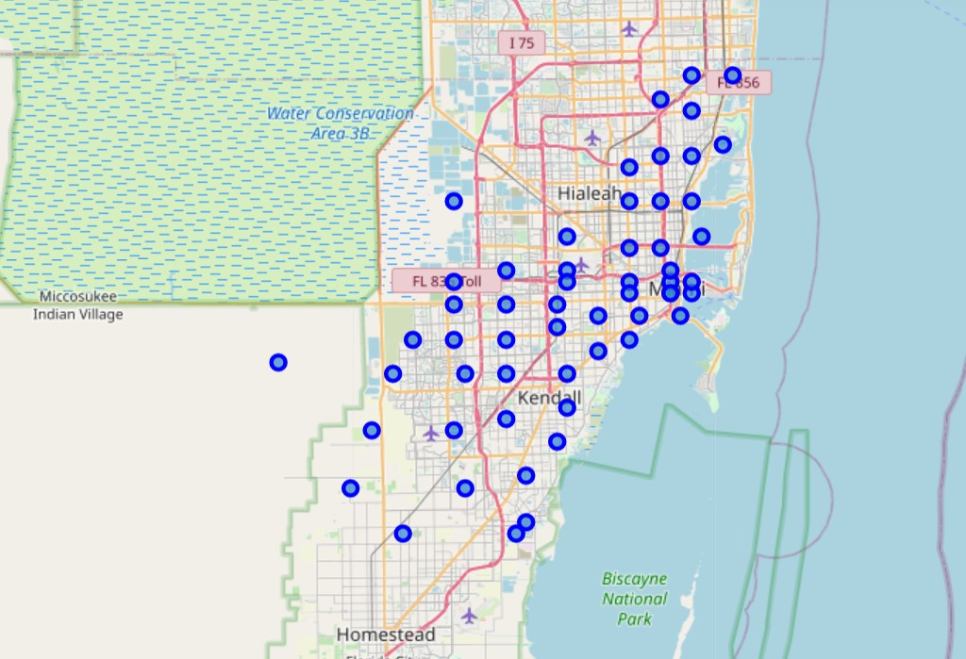
Map of Miami with its zips

Slide 6
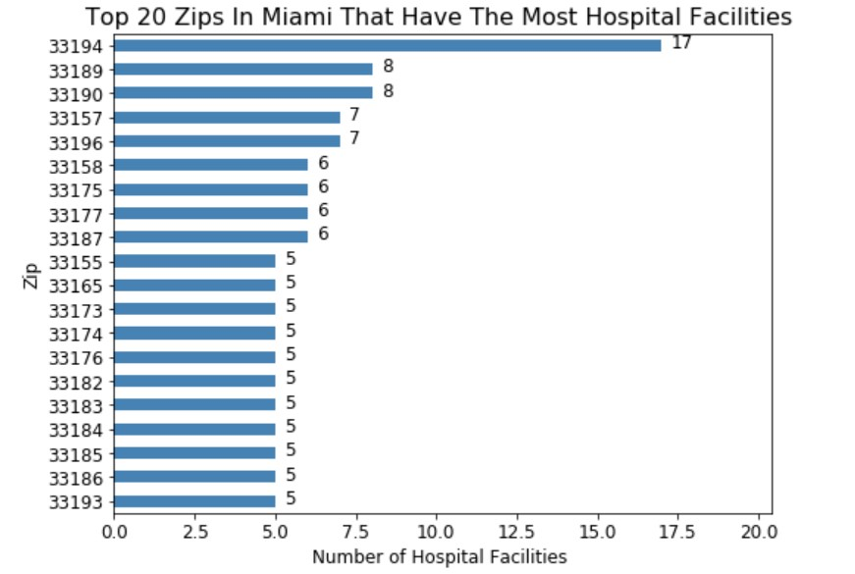
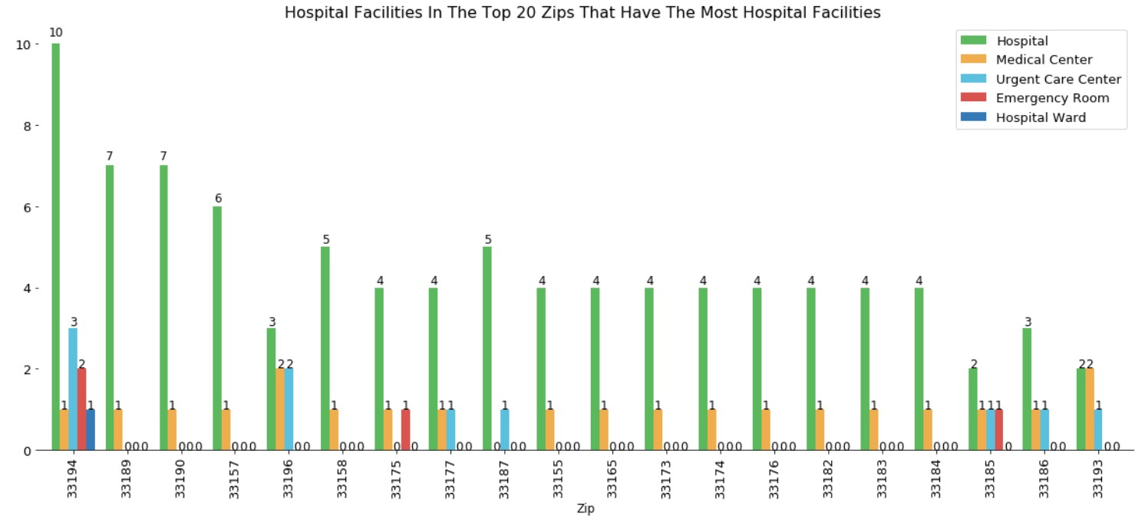
Analyze hospital facilities
Hospital facilities include: hospitals, medical centers, urgent care centers, and emergency rooms.
The top 10 (or more, if there are ties) zips that have the most total numbers of hospital facilities:

Slide 7
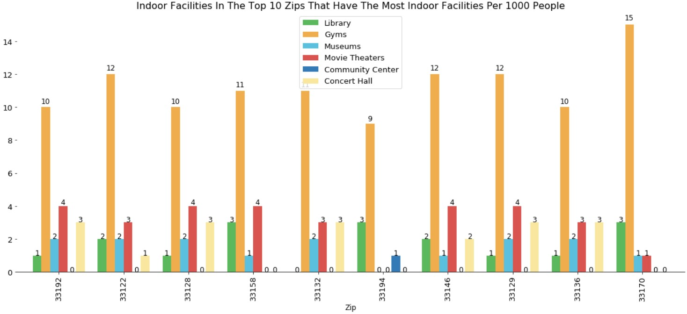
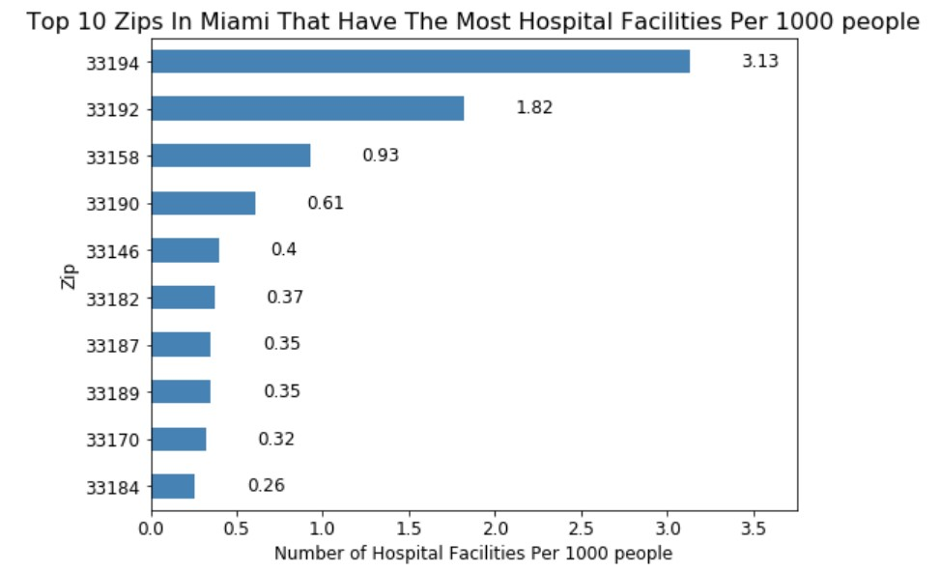
Analyze hospital facilities (cont.)
The top 10 (or more, if there are ties) zips that have the most numbers of hospital facilities per 1000 people:

Slide 8
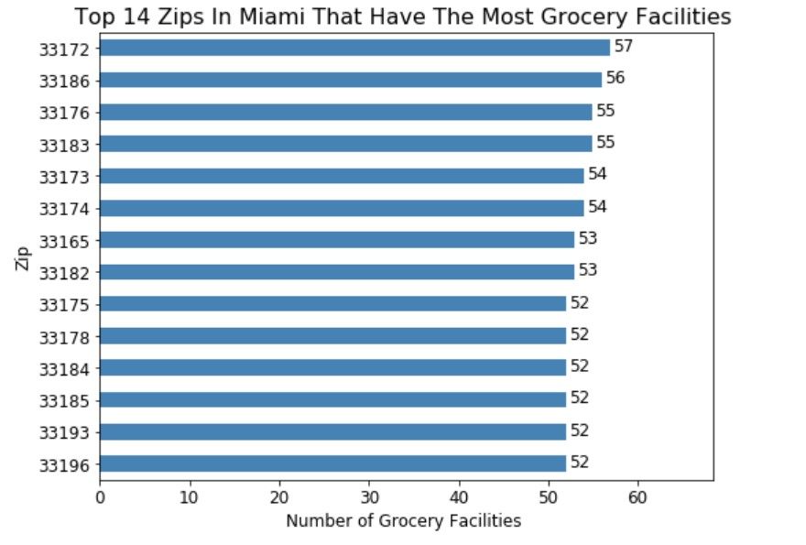
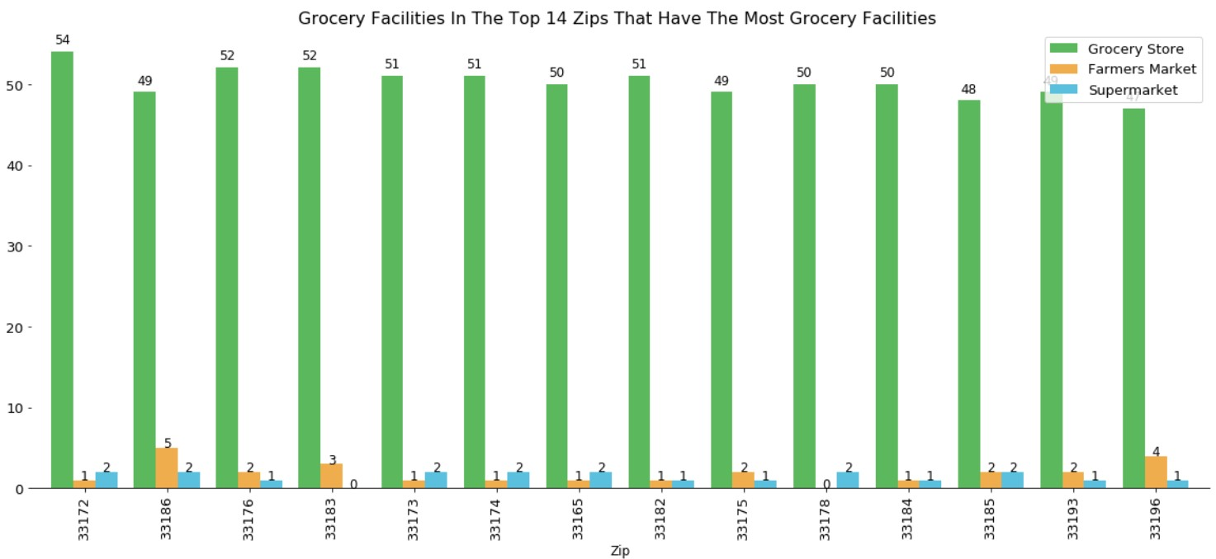
Analyze grocery facilities
Grocery facilities include: grocery stores, farmers markets, and supermarkets.
The top 10 (or more, if there are ties) zips that have the most total numbers of grocery facilities:

Slide 9
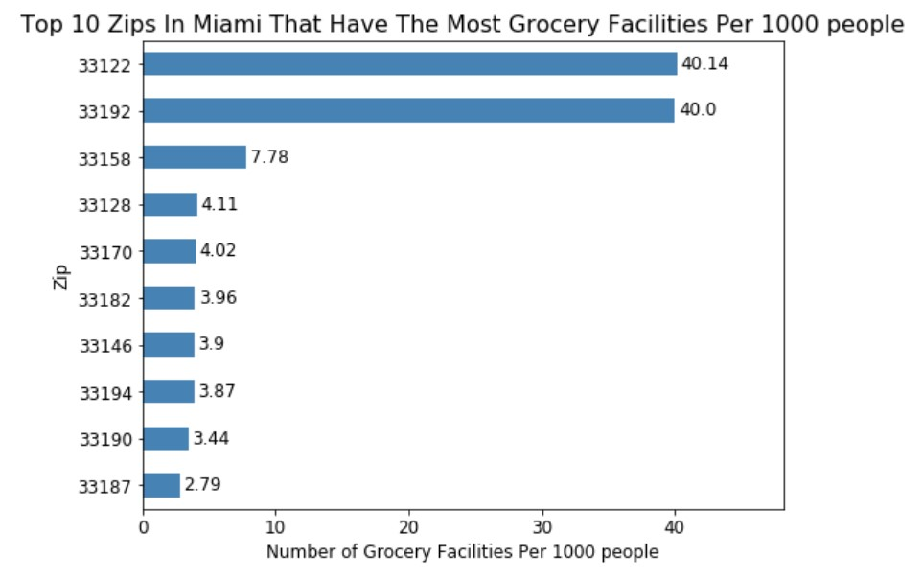
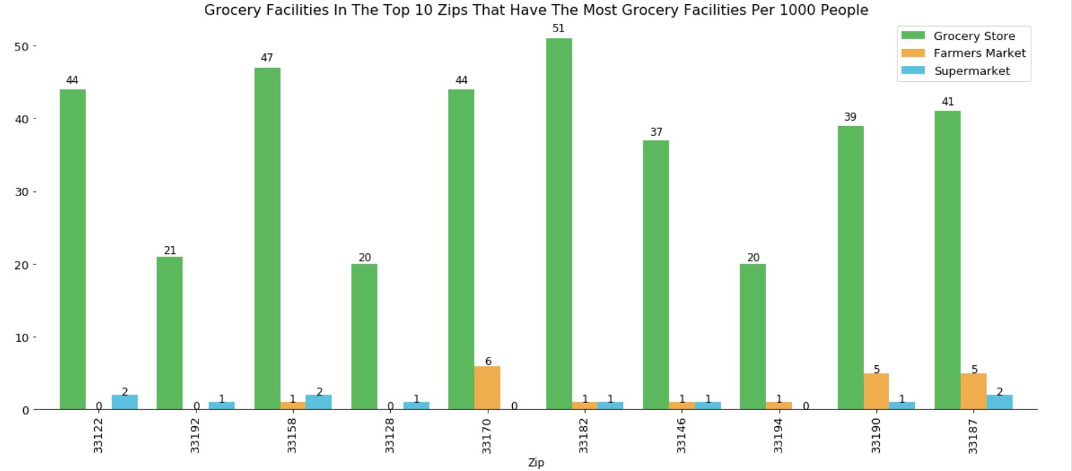
Analyze grocery facilities (cont.)
The top 10 (or more, if there are ties) zips that have the most numbers of grocery facilities per 1000 people:

Slide 10
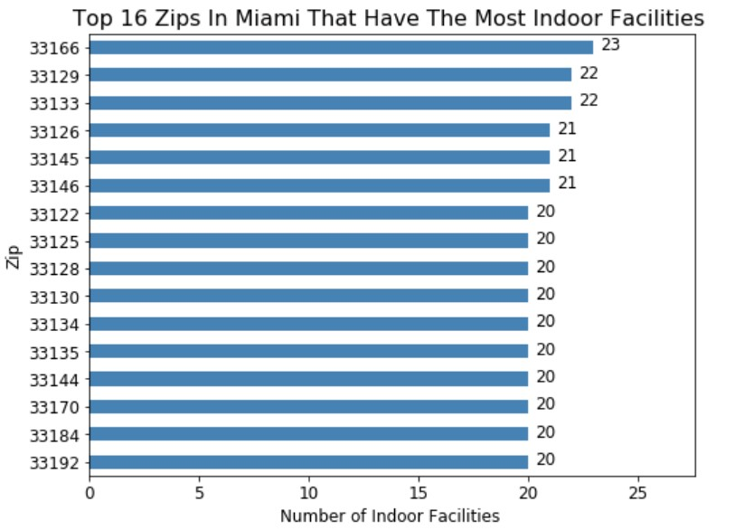
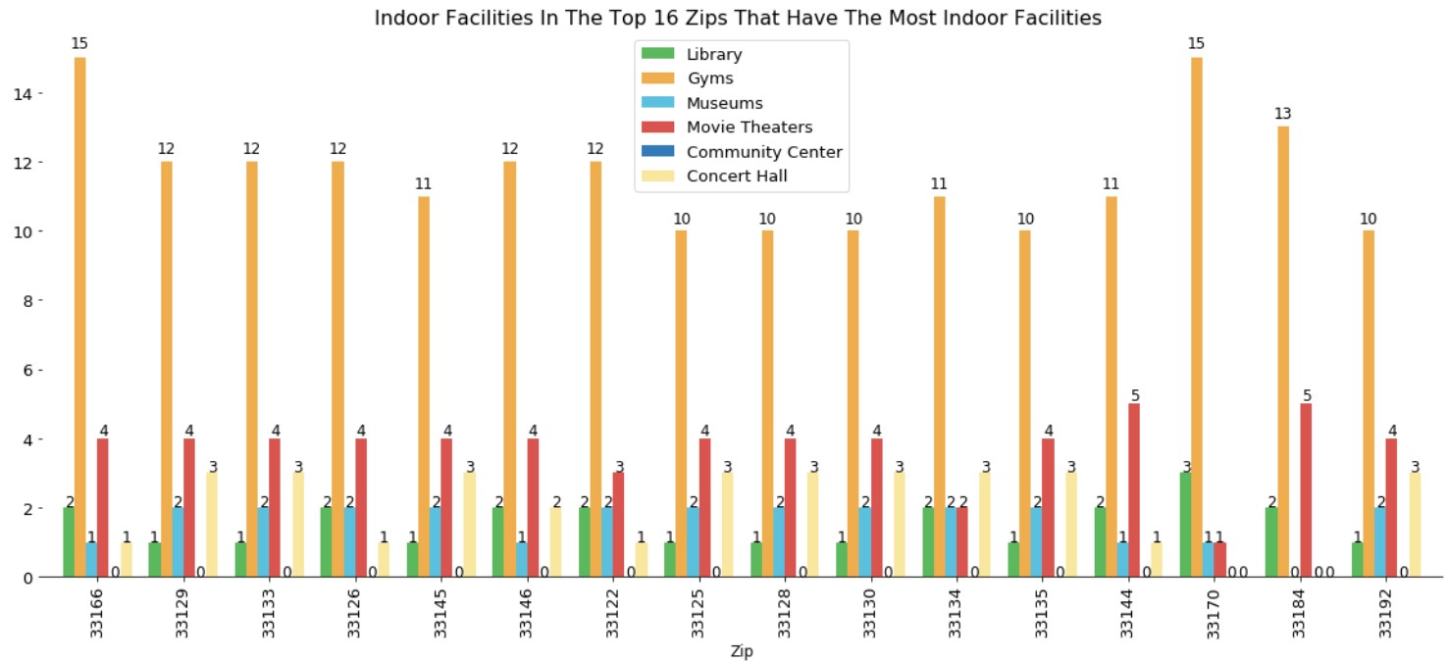
Analyze indoor facilities
Indoor facilities include: libraries, gyms, museums, movie theaters, community centers, and concert halls.
The top 10 (or more, if there are ties) zips that have the most total numbers of indoor facilities:

Slide 11
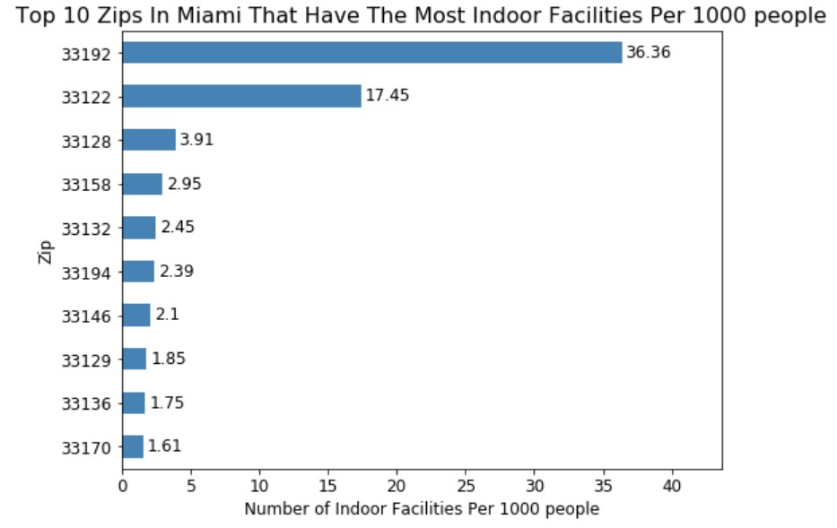
Analyze indoor facilities (cont.)
The top 10 (or more, if there are ties) zips that have the most numbers of indoor facilities per 1000 people:

Slide 12
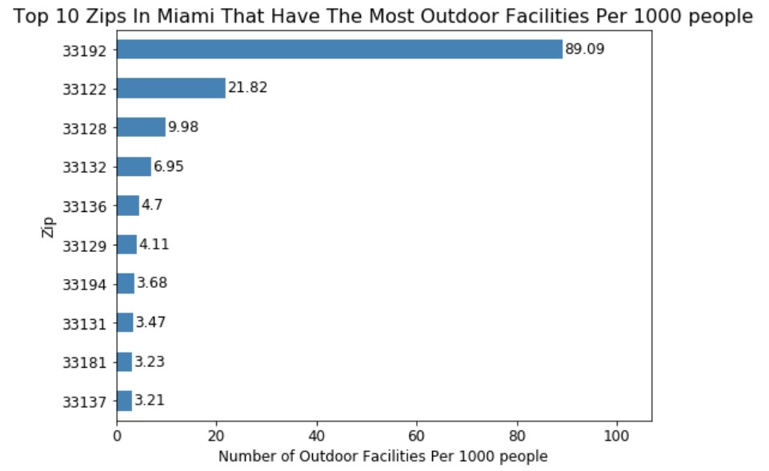
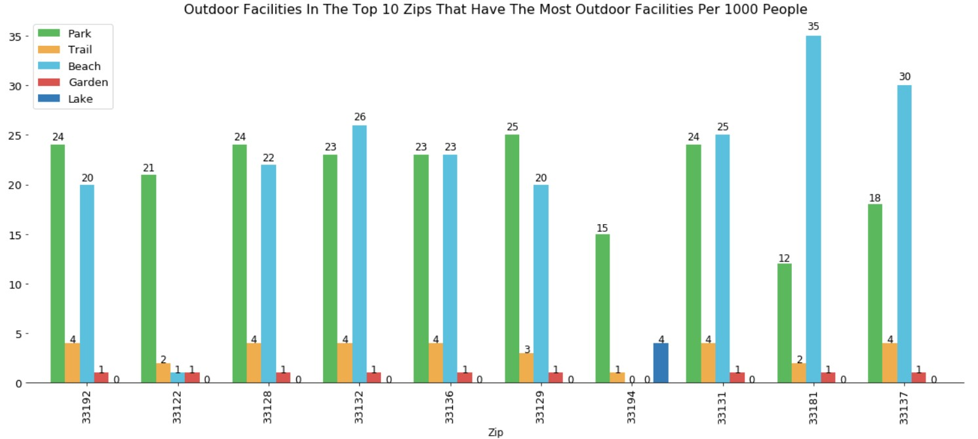
Analyze outdoor facilities
Outdoor facilities include: parks, trails, gardens, beaches, and lakes.
The top 10 (or more, if there are ties) zips that have the most total numbers of outdoor facilities:

Slide 13
Analyze outdoor facilities (cont.)
The top 10 (or more, if there are ties) zips that have the most numbers of outdoor facilities per 1000 people:

Slide 14
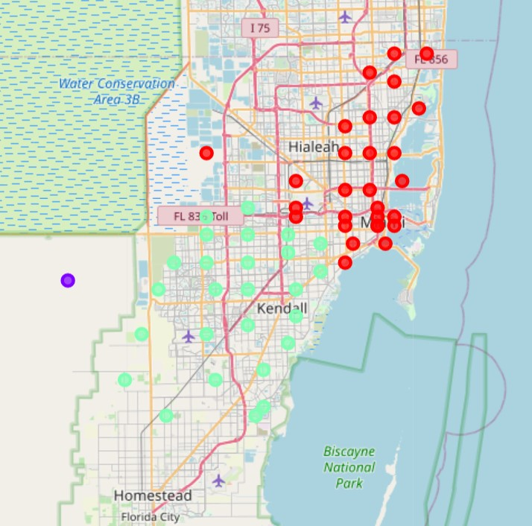
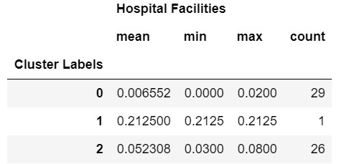
Clustering for hospital facilities
Cluster 0: red, relatively fewer hospital facilities;
Cluster 1: purple, relatively more hospital facilities;
Cluster 2: green, medium number of hospital facilities.

Slide 15
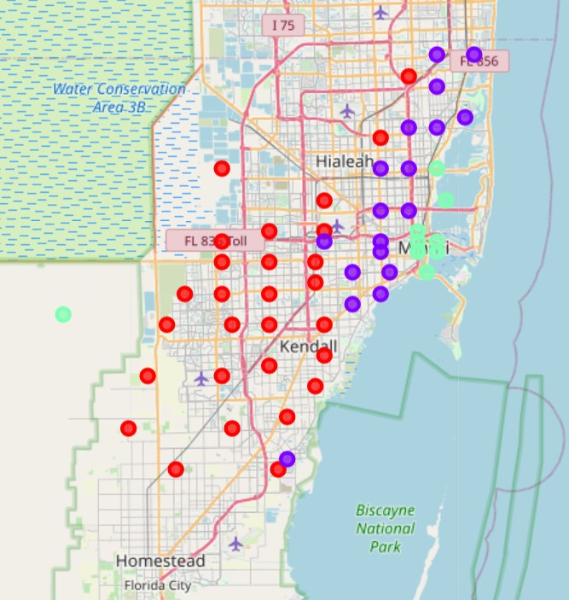
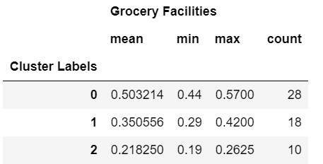
Clustering for grocery facilities
Cluster 0: red, relatively more grocery facilities;
Cluster 1: purple, medium number of grocery facilities;
Cluster 2: green, relatively fewer grocery facilities.

Slide 16
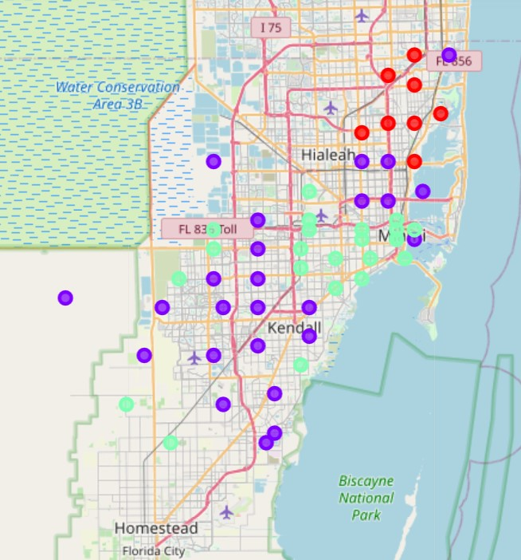
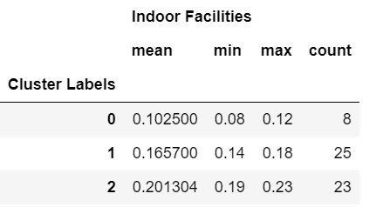
Clustering for indoor facilities
Cluster 0: red, relatively fewer indoor facilities;
Cluster 1: purple, medium number of indoor facilities;
Cluster 2: green, relatively more indoor facilities.

Slide 17
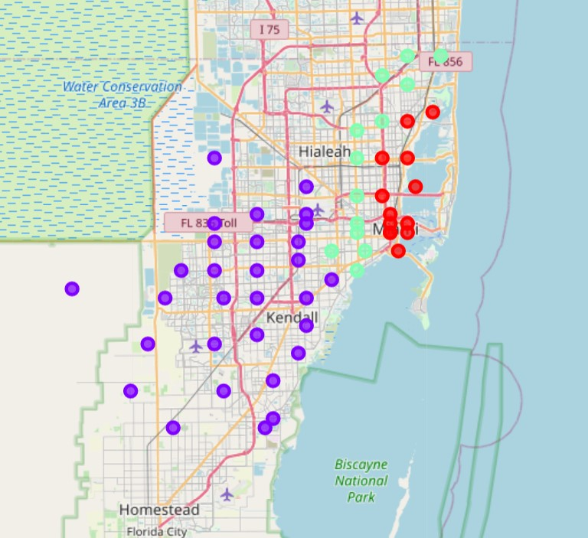
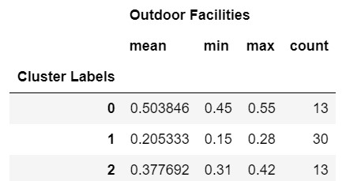
Clustering for outdoor facilities
Cluster 0: red, relatively more outdoor facilities;
Cluster 1: purple, relatively few outdoor facilities;
Cluster 2: green, medium number of outdoor facilities.

Slide 18
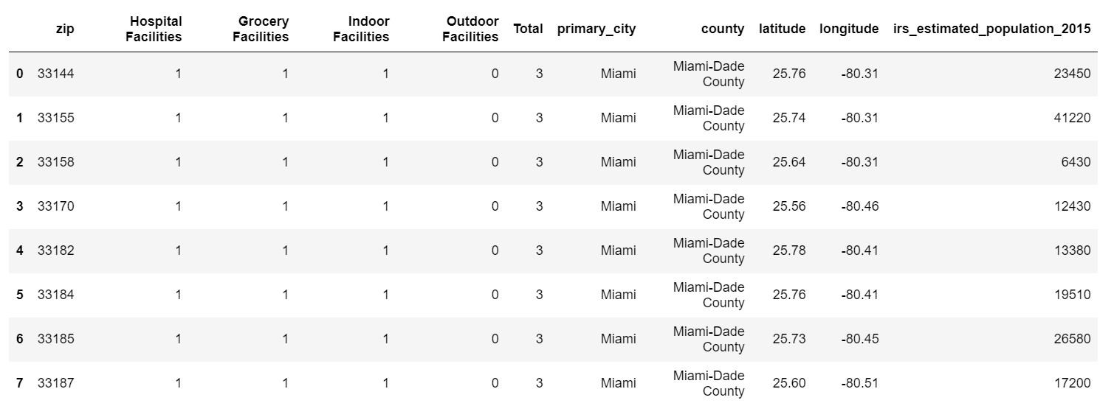
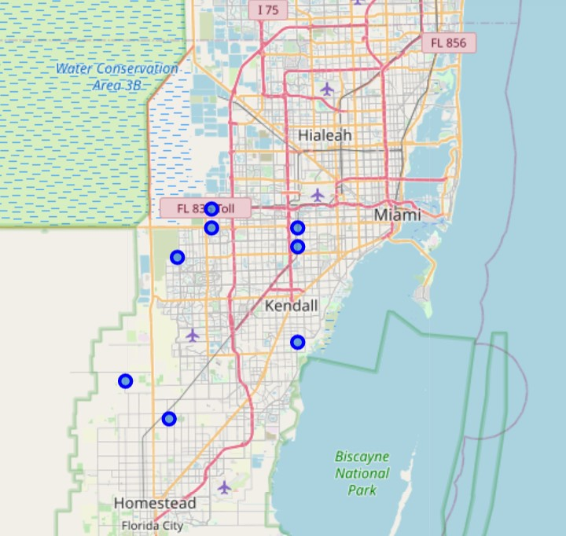
Result
The zips in most of the clusters with relatively more facilities:

Slide 19
Discussion and Conclusion
Found top zips with the highest numbers of total and average facilities for each category group, and plotted bar charts to demonstrate the numbers and to compare each venue in the category group for the top zips.
With the k-means clustering method, for each category group, clustered the zips into 3 clusters based on the concentration, and marked them with different colors on the Miami map.
Found the zip list appearing in most clusters having more facilities.
The final decision on which zips of the city they would move to will be made by customers based on their individual or specific requirements/interests.
With minor changes, this analysis can also be used by customers who would relocate to any city in the country with other preferences.
Furthermore, can extend this project to analyze and compare the neighborhoods within each zip on the final list.

