Slide 1

Embedded SoC Term Project
Designing General Purpose Parallel Compute Unit
범용 병렬 계산기 설계
우주선 조
2014161001 강승우
KOREATECH Univ, ki6080@gmail.com

Slide 2
Data to process
Data to process
Data to process
Data to process
Process with single powerful CPU
Data to process
Data to process
Data to process
Data to process
Data to process
Fetch
Process
Writeback
Data to process
Powerful function
(Not used)
Super poerful function
(Not used)
Really powerful function
(Not used)
Data processed

Slide 3
Process with numerous simple processors
Powerful CPU
Feed data
Data to process
Data to process
Fetch
Process
Writeback
Data to process
Fetch
Process
Writeback
Data to process
Fetch
Process
Writeback
Data to process
Fetch
Process
Writeback
Fetch
Process
Writeback
Fetch
Process
Writeback
Receive data
Data to process
Data to process
Data to process
Data to process
Data processed

Slide 4
Concept
Core
(Instruction Feeder)
Thread 0
Thread 1
Thread 2
Thread 3
Thread 4
Thread 5
… Thread 2^n-1
Single Instruction performs 2^n operations
Each thread has 32*32 bit general purpose registers.
No programmable instruction memory, no flow control on its own.
only logic & arithmetic operation supported. Instructions should be fed from outside.

Slide 5
Goal
Advanced SIMD operation
Platform Independence
Ultra Fast Massive Data Processing
Numerous independent processors executes same command at the same time
Fast local memory access
Synthesis level independence (IP Interfacing)
Application level independence
Intensive RISC Instructions
5 Stage pipelined architecture (Nested 2-stage pipelined FPU)
Can accept 200MHz input clock → 64 * 50MHz = 3.2GFlops per Core

Slide 6



System Overview
Transaction
High-performance CPU
Instr
DATA BUS
Instruction Queue (FIFO)
Transaction
Processor Array

Slide 7
Core, Thread, Task
Core
Instruction Feeder
Thread [Task 0….n]
Thread [Task 0….n]
Thread [Task 0….n]
Thread [Task 0….n]
Core includes Threads.
Threads execute instructions in parallel
Large number of operations which is more than maximum thread count, will be abstract by task

Slide 8
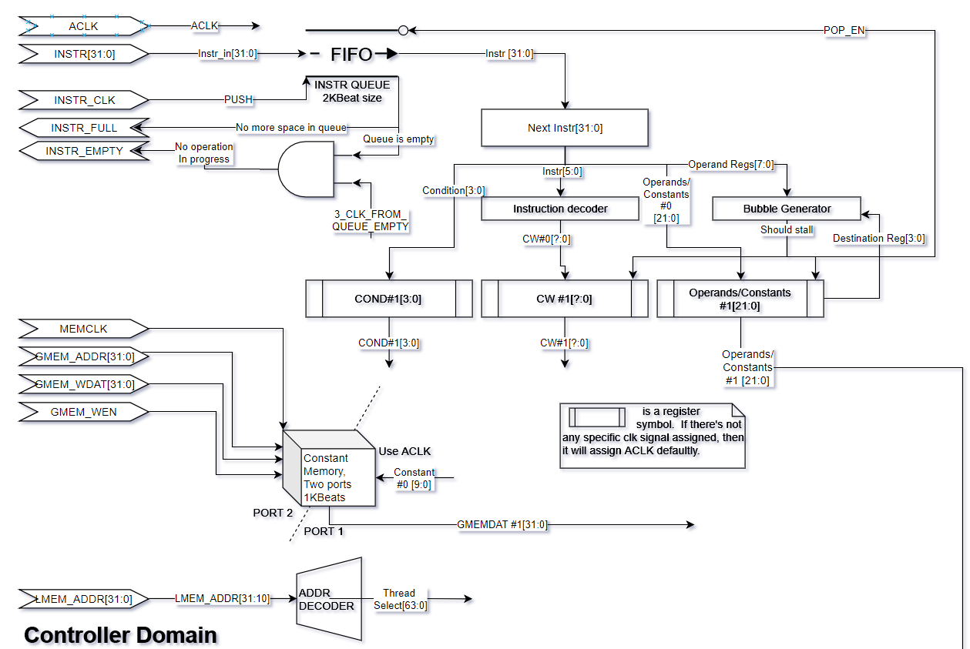
Instruction from outside → Enqueued
Constant memory. This is a ROM in view of the thread
Core

Slide 9
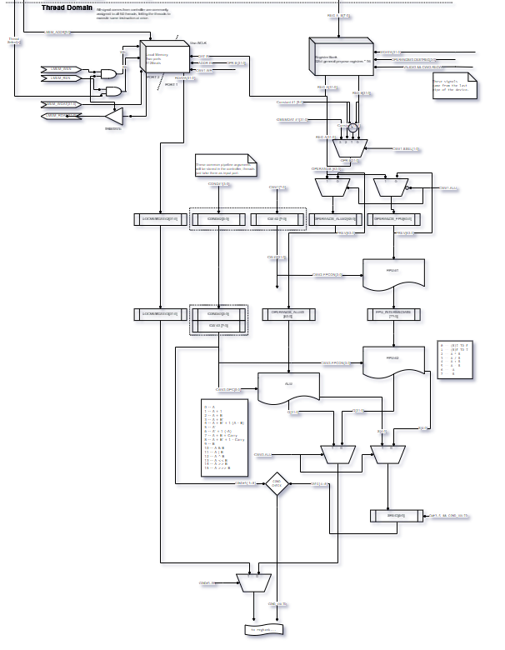
External local memory access
/Internal local memory access
= Dual Port
Thread
Pipelined FPU
Nested 1KBeat local memory (DP SRAM)
Conditional Instruction Execution

Slide 10
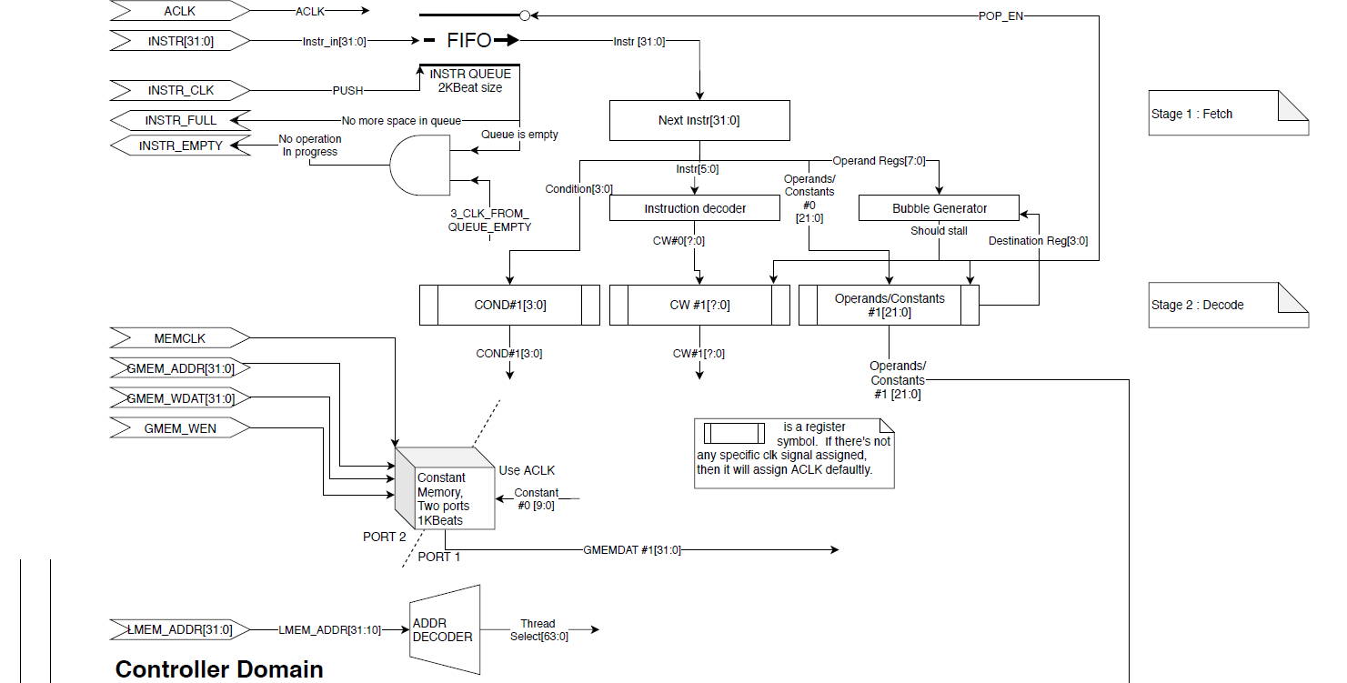

Slide 11
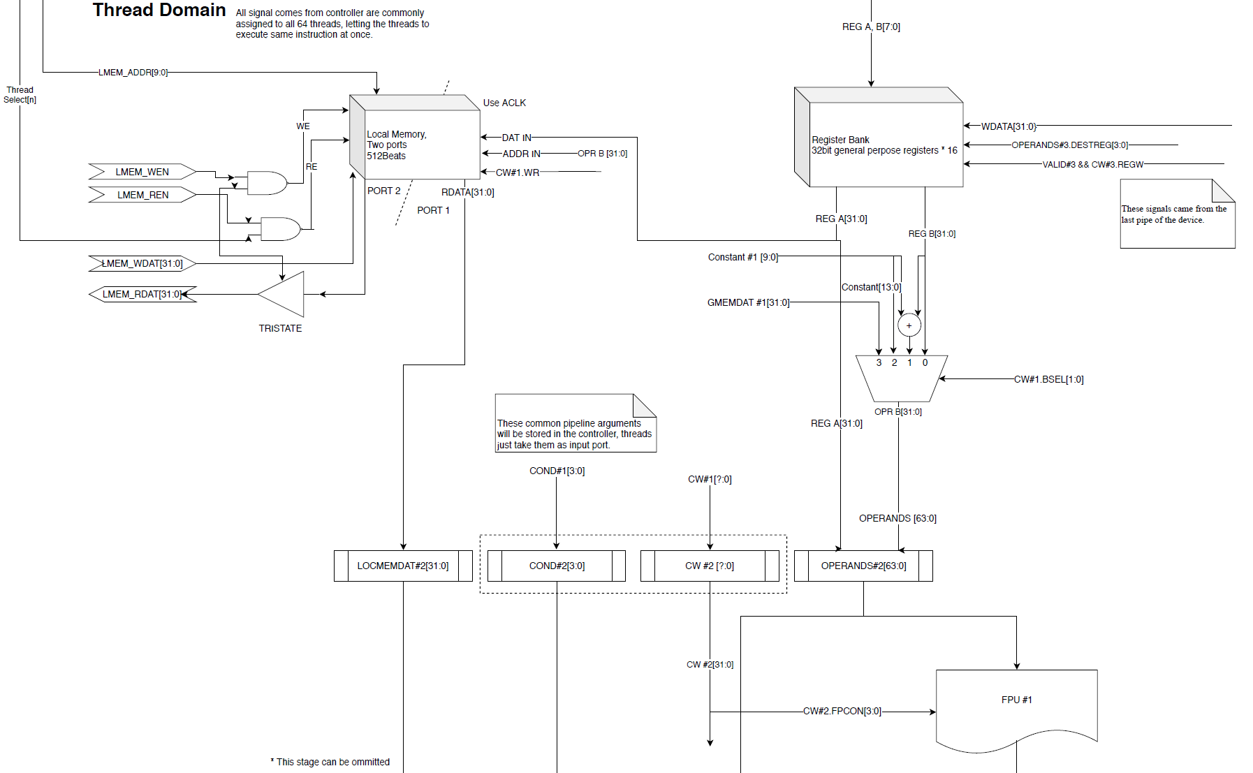

Slide 12
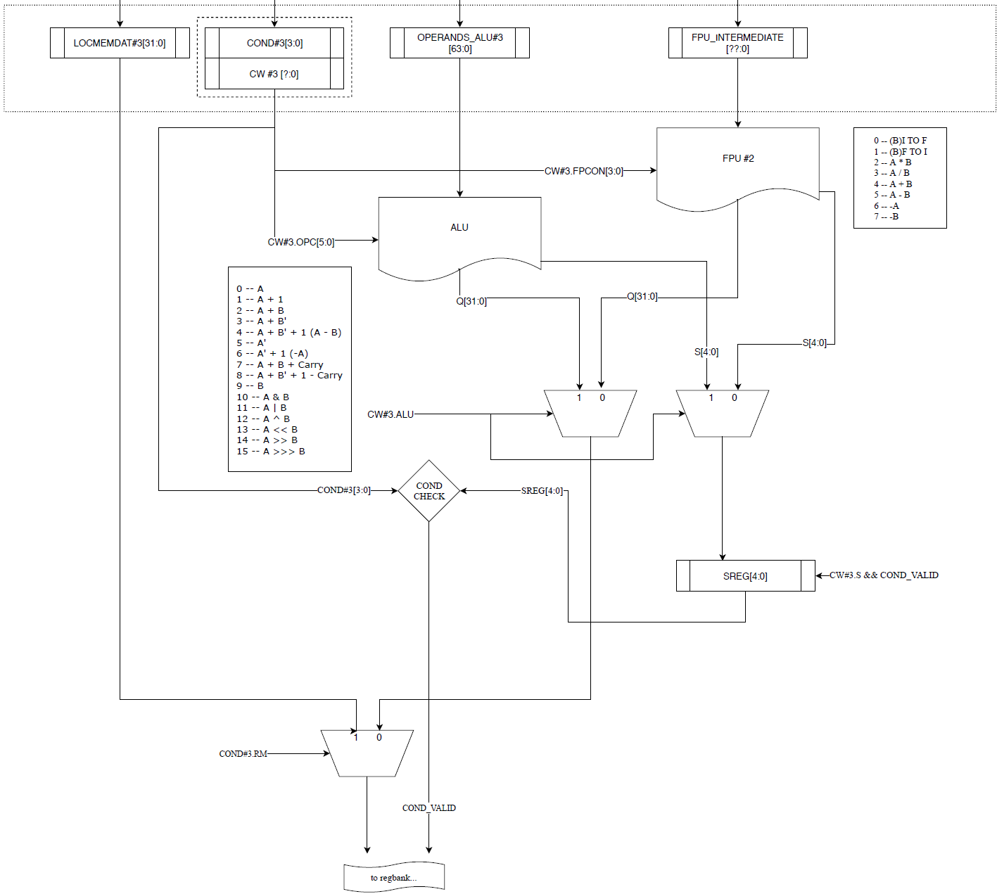

Slide 13
Task
Abstract parallel process
Core
Task
Task
Task
Task
Task
…
Thread
Task
Task
Task
Task
Task
…
Thread
Task
Task
Task
Task
Task
…
Thread
Core
Thread
Task[0..n]
Thread
Task[0..n]
Thread
Task[0..n]
Implement
Serial processing on actual execution

Slide 14
Interface
Data transaction
Global memory write
(Constant ROM)
Local memory access
Queue instruction
[Conditional]
Arithmetic Operations
Write
Read
Floating point
Integer
Load/Store operation

Slide 15
Thread ISA
32 bit RISC Instruction
Morph of ARM Architecture
3 Instruction Models
COND | OPR | S | RD | RA | IMM | RB
31 28 | 27 23 | 22 | 21 17 | 16 12 | 11 5 | 4 0
COND | OPR | S | RD | RA | IMM
31 28 | 27 23 | 22 | 21 17 | 16 12 | 11 0
COND | OPR | S | RD | IMM
31 28 | 27 23 | 22 | 21 17 | 16 0

Slide 16
Thread ISA
ALU
FPU
GENERAL
MOV D := M
ADC D := A+M+C
SBC D := A+'M+'C
AND D := A&M
ORR D := A|M
XOR D := A^M
ADI D := A+I
SBI D := A-I
MVI D := I
MVN D := 'M+1
ITOF
FTOI
FMUL
FDIV
FADD
FSUB
FNEG
LDL D := L[A+I]
LDC D := G[A+I]
LDCI D := G[I]
STL L[B+I] := A
L : Local memory
G : Const memory

Slide 17
Instruction Level Parallelism
MOV R1,R2
ADDI
R1, R3, 4
LD R3,[R1]
FETCH
DECODE
EXEC1
WRITEBACK
FETCH
DECODE
…
EXEC1 *Data Preview Support
WRITE
FETCH
…
DECODE
WRITEBACK
EXEC2
EXEC2
…
EXEC1
EXEC2
5-stage pipeline
Hardware prevents data hazard by inserting bubble
CPI decreases on every bubble…

Slide 18
Instruction Level Parallelism
Independent tasks run on single core at the same time.
There are 32 Registers inside of each thread
Simulate two internal parallel process, assigning 16 registers per task
No Stalls Anymore!
mvi r15, #0
mov r0, r1
add r2, r0, r3
...
mvi r15, #16
mov r0, r1
add r2, r0, r3
mvi r15, #0
mvi r31, #16
mov r0, r1
mov r16, r17
add r2, r0, r3
add r18, r16, r19
...
This is not hardware-supported,
following cpp code will represent example of this paradigm

Slide 19
Code Example
void mult(float const* a, float const*b, size_t NumData, float* dst)
{
CalcDevice pc;
pc.ClearData();
pc.SetSpacePerTask(sizeof(float)*3);
pc.WritePerTask(
/*Target data*/a,
/*Number of tasks*/NumData,
/*Ofst from task space*/0,
/*Size per write*/sizeof(float));
pc.WritePerTask(
/*Target data*/b,
/*Number of tasks*/NumData,
/*Ofst from task space*/4,
/*Size per write*/sizeof(float) );
a[0] |  |  | a[1] |  |  | a[2] |  |  | …
a[0] | b[0] |  | a[1] | b[1] |  | a[2] | b[2] |  | …

Slide 20
Code Example
pc.ClearTaskQueue();
pc.QueueTaskLoadWord(
// This operation will execute
// LDR DST, [r15 + OFST]
// per task
/*Target Register*/ r1,
/*Data Ofst*/0);
pc.QueueTaskLoadWord(
/*Target Register*/ r2,
/*Data Ofst*/4);
pc.QueueTaskFMul(
/*Target Register*/ r0,
/*OPR A, B*/r1,
r2);
pc.QueueTaskStoreWord(
/*Target Register*/ r0,
/*Data Ofst*/8);
a[0] | b[0] | a[0]*b[0] | a[1] | b[1] | a[1]*b[1] | a[2] | b[2] | a[2]*b[2] | …

Slide 21
Code Example
pc.ExecuteTaskQueue();
pc.Flush();
pc.ReadPerTask(
/*Destination*/dst,
/*Number of tasks*/NumData,
/*Ofst from task space*/8,
/*Size per read*/sizeof(float)
);
}
A kind of return procedure.

Slide 22
Milestone
Design architecture & ISA
Implement pipelined FPU
Implement GPPCU device
Composite overall system (As Memory Mapped Device)
Program application (Device driver, Application)

Slide 23
Progress On Week 5, May 2019
Concept
Week 3, May 2019 Thread Concept
Week 3, May 2019 Core Concept
Week 3, May 2019 Device Concept
Week 4, May 2019 User-Level Usage Concept
Layout
Week 4, May 2019 Core Diagram
Week 4, May 2019 Interface Concept
Week 5, May 2019 Thread Diagram
Week 5, May 2019 System Diagram
Implementation
*On Progress* Pipelined FPU
Processor control word design
Pipeline design (Minimal prevent data hazard)
Week 1, June 2019 Thread ISA

Slide 24
Thank you
Q & A

