Slide 1


Indian Institute of Information Technology, Lucknow
(An Institute of National Importance by Act of Parliament)
B.Tech (CSB) VIIth Semester & M.Sc. Economics and Management Semester II
Term: 2023-2024
Credits: 04, Hours: 56

Slide 2
What human resource management is ? & How it relates to the management process?
Notes:
Working for any organization means that you and those around you share common goals, which include an interest in the growth and continuing development of the organization. Some of those common goals include how work is accomplished within the organization. We now begin our study of the elements of the management process and how they relate to human resource management. Note that such individuals generally work together to achieve the common goals of an organization.

Slide 3
Why Is Human Resource Management Important to All Managers?
To Avoid Personnel Mistakes
To Improve Profits and Performance
Staffing the organization,
designing jobs and teams,
developing skillful employees,
identifying approaches for improving their performance, and rewarding employee successes—
All typically labeled HRM issues—are as relevant to line managers as they are to managers in the HR department.
Notes:
Why Is HR Management Important to All Managers?
Because of the following:
To Avoid Personnel Mistakes – managers don’t want to make personnel mistakes, such as not having employees doing their best, hiring the wrong person for the job, experiencing high turnover, having to be in court due to discriminatory actions, being cited for unsafe practices, letting a lack of training undermined department effectiveness, or committing any unfair labor practices.
2. To Improving Profits and Performance – to help ensure that you get results—through people.
You May Spend Some Time as an HR Manager – about a third of large U.S. businesses surveyed has appointed non-HR managers to be their top human resource executives.
4. HR for Small Business – you may well end up as your own human resource manager. More than half of the
people working in the United States work for small firms. Small businesses as a group also account for most
of the 600,000 or so new businesses created every year
Carefully studying this book will help you in these areas.

Slide 4
HR Management Responsibilities
Training employees for jobs that are new to them
Improving the job performance of each person
Gaining creative cooperation and developing smooth working relationships
Interpreting the company policies and procedures
Controlling labor cost
Developing the abilities of each person
Creating and maintaining departmental morale
Protecting employees’ health and physical conditions
Notes:
3. Training employees for jobs that are new to them.
4. Improving the job performance of each person.
5. Gaining creative cooperation and developing smooth working relationships.
6. Interpreting the company’s policies and procedures.

Slide 5
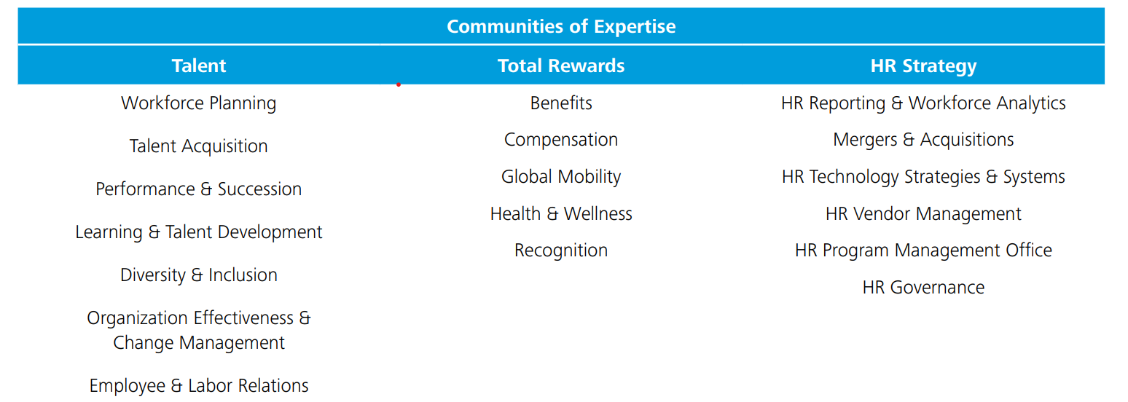
HR Expertise/Functions: Source Deloitte

Slide 6
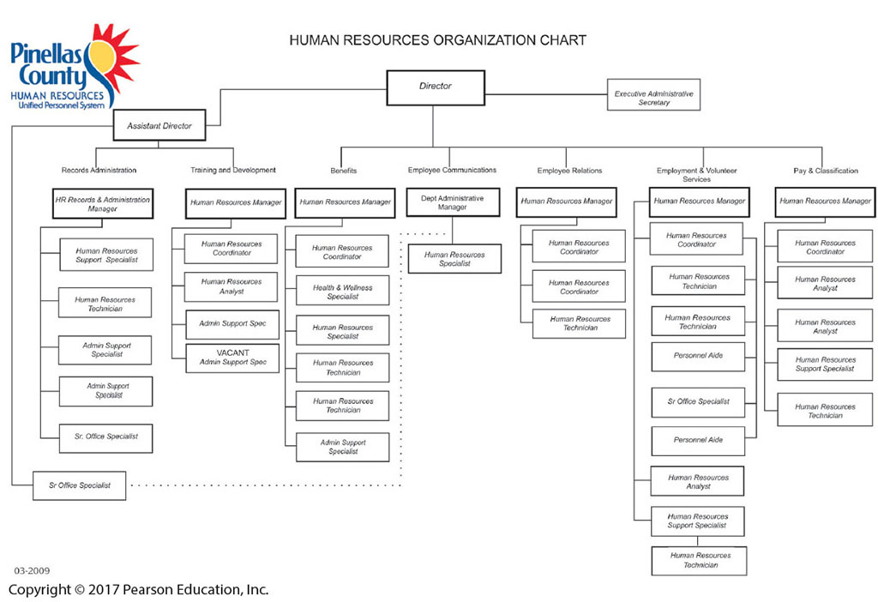
The Human Resources Department
Notes:
In small organizations, line managers may carry out all these personnel duties unassisted.
But as the organization grows, line managers usually need the assistance, specialized knowledge, and advice of a separate human resource staff.
In larger firms, the human resource department provides such specialized assistance.
This FIGURE 1-1 Human Resource Department Organization Chart Showing Typical HR Job Titles
Source: “Human Resource Development Organization Chart Showing Typical HR Job Titles,” www.co.pinellas.fl.us/persnl/pdf/
orgchart.pdf. Courtesy of Pinellas County Human Resources. Reprinted with permission.
Examples of typical jobs include:
● Recruiters. Search for qualified job applicants.
● Equal employment opportunity (EEO) coordinators. Investigate and resolve EEO grievances,
examine organizational practices for potential violations, and compile and submit EEO reports.
● Job analysts. Collect and examine information about jobs to prepare job descriptions.
● Compensation managers. Develop compensation plans and handle the employee benefits
program.
● Training specialists. Plan, organize, and direct training activities.
● Labor relations specialists. Advise management on all aspects of union-management relations.
At the other extreme, the human resource team for a small manufacturer may contain just
five or six (or fewer) staff, and have an organization similar to that in Figure 1-1. There is generally
about one human resource employee per 100 company employees.

Slide 7
Human Capital and HRM

Slide 8
Human Capital and HRM
Words to describe how important people are to organizations – Human Resources, Human Capital, Intellectual Assets, and Talent Management.
Human Capital - The knowledge, skills, and capabilities of individuals that have economic value to an organization
Human capital is intangible and cannot be managed the way organizations manage jobs, products, and technologies.
Valuable because capital:
is based on company-specific skills.
is gained through long-term experience.
can be expanded through development.
“An organization’s ability to learn, and translate that learning into action rapidly, is the ultimate competitive business advantage.” ( Jack Welch, General Electric)

Slide 9
New Approaches To Organizing HR
Reorganizing the HR function of how it is organized and delivers HR services
Shared Services (Transactional) HR teams
Corporate HR teams
Embedded HR teams
Centers of expertise
Notes:
Many employers are changing how they organize their human resource functions.
For example, one survey found that 44% of the large firms surveyed planned to change how they organize and deliver HR services
Most plan to use technology to institute more “shared services” (or “transactional”) arrangements. These establish centralized HR units whose employees are shared by all the companies’ departments to obtain advice on matters such as discipline problems.
You may also find specialized corporate HR teams within a company. These assist top management in top-level issues such as developing the personnel aspects of the company’s long-term strategic plan.
Embedded HR teams is another approach that has HR generalists (also known as “relationship managers” or “HR business partners”) assigned to functional departments like sales and production. They provide the selection and other assistance the departments need.
In addition, Centers of expertise are basically specialized HR consulting firms within the company.

Slide 10
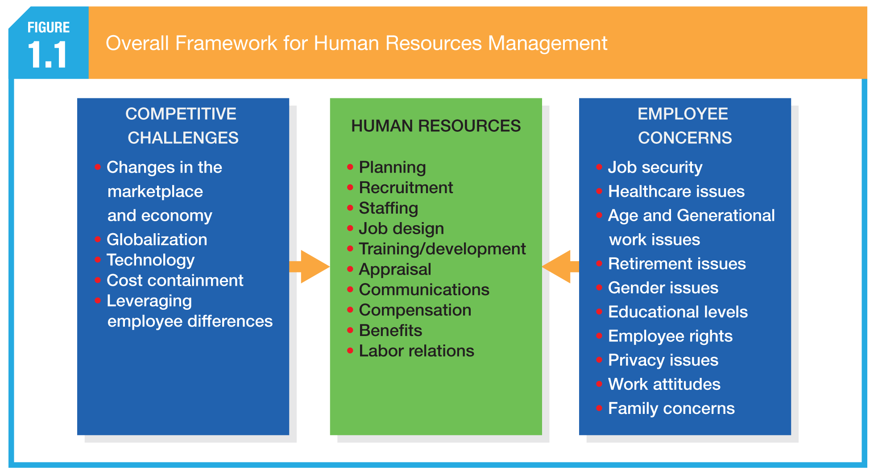
An overall framework of HR activities.

Slide 11
Competitive Challenges and Human Resources Management
Top challenges include:
Responding Strategically to Changes in the Marketplace
Competing, Recruiting, and Staffing Globally
Setting and Achieving Corporate Social Responsibility and Sustainability Goals
Advancing HRM with Technology
Containing Costs While Retaining Top Talent and Maximizing Productivity
Responding to the Demographic and Diversity Challenges of the Workforce
Adapting to Educational and Cultural Shifts Affecting the Workforce

Slide 12
Challenge 1: Responding Strategically to Changes in the Marketplace
Human Resources Managers and Business Strategy
From administrative tasks to strategic partners.
Human resources managers need an intimate understanding of their firms’ competitive business operations and strategies. They need to understand…..
Total quality management
Reengineering
Downsizing
Outsourcing
Change management
Reactive change
Proactive change
Six Sigma
And more….

Slide 13
Challenge 1: Responding Strategically to Changes in the Marketplace (cont.)
Total Quality Management (TQM)
A set of principles and practices whose core ideas include understanding customer needs, doing things right the first time, and striving for continuous improvement.
Six Sigma
A process used to translate customer needs into a set of optimal tasks that are performed in concert with one another.
HR facilitates organizational development of Six Sigma.
HR helps balance the opposing needs for order and control with the needs for growth and creativity.

Slide 14
Challenge 1: Responding Strategically to Changes in the Marketplace (cont.)
Reengineering and HRM
Fundamental rethinking and radical redesign of business processes to achieve dramatic improvements in cost, quality, service, and speed.
Requires that managers create an environment or change.
Depends on effective leadership and communication processes.
Requires that administrative systems be reviewed and modified.

Slide 15
Challenge 1: Responding Strategically to Changes in the Marketplace (cont.)
Downsizing
The planned elimination of jobs (“head count”).
Layoffs
Outsourcing
Contracting outside the organization to have work done that formerly was done by internal employees.
Offshoring (Global Sourcing)
The business practice of sending jobs to other countries.

Slide 16
Challenge 1: Responding Strategically to Changes in the Marketplace (cont.)
Why Change Efforts Fail:
Not establishing a sense of urgency.
Not creating a powerful coalition to guide the effort.
Lacking leaders who have a vision.
Lacking leaders who communicate the vision.
Not removing obstacles to the new vision.
Not systematically planning for and creating short-term “wins.”
Declaring victory too soon.
Not anchoring changes in the corporate culture.

Slide 17
Challenge 2: Competing, Recruiting, and Staffing Globally
Globalization
approximately 70 to 85 percent of the U.S. economy today is affected by international competition.
About 10 percent of what Americans produce every year, dollar-wise, is sold abroad.
Impact of Globalization
“Anything, anytime, anywhere” markets
Partnerships with foreign firms
Lower trade and tariff barriers
NAFTA, EU, APEC trade agreements
WTO and GATT

Slide 18
Challenge 3: Setting and Achieving Corporate Social Responsibility and Sustainability Goals
Corporate Social Responsibility (CSR)
The responsibility of the firm to act in the best interests of the people and communities affected by its activities.
Sustainability is closely related to corporate social responsibility. Sustainability refers to a company’s ability to produce a good or service without damaging the environment or depleting a resource.

Slide 19
Challenge 4: Advancing HRM with Technology
Collaborative software that allows workers anywhere anytime to interface and share information with one another electronically—wikis, document-sharing platforms such as Google Docs, online chat and instant messaging, web and video conferencing, and electronic calendar systems—have changed how and where people and companies do business.
From Touch Labor to Knowledge Workers
Knowledge Workers - Workers whose responsibilities extend beyond the physical execution of work to include planning, decision making, and problem-solving.

Slide 20
Challenge 4: Advancing HRM with Technology (cont.)
Human Resources Information System (HRIS) - A computerized system that provides current and accurate data for purposes of control and decision-making.
It has become a potent weapon for lowering administrative costs, increasing productivity, speeding up response times, improving decision-making, and tracking a company’s talent.
Another way in which information technology is affecting human resources management is relational in nature --connecting people with each other and with HR data they need.

Slide 21
Challenge 4: Advancing HRM with Technology (cont.)
Benefits:
Automation of routine tasks, lower administrative costs, increased productivity and response times.
Self-service access to information and training for managers and employees
Online recruiting, screening, and pretesting of applicants
Training, tracking, and selecting employees based on their record of skills and abilities
Organization-wide alignment of “cascading” goals

Slide 22
Challenge 5: Containing Costs While Retaining Top Talent and Maximizing Productivity
Organizations take many approaches to lowering labor-related costs, including….
Carefully managing employees’ benefits
Downsizing
Furloughing Employees
Outsourcing
Offshoring
Employee Leasing

Slide 23
Challenge 5: Containing Costs While Retaining Top Talent and Maximizing Productivity (cont.)
Hidden Costs of a Layoff
Severance and rehiring costs
Accrued vacation and sick day payouts
Pension and benefit payoffs
Potential lawsuits from aggrieved workers
Loss of institutional memory and trust in management
Lack of staffers when the economy rebounds
Survivors who are risk-averse, paranoid, and political

Slide 24
Challenge 5: Containing Costs While Retaining Top Talent and Maximizing Productivity (cont.)
Benefits of a No-Layoff Policy
A fiercely loyal, more productive workforce
Higher customer satisfaction
Readiness to snap back with the economy
A recruiting edge
Workers who aren’t afraid to innovate, knowing their jobs are safe.

Slide 25
Challenge 5: Containing Costs While Retaining Top Talent and Maximizing Productivity (cont.)
Employee Leasing

Slide 26
Challenge 6: Responding to the Demographic and Diversity Challenges of the Workforce
In a recent survey, almost half of the organizations reported that the biggest investment challenge facing them over the next ten years is obtaining human capital and optimizing their human capital investments. Why is this so? Changes in the demographic makeup of employees, such as their ages, education levels, and ethnicities, is part of the reason why.

Slide 27
Challenge 6: Responding to the Demographic and Diversity Challenges of the Workforce
Demographic Changes
More diverse workforce
Ethnic and cultural challenges
Aging workforce
More educated workforce
Necessity of basic skills training
Managing Diversity
Being aware of characteristics common to employees, while also managing employees as individuals

Slide 28
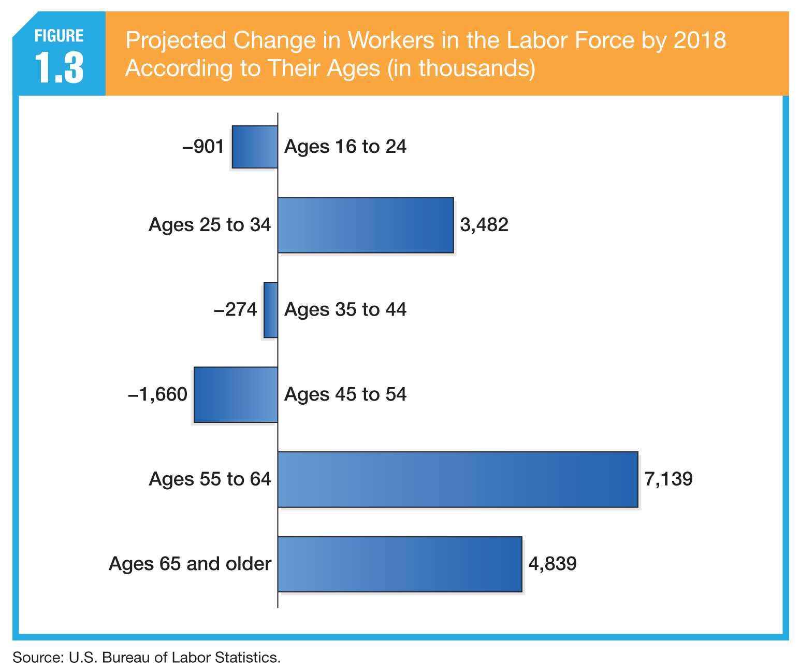
Challenge 6: Responding to the Demographic and Diversity Challenges of the Workforce (cont.)

Slide 29
Challenge 7: Adapting to Educational and Cultural Shifts Affecting the Workforce
Over the years, the educational attainment of the labor force has risen dramatically. Figure 1.5 shows that it clearly pays to get a college education. An education also helps a person stay out of the ranks of the unemployed.
For example, in 2010, the unemployment rate of people ages twenty to twenty-four hit 17 percent. But those in the same age range with college degrees fared better. The unemployment rate for them was a little over 9 percent.

Slide 30
Challenge 7: Adapting to Educational and Cultural Shifts Affecting the Workforce (cont.)
Other Factors:
Cultural and Societal Changes Affecting the Workforce
Employee Rights
Privacy Concerns of Employees
Changing Attitudes toward Work
Balancing Work and Family

Slide 31
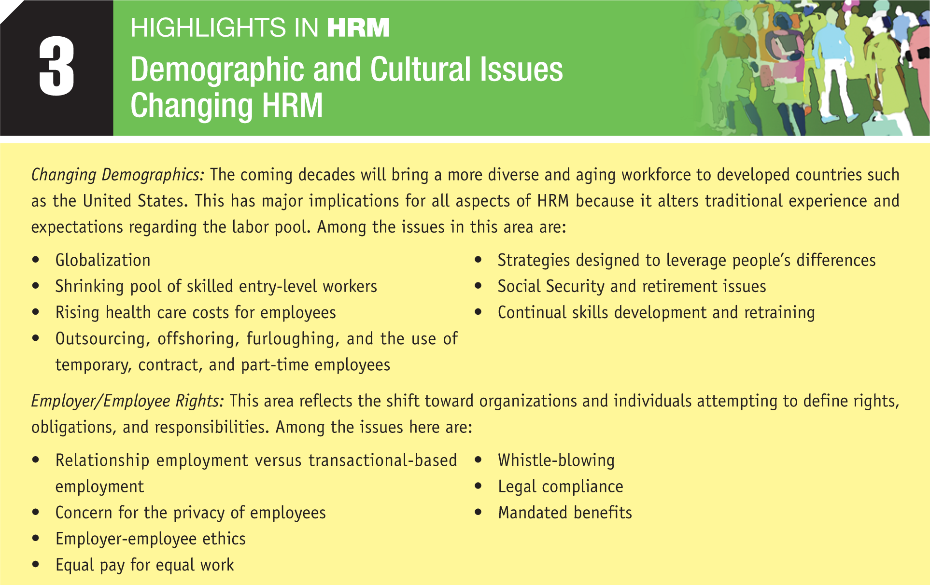
Challenge 7: Adapting to Educational and Cultural Shifts Affecting the Workforce (cont.)

Slide 32
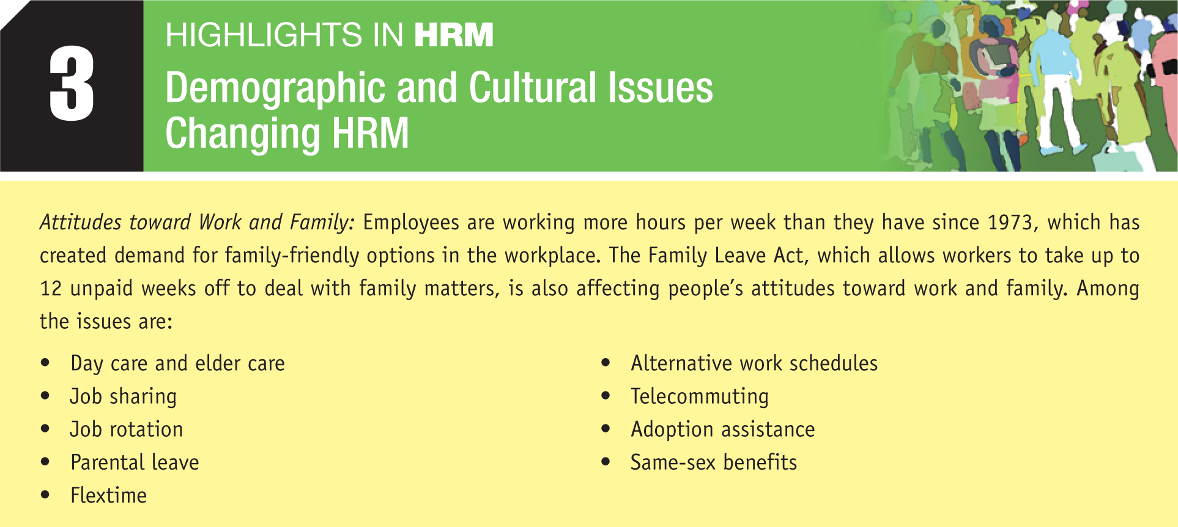
Challenge 7: Adapting to Educational and Cultural Shifts Affecting the Workforce (cont.)

Slide 33
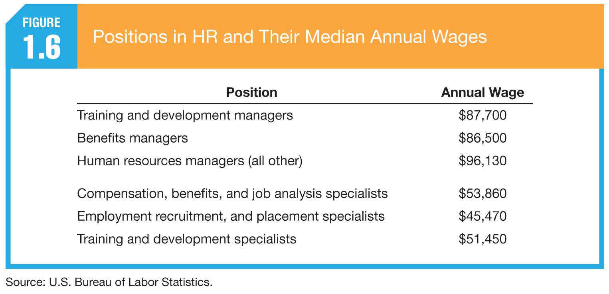
The Partnership of Line Managers and HR Departments
Successful organizations combine the experience of line managers with the expertise of HR managers to develop and utilize the talents of employees to their greatest potential. Line managers are non-HR managers who are responsible for overseeing the work of other employees.
Just as there are different types of line managers who specialize in different functions—operations, accounting, marketing, and so forth—there are different types of human resources managers who specialize in different HR functions.

Slide 34
The Partnership of Line Managers and HR Departments (cont.)
Responsibilities of Human Resources Managers
Strategic advice and counsel
Service
Policy formulation and implementation
Employee advocacy
Competencies Human Resources Managers Require
Business mastery
HR mastery
Personal credibility

Slide 35
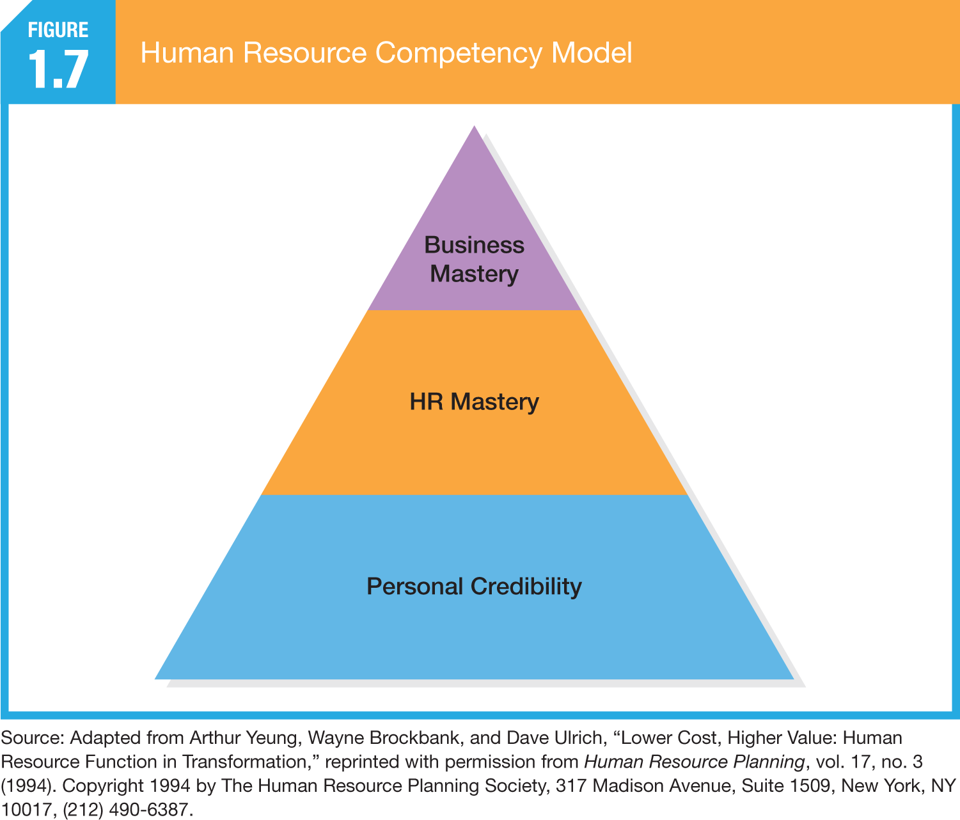
The Partnership of Line Managers and HR Departments (cont.)

Slide 36
Key Terms
managing diversity
offshoring
outsourcing
proactive change
reactive change
reengineering
Six Sigma
total quality management (TQM)
corporate social responsibility
downsizing
employee leasing
globalization
human capital
human resources information system (HRIS)
human resources management (HRM)
knowledge workers

Slide 37
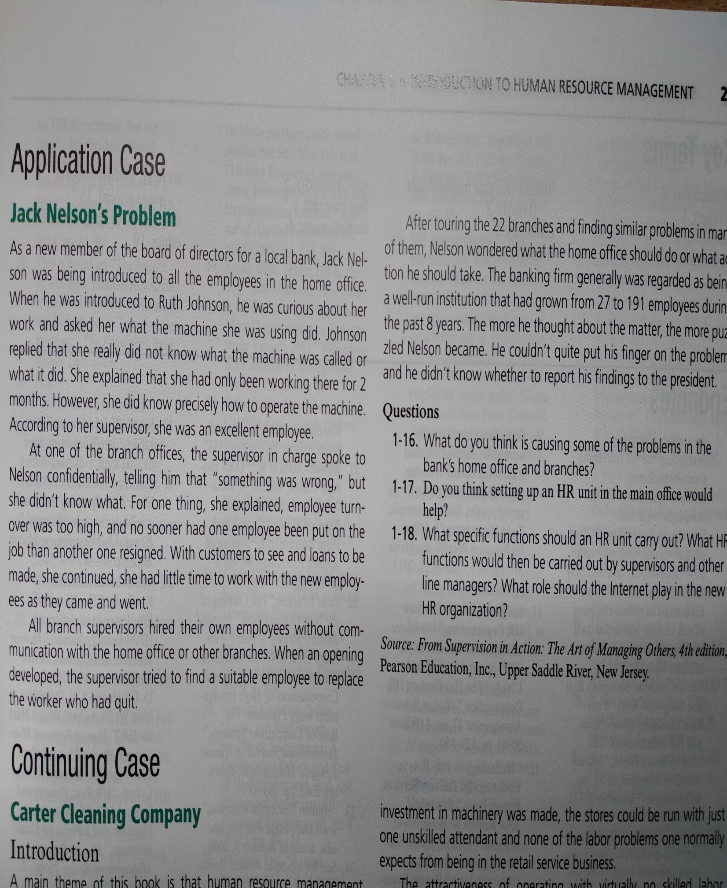

Slide 38
