Slide 1
Fine-Tuning LLaMA 3.3 for Fact-Checking and Hallucination Detection in LLMs
Presentation by Happy Ta and Anthony Clark
Wentworth institute of technology
Advanced topics in Large language models
Professor Salem Othman
^{April 1st}, 2025

Slide 2
Datasets
FEVER (Fact-Extraction and Verification)
Large-scale dataset designed to challenge LLMs in verifying claims against textual evidence
Taken from Wikipedia
Requires LLMs to retrieve relevant documents and sentences
LLM must determine whether the claim is supported, refuted or declare “not enough information”
Challenges complex reasoning
Truthful QA
Benchmark designed to evaluate the truthfulness of LMs
817 questions across 38 categories (example: health, law, finance, politics, etc.)
Question-and-answer format

Slide 3
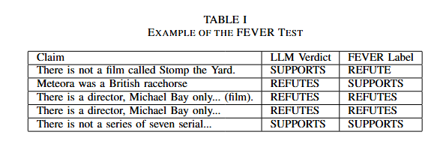
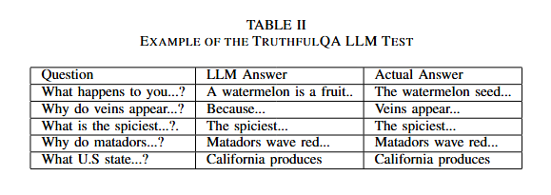
Datasets (Examples)

Slide 4
LLMs
Flan-T5
Large, open-source, instruction-tuned language
Developed by Google
Designed for wide range of NLP tasks through “text-to-text”
GPT-2
Large, transformer-based language model
Developed by OpenAI
Designed to generate human-quality text
LLaMA 3.3
Large, instruction-tuned language model
Developed by Meta
Designed for multilingual dialogue and general-purpose reasoning and chat

Slide 5
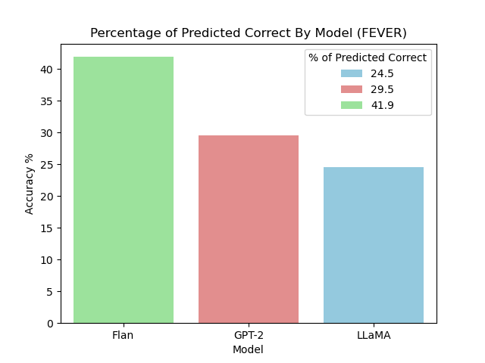
Baseline Evaluation (FEVER)

Slide 6
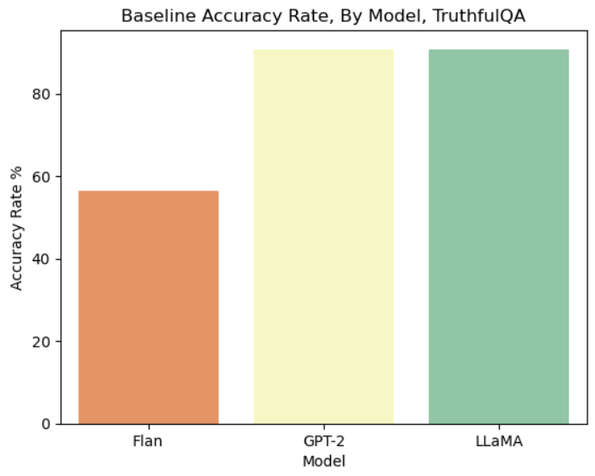
Baseline Evaluation (TruthfulQA)

Slide 7
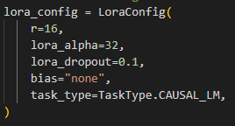
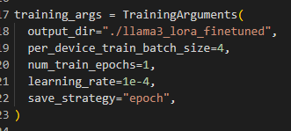
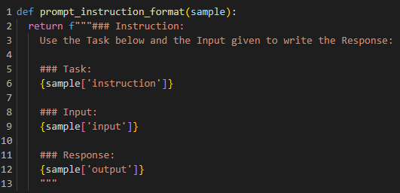
Low-Rank Adaptation (LoRA) Fine-tuning
A method of fine-tuning LLMs by adding low-rank matrices to model’s existing weight matrices
Configuration:
LoRA
Training using SFTTrainer:
Notes:
After bullet point 1:
This reduce the training parameters comparing to full fine-tuning, lowerin memory constraint and computation cost
Avoid catastrophic forgetting
Configuration:
Rank: low-rank decomposition, meaning how much of the original weight will be adapted. Higher means more complex adaption but increase memory usage. 16 is a balance between complex adaption and memory usage
Alpha: Scalling factor, how much influence the LoRA updates have on the model. Cacluated by lora_alpha/rank, our scalling factor is 32/6 = 2
Dropout rate: dropout rate for lora layers during training, avoid overfitting
Bias: telling lora to add no bias terms
Task: set how the model is generate. Casual LM means the final model will generates text in an autoregressive manner

Slide 8
Thank you!
😎😎

Slide 9
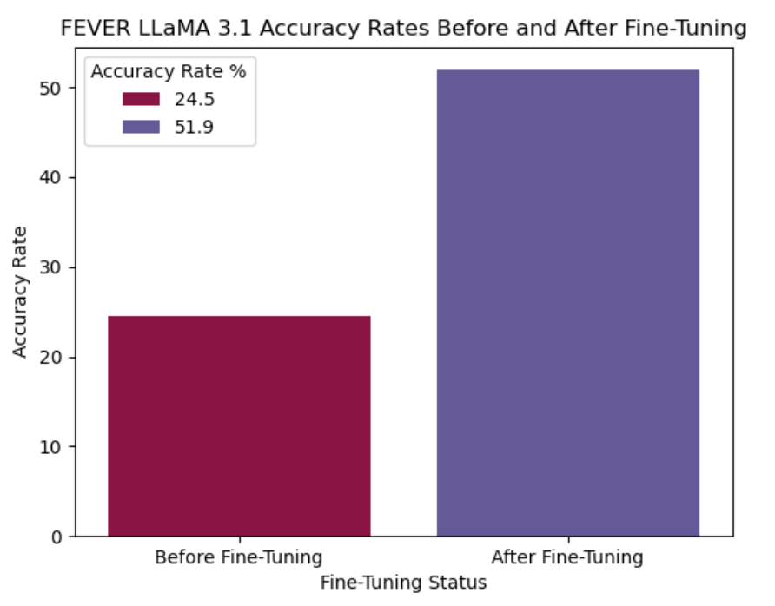
Fine-Tuned LLaMA (FEVER)

Slide 10
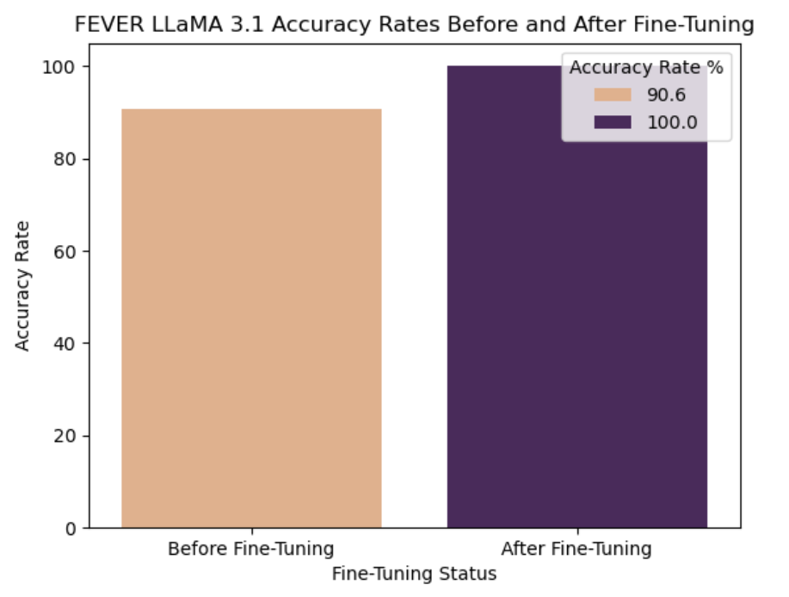
Fine-Tuned LLaMA (TruthfulQA)

Slide 11
Results/Discussion/Conclusion
Baseline Evaluation Between Models:
Flan-T5 performed optimally compared to GPT-2 and LLaMA 3.3 when applied to the FEVER dataset
Flan-T5 performed poorly compared to GPT-2 and LLaMA 3.3 when applied to the TruthfulQA dataset
Flan-T5 designed for verification
GPT-2 and LLaMA 3.3 designed for chat, question-and-answering
Fine-Tuning LLaMA 3.3:
LLaMA 3.3 performance doubled after fine-tuning when applied to FEVER dataset
LLaMA 3.3 accuracy increased from 90.6% to 99.9% after fine-tuning when applied to the TruthfulQA dataset.

Slide 12
Thank You!
😎😎

