Slide 1
Internet安全协议与分析
基于攻击结构性方法
张保稳
26/11/8

Slide 2
问题
VMS的工作机理是什么？
如何以暴力破解形式来分析协议安全性？

Slide 3
本次课程教学安排
CSP基础
基于CSP的安全协议建模

Slide 4


“Dolev-Yao” Model
Inspired by a 1983 paper
  D. Dolev and A. Yao. “On the security of public key protocols”. IEEE Transactions on Information Theory, 29(2):198-208.
Adversary is a nondeterministic process
  Can read any message, decompose it into parts and re-assemble
  Cannot gain partial knowledge, perform statistical tests, …

Slide 5
“Dolev-Yao” Model
“Black-box” cryptography
  Adversary can decrypt if and only if he knows the correct key
  Assumes that cryptographic functions have no special properties
Most mechanized formal methods for security analysis use some version of this model

Slide 6
CSP概念
CSP (Communicating Sequential Processes) is a notation for describing systems of parallel agents that communicate by passing messages.
CSP 是用于刻画交互的一种模型

Slide 7
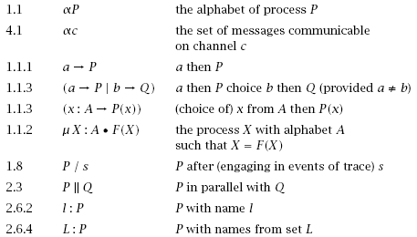
CSP常见符号

Slide 8
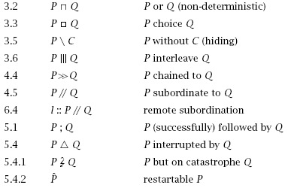
CSP常见符号

Slide 9
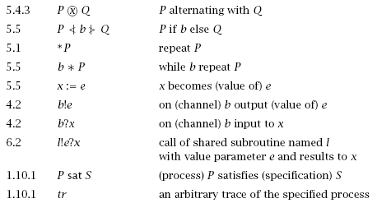
CSP常见符号

Slide 10
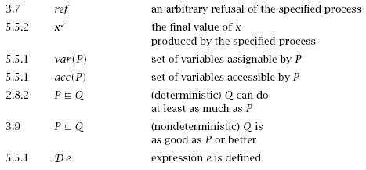
CSP常见符号

Slide 11
CSP 形式化定义
A small mathematical language containing the main constructs for specifying concurrency, parallelism, communication, choice etc.
The evolution of processes is based on a sequence of events or actions
  Visible actions Σ
    Interaction with other processes, communication
  Invisible action τ
    Internal computation steps
Notes:
例子：并行，同学A与B交谈，A，B活动是并行。
并行：A与B交谈，C与D交谈，A与C是并发。

Slide 12
CSP语法（Stop&Input）
Inaction: Stop
    Termination, deadlock, incapability of performing any action, either internal or external
Input: in ? x : A  P(x)
    Execute an input action on channel in, get message x of type A, then continue as P(x)

Slide 13
CSP语法（Output&Recursion）
Output: out ! m  P(x)
    Execute an output action on channel out, send message m, then continue as P(x)
Recursion: P(y₁,…,y_{n}) = Body(y₁,…,y_{n})
    Process definition. P is a process name, y₁,…,y_{n} are the parameters, Body(y₁,…,y_{n}) is a process expression
  Example: Copy = in ? x  out ! m  Copy

Slide 14
CSP语法（ External choice ）
External choice: P [] Q
    Execute a choice between P and Q. Do not choose a process which cannot proceed
  Example: (a ? x  P(x)) [] (b ? x  Q(x))
  Execute one and only one input action. If only one is available then choose that one. If both are available than choose arbitrarily. If none are available then block. The unchoosen branch is discarded (commitment)
Notes:
例子：自动售贩机，根据投币选择商品来提供货物。

Slide 15
CSP语法（ Internal choice ）
Internal choice: P + Q
    Execute an arbitrary choice between P and Q. It is possible to choose a process which cannot proceed
Notes:
随机出现的游戏怪物。

Slide 16
CSP语法（ Parallel operator ）
Parallel operator with synchronization: P || Q
    P and Q proceed in parallel and are obliged to synchronize on all the common actions
  Example: (c ? x  P(x)) || (c ! m  Q)
    Synchronization: the two processes can proceed only if their actions correspond
    Handshaking: sending and receiving is symultaneous (clearly an abstraction. Buffered communication can anyway be modeled by implementing a buffer process)
Notes:
.因循守旧；陈旧古板的做法；前后紧接；步伐一致 lockstep

Slide 17
CSP语法
    Communication: m is transmitted to the first process, which continues as P(m).
    Broadcasting: c ! m is available for other parallel procs
Question: what happens with the process
((c?xP(x)) [] (d?y Q(y))) || (c!m R)

Slide 18
CSP语法（ interleaving ）
Parallel operator with synchronization and interleaving: P ||_{A} Q
    P and Q are obliged to synchronize only on the common actions in A
    They interleave on all the actions not in A

Slide 19
CSP语法（ interleaving ）
  Example:
  (c ? x P(x)) ||_{{c}} ((c ! m Q) [] (d ! n  R))
    the two processes can either synchronize on the action on channel c, or the second process can perform an action on d. In this second case the first process will remain blocked, though, until the second will decide to perform (if ever) an output action on c.
    Question: in what part of the second process could this action on c be performed ?
  Abbreviation: P ||| Q stands for P ||_{φ} Q

Slide 20
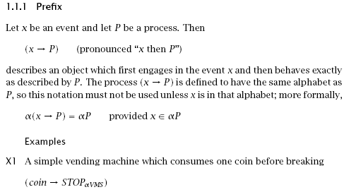
PREFIX

Slide 21
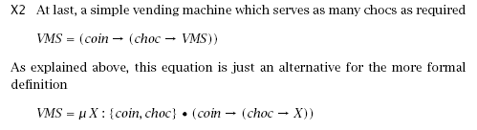
RECURSION
X=F(X)

Slide 22
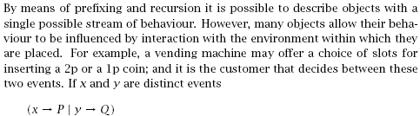
CHOICE

Slide 23
TRACE
A trace of the behaviour of a process is a finite sequence of symbols recording
the events in which the process has engaged up to some moment in time.
Imagine there is an observer with a notebook who watches the process and
writes down the name of each event as it occurs.

Slide 24
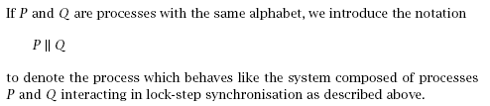
Interaction

Slide 25
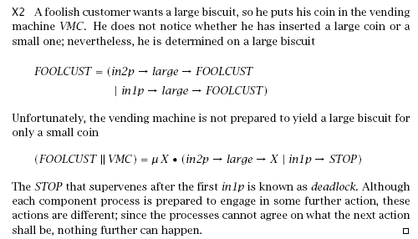
Example

Slide 26
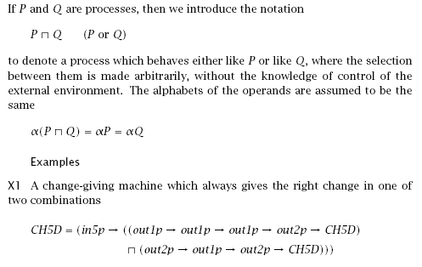

Slide 27
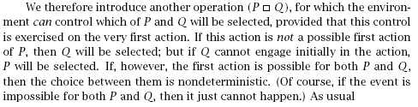
GENERAL CHOICE

Slide 28
FDR
Failures Divergences Refinement Checkers
Specification and Implementations
FDR2--http://www.cs.ox.ac.uk/projects/concurrency-tools/
Notes:
牛津大学计算机系

Slide 29



Slide 30

NS公钥协议

Slide 31

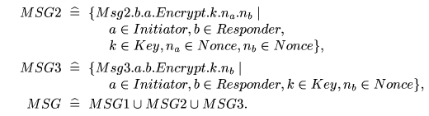
消息刻画

Slide 32
信道定义
Channel user,session,I_running,R_running,
I_commit,R_commit:Initiator,Responder.

Slide 33
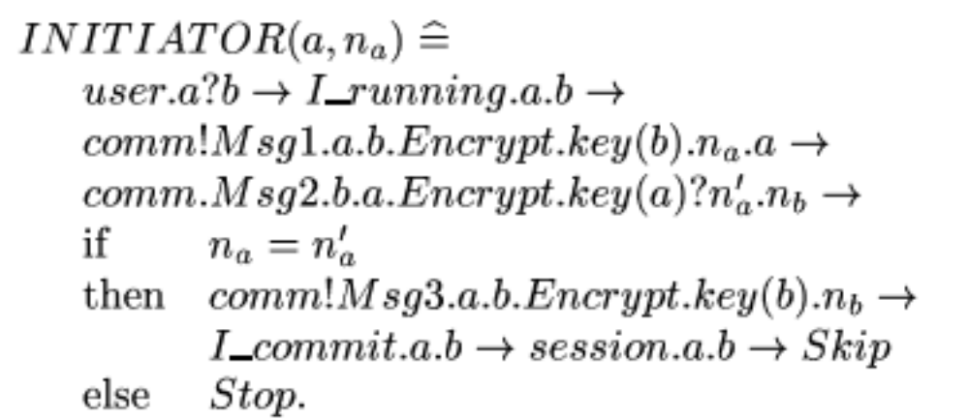
进程刻画

Slide 34
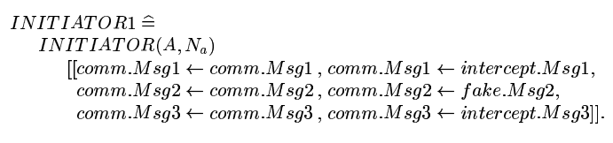
含有攻击的刻画

Slide 35
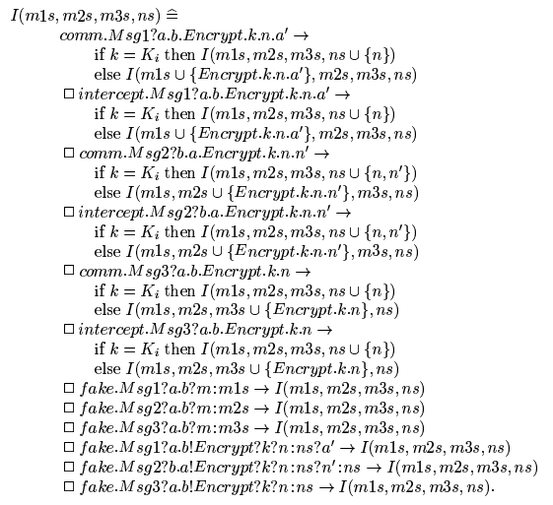
攻击者

Slide 36
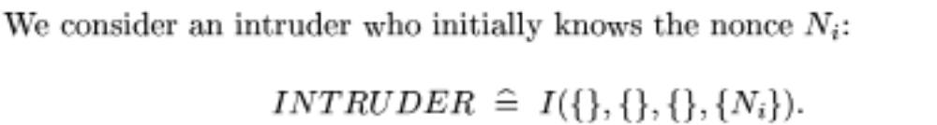
攻击者

Slide 37

系统的进程刻画

Slide 38
认证的含义
对于响应者的认证，当且仅当B确实参与到协议的运行中时，A才commit参与和B的session。
对于发起者的认证，当且仅当A确实参与到协议的运行中时，B才commit参与和A的session。

Slide 39
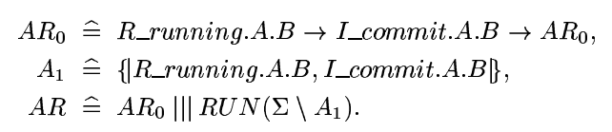
规范的刻画（响应者的认证）

Slide 40
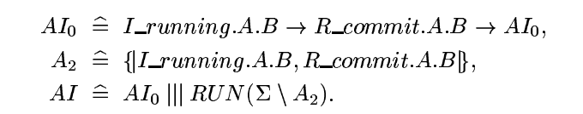
规范的刻画（发起者的认证）

Slide 41
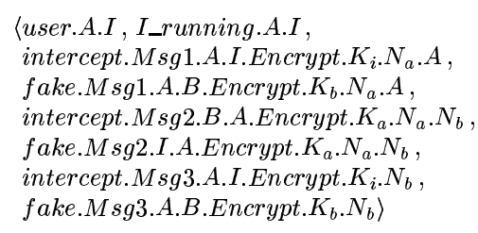
AI规范的违反情形

Slide 42
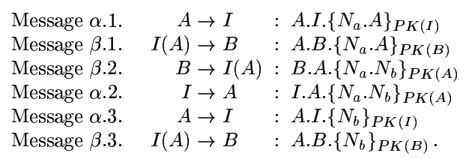
消息形式

Slide 43
使用CSP进行安全协议建模
系统的刻画：消息，信道，agent，攻击者，
规范的刻画：响应者，发起者
运行检查：trace

Slide 44
The End
作业：复习CSP的基本概念和运用CSP分析协议安全性的机理

