Slide 1
TV Store: Automatically Bounding Time Series Storage via
Time-Varying Compression
Yanzhe An, Yue Su, Yuqing Zhu, Jianmin Wang
Speaker wrl
FAST 2022
Notes:
大家好，今天我给大家带来今年FAST上面的一篇paper,TVStore: Automatically Bounding Time Series Storage via Time-Varying Compression,这篇paper的主要工作是根据时间序列数据库的特点设计了一种能够自动调节时变压缩方法。

Slide 2
Background
Time-series Database: The time series database is mainly used to process data with time tags (changing in time order, namely time serialization), and is mainly used for the prediction and analysis of long-term events.
metric
Wind
timestamp | direction | speed | sensor | city
1467627245000 | 23.4 | 3.4 | 95D8-7913 | 上海
1467627245000 | 145.1 | 1.1 | F3CC-20F3 | 北京
1467627247000 | 23.2 | 3.3 | 95D8-7913 | 上海
1467627247000 | 145.0 | 1.2 | F3CC-20F3 | 北京
1467627255000 | 23.3 | 3.3 | 85D8-7913 | 上海
Data point
field
tag
Trend & Big data: Time series databases are becoming more and more popular, but the demand for data storage is becoming more and more serious.
• balance between data volume and storage cost
• storage space is restricted in some specific deployments
• Data compression is demanded for reducing data in both transmission and storage
An effective storage management strategy that can constrain the storage space is desirable and important for time-series databases.
Notes:
我们先来看看background，首先是数据缩减技术。数据缩减技术的目的为了减少存储系统中物理地址使用的存储容量。数据缩减技术大概有以下几种，第一种是常规的压缩，比如GZIP、LZ77等，类压缩方法一般用于普通文件，并且对滑动窗口的相同内容从字符串层面进行压缩。第二种方法就是重复数据删除，这类方法先将文件划分成为固定大小的chunk 一般4KB 8KB 16KB，然后对每个块计算哈希 SHA1 或SHA256等，对于相同的chunk来说，计算得到相同的哈希，就只保留一份chunk。并为每一份文件生成一个配方recipe记录他所需要的chunk，达到节省空间的目的，重复数据删除适用于长大型文件，从块层次对文件全局进行一个压缩。这两种方法目前都被广泛应用于存储，但他们并没有完全利用数据的可压缩性。

Slide 3
Background
Lossless Compression:
• The original data can be completely recovered without any distortion
• Lower upper limit of achievable compression ratio
• Time series databases commonly control storage consumption by directly discarding data older than a given time or exceeding a storage threshold.（Short data time span）
t0
t1
t0
t1
t0
t1
compression
decompression
t0
t0’
t1
t2
t0’
t1
t2
t0’
t1
t2
loss
compression
decompression
Lossy compression:
• Decompression can only restore partial data
• Higher upper limit of achievable compression ratio.
• Incomplete or inaccurate data recovery will affect the results of subsequent analysis or prediction.(Low data integrity)
t0
t2
t0
t2
t0
t2
compression
decompression
Low data integrity
Notes:
我们先来看看background，首先是数据缩减技术。数据缩减技术的目的为了减少存储系统中物理地址使用的存储容量。数据缩减技术大概有以下几种，第一种是常规的压缩，比如GZIP、LZ77等，类压缩方法一般用于普通文件，并且对滑动窗口的相同内容从字符串层面进行压缩。第二种方法就是重复数据删除，这类方法先将文件划分成为固定大小的chunk 一般4KB 8KB 16KB，然后对每个块计算哈希 SHA1 或SHA256等，对于相同的chunk来说，计算得到相同的哈希，就只保留一份chunk。并为每一份文件生成一个配方recipe记录他所需要的chunk，达到节省空间的目的，重复数据删除适用于长大型文件，从块层次对文件全局进行一个压缩。这两种方法目前都被广泛应用于存储，但他们并没有完全利用数据的可压缩性。

Slide 4
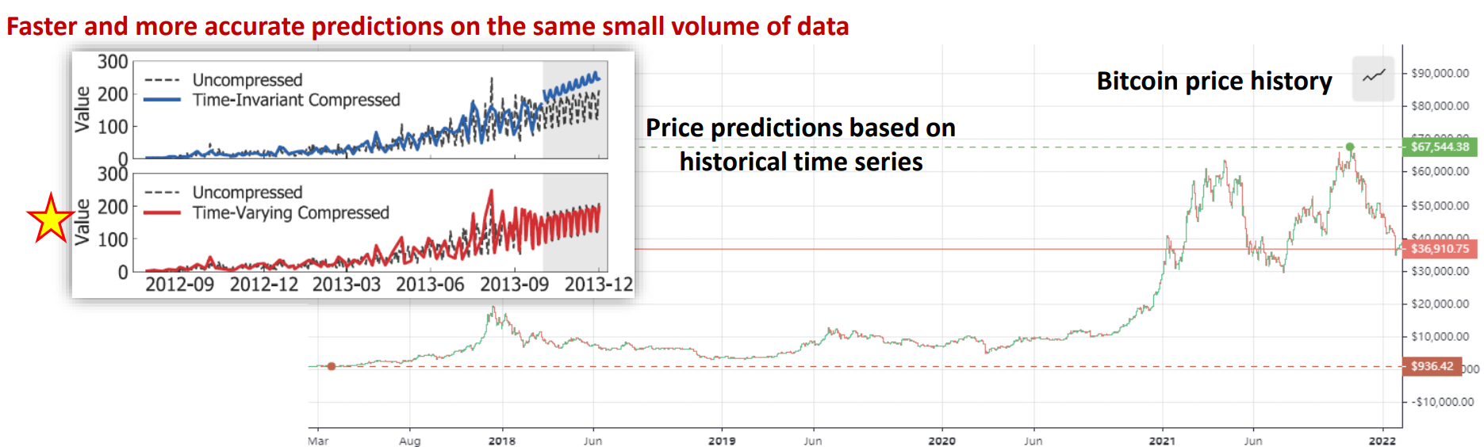
Problem & Motivation
The problem: In the time-series database storage, the contradiction between the time span of data and the integrity of data.
The motivation: The importance of time series data changes along with time.
Notes:
在重复数据删除技术中，存在破坏数据局部性的问题，这会降低系统在存储和恢复中的效率。例如这个图，因为文件的chunk存在不同的container中，在恢复过程中不同Container在缓存中的换入换出和读取会造成巨额的I/O开销。而这一问题因为增量压缩引入一种新的关系（Base chunk与 Delta chunk）的加入，被进一步扩大。因此，本文主要解决的问题是细粒度重复数据删除中由于增量压缩引入的额外局部性问题。
分别是备份工作流中的局部性较差会导致读取Base chunk时 I/O 效率低下。
第二是与单独的重复数据删除相比，增量基数关系会导致更复杂的碎片问题。
最后是因为增量基数依赖关系会导致在增量解码期间出现较差的时态局部性，并导致重复的容器读取。这三个挑战我接下来会具体讲。

Slide 5
Idea&Challenge
Key Idea: time series data can be compressed losslessly or lossily according to its importance, which is in turn related to its age.
• The information of new data will be more important, and users will not be able to accept the loss of new data. ——lossless compression
• Users commonly accept information loss on less important old data. ——lossily compression
Method: A compression method that can automatically adjust according to time series and meet the specified compression rate.
• challenge 1 : How to efficiently compress data according to time series attributes, as data keep being ingested?
• challenge 2 : How to ensure that the data size can be consistently maintained within the specified compression threshold？
Notes:
在重复数据删除技术中，存在破坏数据局部性的问题，这会降低系统在存储和恢复中的效率。例如这个图，因为文件的chunk存在不同的container中，在恢复过程中不同Container在缓存中的换入换出和读取会造成巨额的I/O开销。而这一问题因为增量压缩引入一种新的关系（Base chunk与 Delta chunk）的加入，被进一步扩大。因此，本文主要解决的问题是细粒度重复数据删除中由于增量压缩引入的额外局部性问题。
分别是备份工作流中的局部性较差会导致读取Base chunk时 I/O 效率低下。
第二是与单独的重复数据删除相比，增量基数关系会导致更复杂的碎片问题。
最后是因为增量基数依赖关系会导致在增量解码期间出现较差的时态局部性，并导致重复的容器读取。这三个挑战我接下来会具体讲。

Slide 6

Design —Time-Varying Compression
Key question 1: How to select the appropriate compression ratio for time series data
Key idea: Fitting with a non-decreasing function varying with time
r1=r(1)=2 m=5
r2=r(2)=3 ra =2
data for compression is kept in the unit of chunks
r1=r(1)=2
r2=r(2)=3
Compression ratio sequence generated by function r(t)
r1 r2 r3 r4 … rk
Ratio compliance by approximation
For new data, we compress them losslessly or with a low ratio by lossy compression.
For unimportant data, we compress them by a high compression ratio by lossy compression.

Slide 7
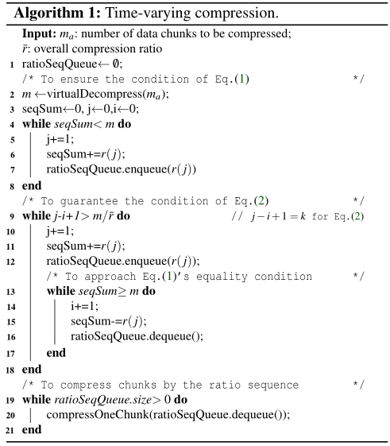
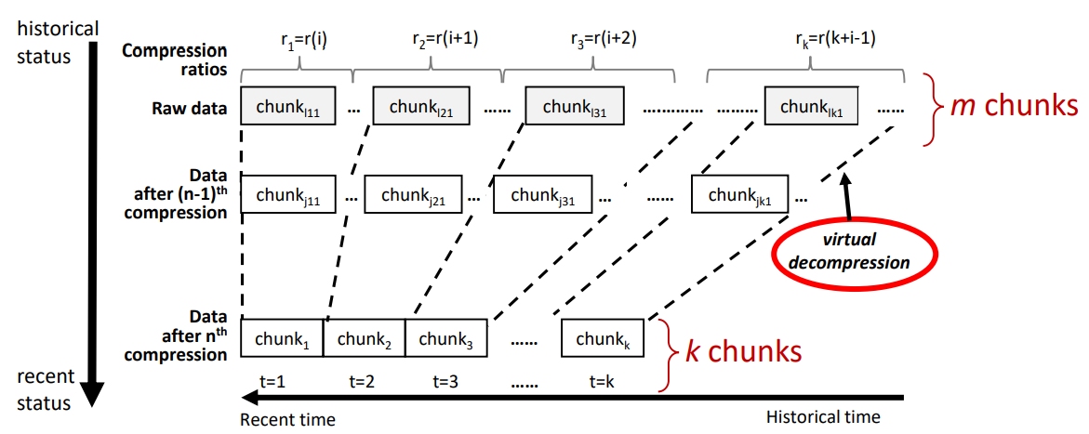
Design —Time-Varying Compression
Key question 2: How to quickly recalculate the compression ratio sequence with new data?
Key idea: Through virtual decompression technology
initialization
Approximate iteration

Slide 8
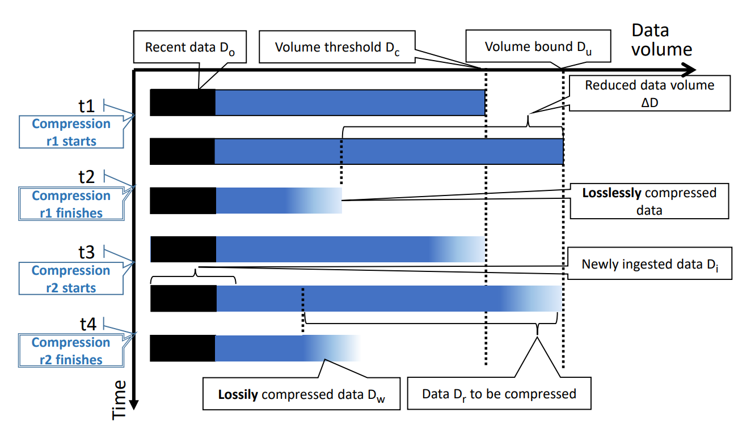
Design —Automatic bounding
Key question 1: Whether to compress all data？
Latest data: The latest data should be used directly without compression
Key question 2: What ratio to compress?
Too large: losing information unnecessarily
Too small: exceeding storage bound
Key question 3: When to compress?
Too early: losing information unnecessarily and involving unnecessary costs
Too late: exceeding storage bound
Key question 4: Whether to save all data？
oldest: Very old data is damaged due to lossy compression, and its availability is low

Slide 9


Design —Automatic bounding
Key question 1: Whether to compress all data？
Solution 1: Users can set the size to be used. (Do)
Key question 2: What ratio to compress?
Solution 2:
Key question 3: When to compress?
Solution 3:
Key question 4: Whether to save all data？
Solution 4: Allows users to specify a compression ratio rmax or an error rate emax

Slide 10
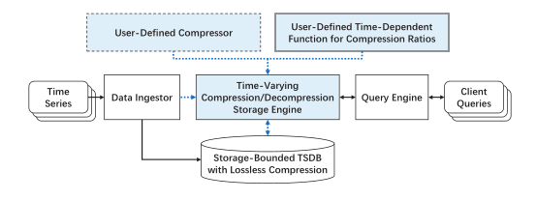
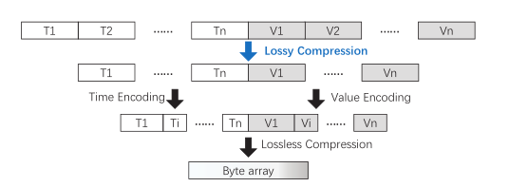
Architecture
PLA Compressor(default)
While exponential, power-law and constant functions are all supported as the time-dependent ratio functions, TVStore uses the power-law function as the default.
TVStore allows users to set the upper bound of storage space and the largest compression ratio permitted.

Slide 11
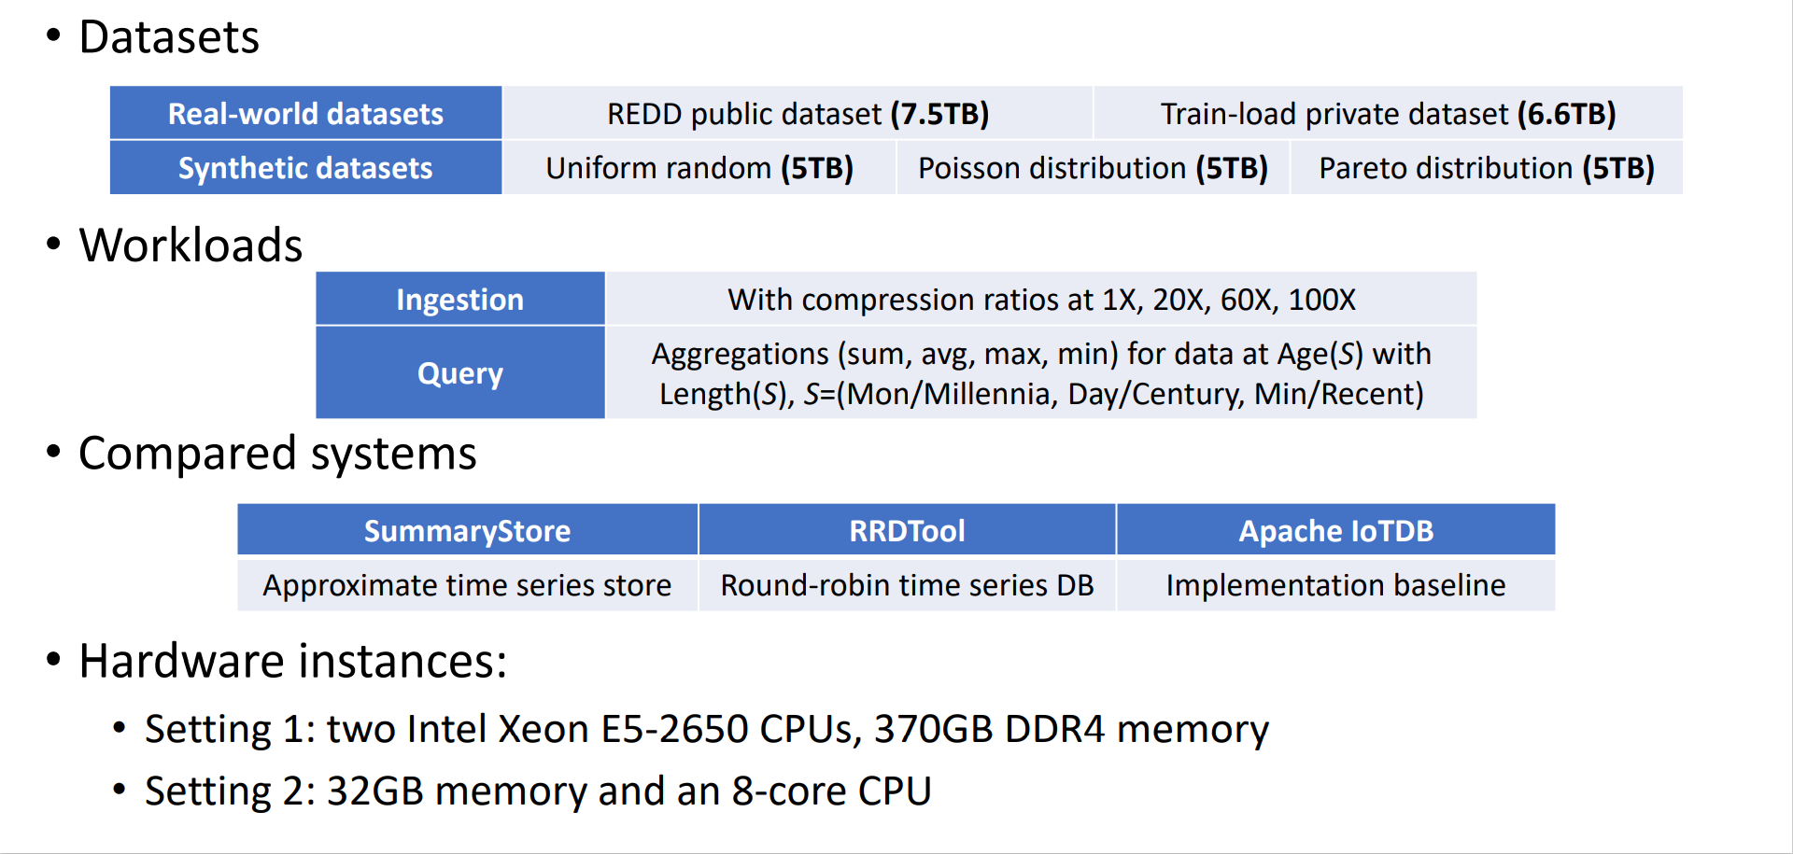
Evaluate

Slide 12
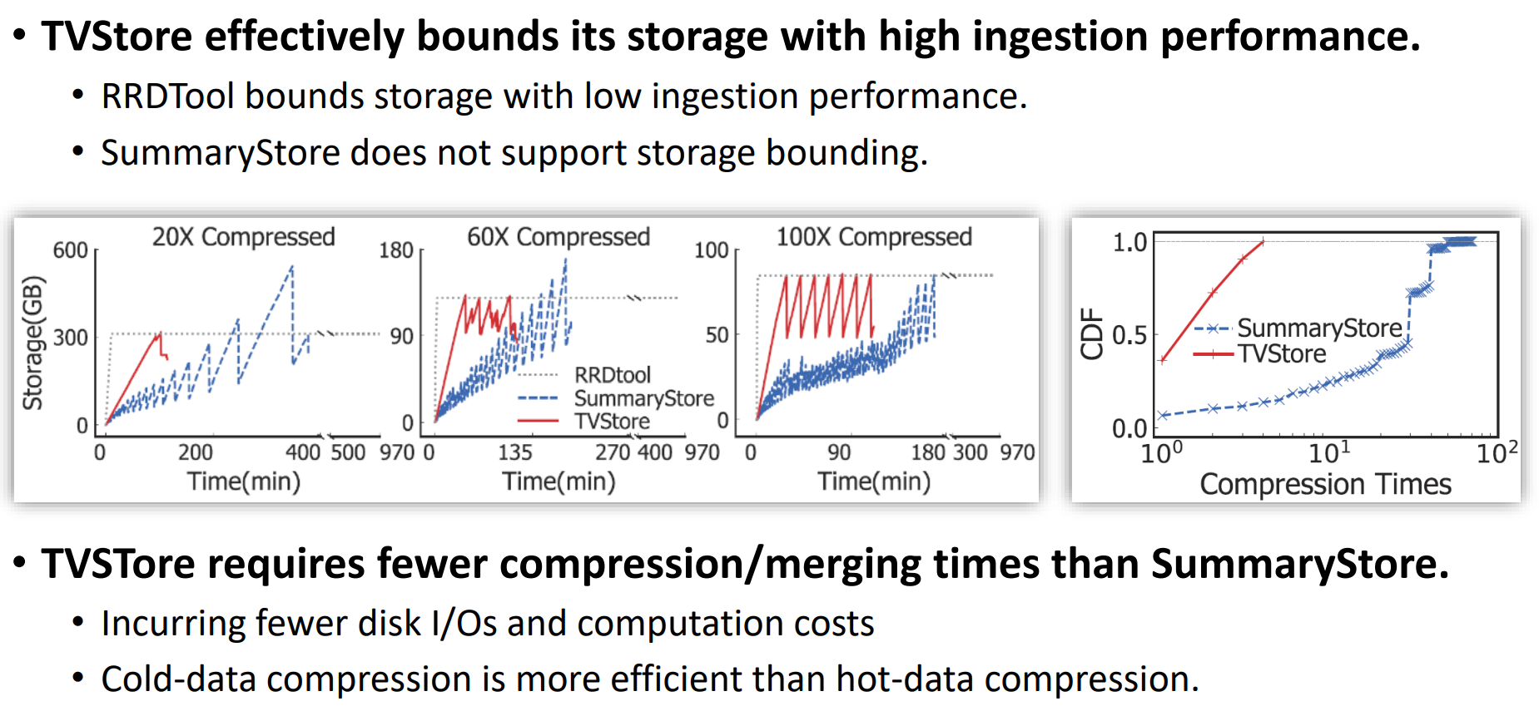
Evaluate —Storage bounding & compression cost

Slide 13
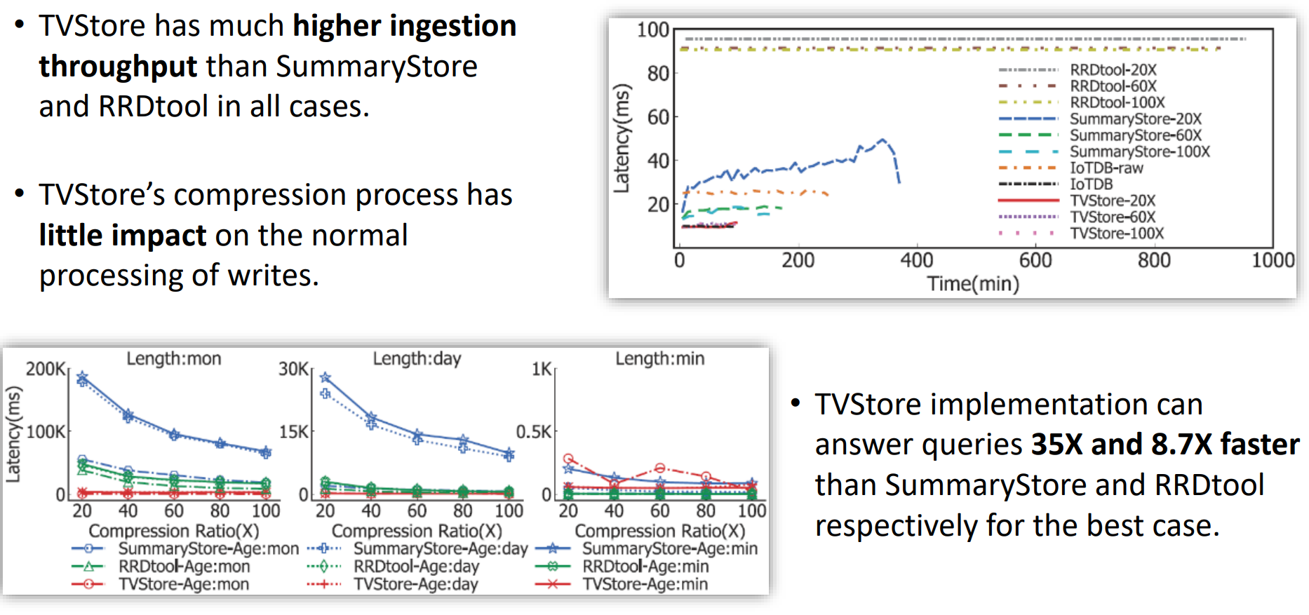
Evaluate —Ingestion & query performances

Slide 14
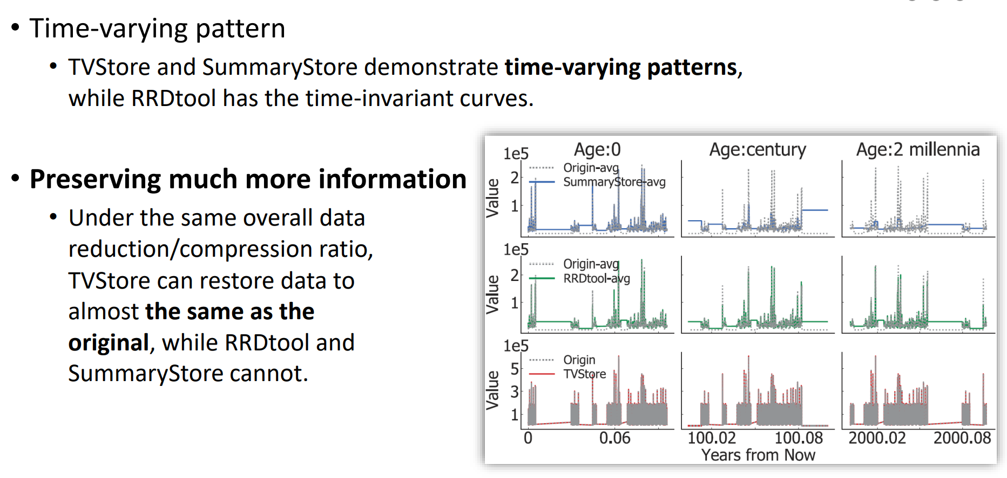
Evaluate —How data look in databases

Slide 15
Conclusion
Motivation
challenge1
Key problem
The importance of time series data changes along with time.
How to efficiently compress data?
How to select the appropriate compression ratio for time series data?
Main idea
How to quickly recalculate the compression ratio sequence with new data?
Data can be compressed losslessly or lossily according to its importance
Time-Varying Compression
the contradiction between the time span of data and the integrity of data
TVStore
challenge2
How to bound the data?
Whether to compress all data？
problem
solution
What ratio to compress？
When to compress?
Whether to save all data？
Automatic bounding
Notes:
最后做个conclusion，这篇paper的想要解决问题细粒度重复数据删除中由于增量压缩引入的额外局部性问题
为了解决这一问题，作者设计了支持高重复数据删除率的高性能细粒度重复数据删除备份存储框架MeGA
因此，提出了三个挑战
1.因为base chunk局部性差，备份工作流中的位置较差会导致读取Base chunk时 I/O 效率低下
2.因为restore-required chunks局部性差，增量基数关系会导致更复杂的碎片问题。
3.因为1in delta-base pairs局部性差，增量基础依赖关系会导致在增量解码期间出现较差的时态局部性，并导致重复的容器读取
针对第一个挑战，作者基于跳过稀疏容器这个key idea，不对稀疏C对应的chunk进行增量压缩，提出了选择增量机制。
针对第二个挑战，作者基于根据生命周期将同一个backup的chunk存储在一起这个key idea，设计了增量友好布局，解决了碎片化问题。
争对第三个挑战，作者基于只读取所有C一次，并且优先读取Delta chunk的思想，设计了AFR遍历方式和增量块与预写机制。
最后作者将三个设计集成到MeGA上，实现了支持高重复数据删除率的高性能细粒度重复数据删除备份存储框架。

