Slide 1
HyperService: Interoperability and Programmability Across Heterogeneous Blockchains
Zhuotao Liu, Yangxi Xiang, Jian Shi, Peng Gao, Haoyu Wang, Xusheng Xiao, Bihan Wen, Yih-Chun Hu

Slide 2
/Background
In today’s blockchain ecosystem, we see many distinct blockchains, falling roughly into the categories of public, private, and consortium blockchains.
In a world deluged with isolated blockchains, interoperability is power.
Blockchain interoperability enables secure state transitions across different blockchains, which is invaluable for connecting the decentralized Web 3.0.
Existing interoperability proposals mostly center around atomic token exchange between two blockchains, aiming to eliminate the requirement of centralized exchanges.

Slide 3


/Background
Account A1 IN BC A
Account B1 IN BC B
BC B
User1
FROM: A1
TO: A2
AMOUNT: XX
SIG OF User1
A trusted third party
Account A2 IN BC A
Account B2 IN BC B
BC A
User2
FROM: B2
TO: B1
AMOUNT: XX
SIG OF User2
Notes:
如果User1想用BC A上的代笔COIN A交换User2在BC B上的代币COIN B
假设有一个可信任的第三方

Slide 4
/Challenge
First, the programming model of cross-chain decentralized applications (or dApps) is unclear.
Second, existing token-exchange oriented interoperability protocols, such as atomic cross-chain swaps (ACCS) , are not generic enough to realize cross-chain dApps.
Another technical challenge is to securely coordinate those transactions to enforce dApp correctness in a fully decentralized manner with zero trust assumptions.
Notes:
缺乏跨链合约的编程模型或框架
代币交换的协议不能直接用来编写DAPP
如何在没有可信实体的情况下，协调交易的执行顺序

Slide 5
/Contribution
We propose the first programming framework for developing cross-chain dApps.
We propose UIP, the first generic blockchain interoperability protocol whose design scope goes beyond cross-chain token exchanges. Rather, UIP is capable of securely realizing complex cross-chain operations that involve smart contracts deployed on heterogeneous blockchains.
Notes:
实现了一个编成框架，
设计了一个语言 HSL，可以通过编写相应的程序，协调多条链上的智能合约，最终会被转化成相应链上的交易，以及交易的依赖图。
协议的设计，确保了这个语言编写的程序能够被顺利地执行

Slide 6
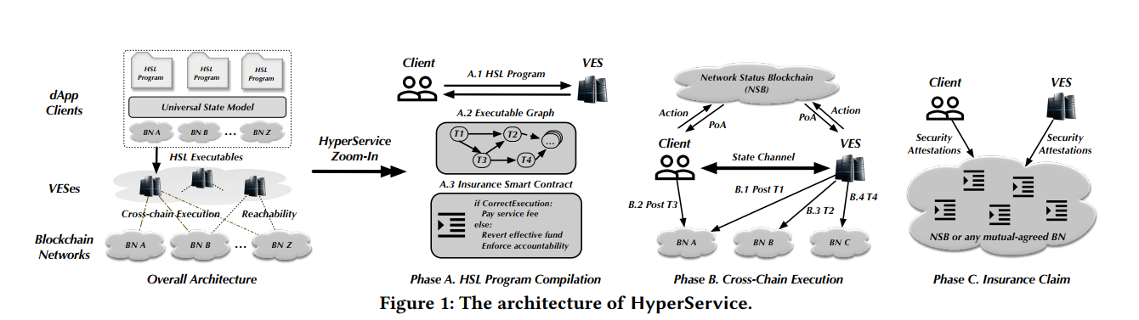
/Overview
Notes:
不同语言中的类型变量进行统一 USM
利用 HSL 编写语言，再通过VES编译，最终放到相应的链上执行
内部：三个阶段
CLI和VES通过UIP协议进行交互，UIP内部是由NSB和ISC组成的

Slide 7
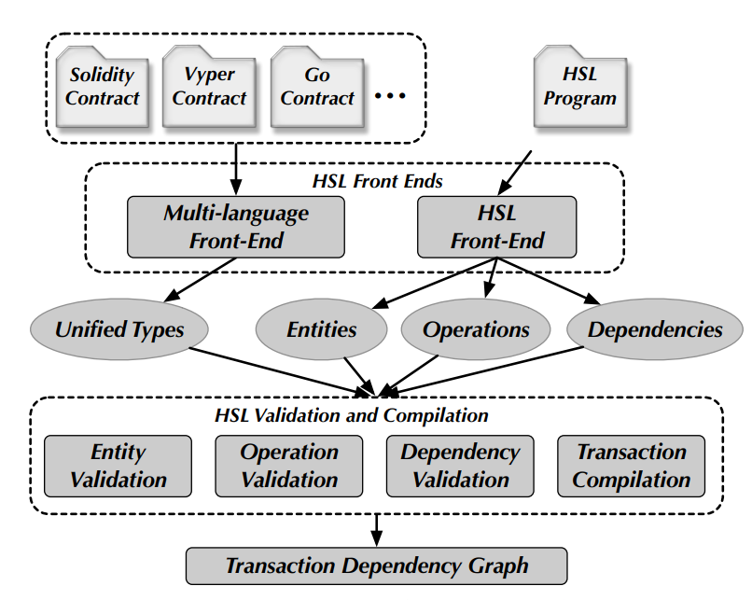
/PROGRAMMING FRAMEWORK
The HSL compiler has two frond-ends: one for extracting entities, operations, and dependencies from a HSL program and one for extracting public state variables and methods from smart contracts deployed on blockchains.

Slide 8
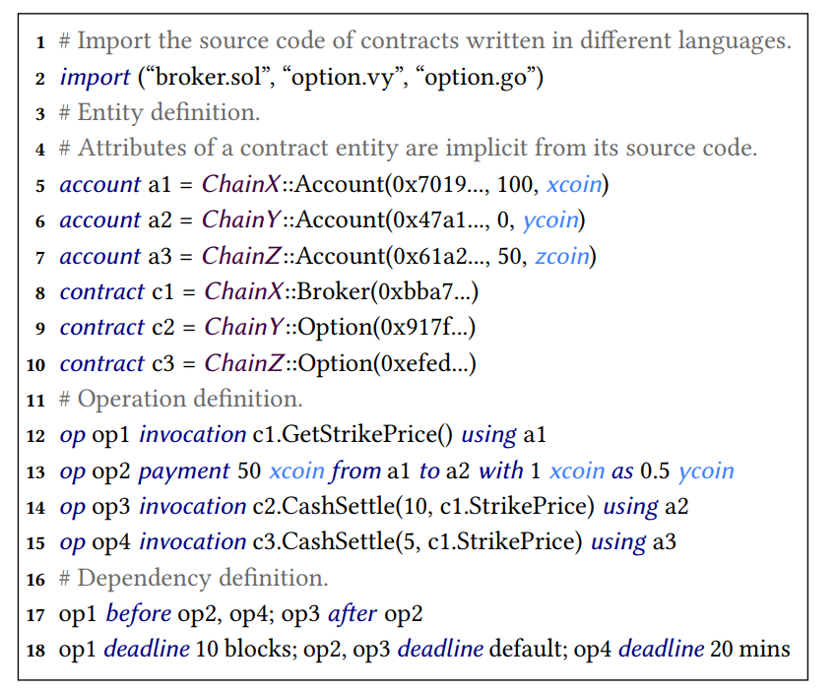
/PF/Universal State Model
Formally, USM is defined as M = {E, P, C} where E is a set of entities, P is a set of operations performed over those entities, and C is a set of constraints defining the dependencies of those operations.

Slide 9
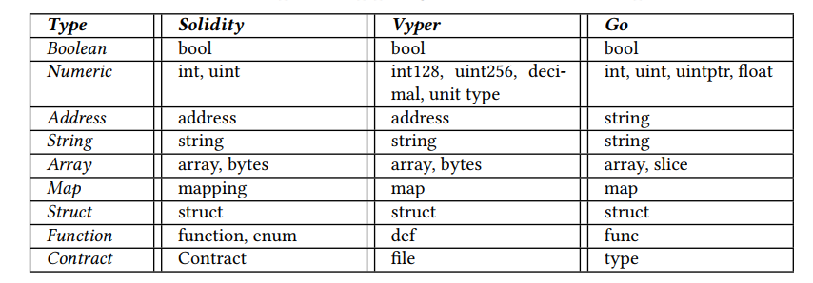
/PF/Unified Type System
Notes:
然后还有相应的语法，这里就不贴图了

Slide 10
/PF/Semantic Validation
First, the compiler guarantees the compatibility and verifiability of the arguments used in invocation operations, especially when those arguments are obtained from other contract entities
Second, the compiler performs dependency validation to make sure that the dependency constraints defined in a HSL program uniquely specify a directed acyclic graph connecting all operations. This ensures that no conflicting temporal constraints are specified.
Notes:
兼容性，类型兼容
可验证性，只有存储在区块链上公开的变量才能在合约中被使用
无环检查

Slide 11
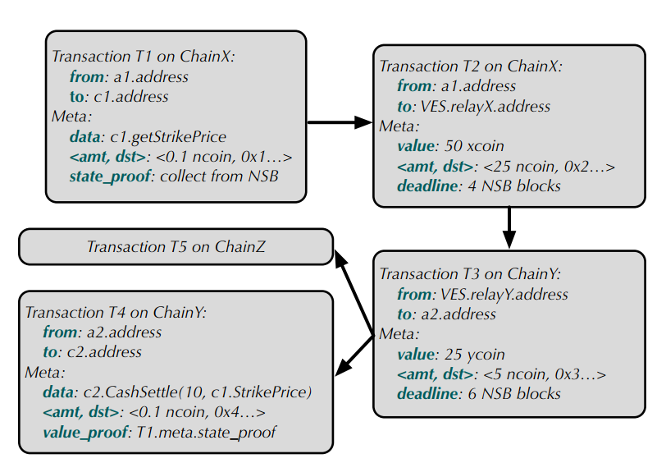
/PF/HSL Program Executables
Each vertex of GT , referred to as a transaction wrapper, contains the complete information to compute an on-chain transaction executable on a specific blockchain, as well as additional metadata for the transaction.
Notes:
如果一笔交易中的输出值在后续需要用到，那么就需要有一个state_proof，在这笔交易完成后，会有相应的state_proof
跨链交易会被拆分为两笔交易

Slide 12
/UIP DESIGN DETAIL
VES
VES and CLI define the execution protocols implemented by VESes and dApp clients, respectively.
CLI
UIP
NSB
Protocol for Network Status Blockchain.
ISC
Protocol for Insurance Smart Contract.
BC
Protocol of the underlying Blockchain

Slide 13
/UIP DESIGN DETAIL
Five States: {unknown, init, inited, open, opened, closed}
Overall, UIP has two phases:
The execution phase where the transactions specified in the HSL executables are posted on blockchains
The insurance claim phase where the execution correctness or violation is arbitrated
Notes:
During the execution phase, a transaction may be in any of the following state {unknown, init, inited, open, opened, closed}, where a latter state is considered more advanced than a former one.
When the execution phase terminates, the final execution status of the HSL program is collectively decided by the state of all transactions, based on which ISC arbitrates its correctness or violation.

Slide 14
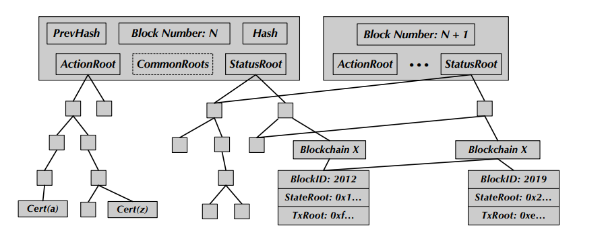
/UIP DESIGN DETAIL
UIP proposes Proof of Actions (PoAs), allowing VES and CLI to stake their execution steps on NSB.
The architecture of NSB blocks
Notes:
对于没有完成的交易，缺少相应的可解释性。
如果某个交易在underlying区块链下已经完成，那么在相应区块链中会有这个交易的默克尔证明。简单来说，就是能够证明这个交易确实已经在相应的区块中完成。
但是，那些未完成的交易，需要通过一系列状态，来记录他的执行情况。因此，在NSB上就记录了这些未完成交易所处状态的证明，即Cert。
ActionRoot 就是保存交易状态的默克尔树根节点
StatusRoot 是保存对应underlying区块某个时刻的状态信息（只记录那些通过UIP发起的交易所属区块链以及对应区块的状态信息）。
To address this issue, ProtUIP proposes Proof of Actions (PoAs), allowing ProtVES and ProtCLI to stake their execution steps on NSB.

Slide 15

/UIP DESIGN DETAIL/VES
This is what we were just talking about
Create ISC
Both parties approve
Deploy ISC to NSB
Stake funds
Daemon PreCompiliation()
Wait Txs in the underlying BCs to be finalized
Daemon PostCompiliation()
Wait Txs in the transaction dependency graph to be avaliable
C
Daemon Watching(sid,{BC...})
Od
Un
Un
I
Od
C
Daemon Watching(sid,NSB)
Notes:
The primary goal of the initialization is to create and deploy an insurance contract to protect the execution of GT .
质押多少钱是由交易链执行到某个状态而不继续前进所造成的损失确定的。
2. Watching 观察 underlying 区块链上已经完成的交易，然后发送close，以在NSB上中止这笔交易
3. Watching 不断扫描可以接下来被执行的交易

Slide 16
/UIP DESIGN DETAIL/VES
The state of each transaction will be gradually promoted in the process of VES and CLI interaction
Upon Receive SInitedTrans(sid, T)
Upon Receive RInitedTrans(Certid)
Upon Receive OpenTrans(Certo )
Upon Receive OpenedTrans(Certod)
Upon Receive CloseTrans(Cclosed )
Upon Receive ClosedTrans(Certc )

Slide 17
/UIP DESIGN DETAIL/CLI
The Protocol implemented by CLI is similar to VES, except:
CLI is not required to proactively watch the status of underlying blockchains or dynamically compute eligible transactions whenever the execution status changes.
Notes:
这是为了减少客户端的负担

Slide 18
/UIP DESIGN DETAIL/EXAMPLE
Both parties should agreed on the Cert
VES
CLI
${Cert}_{i}$:= Cert([T, init]; ${Sig}_{v}$) and CLI.InitTrans(${Cert}_{i}$)
${Cert}_{id}$:= Cert([T, inited, T’]; ${Sig}_{c}$) and VES.InitedTrans(${Cert}_{id}$)
Watching for available Tx
${Cert}_{o}$:= Cert([T, open, T’, topen]; ${Sig}_{v}$) and CLI.OpenTrans(${Cert}_{o}$)
${Cert}_{od}$:= Cert([T, open, T’, topen]; ${Sig}_{v}$; ${Sig}_{c}$) and BC.Exec(T’) and VES.OpenedTrans(${Cert}_{od}$)
Wait until the T’ is finalized on the BC
${Cert}_{closed}$:= Cert([T, closed, T’, tclose]; ${Sig}_{v}$) and CLI.CloseTrans(${Cert}_{closed}$)
${Cert}_{c}$:= Cert([T, closed, T’, tclose]; ${Sig}_{v}$; ${Sig}_{c}$) and VES.ClosedTrans(${Cert}_{c}$)
Notes:
除了 Cert_closed 之外，其他签名都会被记录在NSB区块链上，以此来证明他们确实发送了相应的签名；
One challenge, however, is that it is difficult to enforce accountability for non closed transactions without preserving the execution steps by both parties.
Cert_closed 不需要被记录在区块链的原因是因为VES和CLI都可以通过监视underlying区块链来获取，用户更倾向于去获取，因为如果他不获取的话，他会是受损失的一方
Cert_od和Cert_c可以直接用来证明，因为他包含双方的签名，说明双方都对此进行确认过，并表示同意；其他的Cert则是通过NSB区块链上的默克尔树来证明

Slide 19
/UIP DESIGN DETAIL/ISC
ISC generates the arbitration code, denoted as contract, based on the given dApp executable GT.
ISC registers a callback SettleContract to execute contract terms automatically upon timeout.
Notes:
当时间结束时，ISC会进行仲裁，退还押金或者处罚责任方

Slide 20
/UIP DESIGN DETAIL/ISC
The state of a closed transaction is promoted to correct if its deadline constraint is satisfied.
Then, ISC computes the possible dirty transactions in GT, which are the transactions that are eligible to be opened, but with non-correct state.
Od
C
Id
Un
I
Notes:
就是那些可以到达opened状态的交易，但是在到期时还处在别的状态

Slide 21
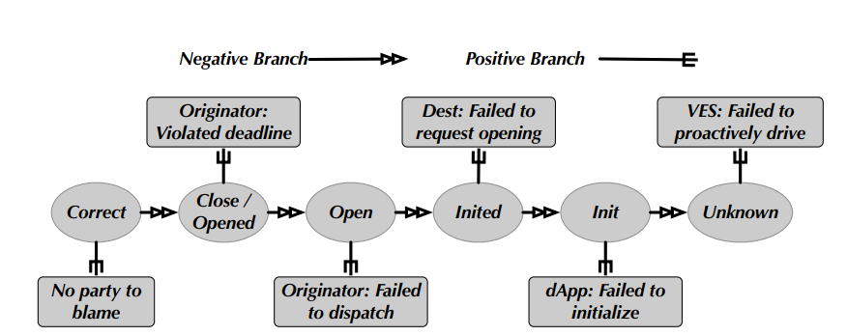
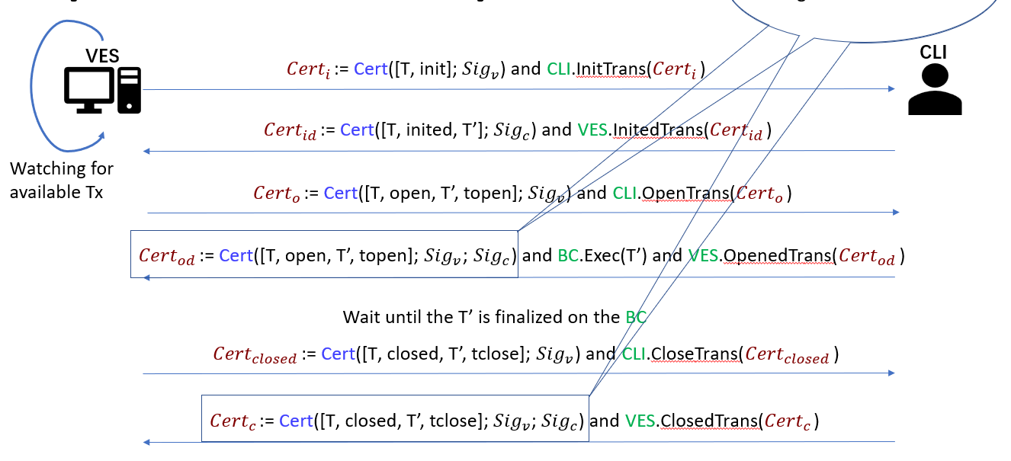
/UIP DESIGN DETAIL/ISC
The decision tree to decide the accountable
party for a dirty transaction.
Notes:
Unkown：这个交易本来可以被执行，因为前面的状态已经满足了，但是未被执行，说明VES没有把这笔交易取出来发给CLI
Init：只有CLI有这个状态，说明VES已经把这个交易取出来交给CLI，但是CLI没有进行下一步
Inited：CLI或者VES已经对交易进行签名，发送给Dest，但是Dest没有进行下一步
Open：DEST收到签名的交易，并发送给ORI，但是ORI没有进行下一步
Opened：交易结束时，还处在Opened状态，说明ORI发起晚了，在对应区块链上的交易还没被确认
或者Close的时候超时：也说明ORI发起晚了

Slide 22
/IMPLEMENTATION AND EXPERIMENTS
At the time of writing, the total development effort includes:
∼1,500 lines of Java code and ∼3,100 lines of ANTLR grammar code for building the HSL programming framework;
∼21,000 lines of code, mainly in Go and Python, for implementing the UIP protocol; and ∼8,000 lines of code, mainly in Go, for implementing the NSB;
∼1,000 lines of code, in Solidity, Vyper, Go and HSL, for writing cross-chain dApps running on HyperService.

Slide 23
/IMPLEMENTATION AND EXPERIMENTS
Financial Derivatives: we implement a cross-chain cash-settled Option dApp in which options can be natively traded on different blockchains.
Cross-Chain Asset Movement: we implement an asset movement dApp with hybrid operations where assets are moved among accounts and smart contracts across different blockchains.
Federated Computing: we implement a federated voting system where delegates in different regions can submit their votes to their regional blockchains, and the logic for computing the final votes based on the regional votes is publicly visible on another blockchain.

Slide 24
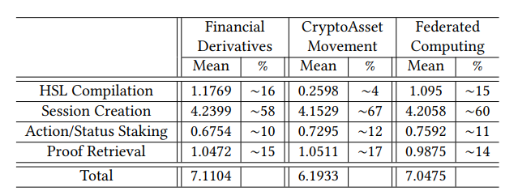
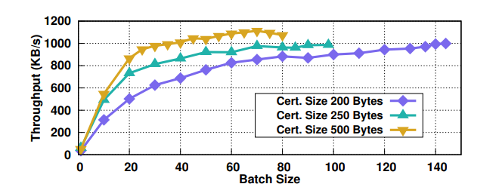
/IMPLEMENTATION AND EXPERIMENTS
End-to-end dApp execution latency on HyperService, with profiling breakdown. All times are in seconds.
The throughput of the NSB, measured as the total size of committed certificates on the NSB per second.
Notes:
-
编译的时间/PostCompliation 会话建立的时间/状态上传区块链的时间/以及从区块链获取证明的时间
三个应用中会话时间最长，因为其中包括了VES与客户端握手以及部署ISC合约及初始化的时间
第二个应用编译时间最短，因为他只调用一个智能合约，而其他两种需要调用两个不同的智能合约
-
运行了一千个客户端，他们将多个Cert绑定在一笔交易中
随着Batch大小的增加，整个系统的吞吐量将会收敛到1000，达到系统极限
不同的Certsize可能是由不同的Underlying BC Txs造成的

Slide 25
THANKS

