Slide 1
Heap and Heap sort
堆与堆排序

Slide 2
Heaps
完全二叉树结构
部份有序：父亲节点值有优势要求，但同层节点之间无任何关系。
16
14
10
8
7
9
3
2
4
1
16
14
10
8
7
9
3
2
4
1

Slide 3
Heaps
A heap is a binary tree with the following conditions:
Shape requirement: it is complete 除最后一层外，其它层都是满的）
Parental dominance requirement: The key at each node is ≥ keys(for max-heap) at its children（父节点值大于儿子节点的值）
All its levels are full except possibly the last level, where only some rightmost leaves may be missing.
…

Slide 4
Properties of Heaps (1)（可以用数组存储堆，数组中的相邻元素没关系）
9
Heap and its array representation.
  think heap as a binary tree（看起为是一棵二叉树）.
  it is easier and more efficient to implement a heap using an array.（用数组存储）
    Store the BFS traversal of the heap’s elements in position 1 through n, leaving H[0] unused.（按BFS遍历顺序存储于数组）
Relationships between indexes of parents and children.
5
3
1
4
2
1 2 3 4 5 6
9 5 3 1 4 2
PARENT(i) LEFT(i) RIGHT(i)
return ⎣i/2⎦
return 2i
return 2i+1

Slide 5
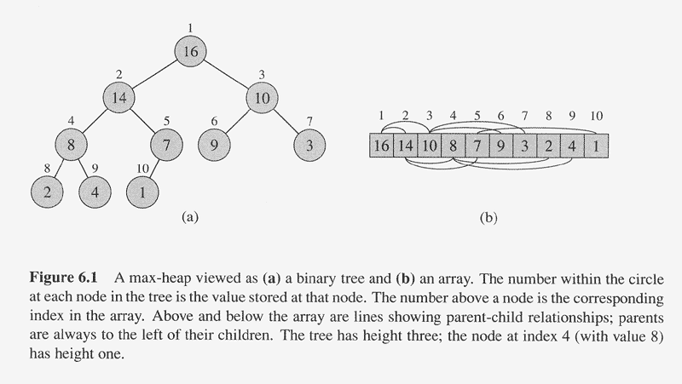

Slide 6
Properties of Heaps (2)
Max-heap property and min-heap property（大顶堆与小顶堆）
  Max-heap: for every node other than root, A[PARENT(i)] >= A(i)
  Min-heap: for every node other than root, A[PARENT(i)] <= A(i)
The root has the largest key (for a max-heap)（堆顶最大）
The subtree rooted at any node of a heap is also a heap
  （子树也是堆）
Given a heap with n nodes, the height of the heap
  （堆的高度），h = log n .

Slide 7
Bottom-up Heap construction（堆的建立）
Build an essentially complete binary tree by inserting n
keys in the given order.
HEAPIFY a series of trees
1. Starting with the last (rightmost) parental node A(n/2), heapify/fix the subtree rooted at it:
if the parental dominance condition does not hold for the key at this node then
    exchange its key K with the key of its larger child;
    Heapify/fix the subtree rooted at it ;
    (now in the child’s position)
2. Stops after this is done for the tree’s root (A(1)).

Slide 8
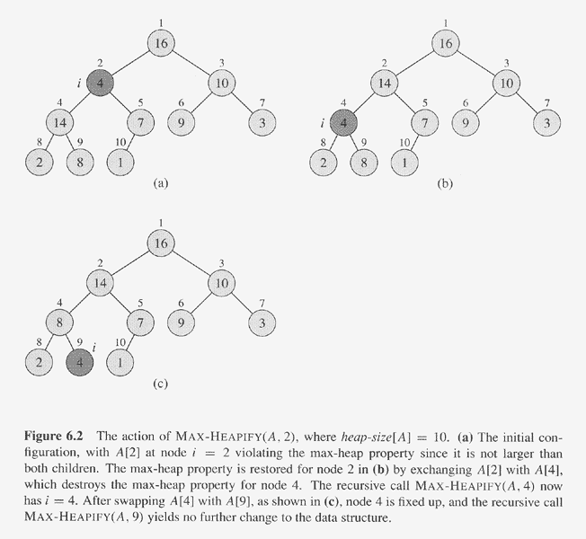

Slide 9
BuildHeap()
  Fact: for array of length n, all elements in
  A[⎣n/2⎦ + 1 .. n] are heaps (Why?)
  So:
    Walk backwards through the array from n/2 to 1, calling HEAPIFY() on each node.

Slide 10
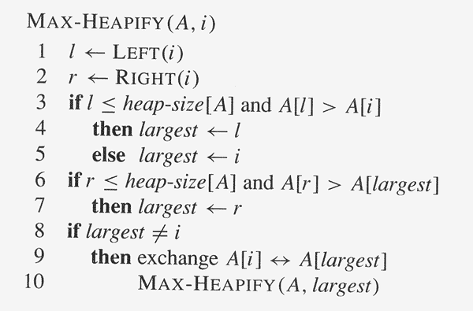
建立初始堆算法-大顶堆
ALGORITHM HeapBottomUp(A[1..n])
for i ← ⎣n/2⎦ downto 1 do
MAX-HEAPIFY(A, i)

Slide 12
Example: 4 1 3 2 16 9 10 14 8 7
→ 16 14 10 8 7 9 3 2 4 1

Slide 13
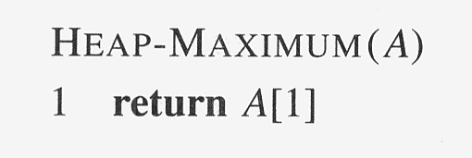
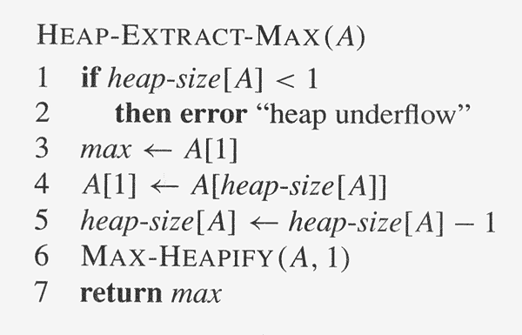
取堆顶算法

Slide 14
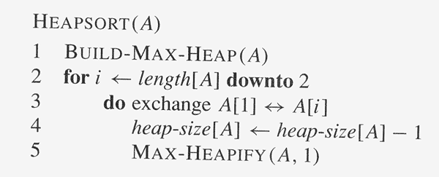
Heap sort（堆排序）

Slide 15
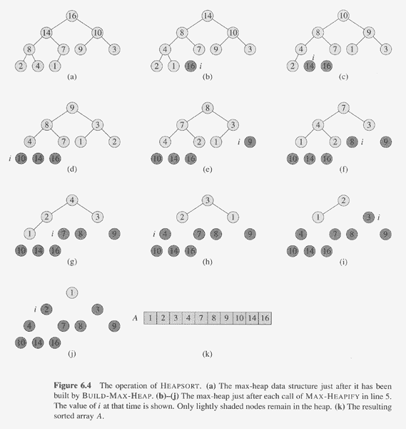

Slide 16
Worst-Case Efficiency（最坏复杂度分析）
Worst case:
a full tree; each key on a certain level will travel to the leaf.
  Fix a subtree rooted at height j: 2j comparisons
  Fix a subtree rooted at level i : 2(h-i) comparisons
    A node’s level + its height = h, the tree’s height.
  Total for heap construction (建立初始堆）phase:
h-1
Σ
2(h-i) 2^{i} = 2 ( n – lg (n + 1)) = Θ(n)
i=0
# nodes at level i

Slide 17
Insertion of a New Element
（插入一个新元素）
The algorithm:
  Insert element at the last position in heap（新元素插在堆中最后一个位置）.
  Compare with its parent, and exchange them if it violates the parental dominance condition.（和父节点比较，必要的话，往上冒）
  Continue comparing the new element with nodes up the tree until the parental dominance condition is satisfied.
Example 1: add 10 to a heap: 9 6 8 2 5 7
Efficiency:
  Inserting one new element to a heap with n-1 nodes requires no more comparisons than the heap’s height
h ∈ O(logn)

Slide 18
Root Deletion（删除堆顶元素）
The root of a heap can be deleted and the heap fixed up as follows:
Exchange the root with the last leaf （将根和最后一个节点元素交换）
Decrease the heap’s size by 1 （堆长度减1）
Heapify the smaller tree in exactly the same way we did it in Max-Heapify().
Efficiency:
Example: 9 8 6 2 5 1
Θ(logn)
It can’t make key comparison more than twice the heap’s height
Notes:
.

Slide 19
Heapsort Algorithm（堆排序算法）
The algorithm
  (Heap construction) Build heap for a given array （建立初始大堆）
  (Maximum deletion ) Apply the root-deletionoperation n-1 times to the remaining heap until heap contains just one node.

Slide 21
Analysis of Heapsort
Recall algorithm:
    Bottom-up heap construction
    Root deletion
    3. Repeat 2 until heap contains just one node.
Θ(n)
Θ(log n)
n – 1 times
Total: Θ(n) + Θ( n log n) = Θ(n log n)
Note: this is the worst case. Average case also Θ(n log n).

Slide 22
Priority queue(优先队列)
Not only is the heap structure useful for heapsort, but it also makes an efficient priority queue. （堆特别适合用于优先队列）
A priority queue maintains a set S of elements, each with an associated value called a key/priority. It supports the following operations:
  find element with highest priority （找优先级最大的元素）
  delete element with highest priority （删除优先级最高的元素）
  insert element with assigned priority（插入一有优先级的元素）
  (Priority queue will be used in SPT（最小生成树） problem!)

Slide 23
三分检索的非递归算法（用循环实现）
输入：n个元素的升序数组A[0..n-1]和元素x;
输出：如果x=A[j],则输出j,否则输出-1。
Low=0; high=n-1；j=-1
while (low≤high)and (j=-1)
mid1=[(low+high)/3]
mid2=[(high-(high-low)/3]
If x=A[mid1]then j=mid1
else if x<A[mid1] then high=mid1-1
else if x=A[mid2]then j=mid2
else if x>A[mid2] then low=mid2+1
else low =mid1+1, high=mid2-1
end while
return j

Slide 24
三分检索的递归实现
Trisearch(int a[], int low, int high,int x)
If (high <low) j=-1
else
int mid1=low+[(high-low)/3]
mid2=[(high-(high-low)/3]
If x=A[mid1] then j=mid1
else if x<A[mid1]
j=Trisearch( a[], low ,mid1-1, x)
else if x=A[mid2]
j=mid2
else if x>A[mid2]
j=Trisearch( a[], mid2+1 ,high, x)
else
j=Trisearch( a[], mid1+1 ,mid2-1, x)
return j

