Slide 1
第一章 操作系统简介
主讲教师:胡小龙
Huxl@csu.edu.cn
中南大学信息科学与工程学院
2017.09

Slide 2
本章内容
什么是计算机操作系统?
操作系统目的和作用
操作系统发展历史
操作系统类型
操作系统结构和模块

Slide 3
计算机操作系统是什么?
很难对“操作系统”给出精确的定义
只能给出操作系统目的、作用、功能性描述
操作系统是计算机系统中最重要的系统软件
有效管理计算机系统资源
使用户易于使用计算机系统

Slide 4
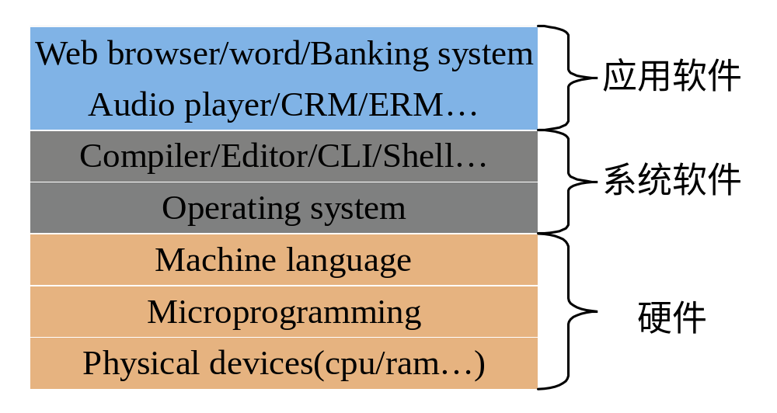
计算机操作系统是什么?
从OS在计算机系统中所处的位置来看

Slide 5

计算机操作系统是什么?
从OS在计算机系统中所处的位置来看

Slide 6
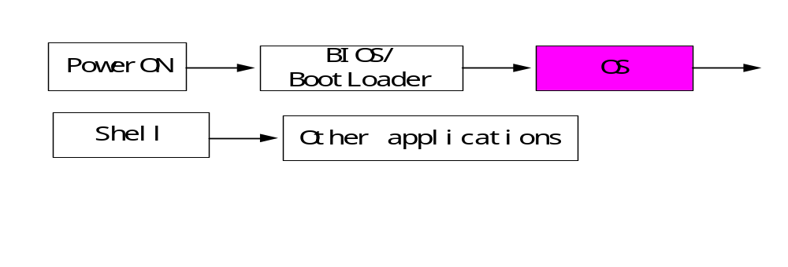
计算机操作系统是什么?
从计算机系统的起动过程来看是执行的第一个软件

Slide 7
计算机操作系统是什么?
从计算机系统所管理的资源来看
对资源进行有效管理
硬件资源
  CPU
  Memory
  I/O
  Timer,Interrupt…
软件资源
  文件及文件系统
  其它软资源(soft timer/semaphore…)

Slide 8
计算机操作系统是什么?
从计算机系统使用者角度来看(易于使用)
命令行接口(CLI)
如DOS、UNIX Shell…
图形用户接口(GUI)
如Windows、Xwindows…
程序接口(API)
如DOS INT 21、Linux INT 80…

Slide 9
操作系统发展历史
操作系统不是从来就有的，随着电子元器件技术、计算机体系结构、计算机系统的应用模式、计算机软件技术的发展和用户的需求增长等而发展起来的,并会一直处于发展过程中.
以体系结构的发展为其主要发展线索

Slide 10
操作系统发展历史(CONT.)
Analytical engine
The first digital computer was designed by the English mathematician Charles Babbage(1792-1871)
  Purely mechanical(wheels,gears,…)
  He realized that he would need software for the machine
  The first programmer is Ada

Slide 11
操作系统发展历史(CONT.)
Vacuum Tubes plugborads (1945-55)
2万个电子管 人工操作
Transistors and batch system(1955-65)
batch FORTRAN off line
典型产品:FMS(Fortran Monitor System)
IBSYS(IBM Operating system)

Slide 12
操作系统发展历史(CONT.)
ICs and Multiprogramming(1965-80)
VLSI(大规模和超大规模集成电路)
1000万集成度，G的速度
个人操作系统、网络操作系统、分布式操作系统、实时操作系统

Slide 13
Unix操作系统发展历史
First developed in 1969 by Ken Thompson and Dennis Ritchie of the Research Group at Bell Laboratories; incorporated features of other operating systems, especially MULTICS.
The third version was written in C, which was developed at Bell Labs specifically to support UNIX.
The most influential of the non-Bell Labs and non-AT&T UNIX development groups — University of California at Berkeley (Berkeley Software Distributions).
  4BSD UNIX resulted from DARPA funding to develop a standard UNIX system for government use.
  Developed for the VAX, 4.3BSD is one of the most influential versions, and has been ported to many other platforms.
Several standardization projects seek to consolidate the variant flavors of UNIX leading to one programming interface to UNIX

Slide 14
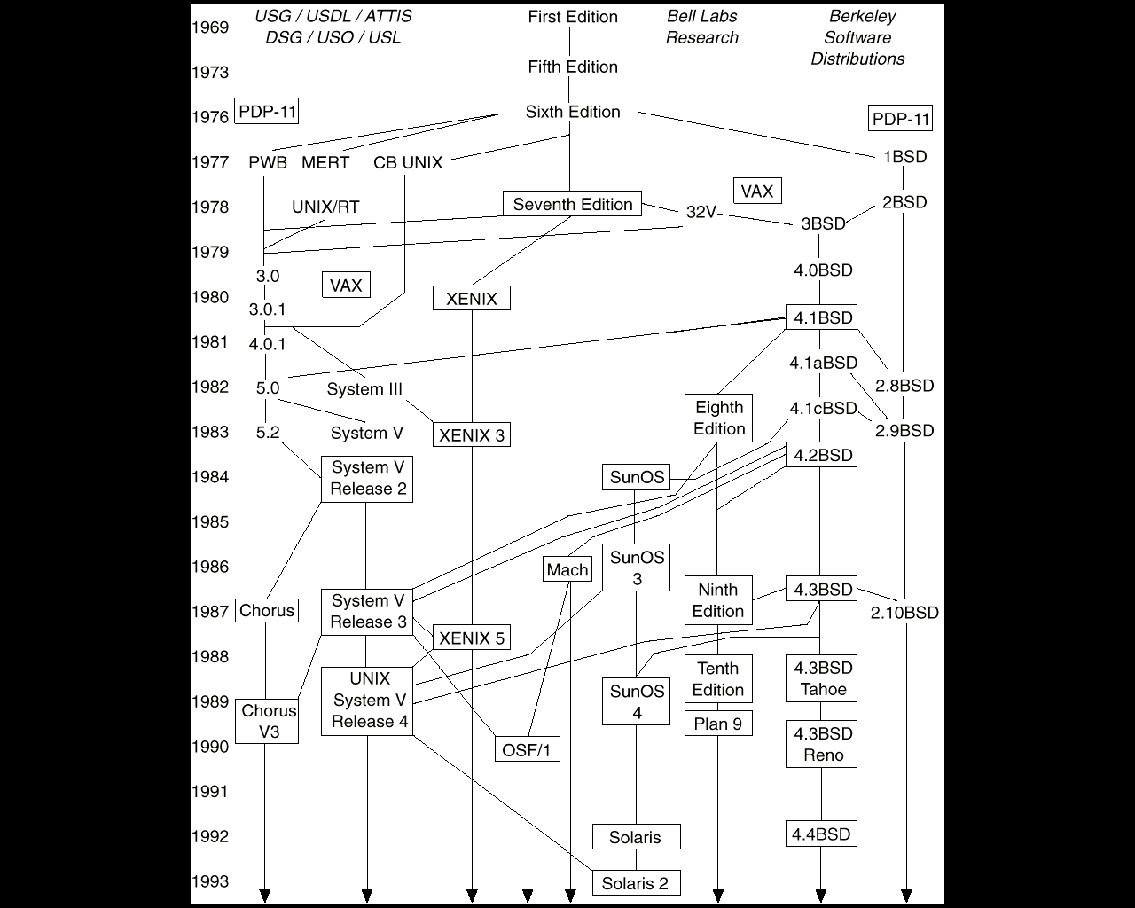
Unix操作系统发展历史

Slide 15
Linux操作系统发展历史
Linux is a modem, free operating system based on UNIX standards.
First developed as a small but self-contained kernel in 1991 by Linus Torvalds, with the major design goal of UNIX compatibility.
Its history has been one of collaboration by many users from all around the world, corresponding almost exclusively over the Internet.
It has been designed to run efficiently and reliably on common PC hardware, but also runs on a variety of other platforms.
The core Linux operating system kernel is entirely original, but it can run much existing free UNIX software, resulting in an entire UNIX-compatible operating system free from proprietary code.

Slide 16
Linux操作系统发展历史
Version 0.01 (May 1991) had no networking, ran only on 80386-compatible Intel processors and on PC hardware, had extremely limited device-drive support, and supported only the Minix file system.
Linux 1.0 (March 1994) included these new features:
  Support for UNIX’s standard TCP/IP networking protocols
  BSD-compatible socket interface for networking programming
  Device-driver support for running IP over an Ethernet
  Enhanced file system
  Support for a range of SCSI controllers for
  high-performance disk access
  Extra hardware support
Version 1.2 (March 1995) was the final PC-only Linux kernel

Slide 17

Linux操作系统发展历史
Linux Kernel 2.0 Released in June 1996, 2.0 added two major new capabilities:
  Support for multiple architectures, including a fully 64-bit native Alpha port.
  Support for multiprocessor architectures
Other new features included:
  Improved memory-management code
  Improved TCP/IP performance
  Support for internal kernel threads, for handling dependencies between loadable modules, and for automatic loading of modules on demand.
  Standardized configuration interface
Available for Motorola 68000-series processors, Sun Sparc systems, and for PC and PowerMac systems.

Slide 18
Windows操作系统发展历史
1981 Xerox之Palo Alto Research Center 推出第一个商用GUI
1983 Apple Computer研制成功Apple Macintosh
1985.11 Windows 1.0
1987.12 Windows 2.0
1990.5 Windows 3.0
1992.4 Windows 3.1
1994 Windows 3.11 Windows NT 3.1-3.5
1995 Windows 95 Windows NT 4.0

Slide 19
Windows操作系统发展历史
1998 Windows 98 Windows NT 5.0
1999 Windows 98 se Windows 2000
2001 Windows 9x终止 发布Windows XP

Slide 20
操作系统类型
按时间响应
  人工操作方式
  单道批处理系统
  多道批处理系统
  分时系统
  实时系统

Slide 21


操作系统类型
Simple Batch Systems
  Hire an operator
  User ≠ operator
  Add a card reader
  Reduce setup time by batching similar jobs
  Automatic job sequencing – automatically transfers control from one job to another. First rudimentary operating system.
  Resident monitor
    initial control in monitor
    control transfers to job
    when job completes control transfers back to monitor

Slide 22


操作系统类型
Spooling
  Overlap I/O of one job with computation of another job. While executing one job, the OS.
    Reads next job from card reader into a storage area on the disk (job queue).
    Outputs printout of previous job from disk to printer.
  Job pool – data structure that allows the OS to select which job to run next in order to increase CPU utilization.

Slide 23

操作系统类型
Multiprogrammed Batch Systems

Slide 24
操作系统类型
Time-Sharing Systems–Interactive Computing
  The CPU is multiplexed among several jobs that are kept in memory and on disk (the CPU is allocated to a job only if the job is in memory).
  A job is swapped in and out of memory to the disk.
  On-line communication between the user and the system is provided; when the operating system finishes the execution of one command, it seeks the next “control statement” not from a card reader, but rather from the user’s keyboard.
  On-line system must be available for users to access data and code.

Slide 25
操作系统类型
Real Time & Embedded Systems
  Often used as a control device in a dedicated application such as controlling scientific experiments, medical imaging systems, industrial control systems, and some display systems.
  Well-defined fixed-time constraints.
  Hard real-time system.
    Secondary storage limited or absent, data stored in short-term memory, or read-only memory (ROM)
    Conflicts with time-sharing systems, not supported by general-purpose operating systems.
  Soft real-time system
    Limited utility in industrial control or robotics
    Useful in applications (multimedia, virtual reality) requiring advanced operating-system features.

Slide 26
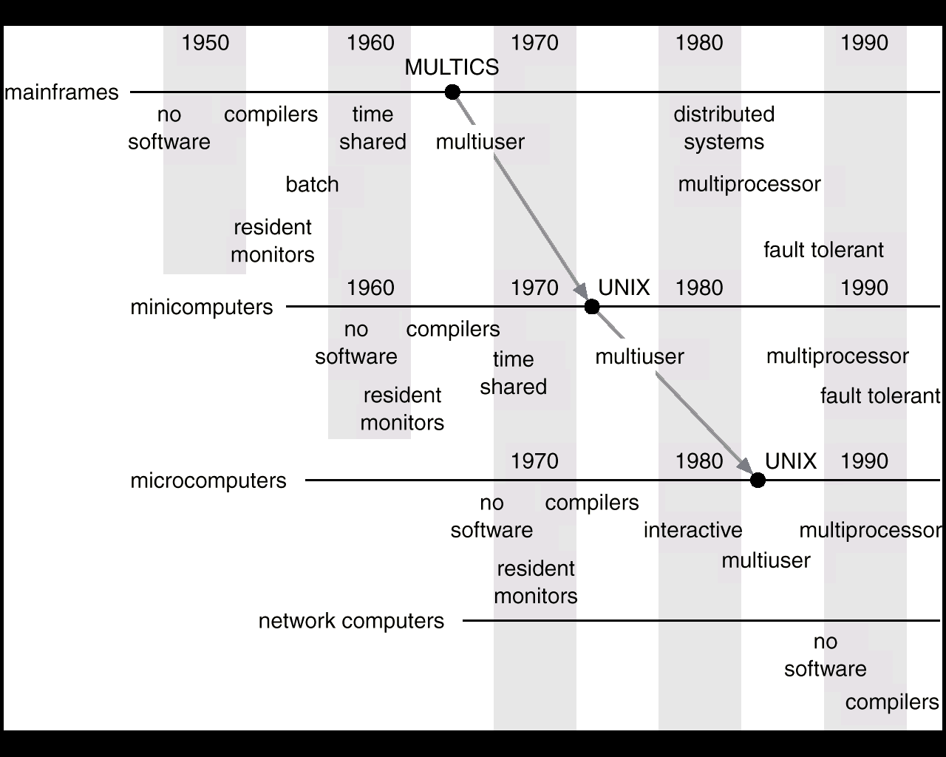
操作系统类型
概
念
演
进

Slide 27
操作系统类型(CONT.)
按体系结构(偶合程度)
  单处理器操作系统
  多处理器操作系统(并行操作系统)
    共享存储器、时钟，一般在同一电路板或同一系统
  分布式操作系统
    较松偶合，在同一系统或局域网
  Cluster
    一般在局域网，提供负载均衡能力
  网络操作系统
  (嵌入式操作系统)

Slide 28
操作系统类型(CONT.)
按用途
  通用操作系统
  专用操作系统
按规模
  个人操作系统
  服务器操作系统
  嵌入式操作系统

Slide 29
操作系统类型(CONT.)
常用的操作系统
  DOS
  Windows(1.0,2.0,3.0,3.2,98, NT, 2000,XP)
  Unix/Linux/Minix
  嵌入式操作系统(Linux,uClinux,VxWorks,uCOS,WinCE)

Slide 30
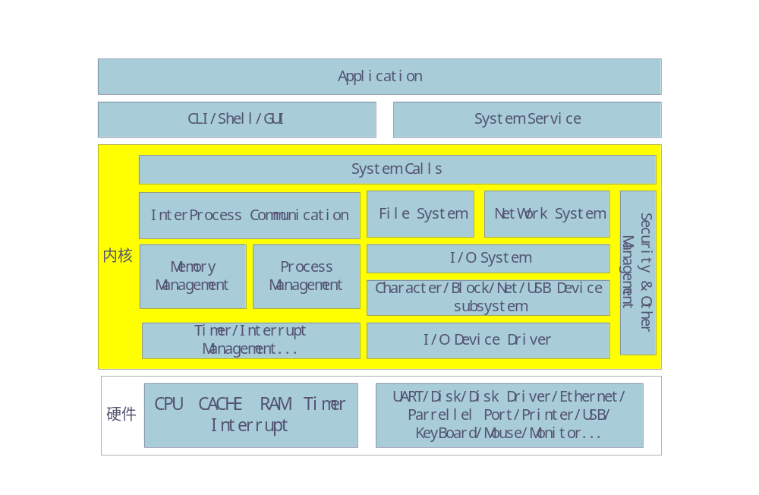
操作系统层次结构

Slide 31
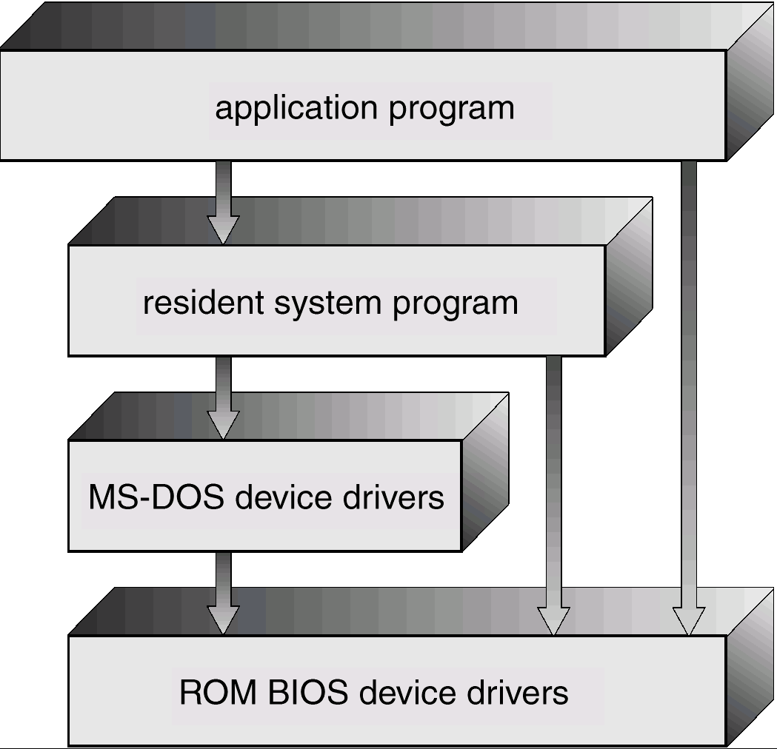
DOS层次结构

Slide 32
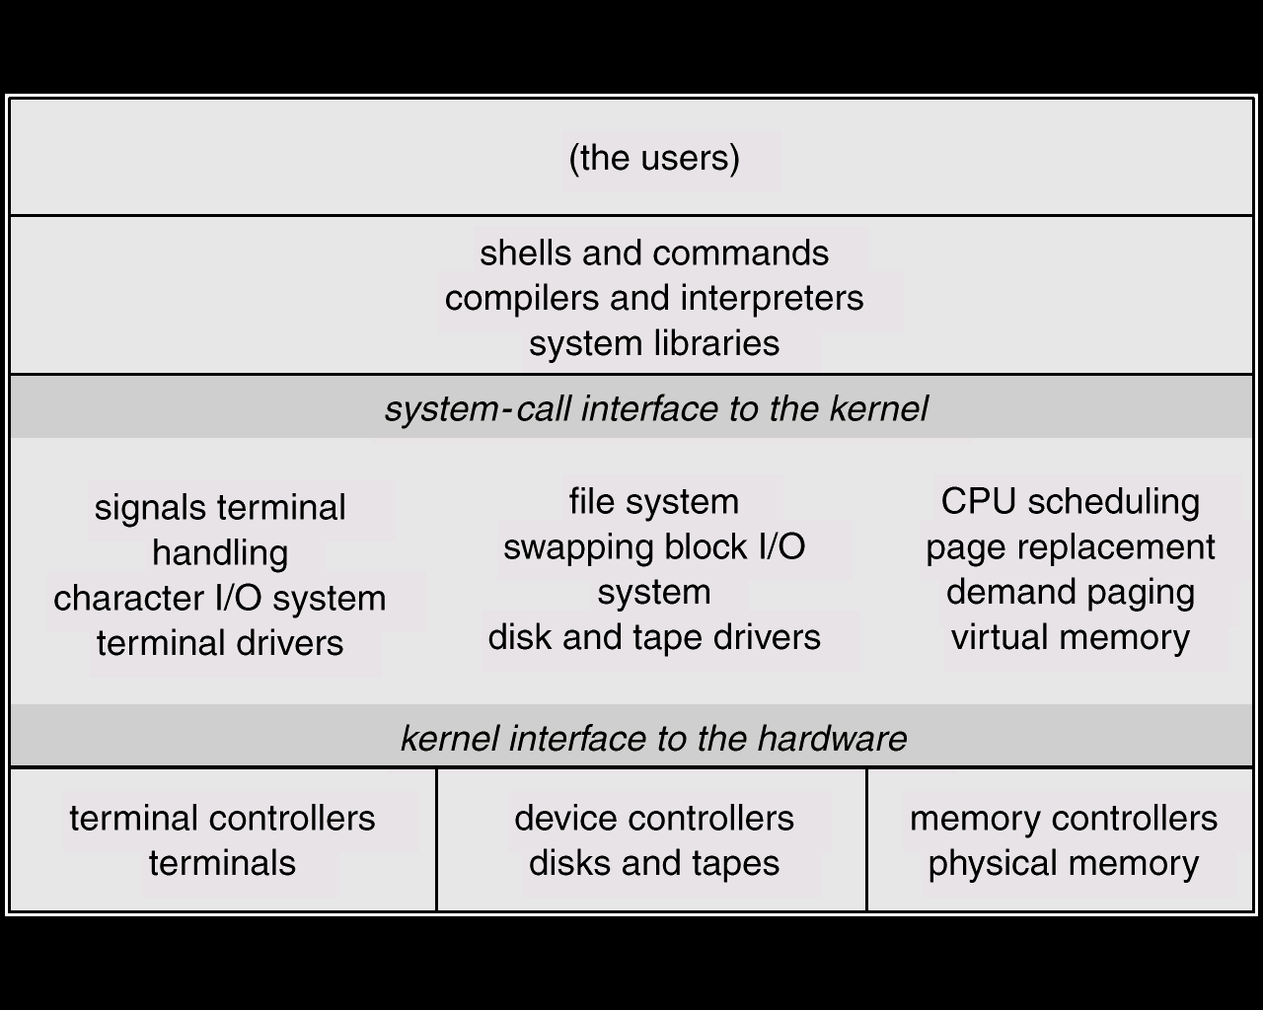
Unix层次结构

Slide 33
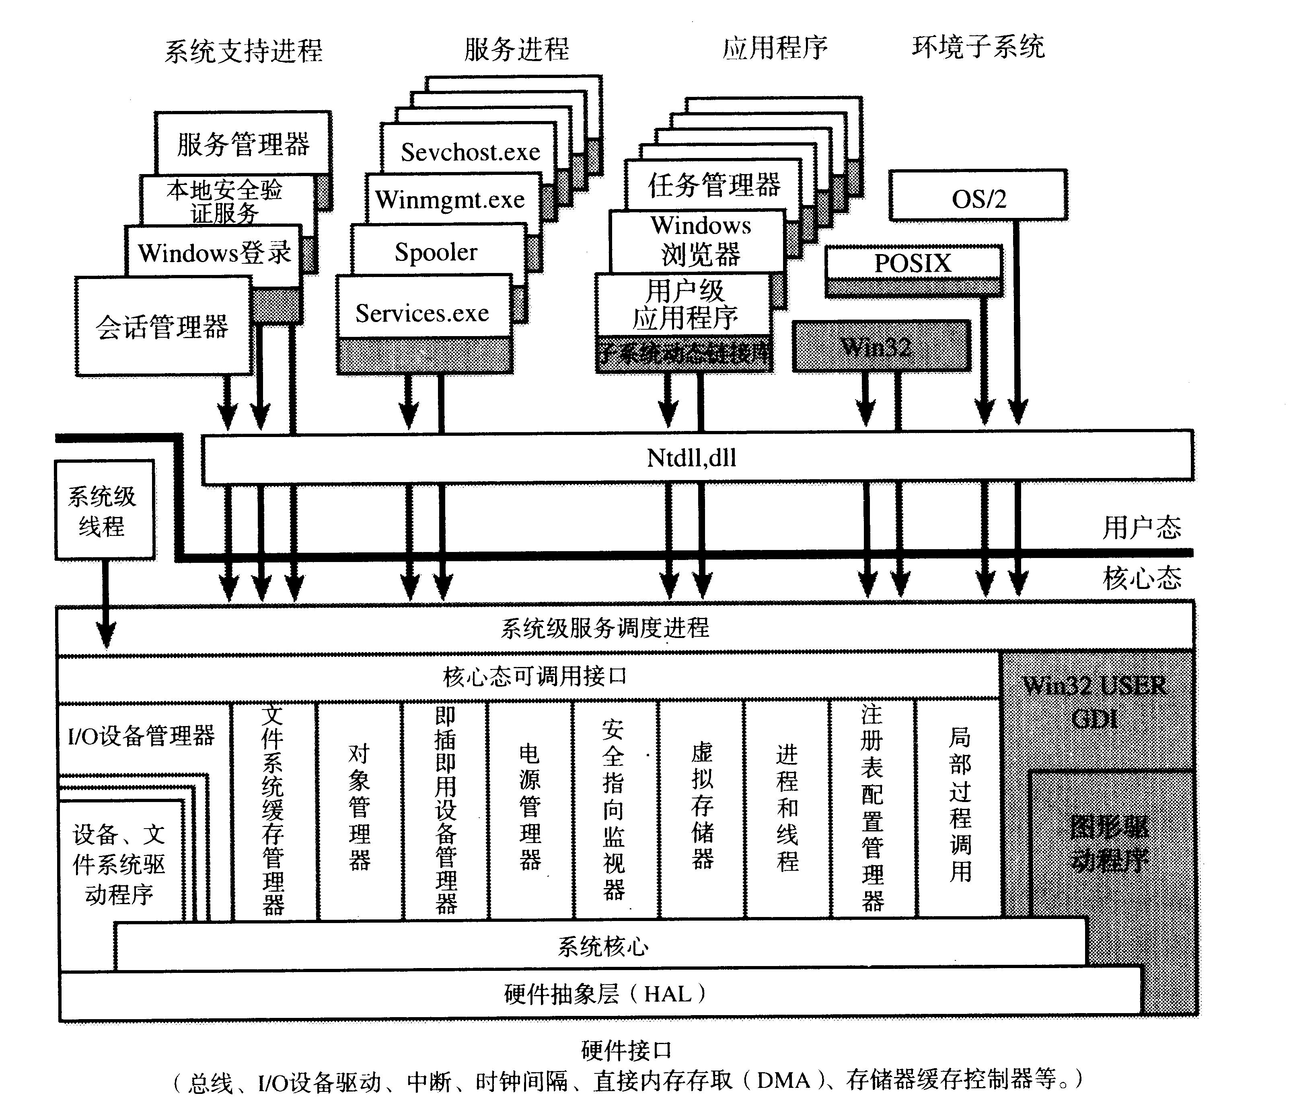
Windows层次结构

Slide 34
OS内核结构
微内核
  结构清晰
  可裁减性好
  便于移植
  需要高效的内核通信机制
大内核
  整个内核可看成一个大程序
  效率较高

Slide 35
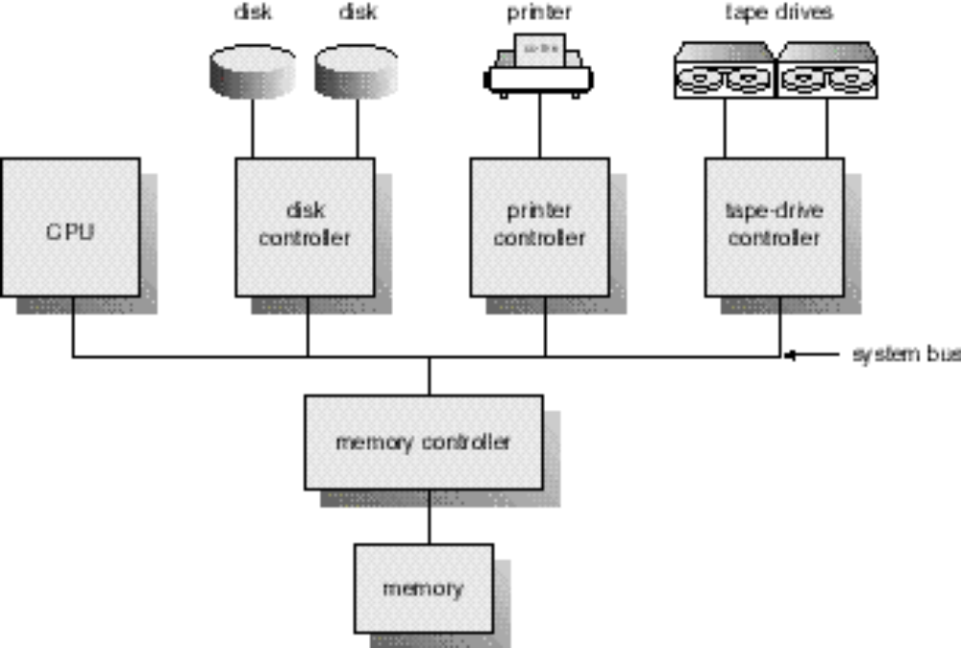
计算机系统结构

Slide 36
计算机系统结构
CPU
  SMP、Cluster、Distributed、network
  Multiprogramming,process,Scheduling,synchronization,IPC,Deadlocks
Memory
  L1 cache
  L2 Cache
  Main Memory (Rom,Flash,EPROM,SRAM, DRAM,SDRAM,DDR RAM)
  Secondary storage(HD,CDROM,magnetic tapes)

Slide 37
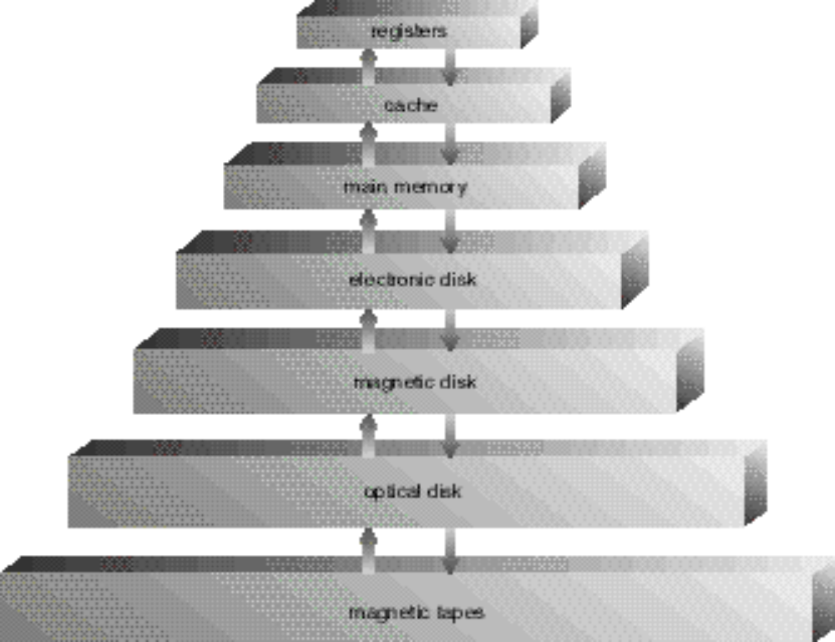
计算机系统结构

Slide 38
计算机系统结构
  Memory Allocation
  Swapping
  Virtual Memory
  File System
I/O device
  Interrupt
  DMA
  Channel
  buffer

Slide 39
阅读材料
Abraham S.等，操作系统概念,Chapter 1-2
尤晋元等，Windows操作系统原理，chapter 1-2
Andrew S.等，操作系统设计与实现，chapter 1
其它有关网络资源

Slide 40
思考题
如果没有操作系统，你该如何使用计算机？
你已经使用过哪些操作系统，各有什么特点？
初步计算一下从你机器的硬盘读取一个扇区需要的时间，其中CPU执行指令花了多长时间？
多道程序设计解决了什么问题？

Slide 41
作业
P34
2,7,8,9,11,16

