Slide 1

Chapter 8: Virtual Memory
基本概念
  局部性原理
  定义
请求分页存储管理方式
  MMU支持
  页面分配
  调入策略
  页面置换算法
  性能分析
  抖动

Slide 2
Chapter 8: Virtual Memory
请求分段存储管理
Intel 80386存储管理方式

Slide 3
Background
局部性原理
  在某个时间间隔内,程序的执行时访问的地址空间局限在某个范围
定义
  把作业的一部分装入内存便可运行的存储器系统
  具请求调入功能和置换功能,能在逻辑上对内存容量进行扩充的存储器系统

Slide 4
Background
虚拟存储器实现方式
  请求分页
  请求分段
虚拟存储器特征
  离散性
  多次性
  对换性
  虚拟性

Slide 5

Demand Paging
Bring a page into memory only when it is needed.
  Less I/O needed
  Less memory needed
  Faster response
  More users

Slide 6
Demand Paging
硬件支持(MMU)
  页表支持
    页号 物理块号 状态位 访问字段 修改位 外存地址
  缺页中断机构
  地址变换机构

Slide 7
地址变换过程
硬件操作
软件操作

Slide 8
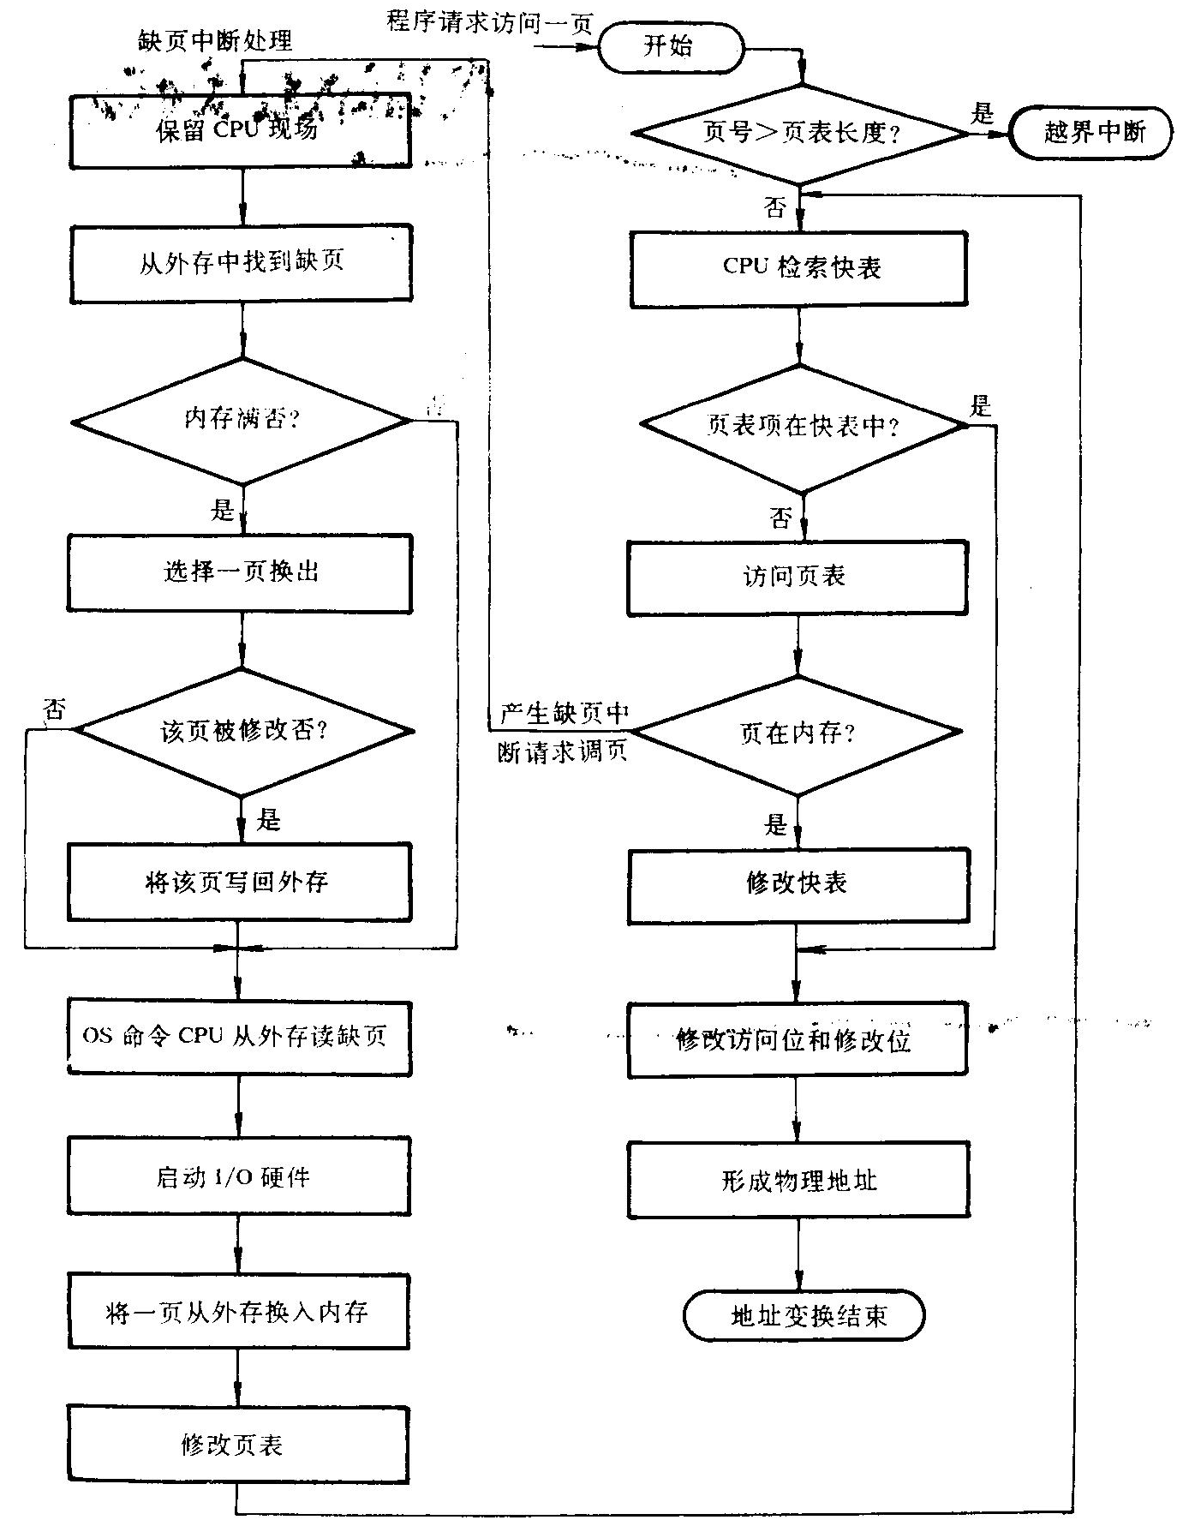

Slide 9
页面分配
最小物理块数
页面分配和置换策略
  固定分配局部置换
  可变分配全局置换
  可变分配局部置换
分配算法
  平均分配
  按比例分配
  考虑优先权的分配算法

Slide 10
页面调入策略
何时调入页面
  预调页策略
  请求调页策略
从何处调入页面
  交换区
  文件区
  混合

Slide 11
页面置换算法
最佳置换算法
先进先出置换算法
LRU置换算法
Clock置换算法
最少使用置换算法
页面缓冲算法

Slide 12

Page-Replacement Algorithms
Want lowest page-fault rate.
Evaluate algorithm by running it on a particular string of memory references (reference string) and computing the number of page faults on that string.
In all our examples, the reference string is
1, 2, 3, 4, 1, 2, 5, 1, 2, 3, 4, 5.

Slide 13

First-In-First-Out (FIFO) Algorithm
Reference string: 1, 2, 3, 4, 1, 2, 5, 1, 2, 3, 4, 5
3 frames (3 pages can be in memory at a time per process)
4 frames
FIFO Replacement – Belady’s Anomaly
  more frames ⇒ less page faults
1
1
1
4
5
1
5
4
2
9 page faults
2
2
2
1
5
1
4
3
3
2
3
4
3
2
3
4
3
10 page faults

Slide 14

Optimal Algorithm
Replace page that will not be used for longest period of time.
4 frames example
1
4
2
6 page faults
3
4
5

Slide 15
Optimal Algorithm
1, 2, 3, 4, 1, 2, 5, 1, 2, 3, 4, 5
How do you know this?
Used for measuring how well your algorithm performs.
1
4
2
3
6 page faults
4
5

Slide 16
Least Recently Used (LRU) Algorithm
Reference string: 1, 2, 3, 4, 1, 2, 5, 1, 2, 3, 4, 5
1
5
2
3
5
4
4
3

Slide 17

Least Recently Used (LRU) Algorithm
Counter implementation
  Every page entry has a counter; every time page is referenced through this entry, copy the clock into the counter.
  When a page needs to be changed, look at the counters to determine which are to change.

Slide 18

LRU Algorithm (Cont.)
Stack implementation – keep a stack of page numbers in a double link form:
  Page referenced:
    move it to the top
    requires 6 pointers to be changed
  No search for replacement

Slide 19
LRU Approximation Algorithms
Reference bit
  With each page associate a bit, initially -= 0
  When page is referenced bit set to 1.
  Replace the one which is 0 (if one exists). We do not know the order, however.

Slide 20

LRU Approximation Algorithms
Second chance
  Need reference bit.
  Clock replacement.
  If page to be replaced (in clock order) has reference bit = 1. then:
    set reference bit 0.
    leave page in memory.
    replace next page (in clock order), subject to same rules.

Slide 21
Counting Algorithms
Keep a counter of the number of references that have been made to each page.
LFU Algorithm: replaces page with smallest count.
MFU Algorithm: based on the argument that the page with the smallest count was probably just brought in and has yet to be used.

Slide 22
Performance of Demand Paging
Page Fault Rate 0 ≤ p ≤ 1.0
  if p = 0 no page faults
  if p = 1, every reference is a fault
Effective Access Time (EAT)
EAT = (1 – p) x memory access
+ p (page fault overhead
+ [swap page out ]
+ swap page in
+ restart overhead)

Slide 23
Demand Paging Example
Memory access time = 100ns=0.1us
P 缺页率
Swap Page Time = 25ms=25000us
EAT = (1 – p) x 0.1 + p (25000)
0.1 + 24999.9P (us)
若p=1/1000,则EAT=25us
若要求有效时间延长不超过10%,则
p < 0.0000004 (2百50万分之一)

Slide 24
Allocation of Frames
Example: IBM 370 – 6 pages to handle SS MOVE instruction:
  instruction is 6 bytes, might span 2 pages.
  2 pages to handle from.
  2 pages to handle to.
Two major allocation schemes.
  fixed allocation
  priority allocation

Slide 25
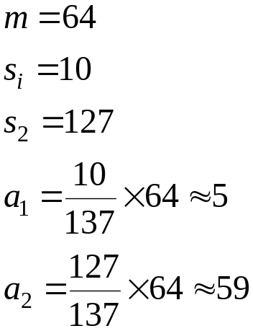
Fixed Allocation
Equal allocation – e.g., if 100 frames and 5 processes, give each 20 pages.
Proportional allocation – Allocate according to the size of process.

Slide 26
Priority Allocation
Use a proportional allocation scheme using priorities rather than size.
If process P_{i} generates a page fault,
  select for replacement one of its frames.
  select for replacement a frame from a process with lower priority number.

Slide 27
Global vs. Local Allocation
Global replacement – process selects a replacement frame from the set of all frames; one process can take a frame from another.
Local replacement – each process selects from only its own set of allocated frames.

Slide 28
Thrashing
If a process does not have “enough” pages, the page-fault rate is very high. This leads to:
  low CPU utilization.
  operating system thinks that it needs to increase the degree of multiprogramming.
  another process added to the system.
Thrashing ≡ a process is busy swapping pages in and out.

Slide 29


Thrashing Diagram
Why does thrashing occur?
Σ size of locality > total memory size

Slide 30
Working-Set Model
Δ ≡ working-set window ≡ a fixed number of page references
Example: 10,000 instruction

Slide 31
Working-Set Model
WSS_{i} (working set of Process P_{i}) =
total number of pages referenced in the most recent Δ (varies in time)
  if Δ too small will not encompass entire locality.
  if Δ too large will encompass several localities.
  if Δ = ∞ ⇒ will encompass entire program.

Slide 32
Working-Set Model
D = Σ WSS_{i} ≡ total demand frames
if D > m ⇒ Thrashing
Policy if D > m, then suspend one of the processes.

Slide 33
Keeping Track of the Working Set
Approximate with interval timer + a reference bit

Slide 34
Keeping Track of the Working Set
Example: Δ = 10,000
  Timer interrupts after every 5000 time units.
  Keep in memory 2 bits for each page.
  Whenever a timer interrupts copy and sets the values of all reference bits to 0.
  If one of the bits in memory = 1 ⇒ page in working set.

Slide 35
Keeping Track of the Working Set
Why is this not completely accurate?
Improvement = 10 bits and interrupt every 1000 time units.

Slide 36

Page-Fault Frequency Scheme
Establish “acceptable” page-fault rate.
  If actual rate too low, process loses frame.
  If actual rate too high, process gains frame.

Slide 37
Other Considerations
Preparing
Page size selection
  fragmentation
  table size
  I/O overhead
  locality

Slide 38
Other Consideration (Cont.)
Program structure
  Array A[1024, 1024] of integer
  Each row is stored in one page
  One frame
  Program 1 for j := 1 to 1024 do
  for i := 1 to 1024 do
  A[i,j] := 0;
  1024 x 1024 page faults
  Program 2 for i := 1 to 1024 do
  for j := 1 to 1024 do
  A[i,j] := 0;
  1024 page faults

Slide 39
Other Consideration (Cont.)
I/O interlock and addressing

Slide 40
Demand Segmentation
Used when insufficient hardware to implement demand paging.
OS/2 allocates memory in segments, which it keeps track of through segment descriptors
Segment descriptor contains a valid bit to indicate whether the segment is currently in memory.
  If segment is in main memory, access continues,
  If not in memory, segment fault.

Slide 41
Intel 80386存储管理方式
寻址方式
  实地址模式
  保护虚地址模式
  虚拟8086模式

Slide 42
Intel 80386存储管理方式
寄存器(7类32个)
通用、段、指令指针、标志、控制、系统地址、排错测试

Slide 43
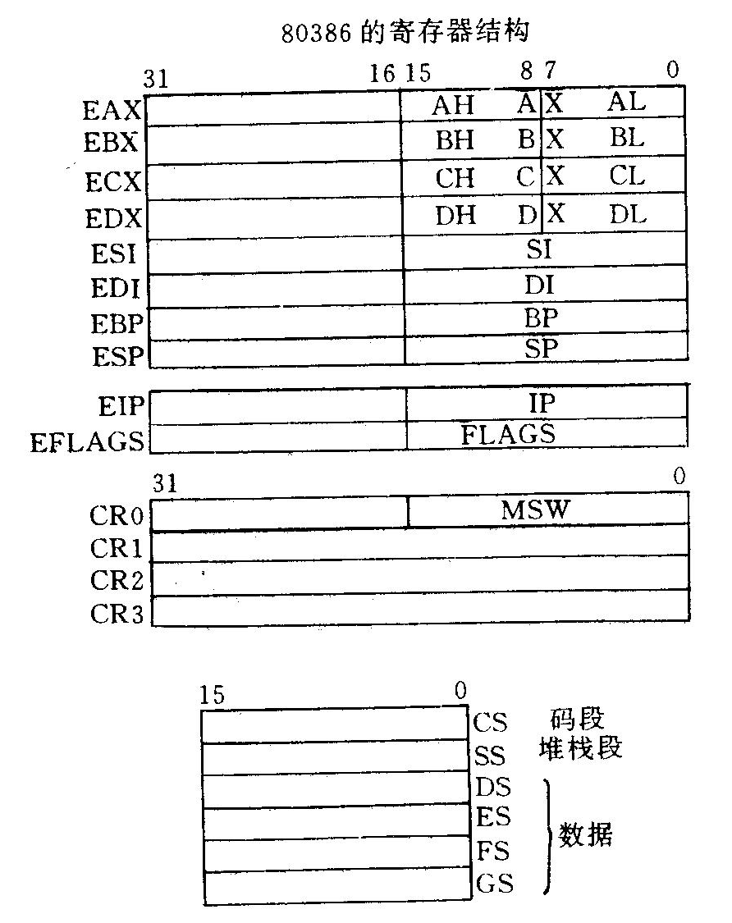
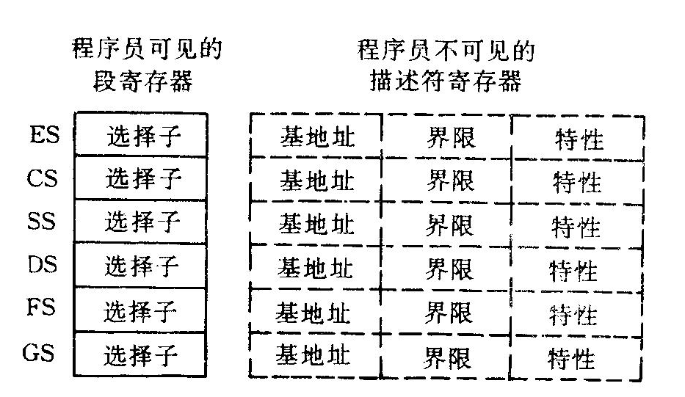
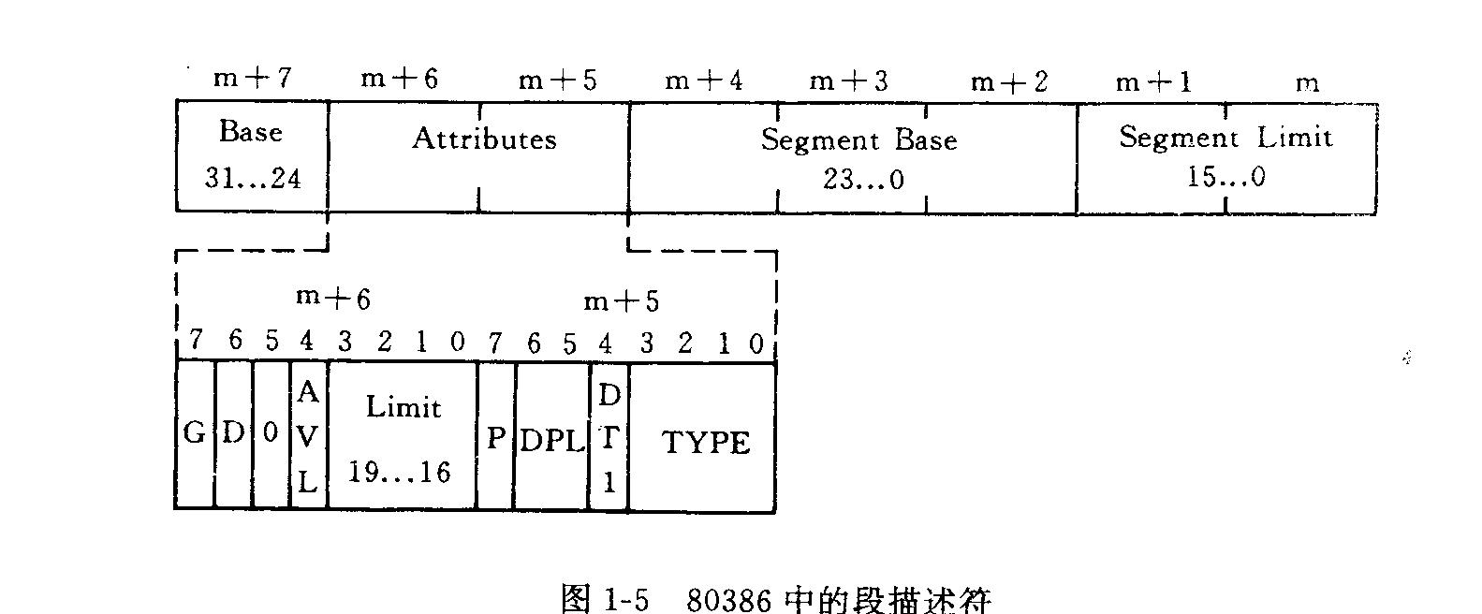
Intel 80386存储管理方式

Slide 44
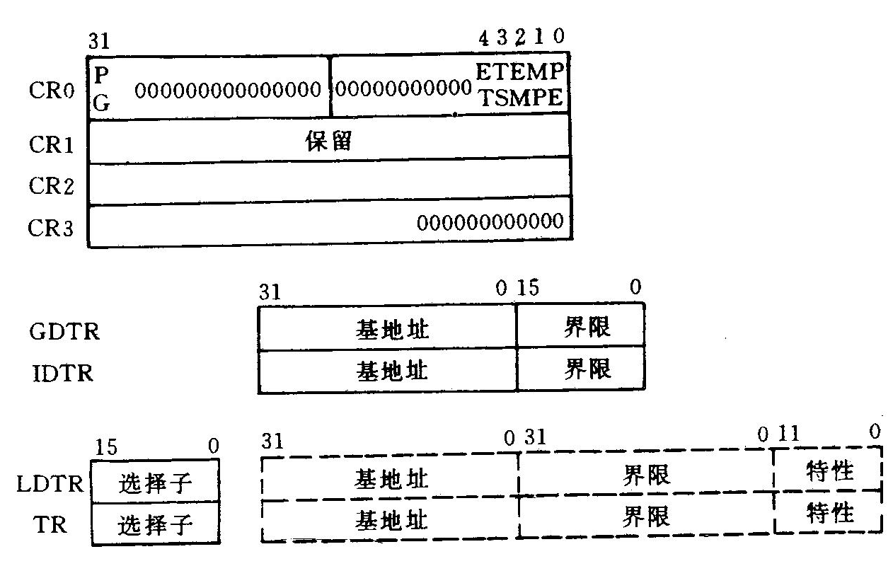
Intel 80386存储管理方式
系统寄存器
启用保护模式，分页，协处理器控制等
页故障线性地址
页目录表基地址

Slide 45
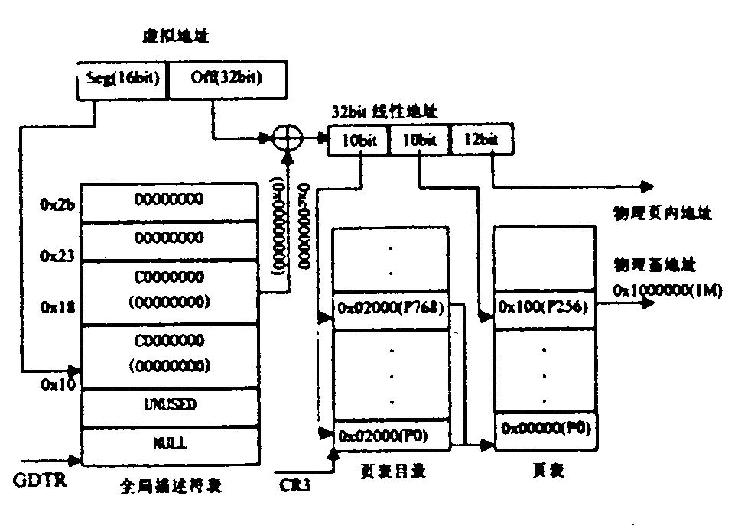
Intel 80386存储管理方式

Slide 46
Linux存储管理方式
物理页框的管理
虚拟内存的管理
内存申请与释放

Slide 47
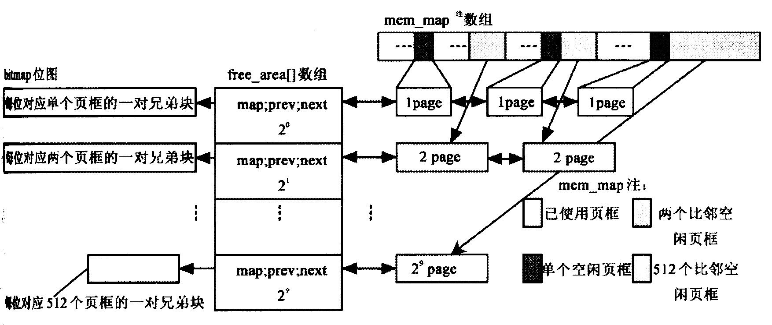
Linux存储管理方式
物理页框的管理(空闲块的管理)
Buddy 算法

Slide 48
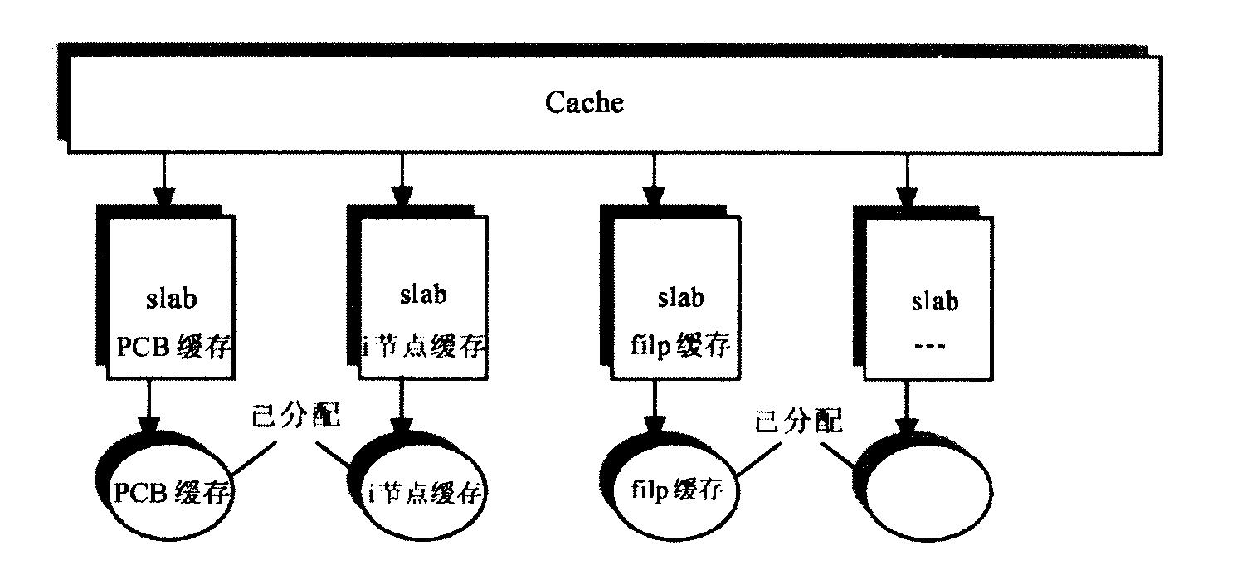
Linux存储管理方式
小块内存的请求
Slab分配器(对象复用;cache)

Slide 49
Linux存储管理方式
内存分配函数
连续(物理)内存区分配
  kmalloc
  kfree
非连续(物理)内存区分配
  malloc
  free

Slide 50
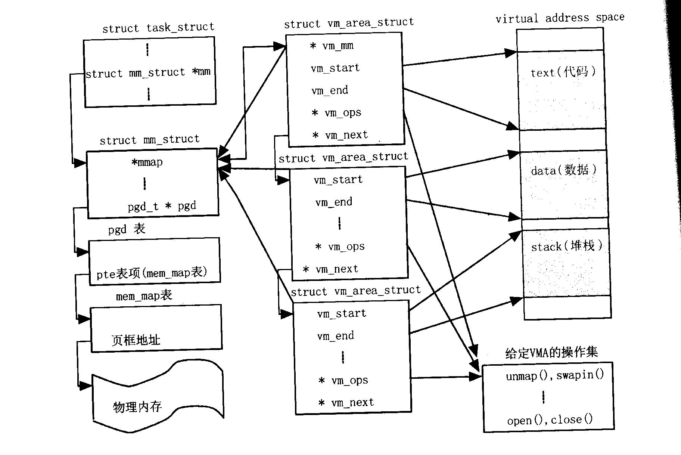
Linux存储管理方式
虚拟地址空间管理及页故障处理

Slide 51
Linux存储管理方式
作业
P194:
1,2,3,4,6,8,9,11,12,13,15,16

