Slide 1
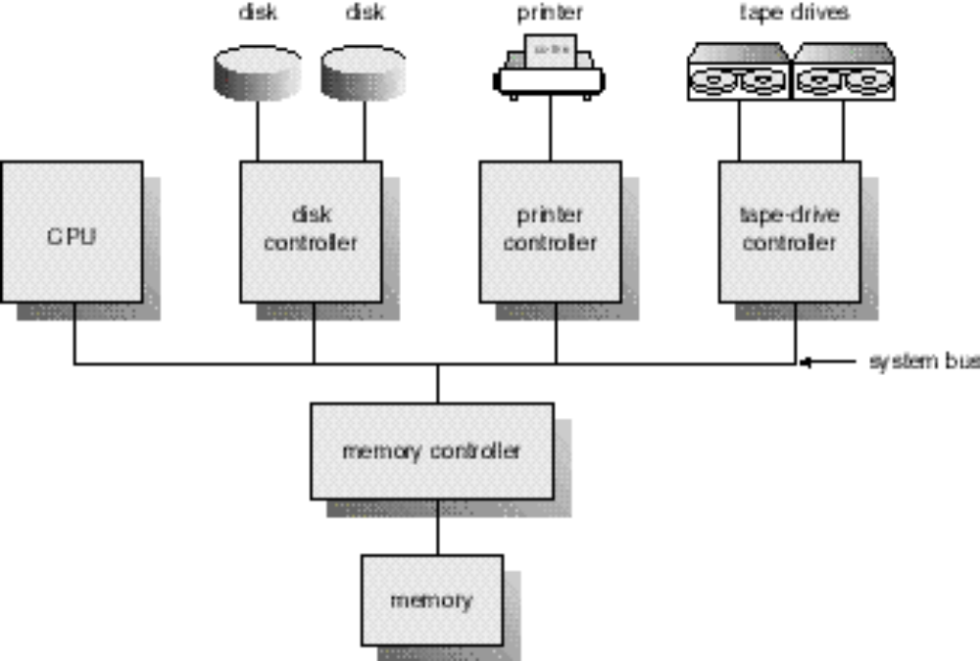
设备管理

Slide 2
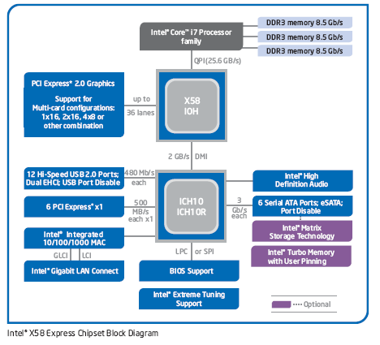

Slide 3
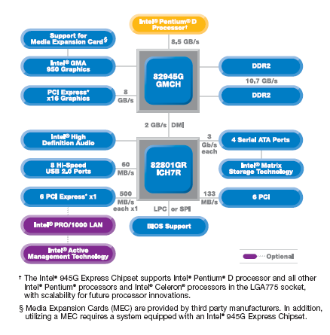

Slide 4
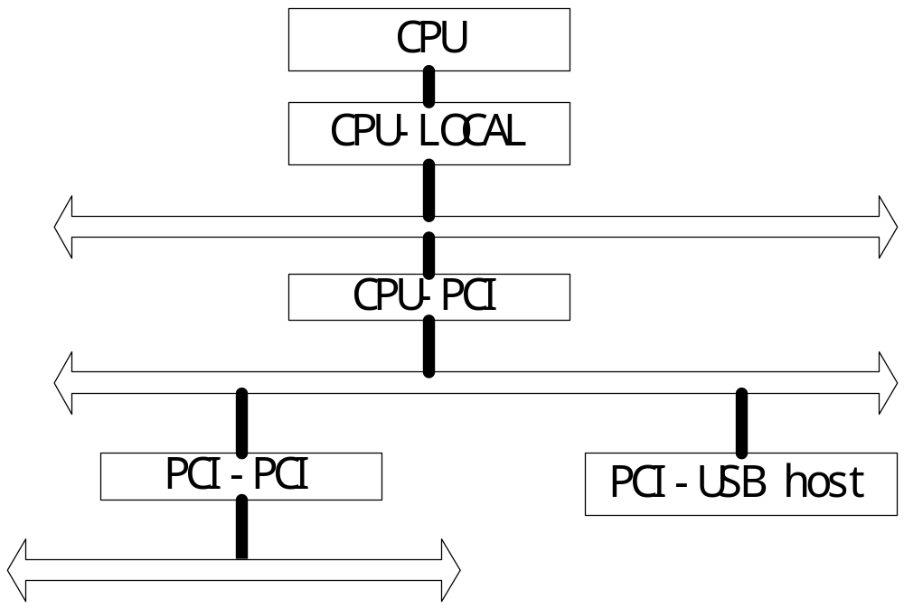

Slide 5
设备管理
I/O 系统组成
  I/O系统
  I/O设备
  I/O控制器
  I/O总线
I/O控制方式
  查询
  中断
  DMA
  通道
缓冲管理
设备驱动程序工作原理
Linux设备驱动程序

Slide 6
I/O 系统组成
Incredible variety of I/O devices
Common concepts
  Port
  Bus (daisy chain or shared direct access)
  Controller (host adapter)
I/O instructions control devices
Devices have addresses, used by
  Direct I/O instructions
  Memory-mapped I/O

Slide 7
Polling
Determines state of device
  command-ready
  busy
  error
Busy-wait cycle to wait for I/O from device

Slide 8
Interrupts
CPU Interrupt request line triggered by I/O device
Interrupt handler receives interrupts
Maskable to ignore or delay some interrupts
Interrupt vector to dispatch interrupt to correct handler
  Based on priority
  Some unmaskable
Interrupt mechanism also used for exceptions

Slide 9
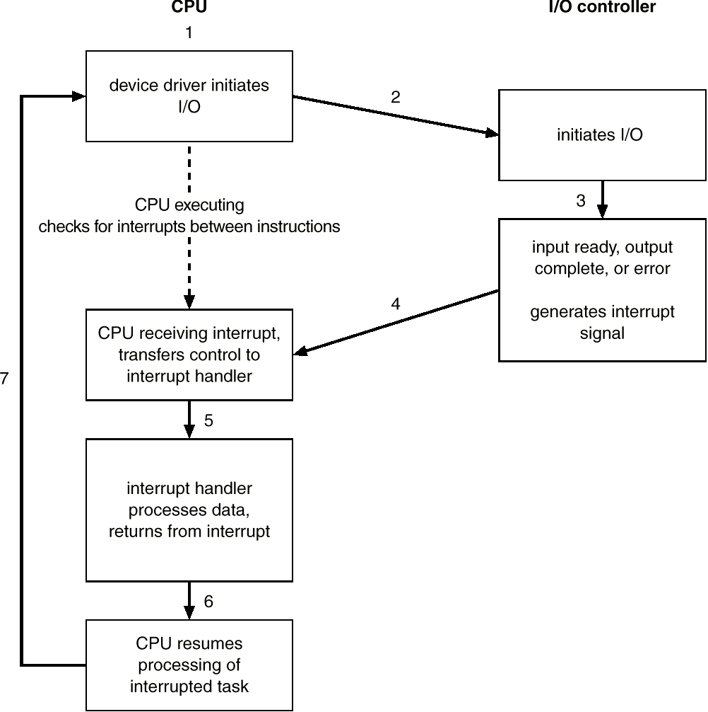
Interrupt-drive I/O Cycle

Slide 10
Direct Memory Access
Used to avoid programmed I/O for large data movement
Requires DMA controller
Bypasses CPU to transfer data directly between I/O device and memory

Slide 11

Six step process to perform DMA transfer

Slide 12
Application I/O Interface
I/O system calls encapsulate device behaviors in generic classes
Device-driver layer hides differences among I/O controllers from kernel
Devices vary in many dimensions
  Character-stream or block
  Sequential or random-access
  Sharable or dedicated
  Speed of operation
  read-write, read only, or write only

Slide 13
Block and Character Devices
Block devices include disk drives
  Commands include read, write, seek
  Raw I/O or file-system access
  Memory-mapped file access possible
Character devices include keyboards, mice, serial ports
  Commands include get, put
  Libraries layered on top allow line editing

Slide 14
Network Devices
Varying enough from block and character to have own interface
Unix and Windows/NT include socket interface
  Separates network protocol from network operation
  Includes select functionality
Approaches vary widely (pipes, FIFOs, streams, queues, mailboxes)

Slide 15
Clocks and Timers
Provide current time, elapsed time, timer
if programmable interval time used for timings, periodic interrupts
ioctl (on UNIX) covers odd aspects of I/O such as clocks and timers

Slide 16
Blocking and Nonblocking I/O
Blocking - process suspended until I/O completed
  Easy to use and understand
  Insufficient for some needs
Nonblocking - I/O call returns as much as available
  User interface, data copy (buffered I/O)
  Implemented via multi-threading
  Returns quickly with count of bytes read or written
Asynchronous - process runs while I/O executes
  Difficult to use
  I/O subsystem signals process when I/O completed

Slide 17
Kernel I/O Subsystem
Scheduling
  Some I/O request ordering via per-device queue
  Some OSs try fairness
Buffering - store data in memory while transferring between devices
  To cope with device speed mismatch
  To cope with device transfer size mismatch
  To maintain “copy semantics”

Slide 18
Kernel I/O Subsystem
Caching - fast memory holding copy of data
  Always just a copy
  Key to performance
Spooling - hold output for a device
  If device can serve only one request at a time
  i.e., Printing
Device reservation - provides exclusive access to a device
  System calls for allocation and deallocation
  Watch out for deadlock

Slide 19
Error Handling
OS can recover from disk read, device unavailable, transient write failures
Most return an error number or code when I/O request fails
System error logs hold problem reports

Slide 20
Kernel Data Structures
Kernel keeps state info for I/O components, including open file tables, network connections, character device state
Many, many complex data structures to track buffers, memory allocation, “dirty” blocks
Some use object-oriented methods and message passing to implement I/O

Slide 21
I/O Requests to Hardware Operations
Consider reading a file from disk for a process
  Determine device holding file
  Translate name to device representation
  Physically read data from disk into buffer
  Make data available to requesting process
  Return control to process

Slide 22
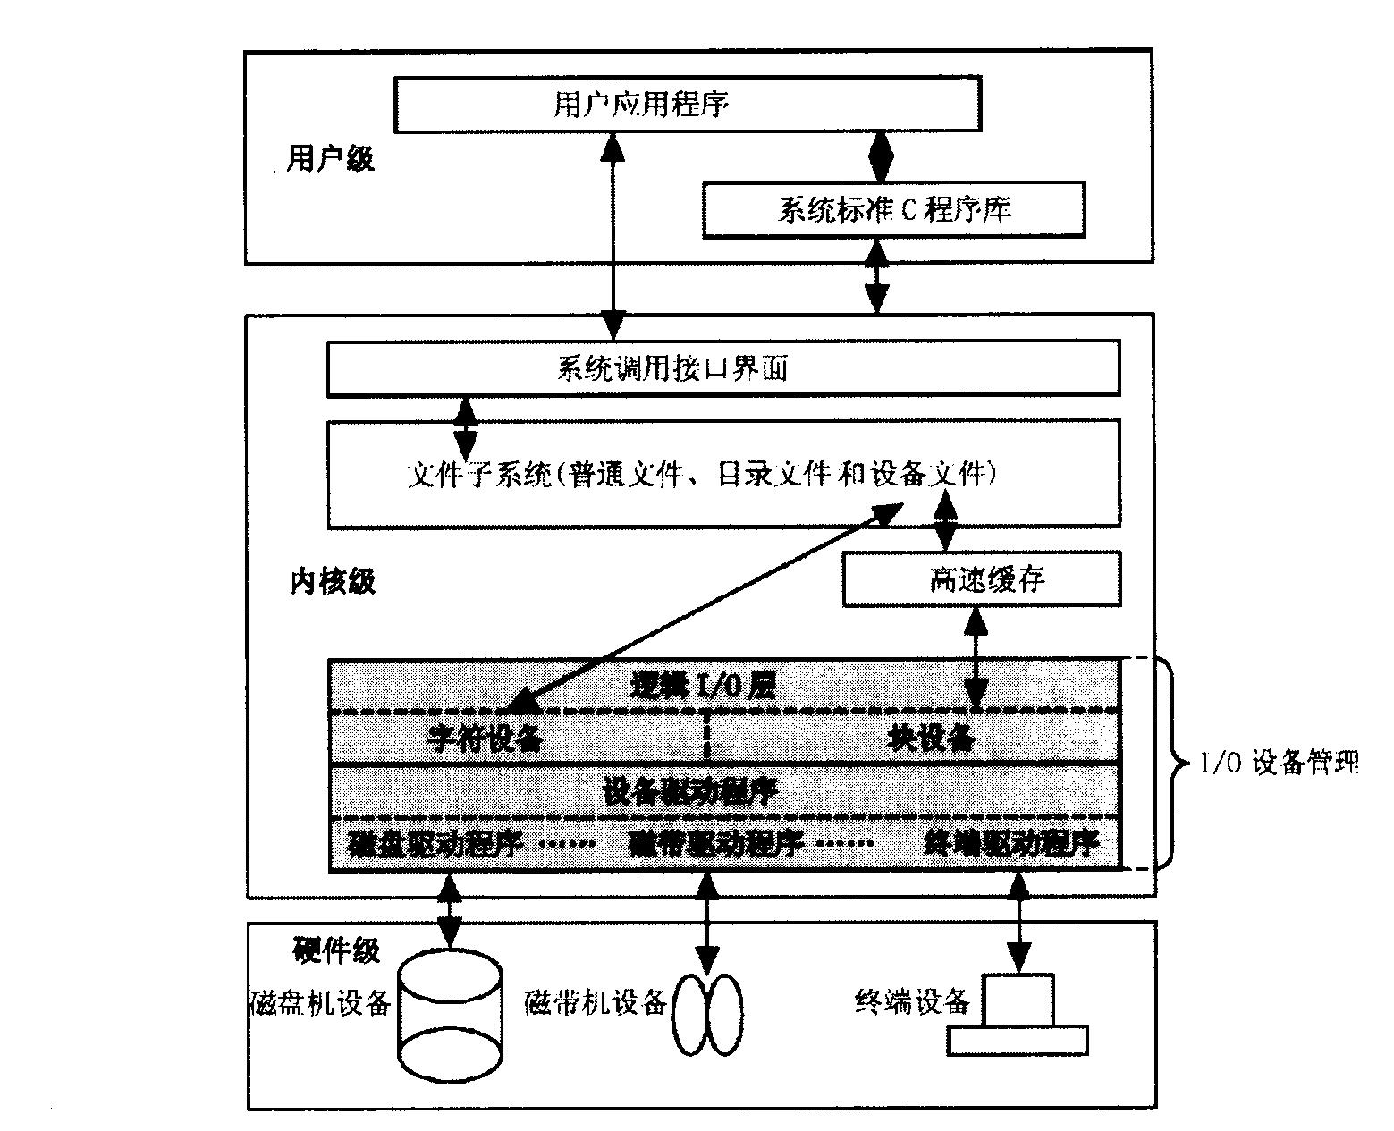
设备子系统与其它部分的关系

Slide 23
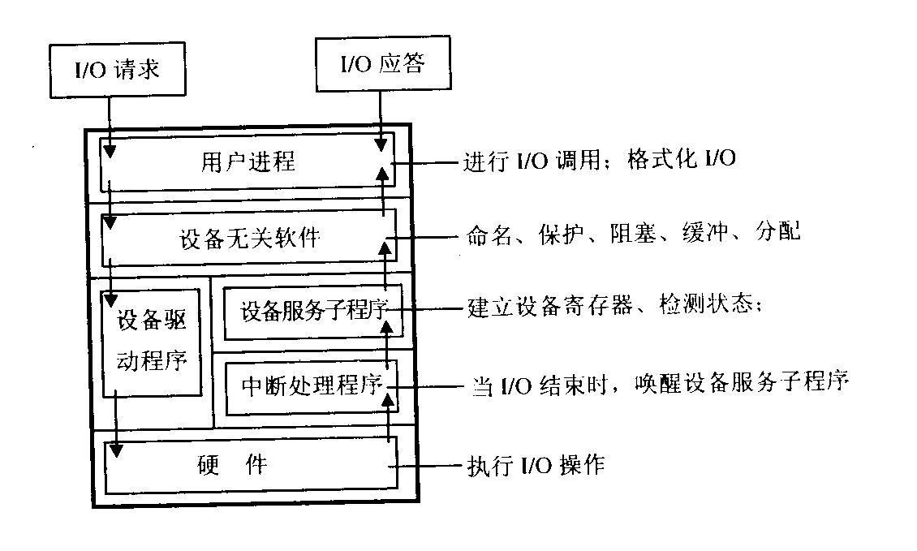
设备管理子系统层次结构

Slide 24
Linux设备驱动程序
设备文件
设备文件用来有示Linux所支持的设备，由系统调用mknod创建：
mknod(const char * filename, int mode, dev_t dev)
设 备 名
设备类型
主设备号
从设备号
字符设备
块 设 备
网络设备

Slide 25
Linux设备驱动程序
设备驱动程序框架
Linux的设备驱动程序的外接接口与DDI/DKI规范相似，可以分成以下3个部分：
（1）驱动程序与内核的接口，通过数据结构file _operations完成；
（2）驱动程序与系统引导的接口，这部分利用驱动程序对设备进行初始化；
（3）驱动程序与设备的接口。

Slide 26
Linux设备驱动程序
设备驱动程序的组成
驱动程序的注册和注销
设备的打开与释放
设备的读和写操作
设备的控制操作
设备的中断和查询处理

Slide 27
Linux设备驱动程序
struct file_operations {
int (*seek) (struct inode * ，struct file *， off_t ，int);
int (*read) (struct inode * ，struct file *， char ，int);
int (*write) (struct inode * ，struct file *， off_t ，int);
int (*readdir) (struct inode * ，struct file *， struct dirent * ，int);
int (*select) (struct inode * ，struct file *， int ，select_table *);
int (*ioctl) (struct inode * ，struct file *， unsined int ，unsigned long);
int (*mmap) (struct inode * ，struct file *， struct vm_area_struct *);
int (*open) (struct inode * ，struct file *);
int (*release) (struct inode * ，struct file *);
int (*fsync) (struct inode * ，struct file *);
int (*fasync) (struct inode * ，struct file *，int);
int (*check_media_change) (struct inode * ，struct file *);
int (*revalidate) (dev_t dev);
}

Slide 28
Linux设备驱动程序
块设备驱动程序的注册
在初始化时通过register_blkdev()函数将相应的块设备添加到数组blkdevs中；
block_device_operations结构。

Slide 29
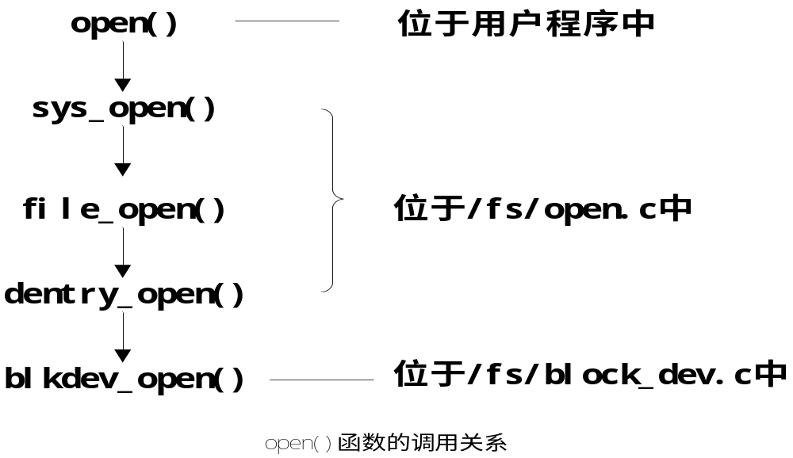
Linux设备驱动程序
块设备驱动程序函数调用关系

Slide 30
内核模块
在内核执行
动态加载
一般用于设备驱动程序和文件系统

Slide 31
内核模块
在哪里？
Lsmod命令
/proc/modules文件
kmod deamon
（调用modprobe = insmod+depmod）

Slide 32
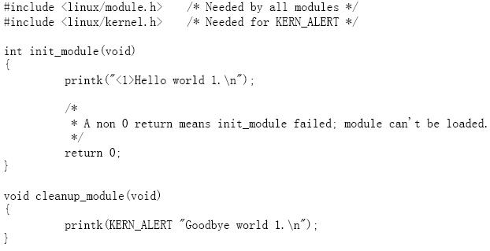
Hello world

Slide 33

Hello world
Makefile
命令

Slide 34
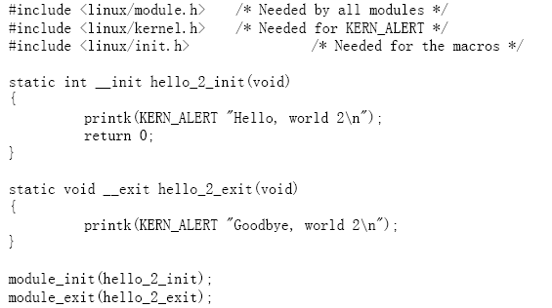
Hello world（2.4）

Slide 35
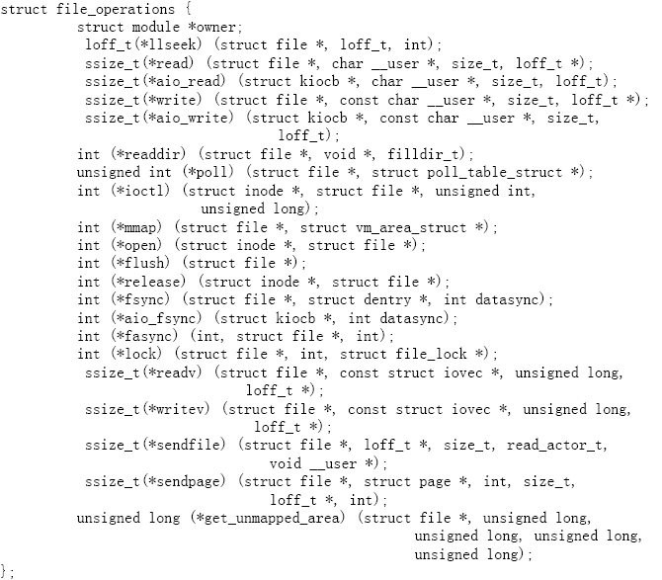
设备驱动-char

Slide 36

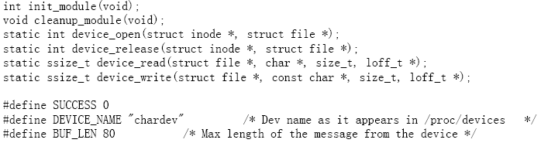

设备驱动-char

Slide 37
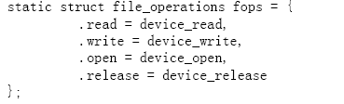
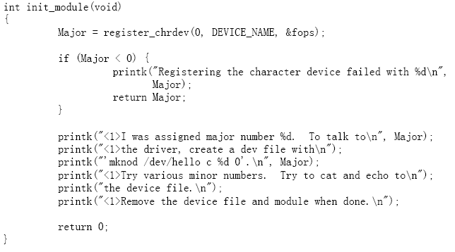
设备驱动-char

Slide 38
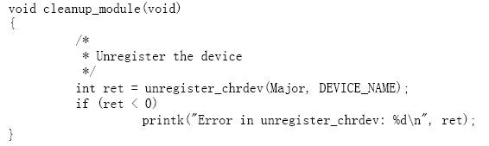
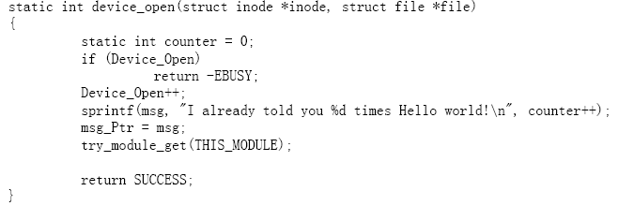
设备驱动-char

Slide 39
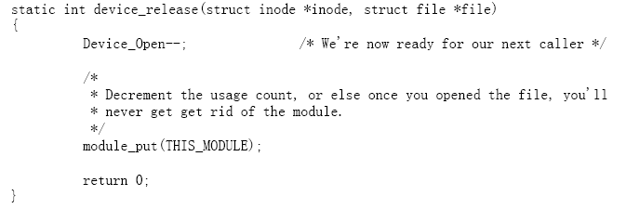
设备驱动-char

Slide 40
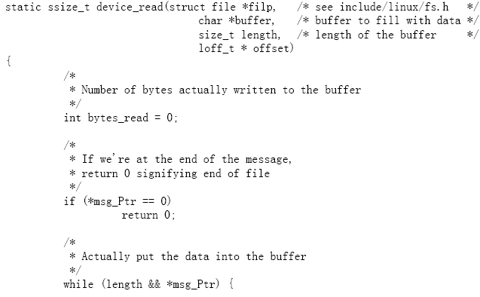
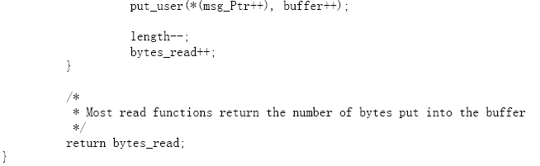
设备驱动-char

Slide 41
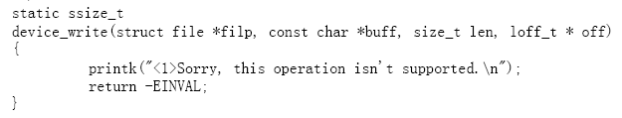

设备驱动-char

Slide 42
设备驱动-char
Insmod chardev.o
(1)在C程序中
Open read write
(2)
Echo “hi” > /dev/hello

