Slide 1
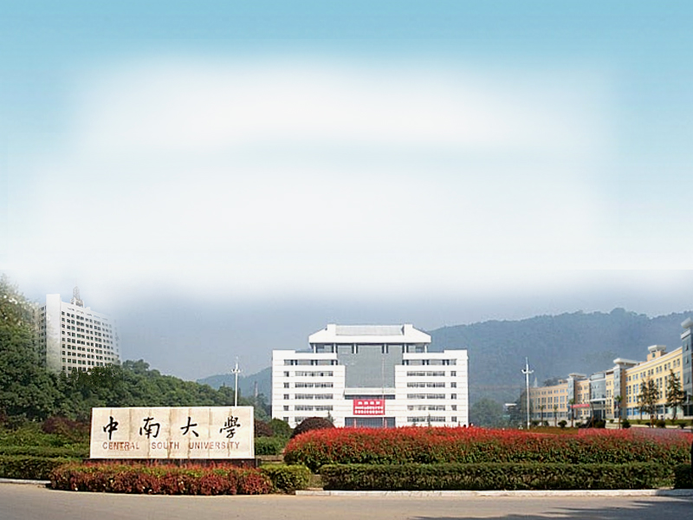
国家精品课程
Principles of Operating System
操作系统原理
胡志刚
中南大学计算机学院

Slide 2
Textbook & References
Silberschatz．Operating System Concepts（第7版）
北京：高等教育出版社, 2007,3
汤子瀛．计算机操作系统．
西安：西北电子科技大学出版社, 1999,5
胡志刚．计算机操作系统．
长沙：中南大学出版社,2005,8
张尧学．计算机操作系统教程（第2版）．
北京：清华大学出版社, 2000,8

Slide 3
About This Course
What is an Operating System?
Why should study?
How to study?

Slide 4
What is an Operating System?
A set of programs that control and manage computer hardware and software, and organize computer's workflow so as to make the computer system convenient for users to use reasonably and efficiently.
Operating system goals
  Make the computer system convenient to use.
  Use the computer hardware in an efficient manner.
Notes:
操作系统就是在用户和计算机硬件之间建立一个桥梁
实现目标位:执行用户进程，让计算机系统更容易的使用

Slide 5
Why should study?
Help you understand important and hard OS concepts
The Concepts/Architectures/ Algorithms/Methods are very traditional and classical

Slide 6
How to study?
Lectures do not cover everything
  Not all questions in homework or exams are from lectures
Students responsibility
  Attend lectures
  Read textbooks
  Homework, Experiments

Slide 7
Chapter 1: Introduction
Computer-System Organization
Operating-System Operations
Batched OS
Multiprogrammed OS
Time-sharing OS
Real-Time Systems

Slide 8
Computer System Structure
Computer system can be divided into 4 components
  Hardware – provides basic computing resources
    CPU, memory, I/O devices
  Operating system – controls and coordinates use of hardware among various applications and users
  Application programs – define the ways in which the system resources are used
    Word processors, compilers, web browsers, database systems, video games
  Users – People, machines, other computers
Notes:
计算机系统原则上分为三层即可：
硬件，操作系统，应用程序

Slide 9

4 Components of a Computer System

Slide 10

Computer System Organization
  One or more CPUs, device controllers connect through common bus providing access to shared memory
Notes:
系统组成包括外设，接口，以及CPU，主存等

Slide 11
Computer-System Operation
I/O devices and the CPU can execute concurrently.
Each device controller is in charge of a particular device type.
Each device controller has a local buffer.
CPU moves data from/to main memory to/from local buffers.
I/O is from the device to local buffer of controller.
Device controller informs CPU that it has finished its operation by causing an interrupt.
Notes:
中断向量
缓冲区间

Slide 12
Common Functions of Interrupts
Interrupt transfers control to interrupt service routine, through the interrupt vector, which contains the addresses of all the service routines.
Interrupt architecture must save the address of the interrupted instruction.
Incoming interrupts are disabled while another interrupt is being processed to prevent a lost interrupt.
A trap is a software-generated interrupt caused either by an error or a user request.
An operating system is interrupt driven.

Slide 13
Interrupt Handling
The operating system preserves the state of the CPU by storing registers and the program counter.
Determines which type of interrupt has occurred:
  polling
  vectored interrupt system
Separate segments of code determine what action should be taken for each type of interrupt.

Slide 14
I/O Structure
2 ways: After I/O starts, control returns to program
only upon I/O completion
  Wait instruction idles the CPU until next interrupt
  Wait loop (contention for memory access).
  At most one I/O request is outstanding at a time, no simultaneous I/O processing.
without waiting for I/O completion
  System call – request to the operating system to allow user to wait for I/O completion.
  Device-status table – contains entry for each I/O device indicating its type, address, and state.

Slide 15

Two I/O Methods
Synchronous
Asynchronous

Slide 16

Device-Status Table

Slide 17
Direct Memory Access Structure
Used for high-speed I/O devices able to transmit information at close to memory speeds.
Device controller transfers blocks of data from buffer storage directly to main memory without CPU intervention.
Only one interrupt is generated per block, rather than the one interrupt per byte.

Slide 18
Caching
Performed at many levels in a computer (in hardware, operating system, software)
Information in use copied from slower to faster storage temporarily
Faster storage (cache) checked first to determine if information is there
  If it is, information used directly from the cache
  If not, data copied to cache and used there
Cache smaller than storage being cached
  Cache size and replacement policy

Slide 19

Performance of Various Levels of Storage
Movement between levels of storage hierarchy can be explicit or implicit
SRAM-http://baike.baidu.com/view/423438.htm
CMOS-http://baike.baidu.com/view/22318.htm

Slide 20

Migration of Integer A from Disk to Register
Multitasking environments must be careful to use most recent value, no matter where it is stored in the storage hierarchy
Multiprocessor environment must provide cache coherency in hardware such that all CPUs have the most recent value in their cache

Slide 21
Mainframe Systems
Batched OS
Multiprogrammed OS
Time-sharing OS

Slide 22
Mainframe Systems: Batch OS
The OS
  was always resident in memory
  automatically transferred control from one job to another.
Batching
  Programmers submitted jobs in a job control languages (shell…)
  Operators batched together jobs with similar needs and ran them as a group.
Drawbacks：fast CPU and slow I/O devices.

Slide 23

Mainframe Systems: Multiprogrammed OS
Multiprogrammed OS
  Keeping many jobs in memory
  Job scheduling for selecting a job to load into memory
  CPU scheduling for selecting which job to run
  Memory management
  Protection.
Drawback: not interactive

Slide 24
作业状态转换示意图
进程调度
作业调度
完成状态
CPU
提交
状态
后备
状态
P1
P2
P3
I/O
运行
Swap Area
中级调度
外存就绪
外存阻塞

Slide 25
Simple/Multiprogramming
Batch System
Job
Monitor
I/O
Job A
Job B
Scheduling
Type I/O
Disk I/O

Slide 26
Advantages of Multiprogramming
(1) Improve CPU utilization: 7%->100% (in theory)
(2) Improve memory and I/O devices utilization
(3) Increase system throughput
Characteristics of Multiprogrammed Batch Systems:
多道性、无序性、调度性（两级）

Slide 27
Mainframe Systems: Time-sharing OS
Job1
User1
CPU
Job2
User2
Mem
Jobn
Usern

Slide 28
Mainframe Systems: Time-sharing OS
Memory sharing →multiprogramming
Memory sharing + time sharing → multiprogramming + interaction (or multi-tasking)
The CPU is rapidly multiplexed among several jobs that are kept in memory.

Slide 29
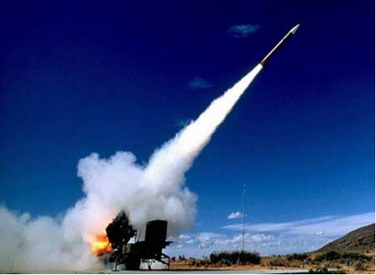
Real-Time Systems
Often used as a control device in a dedicated application
  controlling scientific experiments
  medical imaging systems
  industrial control systems
  some display systems.
Well-defined fixed-time constraints.
Real-Time systems may be either hard or soft real-time.

Slide 30
Real-Time Systems
Hard real-time
  Secondary storage limited or absent, data stored in memory, or read-only memory (ROM)
  Conflicts with time-sharing systems, not supported by general-purpose operating systems.
Soft real-time
  Limited utility in industrial control of robotics
  Useful in applications (multimedia, virtual reality,etc).

Slide 31
Operating-System Operations
OS must protect against :
Software error or request creates exception or trap
  Division by zero, request for operating system service
Other process problems
  infinite loop
  processes modifying each other or the operating system

Slide 32
Operating-System Operations (Cont.)
Dual-mode operation allows OS to protect itself and other system components
  User mode and kernel mode
  Mode bit provided by hardware
    Provides ability to distinguish when system is running user code or kernel code
    Some instructions designated as privileged, only executable in kernel mode
    System call changes mode to kernel, return from call resets it to user

Slide 33

Transition from User to Kernel Mode

Slide 34
End of Chapter 1
Thank You ！

