Slide 1
Problem Solving
Start from a beautiful question - Why….
Part 1: Identify Challenges/Pain Points/Issues
Review positive part of past
But, here are the problems/issues (data driven)
Look to the future, …
Conclude key questions
Part 2:
Provide holistic solutions – Killer Chart
Solution 1
Solution 2..
Part 3:
Take away message

Slide 2

Business Justification for XXXX Task
Name , Title, Date

Slide 3

1
Why we need this Commercialization Workshop?

Slide 4









































In Past Years we got significant growth in Local New Product Introduction
2-1
HV & MV
PSA & Tapes
IS
Residential Water
Lighting
Solar
Wind
Water Filtration
Electronic
Appl.
Transport
Data Center
Fine Chemicals
Floor Pad
Industrial Design
AAD Mechanical
Adhesives
Tapes
XX
XXX
XXX
XXX
XXX
XXX
Clean
Coating
Enclosure
Electrical Insulation
NVH
Abrasive
Hydrocolloid
Digital
Cogent Electronics Ass.
BAP
Wound Care
Fun.Coating
Digital Printing
Passive Welding
Tape & Dressing
Ster. Monitoring
Liquid Medical
Pavement Marking Tape
TTI
Floor Care
Matting

Slide 5
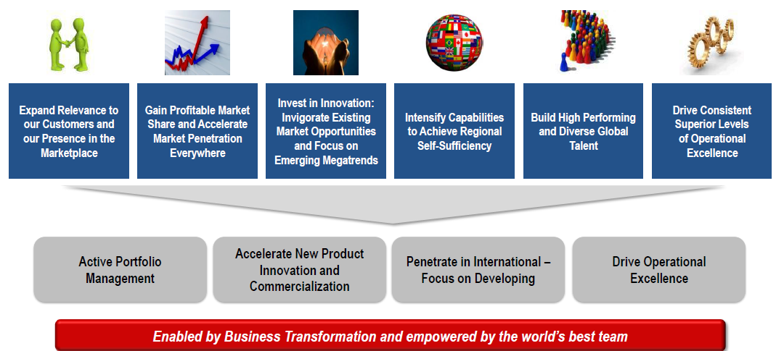
In Past Years we got significant growth in Local New Product Introduction
2-1

Slide 6
Review the past, issue 1: The “Long Tail” for Local NPI 2012 Local New Products Sales Study by Projects
2-2
Total 420 Local NPI Projects Delivered $529M Sales in 2012
55 Projects, each NPI sales < $10K
84 Projects, each NPI Sales $10K~100K
178 Projects, each NPI Sales $100K~1M
103 Projects, each NPI Sales >$1M
Bottom 139 Projects delivered $4.0M in 2012
Top 103 Projects delivered $510M in 2012
Bottom 101 Projects delivered $1.4M in 2012
Bottom 30% NPI just generated 0.5% Sales, however top 20% generate 80% Sales

Slide 7
Review the past, issue 2: Lower gross margin for NPI Overview of 2012 VS 2011 NPI GM%
2-2
2011
2012
-3.6
47.8%
47.6%
NPI GM%
45.1%
45.4%
43.9%
43.9%
43.4%
40.5%
Base Business
Total NPI
Local NPI
2 Yrs Local NPI
1.971
2.119
NPI Sales
941
760
465
529
141
182
Base Business
Total NPI
Local NPI
2 Yrs Local NPI
NP launched in the last 5 yrs are diluting our GM

Slide 8
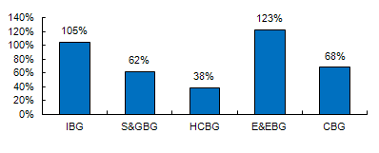
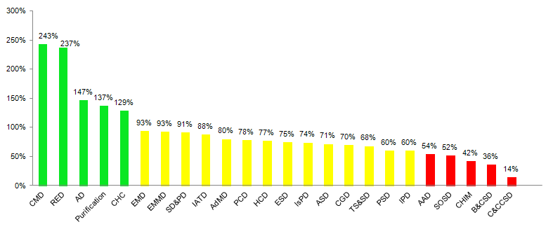
Review the past, issue 3: Lower Local NPI Attainment Local NPI Sales Attainment % = Actual NP Sales / Scale-up Sales FCST
2-2
NPI Sales Tracking: 2012 Y-T-Dec.
(Local NPI Projects Launched From 2011-1-1 To 2012-09-30)
Y-T-Dec.
Target: 100%
Y-T-Dec.
Target: 100%
20% Divisions’ NPI achieved 2012 sales plan for the products launched in the last 2 years

Slide 9
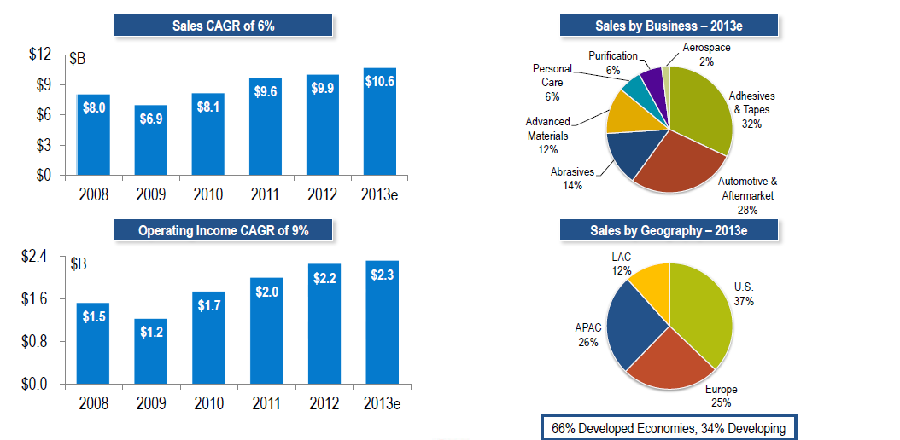
Look to the future , the expectation is high…
2-3

Slide 10
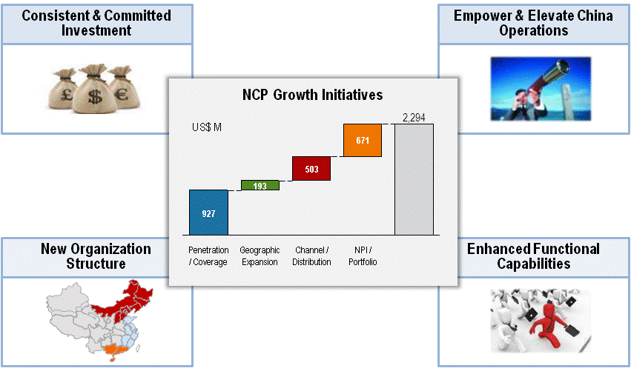
Look into the future, the expectation for Commercialization is very high
2-3
Notes:
10

Slide 11
Discussion points
2-4
What we commercialized , is relevant to our local market needs?
Are we effectively using the tool/process what we already have?
Is the issue that we are lack of resources, or that we are not working on the right projects?
Is “Commercialization” only for R&D or Marketing?

Slide 12
Commercialization Success Project Planning & Execution by 2013-8
3-1
Plan |  | Stop |  | Pending |  | Done
Phases | Milestone | WBS (Work Breakdown Structure) | Owner | 6/15 | 6/30 | 7/15 | 7/30 | 8/14 | 8/29 | 9/13 | 9/28 | 10/13 | 10/28 | 11/12 | 11/27 | 12/12 | 12/27
Phase I: Corporate Top NPI Projects | Identify Phase I Scope | Finalize Top NPI project list | Betty/LOC
 | Commercialization structure "From To" | Project Charter process | Kim/Leon/Vernon
 |  | Gate review process ( PM & gate keeper cheat sheet) | Kim/Leon/Vernon
 |  | Resources allocation process | Kim/Leon/Vernon
 |  | NPI Rating system/Criteria | Kim/Leon/Vernon
 |  | Finalize commercilaization structure | Kim/Leon/Vernon
 | Commcialization Training | NPI PM training | Kim/Leon/Vernon |  |  | material preparing
 |  | NPI gate keeper training | Kim/Leon/Vernon |  |  | material preparing
 | Prioritization Process | Lab overall NPI Prioritization process | Kim/Leon/Vernon
 | Practice new structure | Participate Top NPI gate review and Project management | Leon/Vernon
Phase II: Biz Group level Top NPI Projects | Finalize Group Top NPI | Division & Biz group level top NPI | Biz lab head
 | Commcialization Training | NPI Project leader training | Kim/Leon/Vernon
 |  | NPI gate keeper training | Kim/Leon/Vernon
 | Practice new structure | Participate new process for Biz group & Division top NPI | LOC /Leon/Vernon
Phase III: Replicate new process in whole lab | Communication | Department meeting | Stone/ Leon
 |  | Standard training package ,leverage website resources | Vernon
 | Yearly Prioritization Meeting | Setup NPI review meeting for divisions | Betty/LOC/Leon
Communication | Cross function communication | from LLT to Business group/ NPI level | Betty/LOC
 | R&D communication | From LOC to Division lab heads/ project leaders | Kim/Leon/Vernon

Slide 13
Objective for Commercialization Success Project
3-1
Commercialization Areas |  | From | To
People | Role & Responsibility | PM & Gatekeepers’ role & responsibility are not clear | To increase the understanding of the key ROLES of the PM and Gatekeepers
 | Capable FTE resources allocation | 1 FTE by shared by multiple small project | Dedicate Tech/Mkt/SC /PE FTE 1 key NPI be support by multiple FTEs
Program | Front End Innovation | Me – too, Lower margin Few Projects based on true local VOC | Local customer insight, Develop unique & profitable NPI
 | NPI Prioritization | Many small projects & lack of resources | Focused NPI with sharp scope Creating a funnel not tunnel
Process/ Model | Project Charter | All Project follow “fast track” | Kick-off review for NPI Fast track or full track as appropriate
 | Resources Allocation | Lack of Mfg/Mkt capability for NPI | Switch Mfg/Mkt resources to from LP to HP project development
 | Gate Review | Leadership Challenge | Brave gatekeeper Leadership Support
 | Project Execution & Communication | Commitment to NPI Execution is not strong | The innovative & Supportive environment Commitment to NPI Execution
“Success = Mindset X Passion X Ability”
Notes:
稻盛和夫 INAMORI KAZUO
http://baike.baidu.com/view/1892988.htm

Slide 14

Process Update: NPI Prioritization Approach / Methodology NPI Prioritization meeting for top 15 divisions
3-2
Division first cut
NCP alignment
Resources
Mkt potential
Prioritization criteria define by business
RWW discussion to prioritize
3 NPI buckets
Prioritization outcome & Resource Plan
Prioritize/Reallocate/Leverage
Group 1:
Pre NPI + Idea
Incubation: 60
Top NPIs
Group 2:
Concept , Feasibility, Development
Accelerate: 139
Group 3:
Scale up, Launch
On the shelf: 248
486
331
199

Slide 15
People & Program: Commercialization Manager & Dedicated NPI Mkt Assignment
3-2
Biz Group | Commercialization Manager | Project | Status, Project Phase | Marketers

Slide 16
Dedicated New Product Marketer
3-3
Marketing Operations
Business Unit Planning
Sales Connections
SC/Inventory/SVOP Planning
Pricing
Key Accounts
Vendor Relationships
COGS Improvement
SKU Rationalization
Etc etc etc etc
Plus New Product Marketing
Dedicated New Product Marketing
Drive NPI Programs through commercialization
Front End Innovation
Consumer Insights
Competitive intelligence
Marketing Deliverables at each NPI Phase
Launch Package for New Products Introduction
Etc
You will find more through Market Excellence Team

Slide 17
Take Away
4-1
Start CM with a holistic thinking (4”P”s: People, Process, Program, Place)
Deep dive in Customer insight (listen, observe & interact with customer, decision making)
Leverage what is available (internal: local & global, external: social media, customer, supplier, competitors, etc.)
Focus on General Management & Value creation for customer

Slide 18


Slide 19
Template for each Slide

Slide 20
Agenda

Slide 21
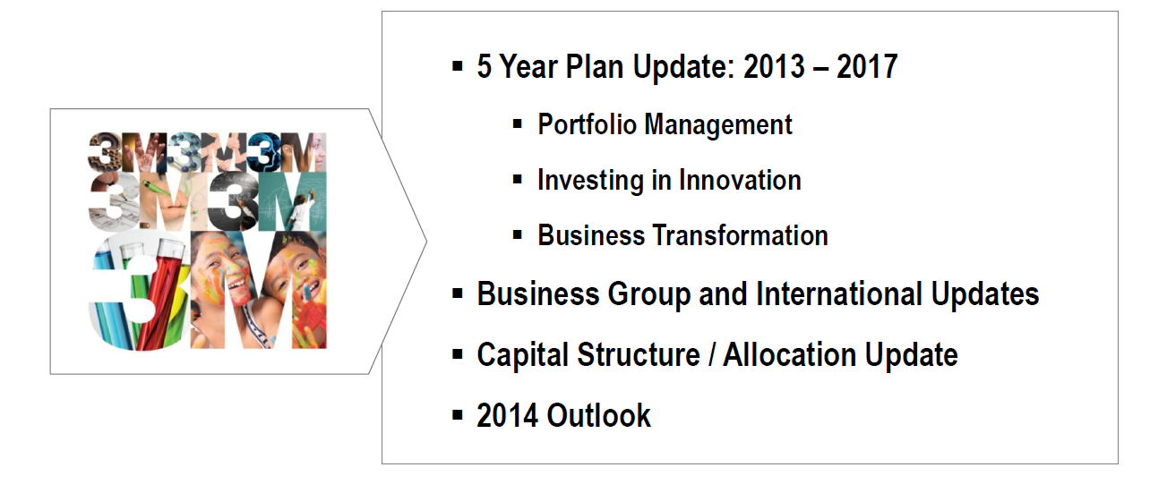
Today’s Agenda
Vision

Slide 22

XXX Business Group Division Overview

Slide 23

From To

Slide 24
Business delivers solid revenue and earnings growth

Slide 25
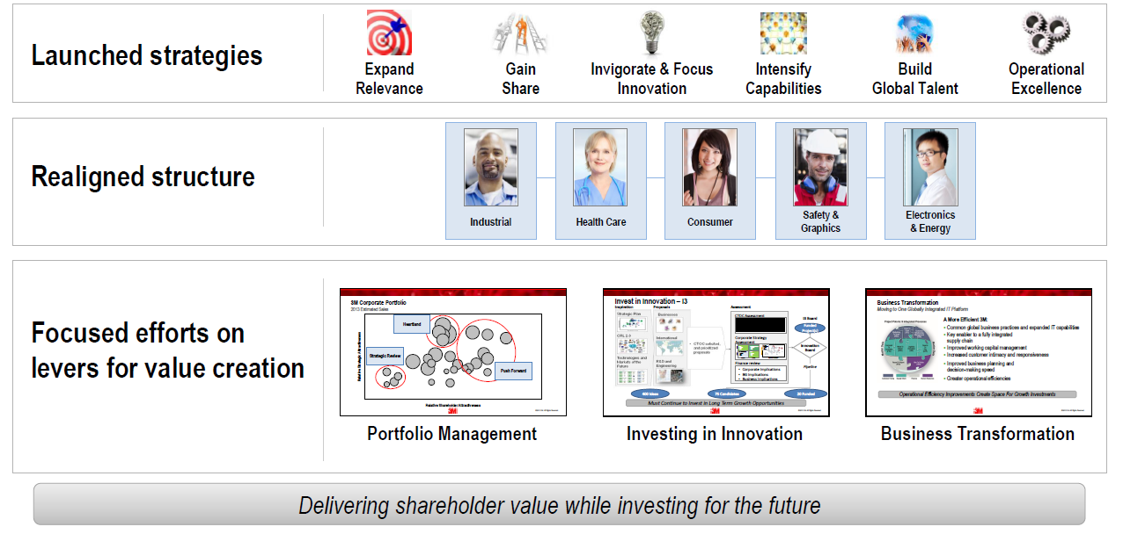
Much has been accomplished in the past 18 months

