Slide 1
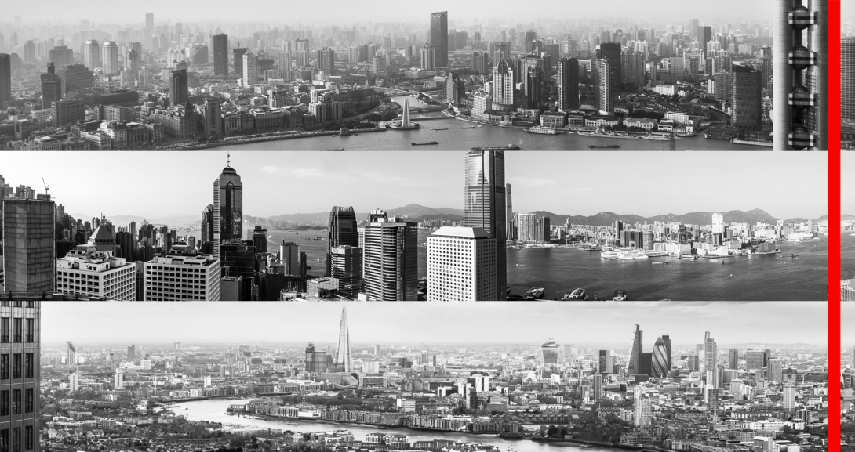
30 September 2014
Establishing HSBC as the Leading International Bank
BoAML Conference
Iain Mackay – Group Finance Director

Slide 2
Forward-looking statements
This presentation and subsequent discussion may contain certain forward-looking statements with
respect to the financial condition, results of operations, capital position and business of the Group.
These forward-looking statements represent the Group’s expectations or beliefs concerning future
events and involve known and unknown risks and uncertainty that could cause actual results,
performance or events to differ materially from those expressed or implied in such statements.
Additional detailed information concerning important factors that could cause actual results to differ
materially is available in our 2013 Annual Report and Accounts and our 2014 Interim Report. Past
performance cannot be relied on as a guide to future performance.
This presentation contains non-GAAP financial information. Reconciliation of non-GAAP financial
measures to the most directly comparable measures under GAAP are provided in the ‘reconciliations
of non-GAAP financial measures’ supplement available at www.hsbc.com.
2

Slide 3
Agenda
1
2
3
HSBC today
Transformation 2011-13 and drivers of growth
Strategic priorities and outlook
3

Slide 4
1. HSBC today
HSBC today
Who we are1
Performance (Reported basis)
Countries and territories
Customers
74
52m
PBT,
USDbn
19.0
21.9
20.6
22.6
7.1
12.3
Employees
Shareholders
Market performance
Market capitalisation1
Dividend payout ratio2
Ordinary dividends3
Source: HSBC 2013 annual report and 1H14 interim report
1.
As at 30 June 2014
2.
FY2013
256,000
216,000 in
129 countries
and territories
USD193bn
57.1%
USD9.2bn
In 1H14 Core
tier 1 ratio
replaced by
Common
equity tier 1
ratio
Core tier
1 ratio, %
Cost
efficiency
ratio, %
ROE, %
12.3
62.8
8.4
2012
13.6
59.6
9.2
2013
9.4
52.0
5.1
2009
10.5
55.2
9.5
2010
10.1
57.5
10.9
2011
11.34
58.6
N/A
1H14
3.
4.
Ordinary dividends declared in respect of the year 2013
On 1 January 2014, CRD IV came into force. Capital and RWAs at 30 June 2014 are calculated and presented on this (end point) basis
4

Slide 5
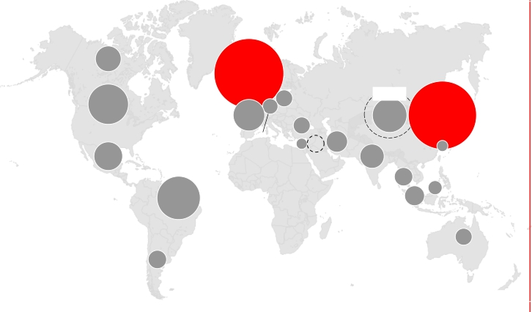
1. HSBC today
Balanced global universal banking model with presence in
key countries and territories
✓✓
✓
Home and priority growth markets
Network markets
Balanced presence across the world
Top 15 countries by Nominal GDP2
2013 Revenue1
Share of revenue from Associates
CAGR
2013-25
%
HSBC
Presence
2025
USDtrn
✓
✓
China
US
30.4
28.5
10.4
4.5
Universal
Universal
Canada
Mexico
✓
✓
✓
✓
✓
India
Japan
Germany
UK
Brazil
8.6
6.5
5.6
4.9
4.6
13.2
2.4
3.6
5.6
6.1
Universal
Wholesale
Wholesale
Universal
Universal
US3
Germany
Turkey
Saudi
China
UAE
India
UK
France
Switzerland
Egypt
Hong Kong
Taiwan
Arabia
Malaysia
✓
France
4.5
3.9
Universal
Brazil
Indonesia
✓
Russia
4.2
6.0
Wholesale
Singapore
✓
Italy
3.0
3.2
Wholesale
Australia
✓
Canada
2.8
3.8
Universal
Argentina
Presence in 74 countries and territories,
with 21 Priority markets of which 2 are Home markets
✓
✓
✓
✓
Mexico
Indonesia
Australia
S. Korea
2.7
2.5
2.5
2.4
6.4
9.3
4.2
5.3
Universal
Universal
Universal
Wholesale
1.
2.
3.
Reported basis. Red circles denote Home markets
Source: Global Insights
US ex. US run-off portfolio (USD1,672m)
5

Slide 6
1. HSBC today
Unrivalled network to support global trade and capital flows
HSBC network coverage1 (USDtrn)
2013
HSBC is present in all the major trade corridors
CAGR
2013-2020 %
2020 trade growth forecasts3 (USDbn)
Strong
presence
74
11%
19
13%
1.4
14%
Mainland China - Hong Kong
Japan - USA
1,363
1,316
12
7
✓
✓
Rest of world/
other markets2
Mainland China - USA
Canada - USA
Mexico - USA
968
910
866
10
5
8
✓
✓
✓
Network and
small markets
23%
27%
30%
Mainland China - Korea
Hong Kong - Japan
Mainland China - Japan
France - Germany
Australia - China
Mainland China - Germany
Canada - Japan
Mainland China - Singapore
Mainland China - Vietnam
India - UAE
552
289
265
244
238
232
207
188
186
181
13
11
10
1
10
8
4
11
17
13
✓
✓
✓
✓
✓
✓
✓
✓
✓
✓
Home and
priority markets
66%
Nominal
GDP
56%
FDI
flows4
60%
Trade
Source: Global Insights, UNCTAD
Notes: Trade is measured as total merchandise exports; FDI is measured as FDI outflows
1.
Home, priority, network and small markets
2.
Includes representative offices and non-strategic markets
2013
2013-2020 growth
✓
Priority markets on both sides
✓
Priority market on one side
3.
4.
Exports and imports (Source: HSBC and Oxford Economics analysis)
Foreign Direct Investment (“FDI”)
6

Slide 7
Agenda
1
2
3
HSBC today
Transformation 2011-13 and drivers of growth
Strategic priorities and outlook
7

Slide 8
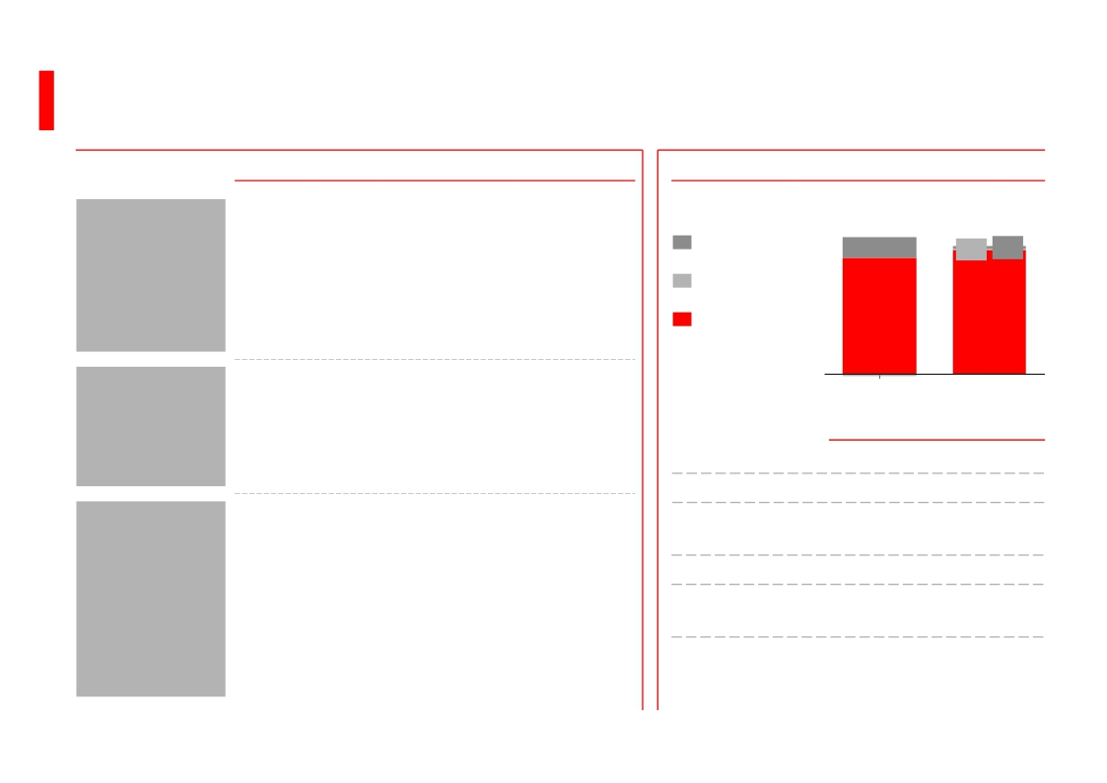
2. Transformation 2011-13 and drivers of growth
2011-13: Created a stronger bank with platform for growth
Achievements 2011-13
Achievements 2011-13
Key financials1 2010-13
▪ Re-defined the strategic core of HSBC
▪ 742 disposals/exits announced since 2011
▪ Running down Legacy portfolios
▪ Introduction of Global Standards and
subsequent progress in de-risking the
business
▪ Transformed the way we manage the business
as a global bank in 4 Global Businesses and
11 Global Functions
▪ USD4.9bn annualised sustainable savings
from 2011 to 2013
▪ Grown Global Business revenue3; CMB (7%
CAGR4), GBM excluding legacy credit (2%)
and Principal RBWM (3%)
▪ Achieved double digit gross loan growth in 13
out of 21 home and priority markets
▪ Leveraging the international network to
improve our market position in strategic
products
Revenue,
USDbn
Underlying
adjustments
Significant
items
Global
Business
revenue3
PBT, USDbn
CER, %
Core tier 1
Ratio, %
ROE, %
Shareholders’
equity, USDbn
Dividend in
respect of
year, USDbn
68.2
10.4
58.9
(1.1)
2010
19.0
55.2
10.5
9.5
148
6.3
64.6
0.6 1.4
62.7
2013
22.6
59.6
13.6
9.2
182
9.2
Re-focused
the business
Simplified and
globalised the
organisation
Grown Global
Business
revenue
1.
2.
3.
4.
Reported basis unless otherwise stated
74 disposals/exits were announced 2011-1H14. Out of these, 62 disposals/exits were announced 2011-13
Global Business reported revenue excluding underlying adjustments and significant items
Compound Annual Growth Rate (“CAGR”) calculated from FY2010 to FY2013
8

Slide 9
2. Transformation 2011-13 and drivers of growth
Resilient revenues in challenging environment and disposals; growth in
Global Businesses
Resilient revenues
Growth in Global Business revenue1
USDbn
Reported revenue
Significant items
Fed funds rate
2013 vs. 2010, USDbn
Underlying adjustments
Global Business revenue1
BoE interest rate
CAGR %
better/(worse)
6%
5%
4%
3%
2%
1%
0%
79.0
2007
81.7
2008
Principal
RBWM
RBWM US
run-off
portfolio
CMB
GBM excluding
legacy credit
Legacy credit
72.3
14.5
58.9
(1.1)
2011
1.9
2.9
1.3
3%
(16%)
7%
2%
(44%)
65.4
2006
66.2
2009
68.2
10.4
58.9
(1.1)
2010
68.3
6.8
61.6
2012
64.6
1.4
62.7
2013
57.6
2005
0.6
(1.4)
(0.7)
Major regulatory changes since 2010
▪ Basel III framework being implemented (2010, 2013)
▪ Dodd Frank: derivative clearing and CCP (2010)
▪ Volcker rule: separation of proprietary trading (2010)
GPB
(0.3)
(4%)
▪ FSB proposing G-SIB banks to hold loss absorbing capacity (2010)
▪ FATCA: global rollout of financial/tax treatment of US persons (2010)
▪ UK ring-fencing (2011)
Total
3.8
2%
Note: 74 disposals/exits were announced 2011-1H14. Out of these 62 disposals/exits were announced 2011-13
1 Global Business reported revenue excluding underlying adjustments and significant items
9

Slide 10
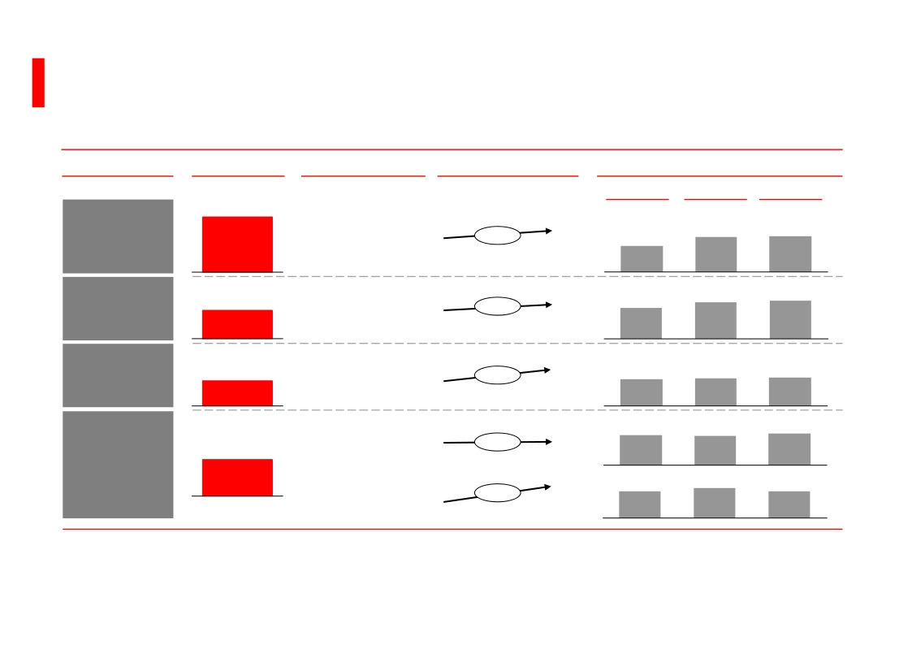
2. Transformation 2011-13 and drivers of growth
Leveraging the international network and HSBC client franchise to
improve our market position in strategic products
Key products of international and business connectivity (selected examples)
Products1
2013 Revenue
Measure
Market growth, CAGR % HSBC’s market share, %
USDbn
7.1
2011-13
2011
2012
2013
Payments
& Cash
Management2
Global Trade
& Receivables
Finance3
Foreign
Exchange4
Capital
Financing5
Payments messages
volume
Merchandise
exports volume
Average daily
volume
International Bonds
Offshore CNY
bonds
10.7
13.1
6.9
5.3
24.2
10.9
13.6
7.1
5.7
21.7
+8%
+2%
+11%
+1%
+36%
8.0
11.1
6.7
5.4
21.8
3.7
3.2
4.0
1.
2.
3.
4.
5.
Key products that directly benefit from the international spread of our global network. Product revenues are as disclosed in the Annual Report 2013 and include both domestic and international elements of the business
Revenue includes Commercial Bank current accounts, savings deposits and PCM embedded foreign exchange revenues; Market volume and share: Swift
Revenue includes Commercial Bank GTRF embedded foreign exchange revenues. Market volume: UNCTAD; Market share of Traditional Trade Finance (includes shadow income from foreign exchange and revenue from
associates): Oliver Wyman analysis / estimates
Revenue contributed from GBM; Market volume: Bank for International Settlements (BIS). CAGR is from 2010-13 as BIS publishes data every 3 years. Market share: Euromoney Global FX Survey; 2013 market share is based on
survey results in May 2014 done for 2013 and similar for previous years
Market volume and share: Bloomberg League table
10

Slide 11
2. Transformation 2011-13 and drivers of growth
Added Shareholders’ equity of c.USD34bn and declared dividends of
c.USD25bn over last three years
Ordinary Shareholders’ equity1
USDbn
Total gross ordinary dividends declared in respect of the year
USDbn
183
9.2
175
8.3
7.3
In 2011-13 HSBC has
been
▪ #2 dividend payer2
in FTSE 100
▪ #5 dividend payer2
6.3
34
35
140
in Hang Seng index
HSBC would be #3
dividend payer2 in
comparison to the
S&P500
2010
Increase
2013
1H14
2010
2011
2012
2013
Shareholders’
equity under
Tier 1 capital4,
USDbn
143
173
Payout
Ratio3 %
Dividend
Yield5,%
47
3.5
42
5.4
55
4.3
57
4.5
Source: 2010, 2011, 2012, 2013 Annual Reports; 1H14 Interim Results
1.
2.
3.
4.
5.
Shareholders’ equity excluding preference share premium and other equity instruments.
Based on sum of total dividends declared and paid to common shareholders in respect of the year from 2011-13; Source: FactSet
Reported payout ratio. Dividends per share declared in a year expressed as a percentage of basic earnings per share
Shareholders’ equity excluding preference share premium, other equity instruments, deconsolidation of special purpose entities
Based on reported dividend per share in respect of the year as a percentage of closing price on annual year end date; Source: Bloomberg
11

Slide 12
Agenda
1
2
3
HSBC today
Transformation 2011-13 and drivers of growth
Strategic priorities and outlook
12

Slide 13
3. Strategic priorities and outlook
2014-16: Three equally weighted priorities
Actions and priorities
▪ Continue to recycle RWAs from low
into high performing businesses within
the Group’s risk appetite
▪ Capitalise on global network and
strengthen position in priority growth
markets
▪ Continue to invest in best-in-class
Compliance and Risk capabilities
▪ De-risk operations and/or improve risk
management in higher risk locations
and businesses
▪ HSBC values – act with courageous
integrity
▪ Re-design key processes and
procedures achieving improvements in
service, quality, cost and risk
▪ Release costs to provide headroom to
invest in growth and Global Standards
By 2016
▪ Return HSBC to revenue growth capitalising on
our unique global footprint (“always where the
growth is”)
▪ Progressively grow dividends and introduce
share buy-backs1 as appropriate
▪ Legacy and non-strategic activities reduced
impact on PBT and RWAs
▪ Significant progress in implementation of
Global Standards2
▪ Establish Global Standards as competitive
advantage and increase quality of earnings
▪ Achieve USD2-3bn additional cost reductions
from 2014 to 2016
▪ Achieve Group CER target of mid 50s
▪ Achieve positive jaws
Grow both
business and
dividends
Implement
Global
Standards
Streamline
processes and
procedures
1.
2.
Subject to meeting United Kingdom regulatory capital requirements and shareholder approval
Conditional on regulatory environment
13

Slide 14
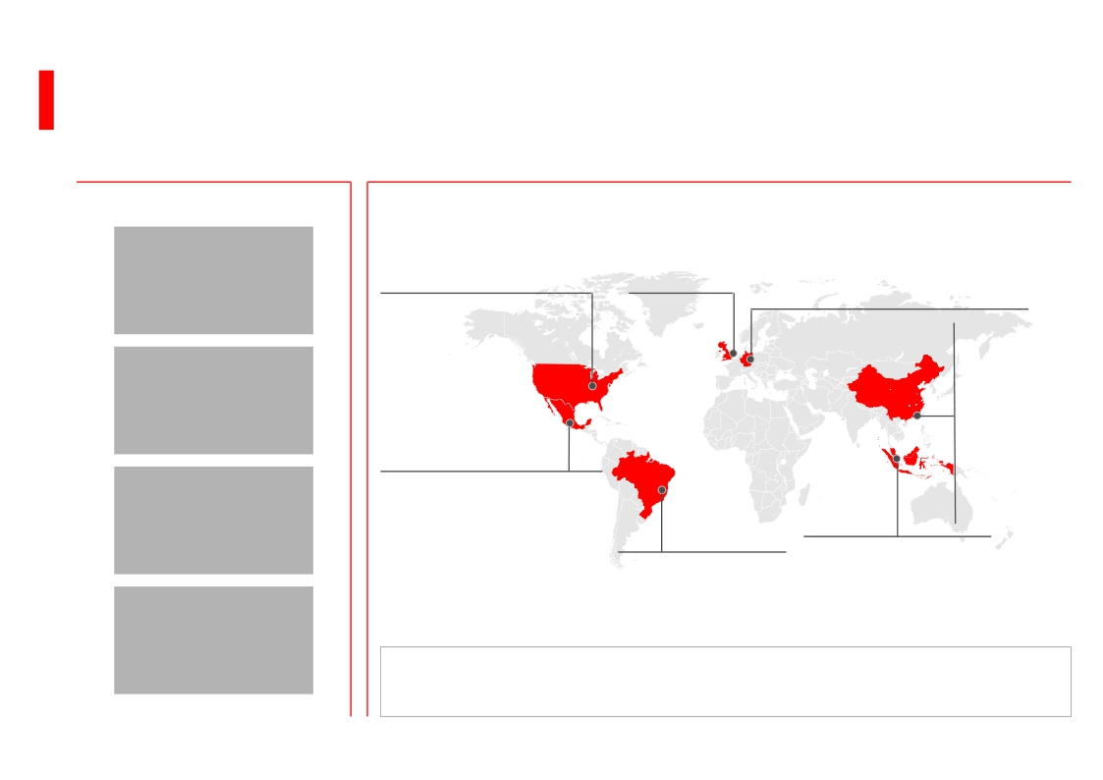
3. Strategic priorities and outlook
Investment priorities to capture areas of growth, building on our
global footprint
Global connectivity and products
Capitalise on unrivalled
global position
Global Trade &
Receivables Finance
Payments & Cash
Management
Foreign Exchange
Geographic priorities
US
Transformation and
targeted expansion of CMB
network in city clusters
Mexico
De-risking progressing;
Investing to increase
UK
Strengthen
home market
position
v
Germany
Build-out corporate franchise
through improved client coverage
and financing products; capture
greater share of key trade corridors
China
Continue
investments in
organic growth;
expand HK
home market
leadership into
Guangdong/
Pearl River
Delta
productivity and leverage
inter-national capabilities, in
particular NAFTA and LAM
connectivity
Cities focus
ASEAN
Develop ASEAN cluster
to support integration
and connectivity with
global HSBC network
Brazil
Leverage scale and
optimise business mix;
optimise cost base
RMB
▪ Invest in city clusters with fast-growing international revenue pools
▪ Align global resources to priority city clusters
14

Slide 15
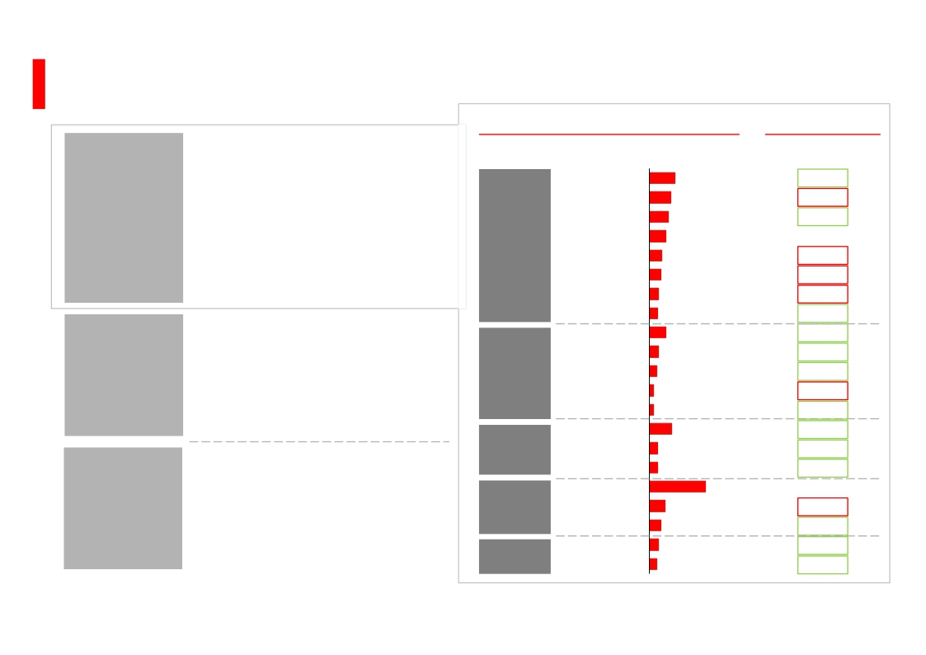
3. Strategic priorities and outlook
External influences
Nominal GDP growth1
2013-14, %
India
Composite PMI2
August 2014
51.6
▪ Strong economic growth prospects, in
particular in home markets; UK
continues its strong economic
13.2
Macro
economic
environment
Regulation
Interest rate
recovery
recovery, HK to benefit from China’s
regain in momentum
▪ Recovery of World and China
composite PMI since 1Q20142
▪ Ongoing uncertainty regarding HSBC
Group capital requirements
▪ Fundamental structural changes
through ringfencing in the UK and
similar efforts in other jurisdictions
▪ Possible increase in interest rates, in
particular USD and GBP from 2015
Indonesia
China
Malaysia
HK
Singapore
Australia
Taiwan
Turkey
UK
Germany
France
Switzerland
Egypt
UAE
Saudi Arabia
Argentina
Brazil
Mexico
Canada
US
11.4
9.8
8.6
6.6
6.1
4.8
4.4
8.6
4.8
3.8
2.0
2.0
11.5
4.5
4.4
8.1
6.0
4.7
3.8
49.53
52.8
n/a
49.6
49.73
47.33
56.13
50.33
59.3
53.7
49.5
52.93
51.6
58.4
60.7
n/a
49.6
52.13
54.83
59.7
Asia
Europe
MENA
Latin
America
North
America
29.3
1.
2.
3.
Based on nominal GDP in local currency. Source: Oxford Economics June 2014
Source: Markit Economics
Manufacturing PMI
15

Slide 16
Summary
HSBC – Unrivalled global position and platform for growth
▪ A leading international bank with presence in 74 countries and territories
▪ Unique international platform
HSBC today
Transformation
2011-13 and
drivers of
growth
2014-16:
Strategic
priorities
– Distinctive network covering over 85% of international trade and capital flows1
– Strong presence in most attractive growth markets
▪ Strong capital position and resilient results
▪ Transformed the organisation to a leaner bank with platform for growth
– Clear strategic direction leading to 74 disposals2
– Leaner organisation managed as global entity
– Recovered significant part of revenues sold in disposals through organic growth
▪ Generated USD34bn of capital3 and USD25bn of dividends4
▪ Grow business and dividends: Investing to capitalise on our global platform to
deliver growth
▪ Implement global standards as competitive advantage and increase quality of
earnings
▪ Further streamline the organisation to fund growth and investments in global
standards
1.
2.
3.
4.
Based on HSBC analysis on Global Insights and UNCTAD data
74 disposals/exits were announced 2011-1H14. Out of these 62 disposals/exits were announced 2011-13
Capital generation calculated from profits attributable to shareholders of the parent company after regulatory adjustment for own credit spread and net of dividends, for the period
31 December 2010 to 31 December 2013
Ordinary dividends declared in respect of 2011, 2012 and 2013
16

Slide 17

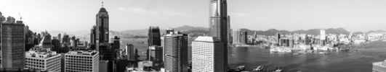

The view from HSBC Building, 8 Century Avenue, Pudong, Shanghai
The view from HSBC Main Building, 1 Queen’s Road Central, Hong Kong SAR
The view from HSBC Group Head Office, 8 Canada Square, London
Cover images: internationalisation of the renminbi
The images show the views from HSBC’s head offices in Shanghai, Hong Kong and
London – the three cities that are key to the development of China’s currency, the
renminbi (RMB). The growth of the RMB is set to be a defining theme of the 21st
century. HSBC has RMB capabilities in over 50 countries and territories worldwide,
where our customers can count on an expert service.
Photography: Matthew Mawson
Cover designed by Creative Conduct Ltd, London. 01/14
Issued by HSBC Holdings plc
Group Investor Relations
8 Canada Square
London E14 5HQ
United Kingdom
Telephone: 44 020 7991 8041
www.hsbc.com
17

