Slide 1

Financial Results for the Nine Months
Ended December 31, 2014
February 6, 2015

Slide 2


The forward-looking statements and projected figures concerning the future performance of NTT
and its subsidiaries and affiliates contained or referred to herein are based on a series of
assumptions, projections, estimates, judgments and beliefs of the management of NTT in light of
information currently available to it regarding NTT and its subsidiaries and affiliates, the economy
and telecommunications industry in Japan and overseas, and other factors. These projections
and estimates may be affected by the future business operations of NTT and its subsidiaries and
affiliates, the state of the economy in Japan and abroad, possible fluctuations in the securities
markets, the pricing of services, the effects of competition, the performance of new products,
services and new businesses, changes to laws and regulations affecting the telecommunications
industry in Japan and elsewhere, other changes in circumstances that could cause actual results
to differ materially from the forecasts contained or referred to herein, as well as other risks
included in NTT’s most recent Annual Report on Form 20-F and other filings and submissions
with the United States Securities and Exchange Commission.
*
**
***
“E” in this material represents that the figure is a plan or projection for operation.
“FY” in this material indicates the fiscal year ending March 31 of the succeeding year.
“3Q” in this material represents the 9-month period beginning on April 1 and ending on December 31.
Financial Results for the Nine Months Ended December 31, 2014
－1－
Copyright (c) 2015 Nippon Telegraph and Telephone Corporation

Slide 3
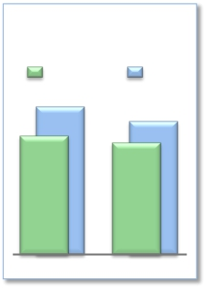
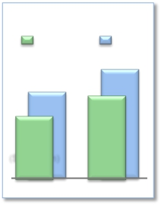
FY2014/3Q Highlights
Consolidated
Operating Income
(Billions of yen)
Operating Revenues increased for the fifth consecutive year
3Q
1,213.7
985.1
FY2013
FY
1,095.0
[forecast]
910.9
FY2014
Expansion of global cloud services
➢Overseas sales: + ¥288.1 billion increase year-on-year; steadily progressing toward
its annual target of $15.0 billion
➢Cross-selling order volume: approximately $146 million
Enhanced competitiveness of network services
➢Expansion of NTT’s user base
Global Revenues
· 13.54 million new rate plan subscribers
(Billions of yen)
FY
1,530.0
($15.0 billion)
[forecast]
1,149.1
($11.2 billion)
FY2014
· 65.27 million mobile phone subscribers (net increase of 2.17 million)
· 18.62 million FLET’S Hikari subscribers (net increase of 0.57 million)
· 4.28 million Hikari TV and FLET’S TV subscribers (net increase of 0.29 million)
➢Cost reductions
· Fixed-line and mobile access cost reductions: NTT achieved cost reductions of ¥154.0
billion during FY2014/3Q, out of its annual target of ¥190.0 billion
Shareholder Returns
➢Completed ¥256.6 billion of share buybacks (mainly from the Japanese government),
out of up to ¥350.0 billion in repurchases by the end of FY2015/1Q
3Q
1,196.0
($12.2 billion)
861.0
($8.9 billion)
FY2013
Financial Results for the Nine Months Ended December 31, 2014
－2－
Copyright (c) 2015 Nippon Telegraph and Telephone Corporation

Slide 4

FY2014/3Q Highlights
Operating Revenues increased for the fifth consecutive year due to the growth of
overseas businesses.
Operating Income decreased but was in line with expectations.
(Billions of yen)
FY2014/3Q
Change
year-on-year
+157.3
+231.5
(74.2)
(34.4)
% progress
compared to
FY2014
Forecasts
74.3%
73.3%
83.2%
85.1%
FY2013/3Q
8,025.2
7,040.1
985.1
484.3
FY2014
Forecasts
11,010.0
9,915.0
1,095.0
529.0
% Year-on-Year
Increase
(Decrease)
+2.0%
+3.3%
(7.5)%
(7.1)%
Operating
Revenues
Operating
Expenses
Operating
Income
*Net Income
8,182.5
7,271.6
910.9
449.9
*
Net income represents net income attributable to NTT, excluding noncontrolling interests.
Financial Results for the Nine Months Ended December 31, 2014
－3－
Copyright (c) 2015 Nippon Telegraph and Telephone Corporation

Slide 5
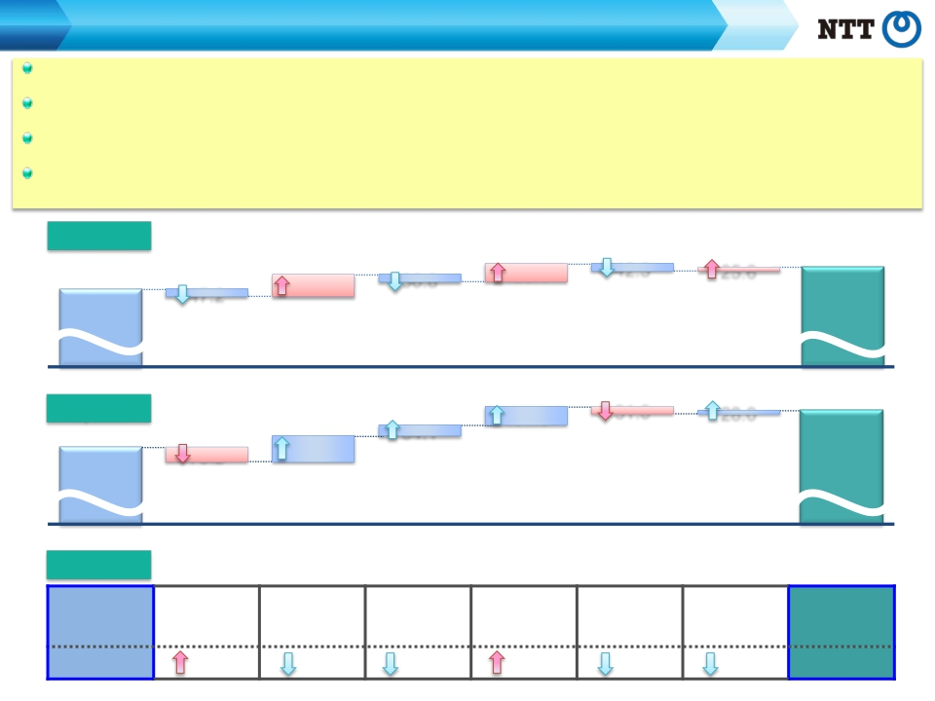
Consolidated Results and Forecasts (U.S. GAAP)
FY2014/3Q Contributing Factors by Segment
Regional communications business: Operating Income increased as a result of vastly improved operational efficiency as well as the reduction of
marketing costs.
Long distance and international communication business: Although intensifying domestic competition led to a decrease in Operating Income, overseas
businesses experienced steady growth.
Mobile communications business: Operating Revenues decreased due to the increased impact of “Monthly Support” discount programs and the effect
of new rate plans, which also resulted in a decrease in Operating Income.
Data communications business: Operating Income increased due to an improvement in gross margin in conjunction with an increase in sales, in
addition to a reduction in unprofitable transactions.
Operating
Revenues
[year-on-year：+157.3]
Mobile
communications
business
Data
communications
business
Other
business
(Billions of yen)
36.8
123.4
42.3
25.6
Elimination of
intersegment/Others
47.2
Regional
communications
business
134.7
Long distance and
international
communications
business
8,025.2
FY2013/3Q
8,182.5
FY2014/3Q
Operating
Expenses
7,040.1
FY2013/3Q
Operating
Income
FY2013/3Q
[year-on-year：+231.5]
147.1
Long distance and
communications
business
[year-on-year： (74.2)]
Regional
Long distance and
international
communications
communications
business
business
101.5
Data
communications
business
Data
communications
business
31.0
Other
business
Other business
28.0
Elimination of
intersegment/Others
Elimination of
intersegment/
Others
64.1
Mobile
communications
business
Mobile
communications
business
78.2
7,271.6
FY2014/3Q
FY2014/3Q
Regional
international
business
communications
985.1
31.0
12.5
100.9
21.9
11.3
2.4
910.9
Financial Results for the Nine Months Ended December 31, 2014
－4－
Copyright (c) 2015 Nippon Telegraph and Telephone Corporation

Slide 6


Progress of Broadband Services

Slide 7
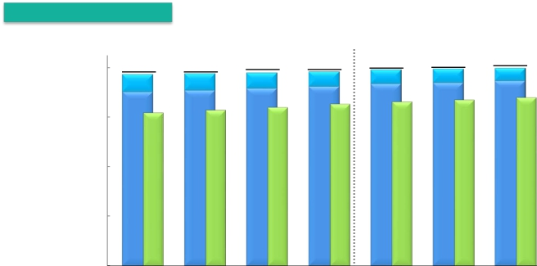



Progress of Broadband Services
Number of Subscribers for Fixed Broadband Services
Number of subscribers
FLET’S ADSL
FLET’S Hikari
(Thousands)
20,000
15,000
10,000
5,000
0
19,788
1,333
18,455
16,705
2014.9
19,892
1,275
18,617
16,910
2014.12
Hikari Denwa
19,271
1,751
17,521
15,412
2013.6
19,335
1,663
17,672
15,664
2013.9
19,444
1,572
17,873
15,950
2013.12
19,534
1,483
18,050
16,256
2014.3
19,717
1,398
18,319
16,507
2014.6
19,954
1,203
18,750
17,106
2015.3E
Changes from the preceding quarter
FY2013
10-12
FY2014
10-12
(Thousands)
FY2014E
4-6
7-9
1-3
4-6
7-9
4-12
FY2013
FLET’S Hikari
*1
220
152
200
178
269
136
162
567
750
700
Number of
opened
connections
FLET’S ADSL
*3
Hikari Denwa
870
(98)
242
707
(88)
252
743
(91)
287
811
(89)
305
879
(85)
251
683
(65)
199
684
(58)
204
2,246
(208)
654
3,131
(365)
1,087
3,000
(280)
850
*
2
*
1 Number of FLET’S Hikari subscribers includes B FLET’S, FLET’S Hikari Next, FLET’S Hikari Light and FLET’S Hikari WiFi Access provided by NTT East and B FLET’S,
FLET’S Hikari Premium, FLET’S Hikari Mytown, FLET’S Hikari Next, FLET’S Hikari Light and FLET’S Hikari WiFi Access provided by NTT West.
* 2 Number of opened connections excludes openings due to relocations.
*
3 Number of Hikari Denwa subscribers is presented in thousands of channels.
Financial Results for the Nine Months Ended December 31, 2014
－5－
Copyright (c) 2015 Nippon Telegraph and Telephone Corporation

Slide 8


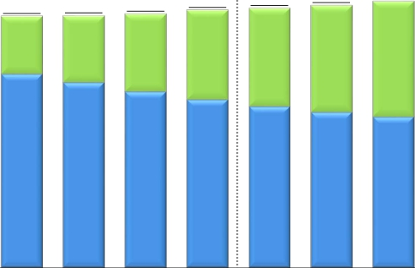


Progress of Broadband Services
Number of Subscribers for Mobile Broadband Services
*
Number of subscribers
(Thousands)
Xi
FOMA
70,000
60,000
50,000
40,000
30,000
20,000
10,000
0
65,274
28,298
36,976
2014.12
61,623
14,198
47,425
2013.6
61,772
16,398
45,374
2013.9
62,182
19,021
43,160
2013.12
63,105
21,965
41,140
2014.3
63,566
24,043
39,523
2014.6
64,295
26,215
38,080
2014.9
67,000
29,700
37,300
2015.3E
Changes from the preceding quarter
FY2013
10-12
FY2014
10-12
(Thousands)
FY2014E
4-6
7-9
1-3
4-6
7-9
4-12
FY2013
Xi+FOMA
87
149
410
924
461
729
979
2,169
1,569
3,900
*
The number of communication module service subscribers is included in mobile broadband subscribers.
Financial Results for the Nine Months Ended December 31, 2014
－6－
Copyright (c) 2015 Nippon Telegraph and Telephone Corporation

Slide 9



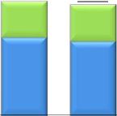



Progress of Broadband Services
*
ARPU of Fixed Broadband Services (FLET’S Hikari)
NTT East
(Yen)
Optional Service
Basic Monthly Charge
6,000
4,000
2,000
0
NTT West
(Yen)
6,000
4,000
2,000
0
5,750
1,760
3,990
4-6
5,840
1,770
4,070
4-6
5,680
1,760
3,920
7-9
5,850
1,790
4,060
7-9
5,650
1,790
3,860
FY2013
10-12
5,850
1,820
4,030
FY2013
10-12
5,570
1,770
3,800
1-3
5,800
1,810
3,990
1-3
5,460
1,770
3,690
4-6
5,750
1,810
3,940
4-6
5,450
1,750
3,700
FY2014
7-9
5,700
1,800
3,900
FY2014
7-9
5,490
1,760
3,730
10-12
5,670
1,800
3,870
10-12
5,660
1,770
3,890
FY2013
5,830
1,800
4,030
FY2013
5,500
1,800
3,700
FY2014E
5,720
1,830
3,890
FY2014E
*
FLET’S Hikari includes B FLET’S, FLET’S Hikari Next, FLET’S Hikari Light and FLET’S Hikari WiFi Access provided by NTT East and B FLET’S, FLET’S Hikari Premium,
FLET’S Hikari Mytown, FLET’S Hikari Next, FLET’S Hikari Light and FLET’S Hikari WiFi Access provided by NTT West. Please see page 22 regarding the calculation of ARPU.
Financial Results for the Nine Months Ended December 31, 2014
－7－
Copyright (c) 2015 Nippon Telegraph and Telephone Corporation

Slide 10
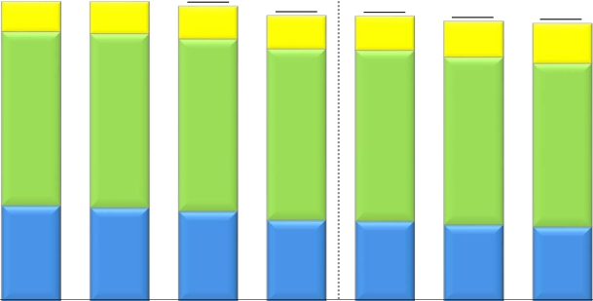

Progress of Broadband Services
ARPU of Mobile Broadband Services (Xi, FOMA)*
Smart ARPU
Packet ARPU
Voice ARPU
(Yen)
5,000
4,000
3,000
2,000
1,000
0
4,680
470
2,720
1,490
4,680
500
2,720
1,460
4,610
510
2,700
1,400
4,460
520
2,680
1,260
4,610
500
2,700
1,410
4,450
530
2,670
1,250
4,370
560
2,620
1,190
4,340
620
2,560
1,160
4,350
570
2,600
1,180
FY2013
10-12
FY2014
7-9
FY2013
FY2014E
4-6
7-9
1-3
4-6
10-12
* NTT DOCOMO’s ARPU calculation methods have been changed from the second quarter of the fiscal year ending March 31, 2015. Accordingly, the ARPU data for the
results for the three months ended Jun. 30, 2013 (from Apr. to Jun., 2013), the three months ended Sep. 30, 2013 (from Jul. to Sep., 2013), the three months ended Dec. 31,
2013 (from Oct. to Dec., 2013), the three months ended Mar. 31, 2014 (from Jan. to Mar., 2014), the year ended Mar. 31, 2014 and the three months ended Jun. 30, 2014
(from Apr. to Jun., 2014) presented above have also been changed.
Please see page 22 regarding the calculation of ARPU.
Financial Results for the Nine Months Ended December 31, 2014
－8－
Copyright (c) 2015 Nippon Telegraph and Telephone Corporation

Slide 11


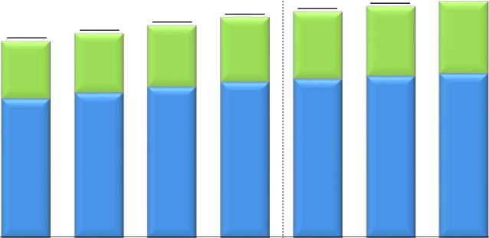
Progress of Broadband Services
Number of Subscribers for Video Services
FLET'S TV
Hikari TV
*
(Thousands)
5,000
4,000
3,000
2,000
1,000
0
4,546
1,346
3,200
FY2014E
4,086
1,209
2,877
2014.6
4,183
1,256
2,927
2014.9
4,275
1,304
2,971
2014.12
3,841
1,113
2,727
2013.12
3,984
1,161
2,823
2014.3
3,552
1,032
2,520
2013.6
3,692
1,067
2,625
2013.9
*
“FLET’S TV” requires a subscription to “FLET’S TV Transmission Service,” provided by NTT East and NTT West, and a subscription to Opticast Inc.’s “Opticast Facility Use
Services” broadcast service.
Financial Results for the Nine Months Ended December 31, 2014
－9－
Copyright (c) 2015 Nippon Telegraph and Telephone Corporation

Slide 12
Financial Information

Slide 13













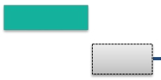



Subsidiaries’ Results (JPN GAAP Non-Consolidated)
NTT East Financial Results
(Billions of yen)
FY2014/3Q
11.0
(0.8)%
FY2014E
2.8
(0.2)%
Operating
Revenues
Progress
73.9%
1,773.8
FY2013
1,771.0
FY2014E
1,319.5
FY2013/3Q
1,308.5
FY2014/3Q
Voice Transmission Services
IP Services
Others
(54.3)
(1.3)
+52.8
Voice Transmission Services
IP Services
Others
(37.6)
(1.3)
+27.8
Operating
Expenses
36.9
(3.0)%
26.0
(1.5)%
Progress
72.1%
1,249.5
FY2013/3Q
Personnel expenses (6.0)
and services and other expenses (30.7)
Depreciation expenses and loss
(0.1)
on disposal of assets
1,212.5
FY2014/3Q
1,707.0
FY2013
Personnel expenses
Expenses for purchase of goods
and services and other expenses
Depreciation expenses and loss
on disposal of assets
(4.9)
(24.2)
+3.1
1,681.0
FY2014E
Expenses for purchase of goods
Operating
Income
Progress
106.6%
25.9
23.2
70.0
+37.0%
95.9
66.7
+34.9%
90.0
Financial Results for the Nine Months Ended December 31, 2014
－10－
Copyright (c) 2015 Nippon Telegraph and Telephone Corporation

Slide 14










Subsidiaries’ Results (JPN GAAP Non-Consolidated)
NTT West Financial Results
(Billions of yen)
FY2014/3Q
8.6
(0.7)%
FY2014E
7.6
(0.5)%
Operating
Revenues
Progress
73.5%
1,589.6
FY2013
1,582.0
FY2014E
1,172.0
FY2013/3Q
1,163.4
FY2014/3Q
Voice Transmission Services
IP Services
Others
(50.3)
+13.3
+29.3
Voice Transmission Services
IP Services
Others
(37.9)
+10.4
+18.8
Operating
Expenses
20.6
(1.8)%
26.2
(1.7)%
Progress
73.2%
Personnel expenses (1.9)
and services and other expenses (16.7)
Depreciation expenses and loss
(1.9)
on disposal of assets
1,573.2
FY2013
Personnel expenses
Expenses for purchase of goods
and services and other expenses
Depreciation expenses and loss
on disposal of assets
+0.5
(27.8)
+1.1
1,547.0
FY2014E
1,153.0
FY2013/3Q
Expenses for purchase of goods
1,132.4
FY2014/3Q
Operating
Income
Progress
88.5%
11.9
18.6
18.9
+63.2%
30.9
16.3
+113.7%
35.0
Financial Results for the Nine Months Ended December 31, 2014
－11－
Copyright (c) 2015 Nippon Telegraph and Telephone Corporation

Slide 15

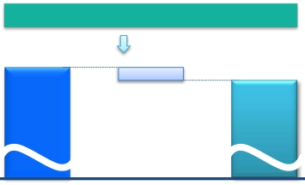








Subsidiaries’ Results (JPN GAAP Non-Consolidated)
NTT Communications Financial Results
(Billions of yen)
FY2014/3Q
24.7
FY2014E
34.0
(3.6)%
Operating
Revenues
(3.6)%
Progress
72.6%
944.0
FY2013
910.0
FY2014E
685.4
FY2013/3Q
Cloud Computing Platforms
Data Networks
Voice Communications
Solution Services
Others
+9.1
(16.7)
(19.0)
+0.2
+1.6
660.6
FY2014/3Q
Cloud Computing Platforms
Data Networks
Voice Communications
Solution Services
Others
+13.0
(20.5)
(20.4)
(8.6)
+2.4
Operating
Expenses
23.5
(2.8)%
10.3
(1.7)%
Progress
73.0%
599.3
FY2013/3Q
Personnel expenses
Expenses for purchase of goods
and services and other expenses
Depreciation expenses and loss
on disposal of assets
(1.5)
(7.9)
(0.8)
589.0
FY2014/3Q
830.5
FY2013
Personnel expenses
Expenses for purchase of goods
and services and other expenses
Depreciation expenses and loss
on disposal of assets
(2.3)
(22.2)
+1.0
807.0
FY2014E
Operating
Income
Progress
69.5%
14.4
10.4
86.0
(16.8)%
71.5
113.4
(9.2)%
103.0
Financial Results for the Nine Months Ended December 31, 2014
－12－
Copyright (c) 2015 Nippon Telegraph and Telephone Corporation

Slide 16












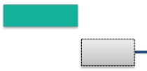


Subsidiaries’ Results (U.S. GAAP Consolidated)
NTT DOCOMO Financial Results
(Billions of yen)
FY2014/3Q
36.8
(1.1)%
FY2014E
61.2
(1.4)%
Operating
Revenues
Progress
75.6%
4,461.2
4,400.0
3,363.6
FY2013/3Q
3,326.8
FY2014/3Q
FY2013
FY2014E
128.0
+3.5%
Operating
Expenses
64.7
+2.4%
Progress
72.7%
2,674.9
FY2013/3Q
2,739.6
FY2014/3Q
3,642.0
FY2013
3,770.0
FY2014E
Operating
Income
Progress
93.2%
101.5
189.2
688.7
(14.7)%
587.1
819.2
(23.1)%
630.0
Financial Results for the Nine Months Ended December 31, 2014
－13－
Copyright (c) 2015 Nippon Telegraph and Telephone Corporation

Slide 17

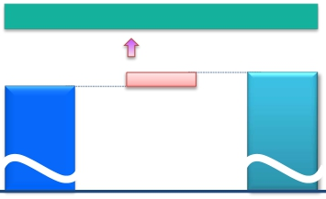






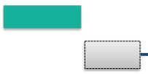
Subsidiaries’ Results (JPN GAAP Consolidated)
NTT DATA Financial Results
(Billions of yen)
FY2014/3Q
124.5
+13.2%
FY2014E
116.2
+8.6%
Operating
Revenues
Progress
73.1%
1,343.7
1,460.0
942.5
FY2013/3Q
1,067.0
FY2014/3Q
FY2013
FY2014E
93.8
+7.3%
Operating
Expenses
101.6
+11.1%
Progress
74.1%
916.8
FY2013/3Q
1,018.4
FY2014/3Q
1,281.1
FY2013
1,375.0
FY2014E
Operating
Income
Progress
22.8
+89.0%
57.2%
48.5
22.4
+35.8%
25.7
62.5
85.0
Financial Results for the Nine Months Ended December 31, 2014
－14－
Copyright (c) 2015 Nippon Telegraph and Telephone Corporation

Slide 18









Details of Difference Between Consolidated Operating Income and Total Operating Income of
5 Major Subsidiaries
FY2013/3Q
19.8
75.8
(Billions of yen)
889.4
Total operating income
of 5 major subsidiaries
(JPN GAAP)
FY2014/3Q
・NTT (Holding Company): 4.6 ・Pension (actuarial difference, etc.): 22.1・Depreciation of engineering facilities: (18.7)
・NTT URBAN DEVELOPMENT (Consolidated): 25.9 ・Adjustments between operating and non-
・NTT COMWARE: 0.9 operating items, including eliminations, etc.
・NTT FINANCE (Consolidated): 14.0
・Outsourcing companies (East): 5.3
・Outsourcing companies (West): (5.4)
・Other companies: 30.5
Total operating income of subsidiaries other than Elimination and
the 5 major subsidiaries (excluding the effect of U.S. GAAPadjustments
dividends received by NTT (Holding Company))
12.2
88.9
985.1
Consolidated operating
income
(U.S. GAAP)
834.2
Total operating income
of 5 major subsidiaries
(JPN GAAP)
・ Pension (actuarial difference, etc.): 14.2
・Depreciation of engineering facilities: (15.6)
・Adjustments between operating and non-operating
items, including eliminations, etc.
Elimination and
U.S. GAAP
adjustments
910.9
Consolidated operating
income
(U.S. GAAP)
・NTT (Holding Company): 4.6
・NTT URBAN DEVELOPMENT (Consolidated): 17.3
・NTT COMWARE: 1.2
・NTT FINANCE (Consolidated): 15.7
・Outsourcing companies (East): 6.4
・Outsourcing companies (West): 4.1
・Other companies: 39.3
Total operating income of subsidiaries other than
the 5 major subsidiaries (excluding the effect of
dividends received by NTT (Holding Company))
Financial Results for the Nine Months Ended December 31, 2014
－15－
Copyright (c) 2015 Nippon Telegraph and Telephone Corporation

Slide 19



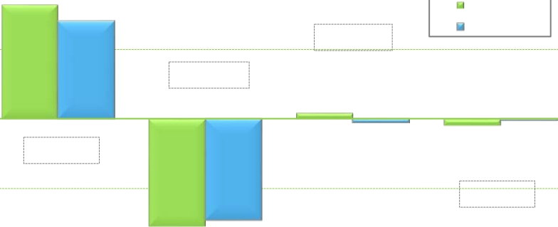
Details of Consolidated Cash Flows
Cash flows from
operating activities
(A)
Cash flows from
investing activities
(B)
FCF
(A) + (B)
Cash flows from
financing activities
（Billions of yen）
2,000
1,623.0
FY2013/3Q
1,399.7
FY2014/3Q
(143.5)
1,000
+79.7
90.2
0
(53.3)
(88.9)
(28.0)
(223.2)
(1,000)
+60.9
(1,532.7)
(1,453.0)
(2,000)
Increase/Decrease from the same period of the previous fiscal year
Copyright (c) 2015 Nippon Telegraph and Telephone Corporation
Financial Results for the Nine Months Ended December 31, 2014
－16－

Slide 20
Appendices

Slide 21
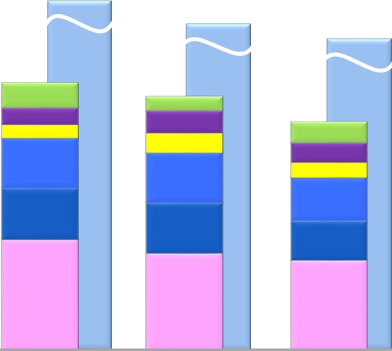
Appendices
Capital Investment
1,907.5
(Billions of yen)
[1,970.0]*
1,301.3
[1,342.2]*
118.4
82.9
64.7
245.4
249.5
540.4
FY2012/3Q
FY2012
1,795.7
[1,892.8]*
1,235.8
[1,309.0]*
66.8
109.2
95.0
246.4
246.1
472.3
FY2013/3Q
FY2013
1,750.0
[1,890.0]*
1,113.3
[1,197.3]*
98.9
95.8
74.1
213.9
191.3
439.3
FY2014/3Q
FY2014E
Other
NTT DATA (Consolidated)
NTT Communications
NTT West
NTT East
NTT DOCOMO (Consolidated)
* Figures in [ ] include investments related to real estate and solar power generation operations.
Financial Results for the Nine Months Ended December 31, 2014
－17－
Copyright (c) 2015 Nippon Telegraph and Telephone Corporation

Slide 22
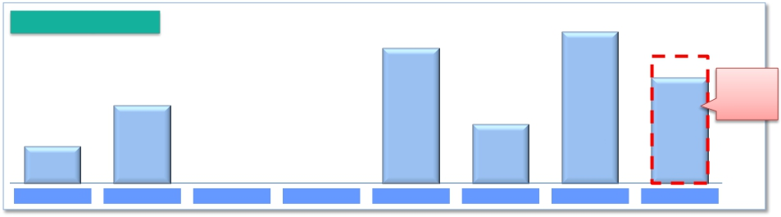
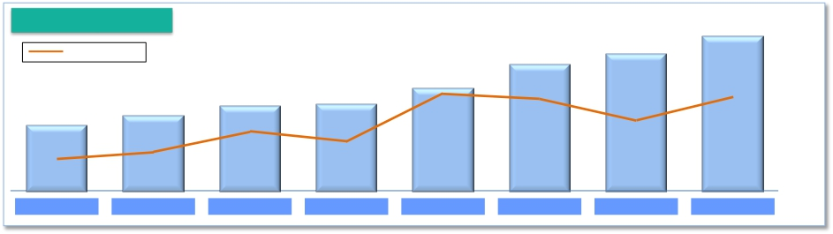
Shareholder Returns
Share buybacks
406.5
(Billions of yen)
Up to
350.0
381.7
200.0
290.7
As of
Jan. 2015
150.0
94.4
FY2007
FY2008
FY2009
FY2010
FY2011
FY2012
FY2013
2014.11-2015.6
Dividends per share
● Payout ratio
180
(yen)
160
170
140
●
38.2%
FY2011
120
●
32.3%
FY2009
120
●
31.2%
FY2010
90
●
19.5%
FY2007
110
●
27.5%
FY2008
●
37.2%
FY2012
●
37.6%
FY2014E
●
33.4%
FY2013
Financial Results for the Nine Months Ended December 31, 2014
－18－
Copyright (c) 2015 Nippon Telegraph and Telephone Corporation

Slide 23

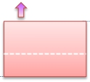











Appendices
FY2014/3Q Details of Financial Results (Per Item)
Operating
Revenues
Fixed IP/packet : (11.5)
Mobile IP/packet : (28.2)
Other : +0.2
(Billions of yen)
[year-on-year：+157.3]
SI revenues and sales
of telecommunications
equipment
Voice related
services revenues
226.5
Fixed voice
362.3
Systems Integration
Other revenues
61.0
39.5
IP/packet
communications
X.X
8,025.2
Telecommunications
equipment
Systems Integration
services revenues
: +307.9
8,182.5
Mobile voice
Fixed voice : (97.5)
Mobile voice : (129.0)
Telecommunications equipment (Fixed-line) : (1.6)
Telecommunications equipment (Mobile) : +55.9
FY2013/3Q
FY2014/3Q
Operating
Expenses
[year-on-year：+231.5]
89.8
Personnel expenses
2.0
Other expenses
177.0
33.4
7,040.1
FY2013/3Q
Depreciation
expenses and loss on
disposal
of assets
Expenses for purchase
of goods and services
and other expenses
7,271.6
FY2014/3Q
Financial Results for the Nine Months Ended December 31, 2014
－19－
Copyright (c) 2015 Nippon Telegraph and Telephone Corporation

Slide 24





Appendices
Details of Consolidated Balance Sheet
March 31, 2014
(Billions of yen)
20,284.9
December 31, 2014
20,642.3
Liabilities
9,615.7
[+281.5]
Interest-Bearing
Debt
4,862.4
[+662.4]
Liability for Employees’
Retirement Benefits
1,365.9
[+38.0]
Other
26.6[+0.7]
Equity
11,000.0
[+75.2]
Treasury Stock
(416.1)
[(259.2)]
Liabilities
Interest-Bearing
Debt
4,200.0
Liability for Employees’
Retirement Benefits
1,327.9
Other
25.9
Equity
10,924.8
Treasury Stock
(156.9)
Assets
20,642.3
[+357.3]
Depreciable Assets
(property, plant and
equipment)
8,055.6
[(186.3)]
Deferred Tax Assets
(non-current)
639.8
[(21.7)]
Assets
20,284.9
Depreciable Assets
(property, plant and
equipment)
8,241.9
Deferred Tax
Assets
(non-current)
661.5
9,334.2
Financial Results for the Nine Months Ended December 31, 2014
－20－
Copyright (c) 2015 Nippon Telegraph and Telephone Corporation

Slide 25
Appendices
Consolidated and Main Subsidiaries’ Financial Results for FY2014/3Q
(Billions of yen)
NTT DATA
Consolidated
(JPN GAAP)
1,067.0
124.5
13.2%
1,460.0
73.1%
1,018.4
101.6
11.1%
1,375.0
74.1%
48.5
22.8
89.0%
85.0
57.2%
(1)
NTT
Consolidated
(U.S. GAAP)
8,182.5
157.3
2.0%
11,010.0
74.3%
7,271.6
231.5
3.3%
9,915.0
73.3%
910.9
(74.2)
(7.5)%
1,095.0
83.2%
NTT
(Holding Company)
Non-Consolidated
(JPN GAAP)
372.1
(17.1)
(4.4)%
412.0
90.3%
95.3
(4.8)
(4.9)%
140.0
68.1%
276.8
(12.2)
(4.2)%
272.0
101.8%
NTT East
Non-Consolidated
(JPN GAAP)
1,308.5
(11.0)
(0.8)%
1,771.0
73.9%
1,212.5
(36.9)
(3.0)%
1,681.0
72.1%
95.9
25.9
37.0%
90.0
106.6%
NTT West
Non-Consolidated
(JPN GAAP)
1,163.4
(8.6)
(0.7)%
1,582.0
73.5%
1,132.4
(20.6)
(1.8)%
1,547.0
73.2%
30.9
11.9
63.2%
35.0
88.5%
NTT Com
Non-Consolidated
(JPN GAAP)
660.6
(24.7)
(3.6)%
910.0
72.6%
589.0
(10.3)
(1.7)%
807.0
73.0%
71.5
(14.4)
(16.8)%
103.0
69.5%
NTT DOCOMO
Consolidated
(U.S. GAAP)
3,326.8
(36.8)
(1.1)%
4,400.0
75.6%
2,739.6
64.7
2.4%
3,770.0
72.7%
587.1
(101.5)
(14.7)%
630.0
93.2%
Operating Revenues
Change year-on-year
(% change)
Forecasts for FY2014
(% progress)
Operating Expenses
Change year-on-year
(% change)
Forecasts for FY2014
(% progress)
Operating Income
Change year-on-year
(% change)
Forecasts for FY2014
(% progress)
Income Before
Income Taxes
(2)
910.2
273.6
110.3
26.8
88.0
595.0
45.3
Change year-on-year
(% change)
Forecasts for FY2014
(% progress)
Net Income
Change year-on-year
(% change)
Forecasts for FY2014
(% progress)
(113.9)
(11.1)%
1,075.0
84.7%
449.9
(34.4)
(7.1)%
529.0
85.1%
(10.1)
(3.6)%
268.0
102.1%
561.2
278.3
98.4%
558.0
100.6%
20.4
22.7%
103.0
107.1%
70.7
12.8
22.2%
62.0
114.1%
(0.7)
(2.8)%
28.0
96.0%
16.6
(1.8)
(9.8)%
19.0
87.6%
(14.3)
(14.0)%
113.0
77.9%
57.6
(11.4)
(16.5)%
72.0
80.1%
(108.6)
(15.4)%
639.0
93.1%
381.9(4)
(48.3)
(11.2)%
420.0
90.9%
16.9
59.5%
75.0
60.5%
21.7
11.6
114.6%
37.0
58.8%
(3)
(1) NTT has 920 consolidated subsidiaries and accounts for 122 companies under the equity method.
(2) “Income Before Income Taxes” for NTT (Holding Company), NTT East, NTT West, NTT Communications and NTT DATA represents their recurring profits.
(3) “Net Income” for NTT Consolidated represents “Net income attributable to NTT, excluding noncontrolling interests.”
(4) “Net Income” for NTT DOCOMO represents “Net income attributable to NTT DOCOMO, excluding noncontrolling interests.”
Financial Results for the Nine Months Ended December 31, 2014
－21－
Copyright (c) 2015 Nippon Telegraph and Telephone Corporation

Slide 26

Appendices
Calculation of ARPU
Average monthly revenue per unit, or ARPU, is used to measure average monthly operating revenues attributable to each designated service on a per user basis. In the case of NTT Group’s fixed-line business, ARPU is calculated by dividing revenue
items included in the operating revenues of NTT Group’s regional communications business segment, that is, FLET’S Hikari, by the number of Active Subscribers to the relevant services.
In the case of NTT Group’s mobile communications business, ARPU is calculated by dividing revenue items included in operating revenues from its mobile communications business segment, such as revenues from Xi mobile phone services and
FOMA mobile phone services, that are incurred consistently each month (i.e., basic monthly charges and voice/packet transmission charges), by the number of Active Subscribers to the relevant services. The calculation of these figures excludes
revenues that are not representative of monthly average usage, such as telecommunications equipment sales, activation fees and universal service charges.
NTT believes that its ARPU figures calculated in this way provide useful information regarding the monthly average usage of its subscribers. The revenue items included in the numerators of NTT Group’s ARPU figures are based on its financial results
comprising its U.S. GAAP results of operations.
For a complete discussion on the calculation of ARPU, please see the “Supplementary Data for the Nine Months Ended December 31, 2014.”
Notes:
(1) FLET’S Hikari ARPU of NTT East and NTT West is calculated based on revenues from "FLET’S Hikari" (including "FLET’S Hikari" optional services), which are included in operating revenues from IP Services, revenues from monthly charges, call
charges and connection device charges for "Hikari Denwa," and revenues from "FLET’S Hikari" optional services, which are included in Supplementary Business revenues.
- "FLET'S Hikari" includes "B FLET'S," "FLET'S Hikari Next," "FLET'S Hikari Light" and "FLET'S Hikari WiFi Access" provided by NTT East, and "B FLET'S," "FLET'S Hikari Premium," "FLET'S Hikari Mytown," "FLET'S Hikari Next,"
"FLET'S Hikari Light" and "FLET'S Hikari WiFi Access" provided by NTT West.
(2) For purposes of calculating FLET'S Hikari ARPU, number of subscribers is determined based on the number of "FLET'S Hikari" subscribers, including subscribers to "B FLET'S," "FLET'S Hikari Next," "FLET'S Hikari Light" and "FLET'S Hikari WiFi
Access" provided by NTT East, and subscribers to "B FLET'S," "FLET'S Hikari Premium," "FLET'S Hikari Mytown," "FLET'S Hikari Next," "FLET'S Hikari Light" and "FLET'S Hikari WiFi Access" provided by NTT West.
(3) The following is the formula we use to compute ARPU for mobile business conducted by NTT DOCOMO.
・Mobile Aggregate ARPU ("Xi"+"FOMA") = Voice ARPU ("Xi"+"FOMA") + Packet ARPU ("Xi"+"FOMA") + Smart ARPU ("Xi"+"FOMA").
- NTT DOCOMO’s Voice ARPU ("Xi"+"FOMA") is based on operating revenues related to voice services, such as basic monthly charges and voice communication charges attributable to our "Xi"+"FOMA" services, our Packet ARPU
("Xi"+"FOMA") is based on operating revenues related to packet services, such as flat monthly fees and packet communication charges attributable to our "Xi"+"FOMA" services, and our Smart ARPU ("Xi"+"FOMA") is based on
operating revenues from a part of Other Operating Revenues attributable to "Xi"+"FOMA" wireless communications services (revenues from content, collection of charges, mobile phone insurance service, advertising and others).
(4) Subscriptions for and revenues from communication module services, “Phone Number Storage,” “Mail Address Storage,” “docomo Business Transceiver” and wholesale telecommunications services and interconnecting telecommunications
facilities that are provided to Mobile Virtual Network Operators (MVNOs) are not included in the Mobile Aggregate ARPU calculation.
(5) NTT DOCOMO‘s ARPU calculation methods have been changed from the second quarter of the fiscal year ending March 31, 2015. Accordingly, the ARPU data for the results for the three months ended Jun. 30, 2013 (from Apr. to Jun., 2013), the
three months ended Sep. 30, 2013 (from Jul. to Sep., 2013), the three months ended Dec. 31, 2013 (from Oct. to Dec., 2013), the three months ended Mar. 31, 2014 (from Jan. to Mar., 2014), the year ended Mar. 31, 2014 and the three months
ended Jun. 30, 2014 (from Apr. to Jun., 2014) have also been changed.
(6) Numbers of active subscribers used in the ARPU calculation of NTT East and NTT West are as below.
- 1Q Results: Sum of number of active subscribers* for each month from April to June
- 2Q Results: Sum of number of active subscribers* for each month from July to September
- 3Q Results: Sum of number of active subscribers* for each month from October to December
- 4Q Results: Sum of number of active subscribers* for each month from January to March
- Nine Month Results: Sum of number of active subscribers* for each month from April to December
- FY Results: Sum of number of active subscribers* for each month from April to March
- FY (Forecast): Sum of the sum of actual number of active subscribers at the end of each month from April to September and the average expected active number of subscribers during the second half of the fiscal year ((number of
subscribers at September 30, 2014 + number of expected subscribers at March 31, 2015)/2)x6.
(7) Numbers of active subscribers used in the ARPU calculation of NTT DOCOMO are as below.
- 1Q Results: Sum of number of active subscribers* for each month from April to June
- 2Q Results: Sum of number of active subscribers* for each month from July to September
- 3Q Results: Sum of number of active subscribers* for each month from October to December
- 4Q Results: Sum of number of active subscribers* for each month from January to March
- Nine Month Results: Sum of number of active subscribers* for each month from April to December
- FY Results: Sum of number of active subscribers* for each month from April to March
- FY (Forecast): Sum of expected number of active subscribers* for each month from April to March
(8) Forecasts for the year ending March 31, 2015 have not been changed from those announced in the financial results for the six months ended September 30, 2014.
*Active subscribers = (number of subscribers at end of previous month + number of subscribers at end of the current month)/2
Financial Results for the Nine Months Ended December 31, 2014
－22－
Copyright (c) 2015 Nippon Telegraph and Telephone Corporation

