Slide 1
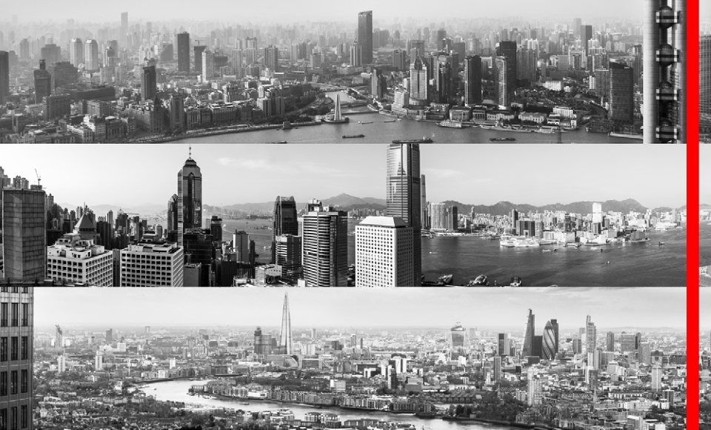

17th Annual Credit Suisse Asian Investment Conference
HSBC Group Finance Director Iain Mackay
March 2014

Slide 2
Forward-looking statements
This presentation and subsequent discussion may contain certain forward-looking statements
with respect to the financial condition, results of operations, capital position and business of the
Group. These forward-looking statements represent the Group’s expectations or beliefs
concerning future events and involve known and unknown risks and uncertainty that could
cause actual results, performance or events to differ materially from those expressed or implied
in such statements. Additional detailed information concerning important factors that could
cause actual results to differ materially is available in our Annual Report and Accounts. Past
performance cannot be relied on as a guide to future performance.
This presentation contains non-GAAP financial information. Reconciliation of non-GAAP
financial measures to the most directly comparable measures under GAAP are provided in the
‘reconciliations of non-GAAP financial measures’ supplement available at www.hsbc.com.
2

Slide 3
Delivering the strategy
Who we are / Financial results
Strategic update
Regulatory environment
3
3

Slide 4
Who we are / Financial
results

Slide 5
Who we are
§Leading international bank
§Headquartered in London, with 4 Global Businesses
§Our network covers 75 countries and territories in six geographical regions, serving 54
million customers
§Market cap c.USD 207 billion
§One of the best capitalised banks with CET1 capital at 10.9%
§One of the highest dividend payers in FTSE
5

Slide 6
Annual results 2013
Financial highlights1
Summary financial highlights
% better/(worse)
2013 vs 2012
9
41
14
9
KPI
12 – 15
< 90
9.5 – 10.5
9.5 – 10.53
2012
20.6
15.3
0.74
0.45
2012
8.4
74.4
12.3
9.5
2013
22.6
21.6
0.84
0.49
2013
9.2
72.9
13.6
10.9
Reported PBT (USDbn)
Underlying PBT (USDbn)
EPS (USD)
Dividends2 (USD)
Key ratios %
Return on average ordinary shareholders’ equity
Advances-to-deposits ratio
Core tier 1 ratio
Common equity tier 1 ratio
Notes:
1.
2.
3.
All figures are as reported unless otherwise stated
Dividends per share declared in respect of the year
Target for 2014-16 is >10%
6

Slide 7
Annual results 2013
Regional and business profit contributions
Geographical regions
Global businesses
% better/(worse)
2013 vs 2012
13
20
26
(62)
272
n/a
41
Underlying PBT
(USDbn)
Commercial Banking
Global Banking and Markets
Retail Banking and
Wealth Management
Global Private Banking
Other
Total
2012
7.5
7.9
4.0
0.9
(5.0)
15.3
2013
7.9
9.0
6.4
0.2
(1.9)
21.6
% better/(worse)
2013 vs 2012
5
15
60
(79)
62
41
Underlying PBT (USDbn)
Hong Kong
Rest of Asia-Pacific
MENA
Latin America
Europe
North America
Total
2012
7.2
5.6
1.3
1.9
0.8
(1.5)
15.3
2013
8.1
6.7
1.7
0.7
2.8
1.6
21.6
7

Slide 8
Strategic update

Slide 9
First phase strategic achievements, 2011-13
Objectives
Achievements
•
•
•
•
•
•
•
Six filters driving disposals and closures of
non-strategic and/or underperforming positions
(Legacy) or businesses
Turnaround of strategically relevant businesses
Simplify and delayer the organisation
Target USD2.5-3.5bn in sustainable cost
savings in three years, achieving our 48-52%
CER target
by 2013
Revenue growth in Latin America, Hong Kong,
RoAP and MENA
Capture wealth opportunity
(to generate USD4bn in additional revenues)
Leverage intra-group connectivity between
CMB and GB&M
(to generate USD1bn of additional revenues)
•
•
•
•
•
•
•
•
•
63 disposals/exits announced since 2011, reduced
c.USD95bn RWAs1 and c.20k FTE
Progress on running down and de-risking Legacy
portfolios since the start of 2011
– US run off portfolio down from USD58bn to USD30bn3
– GB&M legacy credit portfolio2 down from USD47bn
to USD28bn
Transformed the way we manage the business
– Four global businesses
– 11 global functions
USD4.9bn in annualised sustainable savings from
2011 to 2013
Net reduction of 41k FTE, including disposals/exits
Latin America, Hong Kong, RoAP and MENA regions’
revenues up 21%, total CMB up 18%3,4
Achieved double digit gross loan growth in 13 out of
22 home and priority markets3,4
Wealth management revenues increased by
USD0.9bn3,4. Revised target to USD3bn for 2014-16
c.USD1.3bn3,4 incremental collaboration revenue
(increased target to USD2bn in 2012)
Capital
deployment
Organisation
and cost
efficiency
Growth
Capital generation5, USD31bn, and dividends6, USD25bn
Notes:
1.
2.
3.
4.
5.
6.
Expected reduction in RWAs after completion of all 63 transactions
Based on reported ABS carrying values FY10 to FY13
From FY10 to FY13
Reported basis
Capital generation calculated from profits attributable to shareholders of the parent company after regulatory adjustment for own credit spread and net of dividends, for the
period 31 December 2010 to 31 December 2013
Dividends in respect of 2011, 2012 and 2013
9

Slide 10
Next phase strategic priorities, 2014-16
Objectives
2016 milestones
•
Continue to recycle RWAs from lower into
higher performing businesses within the
•
Continue to grow RWAs in line with our organic
investment criteria
Grow both
business and
dividends
Group’s
risk appetite, in particular, trade, PCM, forex,
renminbi internationalisation and in the Pearl
River Delta and ASEAN
•
•
Progressively grow dividends and introduce share
buy-backs1 as appropriate
Reduce impact of Legacy and non-strategic activities
on PBT and RWAs
•
Continue to invest in best-in-class Compliance
and Risk capabilities
• Significant progress in implementation of
Global Standards
Implement
Global
Standards
•
•
De-risk operations and/or improve risk
management in higher risk locations and
businesses
HSBC values – act with courageous integrity
•
Re-design key processes and procedures
achieving improvements in service, quality,
•
Achieve USD2-3bn additional sustainable savings from
2014 to 2016
Streamline
processes and
procedures
Note:
cost and risk
Cost savings to provide headroom to invest in
growth and Global Standards
•
1. Subject to meeting United Kingdom regulatory capital requirements and shareholder approval
10

Slide 11
Cohesive and focused geographic portfolio
Hong Kong and
Rest of Asia
Pacific
Middle East
and North
Africa
Europe
North America
Latin America
Home
markets
§ Hong Kong
§ United
Kingdom
§ Australia
§ Mainland China
§ India
§ France
§ Germany
§ Switzerland
§ Egypt
§ Saudi Arabia
§ UAE
§ Canada
§ USA
§ Argentina
§ Brazil
§ Mexico
Priority
Growth
markets
§ Indonesia
§ Malaysia
§ Singapore
§ Taiwan
§ Vietnam
§ Turkey
Network
markets
Small
markets
§ Operations primarily focused on CMB and GBM international clients and businesses
§ Together with home and priority growth markets these concentrate c.85-90% of international
trade and capital flows
§ Markets where HSBC has profitable scale and focused operations
§ Representative Offices
11

Slide 12
HSBC network covers over 90% of international trade and capital
flows
Trade and capital flow connectivity is concentrated
Cumulative growth in total merchandise export and
import, 2012-2022, 100% = USD35.0trn
HSBC network covers >90% of global flows
% of world
HSBC coverage
100%
90%
80%
70%
60%
50%
40%
30%
20%
10%
0%
Trade growth
2012-2022
FDI flows
2006-2011
FX reserves
2012
External debt
2012
Market cap
20131
92%
94%
94%
94%
98%
§ 38 markets represent 90%
of growth in trade flows
§ Similar degree of
concentration in:
– External debt, foreign
exchange reserves, and
current account balances
– Banking profit growth
– Foreign direct
investment
Number of Markets (total: c.200
markets)
Source: Global Insights, UNCTAD, CIA World Factbook, FactSet
1
As of 1 May 2013
12

Slide 13
Growth – HSBC has exposure to markets with strong fundamentals
driving wealth creation
Top economies by 2050
GDP, USDtn
China
US
India
8.2
Japan
6.4
Germany
3.7
UK
3.6
Brazil
3.0
Mexico
2.8
France
2.8
Canada
2.3
Turkey
2.1
Source: HSBC – The World in 2050 (Jan 2012), Global Insights
Income per capita in 2050
Multiple over 2010 income
6.9x
1.5x
6.4x
1.6x
2.1x
1.8x
2.9x
3.5x
1.7x
2.0x
4.3x
2.5
GDP Growth 06-11, CAGR
11%
1%
8%
0%
1%
0%
4%
1%
0%
1%
3%
25.3
22.3
13

Slide 14

Clear organic investment criteria
Where should we invest additional resources?
What fits HSBC’s portfolio?
§ Connectivity
§ Economic
development
Six Filters
§ Profitability
§ Efficiency
§ Liquidity
§ Financial crime risk
§ Invest
§ Turnaround/improve
Resulting
Strategic
Invest only in
businesses
aligned to our
strategy
Risk
Consistent with
our risk appetite
§ Is it strategic?
‒ Mostly in 22 home and
priority markets
‒ Target businesses and
clients
§ Does it meet our risk appetite?
– Credit
– Market
– Operational
actions
§ Continue as is
§ Discontinue/dispose
Financial
Value
accretive
for the
Group
§ Does it meet the minimum
hurdle?
– Marginal RoRWA
– Revenues/costs
14

Slide 15




Key opportunities in Growth Priority Markets
Asia Pacific
Latin America
§ Leading foreign bank for RMB in 2013
§ Debt and equity financing opportunities
§ International desks driving China
in/outbound business
§ Largest branch network among foreign
peers
§ Invest in accelerating growth of
internationally-focused corporate
franchise
§ Expand distribution for retail opportunity
§ Develop Wealth management and
Private Banking
§ Expand Trade Finance
§ Continue strong growth in CMB,
particularly with international customers
§ Drive collaboration revenues from CMB
to GBM, RBWM and GPB
§ Capture Wealth Opportunity and
accelerate growth in Premier/Advance
§ Leverage 1,000+ branches to capture fair
share of lending in RBWM and Business
Banking
§ Grow Wealth Management business
§ Drive corporate opportunity through GBM
and CMB collaboration (FX, Trade, DCM)
Mainland
China
India
Singapore
Brazil
Mexico
South – South Corridor
§ 9% share of fast growing Brazil – China trade
§ Recognised as ‘Financial institution of the year’ (2011) by the Brazil-China Chamber of Commerce for having
contributed most to the growth and development of the trade corridor
§ Asia-Latin America desks in place to facilitate cross border business
15

Slide 16
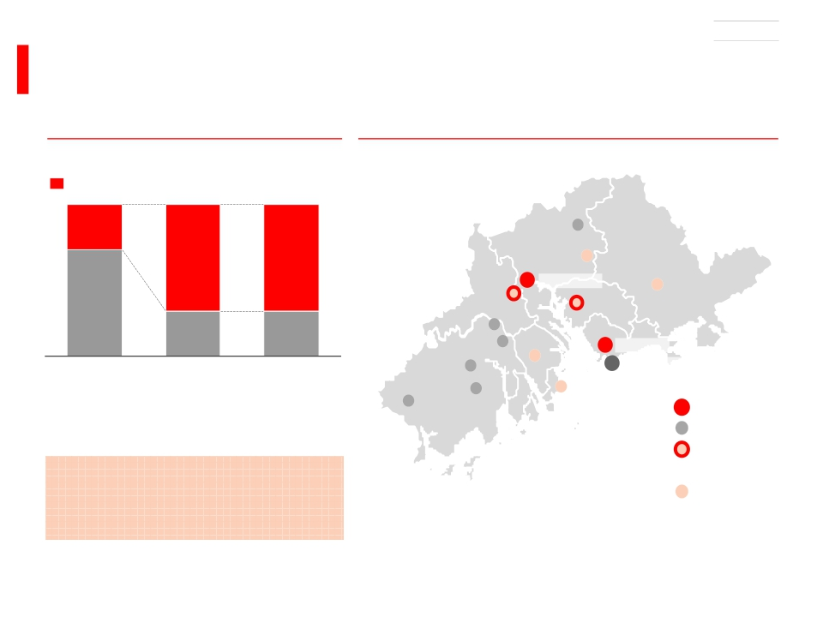
EXAMPLE
In Mainland China c.70% of the international opportunity in
the top-10 city clusters
Mainland China city clusters
% of Mainland China total
Top-10 city clusters
c.30
c.70
Example: Guangzhou-Shenzhen city cluster
Major cities of cluster
Conghua
Zengcheng
c.70
Guangzhou
Dongguan
Huizhou
c.70
Foshan
c.30
c.30
Heshan
Jiangmen
Zhongshan
Shenzhen
Kaiping
Hong Kong
Population
GDP growth
2010-25
Int’l commercial
banking
Taishan
Zhuhai
revenue growth
2010-25
Globally, top 100 city clusters
concentrate c.70% of international
commercial banking revenue growth
2010-25
Source: McKinsey & Company
Enping
Hub city
Spoke city
High income city
(household income
>RMB100k)
Mid-High income city
(household income
>national average)
16

Slide 17
Regulatory environment

Slide 18

Regulatory change has made banks safer but…unintended
consequences?
Regulatory initiatives
A continuous stream of new
regulations
· G20 Pittsburgh Summit in 2009 set out
four regulatory themes
· Better capital and less pro-cyclicality
Consequences
Banks are safer…
· Better quality of bank capital
· Improvements in risk weighting
· Increase in capital ratios beyond Basel 3
Basel Monitoring Report – March 2014
· Reforming compensation
Larger Banks
H1 2011 H1 2013
· Improve OTC derivative markets
· Addressing cross-border resolution and G-
SIFIs
Basel 3 CET1
CET1 Shortfall
7.1%
€486bn
9.5%
€57bn
· FSB report to G20 in Sept 2013 on
39 recommendations
· Policy completed in 11 areas at global level
· Four areas facing difficulties at global level
· 14 areas facing difficulties at national level
including cross border resolution
· Additional national and supra-national
initiatives in key areas such as
structural reform
…but regulations are creating risks and
inefficiencies
· Operational risks in implementation
· Additional costs delay capital building
· Uneven implementation distort markets
· Dangers of trapped capital and funding
· Concentration in few asset classes
· Risk of complacency on underlying risks
18

Slide 19
Authorities might consider three measures to improve the situation
Limit regulatory uncertainty
Continuous regulatory
change stifles investment
· Higher capital requirements
through numerous actions
· Increasing risk-weights
· More aggressive stress-tests
· Faster implementation
· Higher absolute levels
· Review of conduct through
retrospective view
· UK mis-selling costs
· Extended regulatory
agenda…is the end in sight?
Improve coordination
Lack of international
coordination increases risks
· Cross –border resolution is a
critical regulatory reform
· Cooperation Agreements
between regulators are not yet
in sight
· Geographic ring-fencing is
increasing
· Is the real economic impact
understood, globally?
· Clarity and consistency can
reduce negative effects for
economies
Deploy macro-prudential policy
Regulatory reform is still
focused on individual banks
· Systemic failures are more
often associated with asset
classes, not banks
· Macro-prudential analysis
needs to be improved
· Capture system-wide, as well
as bank-specific risks
· Private capital – personal and
corporate – must be measured
alongside bank capital
· Economic models must include
the banking system
International cooperation and consistency vital to avoid market place distortions
19

Slide 20
Well positioned for future growth
§Capital strength through diversified capital generative business model
§Progressive dividend history and capacity
§Demonstrated adaptability over last three years and capability in future
Delivering consistent returns
From:
To:
35%
45%
40%
50%
Dividends
15%
Growing ordinary dividends1
Variable pay
Earnings retained
15%
USD
Per share
1Q
2Q
3Q
4Q
Total USDbn
– of which scrip
1. In respect of the year
2. The board has a policy of quarterly interim dividends with an intended pattern of three
equal interim dividends and a variable fourth. It is envisaged that the first interim
2012
0.09
0.09
0.09
0.18
0.45
8.3
2.7
2013
0.10
0.10
0.10
0.19
0.49
9.2
2.73
20142
0.10
0.10
0.10
dividend in respect of 2014 will be USD0.10 per share
3. Includes 4th interim dividend with scrip estimated at 20%
20

