Slide 1

2015 R&D strategy
Global R&D leading Social Innovation Business
15 April 2015
Keiji KOJIMA, Ph.D.
Vice President & Executive Officer
Chief Technology Officer
President & CEO, Research & Development Group
Hitachi, Ltd.
© 2015 Hitachi, Ltd. All rights reserved.

Slide 2
Contents
1.
2.
3.
4.
Realignment of global R&D structure
For new growth
Strategic steps for the future
Summary
© 2015 Hitachi, Ltd. All rights reserved.

Slide 3

1-1 2015 Mid-term Management Plan: Management Focus
2015 Mid-term Management Plan
- Achieving Growth and Hitachi’s Transformation -
Innovation
Strengthen service
businesses that maximize
the utilization of IT and
bring about innovation
Global
Deliver Innovation to
Customers and Society
globally
Transformation
Transform Hitachi:
To deliver innovation by
standardized and speedy
operation
© 2015 Hitachi, Ltd. All rights reserved.
2

Slide 4
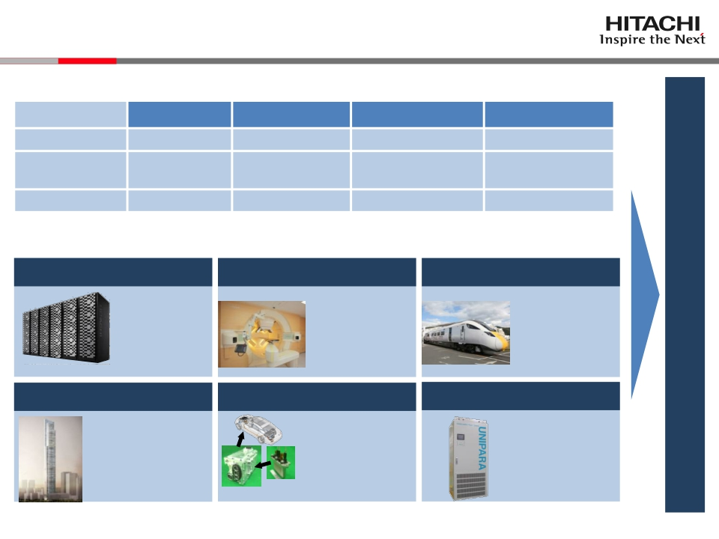
1-2 Contributing to Social Innovation Business
Pursuing transformation to fulfill 2015 Mid-term Management Plan
Mgmt. index
Revenue
Operating
income ratio
% overseas
'12
JPY9,041B
4.7%
41%
'13
JPY 9,616.2B
5.5%
45%
’14 (Forecast)
JPY9, 600B *1
6.0% *1
47% *2
'15 (Target *2)
JPY10,000B
Over 7%
Over 50%
*1: as at 2015/2/4, *2: as at 2014/5/12
Timely integration of R&D results in products for the global market
Storage systems
'14/4
Proton beam therapy '14/8
Railway systems
'15/1
VSP G1000
Uninterrupted
service through
virtualization
technology
VSP: Virtual Storage Platform
Strengthen innovation for new growth
PROBEAT-RT *3
Improved precision
through moving tumor
tracking irradiation
technology
Class 800 series
Simplification of
impact absorption
structure through
analysis-led design
Elevators
'14/4
Eco-friendly vehicles '14/12
UPS
'15/6
'15/2
World’s fastest elevator
Improved riding comfort
through active control
technology
Inverters
Reduced inverter
size through
dual-sided cooling
power modules
UNIPARA
30% size reduction
through modular
power conversion unit
Inverter
Power
module
*3: Developed with Hokkaido University under the FIRST Program (Cabinet Office of Japan),
‘14/8 Approval granted for partial amendment of previously approved items under Japan’s
Pharmaceutical Affairs Law (tumor tracking system).
© 2015 Hitachi, Ltd. All rights reserved.
3

Slide 5
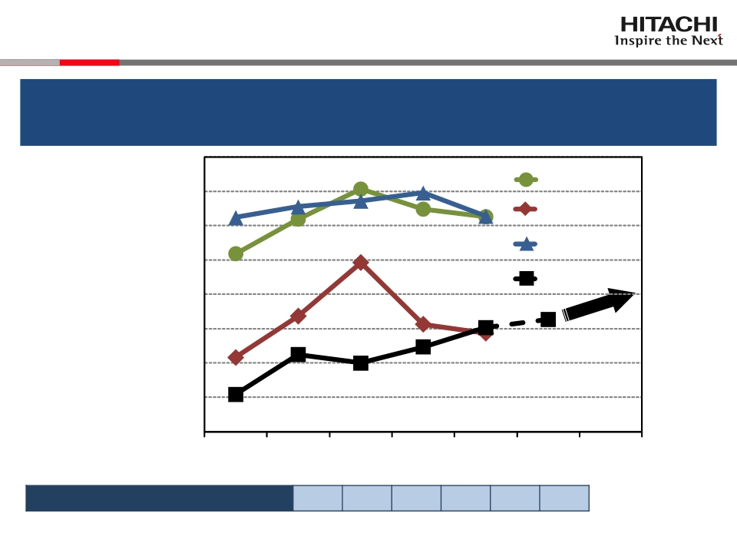
1-3 Benchmarking Innovation Strength
Strengthen innovation transforming R&D investment into business
earnings to take on the challenge of global major players
(Forecast)
R&D investment as a % of revenue
*Figure for FY2014 is given as forecasted on 2015/2/4
© 2015 Hitachi, Ltd. All rights reserved.
CompanyA
4.0
CompanyB
3.5
CompanyC
3.0
2.5
Hitachi
2.0
R&D investment as a ratio of sales profit
(Sales profit/R&D investment)
1.5
1.0
4.2%4.2%4.3%3.8%3.7%3.7%
0.5
0.0
Fiscalyear
’15~
’09
’10
’12
’11
’13
’14
4

Slide 6
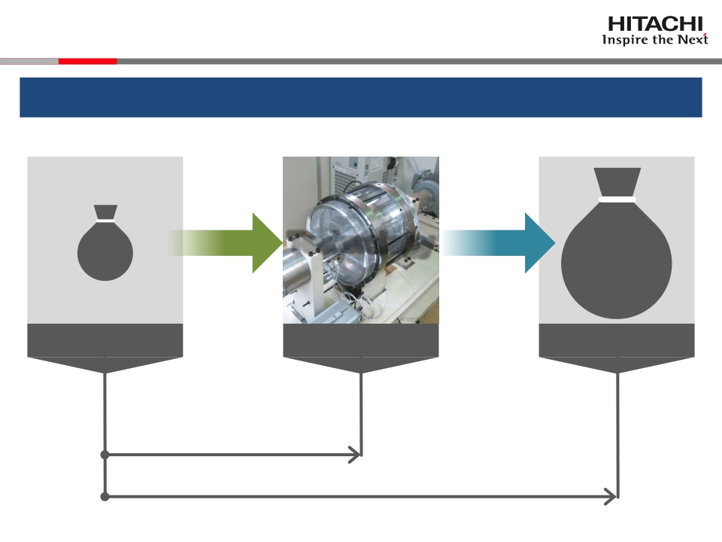
1-4 R&D for New Growth
R&D: From generating technology to driving innovation
$
Research
investment
Technology
Knowledge
$
Business
profit
Research
R&D until today
Innovation
R&D which addresses innovation
© 2015 Hitachi, Ltd. All rights reserved.
5

Slide 7
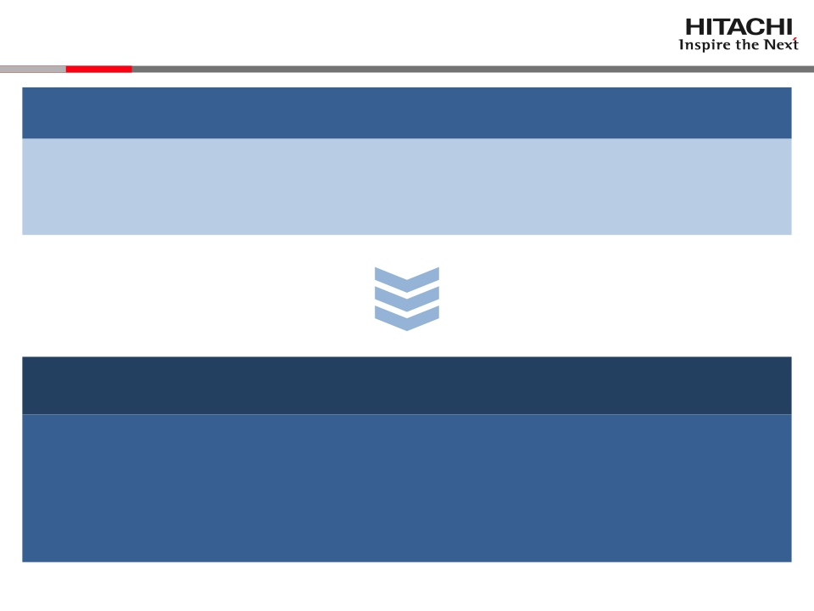
1-5 R&D Policy
Hitachi Gr. business policy: increase business income
From “product-out” to “market-in”
Shift to “customer-driven”
Realign R&D organization, enhance innovation strength
1. Assign researchers close to customers to expand
collaborative creation
2. Create innovative technology that satisfy market needs
© 2015 Hitachi, Ltd. All rights reserved.
6

Slide 8
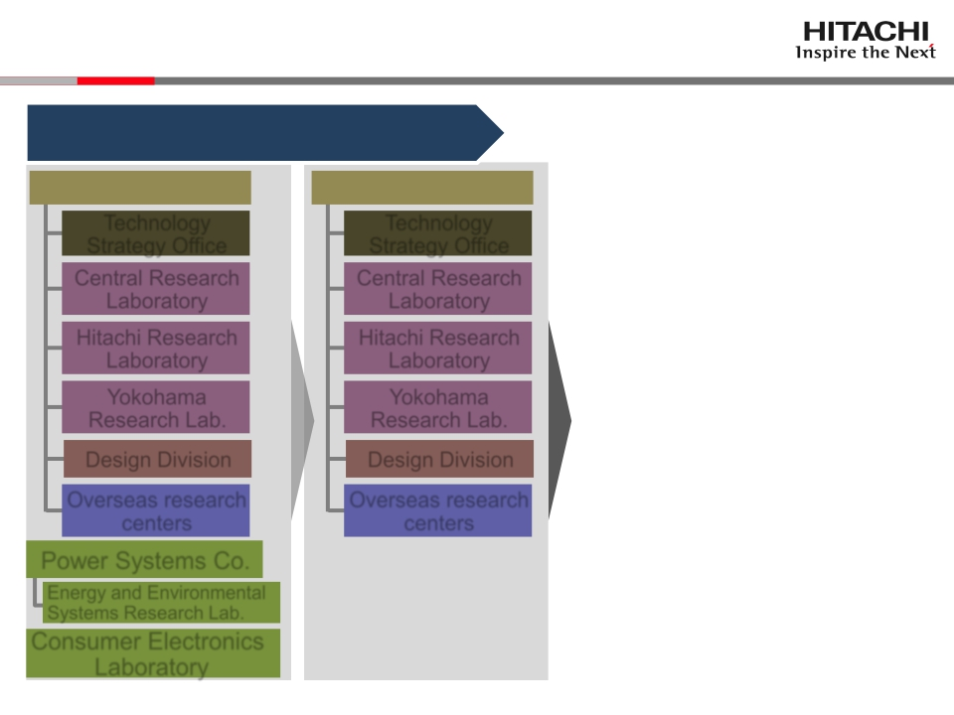
1-6 Realignment of Global R&D Organization
2011/4: Consolidate sites,
integrate technology areas
R&D Group
Technology
Strategy Office
Central Research
Laboratory
Hitachi Research
Laboratory
Yokohama
Research Lab.
Design Division
Overseas research
centers
Power Systems Co.
Energy and Environmental
Systems Research Lab.
Consumer Electronics
Laboratory
R&D Group
Technology
Strategy Office
Central Research
Laboratory
Hitachi Research
Laboratory
Yokohama
Research Lab.
Design Division
Overseas research
centers
© 2015 Hitachi, Ltd. All rights reserved.
7

Slide 9
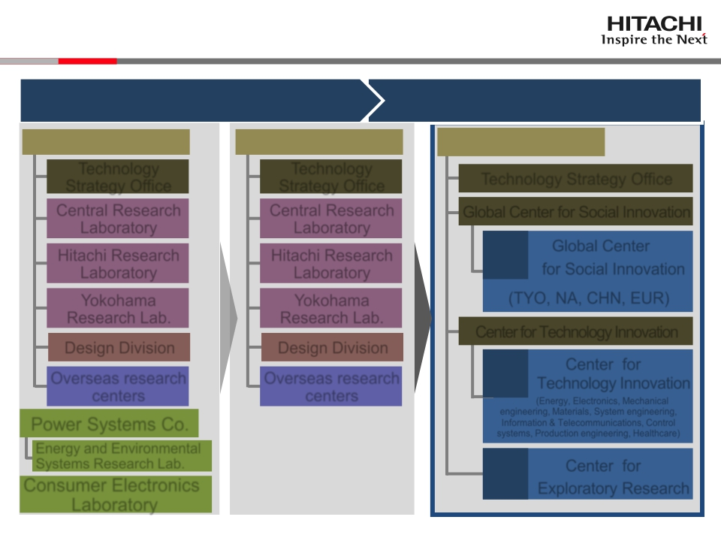
1-7 Realignment of Global R&D Organization
2011/4: Consolidate sites,
integrate technology areas
2015/4: Global realignment to speed-up
collaborative creation
R&D Group
Technology
Strategy Office
Central Research
Laboratory
R&D Group
Technology
Strategy Office
Central Research
Laboratory
R&D Group
Technology Strategy Office
Global Center for Social Innovation
Hitachi Research
Laboratory
Hitachi Research
Laboratory
CSI
Global Center
for Social Innovation
Yokohama
Research Lab.
Design Division
Yokohama
Research Lab.
Design Division
(TYO, NA, CHN, EUR)
Center for Technology Innovation
Center for
Technology Innovation
(Energy, Electronics, Mechanical
Overseas research
centers
Overseas research
centers
CTI
Power Systems Co.
Energy and Environmental
engineering, Materials, System engineering,
Information & Telecommunications, Control
systems, Production engineering, Healthcare)
Systems Research Lab.
Consumer Electronics
Laboratory
CER
Center for
Exploratory Research
© 2015 Hitachi, Ltd. All rights reserved.
8

Slide 10
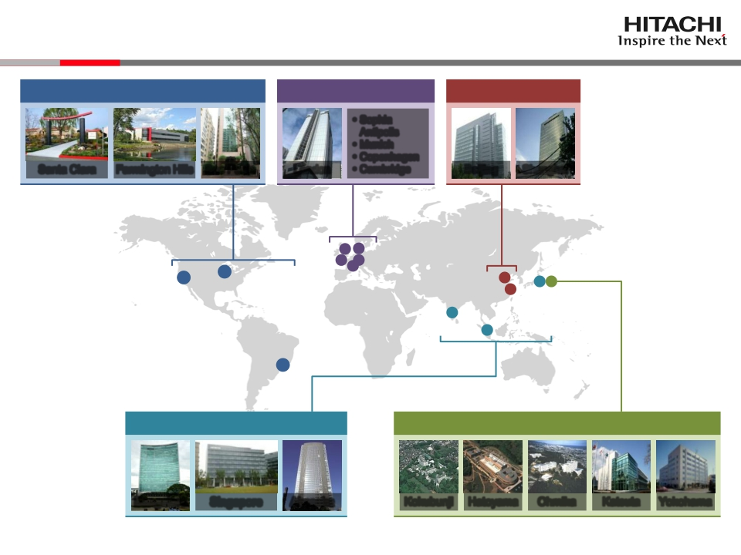
1-8 Research Sites & Personnel
CSI North America [100]
CSI Europe [50]
· Sophia
Antipolis
· Munich
· Copenhagen
CSI China [100]
Santa Clara
Farmington Hills
Sao Paulo
London
· Cambridge
Beijing
Shanghai
CSI Tokyo (APAC) [250]
CTI [2,000], CER [100]
Bangalore Singapore
[ ]: Head count, APAC: Asia-Pacific
Akasaka
Kokubunji
Hatoyama
Ohmika
Katsuta
Yokohama
© 2015 Hitachi, Ltd. All rights reserved.
9

Slide 11
Contents
1.
2.
3.
4.
Realignment of global R&D structure
For new growth
Strategic steps for the future
Summary
© 2015 Hitachi, Ltd. All rights reserved.

Slide 12
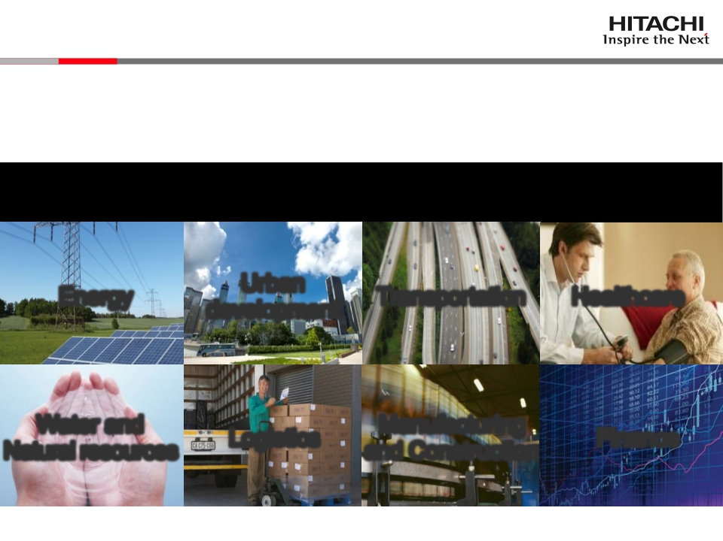
2-1 Hitachi’s Social Innovation Business
Serving the world with our Social Innovation Business
SOCIAL INNOVATION - IT’S OUR FUTURE
“IT × Social infrastructure”
Urban
development
Logistics
Energy
Water and
Natural resources
Transportation
Manufacturing
and Construction
Healthcare
Finance
© 2015 Hitachi, Ltd. All rights reserved.
11

Slide 13
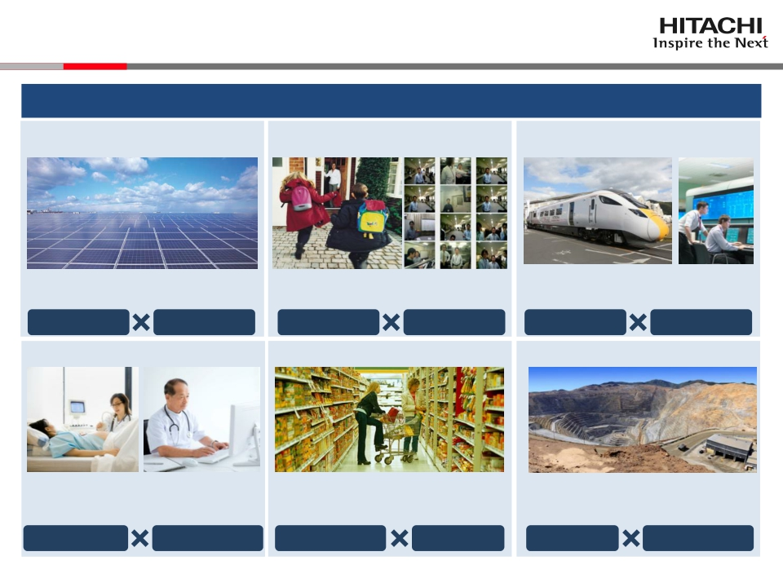
2-2 Hitachi’s Social Innovation Business
Build-up solutions utilizing IoT and big data
Renewable energy
Raise facility output by detecting PV
module failure or deterioration
Safe & secure cities
Secure safety & comfort by using wide-
area surveillance & high-speed image
search to protect communities
Rail systems
Raise reliability by remote monitoring of
carriage condition to predict failure
Mega solar
Sensing
Community
Security
Rail cars
Sensing
Preventive medicine
Predict and reduce lifestyle disease
related medical costs in groups by big
data analytics on health check-up data
Distribution
Improve retail performance by analyzing
customer behavior patterns with AI
Mining
Improve productivity by optimizing
dispatch through big data analytics of
equipment position & operational status
Lifestyle disease
Big data analytics
Human behavior
AI
Mine devt.
Big dataanalytics
IoT: Internet-of-Things
AI: Artificial intelligence
© 2015 Hitachi, Ltd. All rights reserved.
12

Slide 14
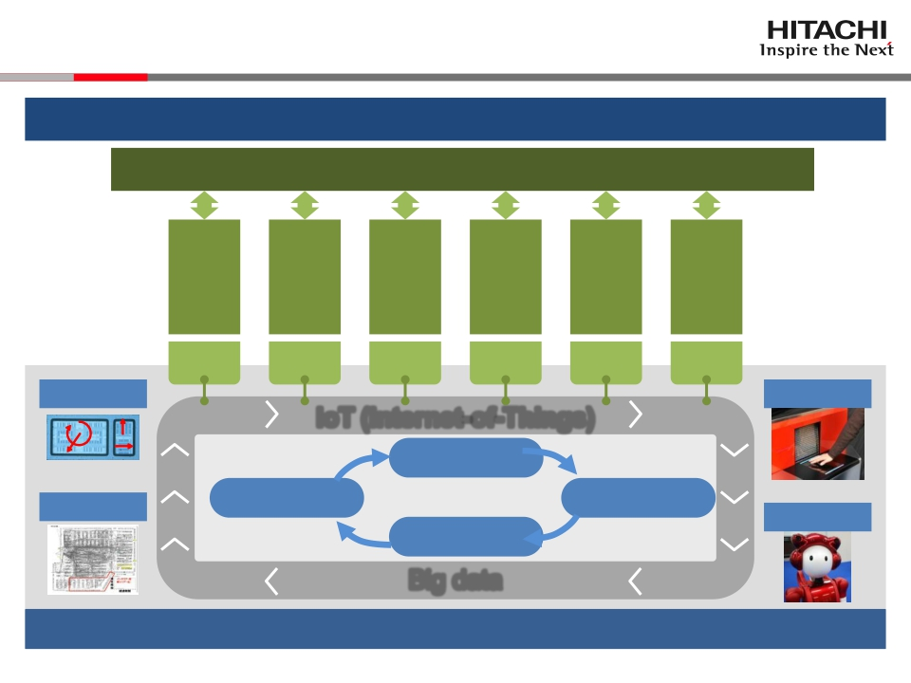
2-3 Evolution of Social Innovation Business
Build-up common platforms, accelerate business expansion
Accelerate global collaborative creation with customers
・・・
Construction
Energy
ment
Mnfg. &
develop-
Transpor-
Healthcare
Urban
tation
Logistics
Job
Job
Job
Job
Job
Job
Sensing
Security
IoT (Internet-of-Things)
y
z
x
Proof of value
AI
Issue analysis
Service business
Operation
Big data
Build-up solution
Robotics
Scale-up using symbiotic ADS platform
ADS: Autonomous Decentralized System
© 2015 Hitachi, Ltd. All rights reserved.
13

Slide 15
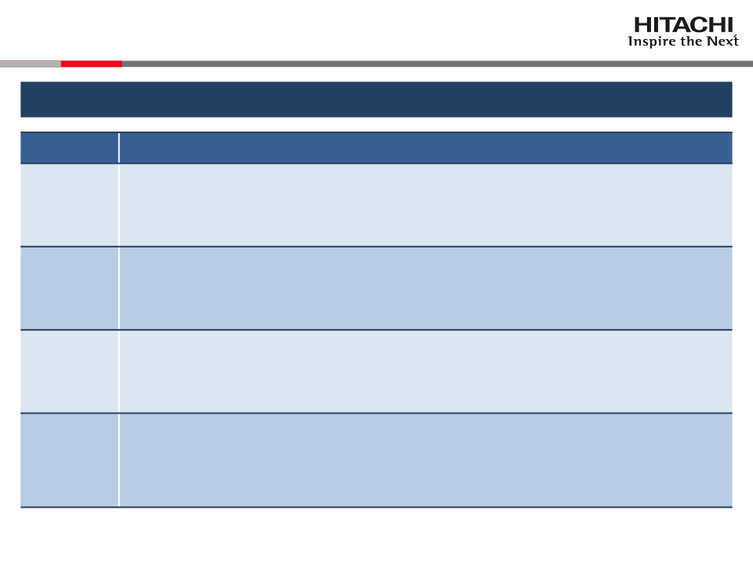
2-4 Accelerate Global Collaborative Creation with Customers
Position researchers close to customers to accelerate collaborative creation
Region
Tokyo
(APAC)
North
America
China
Europe
Research strategy
Co-create solutions with key accounts in the APAC region
leveraging customer collaborative creation methods developed
through service design research
Construct big data analytics platforms, and pursue collaborative
creation with customers in areas such as energy,
telecommunications, finance and healthcare
Strengthen collaborative creation with key accounts in elevators/
escalators, ATMs, etc. to realize solutions to industrial policies
such as low-carbon society and new-type urbanization
Together with major institutions, participate in market creation
through standardization activity in Europe, to realize solutions for
developed nations which resolve issues in mature society
© 2015 Hitachi, Ltd. All rights reserved.
14

Slide 16
Contents
1.
2.
3.
4.
Realignment of global R&D structure
For new growth
Strategic steps for the future
Summary
© 2015 Hitachi, Ltd. All rights reserved.

Slide 17
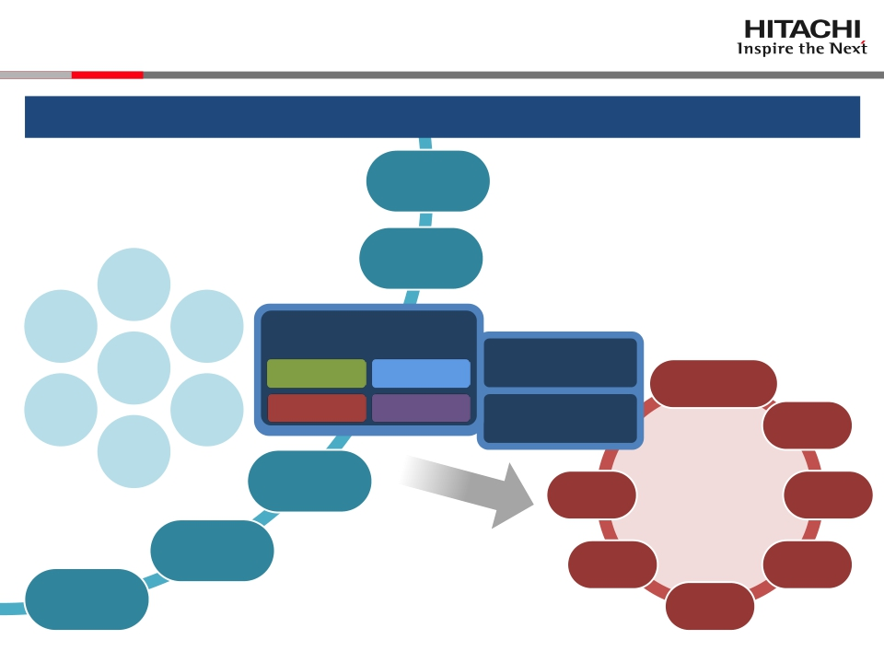
3-1 Pursue Vision-based Basic Research
Pioneer new frontiers through creative vision-driven exploratory research
Country/
Governments
Regional
communities
Open innovation
Agriculture
Space Education
Societal
information
Innovative
materials
Symbiotic
robot
Center for
Exploratory Research
Physical Information
sciences sciences
Life sciences Frontier
Universities
Hitachi Group
Information &
Telecommunication
Systems
Power &Energy
Urban
development
Transport
Healthcare
Water
Healthcare
& Natural resources
Global Center for
SocialInnovation
Center for
TechnologyInnovation
Financial
services
Advanced
medical
care
Infrastructure
Future
Social Innovation
Business areas
Logistics
Manufacturing
& Construction
Finance
Construction
machinery
Research
institutes
High
functional
materials
Automotive
systems
Private
industry
© 2015 Hitachi, Ltd. All rights reserved.
16

Slide 18
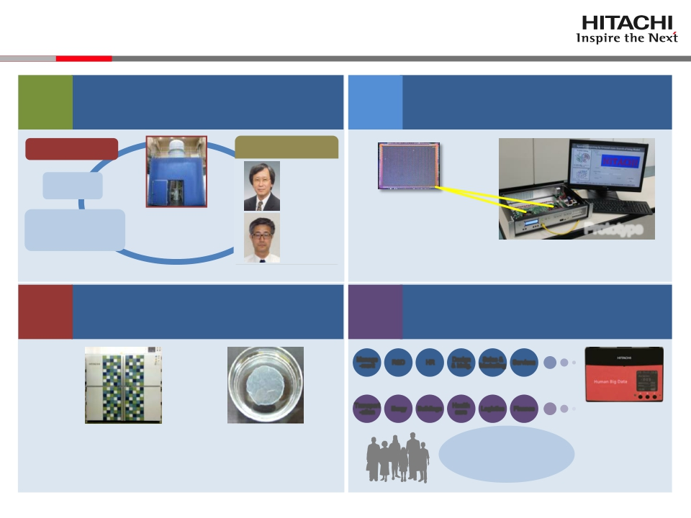
3-2 Case Examples
Realize an eco-friendly society by
creating innovative material using the
holography electron microscope
Inform-
ation
sciences
Realize a smart society by new
paradigm computing
Physical
sciences
Hitachi, Ltd.
NIMS
RIKEN
Prof.
TOKURA
Yoshinori
Prof.
SHINDO
Daisuke
“Ising chip” solving
combinatorial optimization
problem at ultra-high-speeds Prototype
Develop applications for the “Ising Chip”
Overseas/domestic
research institutes &
user companies
HolographyEM
World’s highest
resolution: 0.043 nm
Supported by the FIRST program (Cabinet Office) through JSPS
through industry-academia-government collaboration
Realize a healthy high QoL society by
innovations in automatic cell culturing
Realize increased organizational
productivity & satisfaction
through human big data analytics
Life
sciences
Frontier
Manage
-ment
R&D
HR
Design
& Mnfg.
Sales &
Marketing
Services
Applicable to many industries & operations
Transport
-ation
Energy
Buildings
Health
care
Logistics
Finance
Wearable sensor
Cell sheetAutomated cell culturing equipment
Devt. with the Tokyo Women’s Medical University
through broad industry-academia-government collaboration
Supported by MEXT program for the creation of innovation centers for advanced
interdisciplinary research. This work was based on the results of research supported
by NEDO.
Realize corporate
management
focusing on collective
happiness
Collaboration
with MIT & other
US universities
NIMS: National Institute for Material Science, EM: Electron microscope
CMOS: Complementary metal-oxide semiconductor, QoL: Quality-of-Life
© 2015 Hitachi, Ltd. All rights reserved.
17

Slide 19
Contents
1.
2.
3.
4.
Realignment of global R&D structure
For new growth
Strategic steps for the future
Summary
© 2015 Hitachi, Ltd. All rights reserved.

Slide 20
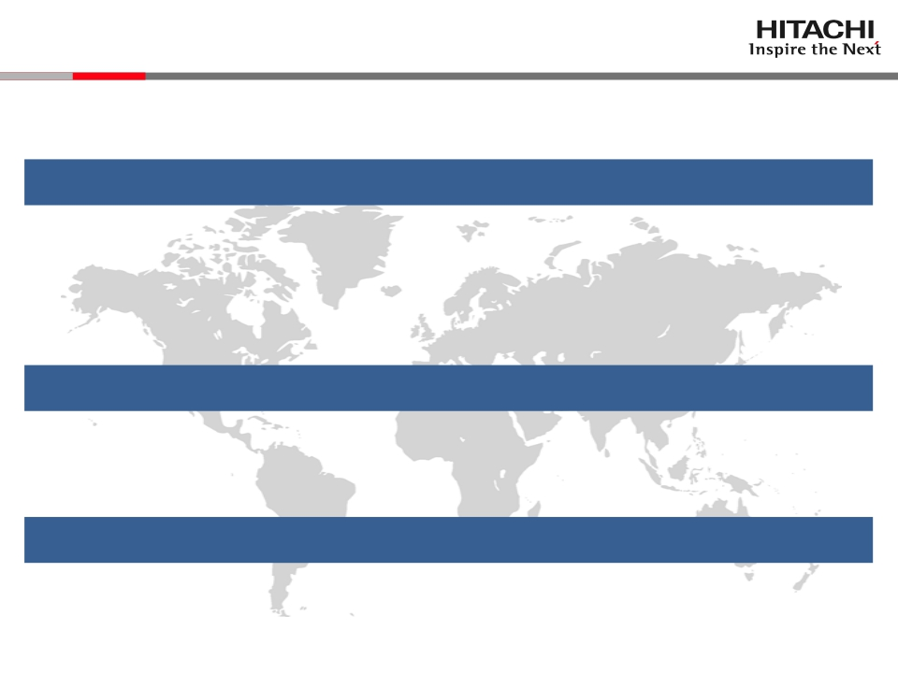
4 Summary
Global R&D leading Social Innovation Business
Realignment of global R&D structure
● Realign R&D organization to strengthen innovation
・ Global Center for Social Innovation
・ Center for Technology Innovation
・ Center for Exploratory Research
For new growth
● Build-up autonomous ADS platforms, expand business
● Accelerate global collaborative creation with customers
Strategic steps for the future
●As an innovation hub, pioneer new frontiers
© 2015 Hitachi, Ltd. All rights reserved.
19

Slide 21
END
2015 R&D strategy
Global R&D leading Social Innovation Business
15 April 2015
Keiji KOJIMA, Ph.D.
Vice President & Executive Officer
Chief Technology Officer
President & CEO, Research & Development Group
Hitachi, Ltd.
© 2015 Hitachi, Ltd. All rights reserved.
20

Slide 22


