Slide 1

Hitachi’s IP Strategy to Support Social Innovation Business
~ Competition + Co-creation ~
15 April 2015
Takashi Suzuki
Corporate Officer
General Manager
Intellectual Property Division
Hitachi, Ltd.
© Hitachi, Ltd. 2015. All rights reserved.

Slide 2
Contents
1. Expanding Footprint of IP Division
2. Securing IP Power Globally
3. Contributing to Competitive Strategy and Co-creation Strategy
© Hitachi, Ltd. 2015. All rights reserved.
1

Slide 3
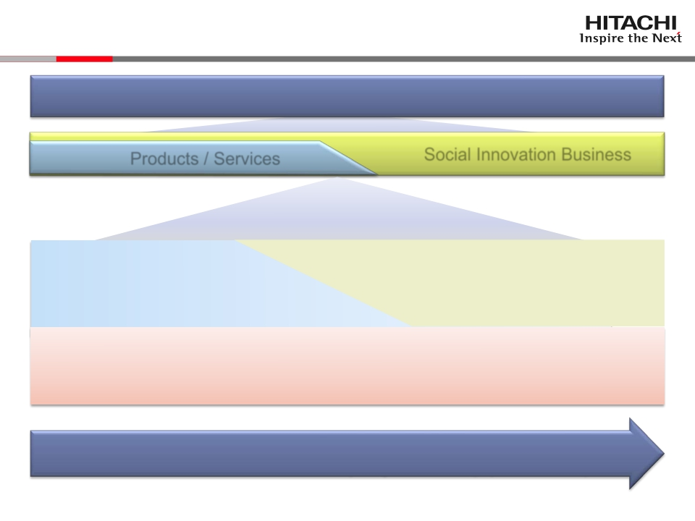
1. Expanding Footprint of IP Division
Serving the World with Our Social Innovation Business
Products / Services
Social Innovation Business
Let’s make it happen with the Power of Patents
Competitive Strategy
Exploiting IP power to create
barriers to entry →3-2, 3-3
Co-creation Strategy
Exploiting IP power to promote
partnerships →3-4, 3-5
Securing IP power globally (Attaining IP rights,
identifying and managing know-how)
→2-1, 2-2
Intellectual Property “Rights” Division
→ Intellectual Property Division (April 2015～)
© Hitachi, Ltd. 2015. All rights reserved.
協創戦略 （Co-creation）
パートナーシップ促進に知財力を活用
2

Slide 4
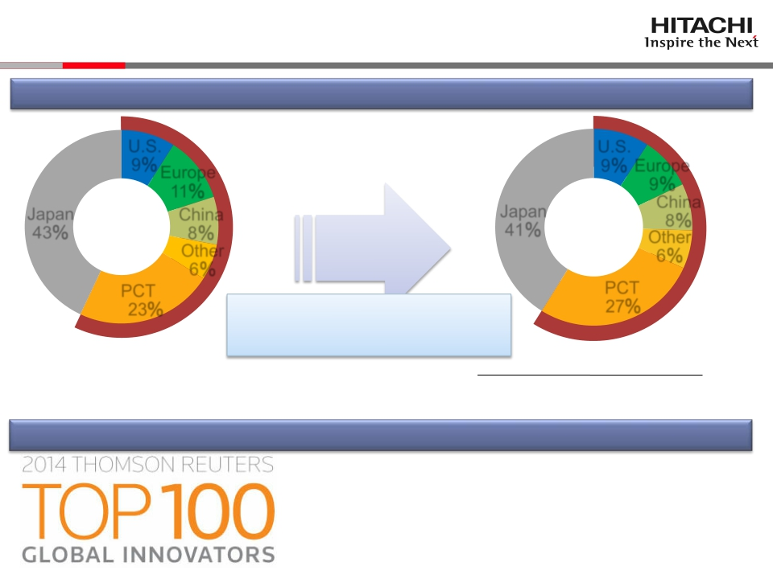
2-1. Securing IP Power Globally(1)
Utilizing PCT to cover potential markets globally and flexibly
U.S.
Europe
11％
FY2012 8％
Other
6％
U.S.
9％ Europe
9％
China
FY2014 8％
6％
9％
Japan
43％
China
Japan
41％
Other
PCT *1
23％
PCT
27％
Overseas Patent Appl. Ratio *2
57％⇒59％
PCT: Patent Cooperation Treaty
*1 Filing one patent application can have
an effect of filing multiple patent applications
*2 Overseas Patent Appl. Ratio = The number of overseas patent Applications
For each PCT application, we counted expected number of countries where
The number of patent Appl. filed W.W.
we plan to obtain patents.
Have received TOP 100 Global Innovators Award for four consecutive years
Award for innovative companies and
organizations selected based on patent data
© Hitachi, Ltd. 2015. All rights reserved.
3

Slide 5
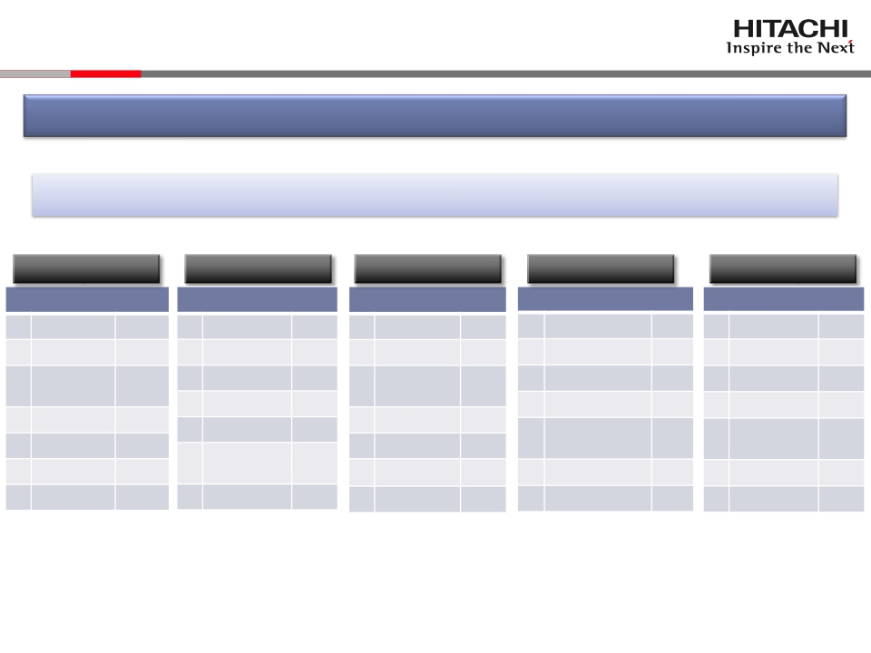
2-2. Securing IP Power Globally (2)
Globally building up patent portfolio comparable to the rivals in size
Patent Applications Published in 2014 (Granted patents for U.S.) *1
Japan
Corporate group
U.S.
Corporate group
PCT
Corporate group
China
Corporate group
Europe
Corporate group
1
Hitachi
8,300
1
IBM
7,600
1
Hitachi
2,400
1
Hitachi
2,000
1 Siemens
2,100
2
Toshiba
6,900
2
Toshiba
3,000
2 Siemens 2,200
2
Siemens
1,900
2
GE
1,000
3 Mitsubishi
4 MHI
5 GE
6 Siemens
5,200
2,300
900
300
3 GE 2,200
4 Hitachi 2,100
5 Siemens 1,900
6 Mitsubishi 900
3 Mitsubishi
4 Toshiba
5 GE
6 MHI
1,600
1,000
900
600
3
4
5
6
Toshiba
IBM
Mitsubishi
Electric
GE
1,300
1,300
1,200
1,200
3 Hitachi
4 Toshiba
5 Mitsubishi
6 MHI
700
600
500
400
Electric
Electric
Electric
Electric
7
IBM
300
7
MHI
400
7
IBM
500
7
MHI
300
7
IBM
100
*1 Hitachi’s survey on selected rivals using Shareresearch, Patolis, IFIPAT/Questel‐orbit, and Pat-List/CN.
The ranks are determined based on the number of the patent applications before rounding off
*2 Mitsubishi Heavy Industries
© Hitachi, Ltd. 2015. All rights reserved.
4

Slide 6
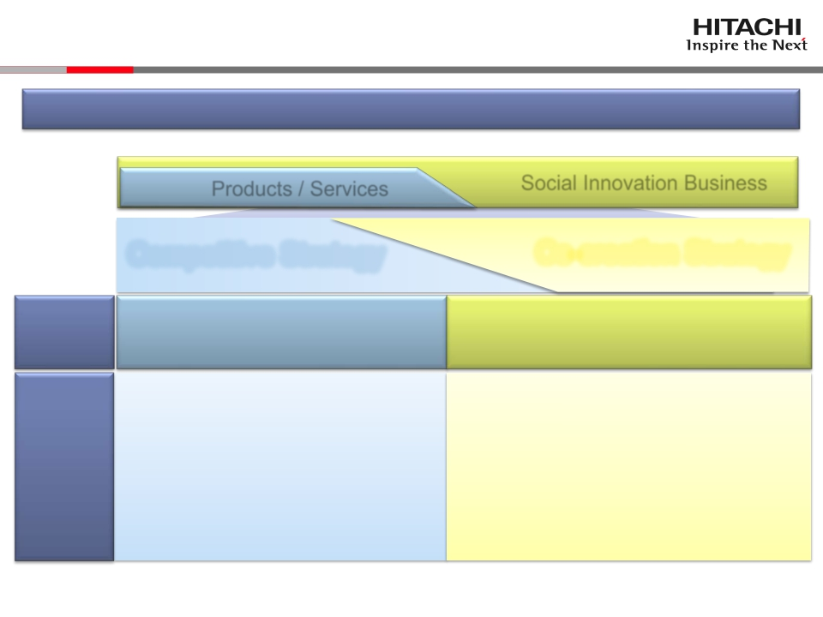
3-1. Contributing to Competitive and Co-creation Strategy
Aligning with the shift to social innovation business
Products / Services
Competitive Strategy
Building up barriers to entry
(1) Acquiring IP rights for points of
differentiation
(2) Against rivals,
· Deterring and excluding follow-ups
· Obtaining licensing fee
(3) Mitigating risks of rivals’ IP rights
Social Innovation Business
Co-creation Strategy
Promoting partnerships
(1) Maintaining IP for partner-appealing
points
(2) To the partners,
· promoting co-creation through
taking advantage of Hitachi’s IP
(3) Appropriately caring partners’ IP
Role of
IP
IP
Activities
© Hitachi, Ltd. 2015. All rights reserved.
5

Slide 7
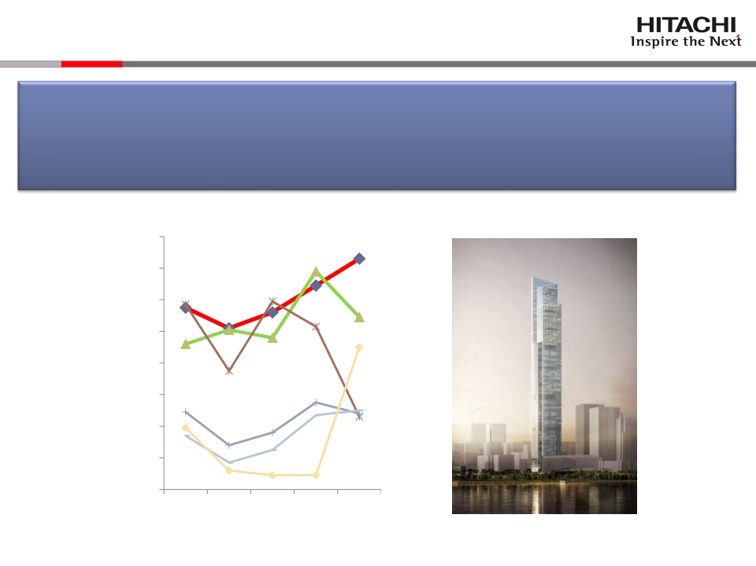
3-2. Contributing to Competitive Strategy: Elevator
● Reinforcing the patent portfolio in China, the largest market
● Appealed the technologies of the world’s fastest elevator for
Guangzhou CTF Finance Centre, with relevant patents, in one of
the largest elevator expo
*2
Hitachi
Group
Company A
Company B
Company C
Company D
Company E
© Hitachi, Ltd. 2015. All rights reserved.
PatentapplicationspublishedinChina(Elevator)
GuangzhouCTFFinanceCentre
(Rendering)
160
140
120
100
80
Number of patent applications published
60
*1)TheWorldElevator&EscalatorExpo2014
20092010201120122013
*2)Hitachi’ssurveyusingShareresearch
40
20
Publicationyear
0
6

Slide 8
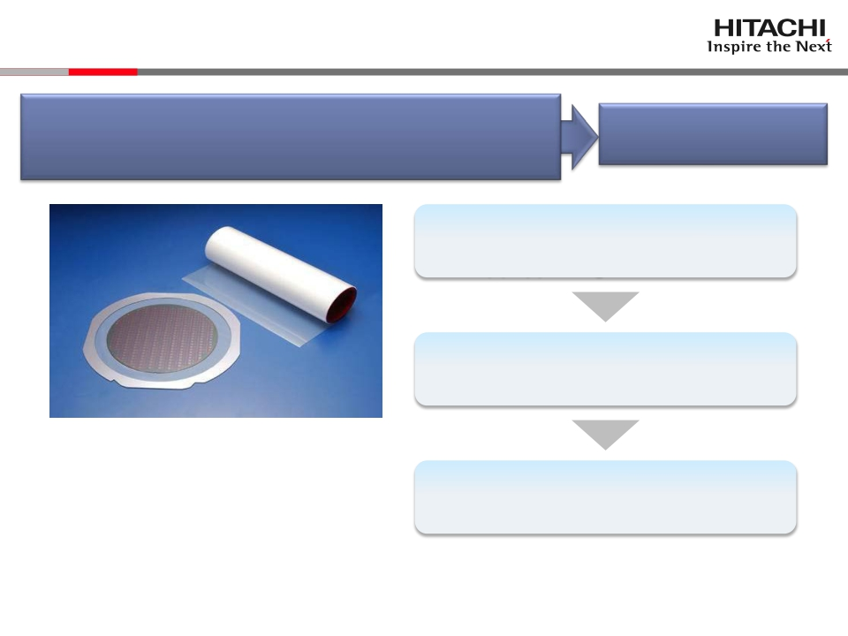
3-3. Contributing to Competitive Strategy:
Dicing Die Bonding Film
Appealed a patent to rivals and customers
Provided notice and filed a lawsuit against a
potential patent infringer
Deterring and
blocking follow-ups
Patent publicity including news releases
→(i) deterring rivals and
(ii) appealing to customers
Discovered a potential patent infringer
Dicing die bonding film
Dicing die bonding film:
Integrated film that combines the function of
dicing film which fixes the semiconductor
wafer to the work while the wafer is cut into
chips and the function of die bonding film
which adheres the cut semiconductor chips
to the substrate
Provided notice to respect the IP right
→Filed a lawsuit*
*) Hitachi Chemical dismissed the case upon
agreement from the both sides
© Hitachi, Ltd. 2015. All rights reserved.
7

Slide 9
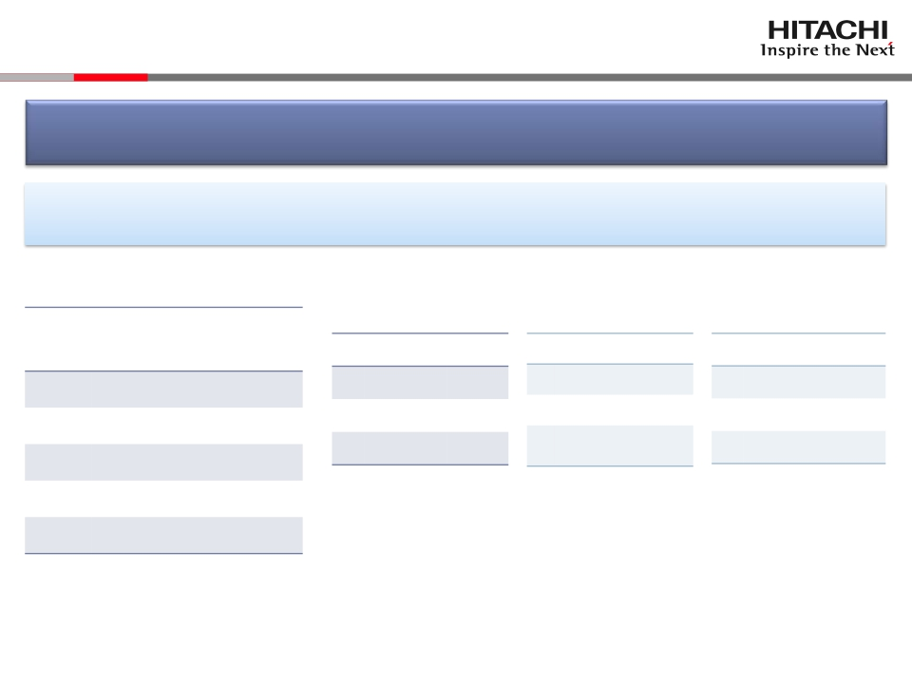
3-4. Contributing to Co-creation Strategy:
Appealing Technology to Customers
Globally building up the patent portfolio on Big-Data-related technology
Promoting co-creation by the technologies backed-up by patent portfolio
Big-Data-related technology patent applicant ranking
(Sum of patent appl. to Japan, U.S., Europe, China &Korea. A survey by Japan Patent Office)
Total
Segmentation by field of technology
Base technology for
Technology for data
Technology for data
# of
appl.
data analysis*2
Applicant
stream analysis
Applicant #
stock analysis*3
Applicant #
Rank Applicant
#
1
2
3
IBM*1
Hitachi
Microsoft*1
1,967
1,682
1,130
1 Hitachi
2 IBM
…
1,217
658
1 IBM
…
3 Hitachi
108
71
1 IBM
…
3 Hitachi
1,309
442
4
5
Fujitsu
NTT
610
548
Japan Patent Office, “2013 Patent Application Survey on Big Data
Analysis Technology”
*1: U.S.
*2: Distributed file system/DB, privacy protection, parallel distributed system, data
falsification protection, and other base technology for data analysis
*3: Pre-processing technology for data stock analysis, database for analysis,
technology for data analysis
© Hitachi, Ltd. 2015. All rights reserved.
8

Slide 10
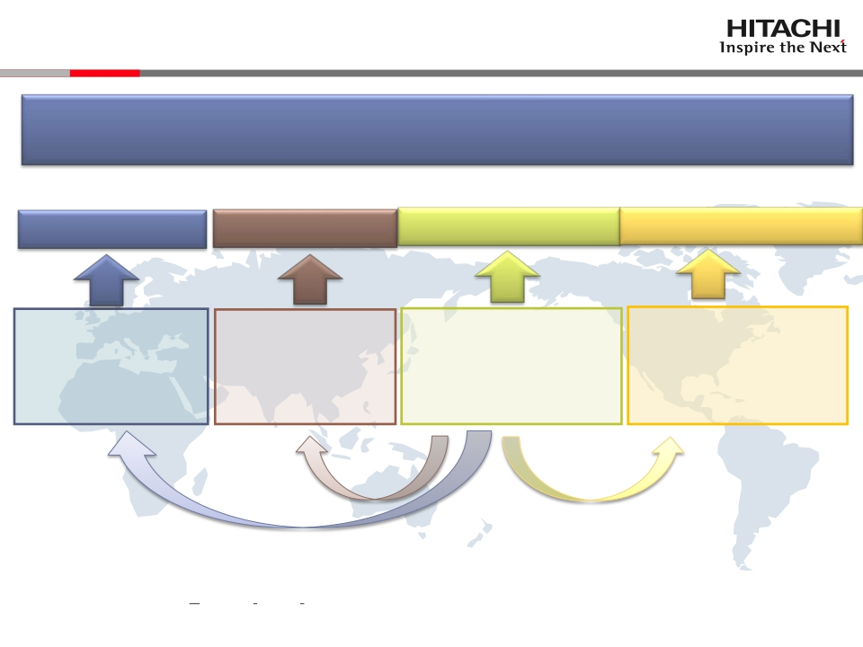
3-5. Contribution to Co-Creation Strategy：：
Global IP Support
■Supporting co-creation activities from local IP sites
■Transferring IP Practice from Intellectual Property Division in Japan
ＣＳＩ Europe
IP Site in Europe
・Munich
ＣＳＩ China
IP Site in China
・Beijing
・Shanghai
ＣＳＩ Tokyo(APAC)
Intellectual
Property Division
・Tokyo, Hitachi, Yokohama
・ Customer Co-Creation
IP Center(15/4-)
ＣＳＩ North America
IP Site in
North America
・San Francisco
・New York
・Santa Clara
◆Maintaining IP for co-creation
◆Appropriately caring partners’ IP
CSI：Global Center for Social Innovation
APAC：Asia Pacific
© Hitachi, Ltd. 2015. All rights reserved.
9

Slide 11
END
Hitachi’s IP Strategy to Support Social Innovation Business
~ Competition + Co-creation ~
Takashi Suzuki
Corporate Officer
General Manager
Intellectual Property Division
Hitachi, Ltd.
© Hitachi, Ltd. 2015. All rights reserved.
10

Slide 12


