Slide 1

Financial Results for the Six Months
Ended September 30, 2014
November 7, 2014

Slide 2


The forward-looking statements and projected figures concerning the future performance of NTT
and its subsidiaries and affiliates contained or referred to herein are based on a series of
assumptions, projections, estimates, judgments and beliefs of the management of NTT in light of
information currently available to it regarding NTT and its subsidiaries and affiliates, the economy
and telecommunications industry in Japan and overseas, and other factors. These projections
and estimates may be affected by the future business operations of NTT and its subsidiaries and
affiliates, the state of the economy in Japan and abroad, possible fluctuations in the securities
markets, the pricing of services, the effects of competition, the performance of new products,
services and new businesses, changes to laws and regulations affecting the telecommunications
industry in Japan and elsewhere, other changes in circumstances that could cause actual results
to differ materially from the forecasts contained or referred to herein, as well as other risks
included in NTT’s most recent Annual Report on Form 20-F and other filings and submissions
with the United States Securities and Exchange Commission.
* “E” in this material represents that the figure is a plan or projection for operation.
** “FY” in this material indicates the fiscal year ending March 31 of the succeeding year.
*** “2Q” in this material represents the 6-month period beginning on April 1 and ending on September 30.
Financial Results for the Six Months Ended September 30, 2014
－1－
Copyright (c) 2014 Nippon Telegraph and Telephone Corporation

Slide 3

FY2014/2Q Highlights
Operating Revenues increased for the fifth consecutive year due to the growth of overseas businesses.
Operating Income decreased due to a larger decrease in profit of the Mobile communications segment despite an
increase in profit of the Regional communications segment and the Data communications segment.
(Billions of yen)
FY2014/2Q
FY2013/2Q
Change
year-on-year
+107.6
+169.7
(62.1)
(33.2)
% Year-on-Year
Increase
(Decrease)
+2.0%
+3.7%
(9.5)%
(10.3)%
Operating
Revenues
Operating
Expenses
Operating
Income
*Net Income
5,373.7
4,782.7
590.9
290.3
5,266.1
4,613.0
653.0
323.5
*
Net income represents net income attributable to NTT, excluding noncontrolling interests.
Financial Results for the Six Months Ended September 30, 2014
－2－
Copyright (c) 2014 Nippon Telegraph and Telephone Corporation

Slide 4
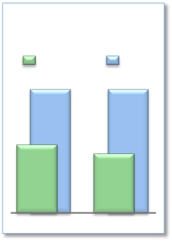
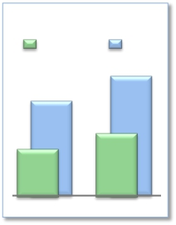
FY2014/2Q Highlights
Operating Revenues increased for the fifth consecutive year,
while Operating Income decreased
Consolidated
Operating Income
(Billions of yen)
2Q
1,213.7
653.0
FY2013
FY
1,215.0
(Previous
forecast)
590.9
FY2014
Expansion of global cloud services
➢Cross-selling order volume: approximately $117 million
➢Promoting M&A
· Proposal to acquire Oakton Limited, an Australia-based ICT service provider
➢NTT Group holds the largest data center space in the world
➢Overseas sales: +￥￥190.6 billion increase year-on-year; growth of 29% when
discounting the effects of the depreciating yen
Enhanced competitiveness of network services
➢Expansion of NTT’s user base
Global Revenues
(Billions of yen)
· Number of new rate plan subscribers exceeded 9.43 million
2Q
1,196.0
556.9
FY2013
FY
1,530.0
(Previous
forecast)
747.5
FY2014
· Net increase of 1.19 million mobile phone subscribers from the end of FY2013 (0.95
million increase from FY2013/2Q)
· 18.45 million FLET’S Hikari subscribers (net increase of 0.40 million)
· 4.18 million Hikari TV and FLET’S TV subscribers (net increase of 0.20 million)
➢Cost reductions
· Fixed-line and mobile access cost reductions: NTT achieved cost reductions of ¥90
billion yen during FY2014/2Q, out of its annual target of ¥190 billion
Shareholder Returns
➢ NTT passed a resolution to increase the amount of cash available to repurchase shares of its
common stock from ¥250.0 billion to ¥350.0 billion.
Financial Results for the Six Months Ended September 30, 2014
－3－
Copyright (c) 2014 Nippon Telegraph and Telephone Corporation

Slide 5
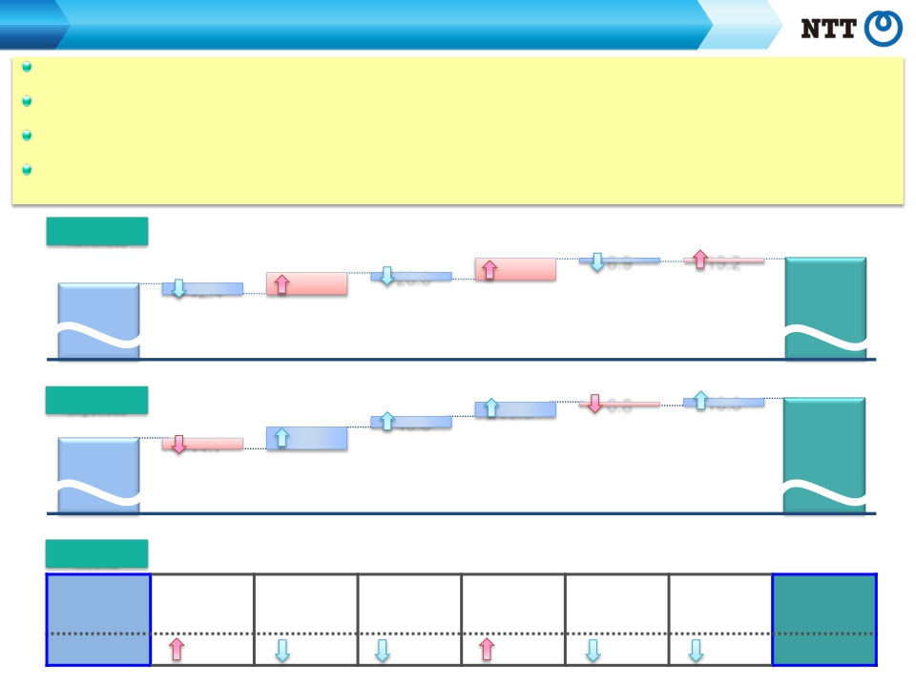
Consolidated Results and Forecasts (U.S. GAAP)
FY2014/2Q Contributing Factors by Segment
Regional communications business: Operating Income increased as a result of continued efforts to improve operational efficiency, despite the
increased impact of FLET’S Hikari discounts.
Long distance and international communication business: Although Operating Income decreased year-on-year, profit improvement in overseas
businesses contributed to an increase in profit for the six-month period ended September 30.
Mobile communications business: Operating Income decreased due to the increased impact of “Monthly Support” discount programs and the effect of
new rate plans to decrease Operating Revenues.
Data communications business: Operating Income increased due to the effect of reducing unprofitable transactions, in addition to the improvement of
gross margin in conjunction with an increase in sales.
Operating
Revenues
5,266.1
FY2013/2Q
[year-on-year：+107.6]
86.1
Regional Long distance and
communications
international
business
communications
business
Mobile
communications
business
26.0
Data
communications
business
81.7
Other
business
6.9
(Billions of yen)
15.2
Elimination of
5,373.7intersegment/Others
FY2014/2Q
42.4
Operating
Expenses
4,613.0
FY2013/2Q
Operating
Income
FY2013/2Q
[year-on-year：+169.7]
91.2
Long distance and
communications
business
[year-on-year： (62.1)]
Regional
Long distance and
international
communications
communications
business
business
60.6
Data
communications
business
Data
communications
business
0.8
Other
business
Other business
16.6
Elimination of
intersegment/Others
Elimination of
intersegment/
Others
46.8
Mobile
communications
business
Mobile
communications
business
44.7
4,782.7
FY2014/2Q
FY2014/2Q
Regional
international
business
communications
653.0
2.2
5.1
72.8
21.1
6.1
1.5
590.9
Financial Results for the Six Months Ended September 30, 2014
－4－
Copyright (c) 2014 Nippon Telegraph and Telephone Corporation

Slide 6
Consolidated Results and Forecasts (U.S. GAAP)
Consolidated Forecasts for FY2014
Forecasts for both Operating Revenues and Operating Income have been adjusted due to the
higher-than-expected spread of new rate plans
(Billions of yen)
FY2014
Forecasts
% Progress
(Billions of yen)
FY2014
FY2014/2Q
Compared to
Change
from Initial
Forecasts
(190.0)
(70.0)
(120.0)
(57.0)
(57.00)
Forecasts
48.8%
48.2%
54.0%
54.9%
Operating Revenues
Operating Expenses
Operating Income
Net Income
EPS(yen)
11,010.0
9,915.0
1,095.0
529.0
479.00
5,373.7
4,782.7
590.9
290.3
*
*
Net income represents net income attributable to NTT, excluding noncontrolling interests.
Financial Results for the Six Months Ended September 30, 2014
－5－
Copyright (c) 2014 Nippon Telegraph and Telephone Corporation

Slide 7

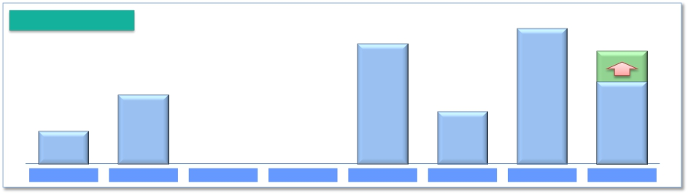
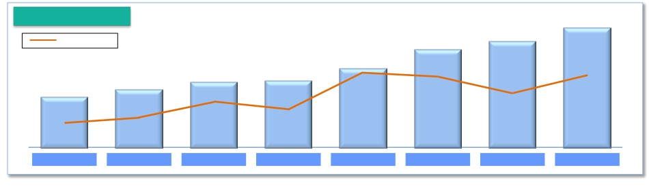
Shareholders Returns
Share buybacks: NTT passed a resolution to increase the cash available to repurchase
shares of its common stock from ¥250.0 billion to ¥350.0 billion.
Dividend: An annual dividend of ¥180 per share for FY2014
Share buybacks
406.5
(Billions of yen)
Up to
350.0
381.7
200.0
150.0
94.4
FY2007
Up to
250.0
2014.11-2015.6
FY2008
FY2009
FY2010
FY2011
FY2012
FY2013
Dividend per share
180
(yen)
160
●
37.2%
FY2012
170
●
33.4%
FY2013
Payout ratio
●
90
●
19.5%
FY2007
140
●
38.2%
FY2011
120
●
32.3%
FY2009
120
●
31.2%
FY2010
110
●
27.5%
FY2008
●
37.6%
FY2014E
Financial Results for the Six Months Ended September 30, 2014
－6－
Copyright (c) 2014 Nippon Telegraph and Telephone Corporation

Slide 8


Medium-Term Management Strategy,
“Towards the Next Stage” Update

Slide 9

Current Status of Medium-Term Management Strategy
Steady Progress in Transformation of NTT’s Business Structure
- Toward a multifaceted competitive model based on innovation and collaboration
- Transforming NTT itself as a “Value Partner”
Ⅰ
Ⅱ
“Global Cloud Services” as the Cornerstone of NTT’s Business Operations
Enable provision of fully-stacked, full-lifecycle services
Plan to reach $15 billion in overseas sales volume in FY 2014
Comprehensively Strengthen Network Service Competitiveness
Comprehensively reduce cost in fixed and mobile access networks
Execute proactive initiatives such as NTT DOCOMO’s “New Billing Plan” and
NTT East and NTT West’s “Hikari Collaboration Model”
EPS Growth Still in Progress
Focus on profit growth, which is still in progress despite the completion of a change
in course towards a new direction
Restart for growth in profits
At the announcement of FY 2014 results,
NTT will upgrade its strategy to “Towards the Next Stage 2.0”
Financial Results for the Six Months Ended September 30, 2014
－7－
Copyright (c) 2014 Nippon Telegraph and Telephone Corporation

Slide 10
“Towards the Next Stage 2.0”
Continuous Enhancement of Fundamental Business Strategies
Ⅰ
Ⅱ
Accelerate Speed of Profit Generation of “Global Cloud Services”
Continue to make anticipatory investments for profit growth
Develop operations combining strengths of the whole group
Accelerate the optimization of operations
Enhance Profitability of Network Services
Cut costs in all business processes
Provide value-added services through collaboration with various industry players
Expansion of B2B2X Business
Support business model transformation of our clients as a “Value Partner”
➢ Create new business models with sophisticated Wi-Fi platforms
➢ Contribute to the “Vitalization of Local Economies” by resolving various issues facing
each local region
➢ Support the innovation of various industry players in anticipation of 2020
Enhance NTT’s security business, essential for a safe and secure society
Earnings Per Share
Set new goals based on FY 2014 results
Financial Results for the Six Months Ended September 30, 2014
－8－
Copyright (c) 2014 Nippon Telegraph and Telephone Corporation

Slide 11



(Reference) Cybersecurity Training Initiatives
Strengthen NTT Group’s Cybersecurity Training
Develop capacity for approximately 10,000 domestic cybersecurity experts by 2020
➢ Develop and deploy training programs throughout NTT Group
Contribute to Japan’s Cybersecurity Training
Establish a “Cyber-attack and Cyber-defense Technologies” course at Waseda
University in April 2015
➢ Expand to other universities subsequently through collaboration with
participating companies
Assist in providing an “Information Security for Complete Novices” course through
“gacco*” in May 2015
*MOOC (Massive Open Online Courses) provided by NTT DOCOMO and NTT Knowledge Square
Strengthen NTT Group’s Cybersecurity Training
Cybersecurity Experts
(Domestic)
Approx. 2,500
people
Present
Approx. 10,000
people
2020
① Produce “Top Gun” class of experts
② Build-up of specialists
③ Raise the cybersecurity skill level
of engineers
50-100
people
2,000
people
8,000
people
Financial Results for the Six Months Ended September 30, 2014
－9－
Copyright (c) 2014 Nippon Telegraph and Telephone Corporation

Slide 12
Progress of Broadband Services

Slide 13



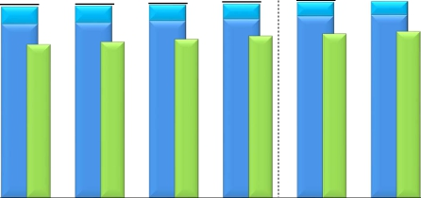

Progress of Broadband Services
Number of Subscribers for Fixed Broadband Services
Number of subscribers
(Thousands)
FLET’S ADSL
FLET’S Hikari
Hikari Denwa
20,000
15,000
10,000
5,000
0
19,271
1,751
17,521
15,412
2013.6
19,335
1,663
17,672
15,664
2013.9
19,444
1,572
17,873
15,950
2013.12
19,534
1,483
18,050
16,256
2014.3
19,717
1,398
18,319
16,507
2014.6
19,788
1,333
18,455
16,705
2014.9
19,954
1,203
18,750
17,106
2015.3E
Changes from the preceding quarter
FY2013
10-12
FY2014
7-9
(Thousands)
FY2014E
4-6
7-9
1-3
4-6
4-9
FY2013
FLET’S Hikari*
1
220
152
200
178
269
136
405
750
700
Number of
opened
connections
FLET’S ADSL
*3
Hikari Denwa
870
(98)
242
707
(88)
252
743
(91)
287
811
(89)
305
879
(85)
251
683
(65)
199
1,562
(150)
450
3,131
(365)
1,087
3,000
(280)
850
*
2
*
1 Number of FLET’S Hikari subscribers includes B FLET’S, FLET’S Hikari Next, FLET’S Hikari Light and FLET’S Hikari WiFi Access provided by NTT East and B FLET’S,
FLET’S Hikari Premium, FLET’S Hikari Mytown, FLET’S Hikari Next, FLET’S Hikari Light and FLET’S Hikari WiFi Access provided by NTT West.
* 2 Number of opened connections excludes openings due to relocations.
*
3 Number of Hikari Denwa subscribers is presented in thousands of channels.
Financial Results for the Six Months Ended September 30, 2014
－10－
Copyright (c) 2014 Nippon Telegraph and Telephone Corporation

Slide 14

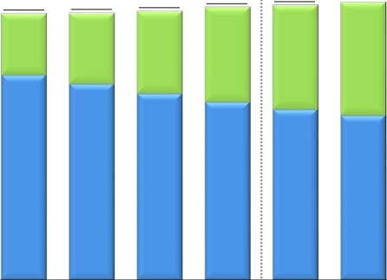


Progress of Broadband Services
Number of Subscribers for Mobile Broadband Services
*
Number of subscribers
(Thousands)
70,000
Xi
FOMA
61,623
61,772
62,182
63,105
63,566
64,295
67,000
60,000
50,000
40,000
30,000
20,000
10,000
0
14,198
47,425
2013.6
16,398
45,374
2013.9
19,021
43,160
2013.12
21,965
41,140
2014.3
24,043
39,523
2014.6
26,215
38,080
2014.9
29,700
37,300
2015.3E
Changes from the preceding quarter
FY2013
10-12
FY2014
7-9
(Thousands)
FY2014E
4-6
7-9
1-3
4-6
4-9
FY2013
Xi+FOMA
87
149
410
924
461
729
1,190
1,569
3,900
*
The number of communication module service subscribers is included in FOMA subscribers.
Financial Results for the Six Months Ended September 30, 2014
－11－
Copyright (c) 2014 Nippon Telegraph and Telephone Corporation

Slide 15






Progress of Broadband Services
*
ARPU of Fixed Broadband Services (FLET’S Hikari)
NTT East
(Yen)
Optional Service
Basic Monthly Charge
6,000
4,000
2,000
0
5,750
1,760
3,990
5,680
1,760
3,920
5,650
1,790
3,860
5,570
1,770
3,800
5,460
1,770
3,690
5,450
1,750
3,700
5,660
1,770
3,890
5,500
1,800
3,700
FY2013
FY2014
FY2013
FY2014E
4-6
7-9
10-12
1-3
4-6
7-9
NTT West
(Yen)
6,000
4,000
2,000
0
5,840
1,770
4,070
5,850
1,790
4,060
5,850
1,820
4,030
5,800
1,810
3,990
5,750
1,810
3,940
5,700
1,800
3,900
5,830
1,800
4,030
5,720
1,830
3,890
FY2013
FY2014
FY2013
FY2014E
4-6
7-9
10-12
1-3
4-6
7-9
*
FLET’S Hikari includes B FLET’S, FLET’S Hikari Next, FLET’S Hikari Light and FLET’S Hikari WiFi Access provided by NTT East and B FLET’S, FLET’S Hikari Premium,
FLET’S Hikari Mytown, FLET’S Hikari Next, FLET’S Hikari Light and FLET’S Hikari WiFi Access provided by NTT West. Please see page 26 regarding the calculation of ARPU.
Financial Results for the Six Months Ended September 30, 2014
－12－
Copyright (c) 2014 Nippon Telegraph and Telephone Corporation

Slide 16
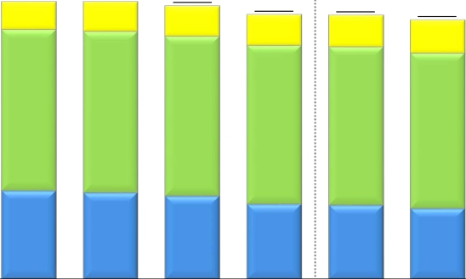

Progress of Broadband Services
ARPU of Mobile Broadband Services (Xi, FOMA)*
Smart ARPU
Packet ARPU
Voice ARPU
(Yen)
5,000
4,000
3,000
2,000
1,000
0
4,680
470
2,720
1,490
4,680
500
2,720
1,460
4,610
510
2,700
1,400
4,610
500
2,700
1,410
4,460
520
2,680
1,260
4,450
530
2,670
1,250
4,370
560
2,620
1,190
4,350
570
2,600
1,180
FY2013
10-12
FY2014
FY2013
FY2014E
4-6
7-9
1-3
4-6
7-9
* NTT DOCOMO‘s ARPU calculation methods have been changed from the second quarter of the fiscal year ending March 31, 2015. Accordingly, the ARPU data for the
results for the three months ended Jun. 30, 2013 (from Apr. to Jun., 2013), the three months ended Sep. 30, 2013 (from Jul. to Sep., 2013), the three months ended Dec. 31,
2013 (from Oct. to Dec., 2013), the three months ended Mar. 31, 2014 (from Jan. to Mar., 2014), the year ended Mar. 31, 2014 and the three months ended Jun. 30, 2014
(from Apr. to Jun., 2014) presented above have also been changed.
Please see page 26 regarding the calculation of ARPU.
Financial Results for the Six Months Ended September 30, 2014
－13－
Copyright (c) 2014 Nippon Telegraph and Telephone Corporation

Slide 17


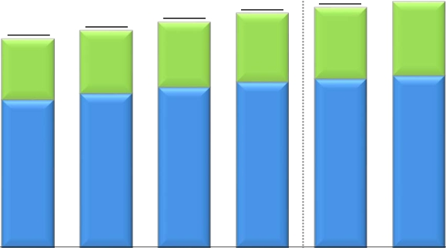
Progress of Broadband Services
Number of Subscribers for Video Services
FLET'S TV
Hikari TV
*
(Thousands)
5,000
4,546
1,346
3,200
FY2014E
4,086
1,209
2,877
2014.6
4,183
1,256
2,927
2014.9
3,841
1,113
2,727
2013.12
3,984
1,161
2,823
2014.3
4,000
3,000
2,000
1,000
0
3,692
1,067
2,625
2013.9
3,552
1,032
2,520
2013.6
*
“FLET’S TV” requires a subscription to “FLET’S TV Transmission Service,” provided by NTT East and NTT West, and a subscription to Opticast Inc.’s “Opticast Facility Use
Services” broadcast service.
Financial Results for the Six Months Ended September 30, 2014
－14－
Copyright (c) 2014 Nippon Telegraph and Telephone Corporation

Slide 18
Financial Information

Slide 19













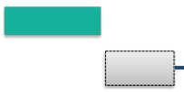



Subsidiaries’ Results (JPN GAAP Non-Consolidated)
NTT East Financial Results
(Billions of yen)
FY2014/2Q
8.7
(1.0)%
FY2014E
2.8
(0.2)%
Operating
Revenues
Same as
Initial Forecast
Progress
49.2%
1,773.8
FY2013
1,771.0
FY2014E
879.9
FY2013/2Q
871.2
FY2014/2Q
Voice Transmission Services
IP Services
Others
(54.3)
(1.3)
+52.8
Voice Transmission Services
IP Services
Others
(25.4)
(2.6)
+19.3
Operating
Expenses
15.0
(1.8)%
26.0
(1.5)%
Progress
48.3%
Same as
Initial Forecast
826.9
FY2013/2Q
Personnel expenses (3.6)
and services and other expenses (15.6)
Depreciation expenses and loss
+4.2
on disposal of assets
811.8
FY2014/2Q
1,707.0
FY2013
Personnel expenses
Expenses for purchase of goods
and services and other expenses
Depreciation expenses and loss
on disposal of assets
(4.9)
(24.2)
+3.1
1,681.0
FY2014E
Expenses for purchase of goods
Operating
Income
Progress
Same as
6.2
+11.8%
65.9%
59.3
23.2
+34.9%
Initial Forecast
90.0
53.0
66.7
Financial Results for the Six Months Ended September 30, 2014
－15－
Copyright (c) 2014 Nippon Telegraph and Telephone Corporation

Slide 20










Subsidiaries’ Results (JPN GAAP Non-Consolidated)
NTT West Financial Results
(Billions of yen)
FY2014/2Q
6.3
(0.8)%
FY2014E
7.6
(0.5)%
Operating
Revenues
Same as
Initial Forecast
Progress
49.1%
1,589.6
FY2013
1,582.0
FY2014E
782.8
FY2013/2Q
776.4
FY2014/2Q
Voice Transmission Services
IP Services
Others
(50.3)
+13.3
+29.3
Voice Transmission Services
IP Services
Others
(25.4)
+5.8
+13.1
Operating
Expenses
4.0
(0.5)%
26.2
(1.7)%
Progress
49.1%
Same as
Initial Forecast
763.4
FY2013/2Q
Personnel expenses
Expenses for purchase of goods
and services and other expenses
Depreciation expenses and loss
on disposal of assets
(1.1)
(3.0)
+0.1
759.4
FY2014/2Q
1,573.2
FY2013
Personnel expenses
Expenses for purchase of goods
and services and other expenses
Depreciation expenses and loss
on disposal of assets
+0.5
(27.8)
+1.1
1,547.0
FY2014E
Operating
Income
Progress
Same as
2.3
(11.9)%
48.7%
17.0
18.6
+113.7%
Initial Forecast
35.0
19.3
16.3
Financial Results for the Six Months Ended September 30, 2014
－16－
Copyright (c) 2014 Nippon Telegraph and Telephone Corporation

Slide 21

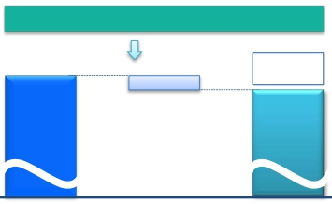








Subsidiaries’ Results (JPN GAAP Non-Consolidated)
NTT Communications Financial Results
(Billions of yen)
FY2014/2Q
16.7
(3.7)%
FY2014E
34.0
(3.6)%
Operating
Revenues
Same as
Initial Forecast
Progress
48.3%
944.0
FY2013
910.0
FY2014E
455.9
FY2013/2Q
Cloud Computing Platforms
Data Networks
Voice Communications
Solution Services
Others
+6.5
(11.5)
(12.8)
+0.0
+1.1
439.2
FY2014/2Q
Cloud Computing Platforms
Data Networks
Voice Communications
Solution Services
Others
+13.0
(20.5)
(20.4)
(8.6)
+2.4
Operating
Expenses
23.5
(2.8)%
Same as
Initial Forecast
4.4
(1.1)%
Progress
48.5%
395.8
FY2013/2Q
Personnel expenses
Expenses for purchase of goods
and services and other expenses
Depreciation expenses and loss
on disposal of assets
(0.9)
(2.9)
(0.4)
391.4
FY2014/2Q
830.5
FY2013
Personnel expenses
Expenses for purchase of goods
and services and other expenses
Depreciation expenses and loss
on disposal of assets
(2.3)
(22.2)
+1.0
807.0
FY2014E
Operating
Income
Progress
46.4%
Same as
Initial Forecast
12.2
10.4
60.0
(20.5)%
47.7
113.4
(9.2)%
103.0
Financial Results for the Six Months Ended September 30, 2014
－17－
Copyright (c) 2014 Nippon Telegraph and Telephone Corporation

Slide 22












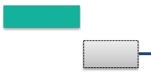


Subsidiaries’ Results (U.S GAAP Consolidated)
NTT DOCOMO Financial Results
(Billions of yen)
FY2014/2Q
26.0
(1.2)%
FY2014E
61.2
(1.4)%
Operating
Revenues
Decrease of 190
from Initial Forecast
Progress
49.4%
4,461.2
4,400.0
2,199.0
FY2013/2Q
2,173.0
FY2014/2Q
FY2013
FY2014E
128.0
+3.5%
Decrease of 70
from Initial Forecast
Operating
Expenses
47.6
+2.8%
Progress
47.0%
1,725.8
FY2013/2Q
1,773.4
FY2014/2Q
3,642.0
FY2013
3,770.0
FY2014E
Operating
Income
Progress
Decrease of 120
73.6
(15.5)%
63.4%
399.6
189.2
(23.1)%
from Initial Forecast
630.0
473.2
819.2
Financial Results for the Six Months Ended September 30, 2014
－18－
Copyright (c) 2014 Nippon Telegraph and Telephone Corporation

Slide 23
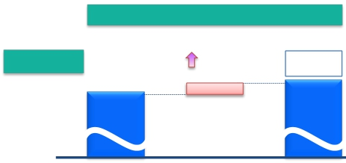
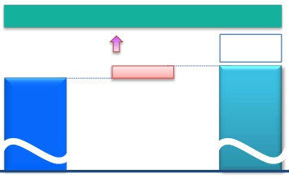






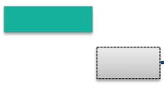
Subsidiaries’ Results (JPN GAAP Consolidated)
NTT DATA Financial Results
(Billions of yen)
FY2014/2Q
82.8
+13.5%
FY2014E
116.2
+8.6%
Same as
Initial Forecast
Operating
Revenues
Progress
47.7%
1,343.7
1,460.0
613.0
FY2013/2Q
695.8
FY2014/2Q
FY2013
FY2014E
93.8
+7.3%
Same as
Initial Forecast
Operating
Expenses
63.4
+10.4%
Progress
49.0%
610.3
FY2013/2Q
673.8
FY2014/2Q
1,281.1
FY2013
1,375.0
FY2014E
Operating
Income
Progress
25.9%
Same as
Initial Forecast
19.3
22.4
2.6
―%
22.0
62.5
+35.8%
85.0
Financial Results for the Six Months Ended September 30, 2014
－19－
Copyright (c) 2014 Nippon Telegraph and Telephone Corporation

Slide 24





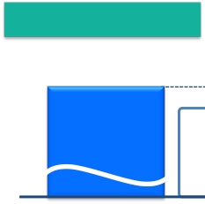



Details of Difference Between Consolidated Operating Income and Total Operating Income of
5 Major Subsidiaries
FY2013/2Q
5.6
39.2
(Billions of yen)
608.2
Total operating income
of 5 major subsidiaries
(JPN GAAP)
FY2014/2Q
・NTT (Holding Company): 2.9 ・Pension (actuarial difference, etc.): 9.5・Depreciation of engineering facilities: (13.0)
・NTT URBAN DEVELOPMENT (Consolidated): 17.8 ・Adjustments between operating and non-
・NTT COMWARE: (0.1) operating items, including eliminations, etc.
・NTT FINANCE (Consolidated): 9.0
・Outsourcing companies (East): 3.6
・Outsourcing companies (West): (4.4)
・Other companies: 10.3
Total operating income of subsidiaries other than Elimination and
the 5 major subsidiaries (excluding the effect of U.S. GAAPadjustments
dividends received by NTT (Holding Company))
8.5
53.6
653.0
Consolidated operating
income
(U.S. GAAP)
545.7
Total operating income
of 5 major subsidiaries
(JPN GAAP)
・ Pension (actuarial difference, etc): 9.4
・Depreciation of engineering facilities: (10.8)
・Adjustments between operating and non-operating
items, including eliminations, etc.
Elimination and
U.S. GAAP
adjustments
590.9
Consolidated operating
income
(U.S. GAAP)
・NTT (Holding Company): 2.2
・NTT URBAN DEVELOPMENT (Consolidated): 13.2
・NTT COMWARE: 0.4
・NTT FINANCE (Consolidated): 9.8
・Outsourcing companies (East): 5.3
・Outsourcing companies (West): 4.7
・Other companies: 17.8
Total operating income of subsidiaries other than
the 5 major subsidiaries (excluding the effect of
dividends received by NTT (Holding Company))
Financial Results for the Six Months Ended September 30, 2014
－20－
Copyright (c) 2014 Nippon Telegraph and Telephone Corporation

Slide 25



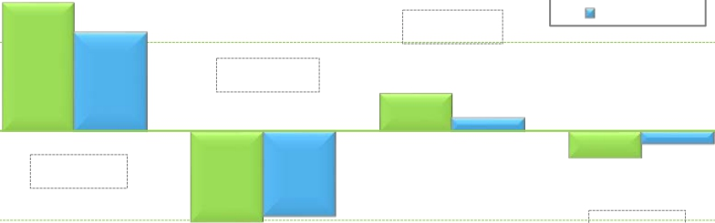
Details of Consolidated Cash Flows
Cash flows from
operating activities
(A)
Cash flows from
investing activities
(B)
FCF
(A) + (B)
Cash flows from
financing activities
（Billions of yen）
2,000
1,436.6
FY2013/2Q
(274.4)
FY2014/2Q
1,101.4
1,000
+60.9
424.6
150.2
0
(335.2)
(298.9)
(137.0)
(1,000)
(2,000)
Financial Results for the Six Months Ended September 30, 2014
(951.1)
－21－
+161.9
Increase/Decrease from the same period of the previous fiscal year
Copyright (c) 2014 Nippon Telegraph and Telephone Corporation
(1,012.0)

Slide 26
Appendices

Slide 27
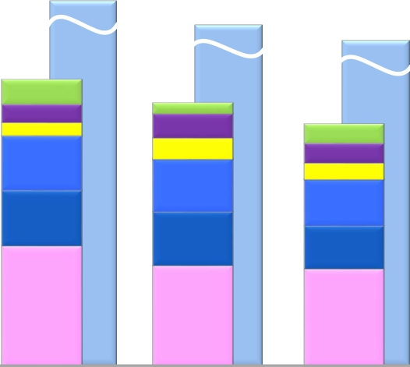
Appendices
Capital Investment
1,907.5
(Billions of yen)
[1,970.0]*
1,795.7
[1,892.8]*
1,750.0
[1,890.0]*
857.1
[884.1]*
73.8
53.6
39.3
163.7
165.7
361.0
FY2012/2Q
788.2
[824.6]*
31.6
72.2
62.9
158.4
161.3
301.8
FY2013/2Q
726.4
[753.5]*
58.1
58.1
49.0
140.0
128.7
292.5
FY2014/2Q
Other
NTT DATA (Consolidated)
NTT Communications
NTT West
NTT East
NTT DOCOMO (Consolidated)
FY2012
FY2013
FY2014E
* Figures in [ ] include investments related to real estate and solar power generation operations.
Financial Results for the Six Months Ended September 30, 2014
－22－
Copyright (c) 2014 Nippon Telegraph and Telephone Corporation

Slide 28

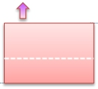











Appendices
FY2014/2Q Details of Financial Results (Per Item)
Operating
Revenues
Fixed IP/packet : (11.4)
Mobile IP/packet : (14.2)
Other : +0.1
(Billions of yen)
[ year-on-year：+107.6]
SI revenues and sales
of telecommunications
equipment
Voice related
services revenues
152.7
Fixed voice
243.6
Systems Integration
Other revenues
42.1
25.4
IP/packet
communications
X.X
5,266.1
Telecommunications
equipment
Systems Integration
services revenues
: +200.5
5,373.7
Mobile voice
Fixed voice : (64.1)
Mobile voice : (88.6)
Telecommunications equipment (Fixed-line) : +0.2
Telecommunications equipment (Mobile) : +42.8
FY2013/2Q
FY2014/2Q
Operating
Expenses
[year-on-year：+169.7]
36.5
Personnel expenses
3.5
Other expenses
143.3
6.7
4,613.0
FY2013/2Q
Depreciation
expenses and loss on
disposal
of assets
Expenses for purchase
of goods and services
and other expenses
4,782.7
FY2014/2Q
Financial Results for the Six Months Ended September 30, 2014
－23－
Copyright (c) 2014 Nippon Telegraph and Telephone Corporation

Slide 29





Appendices
Details of Consolidated Balance Sheet
March 31, 2014
(Billions of yen)
20,284.9
September 30, 2014
20,068.1
Liabilities
9,334.2
Interest-Bearing
Debt
4,200.0
Liability for Employees’
Retirement Benefits
1,327.9
Other
25.9
Equity
10,924.8
Treasury Stock
(156.9)
Assets
20,284.9
Depreciable Assets
(property, plant and
equipment)
8,241.9
Deferred Tax Assets
(non-current)
661.5
Liabilities
[(412.9)]
Interest-Bearing
Debt
4,233.8
[+33.8]
Liability for Employees’
Retirement Benefits
1,352.7
[+24.8]
Other
25.7 [(0.2)]
Equity
11,121.0
[+196.2]
Treasury Stock
(159.5)
[(2.5)]
Assets
20,068.1
[(216.9)]
Depreciable Assets
(property, plant and
equipment)
8,086.3
[(155.6)]
Deferred Tax
Assets
(non-current)
658.1
[(3.4)]
8,921.3
Financial Results for the Six Months Ended September 30, 2014
－24－
Copyright (c) 2014 Nippon Telegraph and Telephone Corporation

Slide 30
Appendices
Consolidated and Main Subsidiaries’ Financial Results for FY2014/2Q
(Billions of yen)
NTT DATA
Consolidated
(JPN GAAP)
695.8
82.8
13.5%
1,460.0
47.7%
673.8
63.4
10.4%
1,375.0
49.0%
22.0
19.3
―
85.0
25.9%
(1)
NTT
Consolidated
(U.S. GAAP)
5,373.7
107.6
2.0%
11,010.0
48.8%
4,782.7
169.7
3.7%
9,915.0
48.2%
590.9
(62.1)
(9.5)%
1,095.0
54.0%
NTT
(Holding Company)
Non-Consolidated
(JPN GAAP)
254.2
(10.3)
(3.9)%
412.0
61.7%
63.9
(2.6)
(4.0)%
140.0
45.6%
190.3
(7.6)
(3.9)%
272.0
70.0%
NTT East
Non-Consolidated
(JPN GAAP)
871.2
(8.7)
(1.0)%
1,771.0
49.2%
811.8
(15.0)
(1.8)%
1,681.0
48.3%
59.3
6.2
11.8%
90.0
65.9%
NTT West
Non-Consolidated
(JPN GAAP)
776.4
(6.3)
(0.8)%
1,582.0
49.1%
759.4
(4.0)
(0.5)%
1,547.0
49.1%
17.0
(2.3)
(11.9)%
35.0
48.7%
NTT Com
Non-Consolidated
(JPN GAAP)
439.2
(16.7)
(3.7)%
910.0
48.3%
391.4
(4.4)
(1.1)%
807.0
48.5%
47.7
(12.2)
(20.5)%
103.0
46.4%
NTT DOCOMO
Consolidated
(U.S. GAAP)
2,173.0
(26.0)
(1.2)%
4,400.0
49.4%
1,773.4
47.6
2.8%
3,770.0
47.0%
399.6
(73.6)
(15.5)%
630.0
63.4%
Operating Revenues
Change year-on-year
(% change)
Forecasts for FY2014
(% progress)
Operating Expenses
Change year-on-year
(% change)
Forecasts for FY2014
(% progress)
Operating Income
Change year-on-year
(% change)
Forecasts for FY2014
(% progress)
Income Before
Income Taxes
(2)
592.2
187.9
74.9
13.9
62.0
404.1
19.5
Change year-on-year
(% change)
Forecasts for FY2014
(% progress)
Net Income
Change year-on-year
(% change)
Forecasts for FY2014
(% progress)
(83.6)
(12.4)%
1,075.0
55.1%
290.3
(33.2)
(10.3)%
529.0
54.9%
(5.9)
(3.1)%
268.0
70.1%
476.0
282.7
146.4%
558.0
85.3%
7.9
11.9%
103.0
72.7%
46.8
4.2
10.0%
62.0
75.6%
(11.6)
(45.4)%
28.0
49.9%
6.3
(9.7)
(60.4)%
19.0
33.6%
(10.1)
(14.1)%
113.0
54.9%
40.7
(12.6)
(23.7)%
72.0
56.6%
(77.7)
(16.1)%
639.0
63.2%
259.5(4)
(40.9)
(13.6)%
420.0
61.8%
18.2
―
75.0
26.1%
7.1
10.8
―
37.0
19.3%
(3)
(1) NTT has 906 consolidated subsidiaries and accounts for 125 companies under the equity method.
(2) “Income Before Income Taxes” for NTT (Holding Company), NTT East, NTT West, NTT Communications and NTT DATA represent their recurring profits.
(3) “Net Income” for NTT Consolidated represents “Net income attributable to NTT, excluding noncontrolling interests.”
(4) “Net Income” for NTT DOCOMO represents “Net income attributable to NTT DOCOMO, excluding noncontrolling interests.”
Financial Results for the Six Months Ended September 30, 2014
－25－
Copyright (c) 2014 Nippon Telegraph and Telephone Corporation

Slide 31

Appendices
Calculation of ARPU
Average monthly revenue per unit, or ARPU, is used to measure average monthly operating revenues attributable to each designated service on a per user basis. In the case of NTT Group’s fixed-line business, ARPU is calculated by dividing revenue
items included in the operating revenues of NTT Group’s regional communications business segment, that is, FLET’S Hikari, by the number of Active Subscribers to the relevant services.
In the case of NTT Group’s mobile communications business, ARPU is calculated by dividing revenue items included in operating revenues from its mobile communications business segment, such as revenues from Xi mobile phone services and
FOMA mobile phone services, that are incurred consistently each month (i.e., basic monthly charges and voice/packet transmission charges), by the number of Active Subscribers to the relevant services. The calculation of these figures excludes
revenues that are not representative of monthly average usage, such as telecommunications equipment sales, activation fees and universal service charges.
NTT believes that its ARPU figures calculated in this way provide useful information regarding the monthly average usage of its subscribers. The revenue items included in the numerators of NTT Group’s ARPU figures are based on its financial results
comprising its U.S. GAAP results of operations.
For a complete discussion on the calculation of ARPU, please see the “Supplementary Data for the Six Months Ended September 30, 2014.”
Notes:
(1) FLET’S Hikari ARPU of NTT East and NTT West is calculated based on revenues from "FLET’S Hikari" (including "FLET’S Hikari" optional services), which are included in operating revenues from IP Services, revenues from monthly charges, call
charges and connection device charges for "Hikari Denwa," and revenues from "FLET’S Hikari" optional services, which are included in Supplementary Business revenues.
- "FLET'S Hikari" includes "B FLET'S," "FLET'S Hikari Next," "FLET'S Hikari Light" and "FLET'S Hikari WiFi Access" provided by NTT East, and "B FLET'S," "FLET'S Hikari Premium," "FLET'S Hikari Mytown," "FLET'S Hikari Next,"
"FLET'S Hikari Light" and "FLET'S Hikari WiFi Access" provided by NTT West.
(2) For purposes of calculating FLET'S Hikari ARPU, number of subscribers is determined based on the number of "FLET'S Hikari" subscribers, including subscribers to "B FLET'S," "FLET'S Hikari Next," "FLET'S Hikari Light" and "FLET'S Hikari WiFi
Access" provided by NTT East, and subscribers to "B FLET'S," "FLET'S Hikari Premium," "FLET'S Hikari Mytown," "FLET'S Hikari Next," "FLET'S Hikari Light" and "FLET'S Hikari WiFi Access" provided by NTT West.
(3) The following is the formula we use to compute ARPU for mobile business conducted by NTT DOCOMO.
・Mobile Aggregate ARPU ("Xi"+"FOMA") = Voice ARPU ("Xi"+"FOMA") + Packet ARPU ("Xi"+"FOMA") + Smart ARPU ("Xi"+"FOMA").
- NTT DOCOMO’s Voice ARPU ("Xi"+"FOMA") is based on operating revenues related to voice services, such as basic monthly charges and voice communication charges attributable to our "Xi"+"FOMA" services, our Packet ARPU
("Xi"+"FOMA") is based on operating revenues related to packet services, such as flat monthly fees and packet communication charges attributable to our "Xi"+"FOMA" services, and our Smart ARPU ("Xi"+"FOMA") is based on
operating revenues from a part of Other Operating Revenues attributable to "Xi"+"FOMA" wireless communications services (revenues from content, collection of charges, mobile phone insurance service, advertising and others).
(4) Subscriptions for and revenues from communication module services, “Phone Number Storage,” “Mail Address Storage,” “docomo Business Transceiver” and wholesale telecommunications services and interconnecting telecommunications facilities
that are provided to Mobile Virtual Network Operators (MVNOs) are not included in the Mobile Aggregate ARPU calculation.
(5) NTT DOCOMO‘s ARPU calculation methods have been changed from the second quarter of the fiscal year ending March 31, 2015. Accordingly, the ARPU data for the results for the three months ended Jun. 30, 2013 (from Apr. to Jun., 2013), the
three months ended Sep. 30, 2013 (from Jul. to Sep., 2013), the three months ended Dec. 31, 2013 (from Oct. to Dec., 2013), the three months ended Mar. 31, 2014 (from Jan. to Mar., 2014), the year Ended Mar. 31, 2014 and the three months
ended Jun. 30, 2014 (from Apr. to Jun., 2014) have also been changed.
(6) Numbers of active subscribers used in the ARPU calculation of NTT East and NTT West are as below.
- 1Q Results: Sum of number of active subscribers* for each month from April to June
- 2Q Results: Sum of number of active subscribers* for each month from July to September
- 3Q Results: Sum of number of active subscribers* for each month from October to December
- 4Q Results: Sum of number of active subscribers* for each month from January to March
- FY Results : Sum of number of active subscribers* for each month from April to March
- FY (Previously Announced Forecast): Sum of the average expected active number of subscribers during the fiscal year ((number of subscribers at March 31, 2014 + number of expected subscribers at March 31, 2015)/2)x12.
- FY (Revised Forecast): Sum of the sum of actual number of active subscribers at the end of each month from April to September and the average expected active number of subscribers during the second half of the fiscal year
((number of subscribers at September 30, 2014 + number of expected subscribers at March 31, 2015)/2)x6.
(7) Numbers of active subscribers used in the ARPU calculation of NTT DOCOMO are as below.
- 1Q Results: Sum of number of active subscribers* for each month from April to June
- 2Q Results: Sum of number of active subscribers* for each month from July to September
- 3Q Results: Sum of number of active subscribers* for each month from October to December
- 4Q Results: Sum of number of active subscribers* for each month from January to March
- FY (Previously Announced Forecast) and FY (Revised Forecast): Sum of expected number of active subscribers* for each month from April to March.
*Active subscribers = (number of subscribers at end of previous month + number of subscribers at end of the current month)/2
Financial Results for the Six Months Ended September 30, 2014
－26－
Copyright (c) 2014 Nippon Telegraph and Telephone Corporation

